Slide 1

An overview about inorganic membrane technology application in the field of hydrogen generation and purification
Adolfo Iulianelli
Institute on Membrane Technology of the Italian National Research Council (ITM-CNR),
Via P. Bucci Cubo 17/C c/o University of Calabria, Rende (CS), 87036 – Italy; a.iulianelli@itm.cnr.it; +39 0984 492011
SEPARATION TECHNIQUES 2016 – Valencia, September 26-28, 2016

Slide 2

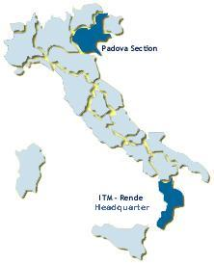
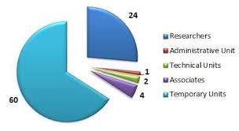
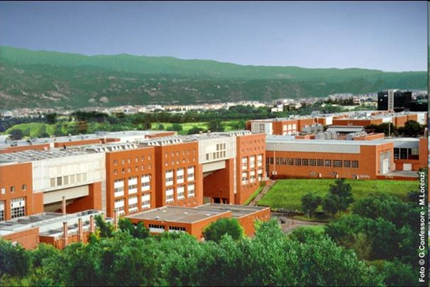
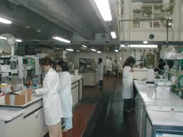
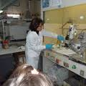

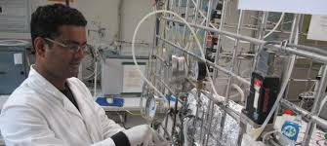
ITM-CNR
Institute on Membrane Technology
ITM-CNR (Headquarter)
University of Calabria
ITM-CNR Laboratories
ITM-CNR Laboratories

Slide 3
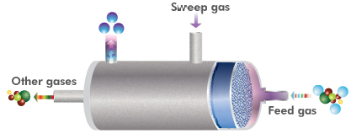

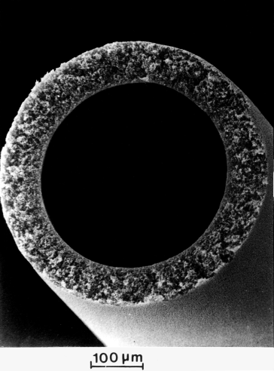

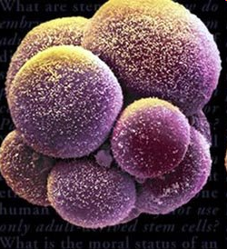
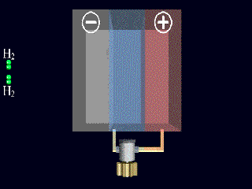
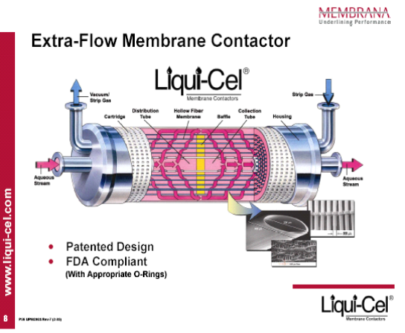
Institute & Activity
Inorganic membrane reactor
Water desalination by membrane filtration
ITM-CNR
Gas separation: polymeric and inorganic membranes
Membrane bioreactor
PEM fuel cell
Membrane contactors

Slide 4
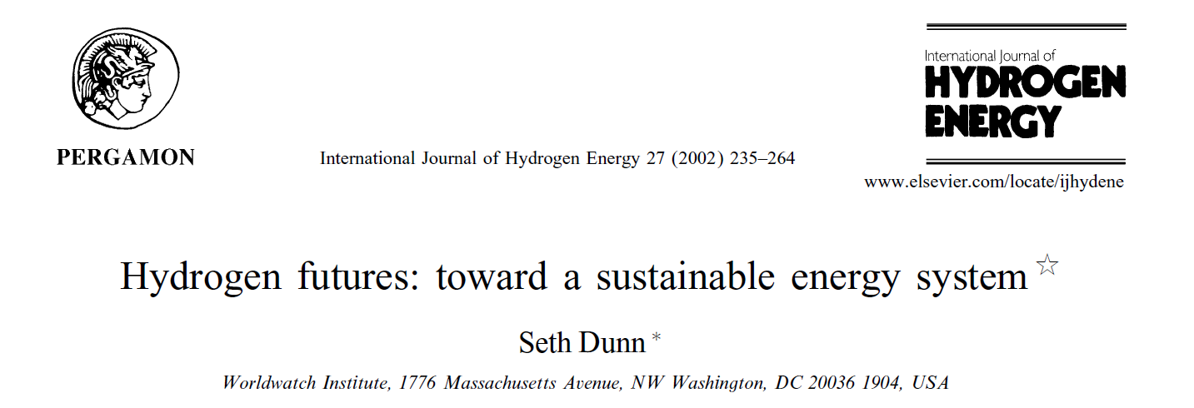
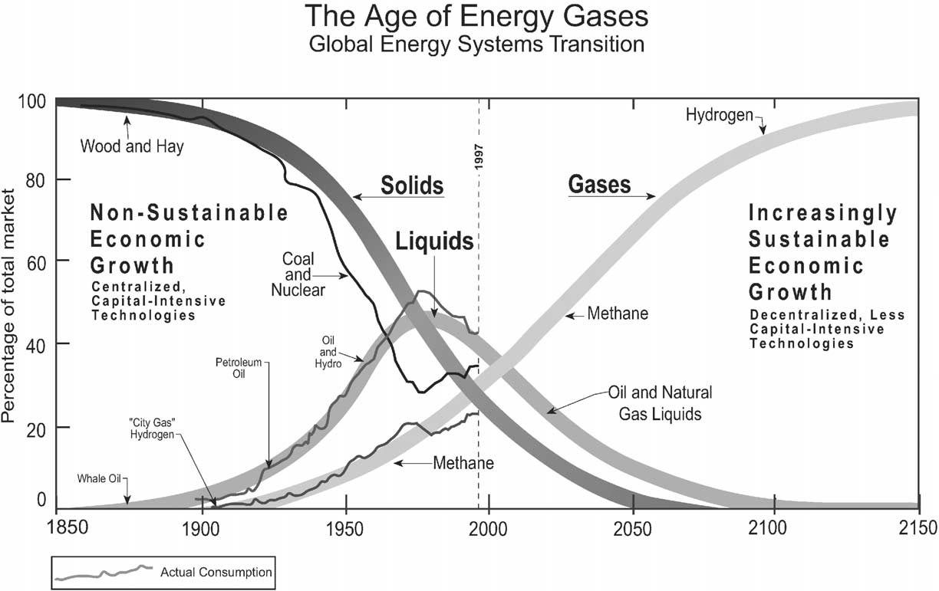

Slide 5

LPG
Petrol
Diesel
CNG,
LNG
FTL
DME
MeOH
Mixed
Alcohol
Bioethanol,
Butanol
Biodiesel,
Bioglycerol
Green
Diesel
Blending
Synthesis
Refining
Esterification
Refining
Hydro-
Thermal
Upgrade
Refining
Gasification
Pyrolysis
Fermentation
Extraction
Hydrolysis
Anaerobic
Digestion
(Biogas)
Crude oil
Natural gas
Coal
Lignocellulosic
biomass
Sugar and
Starch crops
Oil crops
Wet
biomass
FOSSIL FUELS
BIOMASS

Slide 6
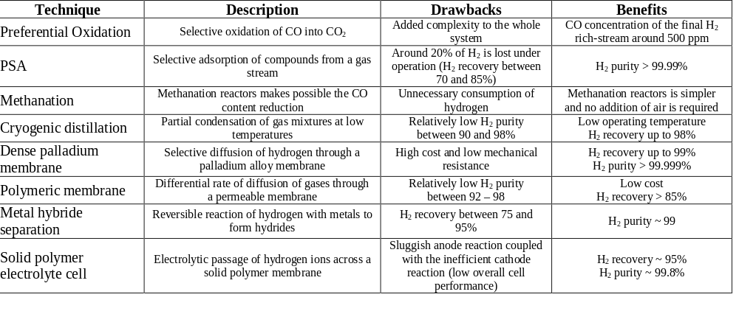
ITM-CNR
Institute on Membrane Technology
Techniques for H₂ separation
Membrane technology for H₂ separation

Slide 7
Membranes for H₂ separation
Membrane | Polimeric | Microporous | Metallic | Carbon | Ceramic
Temperature range | < 200 °C | 200 – 600 °C | 300 – 600 °C | 500 – 900 °C | 600 – 900 °C
α_{H2/N2} | low | 5 – 139 | > 1000 | 4 – 20 | > 100
Stability issues | Swelling, mechanical strenght | Stability in H₂O | Phase Transition | Brittle, Oxidization | Stability in CO₂
Poisoning issues | HCl, SO_{x} |  | H₂S, HCl, CO | Strong adsorbing vapours, organics | H₂S
Material | Polymers | Silica, Alumina, Zirconia, Titania, Zeolite | Palladium, Palladium Alloy, etc. | Carbon | Proton Conductivity ceramics (mainly SrCeO_{3-δ}, BaCeO_{3-δ})
α_{H2/N2} = permeance_{H2}/permeance_{N2}

Slide 8
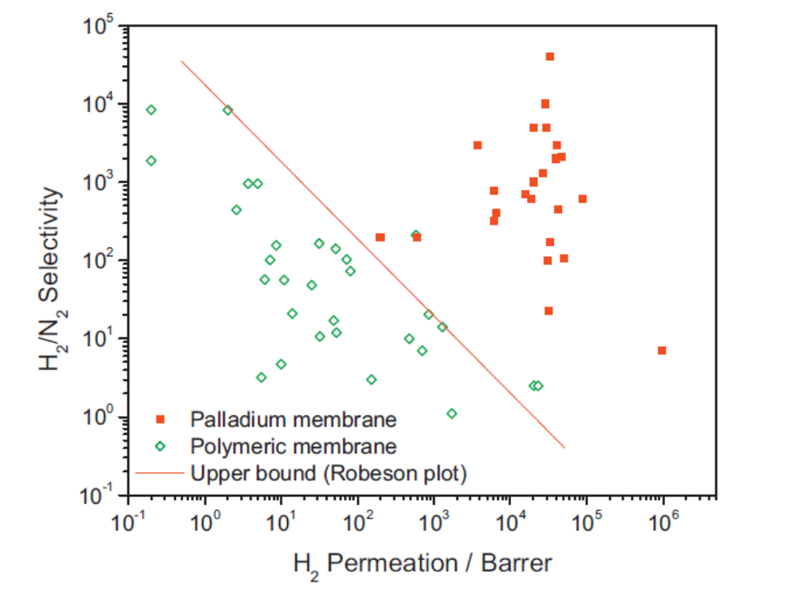
ITM-CNR
Institute on Membrane Technology
Why inorganic membranes for H₂ separation?
Most attractive region
S. Yun, S. Ted Oyama, Correlations in palladium membranes for hydrogen separation: A review, J. Membrane Sci., 375 (2011) 28–45

Slide 9
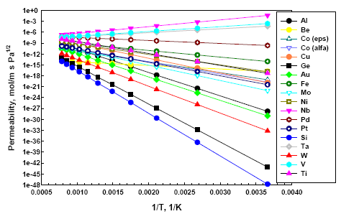
ITM-CNR
Institute on Membrane Technology
Ta, Nb, V
Hydrogen permeability through different metals
Palladium
Dense metal membranes:
Group 10 (Ni, Pd, Pt), Group 5 (V, Ta, Nb)
able to dissociate and dissolve H₂.
Pd membranes show a very high H₂ solubility in a wide range of T
Basile et al., Synthesis, characterization and applications of palladium membranes, Eds. R. Malada, M. Menendez, Elsevier, Ch. 8 (2007).

Slide 10
ITM-CNR
Institute on Membrane Technology
V, Ta and Nb are prone to a severe H₂ embrittlement
DBTC (ductile-to-brittle transition hydrogen concentration) occurs for the V group metal as a function of C_{H2}.
DBTC_{pure Nb}: H/Nb = 0.25 - DBTC_{pure V} : H/V = 0.22
The resistance to H₂ embrittlement of Nb and V, during H₂ permeation, can be improved by keeping C_{H2} below their critical value.
Matsumoto et al., In situ quantitative evaluation of hydrogen embrittlement in group 5 metal used for hydrogen separation and purification, ch. 12 in Advances in hydrogen production, storage and distribution, Woodhead Publishing, A. Basile & A. Iulianelli (Eds.), 2014.

Slide 11
ITM-CNR
Institute on Membrane Technology
Ductile-to-brittle transition hydrogen concentration

Slide 12
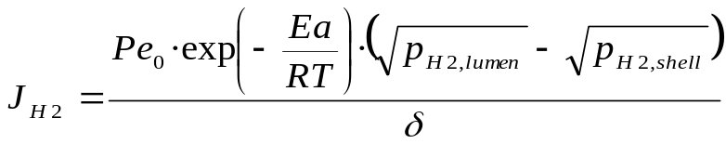
Palladium Membranes for H₂ separation
Dense metal membranes
Dense ceramic membranes (mixed conduction)
Microporous membranes
Dense Pd-based membranes having full hydrogen perm-selectivity follows the Richardson equation:
where δ is the membrane thickness, Pe_{o}, Ea, R and T are the pre-exponential factor, the apparent activation energy, the universal gas constant, and the absolute temperature, respectively.
Steps of solution/diffusion mechanism:
dissociation of molecular hydrogen at the gas/metal interface,
adsorption of the atomic hydrogen on membrane surface;
dissolution of atomic hydrogen into palladium matrix;
diffusion of atomic hydrogen toward the opposite side;
re-combination of atomic hydrogen to form hydrogen molecules at the gas/metal interface;
desorption of hydrogen molecules.

Slide 13
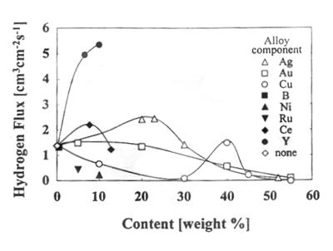
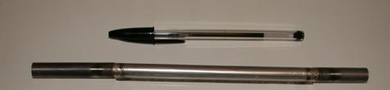

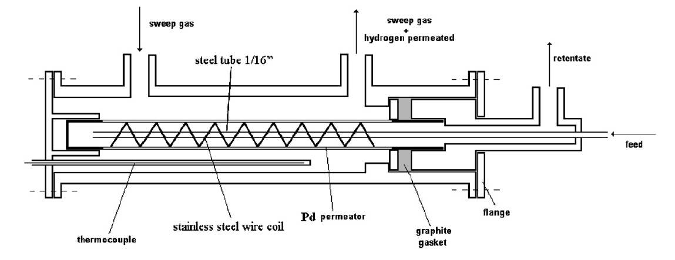
ITM-CNR
Institute on Membrane Technology
Solution to embrittlement phenomenon for Pd membranes: Pd-alloy membranes
Pd-Ag thickness = 50 μm.
Membrane preparation = cold-rolling and welding techinque.
Membrane lenght (active surface) = 15 cm

Slide 14
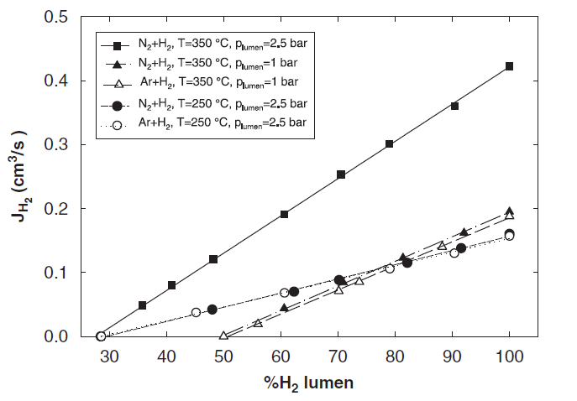
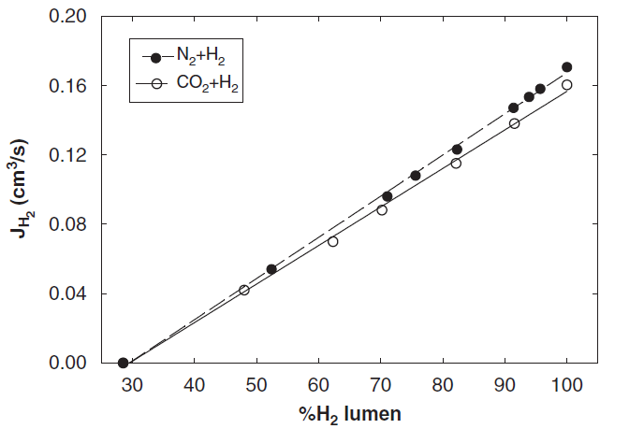
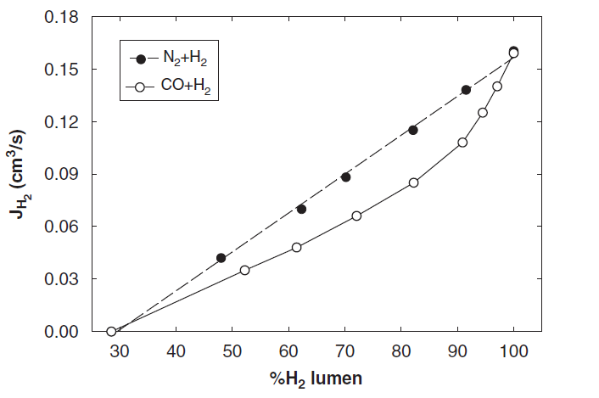
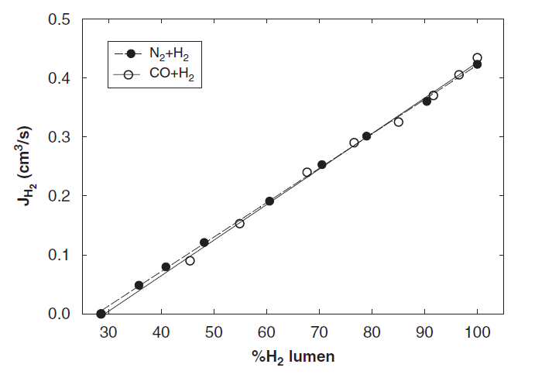
T, p_{lumen}
Hydrogen permeated flow (shell side) for CO₂/H₂ and N₂/H₂ feed mixture (lumen side) at T = 250 °C and p_{lumen} = 3.5 bar; shell is at 1 bar
Pd-Ag dense unsupported membranes
Effect of CO adsorption on the Pd-Ag surface
ΔJ_{H2}
T = 350 °C
J_{H2} vs H₂ concentration in the feed for CO/H₂ and N₂/H₂ feed mixture (lumen side) at T = 250 and 350 °C and p_{lumen} = 3.5 bar; shell is at 1 bar
T = 250 °C
Basile et al., International Journal of Hydrogen Energy 32 (2007) 1837 – 1845

Slide 15
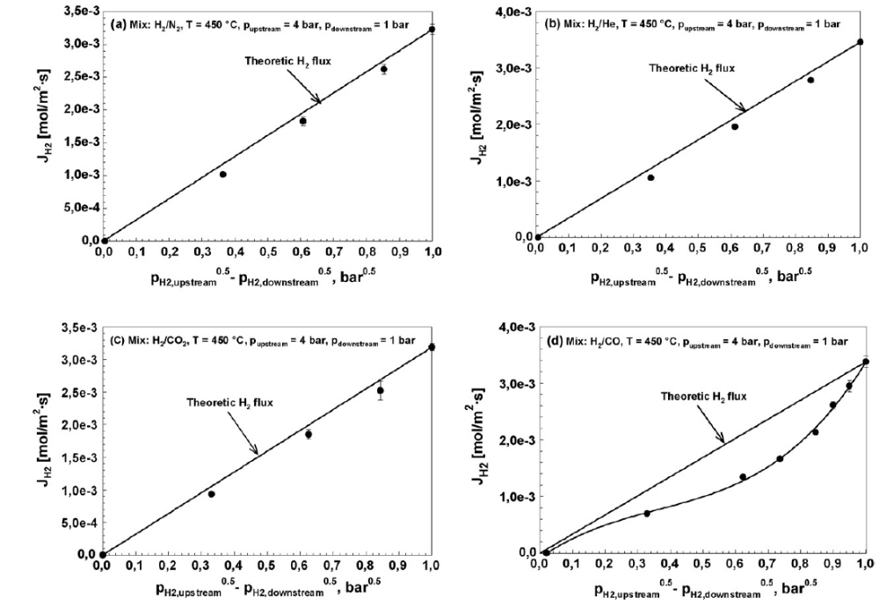

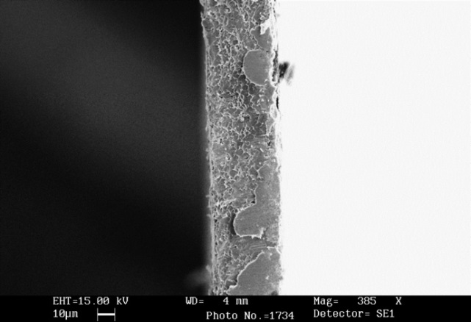
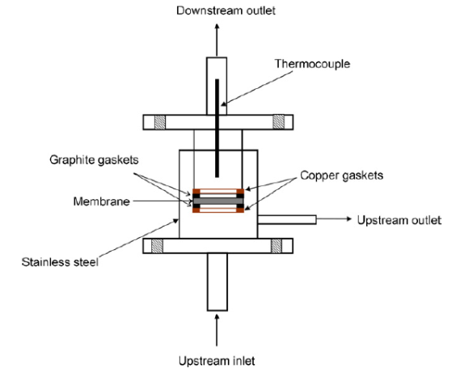
A. Basile, F. Gallucci, A. Iulianelli, G.F.Tereschenko, M.M. Ermilova, N.V. Orekhova, Ti-Ni-Pd dense membranes – The effect of the gas mixtures on the hydrogen permeation, Journal of Membrane Science, 310 (2008) 44-50.
Ti-Ni-Pd dense unsupported membrane

Slide 16
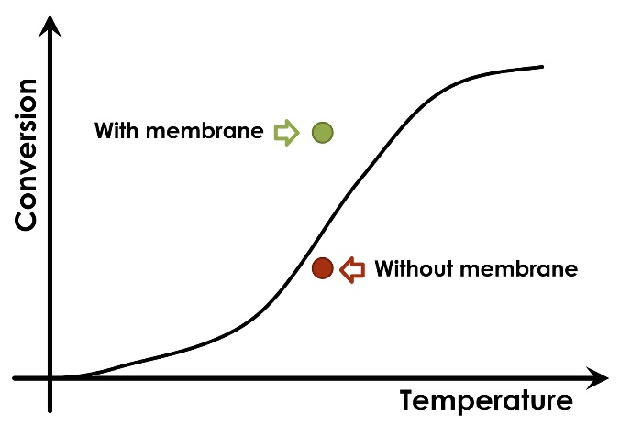
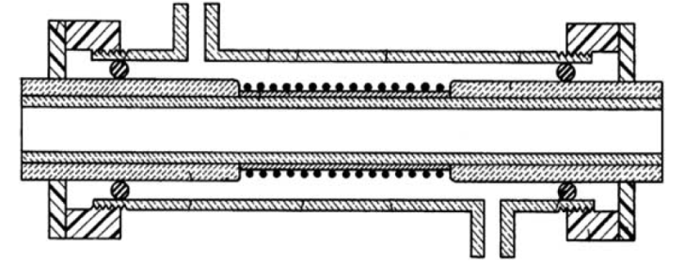
Pd-based Membrane Reactor Technology
Feed
Membrane
Membrane Reactors
Sweep-gas
Permeate
Thermodyanamic equilibrium
Catalyst
Conventional Reactors
Retentate
Consider the following general reversible reaction:
A + B = C + D
If only the product C (for example HYDROGEN) is permeable through the membrane, the conversion becomes higher as the equilibrium is displaced towards the products side.
A + B = C + H₂

Slide 17
Pd-based Membrane Reactor Technology and Process Intensification
PrOx reactor
WGS stages
Conventional Reformer
T = 800 -1000°C
H₂, CO, CO₂, not reacted CH₄ and H₂O
CH₄ + H₂O
HT-WGS rector
LT-WGS reactor
PSA
Other
Low-temperature PEM fuel cells: CO content tollerated in the H₂ supplied: < 10 ppm
H₂, CO, CO₂, not reacted CH₄ and H₂O
PEM fuel cell grade hydrogen
CH₄ + H₂O
Full H₂ perm-selective Pd-based membrane reactor

Slide 18
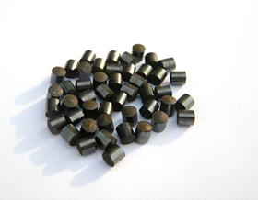
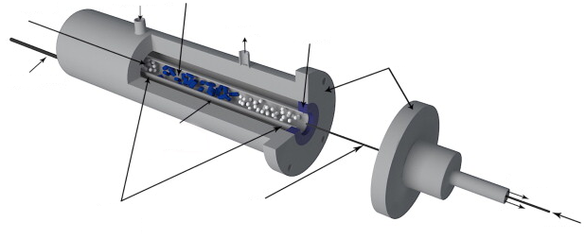
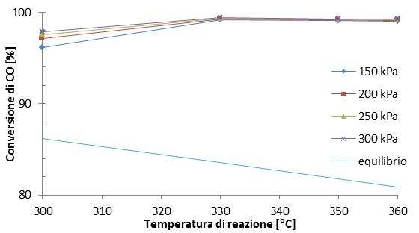
Pd-based Membrane Reactor Technology: Highlights
Unsupported dense Pd-based MRs
Ethanol steam reforming
Methanol steam reforming
Methane steam reforming
Methane Dry reforming
Oxidative ethanol steam reforming
Oxidative methanol steam reforming
Partial oxidation of ethanol
Glycerol steam reforming
Acetic acid steam reforming
Water gas shift
Cyclohexane dehydrogenation
Sfere di vetro
Gas di lavaggio
Catalizzatore
Permeato
Anello di grafite
Modulo del MR
Termocoppia
Fe-Cr catalyst
Membrana
Retentato
Supporti in acciaio inox alle estremità della membrane
Alimentazione
Alimentazione
Pd-Ag dense unsupported membrane, Thickness = 50 μm
MR
10% - 12%
T = 300 °C
WATER GAS SHIFT
REACTION
~ 20%
T = 360 °C
FBR

Slide 19
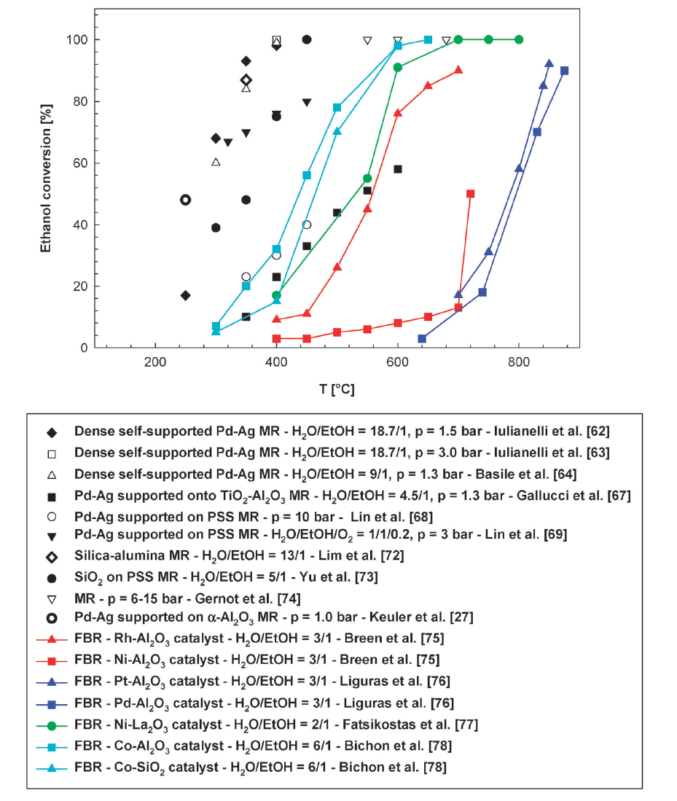
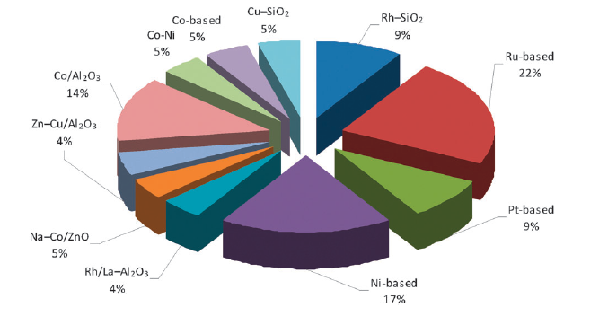
Membrane Reactors
Conventional Reactors
Our work
Ethanol conversion [%]
Catalysts distribution for ESR reaction
ETHANOL STEAM REFORMING
REACTION
A. Iulianelli, A. Basile, Hydrogen production from ethanol via inorganic membrane reactors technology: a review, Catalysis Science & Technology, 1 (2011) 366-379.

Slide 20

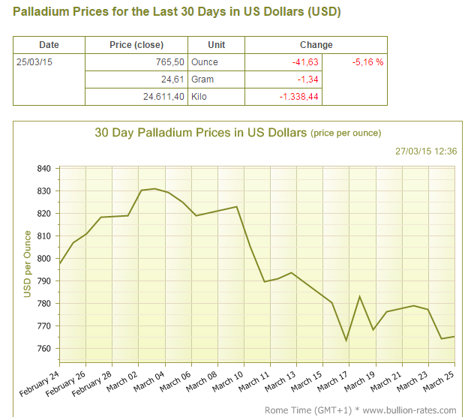
ITM-CNR
Institute on Membrane Technology
Pd-based membranes: potentiality at industrial scale
€
€
$
$
$
$
$
€
€
$
€
$
€
€
$
€
$
€
€
Pd-content
€
$
$
Dense self-supporting Pd-membranes with thickness > 100/150 μm
$
$
H₂ permeance

Slide 21
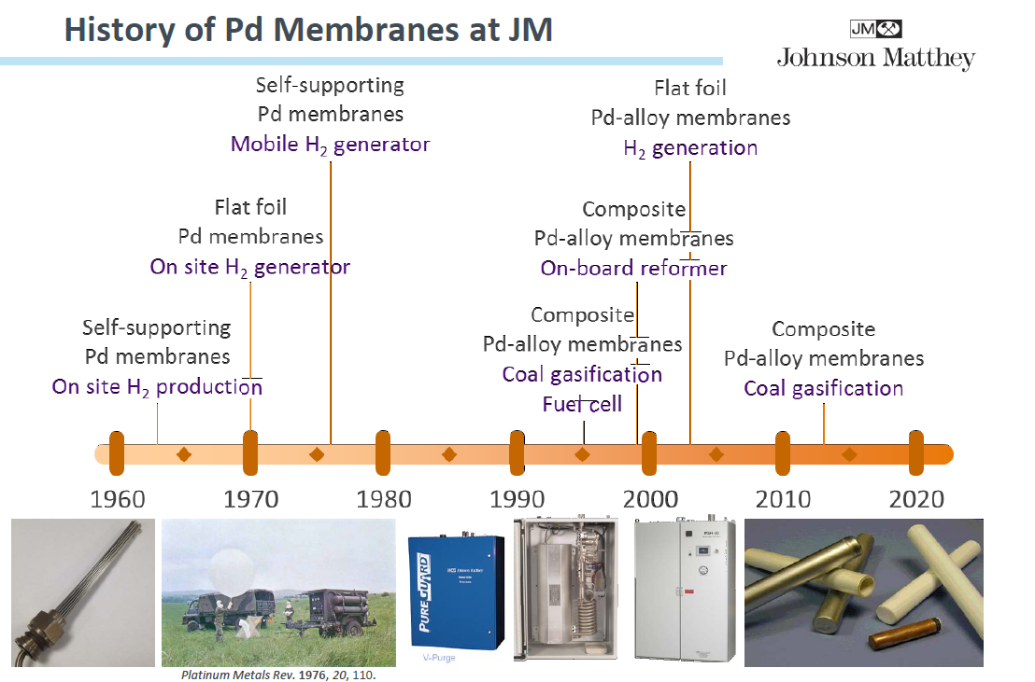

Slide 22
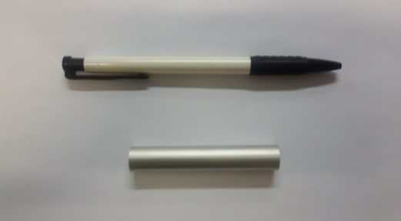
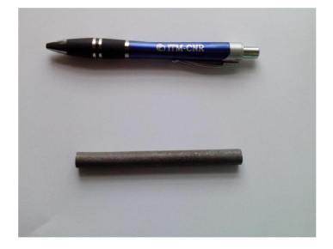
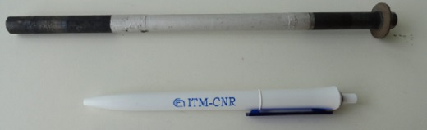
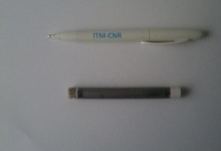
ITM-CNR
Institute on Membrane Technology
From dense self-supported to thin Pd-based supported membranes or not Pd-based membranes for H₂ production
Dense self-supported Ti-Ni-Pd
Composite Pd-layer supported on α-Al₂O₃
Thickness = 40 μm [not commercial, by Topchiev Institute (Moscow, Russia)]
Cyclohexane dehydrogenatation
Dense self-supported Pd-based
Pd layer= 5-8 μm [not commercial, by Najing Tech. University Laboratory (Najing, China)]
Methanol steam reforming
Bio-ethanol steam reforming
Bio-gas steam reforming
Palladium content decrease
Thickness = 50 μm [not commercial, by ENEA Laboratory (Frascati, Itay)]
Thickness = 150 μm [commercial, Johonson & Matthey]
Methane steam reforming
Ethanol steam reforming
Methanol steam reforming
Acetic acid steam reforming
Glycerol steam reforming
Water Gas Shift
Carbon membranes
Composite Pd-Cu
supported on α-Al₂O₃
Not commercial and not Pd-based, by University RoviraiVirgili (Tarragona, Spain)
Methanol steam reforming
Composite Pd-layer supported on porous stainless steel
Pd layer= 20 μm [not commercial, by CNR-ITM & Advanced Catalyst Srl (Rende/Pisa, Italy)]
Bio-gas steam reforming
Pd layer= 10 μm [not commercial, by RSE SpA (Milan, Itay) and University of Genova (Genova, Italy)]
Ethanol/Bio-ethanol steam reforming
Water Gas Shift
Graphene membranes
By University of Valencia (Spain)]

Slide 23
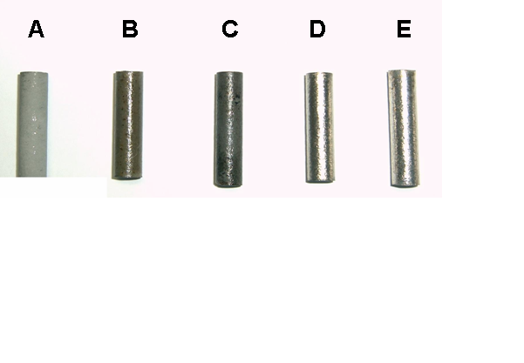
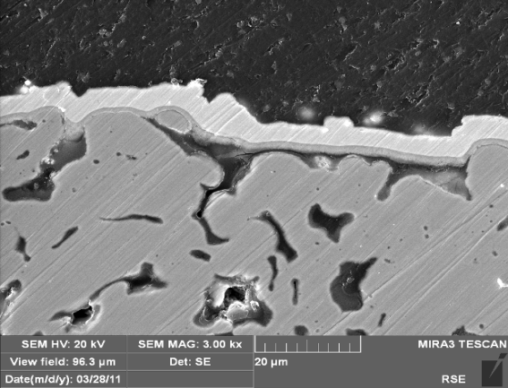
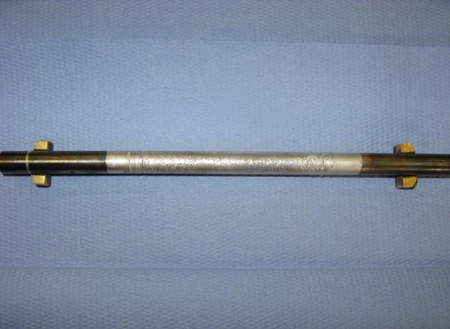


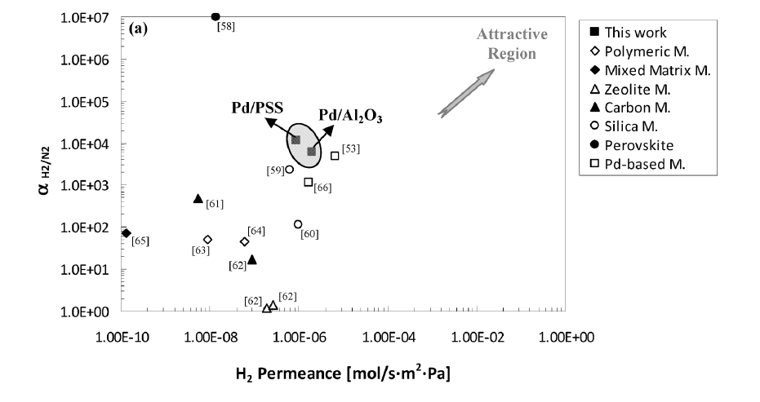
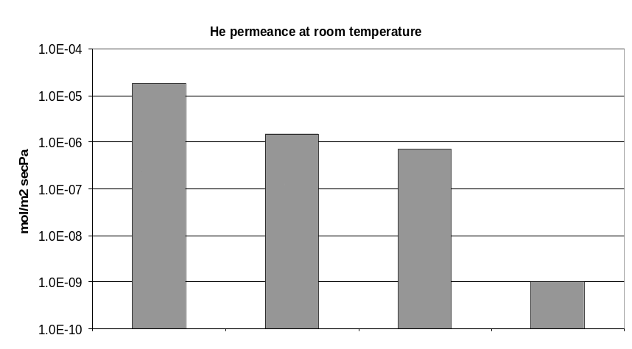
H₂ separation by a Porous Stainless Steel supported Pd-based membrane
A bare support (PSS);
B oxidized support;
C γ-alumina layer; D activated layer;
E Pd-layer 10 μm thick
Ideal selectivity [α _{(H2/N2)}] = H₂ permeance/N₂ permeance
He permeance at room temperature
α _{(H2/N2)} > 10000 (T = 400 °C)
S. Liguori, A. Iulianelli, F. Dalena, P. Pinacci, F. Drago, M. Broglia, Y. Huang, A. Basile, Performance and long-term stability of Pd/PSS and Pd/Al₂O₃ for hydrogen separation, Membranes, 4 (2014) 143-162.

Slide 24
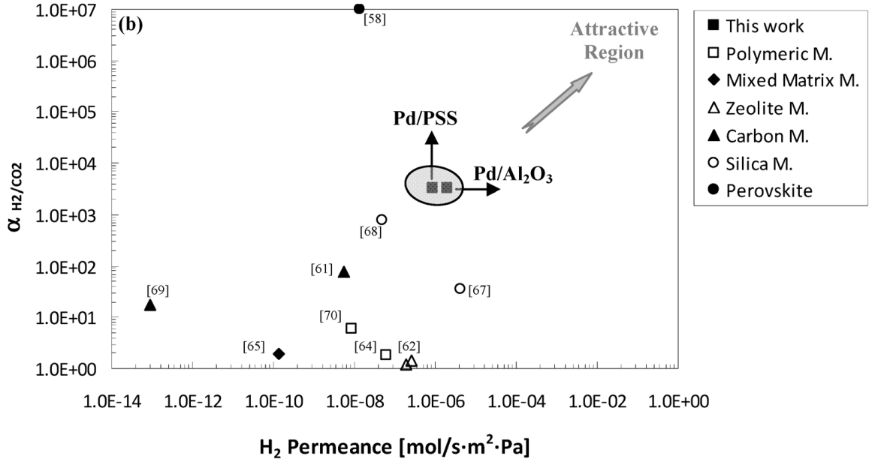
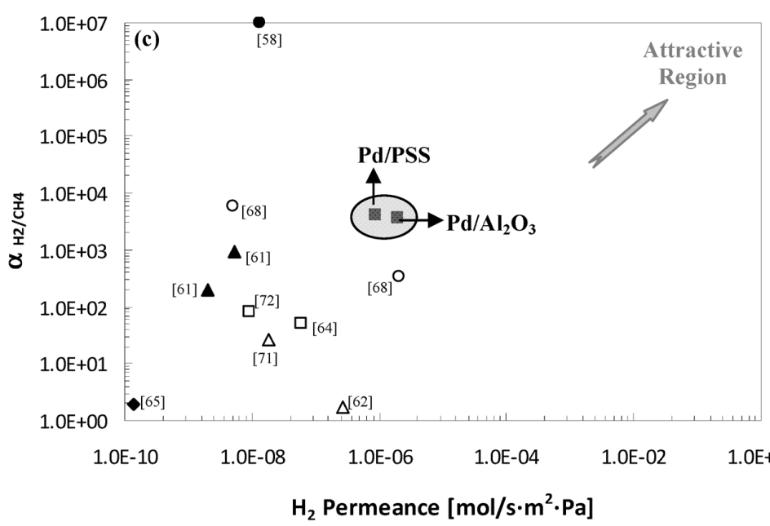
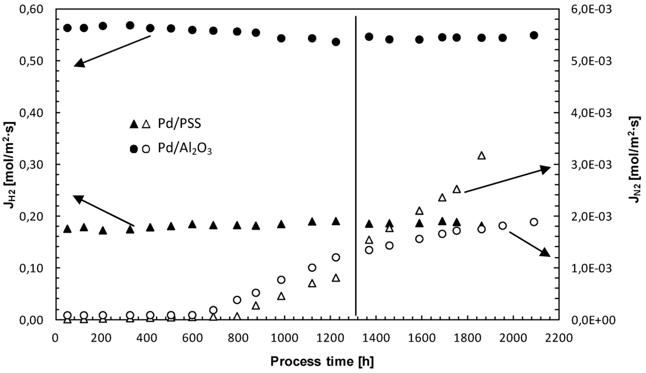
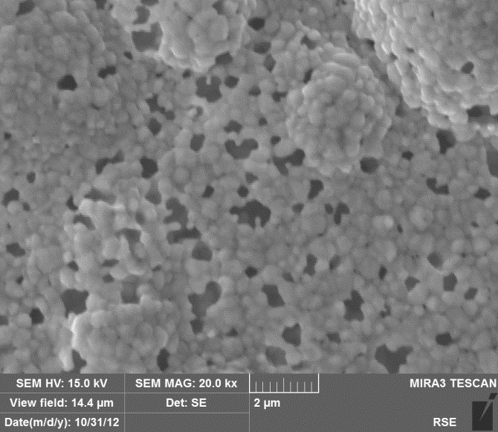
α _{(H2/CO2)} > 4000 (T = 400 °C)
α _{(H2/CH4)} > 9000 (T = 400 °C)
S. Liguori, A. Iulianelli, F. Dalena, P. Pinacci, F. Drago, M. Broglia, Y. Huang, A. Basile, Membranes, 4 (2014) 143-162.

Slide 25
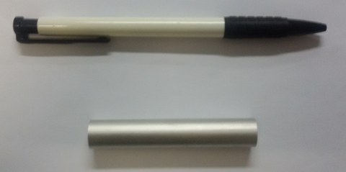




H₂ separation by a Al₂O₃ supported Pd-based membrane
a)
b)
Pd - layer = 5/6 μm, Support: α-Al₂O₃
DOE Target
α_{H2/N2} = 1.0·10⁴
SEM image of the cross section of the composite Pd/Al₂O₃ membrane (a); morphology of the Pd-surface (b).
Membrane failure

Slide 26




Composite Pd/Al₂O₃ Membrane Reactor applied to bio-sources reforming reaction to produce H₂: Highlights
CO-free
H₂ permeate purity vs space velocity (GHSV) during Bio-ethanol steam reforming at 400 °C and 2.0 bar of reaction pressure.
S. Yun, S. Ted Oyama / Journal of Membrane Science 375 (2011) 28–45

Slide 27



Composite Pd/Al₂O₃ Membrane Reactor applied to bio-sources reforming reaction to produce H₂: Highlights
T = 400 °C
Critical issues
Before exp. tests
After exp. tests
A. Iulianelli, V. Palma, G. Bagnato, C. Ruocco, Y. Huang, G. Vitulli, E. Macchia, N.T. Veziroğlu, A. Basile, From industrial bioethanol to high grade hydrogen generation: steam reforming reaction promoted by a novel Co-Pt catalyst in a H₂-full perm-selective Pd-based membrane reactor, submitted to Journal of Power Sources.

Slide 28






Composite Pd-Au/Al₂O₃ Membranes applied to H2 separation and to methane steam reforming in membrane reactor: Highlights
He permeance at room temperature

Slide 29



Methane steam reforming
T = 420 °C
MR
TR
Coke formation
Before exp. tests
After exp. tests
A. Iulianelli, M. Alavi, G. Bagnato, S. Liguori, J. Wilcox, M.R. Rahimpour, R. Eslamlouyan, B. Anzelmo, A. Basile, Supported Pd-Au membrane reactor for hydrogen production: membrane preparation, characterization and testing, Molecules, 21 (2016) 581-594

Slide 30





No Palladium-based inorganic membranes in H₂ separation:
carbon membranes
Transversal photomicrography of the polymer films deposited on the ceramic support at different polymer concentrations (A untreated ceramic;
B 3wt%, C 13, and D 20wt%).
Adsorption–desorption isotherms for supported carbon membranes at different pyrolysis temperatures.
K. Briceño, D. Montané, R. Garcia-Valls, A. Iulianelli, A. Basile, Fabrication variables affecting the structure and properties of supported carbon molecular sieve membranes for hydrogen separation, Journal of Membrane Science, 415-416 (2012) 288-297.

Slide 31





Carbon membranes applied in MR: methanol steam reforming
Carbon layer (10-12 μm)
Ceramic support
Critical issue: low H₂ purity
Methanol steam reforming
Methanol steam reforming
K. Briceño, A. Iulianelli, D. Montané, R. Garcia-Valls, A. Basile, Carbon molecular sieve membranes supported on non-modified ceramic tubes for hydrogen separation in membrane reactors, International Journal of Hydrogen Energy, 37 (2012) 13536-13544.

Slide 32




Future trends: MOC (Membrane on catalyst)
Configuration of the conventional MRF module and MOC module:
A: Conventional MRF module, B: MOC module.

Slide 33





Pall Corporation
Conclusions
Composite Pd-based membranes: a reality
Power & Energy Inc. (USA)
Up to 160 Nm³/h
of nominal flow capacity
H₂ purity
from 97% to 99,9999999%
Hopkins & Zhao, NETL CO2 Capture Technology Meeting Pittsburgh / July 9 – 12, 2012
www.powerandenergy.com

Slide 34









Composite membranes solutions
HySep modules & ECN
Conclusions
Composite Pd-based membranes: a reality
H₂ purity: from 99,5% to 99,995%
H₂ purity ≥ 99,99%
Palladium layer: from 3 to 9 μm
NORAM Engineering & Constructors Ltd. (USA)
Palladium layer: < 20 μm

Slide 35
AKNOWLEDGEMENTS
Separation Techniques Organization
Jessie Koch

Slide 36
ITM-CNR
Institute on Membrane Technology
THANK YOU
FOR YOUR ATTENTION

Slide 37



Slide 38



Permeation of hydrogen through composite Pd-based membranes
S. Yun, S. Ted Oyama / Journal of Membrane Science 375 (2011) 28–45

Slide 39


ITM-CNR
Institute on Membrane Technology
A = Intermediate region; B = High H₂ ideal selectivity and permeance; C = Low H₂ ideal selectivity and permeance;
S. Yun, S. Ted Oyama / Journal of Membrane Science 375 (2011) 28–45

Slide 40




ITM-CNR
Institute on Membrane Technology
Equations for hydrogen permeation through Pd-based membranes
Diffusion coefficient
[mol/m²s] Fick law: flux of hydrogen by diffusion through dense membranes
Concentration gradient
[mol/m²s] Fick law: flux of hydrogen by diffusion through dense membranes
Thickness of metal layer
Henry law: in case of surface reaction or mass transport is rate controlling step
Partial pressure of hydrogen in retentate (high) and permeate (low) sides
Henry law substituted in Fick law
Permeance
Sieverts law constant or solubility

Slide 41




ITM-CNR
Institute on Membrane Technology
Equations for hydrogen permeation through Pd-based membranes
Concentration in Sieverts law substituted in Fick law
Membrane porosity
Pore diameter
Knudsen law proportional to Δp_{H2} = p_{H2,h} – p_{H2,l}
Tortuosity
Molecular weight of diffusing gas
Viscous flow or Hagen-Pouiselle equation
Overal hydrogen permeating flux as a combination of bulk permeance through palladium and Knudsen and Hagen-Pouiselle mechanisms

