Slide 1

Evaluation of HIV status and its spread in HIV patients on RRT and their spouses
Dr. Aditya Agarwal
Clinical Fellow
Indraprastha Apollo Hospitals, New Delhi, India

Slide 2
Introduction
Human immunodeficiency virus (HIV) infection has become a global pandemic.
According to recent UN report,
  India has the third largest number of people living with HIV in the world — 2.1 million at the end of 2013 — and accounts for about 4 out of 10 people living with HIV in the Asia—Pacific region
http://www.thehindu.com/sci-tech/health/india-has-3rdhighest-number-of-hivinfected-people-un/article6220483.ece?css=print Published July 17, 2014

Slide 3
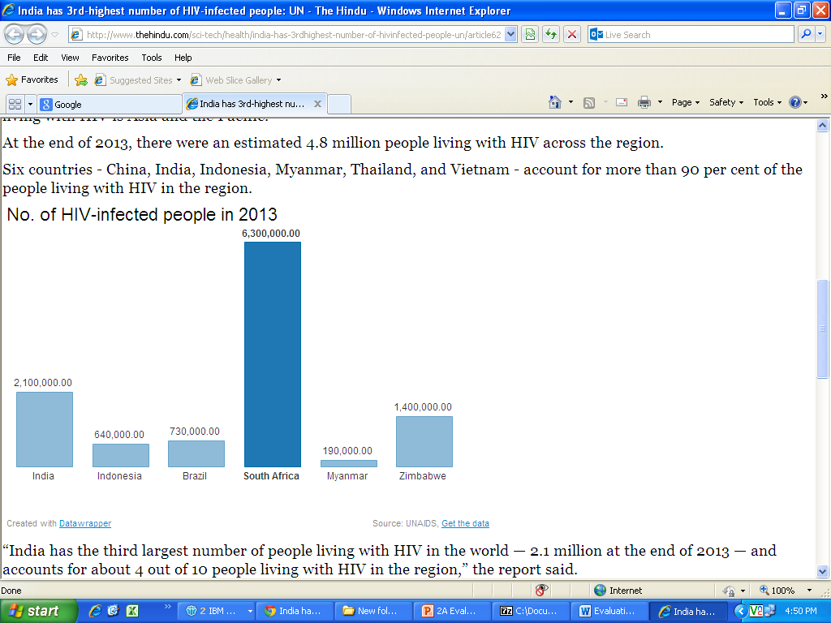
Introduction
http://www.thehindu.com/sci-tech/health/india-has-3rdhighest-number-of-hivinfected-people-un/article6220483.ece?css=print Published July 17, 2014

Slide 4
Introduction
The size of the HIV-infected population and the longevity of HIV-affected patients is increasing due to the Combined anti-retroviral therapy (cART)
Multiple diseases affecting various organ systems in the normal population are becoming manifest in these HIV patients.
  One such spectrum of diseases is renal involvement in HIV patients
Indian J Nephrol. 2012 Mar-Apr; 22(2): 98–102.

Slide 5
Introduction
Renal disease of any stage is a common complication in HIV-infected patients, affecting up to 30% of patients, and is associated with increased morbidity and mortality.
Once established, end-stage renal disease (ESRD) and chronic renal replacement therapy (RRT) substantially increase the risk of death and cardiovascular events in the general and HIV-infected populations.
HIV Medicine. 2013;14(3):127-135.

Slide 6
Aim
As it is evident that awareness and prevention are major tools to combat the spread of HIV infection globally.
Evaluation of HIV status and its spread in HIV patients on RRT and their spouses

Slide 7
Materials and methods
HIV positive patients on renal replacement therapy (maintenance hemodialysis or kidney transplantation) and their spouses were interrogated via a questionnaire.

Slide 8
Results
Total No. of patients in study = 24
Male – 21 (85.5%)
Female – 3 (14.5%)
Most of the patients were Male – probably males are getting more attention in society in comparison to females

Slide 9
Results
24 patients (n = 24)
Maintenance HD patient
(n=14)
Male (n=12)
Female (n=2)
Renal Transplant Patients
(n=10)
Male (n=9)
Female (n=1)

Slide 10
Results
Probable mode of spread in patients
Multiple sexual contact is probably most important mode of spread (83.3%)

Slide 11
Results
Total No. of spouse = 20
  20 Patients out of 24 = had spouses
        4 Patient did not have spouses
  HIV positivity in Spouses
HIV positive = 8 (/20) (40%) all patients were sexually active
HIV negative = 12 (/20) (60%)
40% spouses were found positive for HIV.

Slide 12
Results
Total No. of spouses n = 20
Sexually active = 18
Sexually inactive = 02

Slide 13
Results
Sexually inactive n = 2
Sexually active spouse (n=18)
HIV positive
44.4% (n=8)
HIV negative
55.6% (n=10)
*100% spouses who were found HIV positive, belong to sexually active status meaning by that sexual spread is the most important.

Slide 14
Results
Sexually active spouse
n=18
Use of barrier contraceptive
n=12
HIV positive
n=2 (16.7%)
HIV negative
n=10 (83.3%)
No use of barrier contraceptives
n=6
HIV positive
n=6 (100%)
HIV positivity in relation with contraceptives
* Barrier contraceptive is effective but not a full proof protection from HIV infection because 2 spouses were infected in spite of barrier contraceptive

Slide 15
Results
Chronic Alcoholism in HIV positive patients
Total No. of patient n = 24 (100%)
15 (62.5%)
Chronic Alcoholism n = 15 (62.5%)
9(37.5%)
Not using Alcohol n = 9 (37.5%)
24 (100%)
*Chronic Alcoholism is prevalent amongst HIV infected patients.

Slide 16
Results
Ways of prevention:
Total No. of persons 44 Patient (24) + Spouse (20) n = 44
*90% subjects were of opinion that out of four methods to prevent spread of HIV infection, social workers counseling is more important

Slide 17
Discussion
Indian data suggests more men are HIV positive than women
  Nationally, the prevalence rate for adult females is 0.29 percent, while for males it is 0.43 percent
    means that for every 100 people living with HIV and AIDS (PLHAs), 61 are men and 39 women*
  However, in our study 85.5% were male which is higher
  This may be due to males getting more attention
  Or we need to study factors which may lead to higher kidney damage in males with HIV
*http://www.naco.gov.in/NACO/Quick_Links/HIV_Data/

Slide 18
Discussion
Barrier contraception failure
  Male condoms are an extremely effective means of HIV, STD and pregnancy prevention
  What most often limits condoms’ effectiveness is user failure rather than product failure
    For example, users may fail to either put on a condom before genital contact or completely unroll the condom
      In addition, some people fail to use a condom with every act of sexual intercourse
      Some don’t use condoms because they reduce sexual sensation
      For others, using condoms is seen as a barrier to intimacy.
  Above may be reason of our observation - 2 spouses were infected in spite of barrier contraceptive
http://caps.ucsf.edu/archives/factsheets/barrier-methods#sthash.PPK3ApbU.dpuf

Slide 19
Conclusions
Multiple sexual contacts , chronic alcohol abuse , intravenous drug abuse and spouses of patients are at high risk of contracting HIV infection.
Social workers have tremendous impact in increasing awareness of HIV and restricting its spread along with Media , Educational curriculum and physician’s counselling.

Slide 20
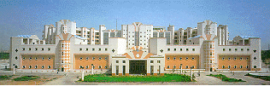
Thank You!

