Slide 1
Interplay between Nucleotide Excision Repair (NER) and Transcription-coupled DNA Repair (TCR) in Repairing Transcriptional DNA Damage
Aditi Nadkarni, PhD
Department of Biology, New York University, New York, New York
Division of Science, New York University Abu Dhabi, Abu Dhabi, United Arab Emirates

Slide 2
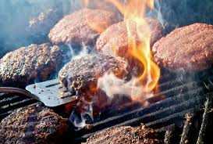



DNA Damage
Cancer
Developmental Diseases
Aging
Notes:
Align all text boxes. Talk will focus on class of carcinogens generated by…… Immune system, phys growth, nervous system. Arrows from all agents_PAHs-metabolism-DNA damage

Slide 3

Nucleotide Excision Repair
Disrupted base pairing
Detected by XPC-hR23B, in conjunction with other factors
Excision of DNA containing damaged base
Xeroderma pigmentosum (XP): cancer susceptibility, sensitivity to sunlight
Transcription-coupled DNA Repair
Damage that blocks gene transcription
Stalled RNA polymerase II detection
Excision and repair as in NER
Cockayne Syndrome (CS): developmental defects
Notes:
Which references should I add and where? At the end of the talk, review articles that I referred to. “There are times when XPC-hR23B is assisted by other factors during sensing of damage” XPE (cyclobutane). Other organs—cancer suscpetibility, Hoejemakers papers. Multiple roles of CS proteins. In XPA eliminate only NER but in CS not just TCR but other mechanisms might be knocked down. No cancer risk in CS is because NER is still functioning. Cut and patch mechanism; cartoons explaining the mechanism? Slide that covers significance: chemo and environmental damage; persistent dna lesions. TCR relies on stalled polymerase for detection and summons downstream repathways

Slide 4
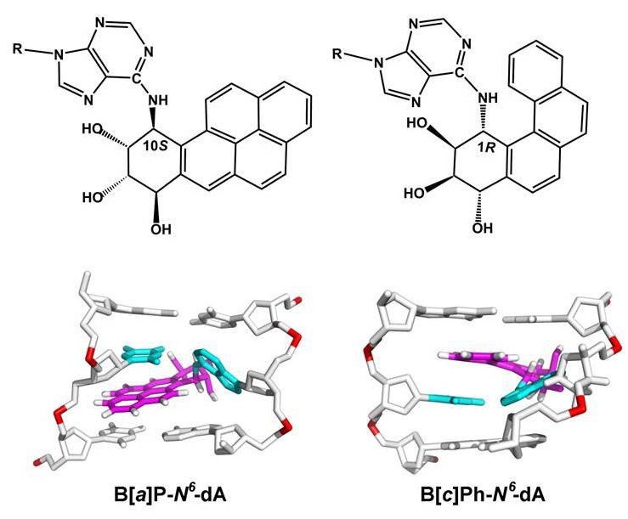
B[a]P-N⁶-dA and B[c]Ph-N⁶-dA
Major helical distortion
Nominal helical distortion
Cai Y, Geacintov NE, and Broyde S (2012) Biochemistry 51, 1486-1499
Notes:
How do I describe topological differences. Not immed obvious but the BaP distorts DNA, but phenanthrene doesn’t distort, stretches it. Structures don’t illustrate what happens in the DNA.

Slide 5
B[a]P-N⁶-dA versus B[c]Ph-N⁶-dA
Effects on Transcription
B[a]P-N⁶-dA
Unknown effect on RNA polymerase II elongation in vitro
B[c]Ph-N⁶-dA
Blocks RNA polymerase II elongation in vitro
Schinecker TM, et al. (2003) Nucleic Acids Res. 31, 6004-6015
Notes:
References

Slide 6
Does B[a]P-N⁶-dA block RNA polymerase II in vitro as well?
If it does, it should be a substrate for TCR.

Slide 7
Site-specific DNA Template for in vitro Transcription
Perlow RA, et al. (2003) Nucleic Acids Res., 31, e40-e40
Constructed by annealing a site-specifically modified 11 base oligomer, and 96 base and 90 base oligomers to a DNA element containing the CMV promoter enhancer
Incubated with HeLa nuclear extract with radioactive nucleotides; RNA products resolved by denaturing PAGE
Interruption of RNA polymerase II elongation is indicated by the presence of truncated transcripts
Notes:
Change the template figure construction. I used the method described in Perlow et al

Slide 8
B[a]P-N⁶-dA Blocks Human RNA Polymerase II
Moinuddin Chowdhury

Slide 9
What is the effect of B[a]P-N⁶-dA or B[c]P-N⁶-dA on gene expression in human cells with varying DNA repair backgrounds?
Notes:
The critical question. Specifically what are the effects NER and TCR. Emphasize that these are patient derived primary fibroblasts.

Slide 10
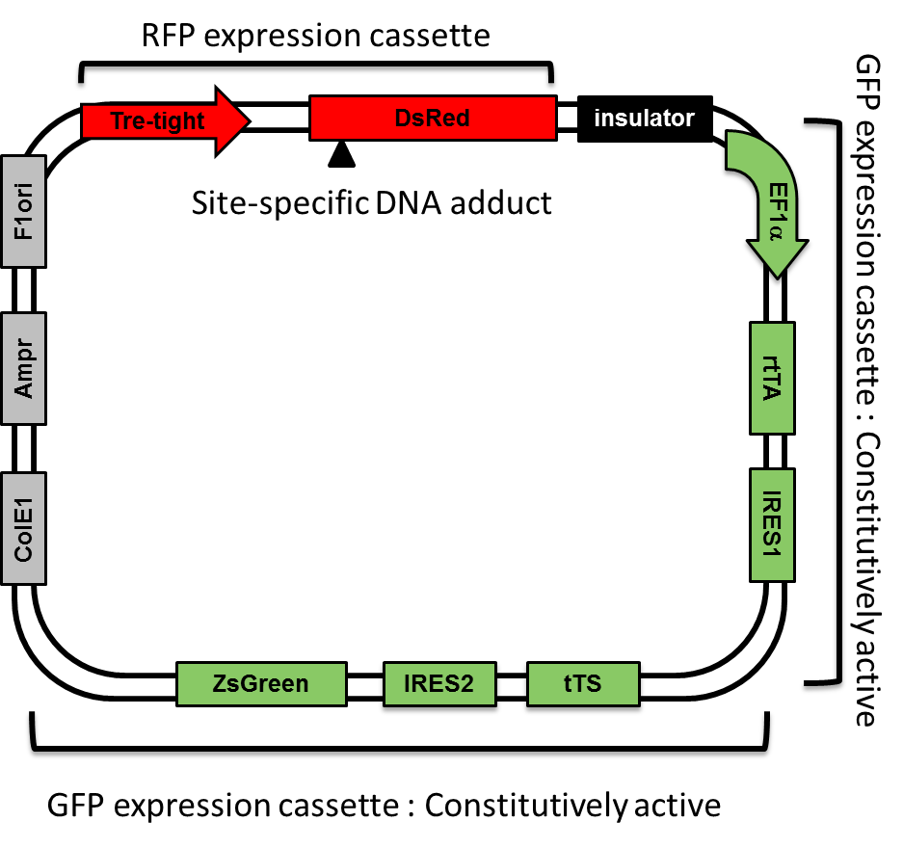
Plasmid Reporter System
John Burns, PhD
Notes:
To test this in cells. Should I have slide after this explaining the system: transfection, harvesting, RNA, flow etc? John Burns working on his doctorate designed this plasmid which I then used to introduce my lesion. When this is transfected into cells,

Slide 11
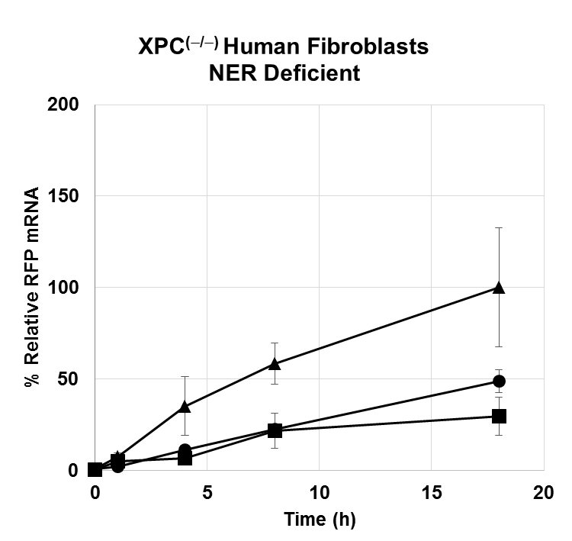
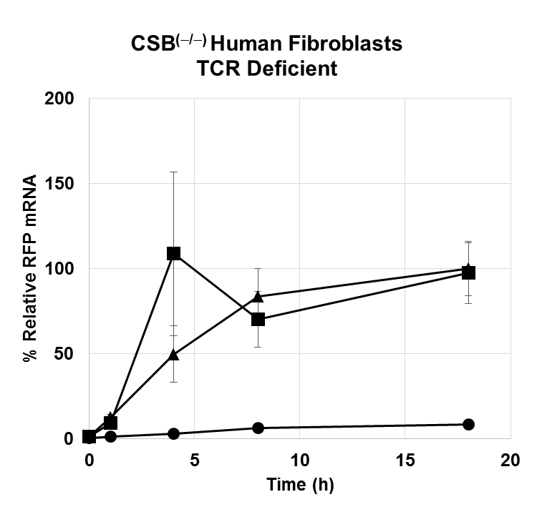
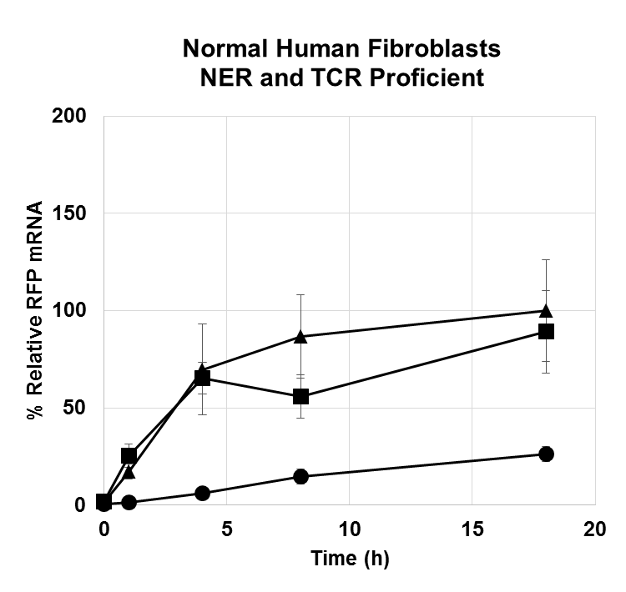
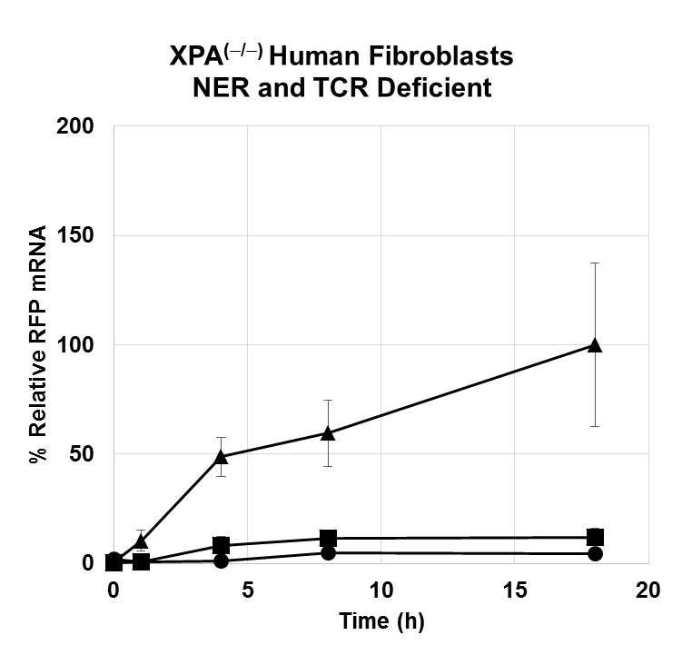
Effects of DNA Adducts on Transcription in Cells with Varying DNA Repair Backgrounds
p<0.05
p<0.02
p<0.02
p<0.01
p<0.03
p<0.04
control vector (); B[a]P-N⁶-dA vector (); B[c]Ph-N⁶-dA vector (•).
Notes:
Put p-value into the graph (p=value for each line). P value for BaP in Normal cells. XPC: TCR deficient and NER proficient

Slide 12
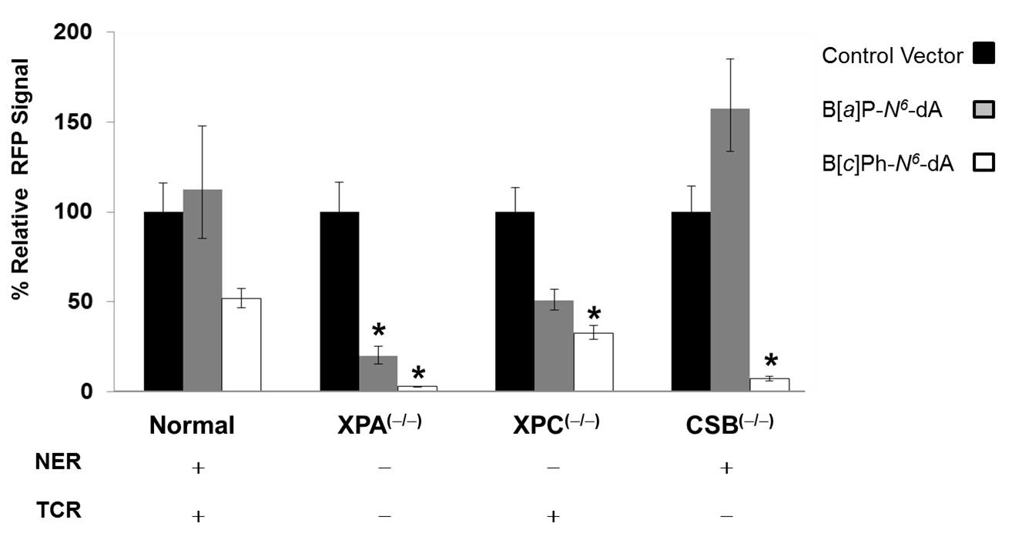
Effects of DNA Adducts on Red Fluorescent Protein in Cells with Varying DNA Repair Backgrounds
* p < 0.001
Notes:
Put p-value standard first

Slide 13
Deep Sequencing of RNA Resulting from Transcription Past B[a]P-N⁶-dA or B[c]Ph-N⁶-dA in Cells
Preliminary Data
Notes:
Description of method not necessary.

Slide 14
Summary of transcriptional mutations due to B[a]P-N⁶-dA and B[c]Ph-N⁶-dA
Cell type | B[a]P-N⁶-dA |  |  | B[c]Ph-N⁶-dA
 | Misincorporations | Deletions | Insertions | Misincorporations | Deletions | Insertions
Normal NER and TCR proficient | Low | - | - | Low | - | -
XPA NER and TCR deficient | High | Moderate | - | High | High | Moderate
XPC NER deficient | Moderate | Low | - | Low | Low | -
CSB TCR deficient | Moderate | - | - | Low | Moderate | Low
Notes:
How is low, medium, high defined? NER and TCR status for each cell type. Stick to early time points.

Slide 15

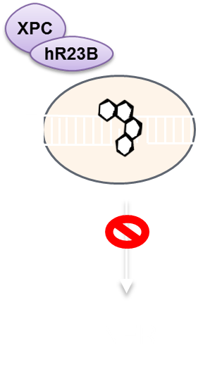
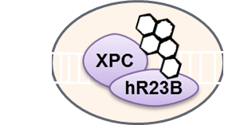




Proposed Model
Polycyclic Aromatic Hydrocarbons
B[a]P-N⁶-dA
B[c]Ph-N⁶-dA
NER
TCR
TCR
Notes:
hR23B. Admit not knowing if XPC-hR23B binds to lesion: productive or unproductive complex. There may be other mechanisms at work in addition to TCR for BaP but principle players are NER and TCR. Jung-Hyun Min Nat Comm 2007 and 2015

Slide 16
Conclusions and Significance
Bulky DNA adducts encountered during transcription block RNA polymerase II elongation
TCR abrogates the deleterious impact of DNA lesions that can escape NER
Why are these findings significant?
Notes:
So far bulky adducts block transcription either completely. Talk about the speculations.

Slide 17
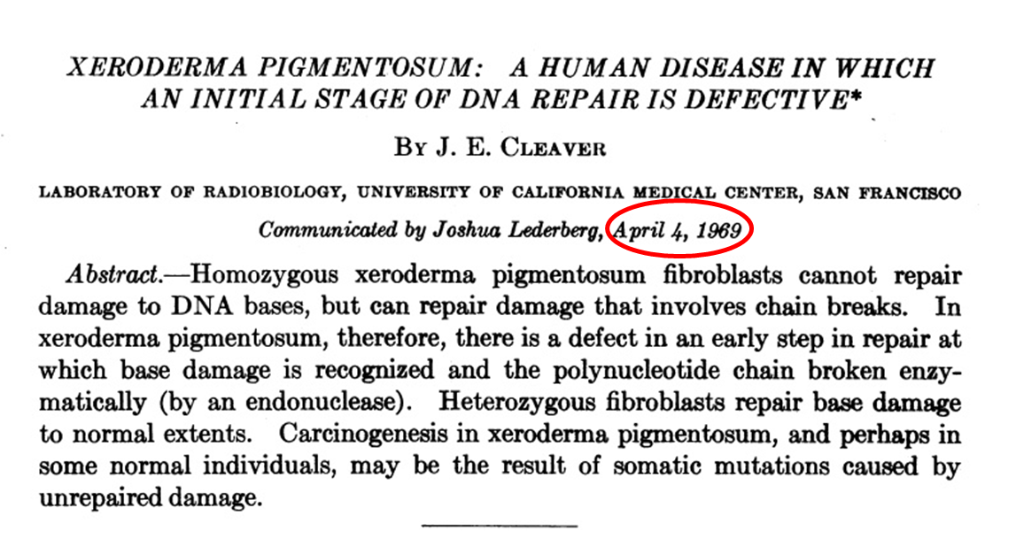
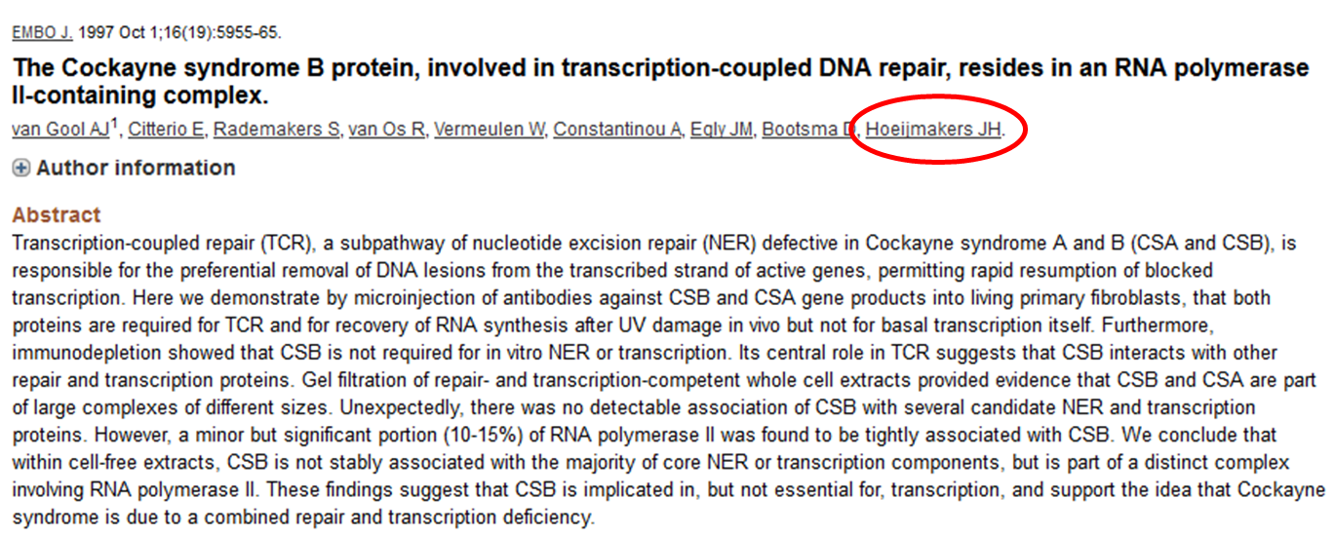
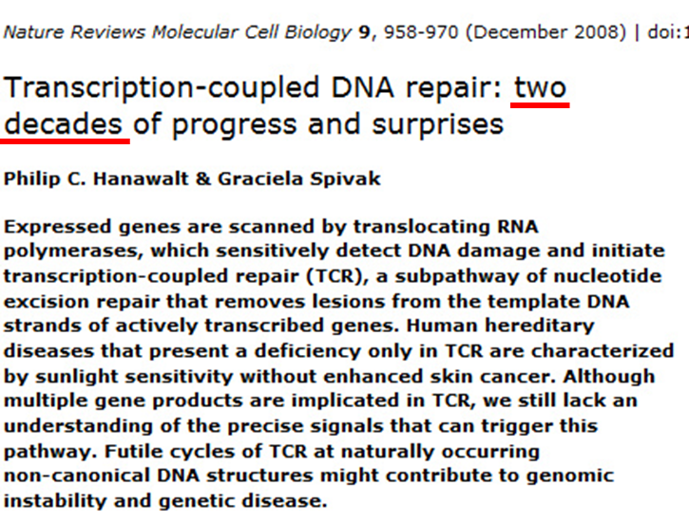
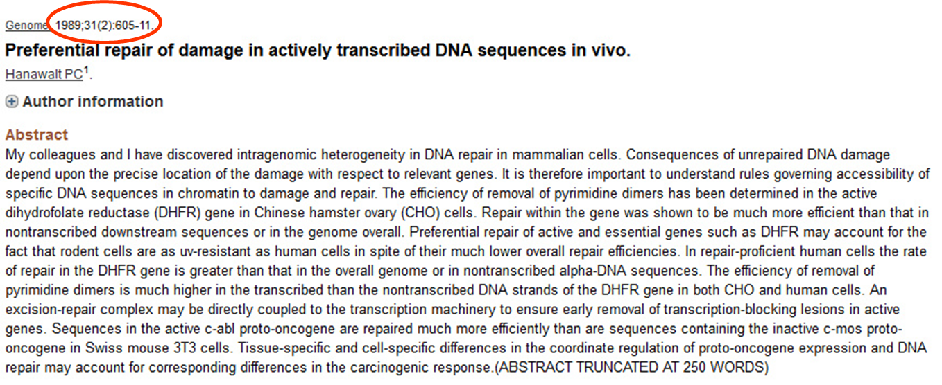
Historical & salient findings in the field

Slide 18
Acknowledgements
David A. Scicchitano, PhD: Principal Investigator
National Institutes of Health Grant ES-010581 to DAS and funds from New York University Abu Dhabi to DAS.

Slide 19
Acknowledgements
¹John Burns, PhD
^{3,4}Alberto Gandolfi, PhD
Mathematical modeling and statistical analysis
¹Moinuddin Chowdhury, MS
In vitro transcription assay
²Nicholas Geacintov, PhD
Site-specific oligonucleotides
¹Suse Broyde, PhD
¹Yuqin Cai, PhD
Technical consultation; previous studies showing structural models of DNA adducts
⁵Christian Berens, PhD
Parental plasmid for gap duplex system
1: Department of Biology, New York University, New York, New York
2: Department of Chemistry, New York University, New York, New York
3: Division of Sciences, New York University Abu Dhabi, Abu Dhabi, United Arab Emirates
4: Dipartimento di Matematica e Informatica “Ulisse Dini”, Università di Firenze, Firenze, Italia
5: Institute of Molecular Pathogenesis, Friedrich-Loeffler-Institut, Jena, Germany
Notes:
Add a references slide before Acknowledgements

Slide 20
Thank you

Slide 23
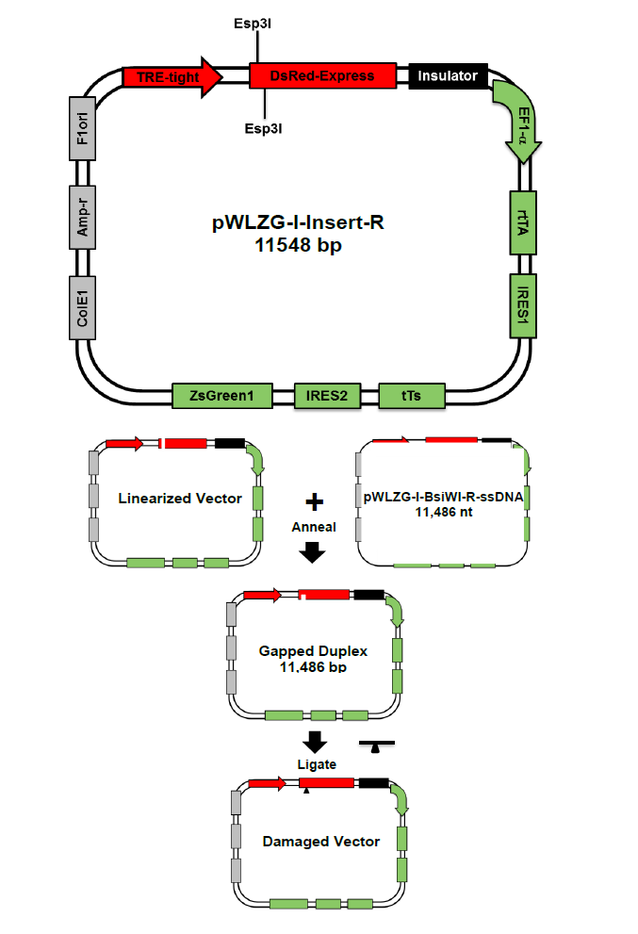
Gap duplex technology

