Slide 1

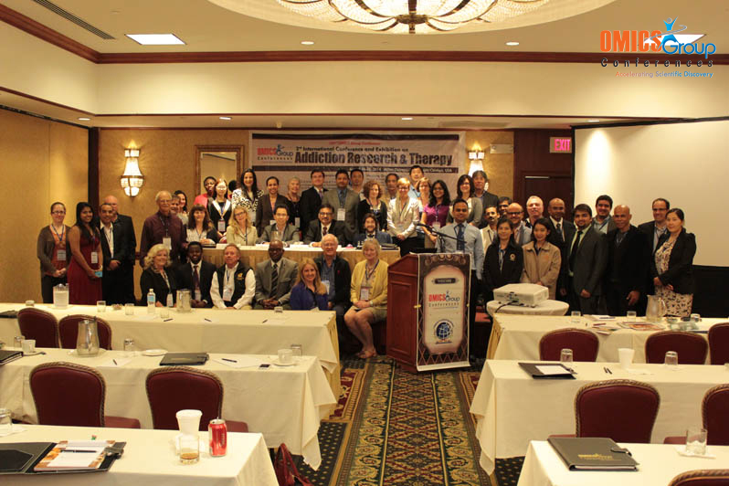
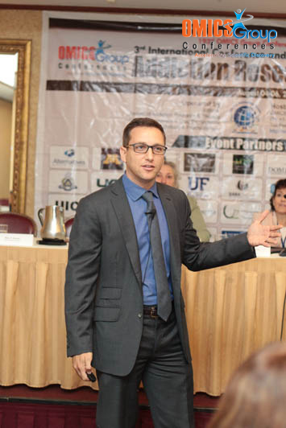
Addiction Therapy-2014
Chicago, USA
August 4 - 6, 2014
Adi Jaffe

Slide 2

Not Ashamed but Still Too Poor
Longitudinal changes in barriers to treatment entry for online treatment seekers
Adi Jaffe, PhD

Slide 3
Background
24 million U.S. residents meet substance use
disorders (SUD) criteria
Only 10% enter treatment (SUDTx) annually
  Additional 1.1 million indicate they needed Tx but could not obtain it.
Treatment effectiveness is moderate
  20% - 40% for more effective approaches
  With such low penetration, actual effective rate of success is low
    10% * 20%-40% = 2% - 4%
Improving Tx is important
Improving penetration might be more important

Slide 4
Barriers
Why aren’t they coming?!
Reasons for delaying or avoiding SUDTx (Cunnigham et. al. 1993):
  Cost
  stigma of seeking information regarding SUDTx.
  Location/information/time-commitment (inconvenience)
  Enjoying using
Notes:
These findings suggest that further efforts are needed to improve resources for SUDTx-seeking individuals.

Slide 5
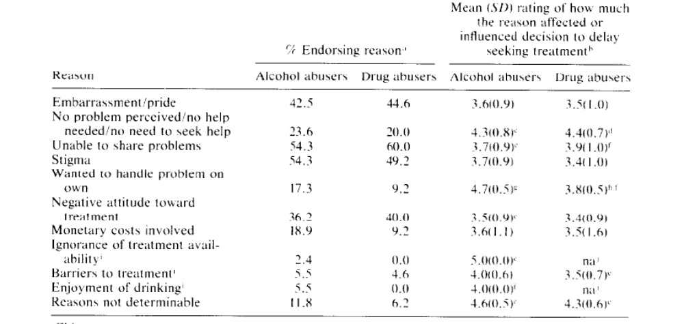
CUNNINGHAM, SOBELL. SOBELL, AGRAWAL, & TONEATTO - 1993

Slide 6
CUNNINGHAM, SOBELL. SOBELL, AGRAWAL, & TONEATTO - 1993

Slide 7
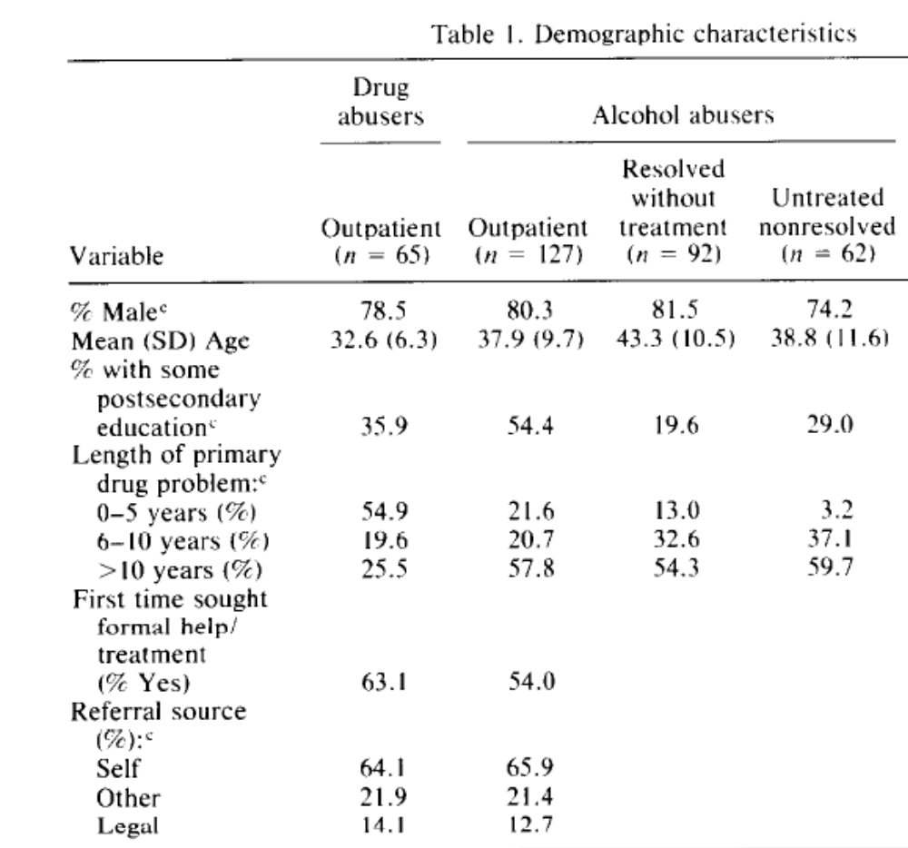
CUNNINGHAM, SOBELL. SOBELL, AGRAWAL, & TONEATTO - 1993

Slide 8
The CALDAR Pilot
Our study examined
  User characteristics
  Barriers to Tx entry
  Service utilization
What happens once people being seeking for treatment (online)?

Slide 9
Methods
We recruited treatment-seekers through
organic (i.e., unpaid) online searches.
Inclusion criteria included:
  Treatment-seeking for self (i.e., not for another)
  expected treatment entry within six months
  Access to a computer, the internet, and an email account
  Availability for four online assessments within six months.

Slide 10
Methods
Assessments utilized:
  CAATS Online Assessment
  ASI – Employment and Criminal Engagement Subscale
  ASSIST
  Drug Avoidance Checklist
  Recovery Assessment Survey
  Relapse Triggers Checklist
  Treatment Effectiveness Assessment
  Website Usability Questions

Slide 11
Participant flow
355 screened
244 excluded
111 Provided emails
44 Completed initial baseline
33 (75%) Followed up

Slide 12
Sample - demographics
Gender – 60% female
Mean Age = 35 years (SD = 8.6)
60% employed in past year
68% Reported High-School as highest degree attained
60% reported having health insurance
  Minimal available additional contribution to Tx costs M = $190 (SD=$300)
53% reported previous arrest or convictions

Slide 13
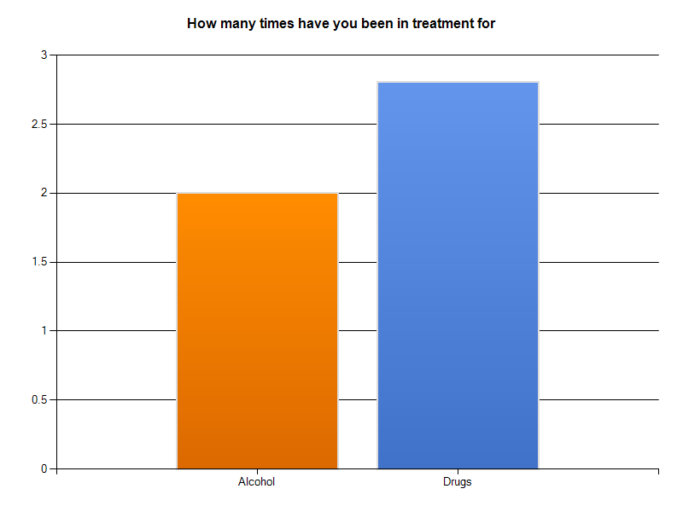
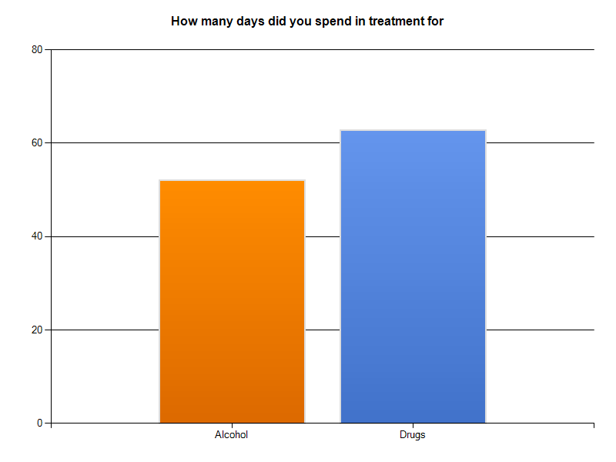
Sample – Seeking & Entering
70% of participants have previously sought Tx (M = 2.0 for alcohol, 2.8 for drugs)
53% have ever entered Tx

Slide 14
CUNNINGHAM, SOBELL. SOBELL, AGRAWAL, & TONEATTO - 1993
Our sample - 40%
Our sample - 32%
Our sample - 30%

Slide 15
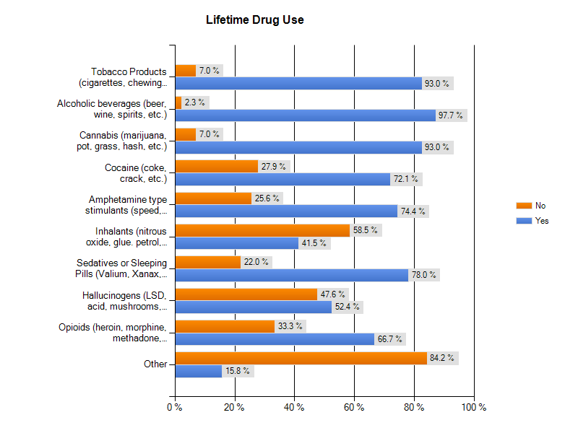
Sample – drug/alcohol use

Slide 16
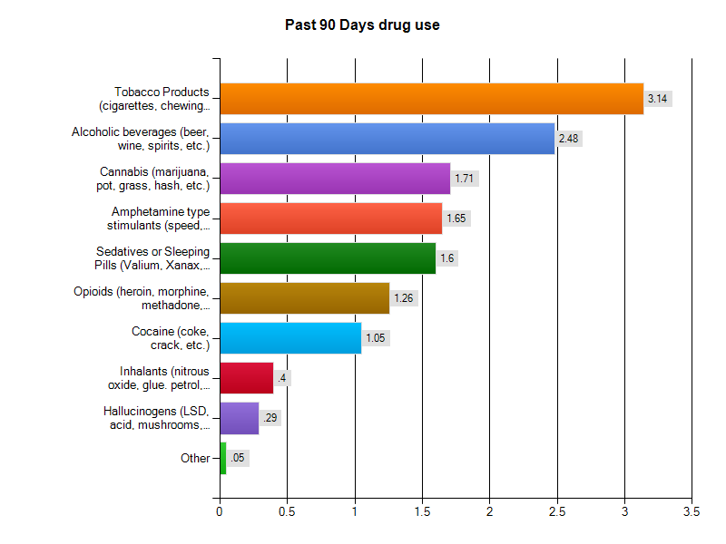
Sample – drug/alcohol use
% Daily
69%
29%
22%
28%
17%
21%
12%
2.4%
0%
4–daily
3–weekly
2–Monthly
1–Once/Twice
0–Never

Slide 17
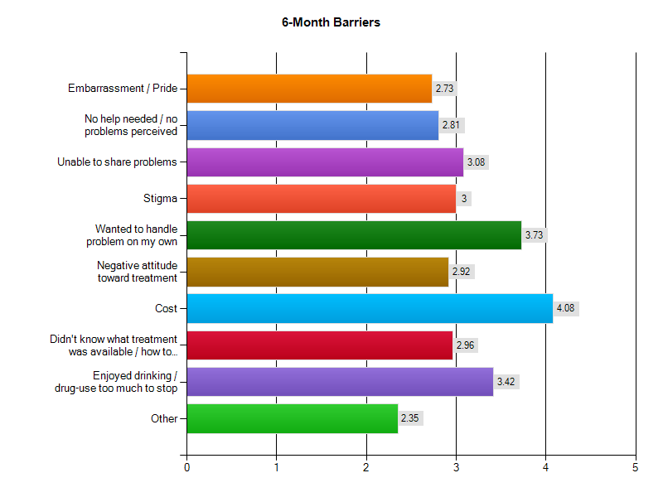
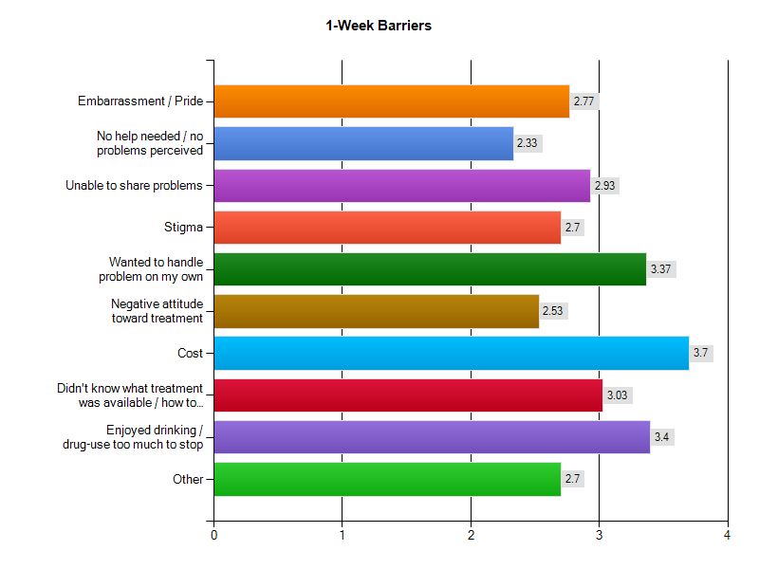
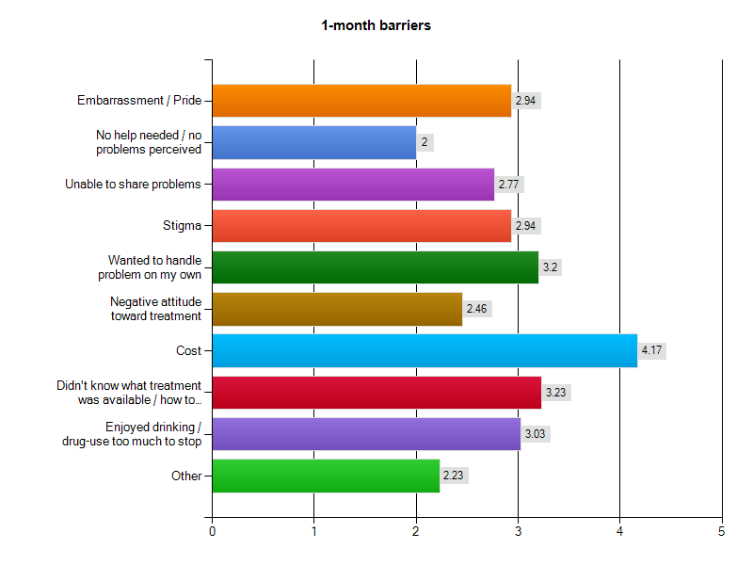
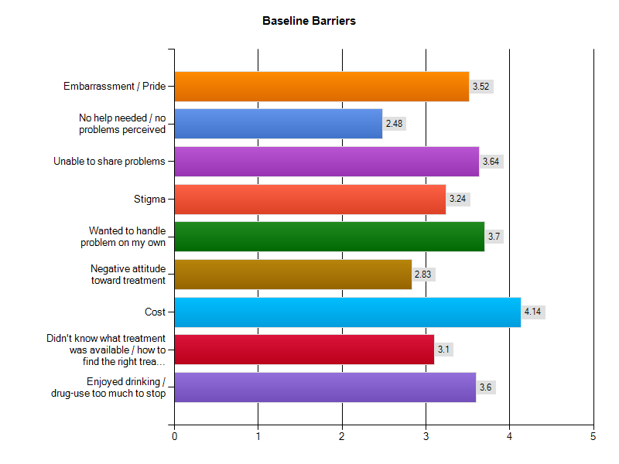
Tada! Barriers to Tx Entry
*0.8 reduction
*0.4 increase
*0.6 reduction

Slide 18
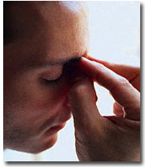
Stigma
Seems to matter more early in the tx-seeking process.
  Later on, logistics, cost and not wanting to stop are more important.
Suggests seeking alone helps
Need to target seekers differently

Slide 19
Easy to address?
Cost?
Accessibility?
Early Stigma?
Not wanting to quit?
Come See My Poster!

Slide 20
Take away(s)
Barriers to treatment entry are key
Improving penetration improves effectiveness
We need to stop blaming the addicts
  Address the needs
Cost, early shame and not wanting to quit are top barriers later in seeking

Slide 21

Acknoledgment
UCLA Integrated Substance Abuse Programs
  Yih-Ing Hser, Ph.D.
  Debra Murphy, Ph.D.
My research assistant
  Tariq Shaheed
  Adam Colman
  Will Strahl

Slide 22
The End

Slide 23
Changing the help we give
How much does stigma matter?
What barriers can we address easily?
What about helping those on the fence?

Slide 24
On the fence?
Not want to stop = Don’t want help ?!
Abstinence only treatment would suggest so
  At least not ready (pre-contemplation, denial, etc.)
Harm reduction and MI disagree
  “Meet the client where s/he is at”
Participants are tx-seeking

Slide 25
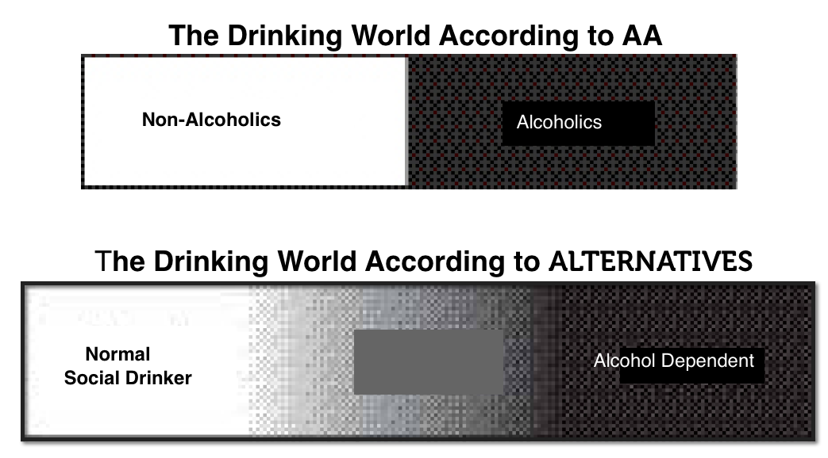
Non-abstinence Tx
A small number of U.S. providers
  Mostly on east-coast
  Often serve low-SES clients
  What about the rest?
At Alternatives we find many are looking for help without abstinence

Slide 26
Results – Drug use patterns
Assist scores – some moderate & gradual
change for sample throughout the study period
Brief Intervention
Ø

Slide 27
Tx Entry moderated Drug use
Didn’t Enter TX

Slide 28
Tx Entry moderated Drug use
Entered TX

Slide 29
Conclusions
Seeking treatment online (or at least online treatment seekers) seem to experience reduced shame through searching alone.
A minority of online-Tx seekers enter treatment
  But those who do utilize online information
No substantial change in drug use behavior among seekers who do not enter
  But Tx-entry does seem to produce change

Slide 30

Implications/Recommendations
Specific effort required to address the special makeup and needs of online Tx seekers
Time since beginning Tx search relevant for barriers and possibly other needs/behaviors
Tx seeking alone is not a good indicator of behavioral change

Slide 31

Meet the eminent gathering once again at
Addiction Therapy-2015
Florida, USA
August 3 - 5, 2015
Addiction Therapy – 2015 Website:
addictiontherapy.conferenceseries.com

