Slide 1
4th International Conference on
Earth Science and Climate Change
Carbon Footprint of residual
Municipal Solid Waste (rMSW) Management
-
The Relevance of Background Systems
Dipl.-Ing. Adele Clausen
Alicante, June 16-18, 2015

Slide 2
Content
Introduction GHG emissions from rMSW management
Selected treatment technologies
Origin of GHG emissions
Relevant background
Background for examplary modelling
Exemplary modelling
Results
Outlook

Slide 3
GHG emissions from rMSW management
rMSW = what remains after separate collection
- Food
- Yard
- Wood
- Paper
- Plastics
- Metals
- Inerts
- Textiles
- Nappies
- Residuals
Materials
Recovery
?
Energy
Recovery
CO₂
Avoided Burden
Treatment options:
Landfilling
Incineration
Mechanical-biological treatment (MBT)
Energy
Demand
GHG Emission
CH₄

Slide 4
Selected treatment technologies
EU LIFE+ Project MARSS
rMSW
rMSW
rMSW
Energy
rMSW
Energy
Incineration
MBT I
(composting)
MBT II*
(drying)
RRBF*
Metal
Metal
Metal
Energy recovery
RRBF*
Plastic
Landfilling
Landfilling
Landfilling
CH₄
CO₂
Energy
CH₄
Energy
CH₄
Energy
CO₂
Energy
* RRBF = Refused Refined Biomass Fuel (Results from EU LIFE+ Project MARSS)

Slide 5
Origin of GHG emissions
Direct emissions
CH₄ Biodegradable materials under anaerobic conditions
CO₂ Combustion of fossil carbon
Indirect emissions
Energy demand GHG emissions from energy generation
Avoided burdens
Materials Substitution of primary raw materials
Energy recovery Substitution of GHG emissions from energy generation
→ Relevant background
→ rMSW composition → Energy background system
Metals / plastics
Fossil carbon
Biodegradable materials
Energy content

Slide 6
Background for examplary modelling
rMSW Composition A:
Separate collection of plastics
rMSW Composition B:
Separate collection of biowaste
Energy background system
1.
Fossil
2.
Renewable

Slide 7
Selected treatment technologies
rMSW
rMSW
rMSW
Energy
rMSW
Energy
Composition A
High
biomass content
Fossil
energy background
Incineration
MBT I
(composting)
MBT II*
(drying)
RRBF*
Metal
Metal
Metal
Energy recovery
RRBF*
Composition B
High
plastics content
Renewable
energy background
Plastic
Landfilling
Landfilling
Landfilling
CH₄
CO₂
Energy
CH₄
Energy
CH₄
Energy
CO₂
Energy
* RRBF = Refused Refined Biomass Fuel (Results from EU LIFE+ Project MARSS)

Slide 8
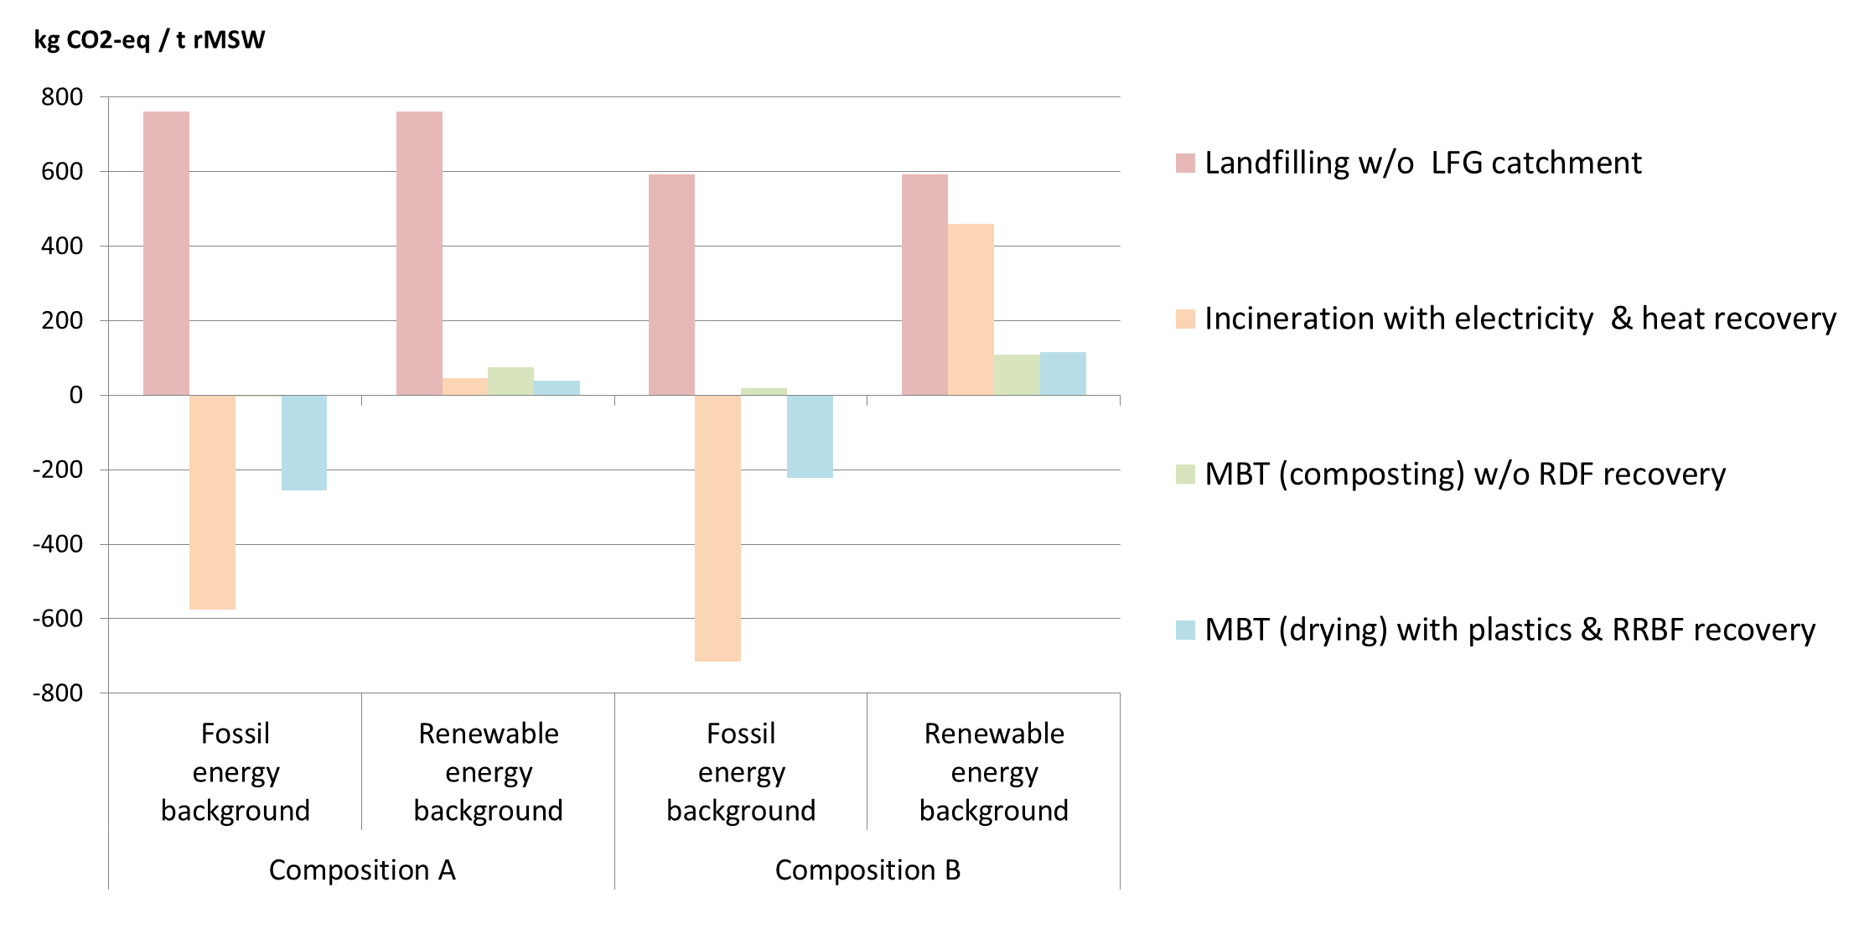
Modelling results

Slide 9
Conclusion
No general statement in terms of superiority of a single technology
Background = Decisive relevance on GHG emissions from rMSW management
Current situation:
Large share of fossil energy background
→ Pro incineration
Future trend:
Renewable energy background ?
→ Pro MBT

Slide 10

Thank you!
Contact
Dipl.-Ing. Adele Clausen
Department of Processing and Recycling
RWTH Aachen University
Wüllnerstr. 2
52062 Aachen
+49 241 80 96 123 (fon)
+49 241 80 92 232 (fax)
clausen@ifa.rwth-aachen.de
www.iar.rwth-aachen.de

Slide 11
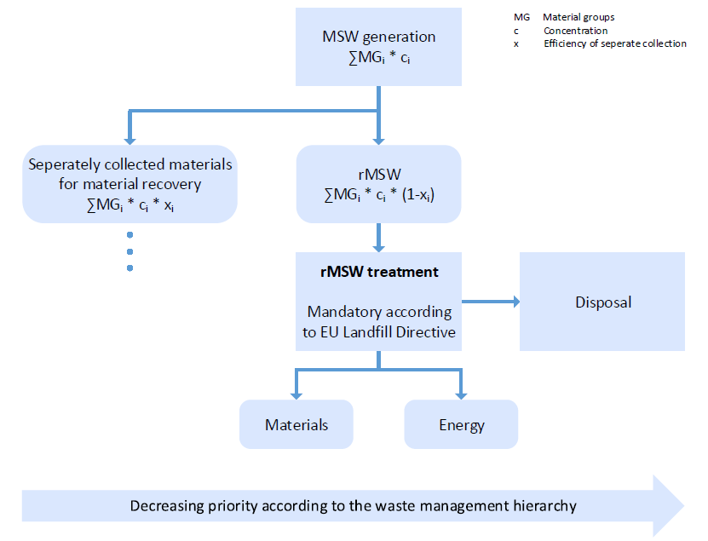
Relevance
Kyoto Protocol: Reduction of GHG emissions (e.g. from waste)
EU Waste Framework Directive: Reduction GHG emissions from waste, LCA…
EU Landfill Directive: Biomass reduction target

Slide 12
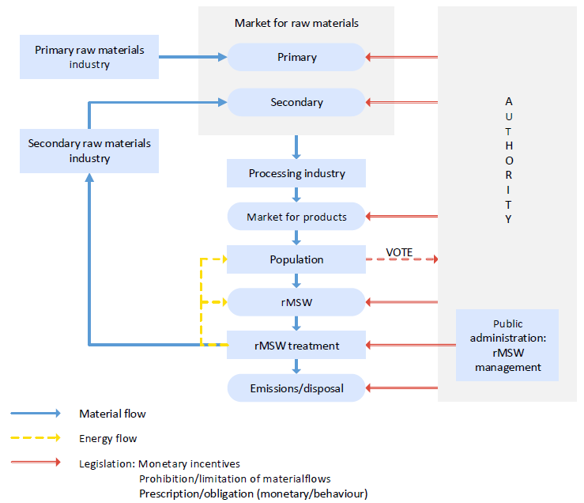
Background system
Interaction of Stakeholders

Slide 13
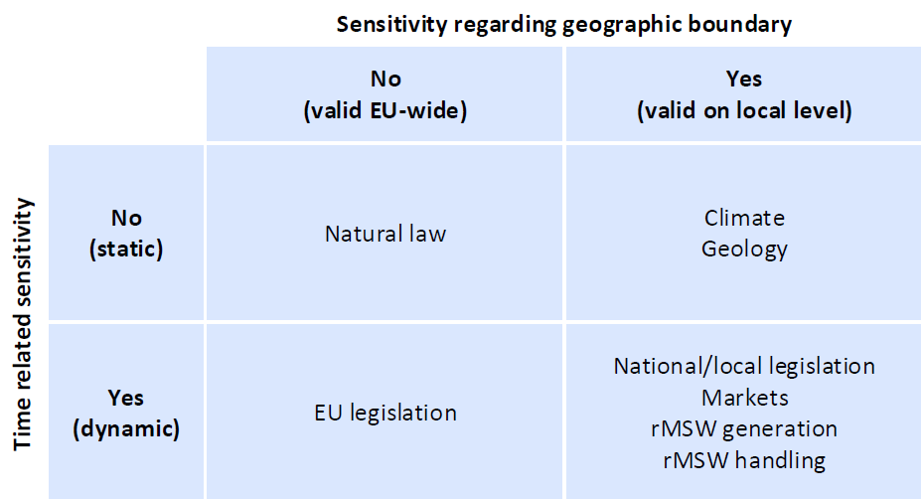
Background system
Dynamics of the background

Slide 14
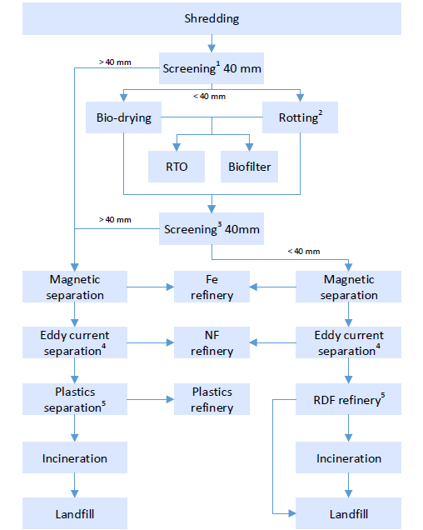
Foreground system
Content
1 Only upstream to rotting
2 Only applicable downstream to screening
3 Only applicable downstream to bio-drying
4 Only applicable downstream to Fe separation
5 Only applicable downstream to bio-drying and screening

Slide 15
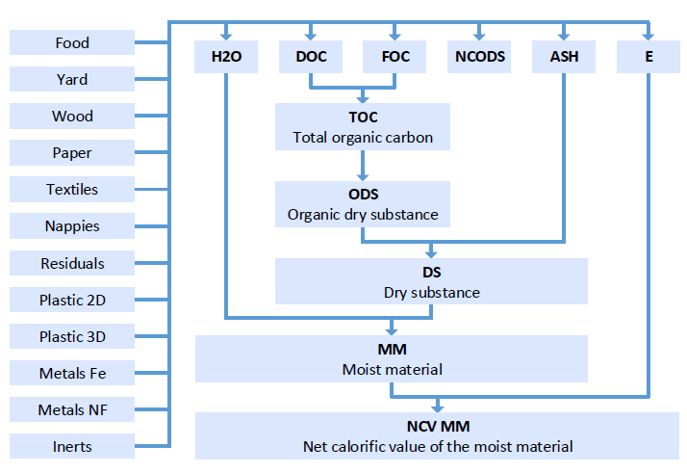
Modelling
Link Population - Foreground

Slide 16
Modelling
Link Markets/Population & Climate - Foreground
Processes | Market/Legislation | Climate/Geology
Shredding | η Energy consumption | -
Screening | η Overflow η Energy consumption | -
Separation | η Product η Impurities Energy consumption | -
Bio-drying | η Oxidisation η GHG transformation η Energy consumption | -
Bio-stabilisation | η Oxidisation η GHG transformation η Energy consumption | Temperature air
Energy supply | Emission factor marginal energy | Emission factor marginal energy
Landfill | Type of landfill η LFG catchment η Energy recovery | Temperature air Humidity air

Slide 17
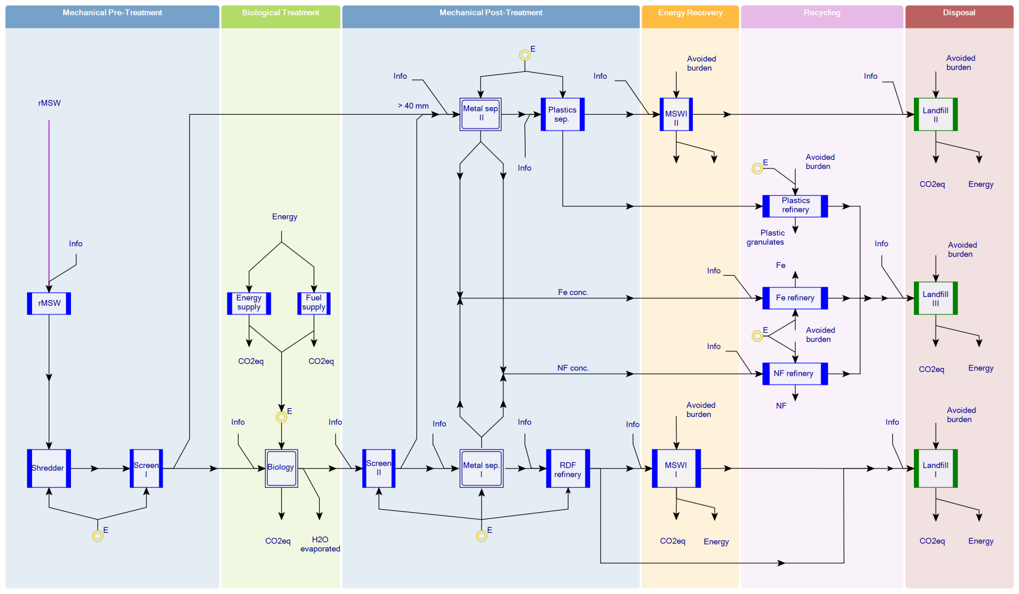
The Model
Generic flow diagram of the Model

Slide 18
Exemplary modelling
Scenarios
 | Landfill |  | MSWI | MBS |  |  |  | MBD
 | 1.0 | 1.1 | 2.0 | 3.0 | 3.1 | 3.2 | 3.3 | 4.0 | 4.1 | 4.2
Biological stabilisation | - | - | - | x | x | x | x | - | - | -
Biological drying | - | - | - | - | - | - | - | x | x | x
Screen II | - | - | - | - | - | - | - | - | x | x
MSWI I | - | - | x | - | - | - | - | x | x | x
Fluidised bed | - | - | - | - | - | - | - | - | x | x
MSWI II | - | - | - | - | - | x | x | - | - | -
Metal separation I | - | - | x | x | x | x | x | x | x | x
Metal separation II | - | - | - | x | x | x | x | - | x | x
Plastics separation | - | - | - | - | - | - | - | - | x | x
RDF refinery | - | - | - | - | - | - | - | - | x | x
RTO | - | - | - | - | - | x | x | - | - | -
LFG catchment * | - | x | - | - | x | - | x | - | - | x
* LFG catchment efficiency = 50%

Slide 19
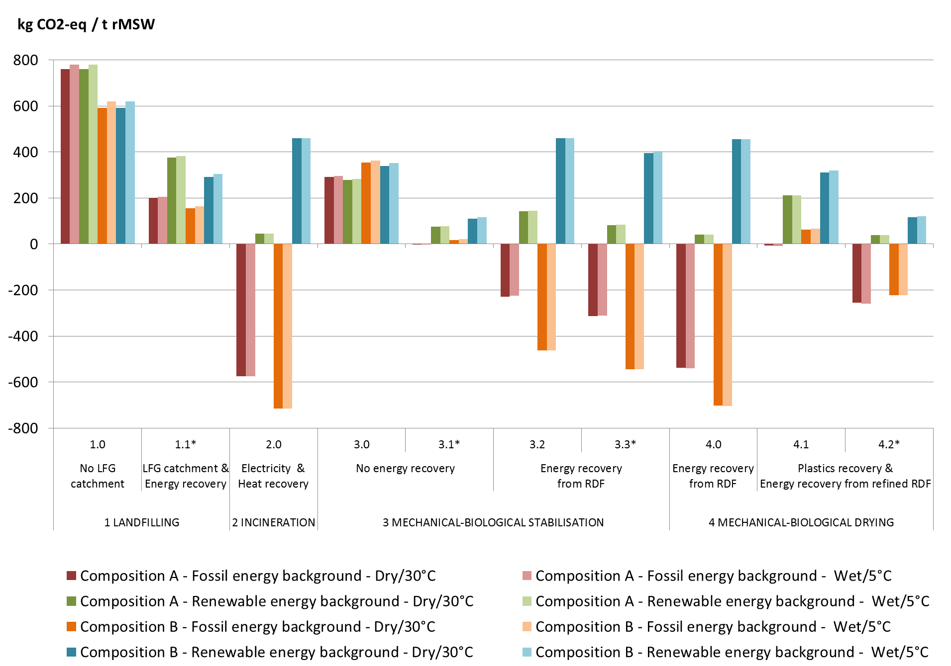
Results
* LFG catchment efficiency = 50%

Slide 20
Conclusion
Summary
Context significantly impacts the climate performance
Priority order is not fix
Composition and energy background are of special relevance
Anaerobic digestion should be considered in future investigations
The scope may be extended to non-EU countries
Real context situations can be investigated
Data for uncertainty studies should be investigated
Outlook

