Slide 1
About OMICS Group
OMICS Group is an amalgamation of Open Access Publications and worldwide international science conferences and events. Established in the year 2007 with the sole aim of making the information on Sciences and technology ‘Open Access’, OMICS Group publishes 500 online open access scholarly journals in all aspects of Science, Engineering, Management and Technology journals. OMICS Group has been instrumental in taking the knowledge on Science & technology to the doorsteps of ordinary men and women. Research Scholars, Students, Libraries, Educational Institutions, Research centers and the industry are main stakeholders that benefitted greatly from this knowledge dissemination. OMICS Group also organizes 500 International conferences annually across the globe, where knowledge transfer takes place through debates, round table discussions, poster presentations, workshops, symposia and exhibitions.

Slide 2
OMICS International Conferences
OMICS International is a pioneer and leading science event organizer, which publishes around 500 open access journals and conducts over 500 Medical, Clinical, Engineering, Life Sciences, Pharma scientific conferences all over the globe annually with the support of more than 1000 scientific associations and 30,000 editorial board members and 3.5 million followers to its credit.
OMICS Group has organized 500 conferences, workshops and national symposiums across the major cities including San Francisco, Las Vegas, San Antonio, Omaha, Orlando, Raleigh, Santa Clara, Chicago, Philadelphia, Baltimore, United Kingdom, Valencia, Dubai, Beijing, Hyderabad, Bengaluru and Mumbai.

Slide 3

Diversity Oriented Synthesis of Low Molecular Weight Acyclic and Heterocyclic Compounds from Resin-bound Polyamides:
Application for Drug Discovery
Adel Nefzi
Torrey Pines Institute for Molecular Studies
Port Saint Lucie, FL 34987

Slide 5
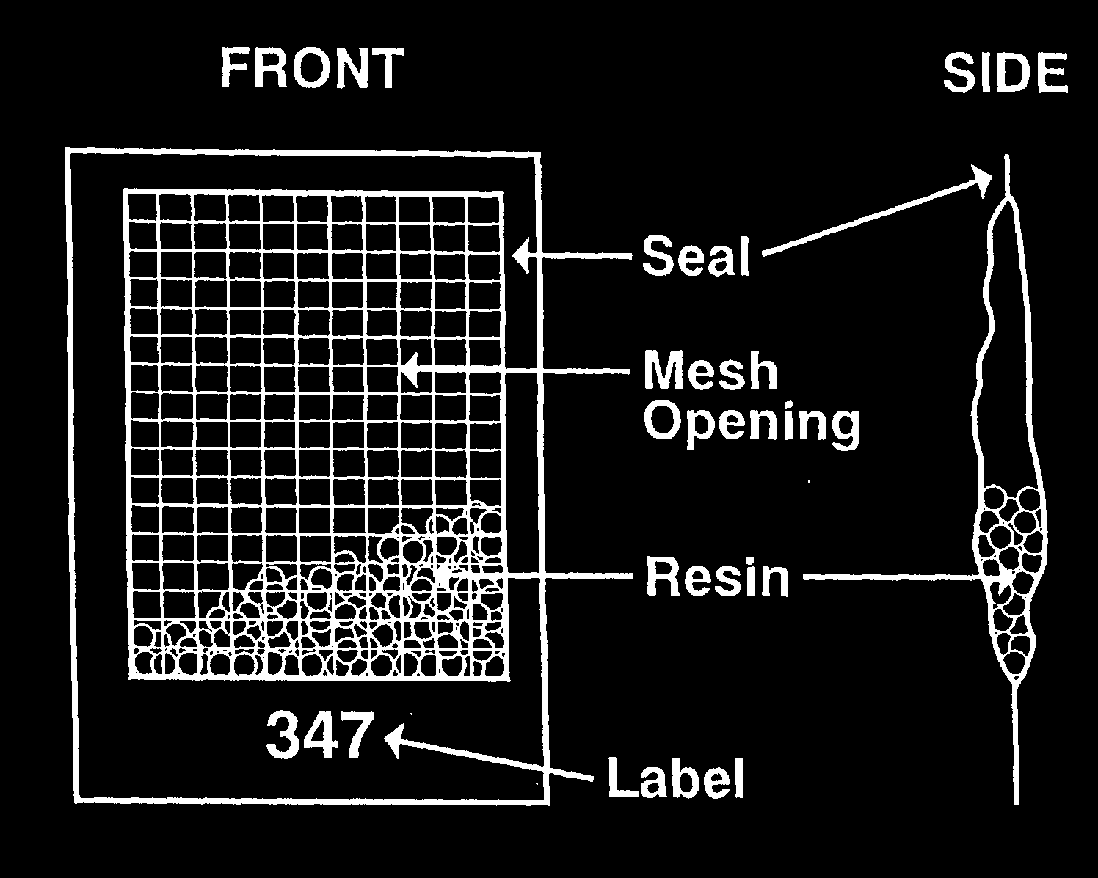

Slide 6
J. Org. Chem. 2004, 69:3603-3609.

Slide 7
J. Org. Chem. 2004, 69:3603-3609.

Slide 8
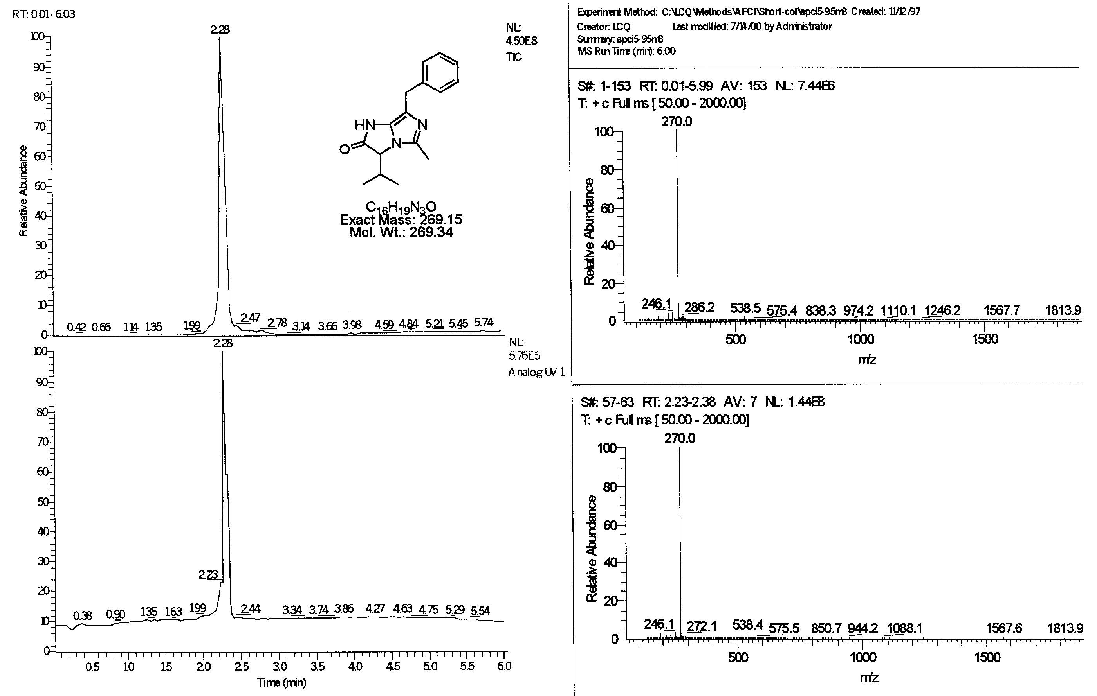

Slide 14
1R01AI105836-01A1 Piedrafita/Nefzi (PIs)
Novel RORgamma antagonists for inflammation and autoimmune disease

Slide 15
J. Org. Chem. 1998, 63, 8622-8623.

Slide 17
J. Comb. Chem. 2001, 3, 68-70.

Slide 21
Synthesis of hexahydro-diimidazo[1,2-d:1',2'-g][1,4]diazepines
J. Med. Chem. 2015, 58, 4905-4917.

Slide 22
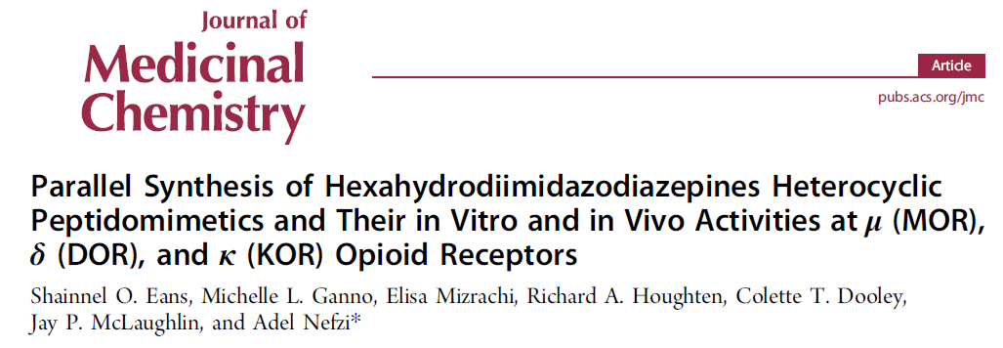
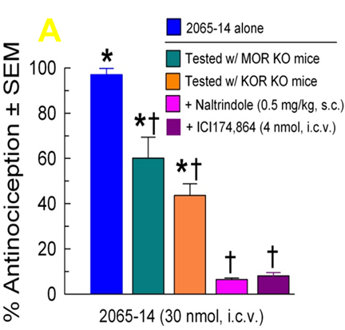

Slide 23
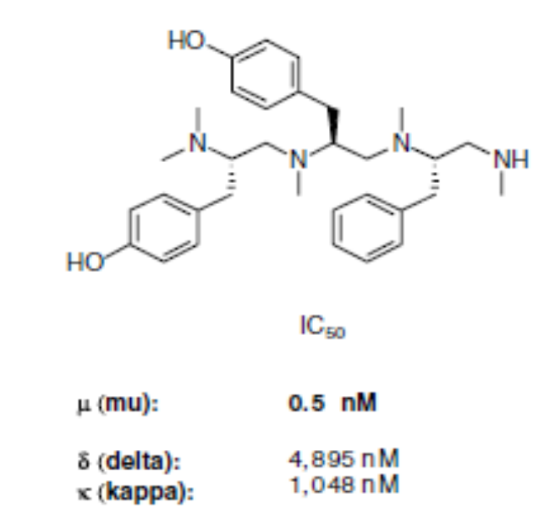
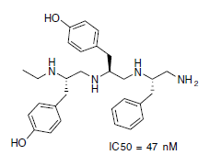
Bioorg. Med. Chem. Lett. 2006, 16, 4331-4338.

Slide 24
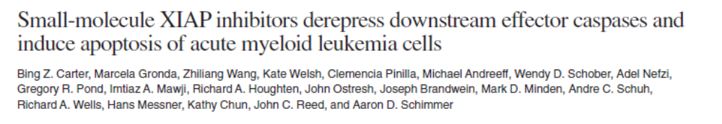
1396-11
1396-34

Slide 25
Representative Small Molecular Libraries: Libraries for Probe, Hit and Lead Identification

Slide 26
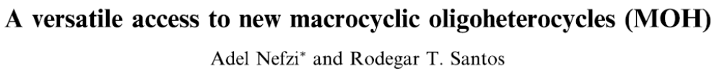
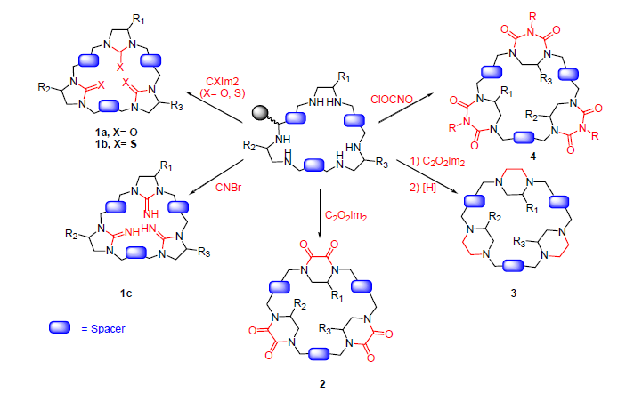
Bioorg. Med .Chem. Lett. 2006, 16:3358-3361.

Slide 29
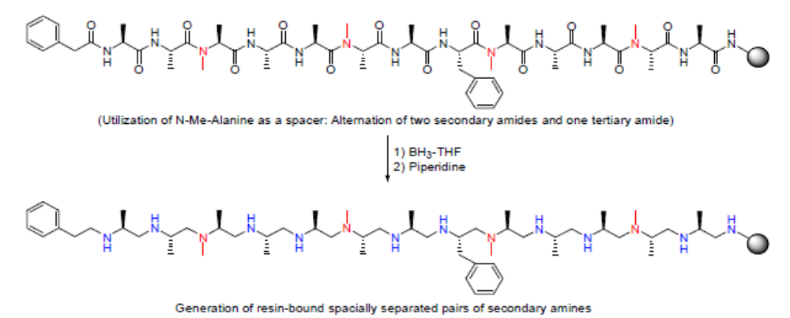

Slide 30
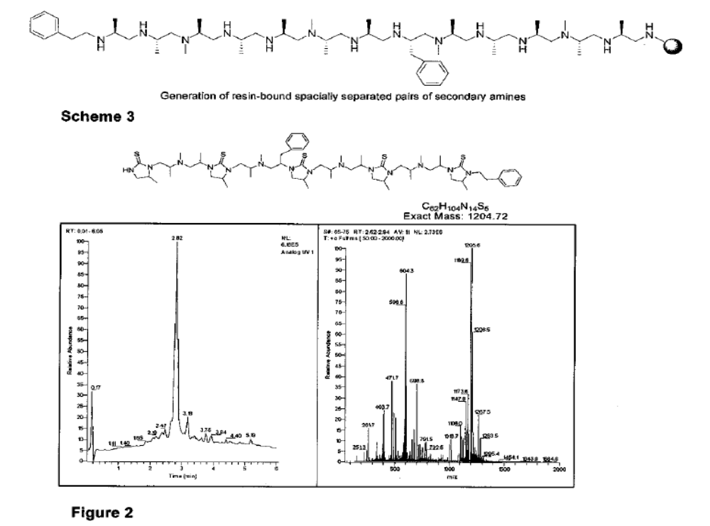

Slide 31
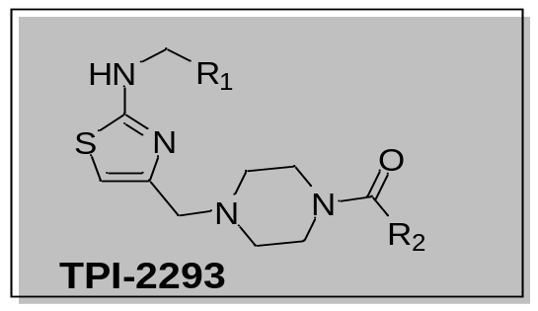
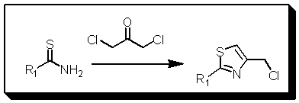
Hantzsch Based Macrocyclization Approach for the Synthesis
of Thiazole Containing Cyclopeptides
Hantzsch reaction

Slide 32
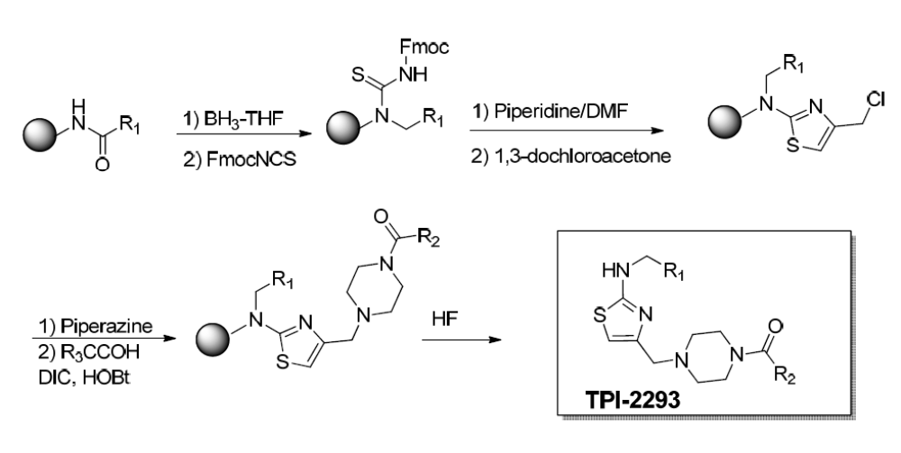
Synthesis of Thiazole tethered Piperazine Library

Slide 34
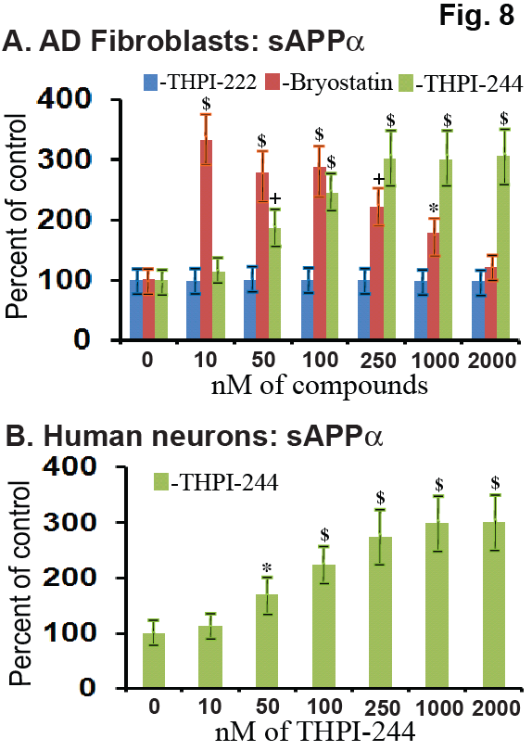
Preclinical evaluation of thiazole piperazine and its analog as Alzheimers drugs

Slide 35
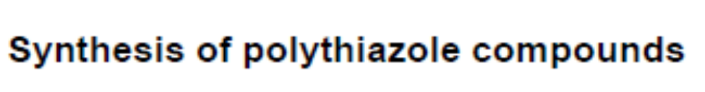
J. Com. Chem. 2010, 12, 315-317.

Slide 36

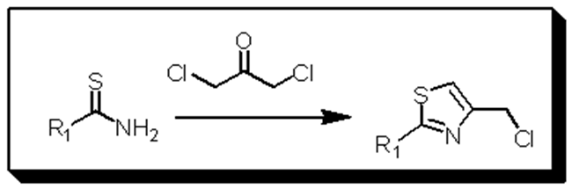
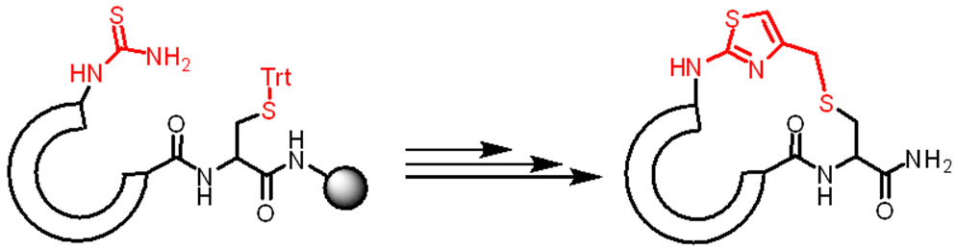

Slide 37

Synthesis of Thiazole Containing Cyclopeptides

Slide 38
Synthesis of Macrocyclic Compounds via Thio-Methyl-Thiazole as Analog of the Disulfide Bridge

Slide 39
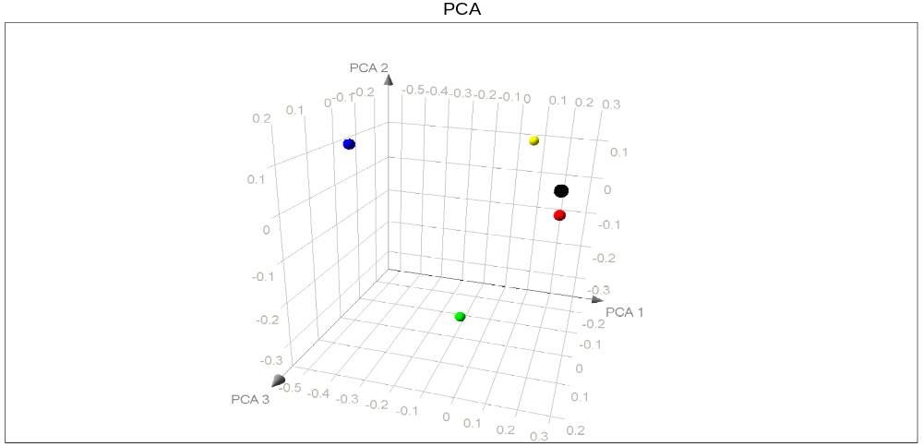
Approximate three-dimensional chemical space distribution of different cyclic peptides
MACCS keys
Variability preserved: 96.8%
Notes:
Figure shows the approximate three-dimensional chemical space of five cyclic peptides. Each data point in the graph represents a group of peptides with the core scaffold indicated in the figure legend. The chemical space was constructed using Tanimoto similarity based on MACCS key fingerprints. The similarity matrix was then subjected to principal component analysis, and the first three principal components, which explained 96.8% of the total variance of the sample, were plotted in the figure. A similar approach has been employed to compare the chemical space of other data sets [1,2]. It is clear from the figure that the thiazole containing cyclic peptides occupy a different region in chemical space as compared to the other cyclic peptides illustrated in the figure.
[1] Houghten, R. A.; Pinilla, C.; Appel, J. R.; Giulianotti, M. A.; Nefzi, A.; Ostresh, J. M.; Dooley, C. T.; Maggiora, G. M.; Medina Franco, J. L.; Brunner, D.; Schneider, J. J. Comb. Chem. 2008, 10, 3
[2] López-Vallejo, F.; Nefzi, A.; Bender, A.; Owen, J. R.; Nabney, I. T.; Houghten, R. A. Medina-Franco, J. L. Chem. Biol. Drug Des., 2011, 77, 328

Slide 40
Synthesis of Thiazole Containing Cyclopeptides Application for the synthesis of DAMGO and EnkephalinConstrained Analogs

Slide 41
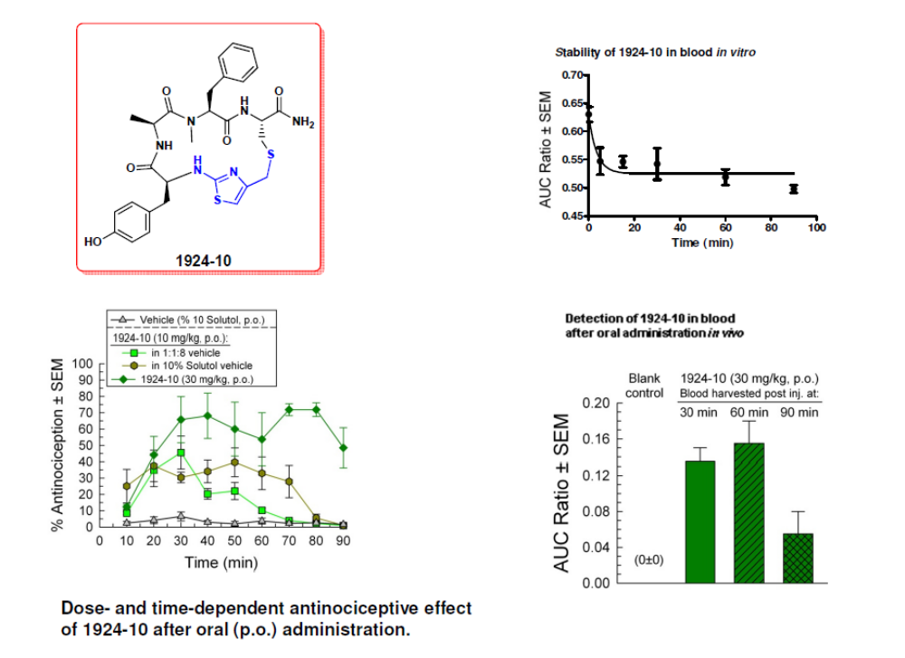
In vivo screening of series TPI-1924 and TPI-1936 compounds

Slide 42
Positional Scanning:
Tetra-Peptide Library
O₁ X X X -NH₂
X O₂ X X -NH₂
X X O₃ X -NH₂
X X X O₄ -NH₂
_{6,250,000 tetra-peptides}
_{125,000 each mixture}
(50 different L-, D-, and Unnatural amino acids)
O = individual X = mixture
Dooley, Houghten (1998) J. Biol. Chem. 273, 18848
Notes:
42
42

Slide 43
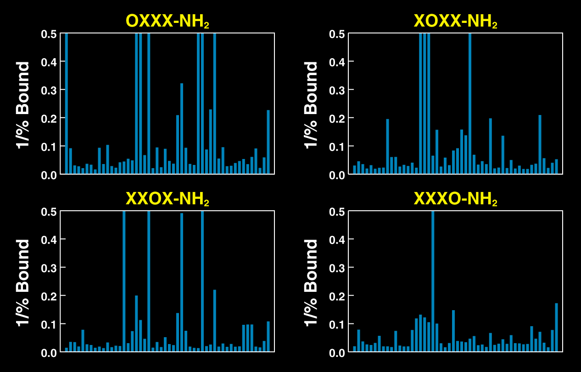
Kappa Receptor Binding Assay
7 x 4 x 4 x 1= 96 individual tetrapeptides
Notes:
43

Slide 44
Kappa Receptor Binding Assay
Positional
Library
Most Active
Residues
Number of
Residues
OXXX-NH₂
DPhe, DNle
2
XOXX-NH₂
DPhe, DNal
2
XXOX-NH₂
DTrp, Dile, DNle
3
XXXO-NH₂
DArg, DCha
2
Total
24
Sequence
IC₅₀ (nM)
(DPhe)(DNal)(DNle)(DArg)-NH₂
1
(DPhe)(DPhe)(DNle)(DArg)-NH₂
2
(DNle)(DNal)(Dile)(DArg)-NH₂
2
All Full Agonists
(DPhe)(DPhe)(Dile)(DArg)-NH₂
2
(DNle)(DNal)(DNle)(DArg)-NH₂
3
(DPhe)(DNal)(Dile)(DArg)-NH₂
4
Notes:
44
44

Slide 45
Kappa Receptor Selectivity
Sequence
κ
U69,593
IC₅₀ (nM)
μ
DAMGO
IC₅₀ (nM)
δ
DSLET
IC₅₀ (nM)
(DPhe)(DNal)(DNle)(DArg)-NH₂
(DPhe)(DPhe)(DNle)(DArg)-NH₂
(DNle)(DNal)(Dile)(DArg)-NH₂
(DPhe)(DPhe)(Dile)(DArg)-NH₂
(DNle)(DNal)(DNle)(DArg)-NH₂
(DPhe)(DPhe)(DNle)(DCha)-NH₂
0.7
2.0
2.0
2.0
3.0
6.0
22,630
42,963
3,034
>150,000
1,709
15,000
49,640
>25,000
19,316
>25,000
>25,000
28,932
Phase III Human Trials 2014/2015
Cara Therapeutics
Notes:
45
45

Slide 46
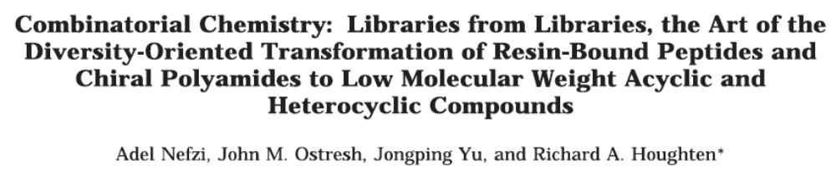
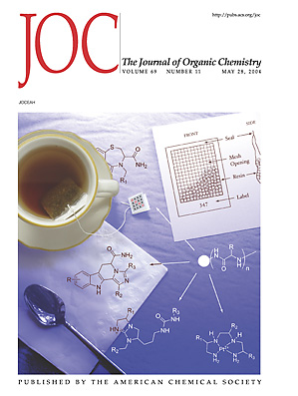

Slide 47
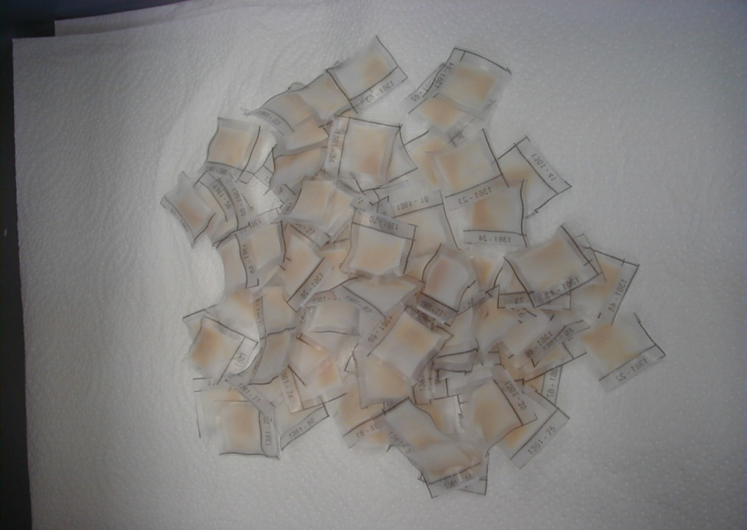
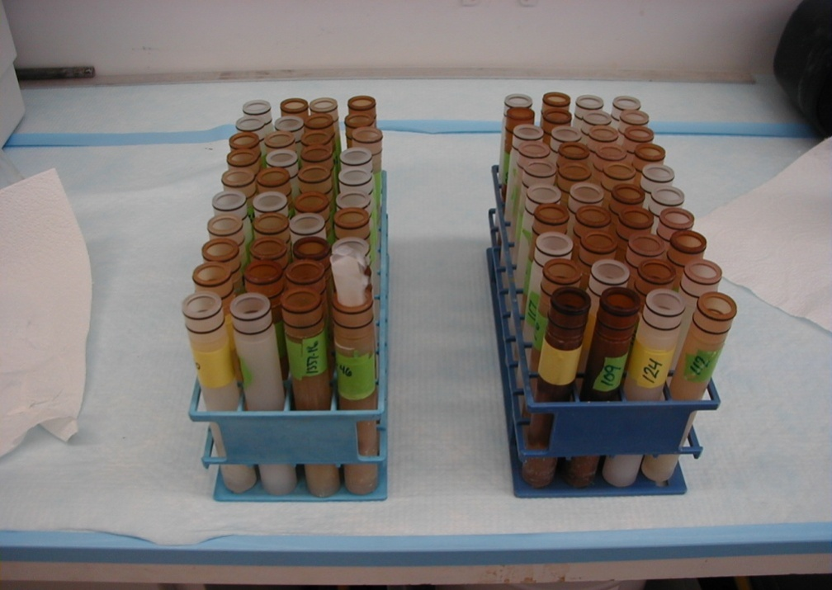
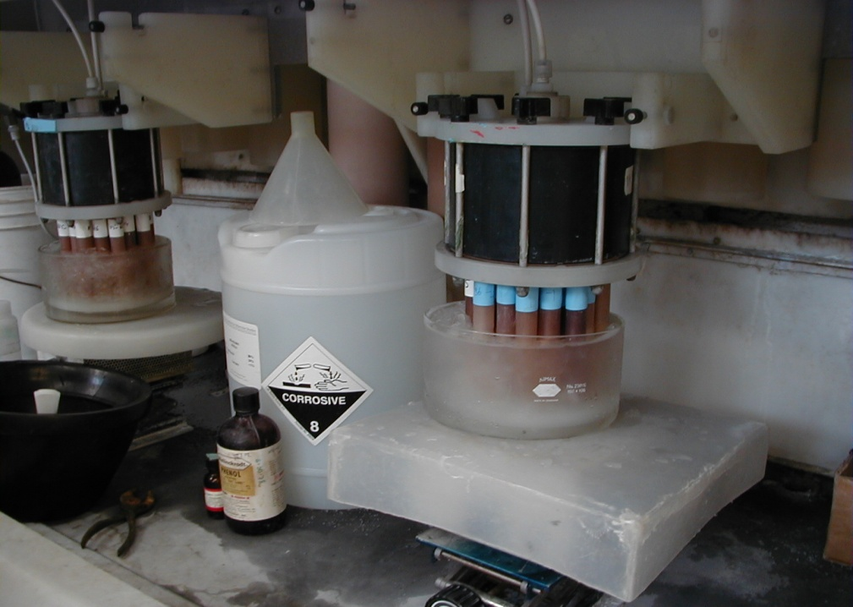
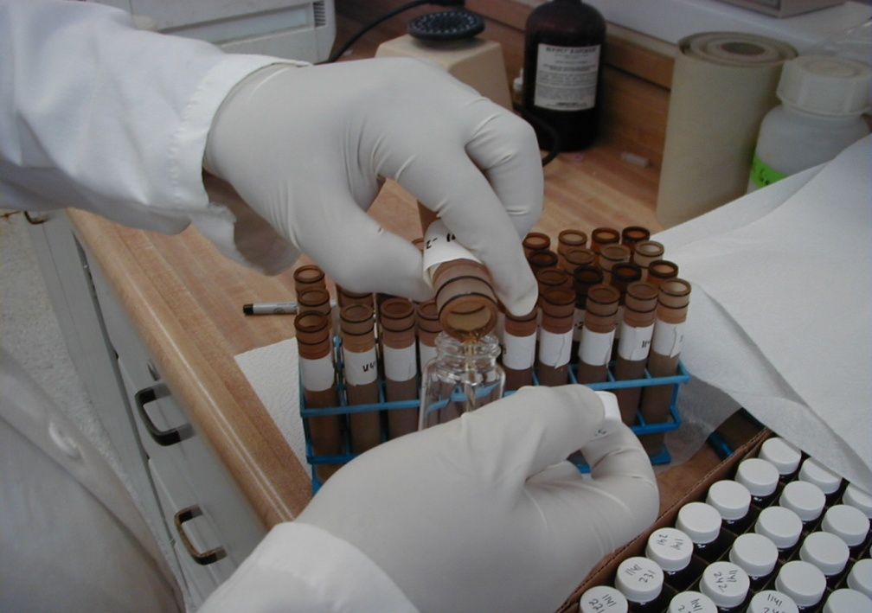

Slide 48
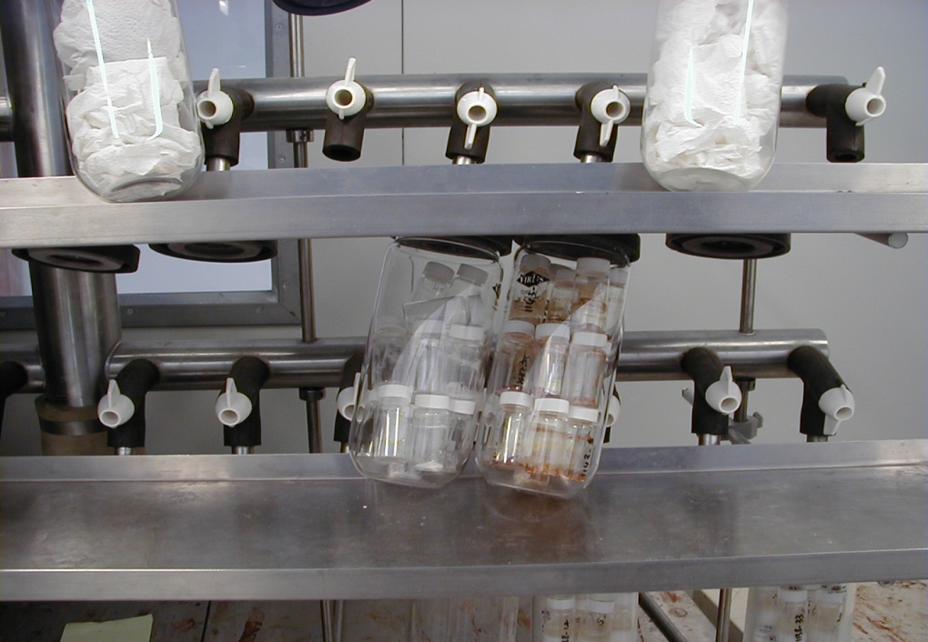
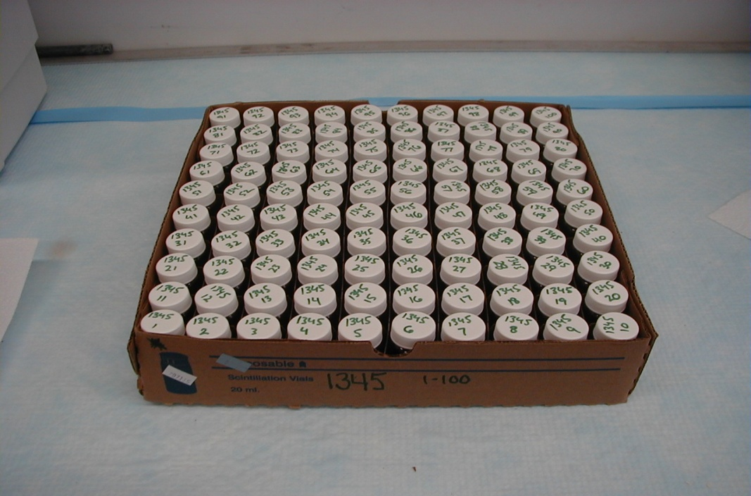
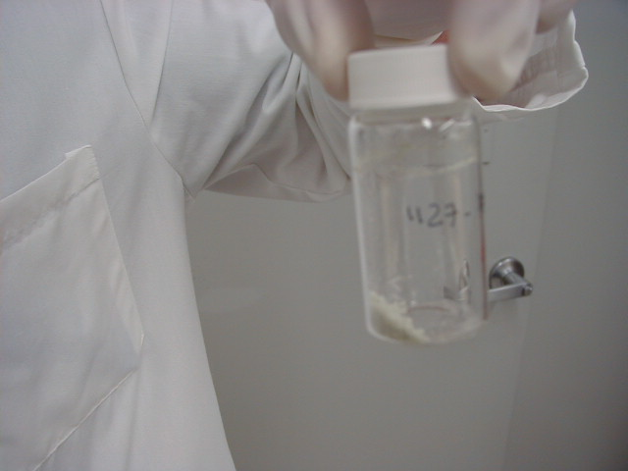
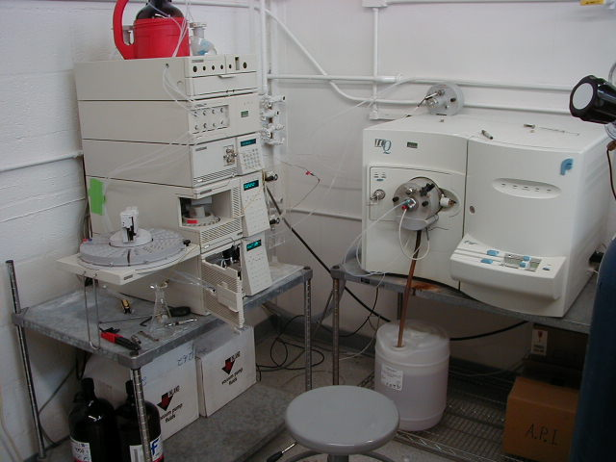

Slide 49
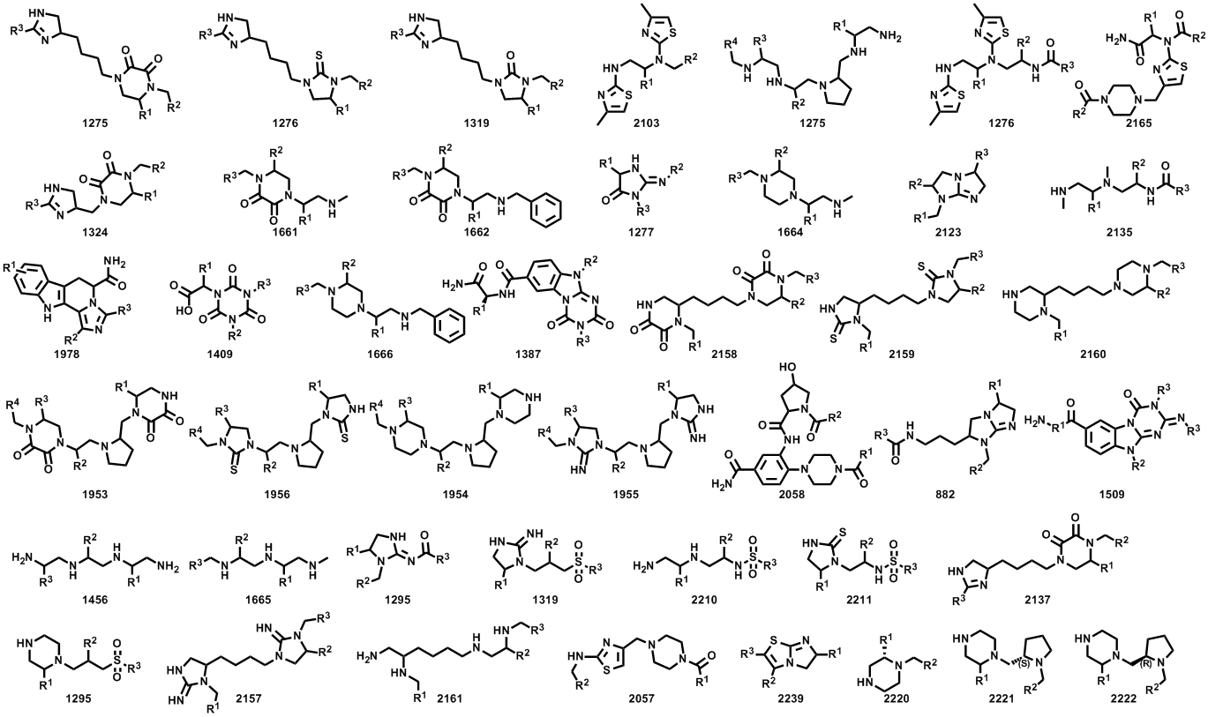
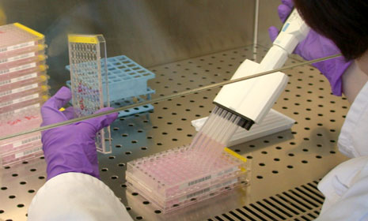
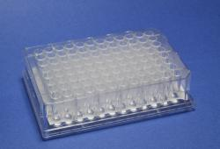
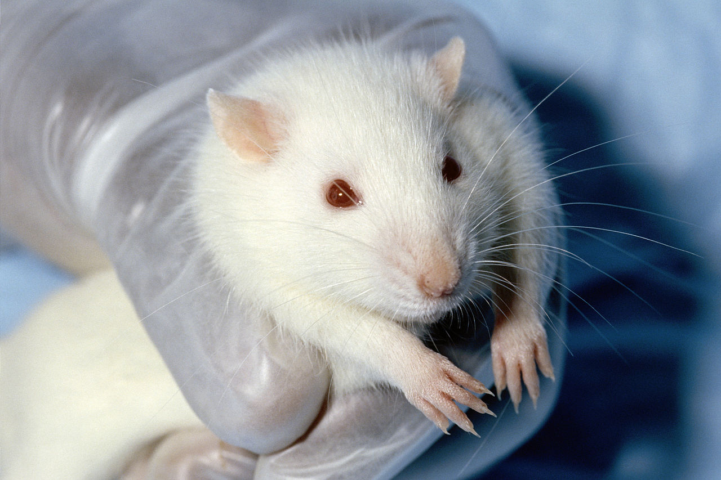

Slide 51

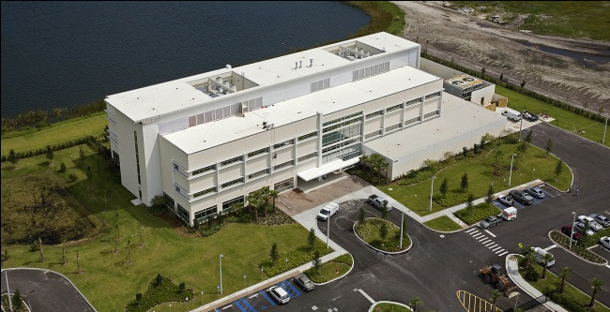
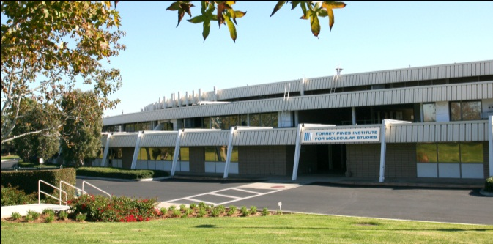
Thank You!
Headquarters
Florida Campus
Port St. Lucie, FL
California Campus
3550 General Atomics Court
San Diego, CA
www.tpims.org

Slide 52
Let us meet again..
We welcome you to our future conferences of OMICS International
2nd International Conference and Expo
on
Drug Discovery & Designing
On
October -31 November-02, 2016 at Istanbul, Turkey
http://drug-discovery.pharmaceuticalconferences.com/

