Slide 1

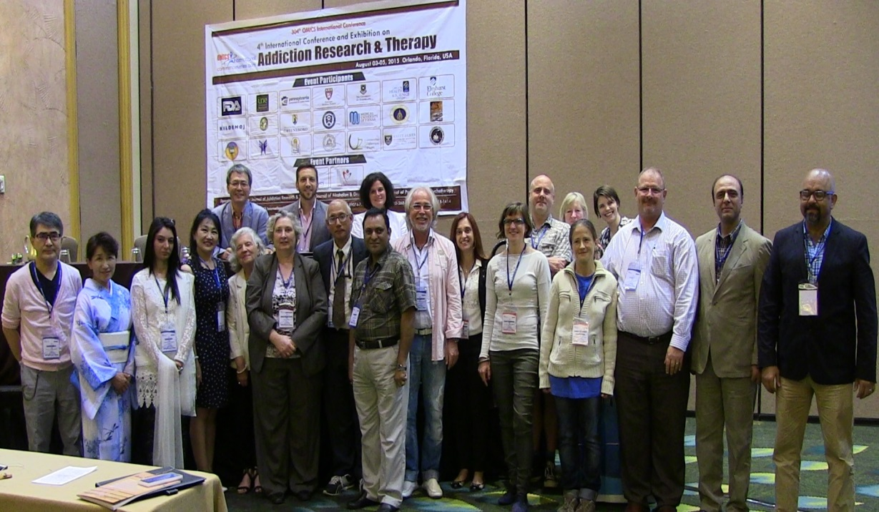
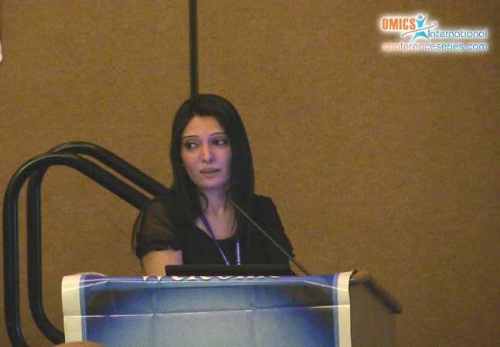
Addiction Therapy 2015
Florida, USA
August 03-08, 2015
Adeela Saba

Slide 2
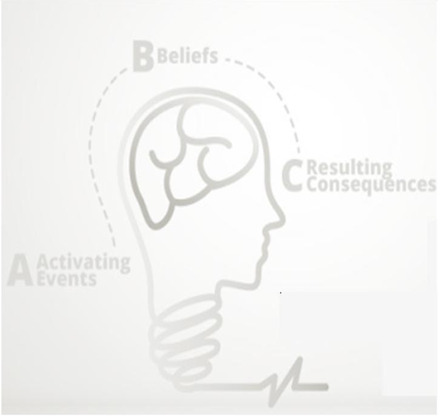
Effectiveness of Rational Emotive Behavior Therapy
in Disputing Irrational Beliefs of
Persons with Substance Used Disorders
BY
Adeela Saba, Qudsia Nashee & Naumana Amjad

Slide 3
Rationale
Irrational beliefs are important psychological constructs (i.e., cognitive vulnerability constructs), which can predict how individuals react emotionally to stressful events, their role in emotional regulation. Indeed, a large body of empirical evidence shows that irrational beliefs impact emotional problems such as self-reported trait anxiety, trait anger, depression, state anxiety, depression, anger, guilt.

Slide 4
When individual developed such type of irrational belief he turned toward social, emotional and psychological illnesses. Addiction is a chronic disease. Albert Ellis proposed that irrational beliefs are the main factor causing emotional, psychological and behavioral disorders.
In the light of literature increasingly irrational believes develop psychological problems and ultimately increase the addiction ratio. REBT is disputing the irrational beliefs into rational beliefs which can decrease the addiction ratio.

Slide 5
Hypothesis
There is likely to be a decrease in irrational beliefs of persons with substance used disorders after the treatment (REBT).

Slide 6
Methodology
Repeated measure design was used. Sample consisted of (N = 12) persons with substance use disorder. It was carried out on in door patients of Drug Addiction at Punjab Institute of Mental Health (PIMH), Fountain House Lahore.

Slide 7
Implementation for Intervention
Pictorial presentation of the REBT techniques gives better understanding and significant results. Participants are highly interested in therapy and enjoyed the concept presented with pictures.

Slide 8
Assessment Measurement
Shortened General Attitude and Belief Scale
The Shortened General Attitude and Belief Scale (SGABS) (Lindner, Kirkby, Wertheim, & Birch, 1999)was used to measure irrational beliefs of the participants. It is a 26 item scale utilizing a five point Likert response scale with responses ranging from 1 (strongly disagree) to 5 (strongly agree). Higher scores indicate stronger beliefs.

Slide 9
SHORTENED GENERAL ATTITUDE AND BELIEF SCALE (SGABS)
1. it’s unbearable to fail at important things, and I can’t stand not succeeding at them.
Strongly Disagree Disagree Neutral Agree Strongly agree
1 2 3 4 5
2. I can’t stand a lack of consideration from other people, and I can’t bear the possibility of their unfairness
Strongly Disagree Disagree Neutral Agree Strongly agree
1 2 3 4 5
3. It’s unbearable being uncomfortable, tense or nervous and I can’t stand it when I am.
Strongly Disagree Disagree Neutral Agree Strongly agree
1 2 3 4 5
4. I have worth as a person even if I do not perform well at tasks that are important to me.
Strongly Disagree Disagree Neutral Agree Strongly agree
1 2 3 4 5
5. I can’t stand being tense or nervous and I think tension is unbearable.
Strongly Disagree Disagree Neutral Agree Strongly agree
1 2 3 4 5

Slide 10
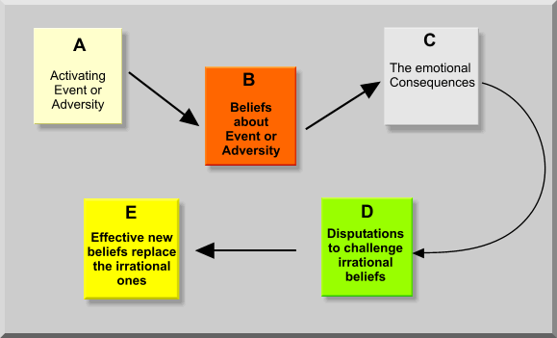

Slide 11
Mastering The Art of Personal Happiness
Persona happiness means different thing to different people I cannot tell you how to be happy because what you as a unique in dividable, do and how much pleasure you get from doing something depends on your personal preference which I cannot well predict if I cannot tell you how to avoid feeling unduly unhappy or miserable? To some extent yes I know for sure, that people almost always make themselves miserable when they make themselves noxious angry depressed, guilty or ashamed. And I as a psychologist after having worked wig may unhappy people can often tell you what you do to make yourself desperately.

Slide 12
Rational Emotive Behavior Therapy
Belief
System B
Activating
Event A
Consequences
C

Slide 13
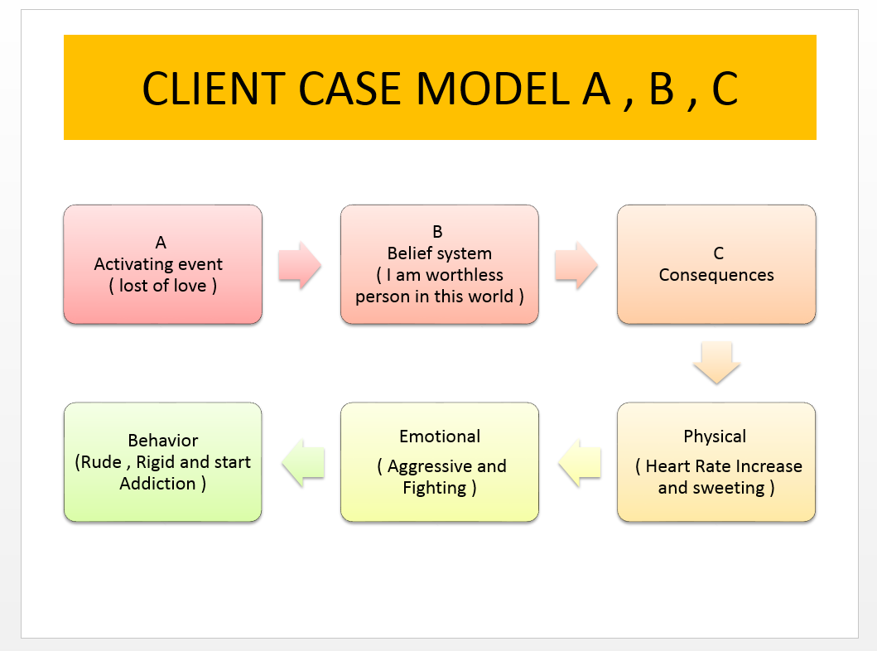

Slide 14
WHO CREATES YOUR EMOTIONAL DISTURBANCE?
PEOPLE
FAMILY
FRIENDS
KIDS
CO-WORKERS
LIFE STRESSORS
TRAFFIC JAMS
PEOPLE IN YOUR LIFE
WORLD
UNFAIRNESS

Slide 15
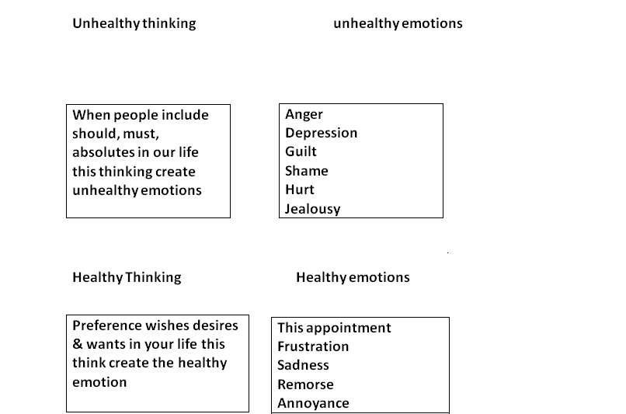

Slide 16
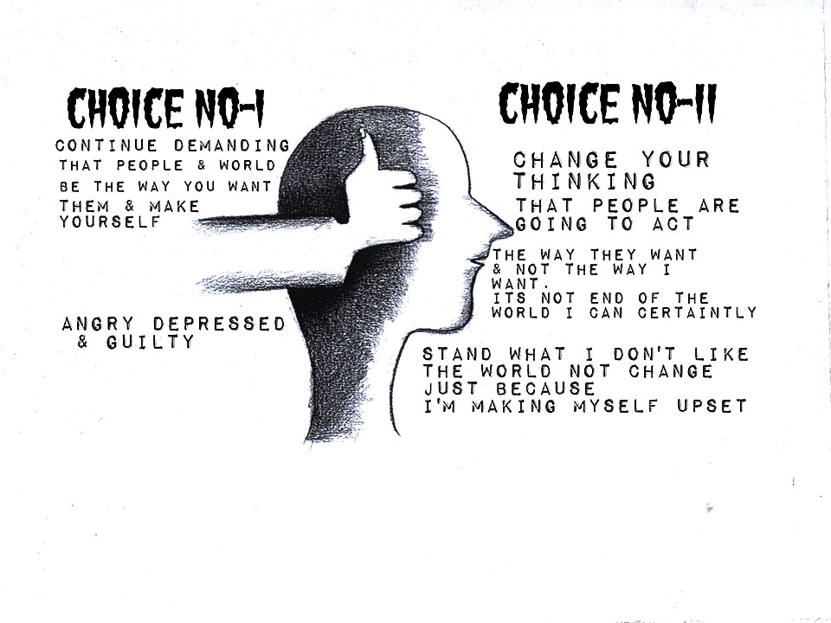

Slide 17
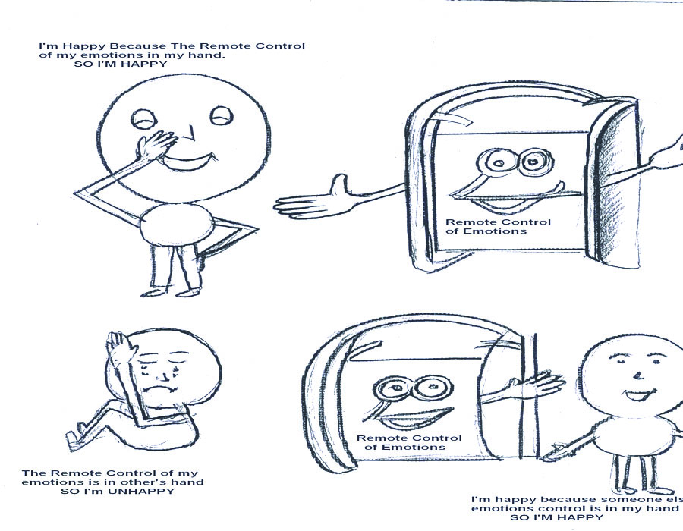

Slide 18
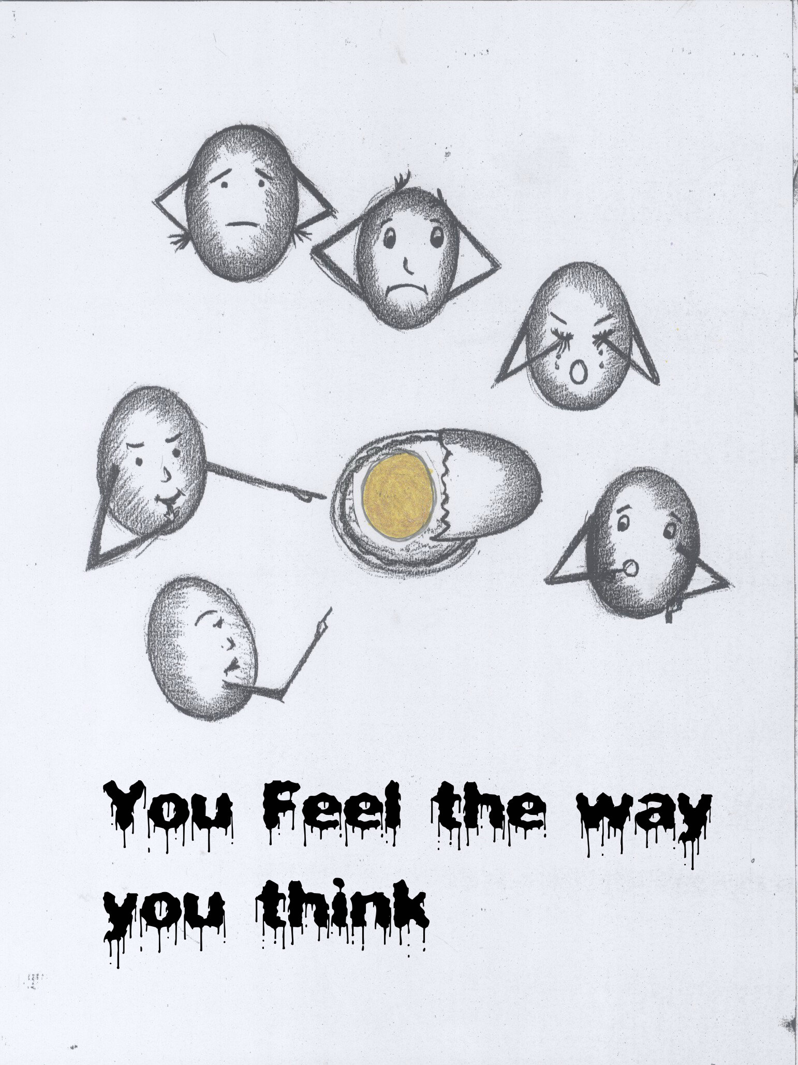

Slide 19
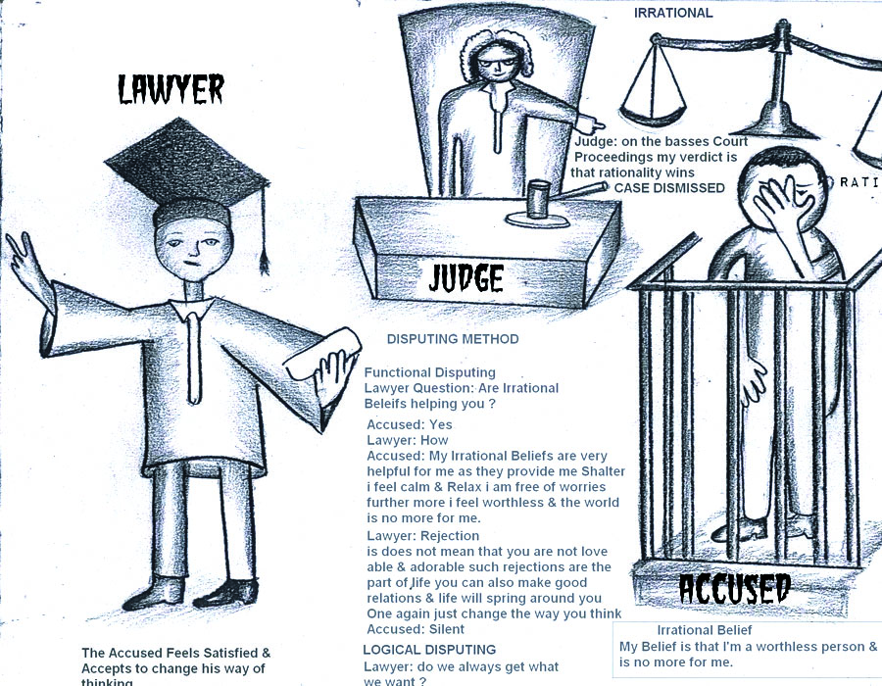

Slide 20
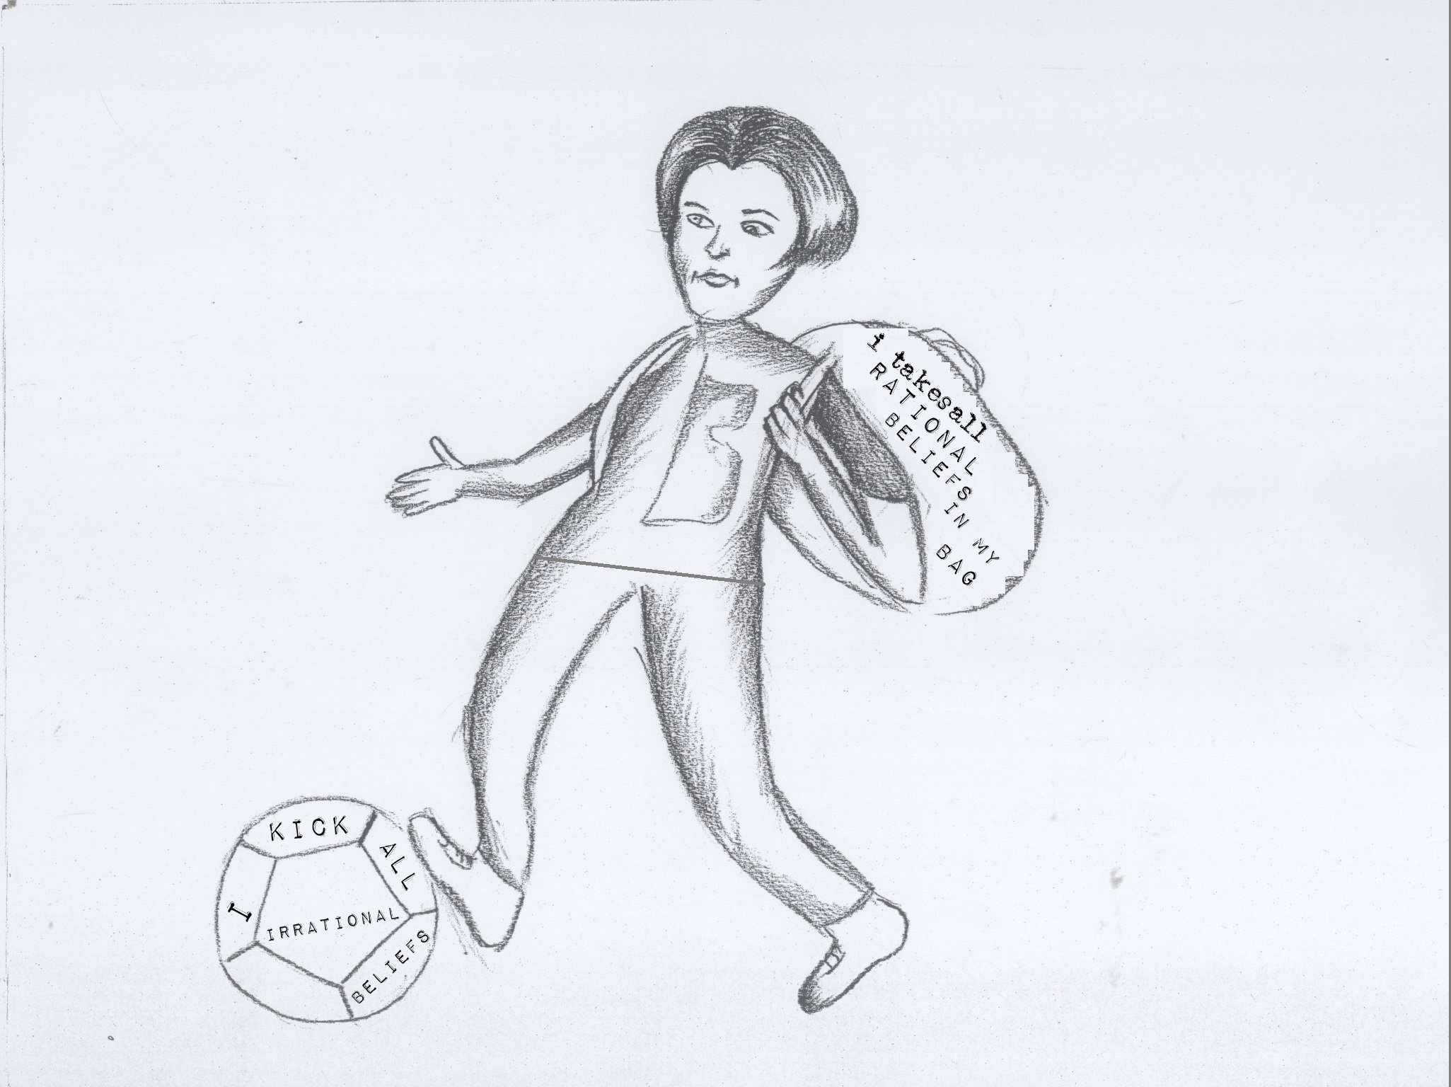

Slide 21
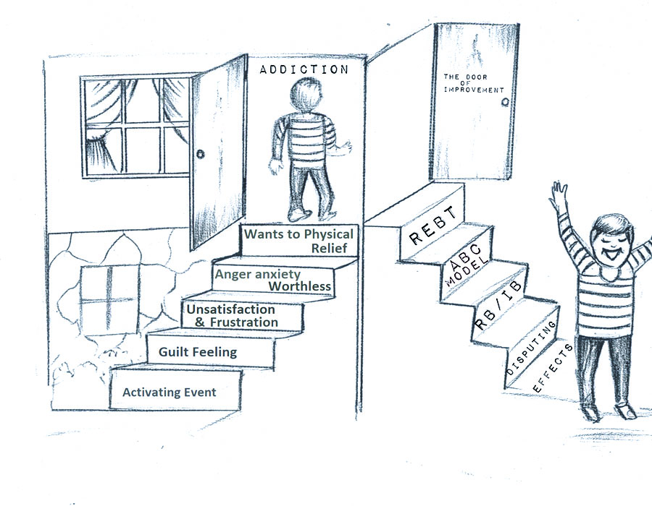

Slide 22
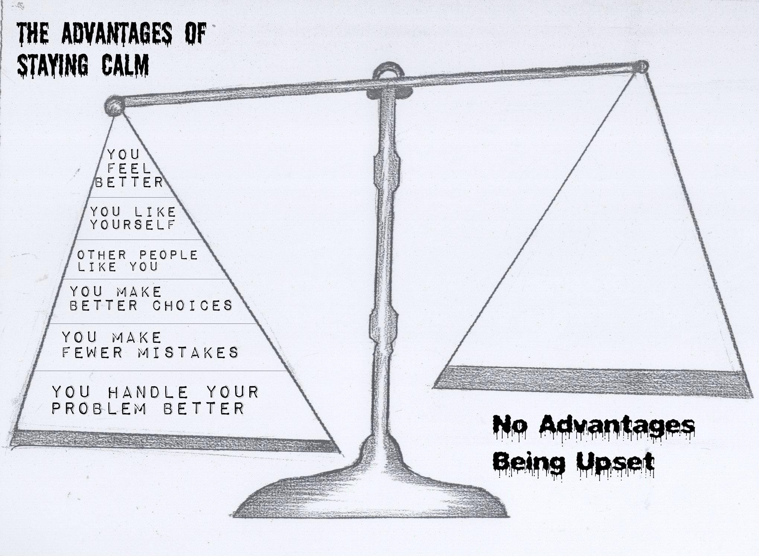

Slide 23
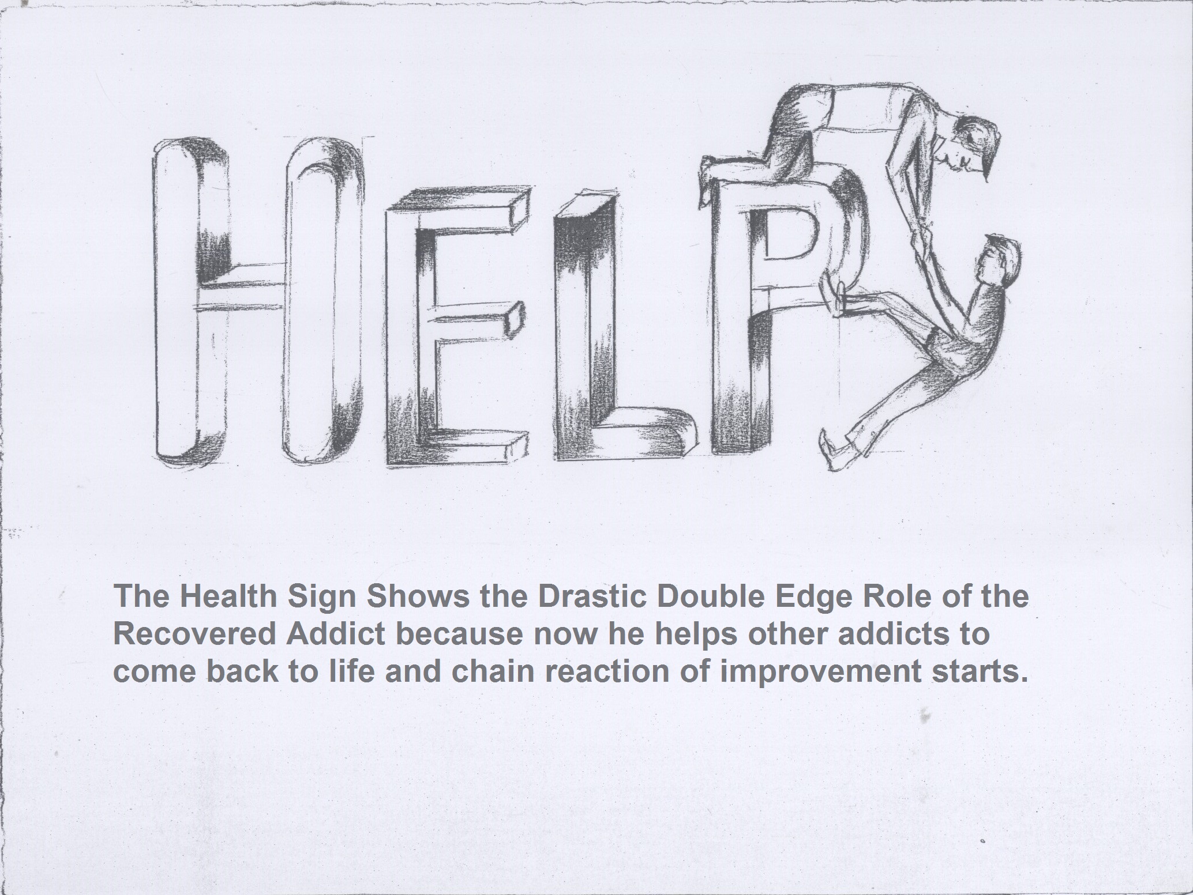

Slide 24
CONCLUSION
NO ONE CAN UPSET ME, INSULT ME, PUT ME DOWN OR HURT ME WITHOUT MY PE RSMISSION
I MAKE MYSELF UPSET- NOT OTHERS OR MY CIRCUMSTANCES! I WILL TAKE THE REMOTE CONTROL OF MY EMOTIONS IN MY HANDS FROM THIS MOMENT ONWARDS!
I WILL GIVE PEOPLE THE RIGHTTO BE WRONG BECAUSETHEY WILL EXERCISE THAT RIGHT WHETHER I GIVE ITTO THEM OR NOT!

Slide 25
PROGRESS SHEET
What you learned?
What is most use full?
In the high risk situation what is your beliefs or emotions?
What are the signs?
Thoughts/Feelings/behaviours
Therapy of Goal
Achieved/mostly achieved / not achieved
Completed the therapy or not?
After that end of the therapy set their personal goals
Short term goals
Things you like to do in six months
Long term goals
Things they light to do in his life
Life time goals what they want to do in the remaining life

Slide 26
Results
Wilcoxon singed rank test used to examine the effectiveness of REBT in disputing irrational beliefs in substance use disorder.
Shortened General Attitude and Belief Scale
Note.(N=12) M = mean, SD = standard deviation
Pre assessment M (S.D) | Post assessment M (S.D) | p value
48.33 (21.80) | 45.92(20.58) | 0.01

Slide 27
To analyze the effectiveness of REBT Wilcoxon singed rank test was performed. Scores on irrationality scale were significantly lower on post test compare to pre test. z = -3.13, p< .01.

Slide 28
Conclusion
Many people think that drug taking behavior is one of the best options to escape from tensions. When person have bad experiences in life then they become stuck and over generalize the experiences. Irrationality occur due to stuck thinking about the own self, related to people and situations.

Slide 29
The present study helpful in resolving patient’s emotional turmoil results of irrational beliefs that may put them at risk for psychological illnesses and drug addiction. It may also help the patient to tolerate own self and others and helpful for goals achievements and the effectiveness of psychological intervention.

Slide 30
SR. NO | ACTIVATING EVENT | BELIEF SYSTEM | CONSEQUENCES PHY/EMO/BEH | RESON FOR EMOTIONAL/DIS | UNHEALTHY THINKING & UNHEALTHY EMO | HEATHY THINKING & HEALTHY EMO | CHOICES | UNHELP FULL THINKING HABITS | IMAGERY EXERCISE
1 | Lost of love | World is selfish | Hot flushes/fighting with others/addiction | People in his life | Should must/absolutes words add creates/anger depression/guilt | Add wishes desires/wants in life/create disappointment/furs/sadness | Continue Stop demand word & People | Mind filter judgment prediction emotional Reasoning | Create the relaxation
2 | Lost of job | I’m a worthless person in the world | Increase the heart rate/sweating | Life stressors | Should must/absolutes words add creates/anger depression/guilt | Add wishes desires/wants in life/create disappointment/Furs/sadness | Continue Stop demand word & People | Mind filter judgment prediction emotional Reasoning | Create the relaxation
3 | Lost of love | World is selfish | Palpitation/aggression | People in his life | Should must/absolutes words add creates/anger depression/guilt | Add wishes desires/wants in life/create disappointment/Furs/sadness | Continue Stop demand word & People | Mind filter judgment prediction emotional reasoning | Create the relaxation

Slide 31
4 | Death of grand Pa | No aim of my life | Fatigue/rude/fighting/addiction | Life stressors | Should must/absolutes words add creates/anger depression/guilt | Add wishes desires/wants in life/create disappointment/Furs/sadness | Continue Stop demand word & People | Mind filter Judgment prediction motional Reasoning | Create the relaxation
5 | Lost of friendship | Not make the friends | Restlessness/anger addiction | Friend | Should must/absolutes words add creates/anger depression/guilt | Add wishes desires/wants in life/create disappointment/Furs/sadness | Continue Stop demand word & People | Mind filter Judgment prediction motional Reasoning | Create the relaxation
6 | Lost of love | nobody loves me | Eyes becomes red & burning feeling in the body/anger/addiction | People | Should must/absolutes words add creates/anger depression/guilt | Add wishes desires/wants in life/create disappointment/Furs/sadness | Continue Stop demand word & People | Mind filter Judgment prediction emotional Reasoning | Create the relaxation
7 | Lost of love | No one add in my life again | Irritation/fatigue /hurt/addiction | People | Should must/absolutes words add creates/anger depression/guilt | Add wishes desires/wants in life/create disappointment/Furs/sadness | Continue Stop demand word & People | Mind filter Judgment prediction emotional Reasoning | Create the relaxation

Slide 32
8 | Lost of love | I am worthless person | Hot flashes/aggressive/addiction | People in the life | Should must/absolutes words add creates/anger depression/guilt | Add wishes desires/wants in life/create disappointment/Furs/sadness | Continue Stop demand word & People | Mind filter Judgment prediction emotional Reasoning | Create the relaxation
9 | Lost of love | Not makes friends in life again | Feel irritation/aggressive/addiction | Friends | Should must/absolutes words add creates/anger depression/guilt | Add wishes desires/wants in life/create disappointment/Furs/sadness | Continue Stop demand word & People | Mind filter Judgment prediction emotional Reasoning | Create the relaxation
10 | Lost of wife | Nobodies loves me I am worthless person | Fatigue/feeling guilty and shame/addiction | Family | Should must/absolutes words add creates/anger depression/guilt | Add wishes desires/wants in life/create disappointment/Furs/sadness | Continue Stop demand word & People | Mind filter Judgment prediction emotional Reasoning | Create the relaxation
11 | Lost of love | No one add in my life again | Shaking of body/depression /addiction | People in the life | Should must/absolutes words add creates/anger depression/guilt | Add wishes desires/wants in life/create disappointment/Furs/sadness | Continue Stop demand word & People | Mind filter Judgment prediction emotional Reasoning | Create the relaxation

Slide 33
12 | Lost of love | The girl always deceived | Increase heat rate/difficulty in breathing/guilty/addiction | People in the life | Should must/absolutes words add creates/anger depression/guilt | Add wishes desires/wants in life/create disappointment/Furs/sadness | Continue Stop demand word & People | Mind filter Judgment prediction emotional Reasoning | Create the relaxation

Slide 34
Sr. No | Emotional Tirg | You Feel the way you think | Coping statement | Disputing | Effects of new belief | Progress sheet | Personal goal | Healthy goal
1 | Take the remote control of your emotions in your hand | Exp of brocken eggs /you are always no tables to change the situations & people around of you | Gave them coping statement related to the patient problem | Philosophical /logicaly | Adv/stay calm & no adv being upsets | What is the most Usefull in high risk sitution | Short term/long term/life term | Patient response about the theropy goal /achieved/not achieved
2 | Take the remote control of your emotions in your hand | Exp of brocken eggs /you are always no tables to change the situations & people around of you | Gave them coping statement related to the patient problem | Logical/philosophical | Adv/stay calm & no adv being upsets | What is the most Usefull in high risk sitution | Short term/long term/life term | Patient response about the theropy goal /achieved/not achieved
3 | Take the remote control of your emotions in your hand | Exp of brocken eggs /you are always no tables to change the situations & people around of you | Gave them coping statement related to the patient problem | Functional/logical | Adv/stay calm & no adv being upsets | What is the most Usefull in high risk sitution | Short term/long term/life term | Patient response about the theropy goal /achieved/not achieved

Slide 35
4 | Take the remote control of your emotions in your hand | Exp of brocken eggs /you are always no tables to change the situations & people around of you | Gave them coping statement related to the patient problem | Empirical/functional | Adv/stay calm & no adv being upsets | What is the most Usefull in high risk sitution | Short term/long term/life term | Patient response about the therapy goal /achieved/not achieved
5 | Take the remote control of your emotions in your hand | Exp of brocken eggs /you are always no tables to change the situations & people around of you | Gave them coping statement related to the patient problem | Functional/empirical | Adv/stay calm & no adv being upsets | What is the most Usefull in high risk sitution | Short term/long term/life term | Patient response about the therapy goal /achieved/not achieved
6 | Take the remote control of your emotions in your hand | Exp of Brocken eggs /you are always no tables to change the situations & people around of you | Gave them coping statement related to the patient problem | Logical | Adv/stay calm & no adv being upsets | What is the most Useful in high risk situation | Short term/long term/life term | Patient response about the therapy goal /achieved/not achieved
7 | Take the remote control of your emotions in your hand | Exp of brocken eggs /you are always no tables to change the situations & people around of you | Gave them coping statement related to the patient problem | Philosophical | Adv/stay calm & no adv being upsets | What is the most Usefull in high risk sitution | Short term/long term/life term | Patient response about the therapy goal /achieved/not achieved

Slide 36
8 | Take the remote control of your emotions in your hand | Exp of brocken eggs /you are always no tables to change the situations & people around of you | Gave them coping statement related to the patient problem | Empirical/logical | Adv/stay calm & no adv being upsets | What is the most Usefull in high risk sitution | Short term/long term/life term | Patient response about the therapy goal /achieved/not achieved
9 | Take the remote control of your emotions in your hand | Exp of brocken eggs /you are always no tables to change the situations & people around of you | Gave them coping statement related to the patient problem | Empirical/Philosophical | Adv/stay calm & no adv being upsets | What is the most Usefull in high risk sitution | Short term/long term/life term | Patient response about the therapy goal /achieved/not achieved

Slide 37
10 | Take the remote control of your emotions in your hand | Exp of brocken eggs /you are always no tables to change the situations & people around of you | Gave them coping statement related to the patient problem | Philosophical /Empirical | Adv/stay calm & no adv being upsets
11 | Take the remote control of your emotions in your hand | Exp of Brocken eggs /you are always no tables to change the situations & people around of you | Gave them coping statement related to the patient problem | Functional/logical | Adv/stay calm & no adv being upsets
12 | Take the remote control of your emotions in your hand | Exp of brocken eggs /you are always no tables to change the situations & people around of you | Gave them coping statement related to the patient problem

Slide 38

Thank Your

Slide 39

Meet the eminent gathering once again at
Addiction Therapy 2016
Miami, USA
October 06-08, 2016
Addiction Therapy 2016
Website: addictiontherapy.conferenceseries.com

