Slide 1
Women’s Health / Nutrition
Challenges in caring for
Obese Patients
Adarsh K. Gupta, DO, MS, FACOFP
Director, Center for Medical Weight Loss & Metabolic Control
Director, Center for Information Mastery
Associate Professor, Family Medicine
Copyright 2015. Adarsh K. Gupta, DO, MS, FACOFP

Slide 2
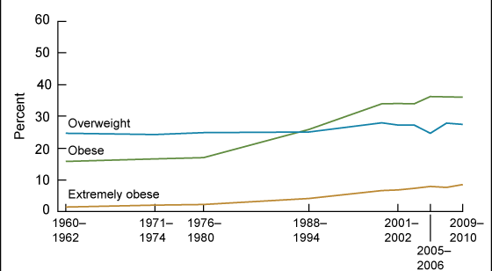
Latest Obesity Stats
Women aged 20-74

Slide 3
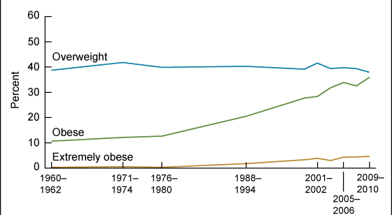
Latest Obesity Stats
Men aged 20-74

Slide 4
Latest Obesity Trends
Increasing Obese and Morbidly Obese population
Obesity is more prevalent than smoking and is highly associated with chronic conditions and overall poor physical health similar to smoking and excessive alcohol use¹
Notes:
Obesity is the percentage of the adult population estimated to be obese, defined as having a body mass index (BMI) of 30.0 or higher. BMI, as defined by CDC, is equal to weight in pounds divided by height in inches squared and then multiplied by 703. CDC has a calculator for BMI at www.cdc.gov/nccdphp/dnpa/bmi/calc-bmi.htm. The ranks are based on the preceding year’s data from CDC’s Behavioral Risk Factor Surveillance System (BRFSS). The BRFSS telephone survey has traditionally been completed by people using landlines. During the fielding of the 2011 BRFSS, the methodology was updated to include cellular telephones due to the large number of households that contain only cellular telephones and no landline telephones. Because of these changes, estimates of obesity prevalence from the 2012 Edition onward cannot be compared to estimates from previous years. Shifts in estimates from previous years may be the results of the new methods, rather than measurable changes in the percentages.
Obesity is one of the greatest health threats to the U.S. It contributes significantly to a variety of serious diseases, including heart disease, diabetes, stroke, and certain cancers as well as poor general health.[1] Obesity is a leading cause of preventable death in the U.S., causing an estimated 200,000 deaths annually.[2] The direct medical costs for treating obesity and obesity-related health problems are overwhelming. In 2008 it was estimated that $147 billion was spent on obesity or obesity-related health issues.[3] Obesity is more prevalent than smoking and is highly associated with chronic conditions and overall poor physical health similar to smoking and excessive alcohol consumption.[4] The causes of obesity are complex and include lifestyle, the social and physical environment, as well as genes and medical history. Poor diet and decreased physical activity are major lifestyle contributors to obesity. Since the 1980s, energy intake has steadily climbed and energy expenditure has declined, leading to a growing energy imbalance which closely mirrors the obesity rates.[5] There is growing evidence illustrating the importance of the environment in the obesity epidemic and the need for changes in the environment in order to better facilitate changes in lifestyle.[6] There have been successful interventions targeting a wide variety of populations with various strategies, from school based prevention programs to treatment interventions in aging adults.[7]-[8] While obesity is associated with an increased risk of developing numerous health conditions, weight loss is associated with an attenuation of those risks.[9] The CDC has put together a list of useful resources for community level interventions aimed at lowering obesity rates, available at www.cdc.gov/obesity/strategies/communityStrategies.html.
[1] Centers for Disease Control and Prevention (CDC). Overweight and Obesity. May 24, 2012. http://www.cdc.gov/obesity/. Accessed July 24, 2012.
[2] Danaei G. The preventable causes of death in the United States: Comparative risk assessment of dietary, lifestyle, and metabolic risk factors. PLoS Medicine. 2009;6(4).
[3] Finkelstein EA, Trogdon JG, Cohen JW, Dietz W. Annual medical spending attributable to obesity: Payer- and service-specific estimates. Health Affairs. 2009;28(5): w822-w831.
[4] Sturm R. Does obesity contribute as much to morbidity as poverty or smoking? Public Health. 2001;115(3):229.
[5] Finkelstein EA. Economic causes and consequences of obesity. Annu Rev Public Health. 2005;26(1):239.
[6] Papas MA. The built environment and obesity. Epidemiol Rev. 2007;29(1):129.
[7] Shaya FT. School-based obesity interventions: A literature review. J Sch Health. 2008;78(4):189.
[8] McTigue KM. Obesity in older adults: A systematic review of the evidence for diagnosis and treatment. Obesity. 2006;14(9):1485.
[9] Malnick SDH. The medical complications of obesity. QJM. 2006;99(9):565
- See more at: http://www.americashealthrankings.org/all/obesity#sthash.fI1PjwmF.dpuf

Slide 5
Body Shape and Size
Impressions and Views

Slide 6

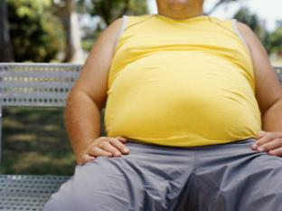
Cultural Importance of the Body
Lean, thin body
  self-discipline, achievement of cultural ideal
Fat, chubby body
  ultimate failure publicly displayed for all to see and judge

Slide 7


Cultural Importance of the Body
Heightened social consciousness and awareness of “the body”
  booming diet industry, estimated to bring in over $40-50 billion dollars each year
  mass media which idealizes an ultra-lean physique
  social value placed on having a lean body

Slide 8

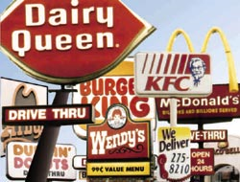
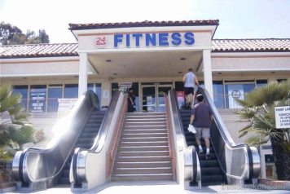
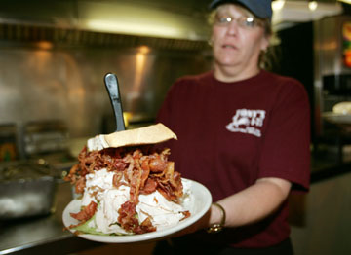
Toxic Environment

Slide 9

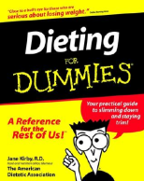
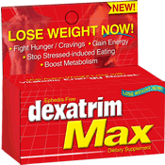


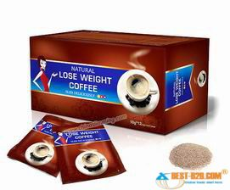

Diet Industry

Slide 10


Mass Media
Larger individuals rarely shown, often stereotyped (Fouts & Burggraf, 2000; Fouts & Vaughan, 2002; Greenberg et al., 2003)
  Unattractive, unappealing
  Target of jokes
  Shown (over)eating
Friends
Shallow Hal

Slide 11
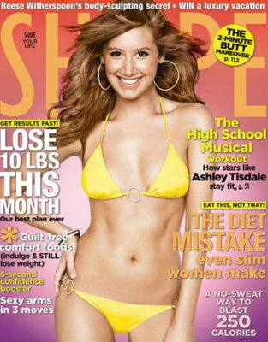

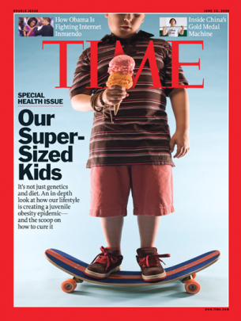
Social Value
Inherent value of thinness?
  Thin = good; fat = bad

Slide 12
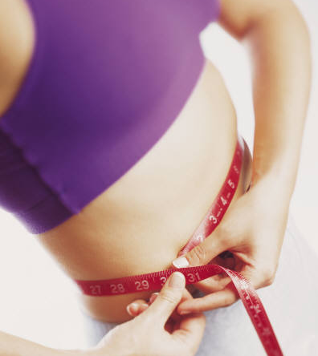
Social Value
Individual responsibility and control (or lack of)
  If you work hard enough…
  If you have enough willpower…
  If you are motivated enough…

Slide 13
Weight Based Stereotypes
Documented harmful weight-based stereotypes that exists are:
  Obese people are lazy
  They are weak-willed
  They are unsuccessful
  They are unintelligent
  They lack self-discipline
  They are non-compliant with weight loss treatment
Notes:
Negative attitudes toward obese persons are
pervasive in North American society. Numerous
studies have documented harmful weightbased
stereotypes that overweight and obese
individuals are lazy, weak-willed, unsuccessful,
unintelligent, lack self-discipline, have poor
willpower, and are noncompliant with weightloss
treatment.1–3
Ref: Puhl RM, Heuer CA. Weight bias: a review and
update. Obesity (Silver Spring). 2009;17(5):941–964

Slide 14
Weight Bias
Negative attitudes affecting interactions
Stereotypes leading to:
  Stigma
  Rejection
  Prejudice
  Discrimination
Verbal, physical and relational forms
Subtle and overt expressions
Source: obesityonline.org
Notes:
These stereotypes give way to
stigma, prejudice, and discrimination against
obese persons in multiple domains of living,
including the workplace, health care facilities,
educational institutions, the mass media, and
even in close interpersonal relationships.1–3
Ref: Puhl RM, Heuer CA. Weight bias: a review and
update. Obesity (Silver Spring). 2009;17(5):941–964

Slide 15
Obesity Stigma
Prevalence of weight discrimination has INCREASED by 66% over the past decade¹
Now it is comparable to prevalence rates of racial discrimination in America
Notes:
Recent estimates suggest that the prevalence
of weight discrimination has increased by
66% over the past decade,1 and is now comparable
to prevalence rates of racial discrimination
in America.2
1. Andreyeva T, Puhl RM, Brownell KD. Changes in
perceived weight discrimination among Americans:
1995–1996 through 2004–2006. Obesity (Silver
Spring). 2008;16(5):1129–1134.
2. Puhl RM, Andreyeva T, Brownell KD. Perceptions of
weight discrimination: prevalence and comparison to
race and gender discrimination in America. Int J Obes
(Lond). 2008;32(6):992–1000.

Slide 16
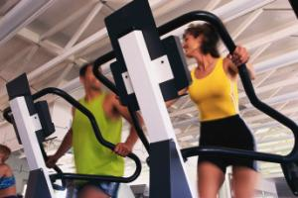

Where does weight bias exists?
Weight bias exists in:
  Education
  Employment
  The Media
  Interpersonal Relationships
  Health Care
    Dietitians
    Psychologists
    Nurses
    Medical Students
    Physicians
    Gynecologists
    Bariatric Specialists
Notes:
There is a considerable amount of scientific research on weight bias. Studies have documented weight bias in multiple domains of living, including employment settings, educational institutions, and health care facilities. Weight bias is also perpetuated in the popular media, news media, and is even expressed in close interpersonal relationships toward obese friends and family members.
While this course focuses specifically on health care practices, it is important to recognize that obese individuals face weight bias in many aspects of their daily lives.
Weight bias has been documented by dietitians, psychologists, nurses, medical students, and physicians (including gynecologists and bariatric specialists).
In this section we will review the research on weight bias in health care.
References:
Puhl RM, Heuer CA. Obesity stigma: Important considerations for public health. Am J Public Health. 2010;100(6):1019-1028.
Puhl RM, Heuer CA. The stigma of obesity: A review and update. Obesity. 2009;17(5):941-964. does

Slide 17
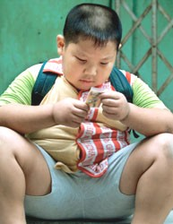
School settings
College admissions
Peer teasing
Teacher bias

Slide 18
Weight Bias in Health Care
Weight bias takes multiple forms in health care settings
  PROVIDER ATTITUDES
    May express negative weight-bias assumptions, stereotypes, or judgments about their overweight patients
      Lazy
      Lacking in self-discipline
      Non-compliant
      Weak-willed
      Unsuccessful
      Unintelligent
    A study by Huzinga et al found that physicians had lower levels of respect for patient as BMI increased¹.
Notes:
How is Weight Bias Expressed in Health Care?
Weight bias can take multiple forms in health care settings, and can exist in both subtle and overt ways. Here are some examples:
Provider Attitudes: Providers may express negative weight-based assumptions, stereotypes, or judgments about their overweight patients. Common attitudes include views that obese patients are lazy, lacking in self-discipline, and non-compliant.
======
Physicians
Studies show that physicians hold negative attitudes and stereotypes about obese patients, viewing them as non-compliant, lazy, lacking in self-control, weak-willed, unsuccessful, unintelligent, and dishonest. Additionally, a recent study found that physicians had lower levels of respect for patients as BMI increased.
Physicians frequently believe obese patients are non-adherent to medications. In some studies, physicians report that their most common frustrations in treating obesity to be poor patient compliance and motivation.
Other research finds that nearly 70% of overweight and obese women report being stigmatized by a doctor because of their weight.
References:
Campbell K, Engel H, Timperio A, Cooper C, Crawford D. Obesity management: Australian general practitioners’ attitudes and practices. Obesity Research. 2000;8:459-466.
Hebl MR, Xu J. Weighing the care: physicians' reactions to the size of a patient. International Journal of Obesity. 2001;25:1246-1252.
Huizinga MM, Bleich SN, Beach MC, Clark JM, Cooper LA. Disparity in physician perception of patients' adherence to medications by obesity status. Obesity. 2010;18(10):1932-1937.
Huizinga MM, Cooper LA, Bleich SN, Clark JM, Beach MC. Physician respect for patients with obesity. J Gen Intern Med. 2009;24(11):1236-1239.
Kristeller JL, Hoerr RA. Physician attitudes toward managing obesity: Differences among six specialty groups. Preventive Medicine. 1997
Maiman LA, Wang VL, Becker MH, Finlay J, Simonson M. Attitudes toward obesity and the obese among professionals. Journal of the American Dietetic Association. 1979;74:331-336. ;26:542-549.
Price JH, Desmond SM, Krol RA, Snyder FF, O'Connell JK. Family practice physicians' beliefs, attitudes, and practices regarding obesity. Am J Prev Med. 1987;3:339-345.
Puhl RM, Brownell KD. Confronting and coping with weight stigma: An investigation of overweight and obese adults. Obesity. 2006;14(10):1802-1815.

Slide 19
Weight Bias in Health Care
Weight bias takes multiple forms in health care settings
  LANGUAGE
    Provider may stigmatize obese patients by referring to a patient’s weight (child or adult) in an undesired way
  WEIGHING PROCEDURES
    Providers may make negative comments or facial gestures while weighing their patients → embarrassment and shame
Notes:
How is Weight Bias Expressed in Health Care?
Weight bias can take multiple forms in health care settings, and can exist in both subtle and overt ways. Here are some examples:
Provider Attitudes: Providers may express negative weight-based assumptions, stereotypes, or judgments about their overweight patients. Common attitudes include views that obese patients are lazy, lacking in self-discipline, and non-compliant.
Language: Providers may stigmatize obese patients by referring to a patient's weight (child or adult) in an undesired way.
Weighing Procedures: Being weighed is a sensitive experience for many overweight and obese patients. Providers may make negative comments or facial gestures while weighing their patients, which leads to embarrassment and shame.
Medical Equipment: In many health care settings, medical equipment is too small to be functional for obese patients. This includes a lack of appropriately-sized patient gowns, examination tables, blood pressure cuffs, speculum, and scales.
Office Environment: Health care environments can be unwelcoming to obese patients for reasons such as negative attitudes by office staff, waiting room chairs that are too small, and reading materials that stigmatize weight.
Each of these forms of weight bias will be addressed in this course. First, evidence demonstrating weight bias among health care providers is summarized.

Slide 20
Weight Bias in Health Care
Weight bias takes multiple forms in health care settings
  MEDICAL EQUIPTMENT
    Too small medical equipment to be functional for obese patients
      Lack of appropriately sized patient gowns
      Small and non-sturdy examination tables
      Smaller blood pressure cuffs
      Smaller speculums
      Smaller weight scales
      Smaller ventilation masks
      Smaller circumference CT-Scanning machines
Notes:
How is Weight Bias Expressed in Health Care?
Weight bias can take multiple forms in health care settings, and can exist in both subtle and overt ways. Here are some examples:
Provider Attitudes: Providers may express negative weight-based assumptions, stereotypes, or judgments about their overweight patients. Common attitudes include views that obese patients are lazy, lacking in self-discipline, and non-compliant.
Language: Providers may stigmatize obese patients by referring to a patient's weight (child or adult) in an undesired way.
Weighing Procedures: Being weighed is a sensitive experience for many overweight and obese patients. Providers may make negative comments or facial gestures while weighing their patients, which leads to embarrassment and shame.
Medical Equipment: In many health care settings, medical equipment is too small to be functional for obese patients. This includes a lack of appropriately-sized patient gowns, examination tables, blood pressure cuffs, speculum, and scales.
Office Environment: Health care environments can be unwelcoming to obese patients for reasons such as negative attitudes by office staff, waiting room chairs that are too small, and reading materials that stigmatize weight.
Each of these forms of weight bias will be addressed in this course. First, evidence demonstrating weight bias among health care providers is summarized.

Slide 21
Weight Bias in Health Care
Weight bias takes multiple forms in health care settings
  FACILITY ENVIRONMENT
    Unwelcoming office or hospital environment
      Negative attitudes by staff
      Smaller and/or non-sturdy waiting room chairs
      Reading materials that stigmatize weight
      Narrow doors and hallways
      Smaller / cramped rest rooms
      Smaller or non-sturdy examination tables
Notes:
How is Weight Bias Expressed in Health Care?
Weight bias can take multiple forms in health care settings, and can exist in both subtle and overt ways. Here are some examples:
Provider Attitudes: Providers may express negative weight-based assumptions, stereotypes, or judgments about their overweight patients. Common attitudes include views that obese patients are lazy, lacking in self-discipline, and non-compliant.
Language: Providers may stigmatize obese patients by referring to a patient's weight (child or adult) in an undesired way.
Weighing Procedures: Being weighed is a sensitive experience for many overweight and obese patients. Providers may make negative comments or facial gestures while weighing their patients, which leads to embarrassment and shame.
Medical Equipment: In many health care settings, medical equipment is too small to be functional for obese patients. This includes a lack of appropriately-sized patient gowns, examination tables, blood pressure cuffs, speculum, and scales.
Office Environment: Health care environments can be unwelcoming to obese patients for reasons such as negative attitudes by office staff, waiting room chairs that are too small, and reading materials that stigmatize weight.
Each of these forms of weight bias will be addressed in this course. First, evidence demonstrating weight bias among health care providers is summarized.

Slide 22
Weight Bias in Health Care
NURSES
  Nurses report views that obese patients are
    Non-compliant
    Overindulgence
    Lazy, and
    Unsuccessful
Notes:
Nurses
Weight bias has also been reported by nurses. Nurses report views that obese patients are non-compliant, overindulgent, lazy, and unsuccessful.
In one study of 107 nurses:
31% said they would prefer not to care for an obese patient at all
24% of nurses agreed that caring for an obese patient repulsed them
12% reported that they preferred not to even touch an obese patient
References:
Bagley CR, Conklin DN, Isherwood RT, Pechiulis DR, Watson LA. Attitudes of nurses toward obesity and obese patients. Perceptual and Motor Skills. 1989;68:954.
Brown I. Nurses' attitudes towards adult patients who are obese: literature review. J Adv Nurs. 2006;53(2):221-232.
Hoppe R, Ogden, J. Practice nurses’ beliefs about obesity and weight related interventions in primary care. International Journal of Obesity. 1997;21:141-146.
Maroney D, Golub S. Nurses’ attitudes toward obese persons and certain ethnic groups. Perceptual and Motor Skills. 1992;75:387-391.

Slide 23
Weight Bias in Health Care
MEDICAL STUDENTS
  They believe obese patients to be
    Lacking in self-control
    Non-compliant with treatment
    Sloppy
    Unsuccessful
    Unpleasant
  Medical students also report making fun of obese patients in the clinical setting
Notes:
Medical Students
How might medical students’ stereotypes of obese individuals interfere with their ability to provide effective treatment for future patients?
Studies show that medical students report that they believe obese patients to be lacking in self-control, non-compliant with treatment, sloppy, awkward, unsuccessful, and unpleasant. Medical students also report making fun of obese patients in the clinical setting.
Given the prevalence rates of obesity, a significant percentage of patients are overweight and obese. Thus, it is critical for academic institutions to educate medical students about the complex etiology of obesity and help to dispel false assumptions and stereotypes.
References:
Blumberg P, Mellis LP. Medical students’ attitudes toward the obese and morbidly obese. International Journal of Eating Disorders. 1980:169-175.
Keane M. Contemporary beliefs about mental illness among medical students: Implications for education and practice. Academic Psychiatry. 1990;14:172-177.
Wigton RS, McGaghie WC. The effect of obesity on medical students' approach to patients with abdominal pain. Journal of General Internal Medicine. 2001;16:262-265.
Wear D, Aultman JM, Varley JD, Zarconi J. Making fun of patients: Medical students' perceptions and use of derogatory and cynical humor in clinical settings. Academic Medicine. 2006;81(5):454-462.

Slide 24
Impact of Weight Bias on Patients
Obesity
Development of Co-morbidities
Health care Utilization increased
Faced with Weight Bias/Stigma
Underutilization of health care
Poor self care and unhealthy behaviors

Slide 25
Impact of Weight Bias on Patients
Weight Bias
Poor Self-esteem
Avoidance of Medical Care
Depression/ Anxiety
Poor Body Image (Binge eating)
Physical Inactivity
Notes:
The Psychological Impact of Weight Bias
Obese individuals who experience weight bias are more vulnerable to depression, anxiety, lower self-esteem, poor body image, and suicide.
Studies of obese adults seeking weight loss surgery found depressed mood to be best predicted by experiences of weight bias, rather than other factors such as BMI, gender, binge eating status, and physical disability. Similarly, a study of obese treatment-seeking adults found frequency of stigmatizing experiences to be associated with depression, body image disturbance, and low self-esteem.
In a nationally representative study of more than 22,000 adults, perceived weight bias was associated with substantial psychiatric morbidity and comorbidity (e.g., mood, anxiety, and substance use disorders). These findings remained even after adjusting for perceived stress, social support, and BMI, indicating that weight bias can be harmful to mental health regardless of weight.
Overweight and obesity is also associated with suicidal ideation in women, and with both suicide attempts and suicidal ideation in men. In addition, overweight youth who experience weight-based victimization are 2-3 times more likely to report suicidal thoughts compared to peers who are not stigmatized for their weight.
References:
Carpenter KM, Hasin DS, Allison DB, Faith MS. Relationships between obesity and DSM-IV major depressive disorder, suicide ideation, and suicide attempts: Results from a general population study. American Journal of Public Health. 2000;90:251-257
Chen EY. Depressed mood in class III obesity predicted by weight-related stigma. Obesity Surgery. 2007;17:669-671.
Friedman KE. Weight stigmatization and ideological beliefs: Relation to psychological functioning in obese adults. Obesity Research. 2005;13:907-916.
Gariepy G, Nitka D, Schmitz N. The association between obesity and anxiety disorders in the population: A systematic review and meta-analysis. Int J Obesity. 2010;34:407-19.
Gariepy G, Wang J, Lesage A, Schmitz, N. The longitudinal association From obesity to depression: Results from the 12-year National Population Health Survey. Obesity. 2010;18(5):1033-1038.
Hatzenbuehler ML, Keyes KM, Hasin DS. Associations between perceived weight discrimination and the prevalence of psychiatric disorders in the general population. Obesity. 2009;17:2033-39.

Slide 26
Impact of Weight Bias on Patients
PHYSICAL HEALTH OF PATIENT
  Experiencing weight bias may trigger responses that interfere with healthy behaviors
    Eating more food
    Refusing to diet
    Binge Eating
Notes:
The Physical Health Impact of Weight Bias
Despite evidence demonstrating the negative consequences of weight bias, some believe that weight bias may serve a purpose to motivate overweight individuals to lose weight. However, research suggests the opposite. Experiencing weight bias may trigger responses that interfere with healthy behaviors.
For example, certain coping responses, such as the adoption of unhealthy eating behaviors, may interfere with weight loss and actually reinforce weight gain.
In a recent self-report study of over 2400 overweight and obese adults, almost 80% of overweight adults reported coping with weight bias by eating more food, and 75% reported refusing to diet in response to weight bias. In addition, overweight individuals who internalize negative weight-based stereotypes report more frequent binge-eating.
One study found that adolescents who reported unfair treatment because of their weight and physical appearance had elevated ambulatory blood pressure, even after controlling for typical determinants of blood pressure including BMI, gender, race, physical activity, posture, consumption, and mood.
Thus, weight bias may contribute to the physical health complications associated with overweight and obesity. Reducing weight bias may improve the health and quality of life of overweight and obese persons.
References:
Gariepy G, Wang J, Lesage A, Schmitz N. The interaction of obesity and psychological distress on disability. Soc Psych Psych Epid. 2010;45:531-540.
Gariepy G, Wang J, Lesage A, Schmitz N. Obesity and the risk of disability in a 12-year cohort study: the role of psychological distress. Soc Psych Psych Epid. 2010;45:531-540.
Matthews KA, Salomon K, Kenyon K, Zhou F. Unfair treatment, discrimination, and ambulatory blood pressure in black and white adolescents. Health Psychology. 2005;24:258-265.
Puhl RM, Brownell KD. Ways of coping with obesity stigma: Conceptual review and analysis. Eating Behaviors. 2003;4:53-78.
Puhl RM, Brownell KD. Confronting and coping with weight stigma: An investigation of overweight and obese adults. Obesity. 2006;14(10):1802-1815.
Puhl RM, Moss-Racusin CA, Schwartz MB. Internalization of weight bias: Implications for binge eating and emotional well-being. Obesity. 2007;15(1):19-23.

Slide 27
Public Health Implications
Public Health Implications of Weight Stigma
  Poses serious risks to the psychosocial and physical health
  Generates health disparities
  Interferes with implementation of effective obesity prevention efforts
Notes:
On the basis of the current evidence, we
conclude that weight stigma is not a beneficial
public health tool for reducing obesity or
improving health. Rather, stigmatization of
obese individuals poses serious risks to their
psychological and physical health, generates
health disparities, and interferes with implementation
of effective obesity prevention efforts.
This evidence highlights the importance
of addressing weight stigma as both a social
justice issue and a priority in public health
interventions to address obesity.
Although there is significant consensus that
stigma undermines public health, this principle
has not been applied to the obesity epidemic.
Common societal assumptions about obesity,
including the notion that obese individuals are
to blame for their weight, contribute to the
disregard of weight stigma and its impact on
emotional and physical health. An examination
of these assumptions in light of current scientific
evidence reveals that obesity stigma creates
significant barriers in efforts to address
obesity and deserves recognition in the public
health agenda.
Puhl RM. Obesity Stigma: Important Considerations for Public Health. Am J Public Health. 2010;100:1019–1028. doi:10.
2105/AJPH.2009.159491

Slide 28
Caring for Obese Patients

Slide 29
How to talk about Weight?
Challenging for many providers to discuss health issues related to excess weight
Important to use straightforward language about weight that patients are comfortable with and may even increase their motivation to lose weight
Notes:
How to Talk About Weight
Approaching the topic of body weight with patients is a sensitive issue. It can be challenging for providers to discuss health issues related to excess weight while also remaining sensitive to terminology and language that may offend patients.
Certain words to describe weight may be hurtful and offensive to patients because of their pejorative connotations (i.e., stigma or blame), and may jeopardize important discussions about health. To help facilitate patient-provider interactions that are both productive and positive, it is important to use straightforward language about weight that patients are comfortable with and may even increase their motivation to lose weight.
If individuals feel that they or their children have been stigmatized by a doctor because of their weight, patients may discontinue or avoid future medical care. Specifically, some research shows that 21% of adults and 35% of parents reported that they would seek a new doctor. Almost 19% of adults and 24% of parents reported that they would avoid future appointments with that doctor.
References:
Dutton GR, Tan F, Perri MG, Stine CG, Dancer-Brown M, Goble M, Van Vessem N. What words should we use when discussing excess weight? J Am Board Fam Med. 2010;23:606-613.
Puhl RM, Peterson JL, Luedicke J. Choose your words wisely: Public preferences and perceptions of weight labels. Ann Behav Med. Under Review.
Puhl RM, Peterson JL, Luedicke J. Weighty words: Parental perceptions of weight terminology that providers use with youth. Pediatrics. Under Review.
Vartanian LR. "Obese people" vs "fat people": Impact of group label on weight bias. Eat Weight Disord. 2010;15:e195-e198.
Wadden TA, Didie E. What's in a name? Patients' preferred terms for describing obesity. Obesity Research. 2003;11:1140-1146.
Ward SH, Gray AM, Paranjape A. African Americansâ€™ perceptions of physician attempts to address obesity in the primary care setting. J Gen Intern Med. 2009;24: 579-584.

Slide 30
How to talk about Weight?
Researchers asked obese patients to rate the desirability of terms used to describe excess weight. Here are the findings:
Desirable terms
  Weight; Excess weight; Overweight; BMI (if it is explained)
Undesirable terms
  Fat; Fatness; Excess fat; Unhealthy BMI; Large size; Weight problem; Heaviness; Obesity; Morbidly Obese; Extremely Obese
Notes:
Research Highlight
Researchers asked obese patients to rate the desirability of terms used to describe excess weight. Here are the findings:
Desirable terms to refer to body weight:
Weight
Excess Weight
Overweight
BMI (if thoroughly explained)
Undesirable terms to refer to body weight:
Fat
Fatness
Excess fat
Unhealthy BMI
Large size
Weight Problem
Heaviness
Obesity
Morbidly Obese
Extremely Obese
- Puhl et al., Under Review A; B; Wadden & Didie, 2003

Slide 31
How to talk about Weight?
Examples of starting a conversation about weight with patients
  Instead of saying: “Mrs. Johnson, we need to talk about your obesity?”
  Try asking: “Mrs. Johnson, could we talk about your weight today?”
  Instead of saying: “Mr. Smith, you haven’t lost any weight. We need to discuss your weight problem.”
  Try asking: “Mr. Smith, why don’t you tell me how you’re feeling about your weight at this time. What are your goals now?”
Notes:
Prior to initiating conversations about weight with your patients, you may want to ask them what terms they would prefer you use when referring to their weight. Here are some other examples of communication strategies to promote positive interactions:
Instead of saying: “Mrs. Smith, we need to talk about your obesity.” Try asking: “Mrs. Smith, could we talk about your weight today?”
Instead of saying, “Mr. Johnson, you haven’t lost any weight. We need to discuss your weight problem.” Try asking: “Mr. Johnson, why don’t you tell me how you’re feeling about your weight at this time. What are your goals now?”

Slide 32
Weighing Protocol
It is a very sensitive aspect of patient care related to obese patients
Weight scale preferably should have wide base
Select a scale that measures in excess of 350 pounds
Weight scale should be located in private area of office
  Should not be done in hallway
  Weight should not be spoken openly (simply write in chart) and discuss it in exam room
  Weight should be recorded with judgment or comments

Slide 33
Reducing Weight Bias in Clinical Practice
Following strategies may promote sensitivity in patient-provider interactions and reduce weight bias
  Consider that patients may have previously experienced bias
  Recognize that being overweight is a product of many factors, some of which are outside of a patient’s control
  Explore all causes of the patient’s presenting problems, not just weight
  Recognize that many patients have tried to lose weight repeatedly
  Acknowledge the difficulty of making lifestyle changes, and provide support
  Recognize that small weight loss can result in significant health gains
Notes:
Key Strategies: Reducing Bias in Clinical Practice
Providers may not be aware of the ways in which they communicate weight bias to their patients. The following suggestions are important strategies for promoting sensitivity in patient-provider interactions and reducing weight bias.
Consider that patients may have previously experienced bias from providers
Recognize that being overweight is a product of many factors, some of which are outside of a patient’s control
Explore all causes of the patient’s presenting problems, not just weight
Recognize that many patients have tried to lose weight repeatedly
Emphasize behavior changes with patients rather than focusing only on weight
Acknowledge the difficulty of making lifestyle changes, and provide support
Recognize that small weight losses can result in significant health gains

Slide 34
Facility Changes to reduce Weight Bias
Only one in 11 physicians has a scale that goes over 350 lbs
  It shows how health care setting have not kept up with reality of obesity epidemic
  68 % of Americans are overweight and about half of those are obese → practices needs to cater for these large patient population (that’s 6 out of 10 patients)
Notes:
Overview
How can we change procedures to ensure that patients of all sizes receive thorough, respectful exams?
What factors should I keep in mind when purchasing equipment?
Only one in 11 physicians has a scale that goes over 350 pounds. That is just one example of how health care settings have not kept pace with the reality of a heavier population. With more than 68 percent of American adults overweight and about half of those obese, a practice setting that is not designed with large patients in mind is dangerously outmoded.
Providing proper seating, medical equipment, and accommodations for obese patients is an ethical responsibility. The purpose of this section is to assist health care providers and office managers in providing safe and suitable environments for delivering healthcare to large patients.
References:
Flegal KM, Carroll MD, Ogden CL, Curtin LR. Prevalence and trends in obesity among U.S. adults, 1999-2008. JAMA. 2010;303(3):235-41.

Slide 35
Facility Changes to reduce Weight Bias
Waiting Room
  Open arm chairs that can support more than 300 pounds
  Firm sofas that can support more than 300 pounds
  Ensure 6–8 inches of space between chairs
  Weight-sensitive reading materials
  Doors and hallways accommodate large size wheelchairs, walkers, scooters
  Bathrooms with split lavatory seat with handled urine specimen collector
  Bathrooms with properly mounted grab bars and floor-mounted toilets

Slide 36
Facility Changes to reduce Weight Bias
Exam Room
  Stepstool with handle for exam table access
  Large size gowns
  Large and extra large adult and thigh blood pressure cuffs
  Long vaginal specula
  Wide examination tables, bolted to the floor
  Hydraulic tilt tables, if possible
  Sturdy armless chairs

Slide 37
In-Patient Setting
Consider early noninvasive positive pressure ventilation if there is evidence of respiratory difficulty in obese patient in hospital bed
  Obesity can lead to reduced lung volume
A small bladder cuff can overestimate blood pressure by up to 50 mm Hg; bladder length needs to be at least 75% of the upper arm circumference, and width needs to be greater than 50% of the upper arm length
Notes:
If critically ill patients are lying flat, they might not have the strength to move their chest walls.
Obesity can also lead to reduced lung volume — including total lung capacity — functional residual capacity, and vital
capacity.
Collectively, these anatomic changes can lead to hypoxemia, hypercarbia, and rapid desaturation during intubation, Dr.
Mallemat noted.
Critically ill obese patients can also have compromised circulation, resulting from increased pulmonary hypertension, left
ventricular hypertrophy, or right or left ventricular dysfunction.
In addition, intra-abdominal pressure and lower esophageal sphincter relaxation can increase aspiration risk.

Slide 38
In-Patient Setting
To counter the increased risk of vomiting and aspiration faced by a critically ill obese patient lying in the supine position, the head of the bed should be elevated 30 and 45 degrees
Notes:
To counter the increased risk of vomiting and aspiration faced by a critically ill obese patient lying in the supine position,
the head of the bed should be elevated 30 and 45 degrees

Slide 39
Emergency Unit in Hosp
Obese patients present unique challenges in terms of
  Airway management,
  Vascular access,
  Advanced imaging, and
  Even patient comfort in the emergency department
It is important to be aware of these limitation and provide care with best possible alternative, strategy.

Slide 40
Addressing Obesity
Should address overweight and obesity in daily practice
  Assess health risk and obesity status
  Analyze risk and recommend treatment options
  Reduce cardio-metabolic risks and mortality

Slide 41
Addressing Obesity
Develop / Get rapid dietary and physical activity assessment tools
Develop / Get patient educational handouts on diet, physical activity recommendations to create behavior change

Slide 42
Addressing Obesity
Documentation & Materials
  Pre-visit questionnaire to include precise bariatric dietary, behavioral and activity history along with other medical information
    W.A.V.E and REAP
  BMI-for-Age Growth Charts
  Food & Activity diary
  Pedometers (if possible)
Notes:
Once the patient is identified as “At risk of overweight” or “overweight”, printed food and activities diaries, patient information sheets on variety of topics, such as, food-guide pyramid, deciphering food labels, healthy snacking, dietary fiber, aerobic exercise and resistance training can be used to support behavior change and facilitate patient education.

Slide 43
Consequences of discrimination
Increases the need for medical attention due to the increases of health effects
Chronic progressive diseases
  diabetes mellitus
  osteoarthritis
  cardiovascular disease
Obesity-related conditions result in 300,000 deaths/year in the U.S.

Slide 44
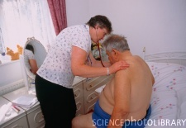
Creating a Supportive Environment
Sensitivity when weighing obese patients
Appropriate medical equipment
Weight-friendly waiting room
Appropriate examination room

Slide 45
Questions?
guptaad@rowan.edu
www.forweightcontrol.mobi
www.forweightcontrol.info

