Slide 1
About OMICS Group
OMICS Group International is an amalgamation of Open Access publications and worldwide international science conferences and events. Established in the year 2007 with the sole aim of making the information on Sciences and technology ‘Open Access’, OMICS Group publishes 400 online open access scholarly journals in all aspects of Science, Engineering, Management and Technology journals. OMICS Group has been instrumental in taking the knowledge on Science & technology to the doorsteps of ordinary men and women. Research Scholars, Students, Libraries, Educational Institutions, Research centers and the industry are main stakeholders that benefitted greatly from this knowledge dissemination. OMICS Group also organizes 300 International conferences annually across the globe, where knowledge transfer takes place through debates, round table discussions, poster presentations, workshops, symposia and exhibitions.

Slide 2
About OMICS Group Conferences
OMICS Group International is a pioneer and leading science event organizer, which publishes around 400 open access journals and conducts over 300 Medical, Clinical, Engineering, Life Sciences, Phrama scientific conferences all over the globe annually with the support of more than 1000 scientific associations and 30,000 editorial board members and 3.5 millionfollowers to its credit.
OMICS Group has organized 500 conferences, workshops and national symposiums across the major cities including San Francisco, Las Vegas, San Antonio, Omaha, Orlando, Raleigh, Santa Clara, Chicago, Philadelphia, Baltimore, United Kingdom, Valencia, Dubai, Beijing, Hyderabad, Bengaluru and Mumbai.

Slide 3
Why aren’t Biosimilars Generics – Regulatory Challenges
4th International Conference on Pharmaceutical Regulatory Affairs
Sep 8-Sep 10, 2014
Raleigh, NC
Adam Sabouni, PhD
PharmaConsultz

Slide 4
Overview
Background: Economic Considerations
ANDA Submission Package
The Path for a Small-Molecule Generics- ANDA
Biosimilars – Guidance and Definition
Biosimilars Development
Emphasis
  General Principles
Conclusion

Slide 5
Background: Economics of a Crowded Generics Market
For Any $ 1 B Oral Brand
 | 2 Gx | 4 Gx | 10 Gx
Available Market | $ 850 MM | $ 850 MM | $ 850 MM
Gx Price % | 42% | 20% | 2%
Gx Mkt Opportunity | $ 357 MM | $ 170 MM | $ 17 MM
Gx Share | 50% | 25% | 10%
Gx Value | $ 179 MM | $ 43 MM | $ 2 MM
As the number of competitors increase, the value for each generic is reduced dramatically

Slide 6
Background: Key Market Characteristics of Biologics
Biologics sales are expected to be ~$ 170 bn by 2017
Majority of current sales from mega blockbusters
Monoclonal antibodies (mAbs) are the largest and fastest growing segment
~30% of industry pipeline in biologics
By 2017, ~$ 70 bn in originator (reference) biologics sales are expected to lose patent exclusivity

Slide 7
In 2012, 7 of the Top 10 Best-Selling Pharmaceuticals
Worldwide were Biologics¹
 | Product | Type | 2012 Estimate¹ (USD bn)
1. | HUMIRA® | Biologic | 9.1
2. | SERETIDE/ADVAIR® | Respiratory / device | 8.1
3. | Enbrel® | Biologic | 7.9
4. | Rituxan® | Biologic | 7.0
5. | Remicade® | Biologic | 6.7
6. | CRESTOR® | Small molecule | 6.2
7. | Herceptin® | Biologic | 6.2
8. | LANTUS® | Biologic | 6.1
9. | AVASTIN® | Biologic | 6.0
10. | Gleevec® | Small molecule | 4.7
1 Source: Evaluate Pharma Oct 30 2012; vaccines excluded

Slide 8
ANDA Submission Package
CMC
  Demonstrate that the API is the same through the commonly used analytical approaches (IR, NMR, melting point, MS, LC-MS, impurity profile limits, etc)
  Often rely on a 3rd party DMF
  Use same inactive ingredients and levels (reverse engineering)
  Use same application route and formulation type
  Demonstrate in vitro equivalent release profile
  Demonstrate adequate stability
Clinical Studies
  Oral: Demonstrate in vivo bioequivalency
  Topical: Carry out a limited clinical study
  Injectables: Not required in most cases
Safety Studies
  Mostly not required. Refer to reference product

Slide 9
The Path for a Small-Molecule Generics- ANDA is ..
A well understood development and marketing path by both, the Generics industry and the FDA
The Generics industry is well equipped (manpower, facilities, technology) to develop new generics in a relatively short period of time
Development of a new generic product is relatively at a low cost and with a high rate of success
A generic product is interchangeable with an FDA-licensed small-molecule reference product

Slide 10
Biosimilars

Slide 11
US Guidance 1
Biologics Price Competition and Innovation Act of 2009 (BPCI Act)

Slide 12
US Guidance 2
351(k) application
  licensure of an application for a biosimilar or interchangeable product under 351(k) of the PHS Act may not be made effective by FDA until the date that is 12 years after the date on which the reference product referred to in the 351(k) application was first licensed under section 351(a) of the PHS Act. In addition, a 351(k) application may not be submitted to FDA for review until 4 years after the date of first licensure of the reference product

Slide 13
US Guidance 3
BPD : biosimilar biological product development programs
The BPCI Act was enacted as part of the Patient Protection and Affordable Care Act (Affordable Care Act) (Public Law 111–148) on March 23, 2010. The BPCI Act amends the PHS Act and other statutes to create an abbreviated licensure pathway for biological products shown to be biosimilar to or interchangeable with an FDA-licensed biological reference product (see sections 7001 through 7003 of the Affordable Care Act). Section 351(k) added by the BPCI Act, sets forth the requirements for an application for a proposed biosimilar product and an application or a supplement for a proposed interchangeable product

Slide 14
US Guidance 4
As provided by section 351(m) of the PHS Act, an additional 6-month period of exclusivity (in which a biosimilar or interchangeable biological product cannot be licensed or accepted for review) will attach to the 12- and 4-year periods, respectively, if the sponsor conducts pediatric studies that meet the requirements for pediatric exclusivity pursuant to section 505A of the Federal Food, Drug, and Cosmetic Act (FD&C Act)

Slide 15
Definition of Biosimilar/Biosimilarity in BPCI Act
Biosimilar or biosimilarity is defined in Section 351 of the PHS Act to mean that “the biological product is highly similar to the reference product notwithstanding minor differences in clinically inactive components, and that “there are no clinically meaningful differences between the biological product and the reference product in terms of the safety, purity, and potency of the product”
Section 7002(b)(2) of the Affordable Care Act, amending section 351(i) of the PHS Act

Slide 16
“Biosimilar” vs “NOT Biosimilar”
What are biosimilars?
Biosimilars are successors to a biologic medicine which are approved via a stringent regulatory pathway
Biosimilars have comparable qualit, safety, and efficacy (via clinical trials)
What are NOT biosimilars?
Non-comparable 'copy biologics‘ not approved in highly regulated markets are NOT biosimilars

Slide 17
Biosimilars Development
Emphasis

Slide 18

Highly Similar Analytical and PK/PD =
Lower Risk of Clinical Differences
Additional Clinical
Studies
351 (a)
package
351 (k)
package
Additional Clinical
Studies
Clin Pharm
Clin Pharm
Nonclinical
Nonclinical
Analytical
Analytical
Two approaches to achieve biosimilarity
Copied from 2012 presentation of M. Shapiro, FDA

Slide 19
Development Approaches of Biosimilars
    A stepwise approach to demonstrating biosimilarity, which can include a comparison of the proposed product and the reference product with respect to structure, function, animal toxicity, human pharmacokinetics (PK) and pharmacodynamics (PD), clinical immunogenicity, and clinical safety and effectiveness
    The totality-of-the-evidence approach that FDA will use to review applications for biosimilar products
    General scientific principles in conducting comparative structural and functional analysis, animal testing, human PK and PD studies, clinical immunogenicity assessment, and clinical safety and effectiveness studies (including clinical study design issues)

Slide 20
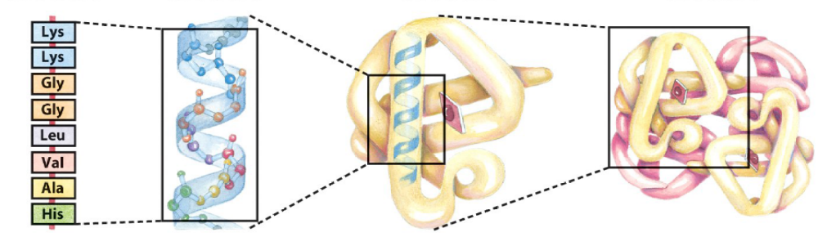
The Complexity of Protein Structure
Primary
Structure
Secondary
Structure
Tertiary
Structure
Quaternary
Structure
Amino acid residues
α Helix
Polypeptide chain
Assembled subunits
All need to be evaluated as part of analytical similarity studies

Slide 21
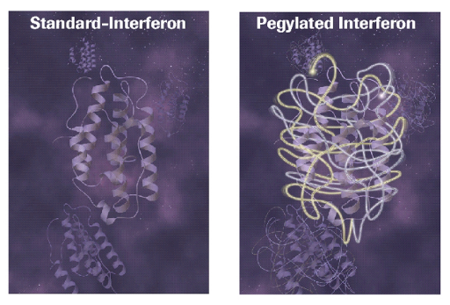
Protein Heterogeneity
Amino Acid Substitution
N-and C-terminal mods
Mismatched S-S bonds
Folding
Truncation
Aggregation
Multimer Dissociation
Denaturation
Acetylation
Fatty acylation
Deamidation
Oxidation
Carbamylation
Carboxylation
Formylation
γ-Carboxyglutamylation
O-linked Glycosylation
N-linked Glycosylation
Methylation
Phosphorylation
Sulphation
PEGylation

Slide 22
General Quality Principles:
Importance of extensive analytical, physicochemical and biological characterization
Product/process impurities, expression system
Identification of lots used in the various analyses for biosimilarity determination
Advances in manufacturing science and Quality-by-Design approaches may facilitate “fingerprint”-like analysis

Slide 23
Analytical Tools to Evaluate Proteins
Amino acid sequence and modifications:
  MS, peptide mapping, chromatographic separations
Folding:
  S-S bonding, calorimetry, HDX and ion mobility MS, NMR, dyes, circular dichroism, Fourier transform spectroscopy, Fluorescence
Subunit interactions:
    Chromatography, ion mobility MS
Heterogeneity of size, aggregates, charge, hydrophobicity:
  Chromatography resins; gel & capillary electrophoresis, light scatter, IM-MS, Analytical ultracentrifugation, size-exclusion chromatography, field flow fractionation, light scatter, microscopy
Glycosylation
  Anion exchange, enzymatic digestion, peptide mapping, CE, MS
Bioactivity
  Cellular and animal bioassays; ligand & receptor binding (ELISA, surface plasmon resonance), signal transduction
Impurities
  Proteomics, immunoassays, metal & solvents analysis

Slide 24
Let Us Meet Again
We welcome you all to our future conferences of OMICS Group International
Please Visit:
regulatoryaffairs.conference@omicsgroup.us
regulatoryaffairs@conferenceseries.net
http://regulatoryaffairs.pharmaceuticalconferences.com/

