Slide 1

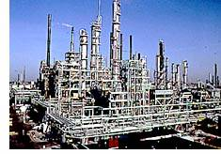
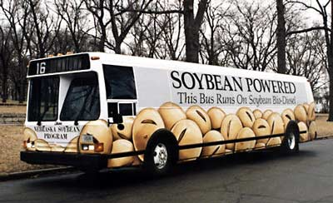
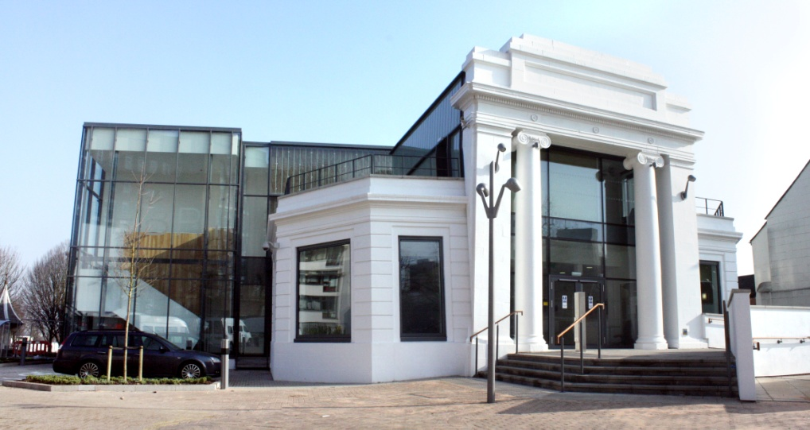
Rational design of nanoengineered catalysts for biofuels production
Professor Adam Lee
a.f.lee@aston.ac.uk
Biofuels & Bioenergy August 27th 2015
European Bioenergy Research Institute

Slide 2

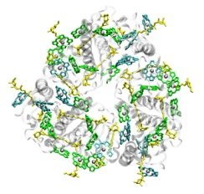


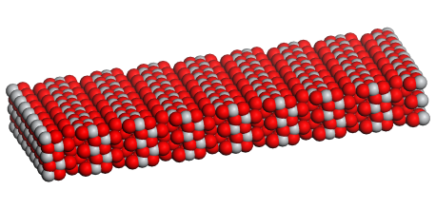

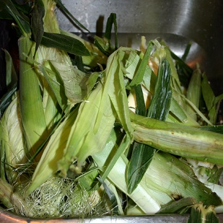
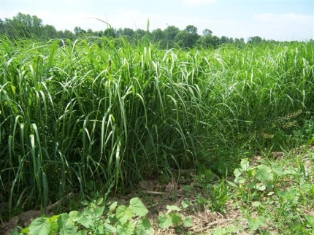

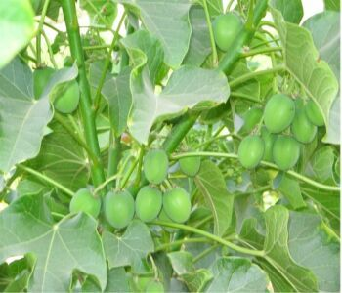
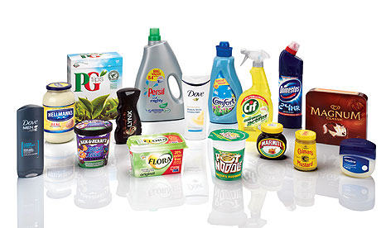
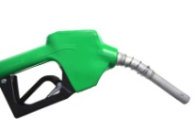


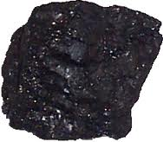
Heterogeneous Catalysis: Chemicals & Energy
Economic
Sustainable
Aqueous phase
Low T
CO₂
H₂
CH₄, CH₃OH
H₂O
.OH + H⁺
e⁻
Semiconductor
Corn husks
Solar fuels/chemicals
Switchgrass
Chemical synthesis
Biorefining
Jatropha curcas
Green
Chemistry
Reforming
Cracking
Organic phase
High T
Fossil fuel refining
Unsustainable
2

Slide 3
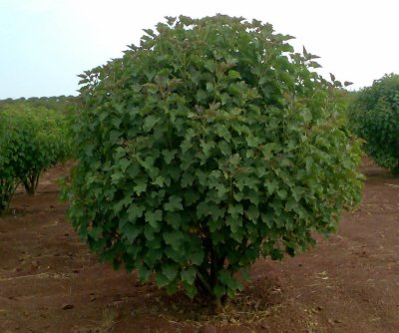
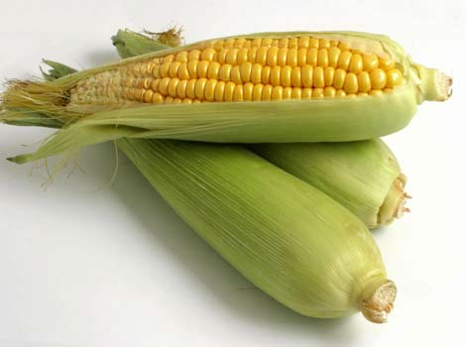
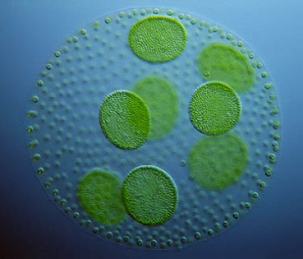
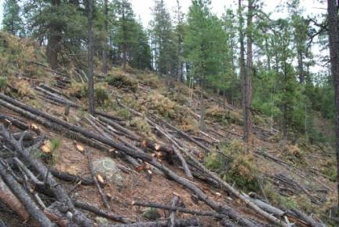
Biofuels: non-food crops
Renewable biofuels require waste/non-food feedstocks.
Non-edible components of crops
(stems, leaves and husks).
Agricultural or forestry waste,
or short rotation crops.
Lignocellulosic feedstocks
Oleo-feedstocks
Jatropha → minimal cultivation.
Aquatic biomass.
Jatropha curcas
~ 2.2-2.7 ton oil/ha
(www.reuk.co.uk)
~180 x more oil/ha than Jatropha
Switchgrass
Algae
Chem. Soc. Rev. 2014, 43, 7887
Catal. Today 2014, 242, 3

Slide 4
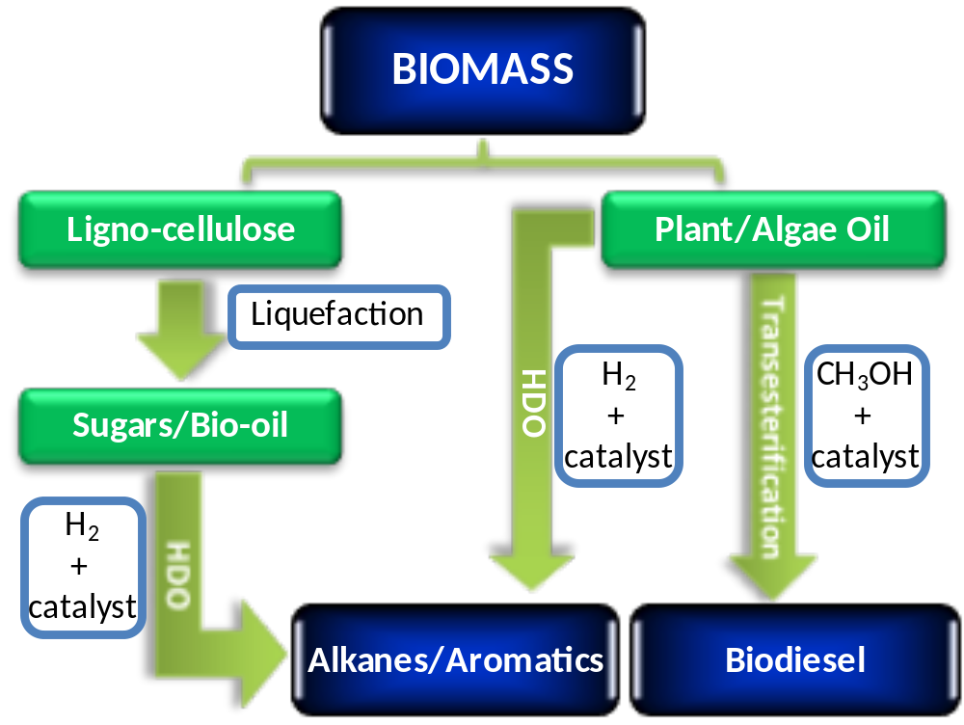
Thermochemical routes to biofuels
  Pyrolytic routes to bio-oil not selective → unstable acidic mixtures.
  Transesterification offers a low energy route to fuel.

Slide 5
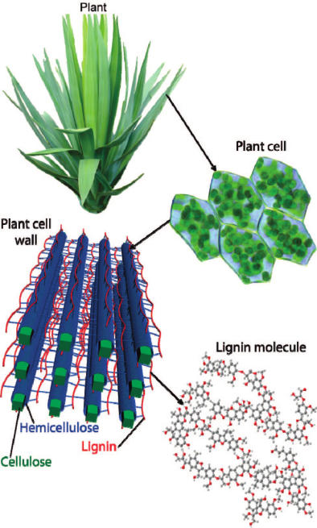
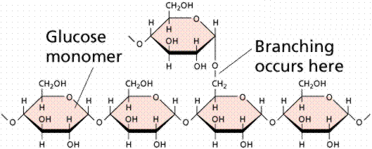
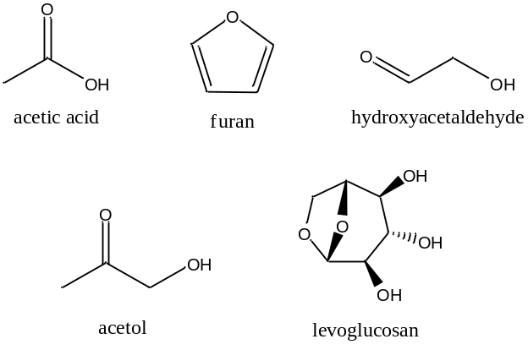
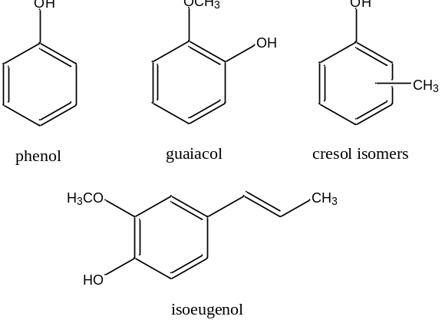
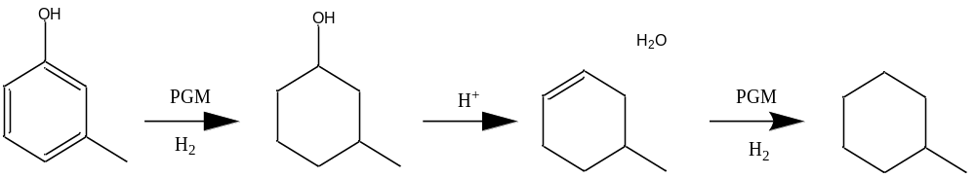
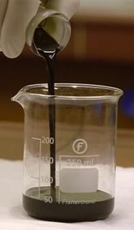
Challenges for Lignocellulosic Bio-fuels
Cellulose
Lignin
Pyrolysis
Sensitive to poisoning.
require e.g. esterification or
ketonisation pretreatments
Hydrodeoxygenation used to upgrade oil to fuel
Bio-oil

Slide 6
Biofuel Synthesis from Plant/Algal Oils
Oil Triglyceride
Hydrogen
+
catalyst
Methanol
+
catalyst
Hydrotreating
Bio-fuel
Synthesis
Transesterification
n-Alkane
+
Propane
Biodiesel
+
Glycerol
‘Drop in’ technology
Reformed fuel – e.g. Jet fuel
Need renewable H₂
Higher temperature process
Energy efficient
Cheap technology
Localised fuel distribution
Fuel properties oil dependent

Slide 7
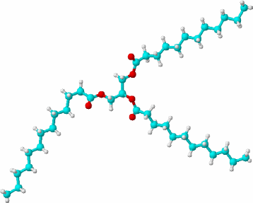


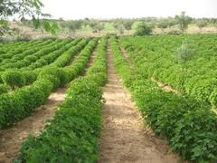

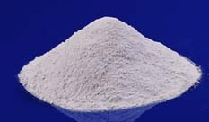
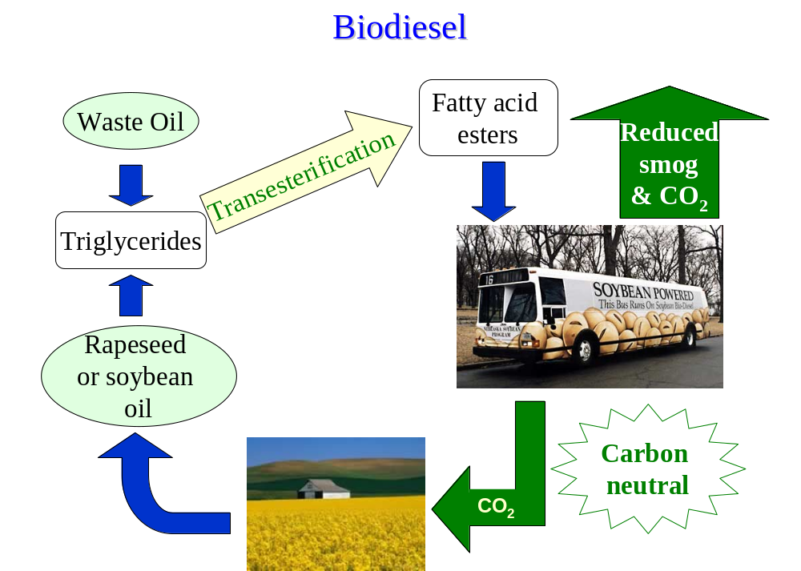
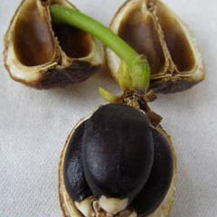
Biodiesel synthesis
Second-generation biofuels from lignocellulose or sustainable bio-oils.
Bio-oil transesterification
New Heterogeneous Catalysts
→ Facile biodiesel separation
3 CH₃OH
❒
3 +
Jatropha
NaOMe
H₂O
Process Intensification
→ Improved energy efficiency
Algae
Biodiesel
(FAME)
Glycerol
Triglyceride
(TAG)
Oil
aqueous quench
Renewable
bio-oils
stable emulsions
energy intensive separation
Low
carbon
Cat. Sci. Tech. 2012, 1, 1
J. Biobased Mater. Bioenergy 2007, 1, 19

Slide 8
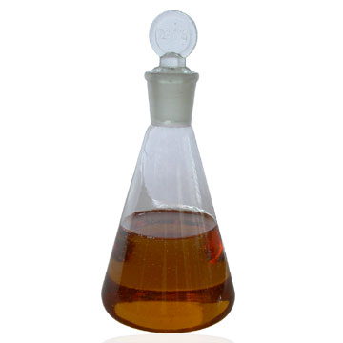
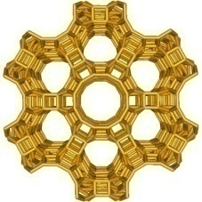
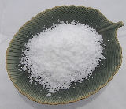
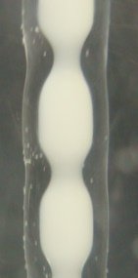
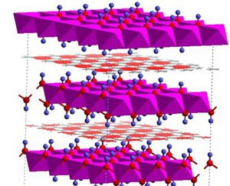
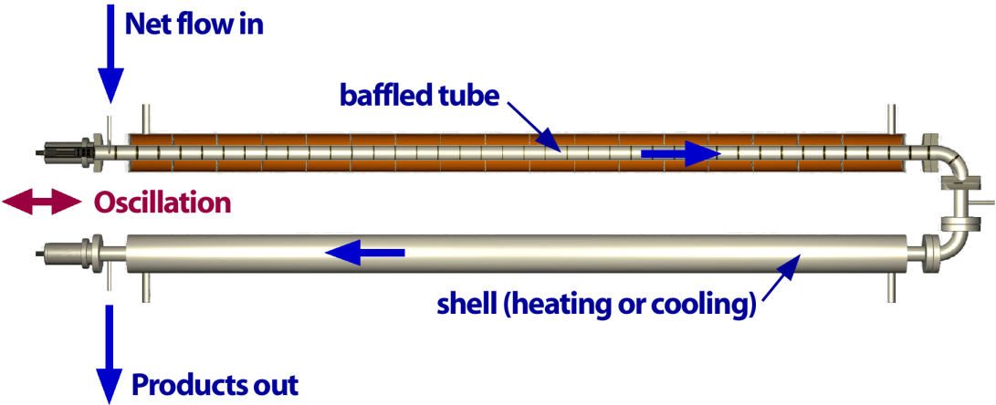


Process variables
Biodiesel synthesis
1. Oil composition
2. Catalyst type
Unsaturation/chain length
Solid acid vs solid base
Glyceryl trioleate
C₁₈ unsaturated
3. Reactor Design
Batch vs Flow
Flow out
Glyceryl tripalmitate
C₁₆ saturated
Zeolites
Fatty acid content?
Baffled
tube
Fatty Acid (FFA)
FAME
Hydrotalcites
H⁺ CH₃OH
Compatibility with oil?
Acid/Base strength?
Effect of porosity?
Flow
in
Uniform catalyst suspension
Oscillation
Ind Eng Chem Res 2001, 40, 5371
Process Intensification

Slide 9
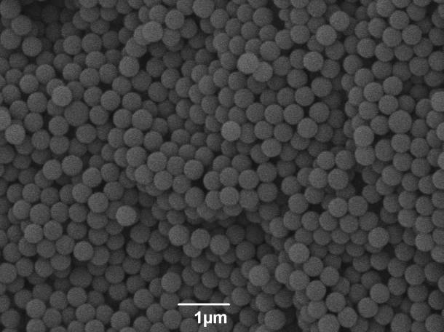
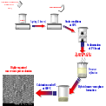
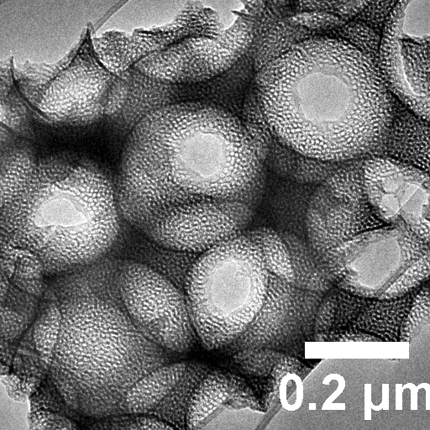
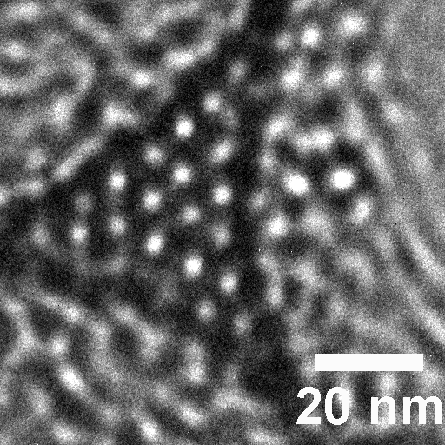
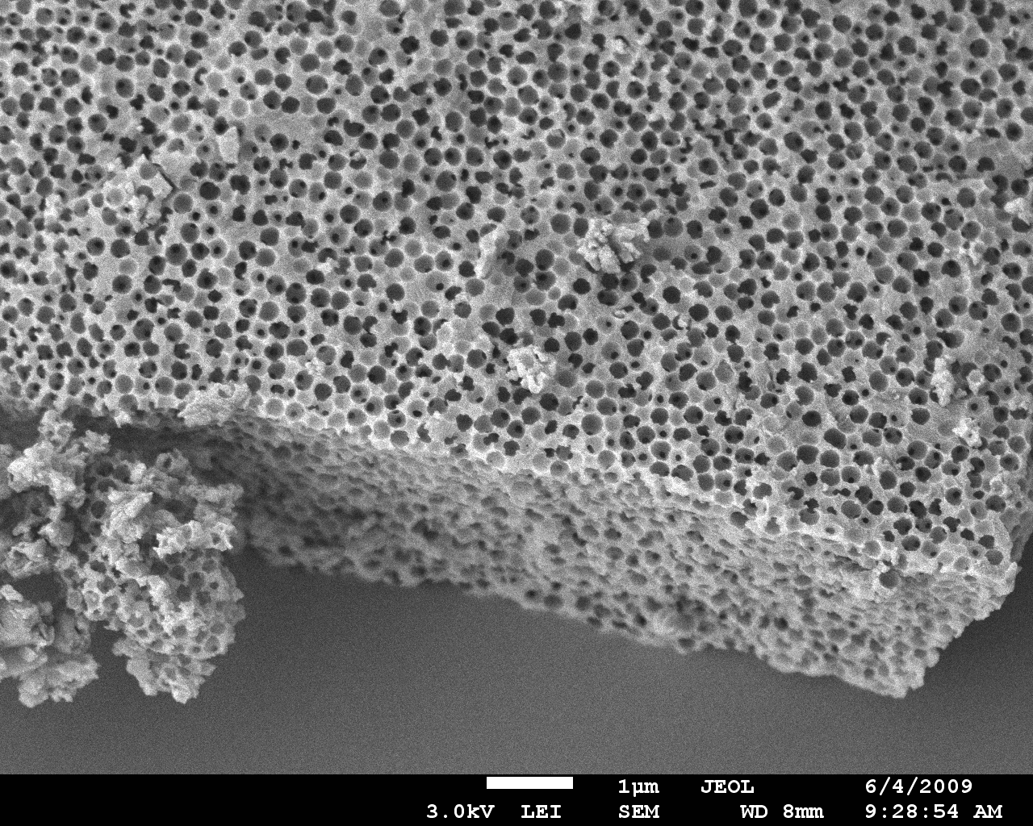
Hierarchical porous nanostructures
Soft Template
Aluminum Isopropoxide/TEOS
Pluronic P123
HNO₃
Static conditions
at 60 °C
Sedimentation
of PS beads
Enhanced mass-transport for bulky feedstocks
Evaporation of
supernatant
Highly organized
macroporous-mesoporous Al₂O₃
Precursor
infiltration
Calcination under O₂
at 600 °C
Hybrid macro-mesophase
formation

Slide 10
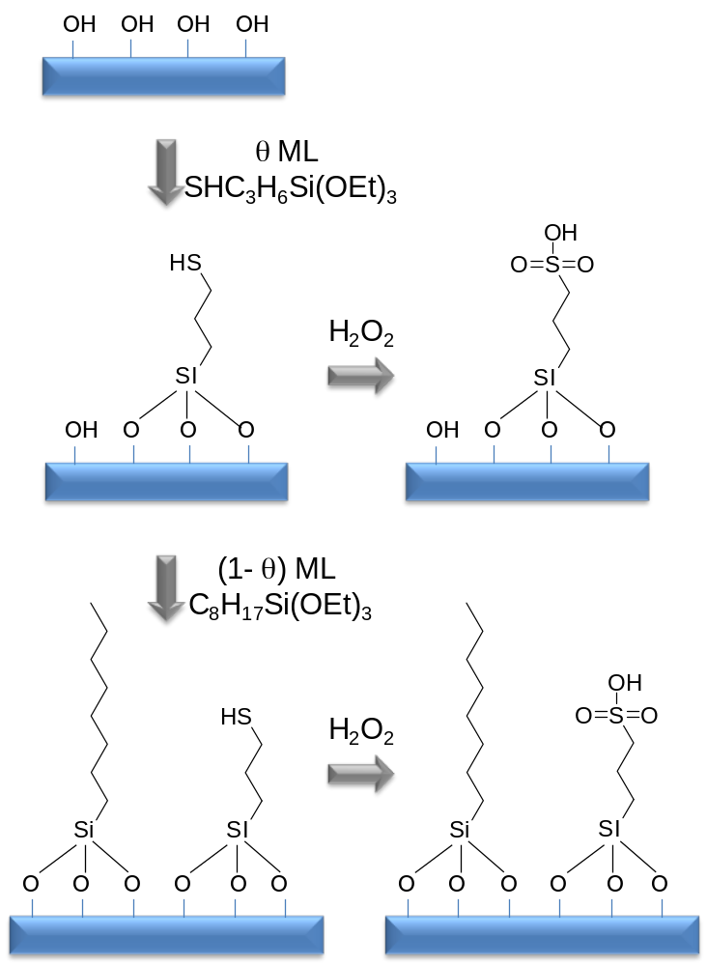
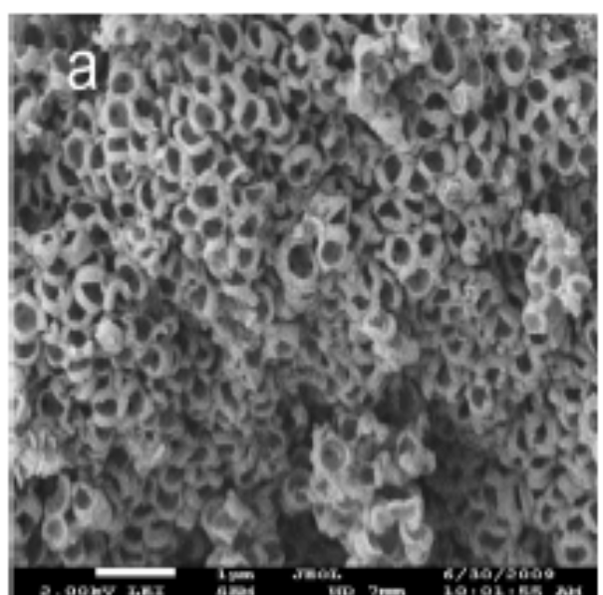
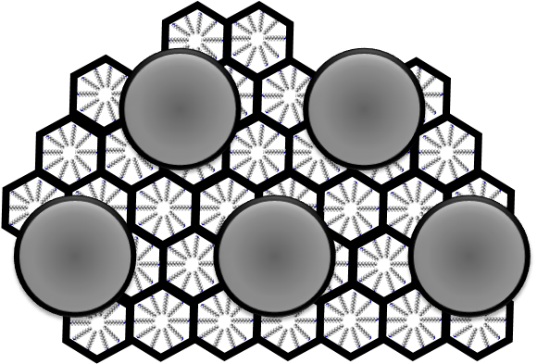
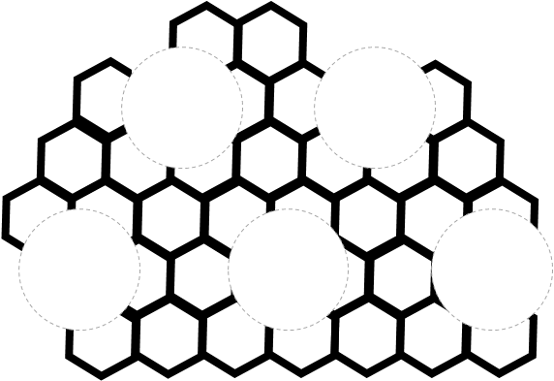
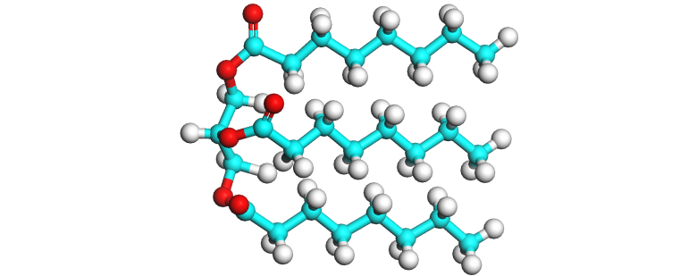
Hierarchical Solid Acids
Macroporous-mesoporous solid acid catalyst:
O₂
SiO₂
Macro-Meso SiO₂
Green Chem. 2010, 12, 296
SiO₂
Triglyceride
Palmitic acid
Hierarchical solids tune structure
and promote biofuels synthesis

Slide 11
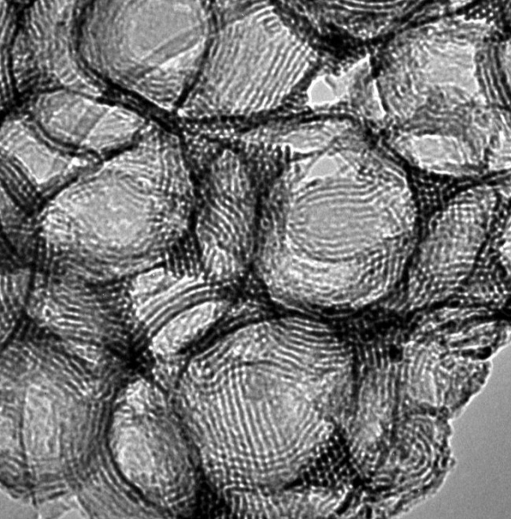
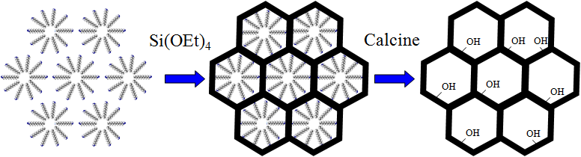

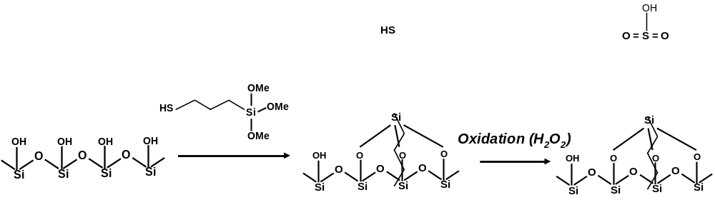
Hierarchical Macro-Mesoporous Supports
Micellar array Templated SiO₂ Mesoporous SiO₂
Si(OEt)₄
128 nm
1 μm
Polystyrene
nanospheres
Calcine
Templated macro-mesoporous SiO₂ Macro-mesoporous SiO₂
J. Am. Chem. Soc., 2009, 131,12896
Green Chem. 2010, 12, 296

Slide 12
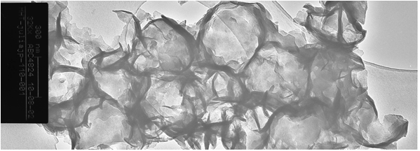
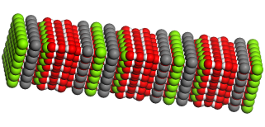
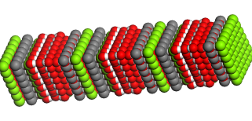
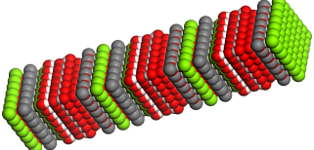

Hierarchical Solid Bases
Hydrotalcite solid base catalysts:
Conventional HT
1 μm
2 μm
Macroporous HT
300 nm
Mg_{x}Al_{y}O_{x+1.5y}
Macropores enhance bulky
bio-oil transformation
Bio-oil chain length
Energy Env. Sci. 2012, 5, 6145

Slide 13



Thin Film Hydrotalcites
Can we generate high area HT thin films to further improve mass transport ?
Green Chem. 2015, 17, 2398
SBA-15
Mesopores
Silica
Macropore
XRD confirms formation of Mg₂Al HT phase.
Hydrotalcite
Enhanced base site accessibility and TOF for TAG transesterification

Slide 14



Process Intensification
Conventional plug flow reactors long catalyst beds for slow reax^{n}.
Oscillatory Baffled Reactor (OBR) superimposes oscillatory on net slow flow.
→ baffled cell acts as CSTR → catalyst particles entrained between baffles.
Net
flow out
No Oscillation
Sedimentation
Oscillation
Uniform suspension
Baffled
tube
First heterogeneously catalysed OBR reaction
→ solid acid catalysed esterification.
Cumulative TON equivalent to stirred batch.
Net flow in
Oscillation
Catal Sci & Tech. 2013, 3, 2373

Slide 15





Conclusions
Sustainable Chemistry
Energy
efficient
Reduced
Pollution
Renewable
resources
Catalyst Development
Surface Chemistry
Materials Design
Chemical Engineering

Slide 16







Acknowledgements
Professor Karen Wilson
Dr Jean-Philippe Dacquin  Jean-Michele Caderon
Dr Cyril Pirez  Dr Amin Osatiashtiani
● Jeremy Dhainaut
● Dr James Bennett
Huddersfield:
Prof D. Robert Brown
Dr Marta Granollers
Bath:
Prof Tina Düren
Dr Jennifer Williams
Newcastle:
Prof Adam P Harvey
Dr Ahn Phan
Valentine Eze
University of Rey Juan Carlos (Madrid)
Prof Juan Melero
Prof Gabriel Morales Sanchez

Slide 17

Huber – Upgrading of Aqueous Phase

Slide 18

Catalytic Bio-oil Upgrading
Bio-oils are complex unstable mixtures - require upgrading to improve:
  oil stability by eliminating reactive components
  hydrocarbon yield by condensing short chain components
  oil compatibility for refining
Cracking
Isomerise
Solid Acids
Aromatization
?
Esterification
Reduce acidity
Dehydration
Solid Bases
- Decarboxylation
- Condensation
Mixed metal oxides
C-C chain growth
https://engineering.purdue.edu/H2biomass/research.php
- Ketonization
Improve fuel stability
- Decarboxylation
Metal (PGM) doped oxides
- Deoxygenation
Enormous opportunities for catalyst and process design

Slide 19



Alkane Fuels – HMF platform
Continuous 5-HMF extraction into the organic phase reduces side reactions.
+ HMF
C₁₂ alkane
H₂
H₂O
Acid catalysed aldol condensation
+ HMF
Organic
C₁₅ alkane
H₂
H₂O
H₂
Aqueous
C₉ alkane
Fructose 5-HMF
H⁺/H₂
H₂O
Metal doped solid acid for HDO
Science, 2006, 312, 1933.

Slide 20







Routes to Biodiesel from Algae or Jatropha
H₂O/nutrients
Reactor
Bioreactor
Algae
Jatropha plantation
Recirculating Tank
CO₂
Cultivate
Harvest
Pump
Extract
Filter
Dry
Press
Separate
Green Fuel Technologies, Cambridge MA.
?
Salt water strains
Polyunsaturated
C₂₀-C₂₂ chains common
Phosphorus problem (10-20% phospholipid)
C₁₈ unsaturated chains
15% free fatty acid
Poisonous seed cake
Need right climate (developing countries)
Biodiesel

Slide 21

Decentralised Fast Pyrolysis & Local Use
http://www.ars.usda.gov/
21

Slide 22
Diffusion modelling framework
Goal to validate and predict catalyst design parameters:
Physical properties of chemicals
Catalyst design parameters
Wilke Chang correlation for infinite dilution diffusion coefficient
Binary diffusion coefficient
Effective diffusivity
Reactant conversion profile
Diffusion flux
Power law based intrinsic kinetics
Add and update product concentration profile
Reaction flux
RSC Advances 2013, 3, 6226

Slide 23


Model substrates for esterification
x
Typical Reaction conditions
Reaction temperature 50-80 °C
Atmospheric pressure
Reaction under air
Identify solvent to use as model bio-oil so as to work as acid concentration representative of that in oil.

Slide 24


Lignocellulose Conversion
Fractionation
H⁺
Cellulose
WASTE
Biocatalysis:
→ dilute, impure aqueous chemicals
→ Energy intensive product isolation
Require catalytic methods to convert lignocellulose to fuels or platform chemicals
Fuels or
Chemicals

Slide 25











Petrochemical to Bio-refining
Biomass
source
Fuels
✗
Solvent
Bulk chemicals
Plastics
✓
Fibres
Fine chemicals
Oils
Fuel & chemical co-production improves process economics

Slide 26







Carbohydrate Transformations
Solid catalysts to reduce waste
Bifunctional Catalysis
OH
Large pore materials as solid supports
H₂

Pt
H⁺
Dehydration
+ Hydrogenation
C-OH Dehydration
C-O-C, C-OH cleavage
Selective hydrogenation or oxidation
Bifunctional catalysts improve process efficiency

Slide 27


Bio-oil Pretreatment 2: Esterification
MCM-41
Green Chem. 2010, 12, 1383
Hydrophobic materials required to improve water tolerance
+ Octyl
RSO₃H
Increased hydrophobicity promotes esterification activity

