Slide 1

Mood247.com:
Improving Healthcare
Information & Integration
Adam Kaplin, MD, PhD
Departments of Psychiatry and Neurology
Johns Hopkins University School of Medicine

Slide 2
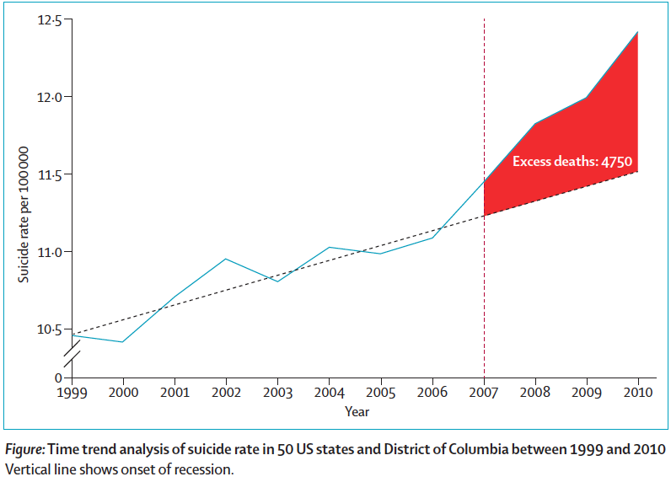
Increase in state suicide rates in the USA
during economic recession

Slide 3
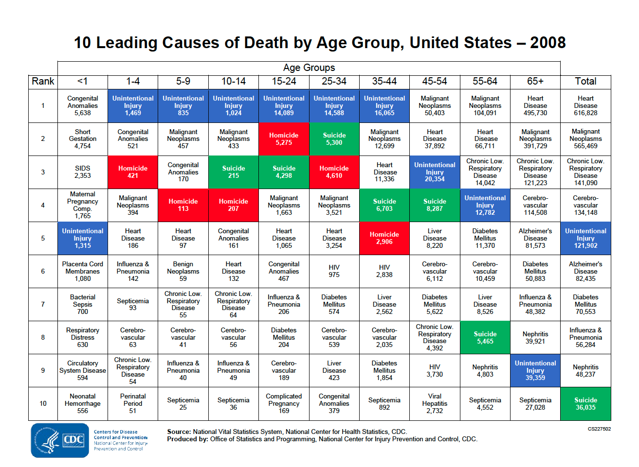

Slide 4
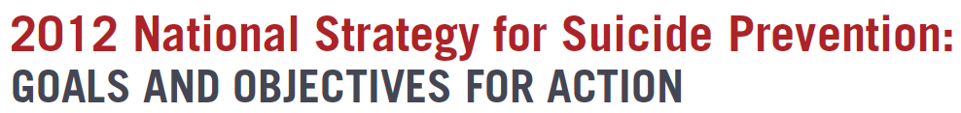

Suicide is the 10th leading cause of death, claiming more than twice as many lives each year as does homicide.
Suicide is the 2nd leading cause of death for 25-34 year olds.
On average, between 2001 and 2009, more than 33,000 Americans died each year as a result of suicide, which is more than 1 person every 15 minutes.
In 2009, more Americans died from suicide than from motor vehicle traffic-related injuries.
For every person who dies by suicide, more than 30 others attempt suicide.
More than 8 million adults (3.7%) report having serious thoughts of suicide in the past year, 2.5 million report making a suicide plan in the past year, and 1.1 million report a suicide attempt in the past year.

Slide 5
Why are We Failing to Effectively Treat Depression?
Do we lack effective treatments?

Slide 6
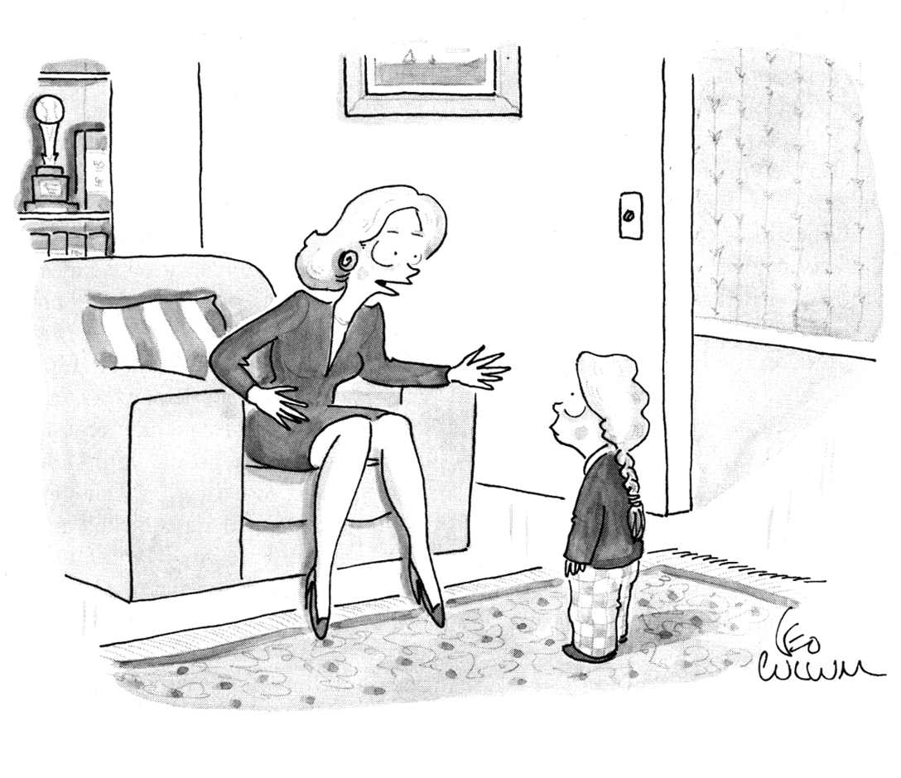
“Of course your daddy loves you.
He’s on Prozac--he loves everybody.”

Slide 7
Why are We Failing to Effectively Treat Depression?
What Does Behavioral Health Presently Lack?
  Information
  Integration

Slide 8

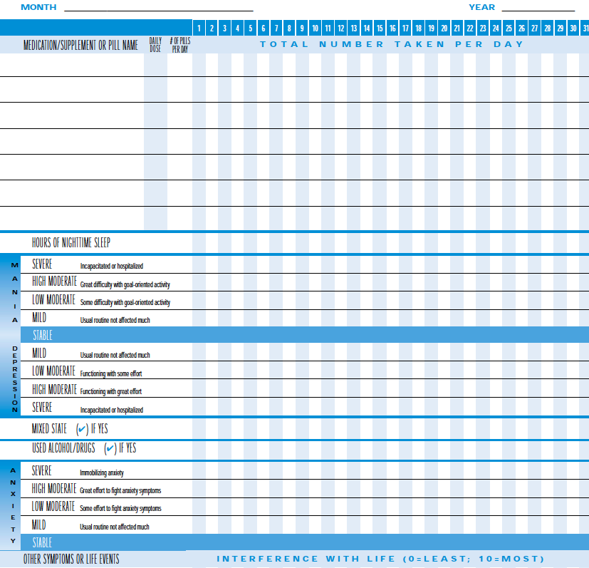
Current Standard

Slide 9
DSM IV Inventory: SIGEMCAPS
Sleep ( ⇓ / ⇑ )
Interest (or pleasure)
Guilt (or worthlessness)
Energy (fatigue)
Mood
Concentration
Appetite ( ⇓ / ⇑ or weight loss or gain)
Psychomotor retardation (or agitation)
Suicidal ideation (or thoughts of death)
≥5/9 Sx for ≥2 weeks
DSM V = Diagnostic and Statistical Manual of Mental Disorders criteria; Sx = symptoms.

Slide 10
Lack of Integration:
Evolution of the Practice of Medicine
Specialization of Medicine & Clinicians:
  American Board of Medical Specialties recognizes a total of 24 specialty areas for board certification and 145 subspecialties.
Average Annual Patient Utilization of Healthcare:
  A typical patient sees a median of two primary care physicians and five specialists each year, in addition to accessing diagnostics, pharmacy, and other services.
  Patients with several chronic conditions may visit up to 16 physicians in a given year.
  More than 130 million Americans—nearly 1 in 2 adults—have at least 1 chronic disease.
(Strandberg-Larsen, Dan Med Bull 2011;58(2):B4245)

Slide 11

TIME HEALTH
More People Have Cell Phones Than Toilets, U.N. Study Shows.
Out of the world’s estimated 7 billion people, 6 billion have access to mobile phones (90%). Only 4.5 billion have access to working toilets.
By Yue Wang March 25, 2013

Slide 12
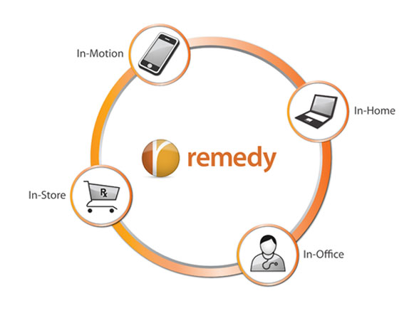


Academic-HIT Company Collaboration

Slide 13
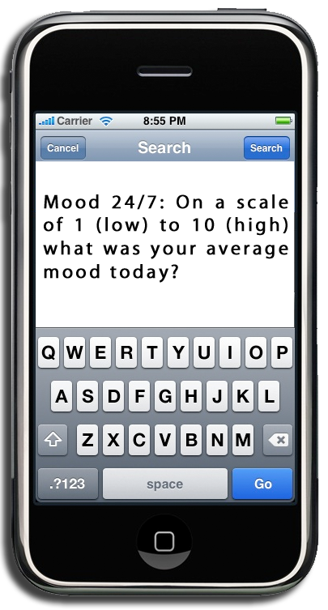
WWW.MOOD247.COM
Mood 24/7: Transforming the Technology You Already Own
Daily text to track mood course.
Takes seconds to respond.
Annotations can be added.
Utilizes individuals own cell phone.
Responses visualized online in real time.
Mood chart can be shared with trusted circle that includes Healthcare Providers, family members and friends.
Healthcare Providers can also annotate directly into the patient’s chart.
Automatic notification can be implemented for closer monitoring.

Slide 14
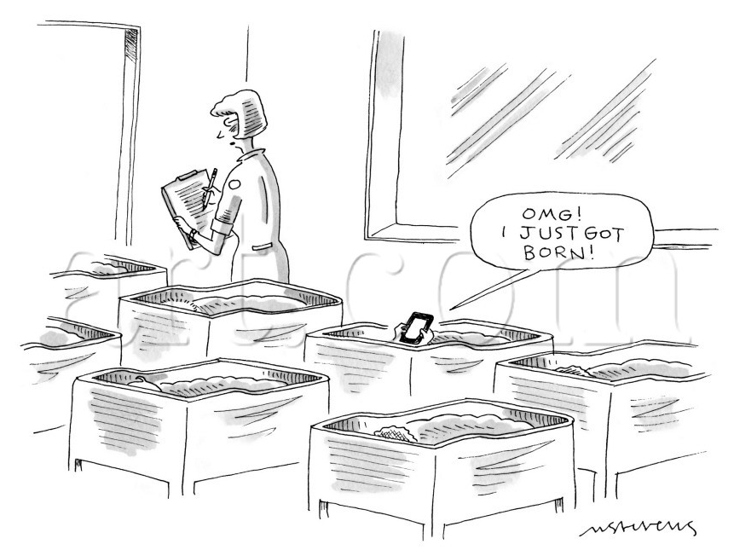

Slide 15
Mood24/7 In Action
Guardian Angel Effect
  “It's like a friend I can count on to call every evening always at the same time, waiting to hear how I'm feeling… I began to be able to see my own patterns and associate what was causing ups or downs.”
Therapeutic and Preventative
  “It makes me think about the the little things that I stress about sometimes. When I get the text from Mood 247, I sit back and think about what is most important to me and that is being happy.”
Through Knowledge Comes Power
  “My patient had these ‘light bulb’ moments where she got what is going on with her mood disorder for the first time. It’s like she went from being a little bobble head in a sea of emotions to being able to stand in the water and brace herself against the tide.”

Slide 16
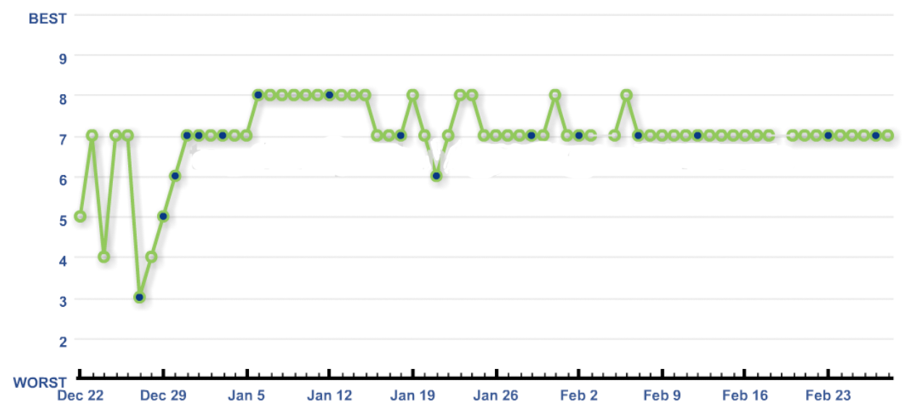
More Accurate Information Than Retrospective Recall
“No change in my mood since starting medication.”
Initiation of medication.

Slide 17
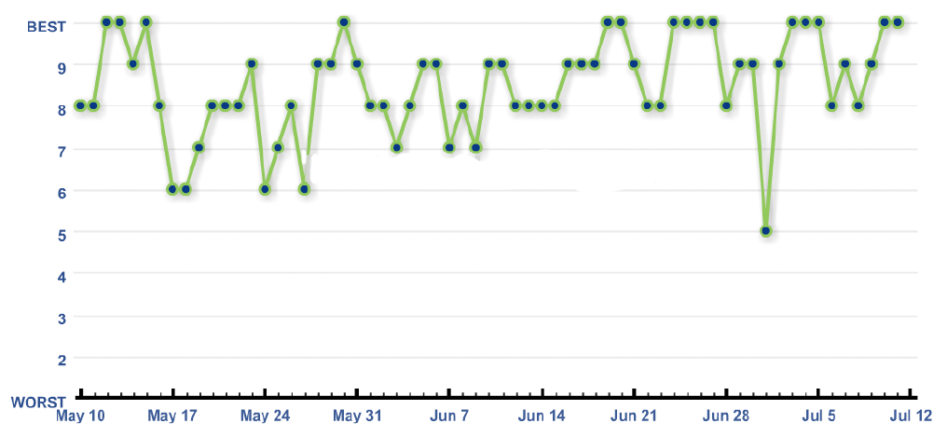
Recognizing the Patterns of Daily Living Aids With Stress Management
More Granular Information on Longitudinal Evaluation
Weekend
Weekend
Work

Slide 18
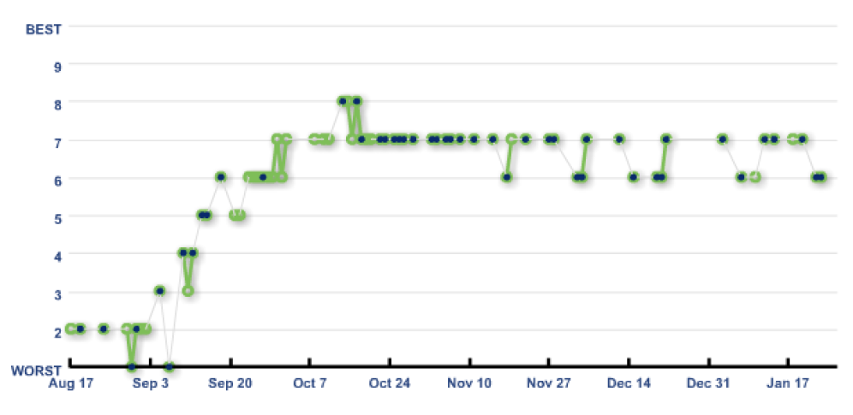
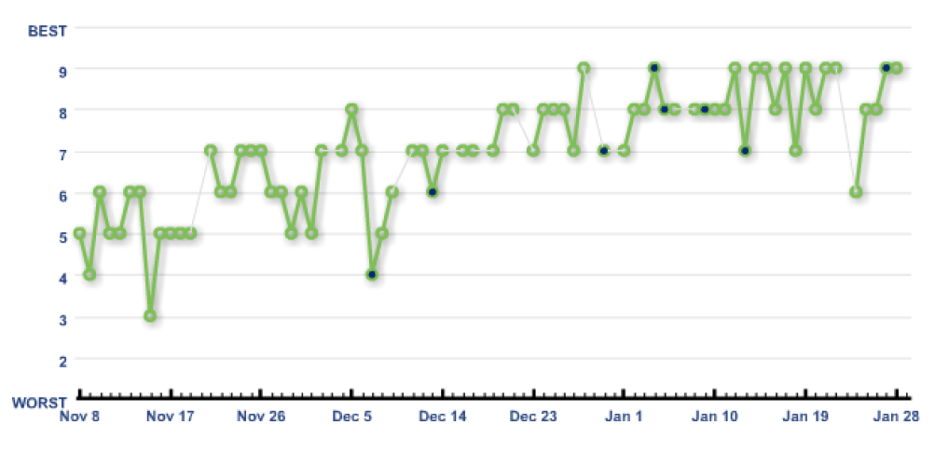
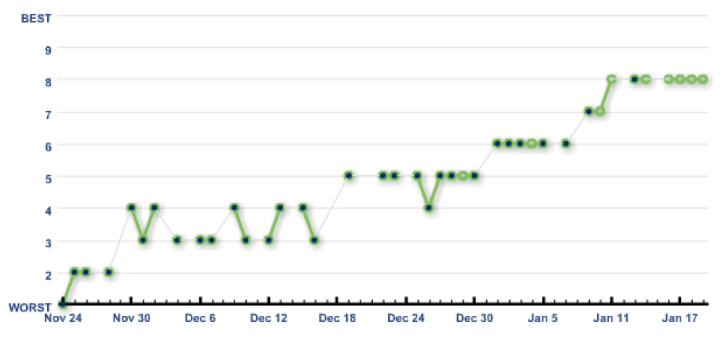
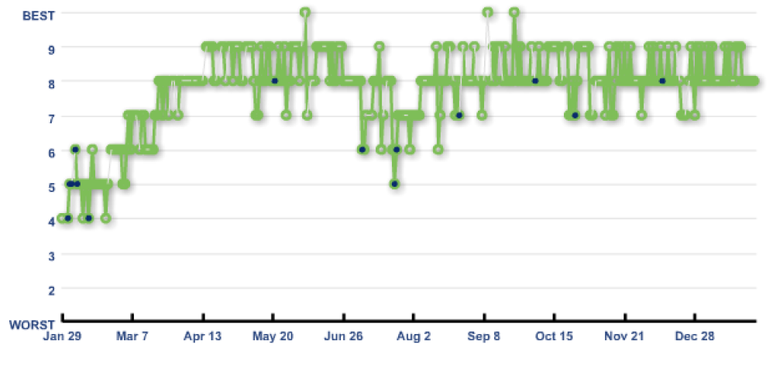
What Does Treatment of
Depression Look Like?

Slide 19
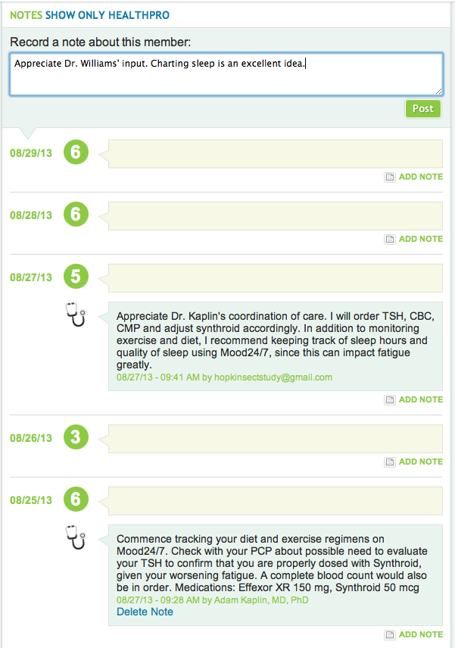
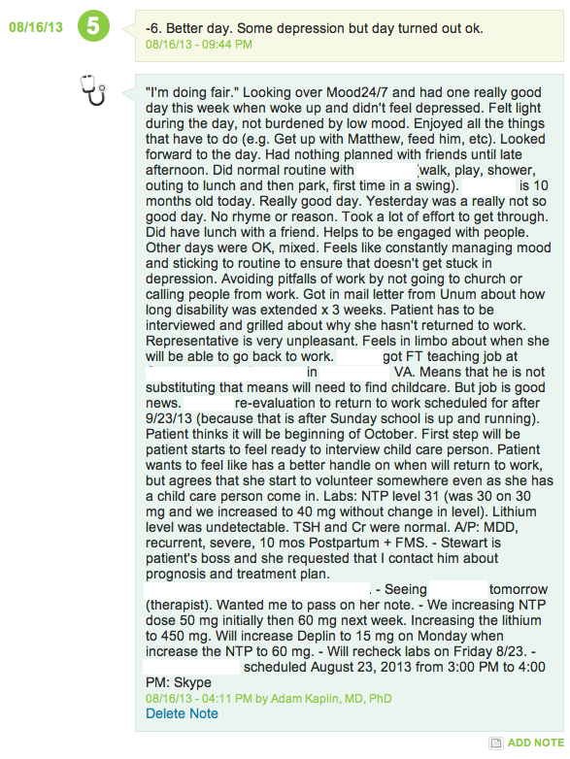
Integration of Care:
Coordinating Patient and HealthCare Providers

Slide 20
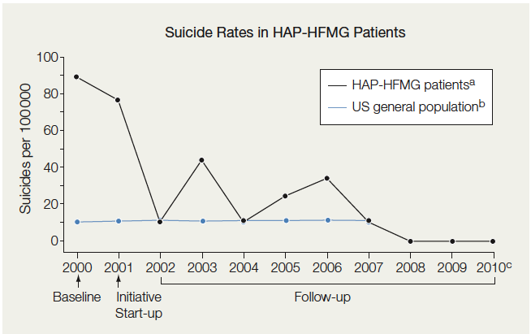
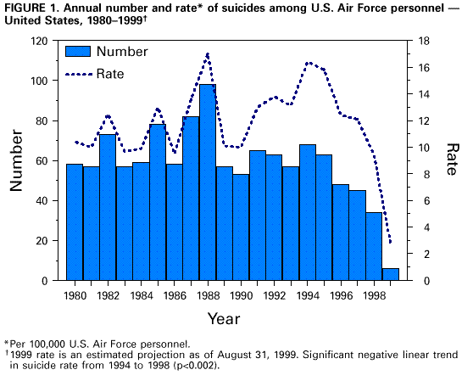
What if we really cared about suicide in this country?
By 1999, 80% reduction in suicide rate from lowest rate since 1980
Proof of Effectiveness of Integrated Suicide Prevention Program Based on IOM
(Hampton, JAMA. 2010;303(19) 1903-1905)
What do these programs have in common?
MMWR

Slide 21
Decreasing Suicide:
What Do These Programs Have in Common?
Awareness:
  Recognition of the problem of suicide and the need to address it.
Accountability:
  A commitment by all stakeholders to address the issue and prevent it.
Ascertainment:
  Routine screening by diverse members of the community and a way of monitoring the problem and response to intervention.
Active, Integrated, Timely Action Plan:
  An integrated plan to address in a timely fashion those in need of help.

Slide 22
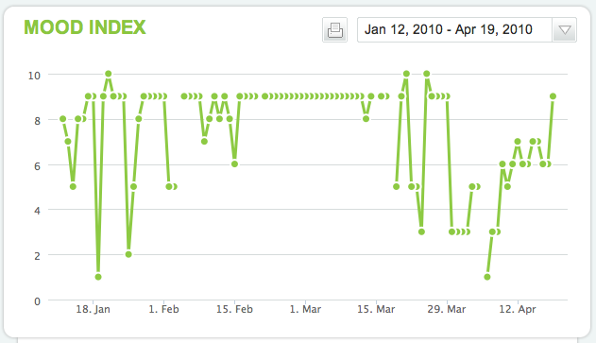
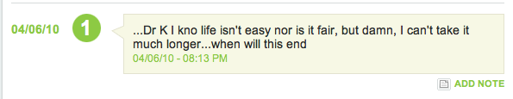
Mood Rating Becomes Part of Daily Routine

Slide 23
www.mood247.com:
Transforming the technology you already own
Simple is not necessarily simplistic
AK@JHMI.EDU
“The drive toward complex technical achievement offers a clue to why the U.S. is good at space gadgetry and bad at slum problems.”
~John Kenneth Galbraith

Slide 25
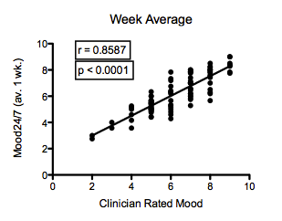
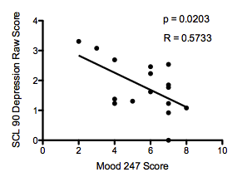
Mood24/7 Reliable? Accurate?:
Patient vs Clinician Rating vs Standardized Test

