Slide 1
About Omics Group
OMICS Group International through its Open Access Initiative is committed to make genuine and reliable contributions to the scientific community. OMICS Group hosts over 400 leading-edge peer reviewed Open Access Journals and organize over 300 International Conferences annually all over the world. OMICS Publishing Group journals have over 3 million readers and the fame and success of the same can be attributed to the strong editorial board which contains over 30000 eminent personalities that ensure a rapid, quality and quick review process.

Slide 2
About Omics Group conferences
OMICS Group signed an agreement with more than 1000 International Societies to make healthcare information Open Access. OMICS Group Conferences make the perfect platform for global networking as it brings together renowned speakers and scientists across the globe to a most exciting and memorable scientific event filled with much enlightening interactive sessions, world class exhibitions and poster presentations
Omics group has organised 500 conferences, workshops and national symposium across the major cities including SanFrancisco,Omaha,Orlado,Rayleigh,SantaClara,Chicago,Philadelphia,Unitedkingdom,Baltimore,SanAntanio,Dubai,Hyderabad,Bangaluru and Mumbai.

Slide 3



Lasers, Optics and Photonics 2014 – Philadelphia, USA, Sept. 9, 2014
Linear optical methods as ultrashort pulse diagnostics
A. Börzsönyi, A.P. Kovács, K. Osvay
Department of Optics and Quantum Electronics, University of Szeged, Hungary
Extreme Light Infrastructure – Attosecond Light Pulse Source, Hungary
CE Optics Research and Development Ltd., Hungary

Slide 4
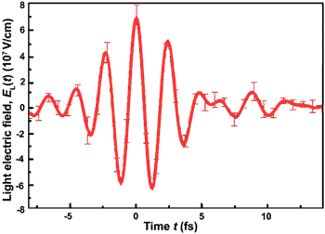
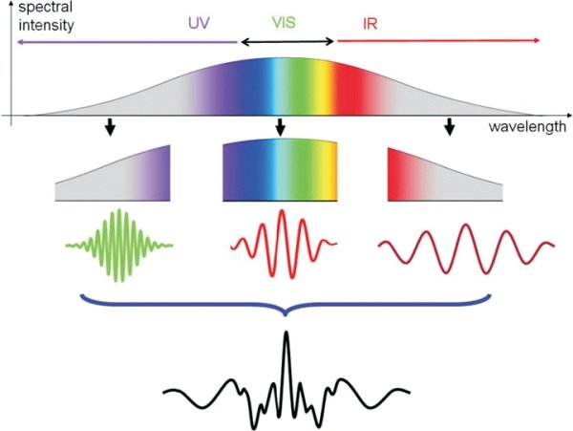
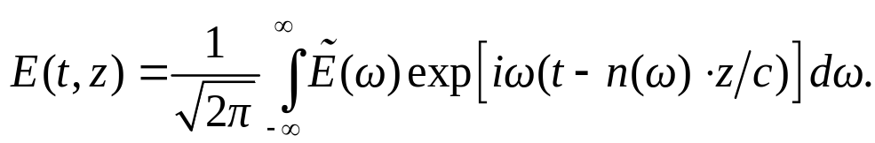

Ultrashort laser pulses
Only a few optical cycles under the pulse envelope
Spectral intensity
UV
VIS
IR
Wavelength
Where the spectral phase is
Fourier analysis suggests that short
pulses have broadband spectra

Slide 5
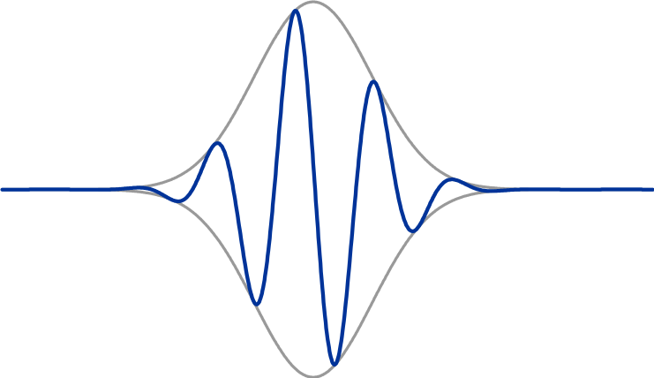
Phase relations of ultrashort pulses
Carrier-envelope phase: relation between the carrier wave and the pulse envelope.
Carrier wave
E-field
Envelope
Propagation time
Use of CEP stabilized pulses
Attosecond physics and high-harmonic generation
High precision optical frequency and time measurements (by stable ”frequency-comb”)
High precision refractive index measurements
Calibration of astronomical mirrors

Slide 6
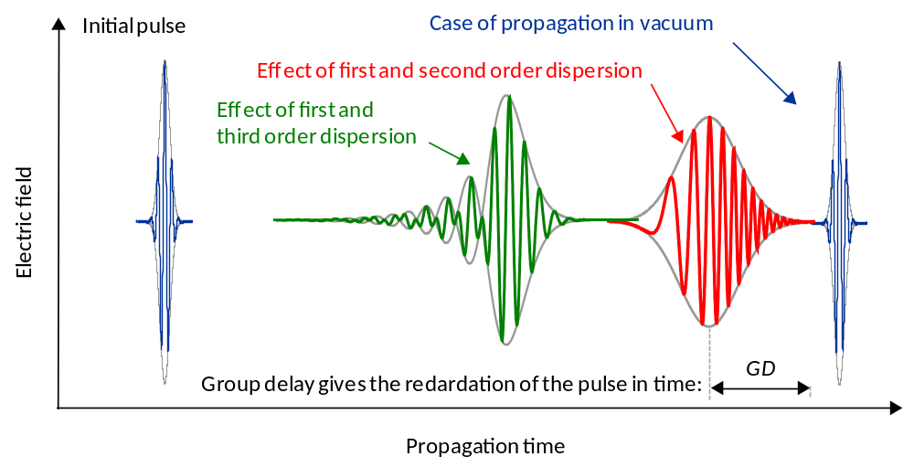
Time-domain pulse distortions
Dispersion of the spectral phase related strongly to the pulse shape:

Slide 7
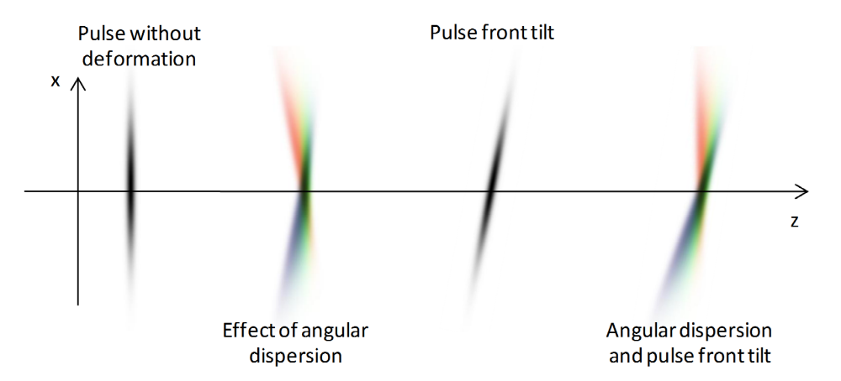
Space-domain pulse distortions
Spectral components of the pulse propagate to different directions
Various spatiotemporal pulse deformations
Also possible to tailor the pulse length in a controlled way:
stretcher-compressor systems of chirped pulse amplifiers

Slide 8
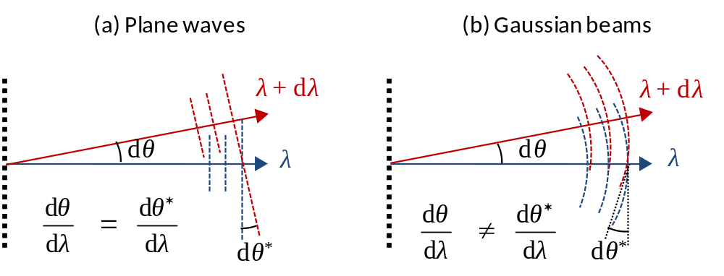
Space-domain pulse distortions
Two different definitions of angular dispersion
Propagation direction of spectral components
Spectral phase fronts of spectral components
Same for plane waves
Different for Gaussian beams, phase front angular dispersion
slowly diminishes during propagation

Slide 9
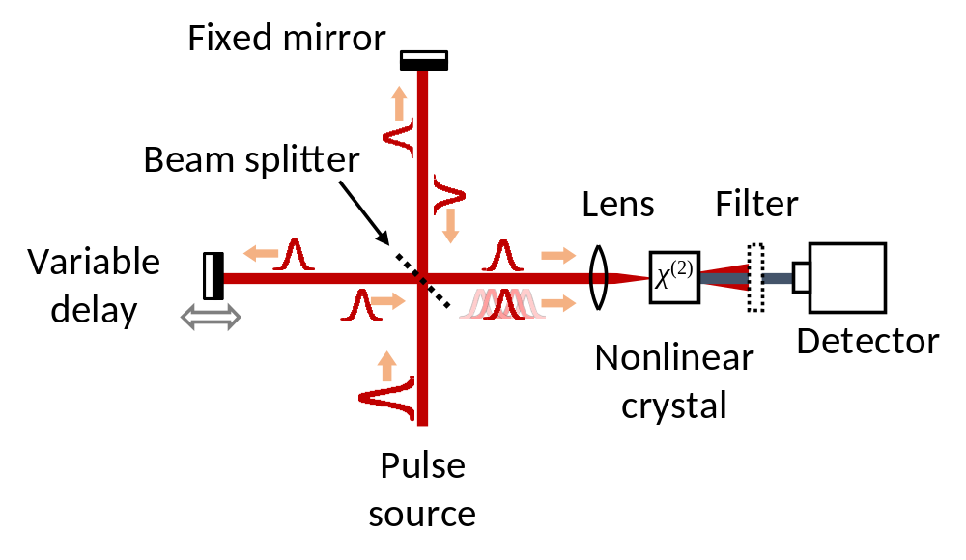
Self-referenced pulse measurements
Based on frequency conversion of the autocorrelation signal
Typical methods: FROG, SPIDER, WIZZLER, etc.
Requires nonlinear process
Usually difficult and iterative algorithms

Slide 10
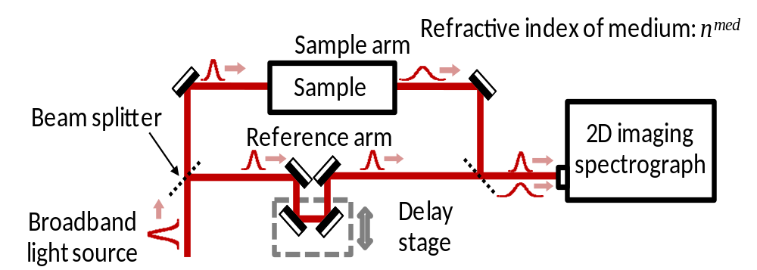
Linear optical methods
Spectrally (and spatially) resolved interferometry
Based on the combination of a two-beam interferometer and an imaging spectrograph
No need for nonlinear processes
Easy and straightforward algorithm
High precision easily achievable
In some cases, it is restricted to measure relative values only

Slide 11
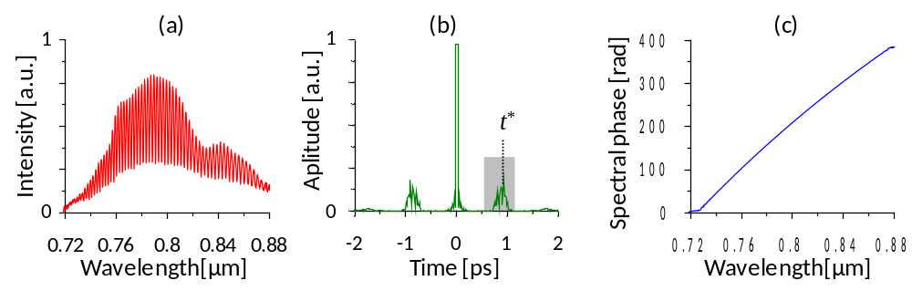
Fourier-transformation algorithm
Evaluation is based on Fourier-domain filtering
Record the spectrally resolved interferogram
Keep only the relevant part in the Fourier domain
Apply inverse Fourier-transformation
Complex angle of the received spectrum gives the phase
Phase derivatives calculated from polynomial fitting

Slide 12
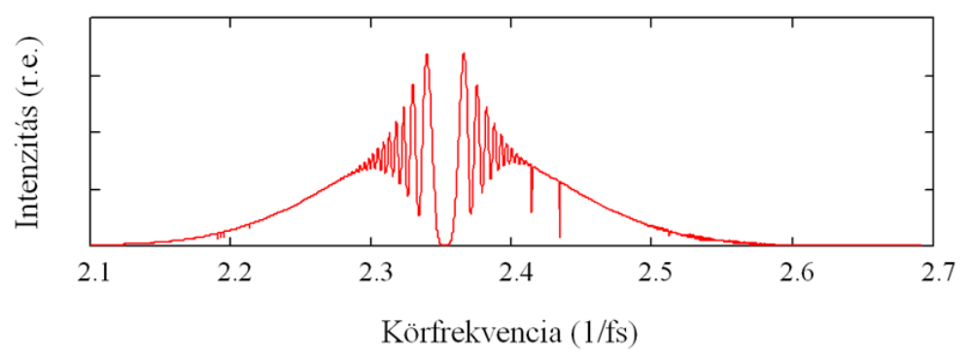
Stationary Phase Point Method
Effective when the sample pulse is much longer than the reference
Can be used to characterize stretchers/compressors
Short pulse is only coherent in a small spectral region
Stationary phase point is where the modulation minimal
SPP can be scanned through the spectrum by changing the delay of the reference pulse
Delayed between the edges of the spectrum tells the length of the stretched pulse
Intensity (a.u.)
Wavelength (nm)

Slide 13
Spectrally and spatially resolved interferometry
A bit more general description of the SRI
Based on the combination of a two-beam interferometer and an two-dimensional imaging spectrograph
A small angle between the incoming beams at the spectrograph’s slit helps the algorithm and visualizes the spectral phase

Slide 14
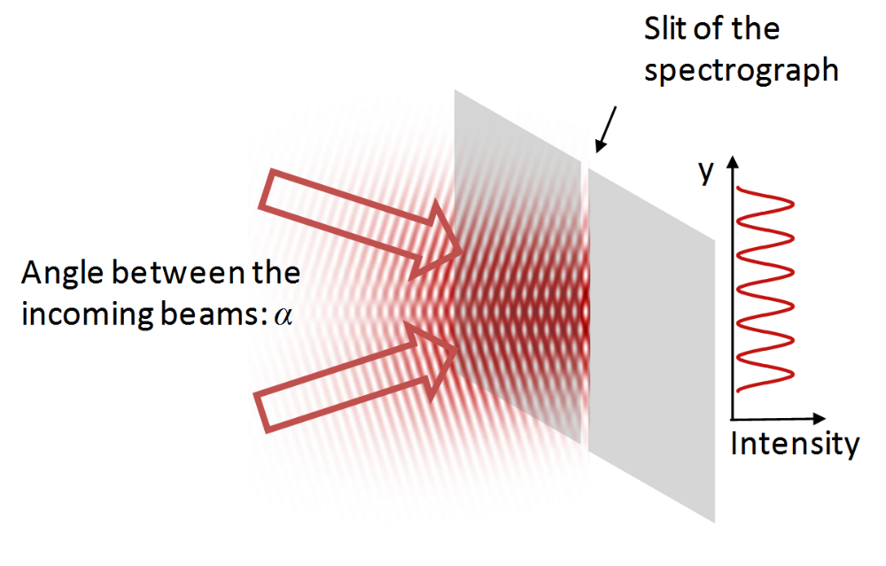
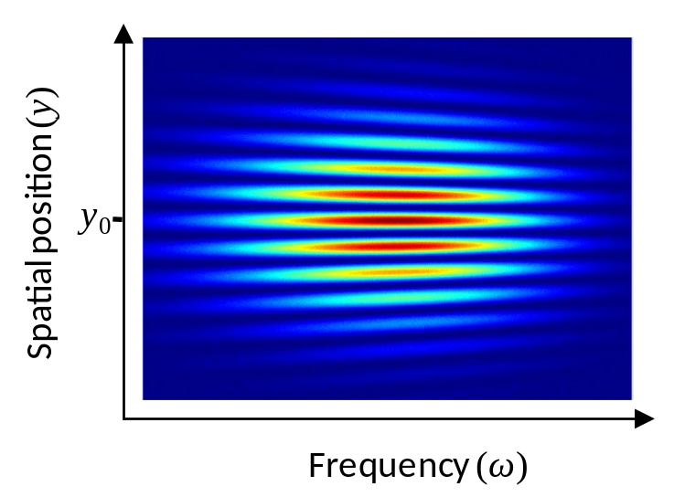
Spectrally and spatially resolved interferometry
A bit more general description of the SRI
Based on the combination of a two-beam interferometer and an two-dimensional imaging spectrograph
A small angle between the incoming beams at the spectrograph’s slit helps the algorithm and visualizes the spectral phase

Slide 15
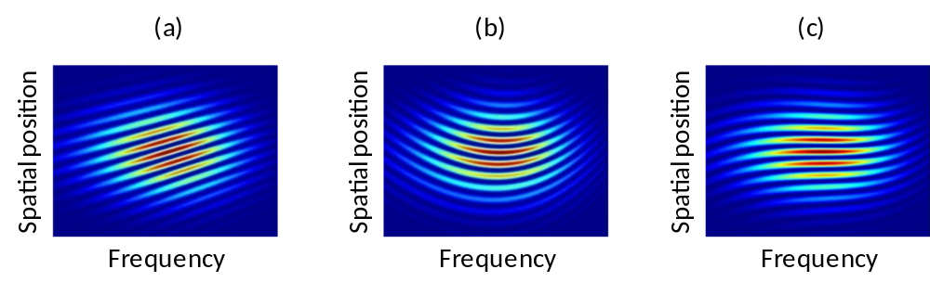
2D Fourier-transformation algorithm
The 2D implementation of the Fourier-domain filtering works well
The shape of the spectral phase translates directly to the shape of the fringes
First order dispersion only (group delay)
Second order dispersion only (group delay dispersion)
Third order dispersion only (third order dispersion)

Slide 16
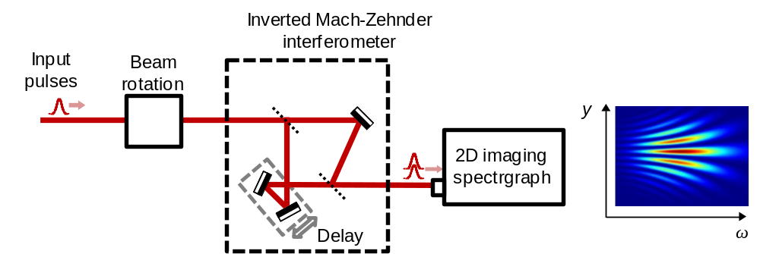
Angular dispersion measurement
Slight modification of the general SSRI setup
The interfering beams are mirrored (e.g. one more reflection)
Spectral density of the fringes correspond to the angle between the interfering beams
If the beam has angular dispersion, the mirroring effect doubles the spectral dependence of the phase front direction
The absolute phase front angular dispersion can be measured

Slide 17
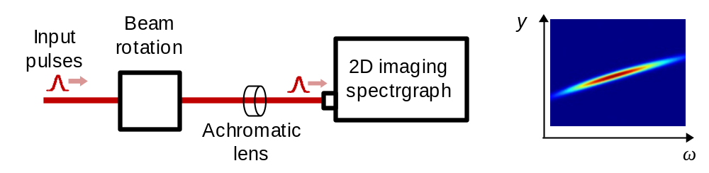
Alternative angular dispersion measurement
Requires a 2D spectrograph, a beam rotation stage and a focusing element only
Focus the beam onto the slit of the spectrograph
The angle of the spectral components translated to position
Spectral components with different position means angular dispersion
Spectrograph resolves the beam spectrally
The tilt of the spectrogram tells the angular dispersion
Polarization (beam orientation) rotation needed for full characterization

Slide 18
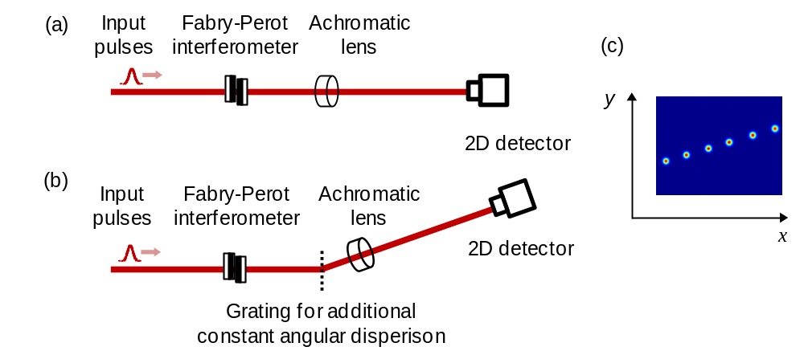
Alternative 2D angular dispersion measurement
Neither spectrograph, nor beam rotation needed
Calibrated spectral filtering (e.g. Fabry-Perot etalon) creates well defined, separated spectral peaks
Focusing element translates angle into position
Spot distances gives the angular dispersion in 2D

Slide 19
Phase relations of ultrashort pulses
Carrier-envelope phase: relation between the carrier wave and the pulse envelope.
Carrier wave
E-field
Envelope
Propagation time
Use of CEP stabilized pulses
Attosecond physics and high-harmonic generation
High precision optical frequency and time measurements (by stable ”frequency-comb”)
High precision refractive index measurements
Calibration of astronomical mirrors

Slide 20
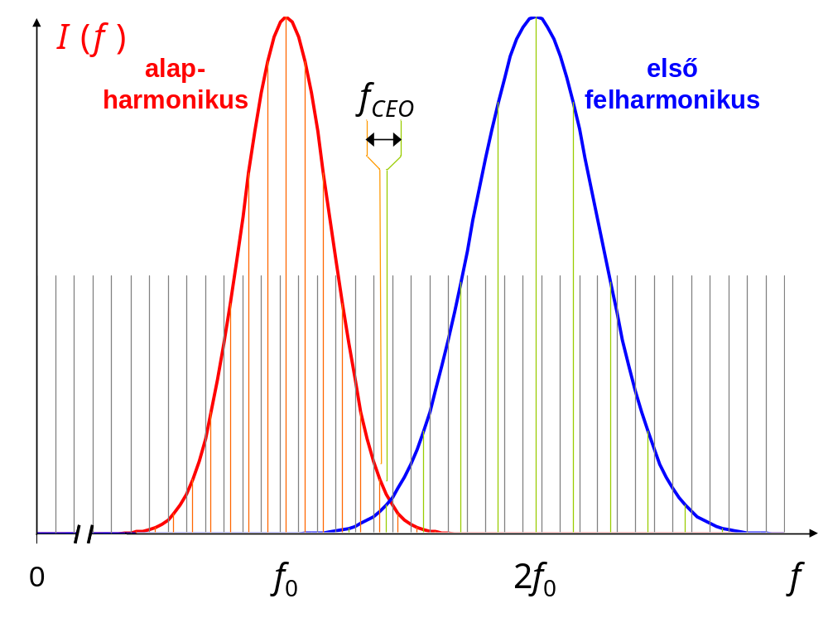
Methods to measure CEP drift
The f-to-2f scheme – the nonlinear way
f ₁ = f_{CEO} + n ·f_{rep}
Original
frequency comb
Second harmonic
frequency comb
f ₂ = 2 · ( f_{CEO} + m ·f_{rep} )
f _{beat} = f₂ – f₁ = f_{CEO}
φ_{CEO} = 2π · f _{CEO} / f _{rep}
Requirements:
Octave-broad bandwidth
2nd harmonic generation
H.R. Telle et al., Appl.Phys. B. 69, 327 (1999).

Slide 21
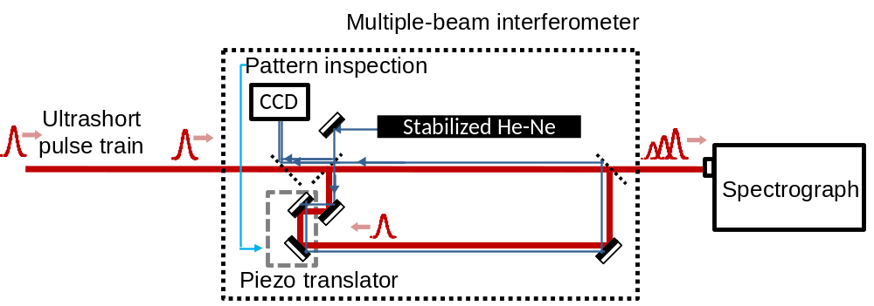
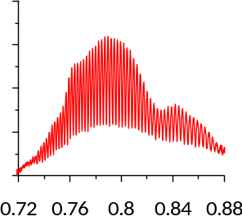
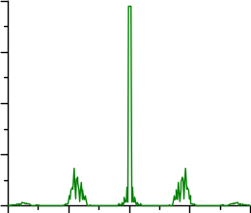
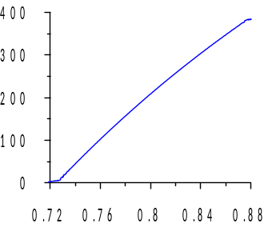
Methods to measure CEP drift
Multiple-beam interferometer – the linear way
Detection:
Spectrally resolved interfero-
metry of subsequent pulses
Length stabilization:
Pattern inspection of a frequency-stabilized HeNe
K. Osvay et al., Opt.Lett. 32, 3095 (2007).
Evaluation steps:
Record interference pattern
FFT and filter the spectrum
Inverse FFT
Complex angle gives the
spectral phase difference
Fitting Taylor-series
Calculate CEP = φ₀ – GD·ω₀
1
(a)
1
(b)
(c)
Intensity [a.u.]
Aplitude [a.u.]
Spectral phase [rad]
0
0
Wavelength[μm]
-2
-1
0
1
2
Time [ps]
Wavelength[μm]
L. Lepetit et al., JOSA B 12, 2467 (1995).

Slide 22
Methods to measure CEP drift
Multiple-beam interferometer – the linear way
Detection:
Spectrally resolved interfero-
metry of subsequent pulses
Length stabilization:
Pattern inspection of a frequency-stabilized HeNe
Linear
Scalable
Bandwidth independent
UV and far infrared lasers
Applicable to a wide range of lasers:
(sub-)picosecond lasers

Slide 23
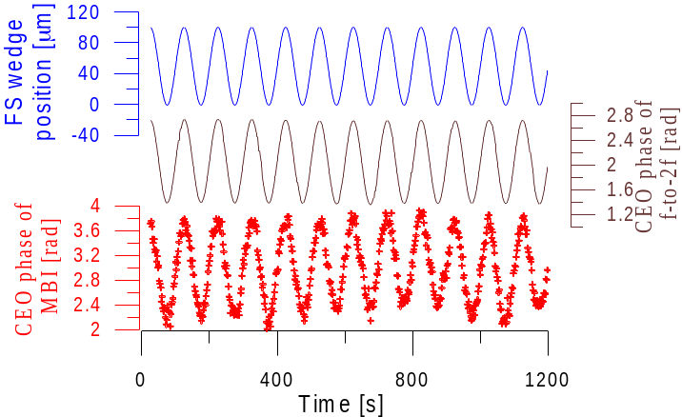
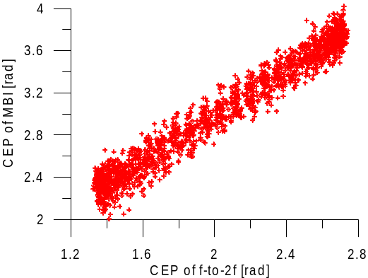
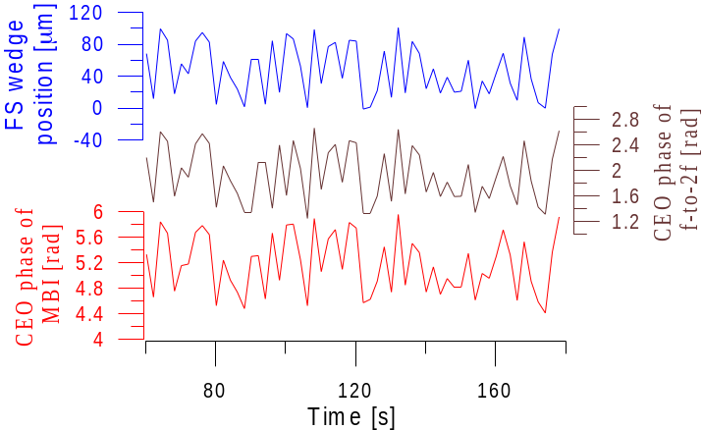
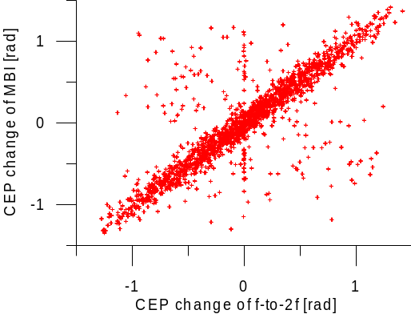
Cross-calibration with f-to-2f method
Sinusoidal intracavity modification of CEP drift
Random intracavity modification of CEP drift
P. Jojart et al., Opt.Lett. 37, 836 (2012).

Slide 24
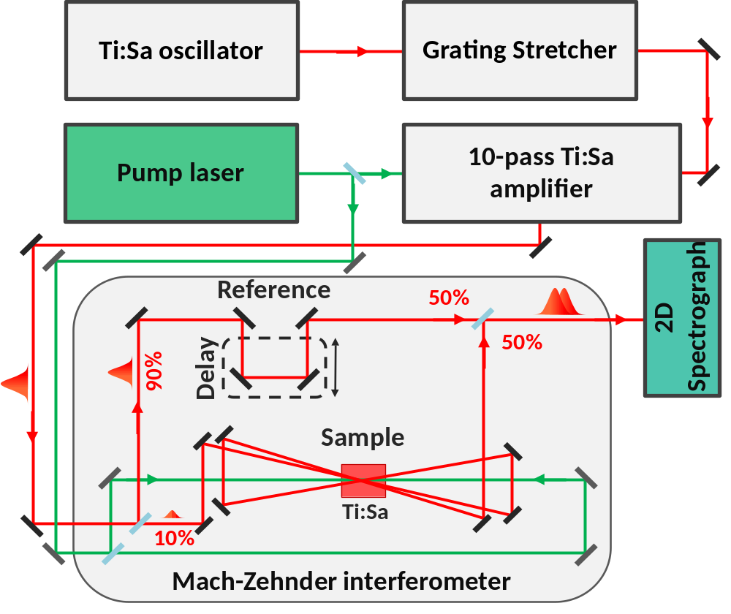
CEP drift noise in a Ti:S amplifier
Spectrally resolved interferometry – relative CEP change
General setup of the measurement (Mach-Zehnder interferometer)
Method: Spectrally Resolved Interferometry (SRI)
Main source of CEP change: Ti:S amplifier crystal
Measuring the change in CEP between non- and amplified pulses

Slide 25
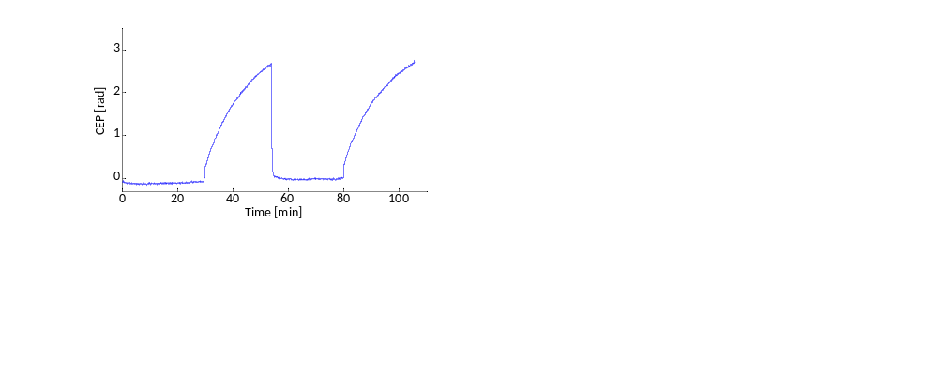
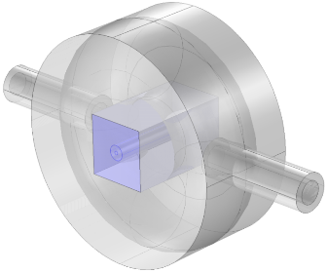
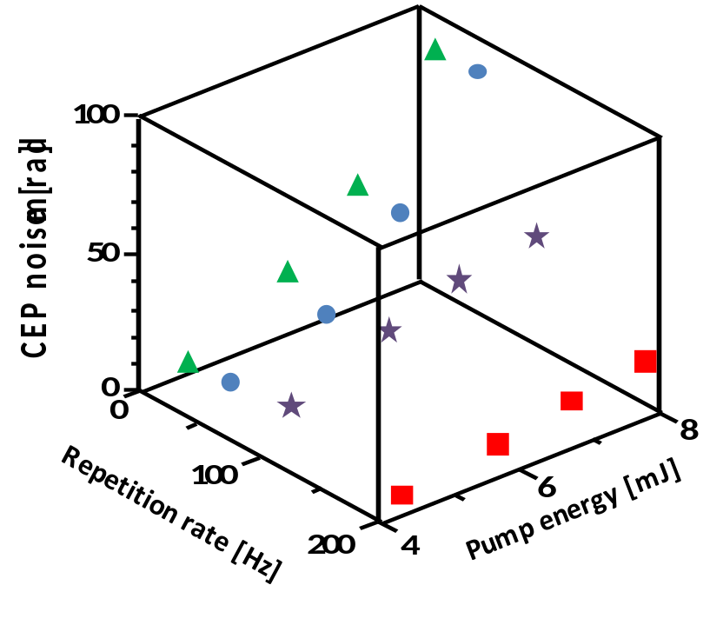
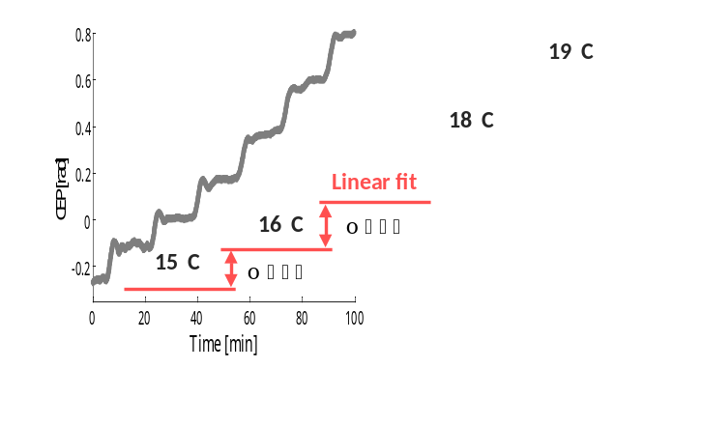
CEO noise and drift measurement
Effect of crystal cooling on CEP stability:
Coolant temperature:
Crystal cooling mount
Cooling
Cooling OFF
Cooling
Cooling OFF
Copper housing
CEP [rad]
14 mm long Ti:Sa
Cooling water
Time [min]
CEP noise:
Temperature values are related to the cooling water

Slide 26

Further developments
Spectrally resolved interferometry is an efficient linear optical method of ultrashort pulse measurement
Most effective if used together with self-referenced characterization techniques
Thank you for your attention!
Acknowledgements:
This research was supported by the European Union and the State of Hungary, co-financed by the European Social Fund in the frameworks of TÁMOP 4.2.4. A/2-11-1-2012-0001 ’National Excellence Program’ and TÁMOP 4.2.2.A-11/1/KONV-2012-0060 – „Pulse lasers for use in materials science and biophotonics” and „TÁMOP-4.2.2.C-11/1/KONV-2012-0010 – „Supercomputer, the national virtual laboratory”.

Slide 27
Let Us Meet Again
We welcome all to our future group conferences of Omics group international
Please visit:
www.omicsgroup.com
www.Conferenceseries.com
http://optics.conferenceseries.com/

