Slide 1

Role of antioxidants and polyphenols in thrombosis and haemostatic function
Abishek Santhakumar, PhD
Lecturer & Course-coordinator - Pathology
School of Medical and Applied Sciences

Slide 2
Overview
Introduction
Platelet activity & Thrombosis
Aim
Methodology
Study overview
  Study 1: Taurine and Caffeine
  Study 2: Hippuric acid
  Study 3: Plums, Prune AOX & thrombosis
  Study 4: Plum AOX & Oxidative stress
Conclusion
Acknowledgements

Slide 3
Introduction
Oxidative stress – pathogenesis of thrombotic/metabolic conditions
Free radicals promote platelet hyperactivity ➔ thrombosis
Endogenous/Exogenous antioxidants – cardio-protective (anti-thrombotic properties)
Dietary polyphenols/phytochemicals
  Free radical scavenging and chelation of metal ions
  Reduce platelet activation & aggregation
  Potential substitute or complement anti-platelet therapy ??
A.B. Santhakumar, A.C. Bulmer, I. Singh (2014). A review of the mechanisms and effectiveness of dietary polyphenols in reducing oxidative stress and thrombotic risk. Journal of Human Nutrition and Dietetics, 27 (1), 1-21.

Slide 4
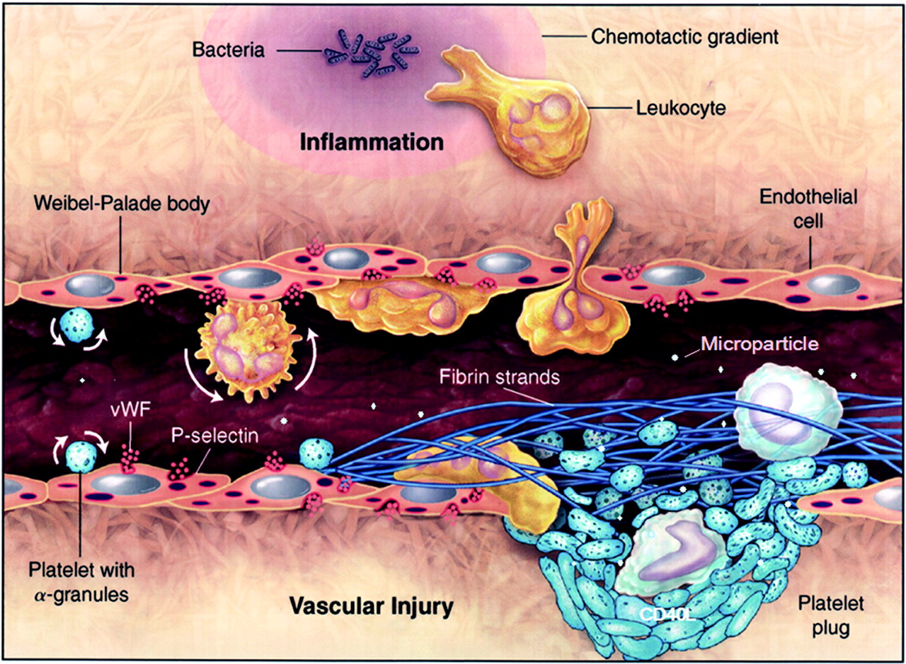
Platelets and Thrombosis

Slide 5
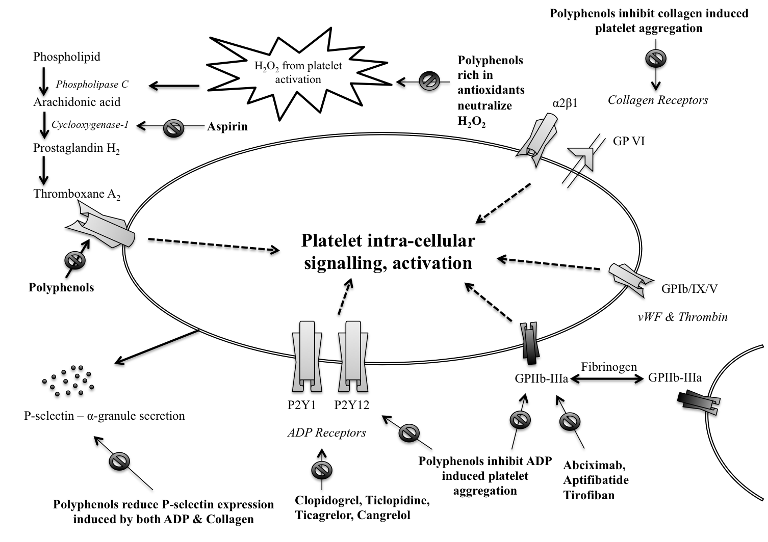
Antioxidants vs. Antiplatelet therapy

Slide 6
Aim
To find a natural dietary phenolic compound/antioxidant which may help reduce the risk of thrombosis or complement current anti-platelet therapeutics

Slide 7
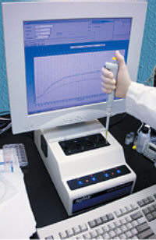
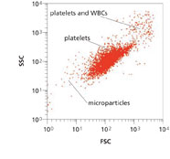
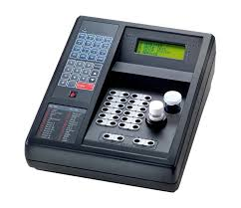
Methodology
Full blood examination
Biochemical profile
Platelet aggregometry
Coagulation factor assays
Flowcytometry – activation-dependent platelet surface marker expression
Total polyphenol/antioxidant content – plasma & urine
OS markers

Slide 8
Study 1: In-vitro effects of Taurine and Caffeine
N=15 (healthy volunteers)

Slide 9
Study 1: continued….
A.B. Santhakumar, N. Fozzard, A. V. Perkins, I. Singh (2013). The synergistic effect of Taurine and Caffeine on platelet activity and haemostatic function. Food and Public Health, 3 (147-153).
A.B. Santhakumar, M.D. Linden, I. Singh (2012). Taurine in lower concentration attenuates platelet activity. Food and Public Health, 2 (58-64).

Slide 10
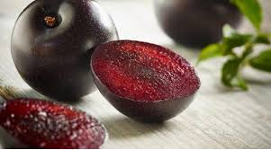
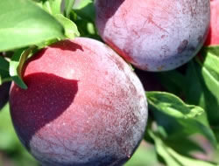
Study 2: Hippuric acid and platelet activation
Potential active metabolite after Queen-Garnet plum consumption
8 times more antioxidant content than any plum variety
Tasty
Available the year throughout
Anthocyanins ??
High urinary Hippuric acid
Anti-thrombotic effects ??

Slide 11
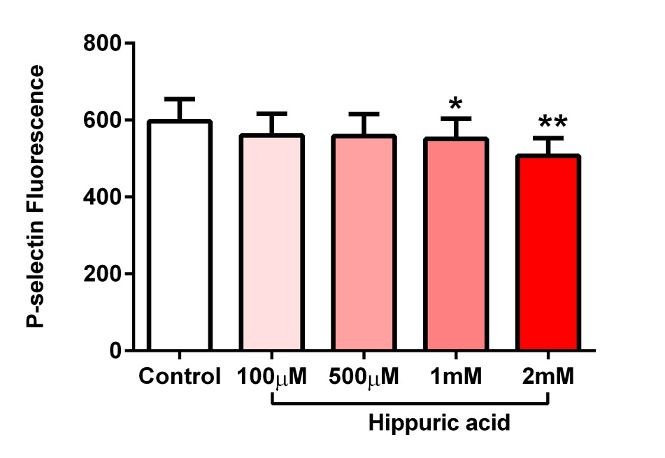
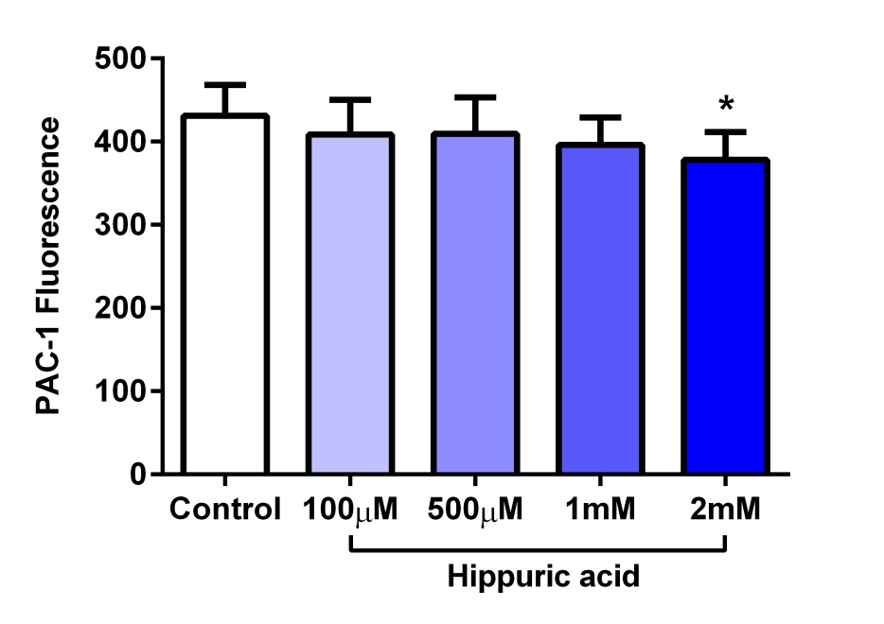
Study 2: Hippuric acid and platelet activation
N= 13 (healthy volunteers)

Slide 12
Study 3: Plums vs Prunes
To evaluate the potential of anthocyanin-rich Queen-Garnet plum juice (QGPJ) vs. commercial prune juice (PJ) supplementation in reducing risk of thrombogenesis
20 healthy volunteers
Baseline sample
QGPJ or PJ or Placebo
28 days – 200 mL/day
14 day washout
Cross-over
Post sample

Slide 13
Results – Platelet aggregation
↓ 5%, P* = 0.02
↓ 2.7%, P* < 0.001
↓ 4%, P* < 0.001

Slide 14
Results – Surface markers
↓ 17.2%, P* = 0.04
No effect on PAC-1 expression

Slide 15
Results – Coagulation
↑ 2.1 sec, P* = 0.03
↓ 7.5%, P* = 0.02

Slide 16
Results – Ox. Stress & Phenolic content
↓ 38%, P* = 0.01
↑ 60%, P* = 0.01
  A.B. Santhakumar, A.R. Kundur, K.F. Fanning, M. Netzel, R. Stanley, I. Singh (2015). Consumption of anthocyanin-rich Queen Garnet plum juice reduces platelet activation related thrombogenesis in healthy volunteers. Journal of Functional Foods. 12: 11-22.

Slide 17
Study 3: QGPJ & oxidative stress
To investigate the effect of anthocyanin-rich QGP supplementation on platelet and haemostatic activity in healthy population with and without exercise-induced oxidative stress
13 healthy volunteers
Baseline sample
QGPJ or Placebo
28 days – 200 mL/day
14 day washout
Cross-over
Baseline sample
Post-exercise sample
Post-exercise sample

Slide 18
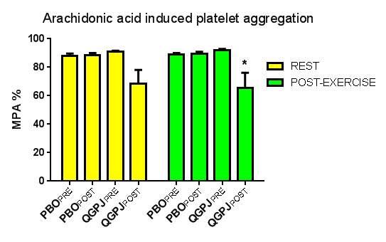
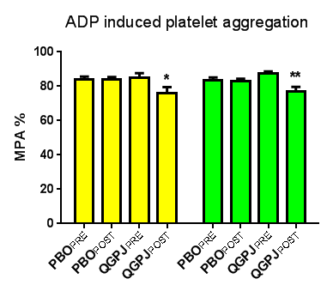
Platelet aggregation
↓ 29%
↓ 11%, 13%

Slide 19
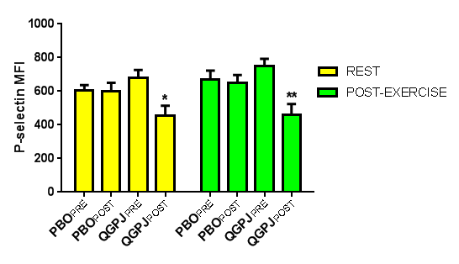
Platelet surface marker expression
↓ 33%, 39%

Slide 20
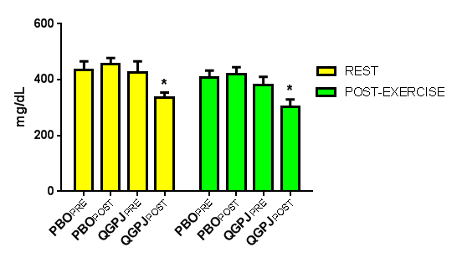
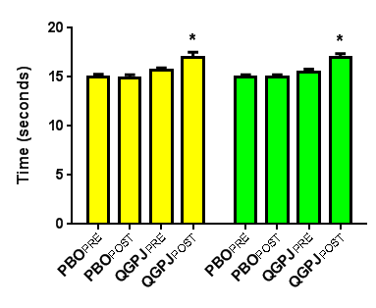
Coagulation assay
Fibrinogen concentration
Prothrombin time
↓ 21.6%, 20.6%
↑ 1.3, 1.4 sec

Slide 21
Conclusion
Natural dietary antioxidants/metabolites have the potential to reduce thrombotic risk
  Both with and without induced oxidative stress
Possible complementary anti-platelet therapeutic ?

Slide 22
Future directions
Anthocyanin-extracts/capsules in prothrombotic populations
With and without induced oxidative stress
Anthocyanins vs Antiplatelet therapy

Slide 23

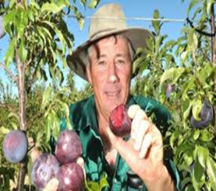
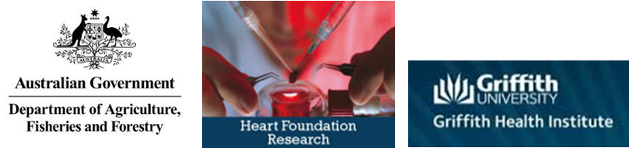
Acknowledgements
Dr. Indu Singh Program Director - MLS, Griffith University | Prof. Roger Stanley Director, Centre for Food Innovation, University of Tasmania
Dr. Michael Netzel Senior Research Fellow University of Queensland | Dr. Kent Fanning Department of Agriculture, Fisheries and Forestry, Agri-Science Queensland
Mr. Avinash Kundur Griffith University | Nutrafruit, Queensland

Slide 24
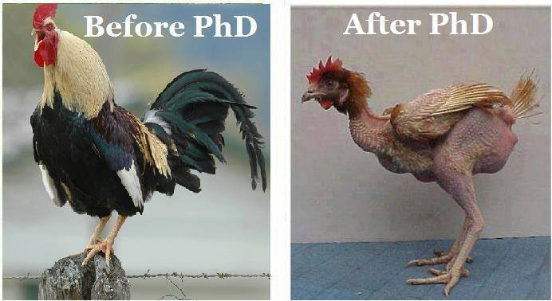
Before Research
After Research
Thank you !!!

