Slide 1


Slide 2
Guidelines and rationale of ABUTMENT SELECTION and designing IN
IMPLANT PROSTHODONTICS
Dr. Abhinav Gupta
M.D.S. , Certificate D.G.O.I.( Implants)
Assistant Professor(Prosthodontics)
Dental College , A.M.U. , Aligarh., INDIA

Slide 3
Definition
IMPLANT ABUTMENT
An abutment is a component that is intermediate between the implant and the restoration and is retained to the implant by a screw or locking taper.

Slide 4
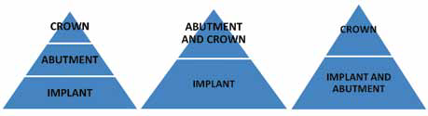
Implant Tier System
Three-Tier System Two-Tier System

Slide 5
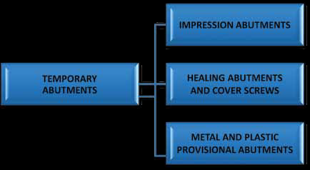
Temporary Abutment Classification
Temporary abutments are usually produced in a stock prefabricated fashion , to be used as it is or customise them as to establish tooth and gingival contours needed .

Slide 6
classification
A) Depending upon retention
- Abutment for screw retention
- Abutment for cement retention
- Abutment for Attachment
B) Depending upon angulation
- Straight abutment
- Angled abutment

Slide 7
c) Depending upon design
d) Depending upon manufacturing
Stock
Customised ( CAD-CAM , CASTED)

Slide 8
Abutments for Cement retention
Better passivity
Easier to obtain esthetics
Fewer porcelain fractures due to occlusal surface integrity
Less fatigue
Manipulation in posterior region easier with cement
Loosen less often as compared to that of screws

Slide 9
disadvantages
- Difficult to retreive unless soft cements are used.
- Gingival retraction may be needed
- When permanent cements are used evaluation and maintenance may sometimes be difficult

Slide 10
Types of abutment for cement retention
1.Single unit or one piece abutment
- does not engage antirotational hex but fits flush with the implant platform.
2. Two piece abutment
- Has one component to engage antirotational hex of implant body and the other component to fixate the abutment and implant body together.

Slide 11
Abutments for screw retention
ADVANTAGES
- Low profile of retention
- Less momentum of force
- No risk of cement in the sulcus
Easily retreivable.
DISADVANTAGES
- Loosening of the screws
- Difficulty to obtain passivity
- Difficult to obtain esthetics
Greater chances of porcelain fracture
Access to posterior regions difficult –risk of aspiration.

Slide 12
Factors that affect screw connection
1. Misfit
2. Poor abutment screw tightening
3. Excessive occlusal loading
4. Settling of screws or abutment
5. Inadequate screw design
Guidelines usually recommend the screws to be tightened by 50 – 70% of yield strength.

Slide 13
Abutment for attachment
Used as an attachment device to retain a removable prosthesis.
Includes ball abutments, mesostructure bars- continuous and non continuous
Superstructure attachments –magnets,clips,hader clips,dolder clips, ceka attachments, ERA attachments, Locators(Zest Anchors).

Slide 14
GUIDELINES FOR ABUTMENT SELECTION
A) DEPTH OF SOFT TISSUE
Vertical height form implant head to gingival margin.
Measured with periodontal probe
Labial margin of abutment is atleast 1 mm subgingival
Marked discrepancy between gingival heights around the margin – prepable abutment is indicated
Diameter close to that of cervical margin of tooth.

Slide 15
B) Implant-abutment interface geometry
Early configurations was the external hexagon incorporated in the dental implant systems. However over years it demonstrated drawbacks -
abutment screw loosening and fracture.
mechanical irritation of the tissues and ingress of bacterial toxin fluids.
negative effect on the stability of the peri-implant hard and soft tissues.
Introduction of internal hex connection many advantages
distribution of intraoral forces deeper within the dental implant
reduced stress on crestal bone, prevent excess screw loading
reduced the potential microleakage and enhanced strength of joint interface when compared with external hex design.
Furthermore, included in such effort is the “Morse” taper with more predictable clinical success rate.
Improvement in screw material science with introduction of newer screw materials (gold alloy instead of titanium)

Slide 16
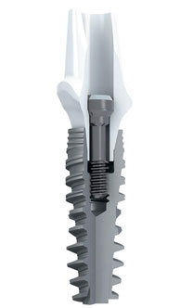
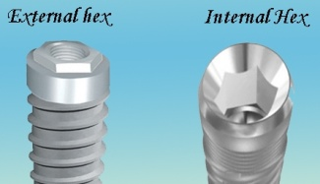
B) Implant-abutment interface geometry
EXTERNAL HEX / INTERNAL HEX
MORSE TAPER

Slide 17
Clinical recommendation
During abutment selection on the basis of implant-abutment connections, clinician should consider the topography of bone, available soft tissue characteristics, force component such as rotational, the prosthetic components required particularly for aesthetic purpose, and single-implant restoration. Finally, clinician can make a decision based on personnel choice.

Slide 18
C) Implant restorative platform
Implant restorative platforms are the interfaces for implant-abutment connections. The selection is based on the size, of the teeth that are being replaced, and diameter may be same as, or narrower than the implants.
“Platform switching” is basically, attaching restorative components with slightly smaller restorative platforms (diameter) onto dental implants.
It has been reported that marked reduction in crestal bone loss around the dental implant when platform switching technique has been applied. Moreover, the impact on the biologic width, overall bone heights of the surrounding implants and restorative stability has been reported.

Slide 19
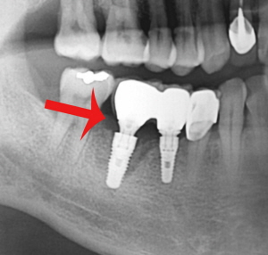
Clinical recommendation
It is a promising strategy in term to reduce or eliminate the crestal bone loss around the implant. Now, the design of dental implant, along with abutment encompasses the concept of maintaining “horizontal biologic width” through built-in platform switching.
PLATFORM
SWITCHING

Slide 20
D) Profile of healing/interim abutment
Healing abutment placement is based on the surgical technique followed i.e., immediately placed during single stage surgical procedure or later at two-stage surgical protocol to guide the healing of soft tissue to replicate the contours and dimensions of natural tooth that is being replaced and to ensure access to the implant restorative platforms for impression and definitive abutment placement

Slide 21
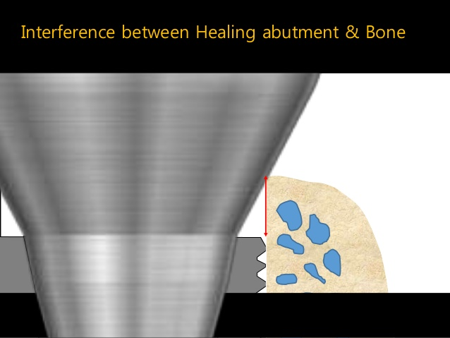
INTERFERENCE BETWEEN HEALING ABUTMENT AND BONE
BONE RESORPTION

Slide 22
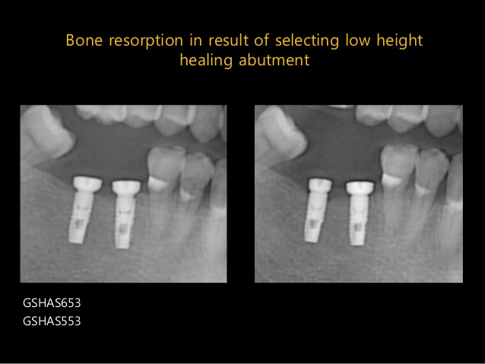

Slide 23
E) Orientation of implant
This evaluates the implant in relation to the final prosthesis and the adjacent teeth. Malpositioning of dental implant may be in any plane either vertical, mesial/distal or facial/lingual plane. These could be most common reason for using custom-processed abutments.
However, if the dental implant is placed at planned location of the teeth, prefabricated abutments may be used at predictable result and low cost.
This criterion is particularly important in deciding whether implant restoration will be screw- or cement-retained.
The main advantage of screw-retained prosthesis is easily retrieval of prosthesis in case of repair or screw loosening . In case of a cementable restoration, the angulations are not as critical since there is no screw-access opening which may interfere with esthetic and/ or function (in case of screw-retained prosthesis).
However, most anatomical variation influences the implant body angulations and hence, the abutment selection.

Slide 24
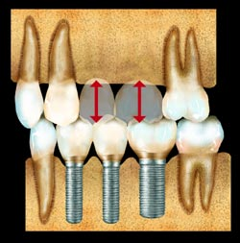
F) Interocclusal space
Interocclusal space corresponds to the vertical distance between the superior surface of the implant and the opposing dentition in maximum intercuspation. This interocclusal space is the total height available for the abutment plus the restoration. At least 2.8 mm of interocclusal space is necessary to restore an implant because of the limitations in commercially available abutments.

Slide 25
Clinical recommendations
A meticulous clinical examination including the diagnostic mounting in maximum intercuspation would facilitate recording the interocclusal space. This will later facilitate the selection of prefabricated or custom-made abutment. Hence, selection is made at initial treatment planning phase under individual clinical need.

Slide 26
G) Depth of peri-implant soft tissue
Tissue height or peri-implant sulcular depth is the distance from the superior surface of the implant to gingival margin. This is measured 6-8 weeks following Stage 2 surgery.
Ideally, in esthetically important areas the margin of the restoration is 1-2 mm subgingival. The tissue height is not as critical if the restoration is not in the esthetic zone and a supragingival margin is planned.
Clinical recommendation
In the area with optimum esthetic requirement, appropriate abutments may be used to contour the peri-implant soft tissue and to develop optimum emergence profile .

Slide 27
H) EMERGENCE PROFILE
Emergence profile allows gradual transition from
implant head and the key for this is the
interdental papilla.
Dependence on various factors
- Contouring of subgingival abutment component.
- Position of the contact point of the restoration.
- Height of the bony crest at the neighbouring
teeth.

Slide 28
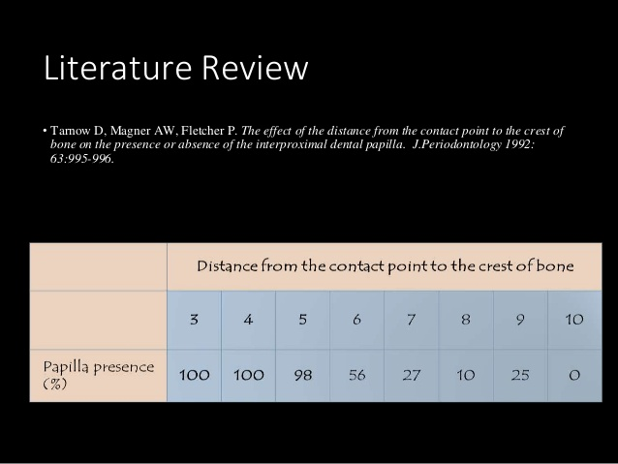
EMERGENCE PROFILE

Slide 29
EMERGENCE PROFILE
Tarnow D,Elian N,Fletcher P et al. Vertical distance from crest of bone to the height of the interproximal papilla between adjacent implants. J.Periodontology 2003;74:1785-1788.
Distance between two adjacent implants should be atleast 3 mm apart inorder to preserve interdental bone and to maintain horizontal component of biologic width.
- An average of 3.4 mm of papillary height expected ( 1- 2 mm still short)

Slide 30
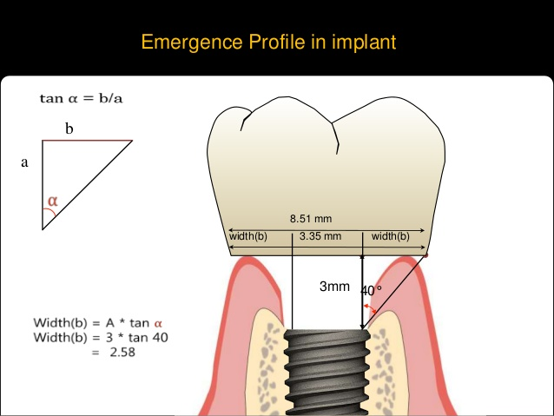
EMERGENCE PROFILE/ ANGLE IN IMPLANTS
Needs atleast 3 mm of vertical space from implant head to gingival margin

Slide 31
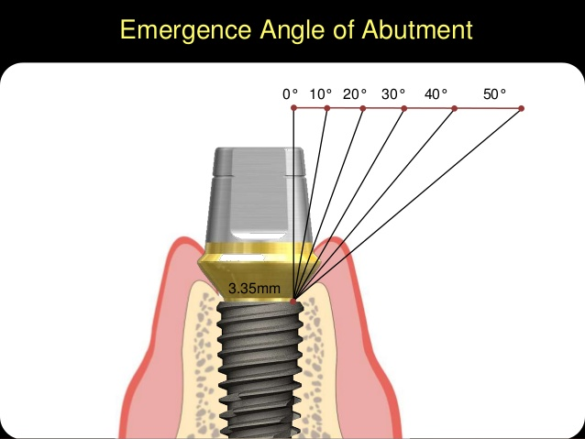
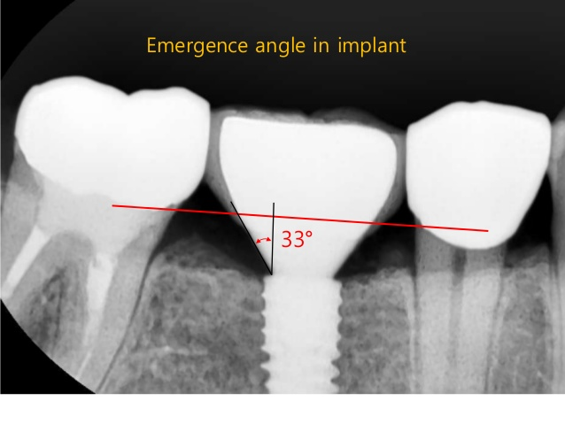
Emergence Angle
Dependent on –
Gingival cuff height.
Abutment diameter.

Slide 32
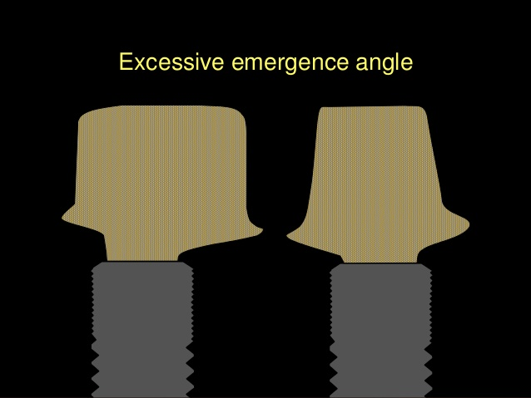
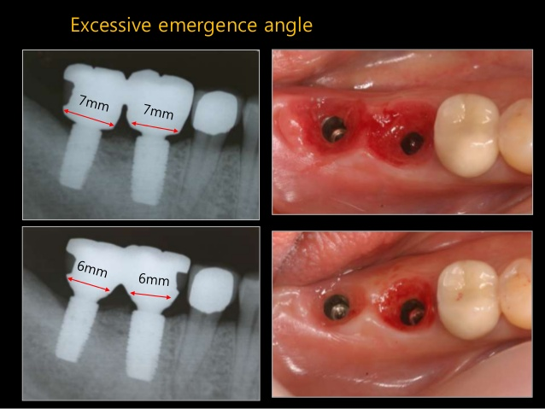

Slide 33
ABUTMENT RETENTION IN CEMENT RETAINED IMPLANT ABUTMENTS
- The retention of a fixed cemented restoration-resist removal of the retainer along the path of insertion .
- Resistance – opposes movement of the abutment under occlusal loads and prevents removal of restoration by forces in apical and oblique direction.

Slide 34
The tenets of retention and resistance include
1) ABUTMENT TAPER
- Retention of a crown decreases as the taper is increased from 6-25⁰.
- Ideal taper was recommended to be within 2-5⁰ of parallelism of path of insertion .
- Parallelism of axial walls has been recognised to be single most factor for retention.
- Eames et al – found that clinically acceptable preparation present a taper of 20⁰.

Slide 35
2) ABUTMENT SURFACE AREA
There is a linear increase in retention as the diameter increase for preparation with identical height.
- Diameter of implant abutment for cement retention is often less than 5 mm which is comparable to prepared lateral incisor – so decrease in surface area results in poorer retention than most natural abutment.

Slide 36
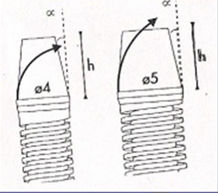
3) Abutment height
A tall preparation offers greater retention than a short abutment
Increase in height increase surface area , increased resistance to lateral forces.
Height of the abutment must be greater than the arc formed by the crown rotating about a fulcrum at the margin of the opposite side of the restoration.

Slide 37
4) Abutment surface roughness
- Surface roughness increase the retention of a restoration by creating microretentive irregularities into which the luting agent projects.
Surface roughness retention is dependent upon the type of burs along with the type and thickness of luting agents.
Large size cross cut fissure bur reduces height and gross reduction of metal abutment post .
Coarse diamond increase amount and depth of scratches on the surface to more than 40 micrometer.
- Internal aspect of the casting should be air abraded with 50 micrometer alumina to enhance retention by 64%.

Slide 38
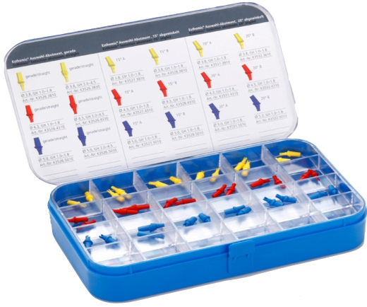
ABUTMENT TRY IN KIT
Provides replicas of abutment types that can greatly assist abutment selection.
Tried intraorally or on a cast.
Made up of aluminium / Silicone rubber
Color coded for easy recognition.
Used for better screw access position , marginal height and emergence.

Slide 39
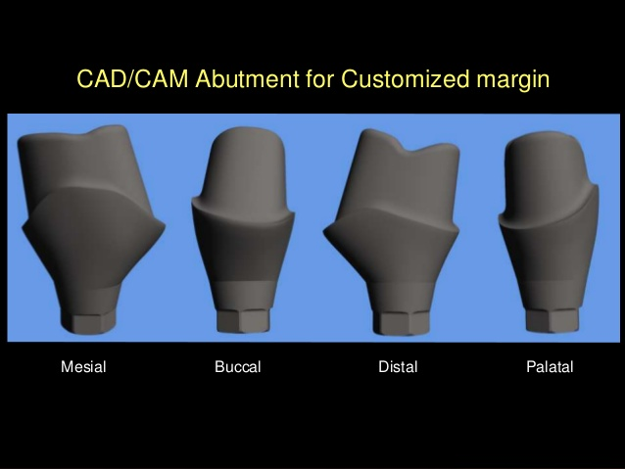
CAD-CAM ABUTMENT VS STOCK ABUTMENT
CUSTOMISED ABUTMENT
Milling Titanium to create and customize abutment applying CAD/CAM technology instead of casting metal from wax up using traditional UCLA abutment.
Patient specific abutment solution
Ideal for optimised function , esthetics and simplicity.

Slide 40
PROBLEMS WITH STOCK ABUTMENT
When path of insertion is compromised.
Lack of retention in case of short clinical crown height.
Difficult to reproduce gingival scallop shape.
Removing cement in subgingival margin could be difficult.
Increase chairtime due to adjustment of abutment during insertion.
Limited length for abutment and collar.
Limitation of Milling.

Slide 41
Problems with ucla abutment
Increase overhead due to gold usage.
Expensive.
Casting error.
Biocompatibility is less than titanium.
Highly dependent on skilled lab technicians.

Slide 42
VIRTUAL DESIGN AND MANUFACTURE OF ABUTMENTS(ATLANTIS )
Previous CAD-CAM : WAX –SCAN –MILL approach
A manufactured custom abutment is first virtually created within the design software by virtual tools before it is machine milled. Before the virtual design process can start, a non-virtual implant master cast must be fabricated. The master cast contains all the implant analogs (that reproduce the intra-oral implant placements) surrounded by a removable soft tissue reproduction.
Soft tissue removability allows for fit and placement evaluations of the final custom abutments.
The abutment bases are fabricated anatomically wider than the implant body and the intra-oral periimplant sulci.

Slide 43
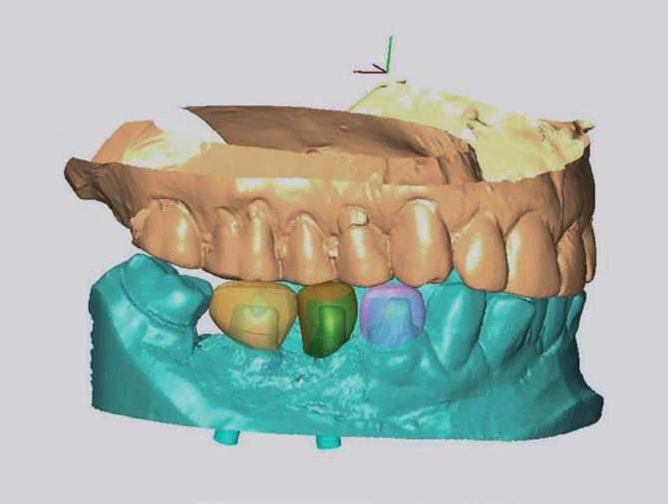
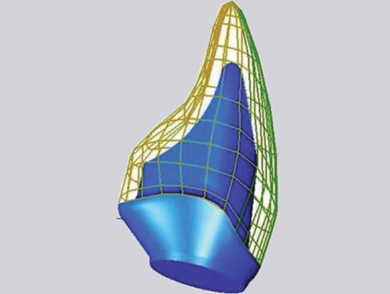
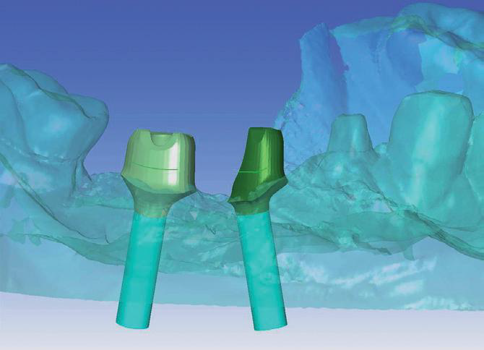
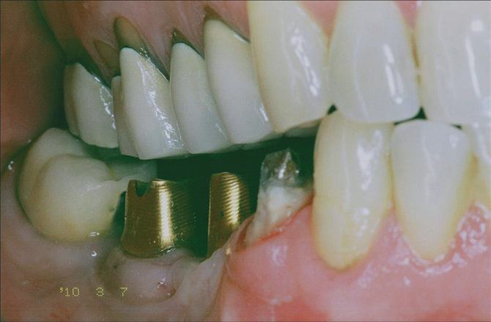
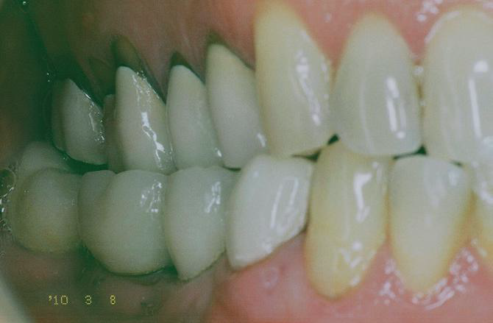
VIRTUALLY OCCLUDED MODEL
VIRTUAL ABUTMENT DESIGNING
PARALLELING ADJACENT
ABUTMENTS VIRTUALLY
MACHINED ABUTMENTS
CROWNS CEMENTED

Slide 44
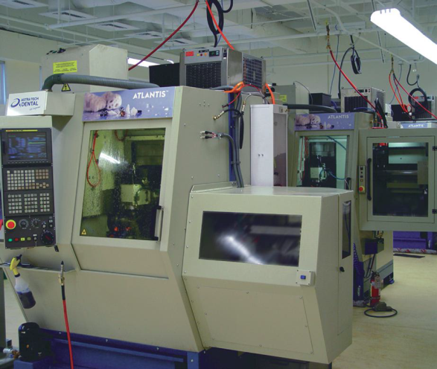
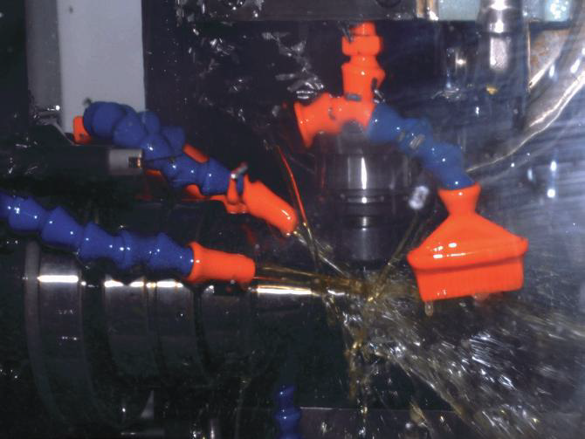
machine milling and finishing
Custom abutments are milled from titanium or ceramic rods, once the virtual design of the abutment is completed. The digital abutment files guide the cutting tools of the milling machines in 6 degrees of freedom through the differing abutment material(s) to manufacture a finished custom abutment.
MACHINE MILLING

Slide 45
VISUAL INSPECTION AFTER MILLING
Key aspects of metallic abutment manual Inspection
• Machine surface finish
• Fit of the abutment interface
• Geometric inspection
• Presence of burrs and surface irregularities
• Comparison of the manufactured abutment to approved virtual abutment design
• Complete coverage of the abutment with the TiN coating
Inspection features specific to Zirconia abutments
• Proper color and shade
• Inspection for surface defects

Slide 46
Ordering an Atlantis Patient-specific Abutment -
CLINICIAN’S INPUT
Implant brand type: Tooth No. / Implant brand / Specific platform.
Duplicate abutments : serve as master die to enhance lab accuracy.
Restoration type : screw retained / cement retained.
Splinted Restoration : should be indicated so that all abutment made perfectly parallel.
Abutment material : Ti / Ti N / Zirconia .
Surface Design : Smooth wall / Retentive grooves
Margin Design : define subgingival depth of margin based on esthetics.

Slide 47
ADVANTGES OF CAD-CAM ABUTMENT OVER STOCK ABUTMENT
Abutments are precision created by smart software requiring no lab technician skill or knowledge to obtain an optimally shaped custom abutment.
surface characteristics of a virtually design abutment are superior to cast abutments because each abutment is precision milled and highly mechanically polished.
Each abutment is a one-piece entity with no abutment cylinder–alloy interface utilized. Therefore, abutments have higher mechanical tolerances for compromised implant placement alignment orwhen employed in tissue-deficient areas.
It is easy to have precise duplicates made, giving the lab technician the exact shape of abutment that the patient needs. Duplicate abutments eliminate any inexact stone reproductions obtained through conventional impression procedures. Crown–abutment fit is therefore improved.
Any compromised abutment contours can be virtually modified to improve the abutment regardless of abutment material used (e.g. zirconia, gold hue, titanium).
Because the machining process is completely software driven and occurs irrespective of the chosen abutment material, any future abutment materials developed (e.g. lithium disilicate, composites) will easily fit into the manufacturing process.

Slide 48
DISADVANTAGES : CAD/CAM solutions not including
Atlantis virtual design
Very labor intensive and requiring highly skilled technicians.
Difficult to ensure passive insertion and parallelism due to the need for wax-up.
Potential inconsistency of the final result due to the dependency on the individualized skill of the technician and the quality of the manual wax-up.
Most abutment systems create the final abutment utilizing an “inside-out approach” where the design focuses on the abutment rather than basing the design on the final tooth shape.
Traditional CAD utilizes individual “points” for adjusting abutment design that do not simultaneously result in improvement changes in other areas of the abutment.
In contrast to traditional CAD, the Atlantis virtual design software employs a parametric design model where appropriate changes in any one abutment contour will automatically alter related parameters, resulting in a cohesive abutment design.

Slide 49
ABUTMENT RELATION TO PERIIMPLANT TISSUES.
CONTOURING THE SOFT TISSUE WITH PROVISIONAL AND
CUSTOM IMPRESSIONS
In order to optimize esthetic outcomes, it is essential,for most sites, to place a provisional restoration onto the implant subsequent to healing.
Customisation to facilitate the maturation and stabilization of peri-implant soft tissues. These procedures are the most predictable and practical method of insuring a natural esthetic soft tissue profile.
The peri-implant tissues in the esthetic zone are often deeply scalloped, making predictable excess removal impossible.
Desired peri-implant soft tissue profile can be achieved with the provisional restoration, an accurate cast of the emergence profile should be made .
A customized impression coping that duplicates the new sulcus form can be made with a two-stage process.
Custom abutments can be either waxed and cast onto machined cylinders or machined from titanium or zirconia using CAD,or copied from a waxed form .

Slide 50
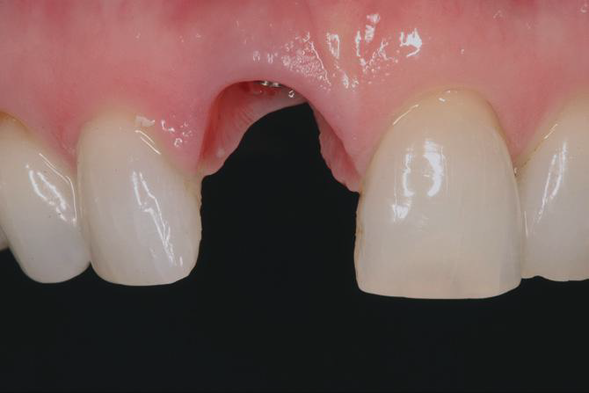
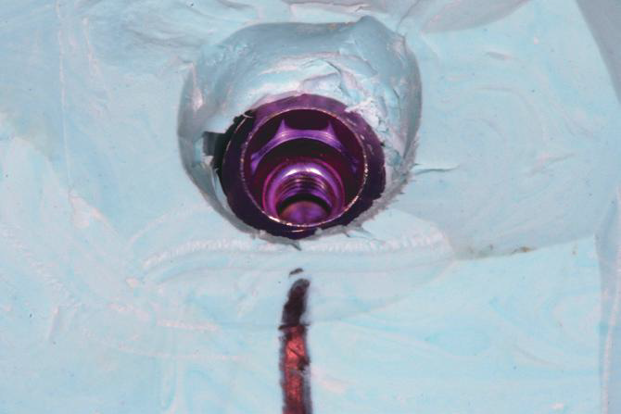
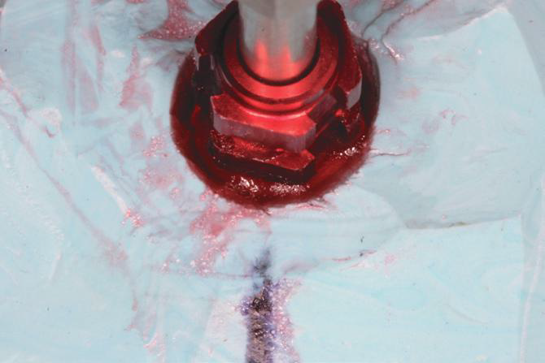
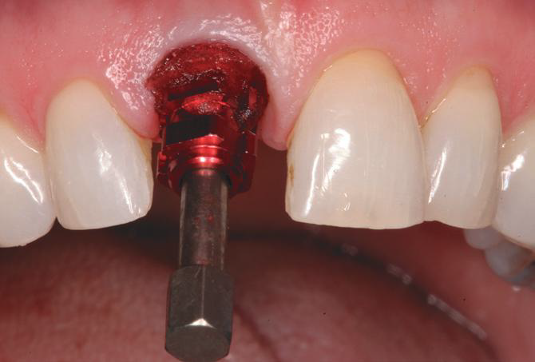
CUSTOMISED IMPRESSION COPING TO RECORD PERI-IMPLANT TISSUE
I
II
PERI-IMPLANT SOFT TISSUE TRANSFERRED INTO PUTTY AFTER
SCREW RETAIN TEMPORARY CROWN REMOVAL ( I, II )
III
IV
B) A FLOWABLE RESIN (GC PATTERN RESIN ) WAS USED TO CUSTOMIZE THE
IMPRESSION COPING WITH THE EMERGENCE PROFILE.( III, IV)

Slide 51
TREATMENT PLAN based selection
Single tooth implant abutment
Fixed/ Fixed detatchable prosthesis-
Implant Overdentures
( Retained / supported)
( Resilient / Rigid)

Slide 52
Single tooth implant abutment
OPTIONS
Two piece esthetic / anatomic abutment( Ti,Zr)
Two piece Regular abutment
Single piece standard /easy abutment(Solid)
Two piece custom abutment

Slide 53
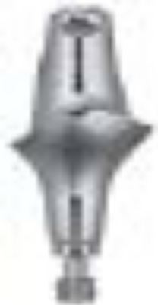
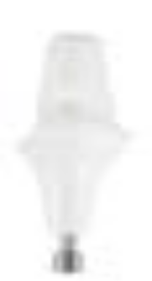
Two piece esthetic / anatomic abutment( Ti,Zr)
For use in single tooth / multiunit splinted restoration specially in esthetic zone.
Minimum interocclusal distance of 4.5 mm + restoration thickness is required.(approx. 7 mm from opposing occlusion)
Stay atleast 1.5 mm away from conical connection.
Leave minimum wall thickness of 1 mm from the screw channel to outer diameter of abutment.
Premachined scalloped margins simplify abutment preparation . In addition abutment may be prepared further if needed.
Ti
Zr

Slide 54
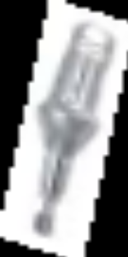
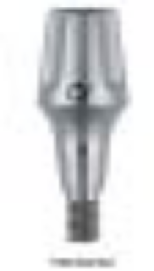
TWO PIECE REGULAR ABUTMENT
- Non anatomic with premachined margins but without Scalloping .
- Sufficient wall thickness to allow customisation by technician .
For use in non esthetic zone or in anterior areas with low height of interdental gingiva.
Space requirement same as esthetic abutment.
SINGLE PIECE STANDARD /EASY ABUTMENT(SOLID)
Solid piece abutment can be used in high
stress situations.
Can not be customised by dentist / technician
ONE TIME ONE ABUTMENT CONCEPT

Slide 55
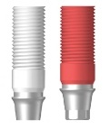
TWO PIECE CUSTOM ABUTMENT (UCLA ABUTMENT)
-Indicated for esthetic custom restorations with a good emergence profile that attach directly to the implant.
Can be used in cases of limited restorative space as there is no intermediary abutment.
A minimum interocclusal distance of 4.5 mm for SD and RD AND 5 mm for the WD UCLA abutments is required between the implant prosthetic table and the top of abutment screw when seated.
Options for both locking and non locking available.
Parallelism can be obtained among implants which are not parallel.

Slide 56
Fixed, fixed detatchable restorations
Criteria for selecting PFM or Hybrid Prosthesis
Porcelain Fused to Metal Hybrid Prosthesis
• cost more cost less
• vertical dim < 15mm vertical dim >15
• technique same technique same
• esthetics same esthetics same
• appointments more appointments less
• soft tissue recon difficult soft tissue recon easy
• repair very difficult repair easy
• arch length varies arch length 1st molar Source: Dental Implant Prosthodontics,
Dr. Carl Misch 2005

Slide 57
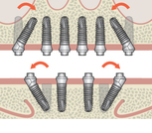
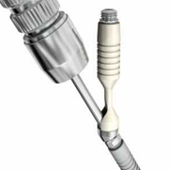
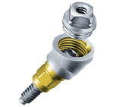
SMARTFIX ABUTMENT / TRANSMUCOSAL ABUTMENT
Application in All on 4 / All on 6 concept.(Tilted implant concept).
Smartfix available in 15⁰ and 30⁰ angulation i.e. Allows 30⁰ and 60⁰ of divergence between adjacent implants.
Transmucosal abutment available in 17°and 30°
Available in different gingival cuff heights to raise the prosthetic platform supragingivally on which hybrid prosthesis seats.

Slide 58





Implant overdentures
A) SNAP ATTACHMENT (RESILIENT)
- Economical direct attachment for an implant attachment-retained overdenture restoration
- For fabrication of overdentures in edentulous mandible with 2 or more implants
- Can be used chairside or in the laboratory.
- Male component is available in various gingival cuff heights .
- Replacable retention inserts are available with different retentive holding force levels.
Ball abutment Clix female Clix inserts

Slide 59
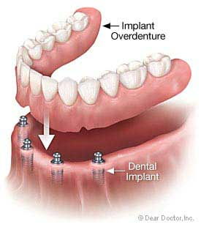
SNAP ATTACHMENT (TECHNICAL ASPECT)
A minimum inter-occlusal clearance of 7.0mm + cuff height is required.
Implants must be relatively parallel to one another with less than 20° of total divergence.
If a patient cannot tolerate pressure on the mucosa, this type of restoration is not an option.
The patient must have good manual dexterity to align the denture directly over the attachments prior to seating.

Slide 60
B) Locator attachment (resilient)
LOCATOR Abutments are used with two or more implants for attachment retained overdenture restorations.
Nylon LOCATOR Replacement Males provide varying degrees of retention which also allows compensation of axial divergences.
Indications:
The LOCATOR Abutment System is designed for use with overdentures or partial dentures retained in whole or in part by implants.
Contraindications:
Not appropriate where a totally rigid connection is required. Not recommended for use on two or more implants with greater than 40° total divergence.

Slide 61
Locator attachment
Technical Considerations:
Lowest Vertical Height: The total height of the LOCATOR Abutment (Abutment plus Replacement Male) Assembly is only 2.5mm plus cuff height .Provides greater freedom at limited space conditions.
Locating Design: Self-locating design allows the patient to easily seat their overdenture without the need for accurate alignment of the attachment components.
Retention Inside and Out: The patented Dual Retention feature provides the LOCATOR Abutment with greater retention surface area than with other attachments. A combination of inside and outside retention ensures the longest lasting performance.

Slide 62
Locator attachment
Locator attachments without an inner retention feature are used when they are aimed to correct interimplant angulation more than 20⁰.
Rotational Pivoting Action: The design of the pivoting LOCATOR Replacement Male delivers a resilient connection for the prosthesis without any resulting loss of retention.
Use With Non-Parallel Implants: Standard LOCATOR Replacement Males can be used to restore an implant with up to 10°of divergence (20° between implants).The LOCATOR Extended Range Replacement Males can accommodate a divergence of up to 20° (40° between implants).

Slide 63

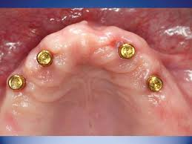
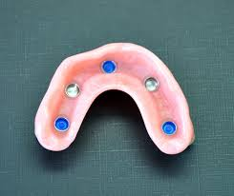
Locator attachment
LOCATOR
ATTACHMENTS
RETENTIVE
CAPS

Slide 64
Bar attachment overdenture
More stable prosthesis
Achieve single line of draw( insertion/ removal) in case non parallel implant placement .
Biomechanical advantage – splinting.
The ideal length of a single bar should be minimum of 20-22 mm to accommodate two clips. Hence, the distance between two implants should be this much while selcting this attachment.Shorter bar attachments cannot provide adequate retention and support.
When the tissue depth exceeds 3mm, a transmucosal abutment (Multi-Unit Abutment) is recommended rather a UCLA abutment to extend the seating platform of the restoration to the abutment approximately 1-1.5mm above the tissue height.

Slide 65
C) BAR ATTACHMENT OVERDENTURE
DISADVANTAGES
Vertical dislodgement, bar type attachments show maximum stress generation around implants
Fabrication is technique sensitive
Higher cost
Maintenance of hygiene is difficult which can lead to problems like mucosal irritation
Frequent loosening of retentive clips.

Slide 66
BAR ATTACHMENT OVERDENTURE
UCLA Abutment System
Technical Considerations:
A minimal inter-occlusal clearance of 4.5mm for SD and RD and 5.0mm for WD UCLA Abutments is required between the implant prosthetic table and the top of the Abutment Screw when seated.
It is recommended that the Abutment Lab Screw be used during laboratory procedures to avoid damage to the final abutment screw.

Slide 67
BAR ATTACHMENT OVERDENTURE
The Multi-Unit Abutment System / balance base abutment is commonly used for a fixed detachable (hybrid) restoration. Additionally, it can be used as a transmucosal abutment for bar overdenture restorations.
The Multi-Unit Abutment’s tapered design provides excellent stability and allows for an easier path of insertion.
Technical Considerations:
• The tapered 18° axial walls allow up to 36° of divergence between adjacent abutments.
• A minimum inter-occlusal clearance of 4.8mm + cuff is required between the implant prosthetic table and the top of the coping screw of the Multi-Unit Abutment.

Slide 68
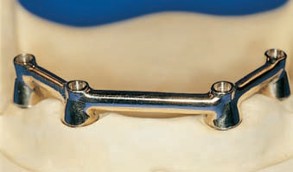
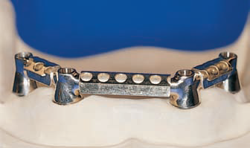

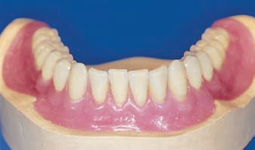
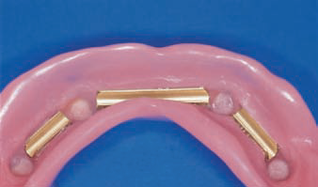
BAR ATTACHMENT OVERDENTURE

Slide 69
D) Telescopic overdenture
SYNCONE CONCEPT
The syncone system is an innovative type of telescopic attachments which is mainly indicated in immediate loading cases.
The syncone system has prefabricated titanium abutments and corresponding gold retainers which come in 4-6° taper.
The abutments can correct angulations by 30° and can rotate 360° for precise alignment. Gold retainers fit on titanium abutments and provide excellent retention and stability.
Patient should have good interarch space to accomodate telescopic attachments .

Slide 70
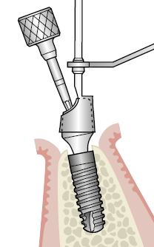
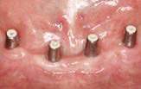
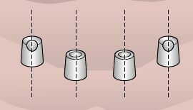
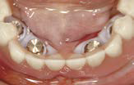
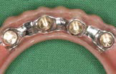
Advantages of syncone concept
Excellent immobilization of the restoration
Flexibility of design
Easy maintenance of oral hygiene
Syncone system has virtually wear resistant attachments. Can also be used on angulated abutments.
SYNCONE TAPERED ABUTMENTS
ABUTMENTS MADE PARALLEL WITH PARALLEL TOOL & SECURED
SYNCONE CAPS ATTACHED
WITH DENTURE

Slide 71
Atlantis conus concept
The concept is composed of patient-specific ATLANTIS Conus abutments together with prefabricated SynCone caps .
It allows dentists on to apply telescopic syncone concept on implants other than Ankylos .
The ATLANTIS Conus abutments are individually designed using the patented ATLANTIS VAD (Virtual Abutment Design) software. This ensures that all abutments are parallel to each other, and that their restorative margin are as close to the soft tissue as possible.
The position of the abutments will be in relation to the space needed for the final restoration.

Slide 72
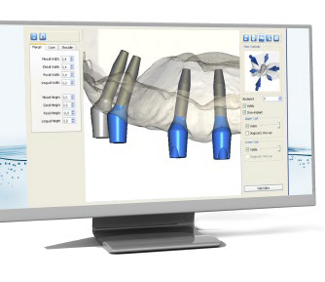
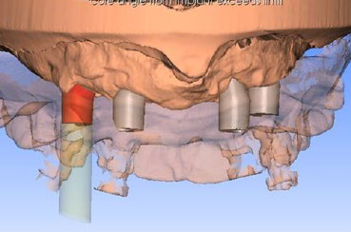


Atlantis conus concept
ATLANTIS CONUS ABUTMENTS DESIGNED BY ATLANTIS VAD SOFTWARE
CONUS ABUTMENTS WITH SYNCONE CAPS
EXISTING PROSTHESIS ATTACHED

Slide 73


