Slide 1
Vitex Nirgundo Phonophoresis – A Key for Pain free life in Knee Osteoarthritis
Presenter:
Dr. Abhijit Merekar (Ph.D.), Professor
Dr.V.V.P.F’s College of Pharmacy, Vikhe Patil Foundation, Ahmednagar

Slide 2
INTRODUCTION
Osteoarthritis is the most common type of joint disease. It is degenerative disorder arising from the biochemical breakdown of articular (hyaline) cartilage in the synovial joints osteoarthritis involves not only the articular carti­lage but the entire joint organ, including the subchondral bone and synovium[1].
Long term osteoarthritis causes dysfunction, debilitating pains in joints and disuse of them leads to peri - articular muscular weakness and high costs for treatment such as joint replacement, so it is essential to improve therapeutic techniques. In addition to medical treatment, using rehabilitation methods and physiotherapy has main role in pain relief and improvement of patient function (5).

Slide 3
Continue…
Physiotherapy (physical therapy) involves using physical modalities to produce therapeutic effects. The use of heat (superficial and deep), cold, pressure, light and electricity have been employed for thousands of years to accelerate healing and decrease pain in musculoskeletal disorders.[6,7]
Phonophoresis (PH) is a technique that employs the use of ultrasound waves to enhance percutaneous absorption of drug delivery similar to iontophoresis.[11,13] Phonophoresis was first used to treat polyarthritis of the hand by delivery of hydrocortisone ointment into inflamed areas in 1954.[14] Since then it has been reported to be used in the treatment of various dermatological and musculoskeletal disorders.[13-16]

Slide 4
Continue…
Vitex nirgundo Linn. (Verbenaceae) is a woody, aromatic shrub growing to a small tree. It commonly bears tri - or penta - foliate leaves on quadrangular branches, which give rise to bluish - purple coloured flowers in branched tomentose cymes.
There are no studies where comparative effectiveness of Diclofenac sodium and Vitex nirgundo oil effectiveness is studied in cases with knee osteoarthritis. Hence purpose of this study was to find out effectiveness of diclofenac sodium and Vitex nirgundo oil phonophoresis along with exercises in osteoarthritis of knee joint.

Slide 5
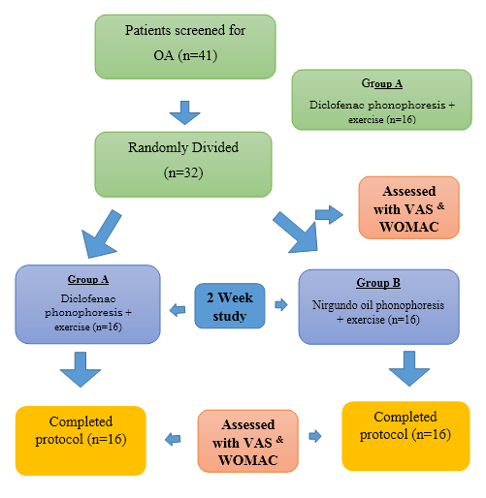
Method:

Slide 6
Result :
Particular | VAS Group A | VAS Group B | P value
Baseline | 6.72±1.58 | 7.82±1.38 | P>0.05
Result after IInd week | 4.42±1.81 | 3.21±2.69 | P=0.001
Comparison of VAS score between group A and group B

Slide 7
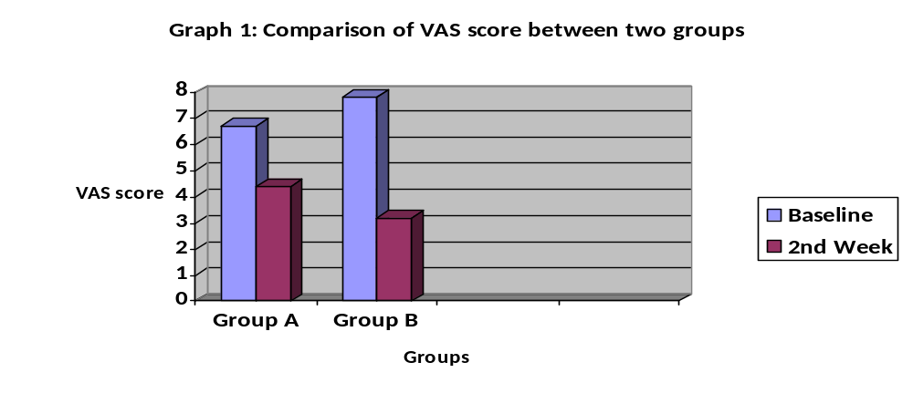
Continue…

Slide 8
Continue…
WOMAC Group A | WOMAC Group B | P Value
15.12±5.14 | 14.76±3.82 | P>0.05
12.90 ±5.21 | 10.61±4.85 | P=.001
comparison of WOMAC score between two groups.

Slide 9
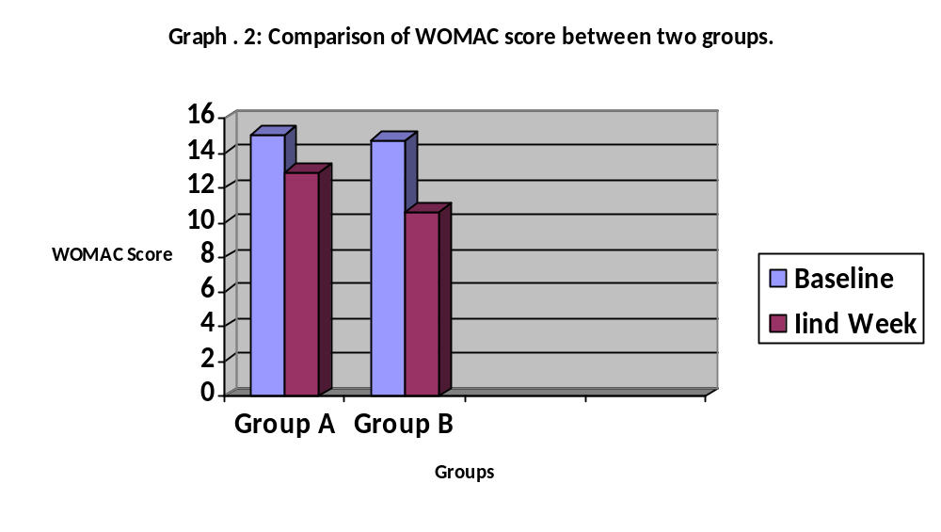
Continue…

Slide 10
CONCLUSION:
Vitex Nirgundo Oil phonophoresis along with physiotherapy is more beneficial than diclofenac sodium phonophoresis in reducing pain and disability in cases with knee osteoarthritis cases.

Slide 11
REFERENCES
Jeffries M, Donica M, Baker L, Stevenson M, Annan AC and Humphrey MB. Genome-wide DNA methyl­ation study identifies significant epigenomic changes in osteoarthritic cartilage. Arthritis Rheumatol. 2014; 66(10):2804-15.
Guzman J. Physical medicine and rehabilitation .3rded; 2007.
Buckwalter J, Saltzman C, Brown T. The impact of os­teoarthritis. Clin Orthoped Rel Res. 2004; 427S: S6-S15.
Srikanth V, Fryer J, Zhai G, Winzenberg T, Hosmer D and Jones G. A meta-analysis of sex differences prevalence, incidence and severity of osteoarthri­tis. Osteoarthritis Cartilage. 2005; 13(9):769–81.
Vahideh Toopchizadeh, Arash Babaei - Ghazani, Bina Eftekhar Sadat Efficiency of Action Potential Stimulation (APS) therapy in compare to Transcutaneous Electrical Nerve Stimulation(TENS) in knee osteoarthritis Life Sci J . 2012; 9(4):3790 - 3794.

Slide 12
Continue…
Hochberg MC. Nutritional supplements for knee osteoarthritis-still no resolution. N Engl J Med 2006;354:858-60.
Loeser RF Jr. Aging and the etiopathogenesis and treatment of osteoarthritis. Rheum Dis Clin North Am 2000;26:547-67.
Yang JH, Kim DK, Yun MY, Kim TY, Shin SC. Transdermal delivery system of triamcinolone acetonide from a gel using phonophoresis. Arch Pharm Res 2006;29:412-7.
Banga AK, Chien YW. Iontophoretic delivery of drugs: fundamental, developmental and biomedical applications. J Controlled Release 1988;17:1-24.
Nirschl RP, Rodin DM, Ochiai DH, Maartmann-Moe C; DEXAHE- 01-99 Study Group. Iontophoretic administration of dexamethasone sodium phosphate for acute epicondylitis. A randomized, double-blinded, placebo-controlled study. Am J Sports Med 2003;31:189-95.

Slide 13
Thank you….

