Slide 1

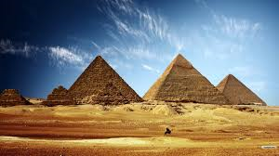
Role of bone morphogenetic protein-2 in primary Knee osteoarthritis
By : Dr. Abeer El Zohiery
A.Prof .Rheumatology & Rehabilitation
Faculty of Medicine, Ain Shams University
EGYPT

Slide 2

Acknowledgement
Nadia El Kadery, Henaz Khaled & Miriam Bekhit
Physical medicine Rheumatology and Rehabilitation department .
My dear patients
Committee of personalized medicine

Slide 3
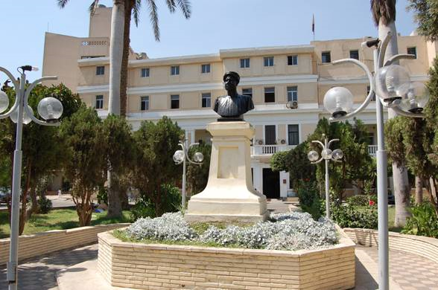
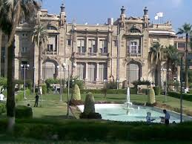
Ain Shams University
,
Faculty of Medicine

Slide 4

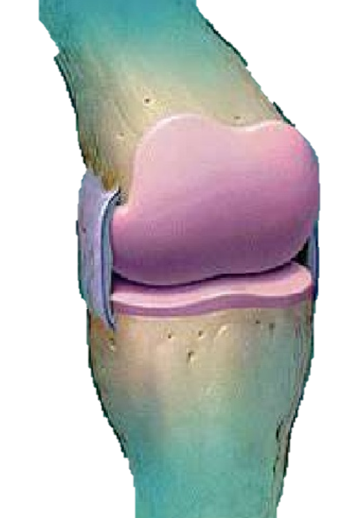
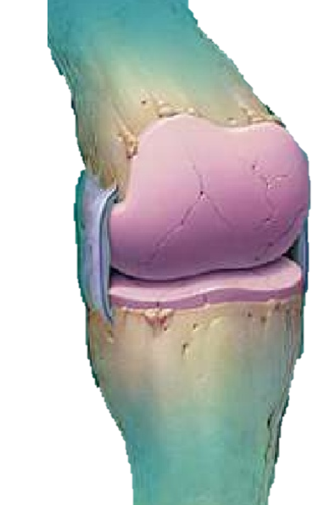
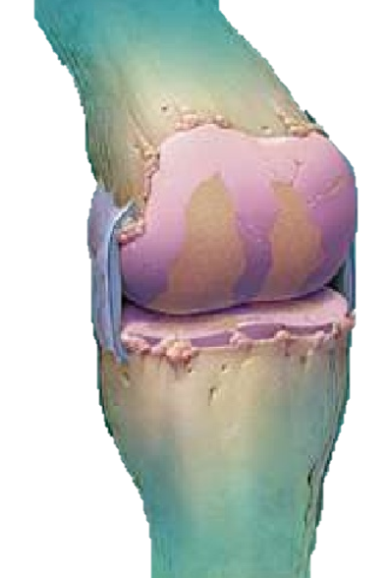
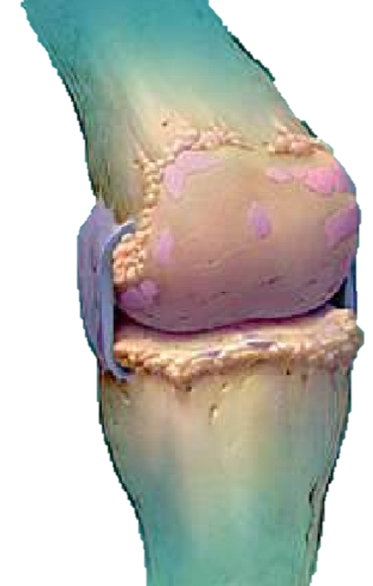
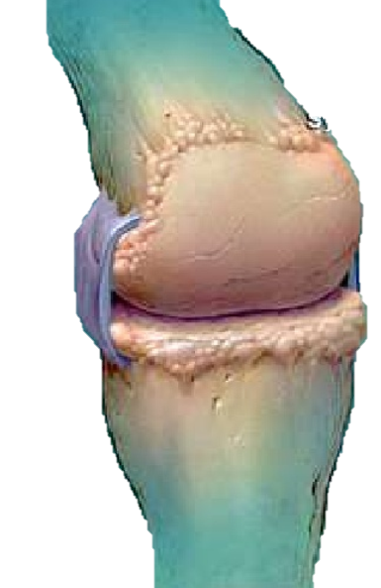
Introduction
Osteoarthritis is the most prevalent complex, degenerative chronic disease.
It is a disorder of the hyaline joints characterized by wear, softening and thinning of the articular cartilage and diminished compliance of the sub-chondral bone.
These pathological changes progressively lead to severe limitation of physical activity and great impairment of quality of life.

Slide 5
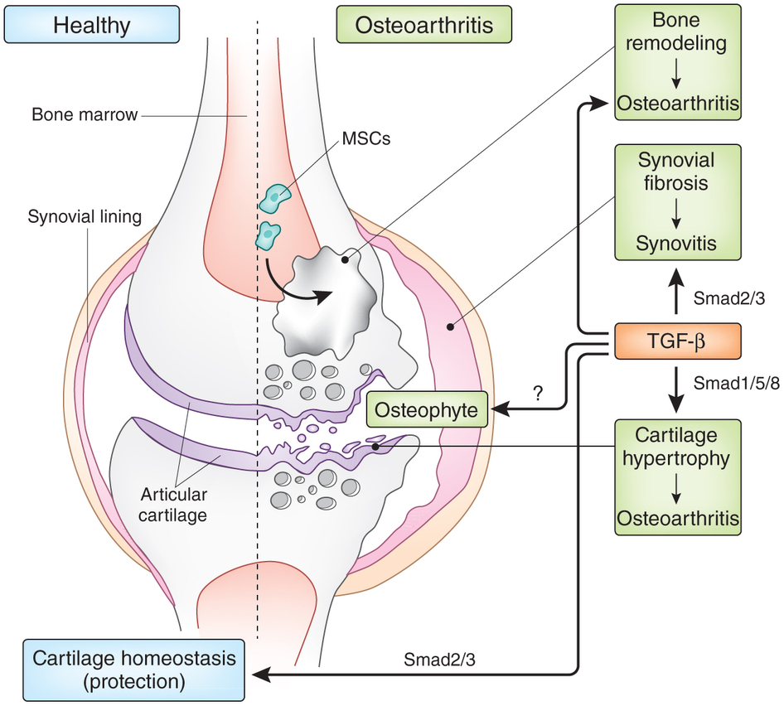
Pathogenesis
BMPs
OA
Progressive damage of articular cartilage
Bone remodeling or new bone formation
Chondrocytes
Hyprertrophic Chondrocytes
Type II,IX,XI collagen
Type X collagen – MMP13

Slide 6
What are Bone Morphogenetic Proteins ??!!
They represent the largest subset within the TGF-β superfamily; a large family of structurally related cell regulatory proteins.
Although other growth factors can be found in bone and have various effects on bone and cartilage cells in vitro, only BMPs have been demonstrated to induce either cartilage or bone formation in vivo.
They are key regulators of :
embryonic skeletogenesis,
fracture repair,
bone regeneration,
endochondral ossification
bone remodeling.

Slide 7
BMP-2
Potent inducer of mesenchymal cell differentiation to osteoblasts
Plays a major role in modulation of chondrocyte phenotype
Interacts with Wnt-signaling pathways
Controls the expression of several other BMPs

Slide 8
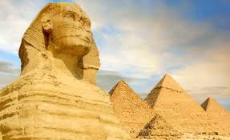


PYRAMIDS & SPHINX

Slide 9

Aim of work
The aim of this study is to investigate the role of plasma BMP-2 in primary knee osteoarthritis in relation to disease severity.

Slide 10

Patients and Methods
The study was conducted on thirty symptomatic patients with primary knee osteoarthritis attending the outpatient clinic of Physical Medicine, Rheumatology and Rehabilitation of Ain-Shams University Hospitals., Egypt
In addition to 7 healthy asymptomatic individuals matched for age and sex were included served as control group.
They were diagnosed according to the American College of Rheumatology (ACR) criteria (Altman et al., 1986).

Slide 11
The patients were subjected to the following:
Full medical history taking
Thorough clinical examination
Routine laboratory investigations as:
Complete blood count (CBC)
Erythrocyte Sedimentation Rate (ESR)
C- Reactive Protein (CRP)
Rheumatoid factor (RF)
Fasting blood sugar (FBS)

Slide 12
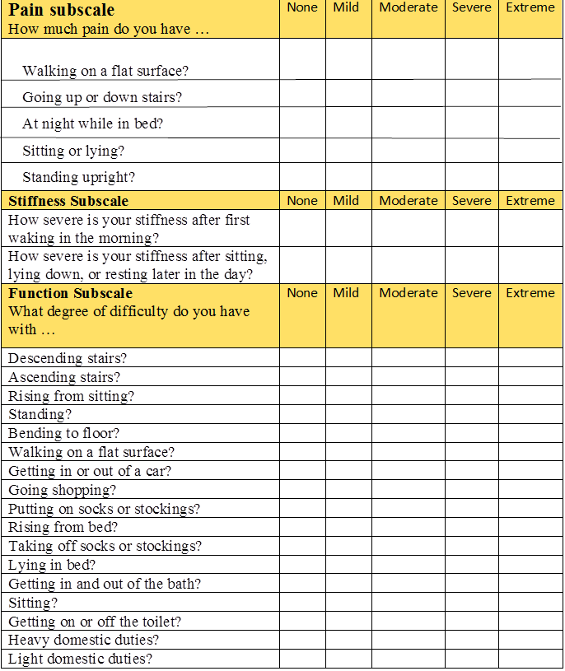
Functional Assessment
Assessment of lower extremity pain and function in patients using the The Western Ontario and McMaster University Osteoarthritis Index (WOMAC) (Lequesneet al., 1987).
Quantitative detection of plasma BMP-2 levels in patients as well as the control groups using ELISA technique.

Slide 13
Radiological Investigations
The severity of the disease was determined using plain X-ray antero-posterior and lateral radiographs of the knees, evaluated according to the Kellgren and Lawrence scoring system (Kellgren and Lawrence, 1957).

Slide 14


Abou Simbel Temple -Aswan
(EGYPT)

Slide 15
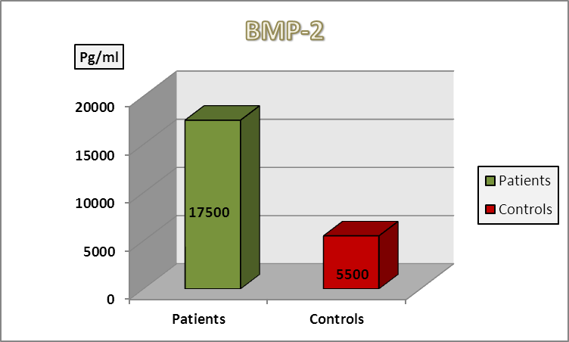
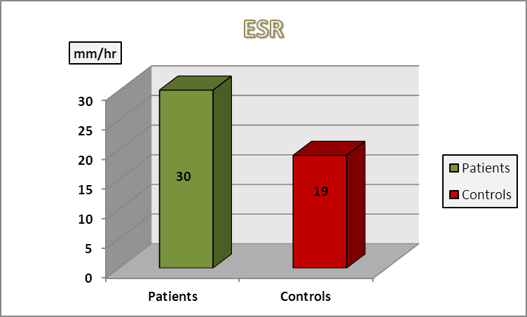
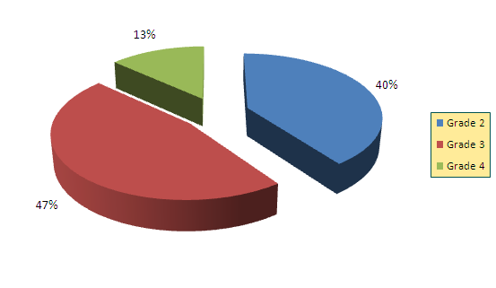
Results
Radiological classification of patients according to K-L score:
Descriptive parameters of the patients:
Descriptive parameters of the controls:
Frequencies of clinical manifestations among studied patients:
Comparison between patients and controls:
Sex groups Cross Tabulation:
Parameters | Range | Mean ±S.D.
Age (years) | 42 - 68 | 53.3±8.49
BMI (kg/m²) | 23.84 - 33.01 | 27.50±3.12
ESR (mm/hr) | 6 - 19 | 11.5±4.72
Hb (g/dl) | 9.8 – 14.5 | 12.27±1.74
WBC (10³/mm³) | 6 – 10.6 | 8.33±1.62
PLT (10³/mm³) | 180 - 430 | 307.8±84.35
AST (u/l) | 10 - 28 | 19.9±5.78
ALT (u/l) | 9 - 28 | 20.6±5.67
ALP (u/l) | 160 - 310 | 237.3±54.68
BUN (mg/dl) | 6 - 19 | 10.7±4.69
S.creat. (mg/dl) | 0.4 - 1 | 0.68±0.19
S.uric acid (mg/dl) | 3 - 4.8 | 3.95±0.59
FBS (mg/dl) | 65 - 115 | 82.3±14.1
BMP-2 (pg/ml) | 2000 – 5500 | 3362.5±1055.513
Parameters | Range | Mean ±S.D.
Age (years) | 44 - 70 | 55.7±7.46
BMI (kg/m²) | 24.34 - 34.71 | 27.89±2.49
Disease duration (years) | 1 - 17 | 5.63±4.53
NPRS for pain | 1 - 9 | 4.6±2.19
Morning stiffness (minutes) | 0 - 10 | 2.43±3.29
Thigh circumference (cm) | 0 - 3.2 | 0.91±1.32
Degree of flexion deformity | 0 - 30 | 3.83±7.50
WOMAC score | 16 - 65 | 28.2±11.34
ESR (mm/hr) | 5 - 30 | 16.3±6.29
Hb (g/dl) | 9 - 15.1 | 11.87±1.90
WBC (10³/mm³) | 5 - 11.1 | 8.48±1.87
PLT (10³/mm³) | 180 - 426 | 292.03±72.61
AST (u/l) | 8 - 29 | 19.77±5.98
ALT (u/l) | 10 - 33 | 20.97±6.43
ALP (u/l) | 100 - 390 | 232.1±68.85
BUN (mg/dl) | 5 - 19 | 11.97±3.59
S.creat. (mg/dl) | 0.2 – 1.4 | 0.74±0.34
S.uric acid (mg/dl) | 1.3 - 6 | 3.86±1.00
FBS (mg/dl) | 60 - 105 | 81.07±13.39
BMP-2 (pg/ml) | 5500 – 17500 | 7473.33±2336.21
Parameters | Patients (N=30) | Controls (N=10) | t | P | Sig.
 | Mean ±S.D. | Mean ±S.D.
Age (years) | 55.7±7.46 | 53.3±8.49 | 0.24 | > 0.05 | NS
BMI (kg/m²) | 27.89±2.49 | 27.50±3.12 | 0.359 | > 0.05 | NS
ESR (mm/hr) | 16.3±6.29 | 11.5±4.72 | 2.549 | < 0.05 | S
ALP (u/l) | 232.1±68.85 | 237.3±54.68 | 0.243 | > 0.05 | NS
BMP-2 (pg/ml) | 7473.33±2336.21 | 3362.5±1055.513 | 4.68 | < 0.01 | HS
 |  |  | Groups |  | Total
 |  |  | Control | Patients
Sex | F | No | 4 | 18 | 22
 |  | % | 57% | 60.0% | 60.0%
 | M | No | 3 | 12 | 15
 |  | % | 43% | 40.0% | 40.0%
Total |  | No | 7 | 30 | 37
 |  | % | 100.0% | 100.0% | 100.0%
Parameter |  | No | %
K-L grading score | Grade 1 | 0 | 00.0%
 | Grade 2 | 12 | 40.0%
 | Grade 3 | 14 | 47.0%
 | Grade 4 | 4 | 13.0%
Clinical manifestations | Patients (30)
 | Number | %
Pain | 30 | 100%
Crepitus | 30 | 100%
Tenderness | 30 | 100%
Palpable bony enlargement | 2 | 6.7%
Patellofemoral test | 21 | 70.0%
Synovial hypertrophy | 8 | 26.7%
Effusion | 10 | 33.3%
Quadriceps disuse wasting | 10 | 33.3%
Ligament laxity | 2 | 6.7%
Deformity | 13 | 43%
First carpometacarpal joint affection | 2 | 6.7%
Heberden and/or Bouchard nodes | 3 | 10.0%
The frequencies of radiological grading among O.A patients.
Comparison between patients and controls regarding plasma BMP-2 levels.
Comparison between patients and controls regarding ESR.

Slide 16
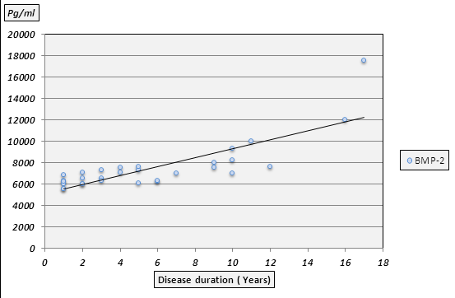
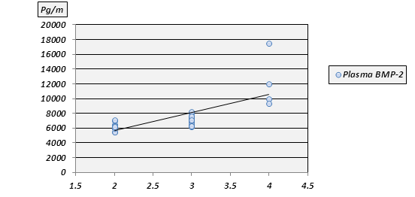
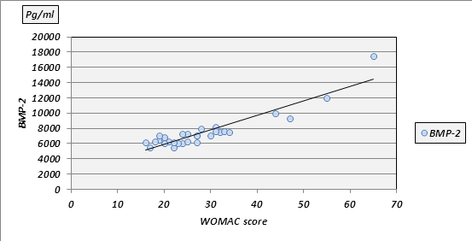
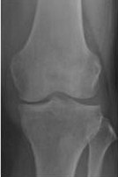
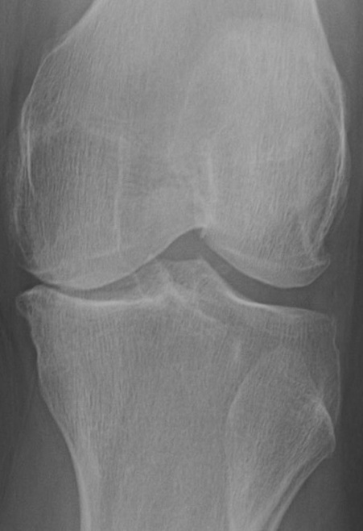
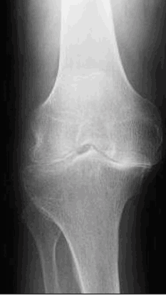
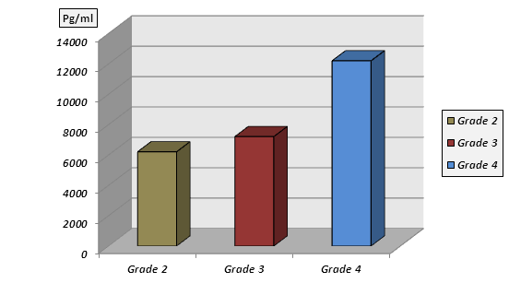
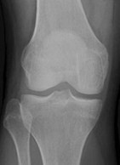
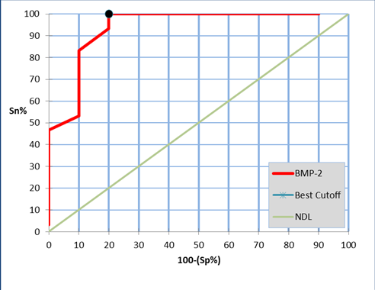
Results
Correlation between BMP-2 and the studied parameters:
Comparison between patients with K-L different grades and clinical parameters:
Comparison between patients with K-L different grades as regards parametric clinical data
Validity of BMP-2 in diagnosis of O.A
 | Efficacy | Cut-off value | Sensitivity | Specificity | PPV | NPV
BMP-2 | 95.0 | 4000 | 100.7 | 80.0 | 93.8 | 100.0
Data | Grade 2 (N=12) | Grade 3 (N=14) | Grade 4 (N=4) | P | Sig.
 | Mean ±S.D. | Mean ±S.D. | Mean ±S.D.
Age (years) | 50.5±5.63 | 57.64±6.32 | 64.5±4.43 | < 0.01 | HS
BMI (kg/m²) | 27.70±2.10 | 28.01±2.16 | 27.72±4.81 | > 0.05 | NS
Disease duration (years) | 2.58±2.61 | 6±3.1 | 13.5±3.51 | < 0.01 | HS
Morning stiffness (minutes) | 2.43±2.59 | 0.33±0.78 | 5.75±1.5 | > 0.05 | NS
WOMAC score | 20.67±3.14 | 27.64±4.48 | 52.75±9.39 | < 0.01 | HS
BMP-2 (pg/ml) | 6208.33±492.60 | 7207.14±599.31 | 12200±3713.94 | < 0.01 | HS
Parameters | BMP-2 |  | Sig.
 | R | P-value
Age (years) | 0.358 | > 0.05 | NS
Disease duration (years) | 0.778 | < 0.01 | HS
BMI (kg/m²) | 0.042 | > 0.05 | NS
Pain (NPRS) | 0.475 | > 0.05 | NS
Morning stiffness (minutes) | 0.677 | > 0.05 | NS
Synovial hypertrophy | 0.051 | > 0.05 | NS
Effusion | 0.293 | > 0.05 | NS
Thigh circumference (cm) | 0.67 | >0.05 | NS
Degree of flexion deformity | 0.699 | > 0.05 | NS
Varus deformity | 0.721 | > 0.05 | NS
WOMAC score | 0.507 | < 0.01 | HS
ESR (mm/hr) | 0.077 | > 0.05 | NS
FBS (mg/dl) | 0.168 | > 0.05 | NS
Parameters |  | Grade 2 |  | Grade 3 |  | Grade 4 |  | P | Sig.
 |  | N | % | N | % | N | %
Pain | Positive | 12 | 100% | 14 | 100% | 4 | 100% | > 0.05 | NS
 | Negative | 0 | 0% | 0 | 0% | 0 | 0%
Morning stiffness | Positive | 2 | 16.7% | 7 | 50.0% | 4 | 100% | > 0.05 | NS
 | Negative | 10 | 83.3% | 7 | 50.0% | 0 | 0%
Quadriceps disuse wasting | Positive | 1 | 8.3% | 5 | 42.9% | 4 | 100% | > 0.05 | NS
 | Negative | 11 | 91.7% | 9 | 35.7% | 0 | 0%
Synovial hypertrophy | Positive | 1 | 8.3% | 3 | 21.4% | 4 | 100% | > 0.05 | NS
 | Negative | 11 | 91.7% | 11 | 64.3% | 0 | 0%
Effusion | Positive | 4 | 33.3% | 6 | 42.9% | 0 | 0% | > 0.05 | NS
 | Negative | 8 | 66.7% | 8 | 57.1% | 4 | 100%
Flexion deformity | Positive | 0 | 0% | 4 | 28.6% | 4 | 100% | > 0.05 | NS
 | Negative | 12 | 100% | 10 | 71.4% | 0 | 0%
Varus deformity | Positive | 2 | 16.7% | 5 | 35.% | 3 | 75% | > 0.05 | NS
 | Negative | 10 | 83.3% | 9 | 64.3% | 1 | 25%
(a)
(b)
(c)
normal plain X-ray knee
Plain X-ray knee showing (c) K-L grade 2, (d) K-L grade 3 and (e) K-L grade 4.
Receiver operating characteristic (ROC) curve analysis showing the diagnostic performance of BMP-2
Correlation between X-ray grading and plasma levels of BMP-2.
Comparison between cases with different K-L grades as regards plasma BMP-2 levels.
Correlation between plasma BMP-2 levels and disease duration.
Correlation between plasma BMP-2 levels and WOMAC score.
Correlation between X-ray grading and plasma levels of BMP-2.

Slide 17

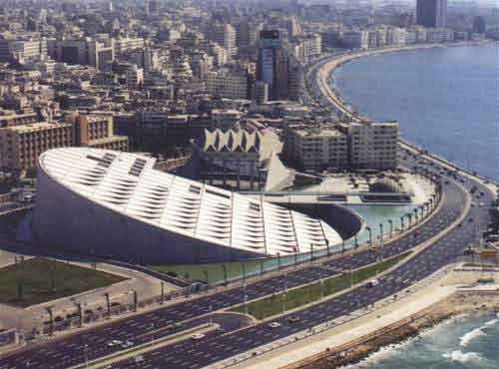
Bibliotheca Alexandrina
=Royal Library of Alexandria

Slide 18

Conclusion
In the current study, patients with high plasma levels of BMP-2 had longer disease duration and experienced significantly more severe K-L and WOMAC scores.
So BMP-2 levels correlate with radiographic severity of O.A which make such biomarker measurement may not only act as a substitute marker for the disease but also has the potential to contribute to the fundamental processes underlying the pathogenesis of O.A.
&

Slide 19
Conclusion cont.
Although BMPs are considered protective for articular cartilage these factors can also be involved in chondrocyte hypertrophy and matrix degradation.
Bone morphogenetic Proteins
Articular cartilage
&
Elevated BMP levels in damaged cartilage can on one side contribute to tissue repair by boosting matrix synthesis but on the other side stimulate cartilage degeneration by altering chondrocyte behavior and stimulating MMP-13 expression.
To serve and protect or a wolf in sheep’s clothing?!!!

Slide 20


Red Sea- EGYPT

Slide 21

Recommendations
BMP-2 is likely to be a useful potential marker to monitor the course and severity of primary knee OA.
Our preliminary data should be confirmed on larger sample size taking into account the effect of other joints than the knee and the synovial level of BMP-2.
We hypothesize to study the possibility of BMP-2 as a potential therapeutic target.
Further studies are recommended to define the potential experimental strategies for the inhibition of BMP-2 mediated O.A process.

Slide 22



Slide 23

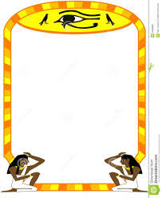

T H A N K
Y O U

Slide 24
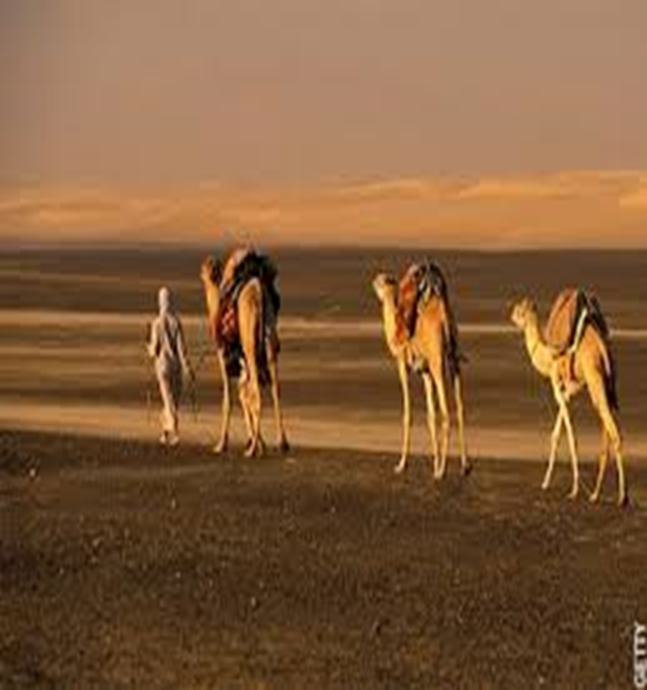
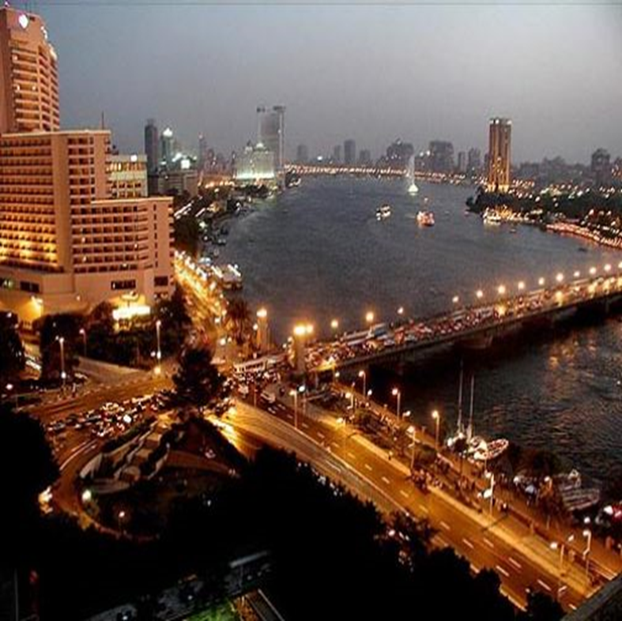
Any questions ?????????
What some people think about EGYPT !
What Egypt really is !

