Slide 1
VASCULARIZED FIBULAR MEDIALIZATION FOR RECONSTRUCTION OF THE TIBIAL DEFECTS
FOLLOWING TUMOUR EXCISION
4th International Conference on Orthopedics & Rheumatology
October 26-28, 2015 Baltimore, Maryland, USA
Abed Al-Negery, MD
Samir Kotb, MD
M.Serry El Saied, MD
Nabil El Moghazy, MD

Slide 2
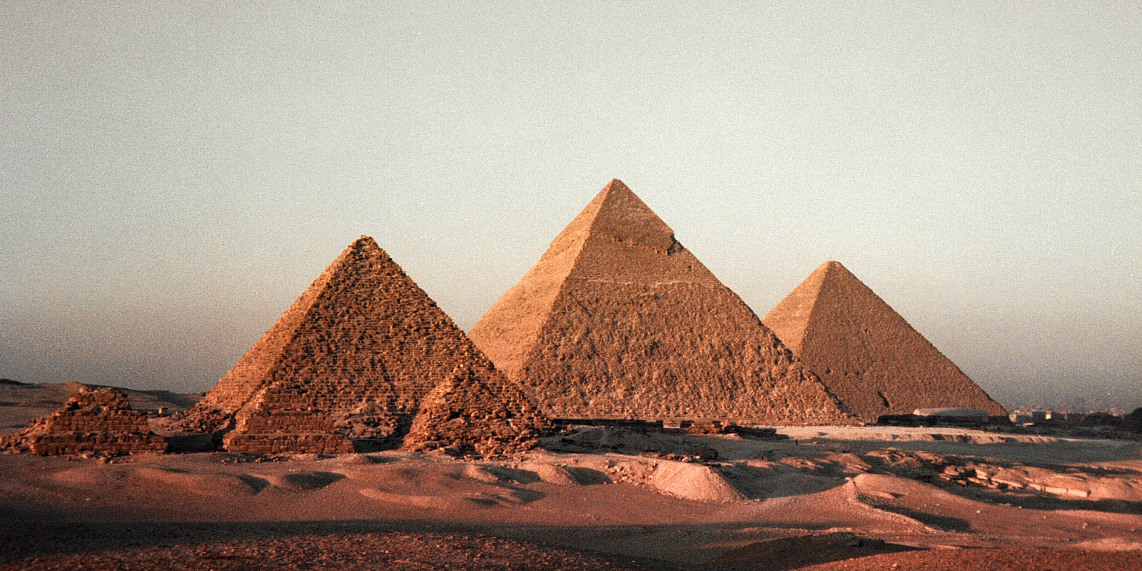
Aim of the Study

Slide 3
Aim of the Study
The purpose of this study was to evaluate the functional and oncologic results of fibular medialization when used alone as a single-stage reconstructive technique after wide excision of malignant tumors of proximal, middle or distal tibia.

Slide 4
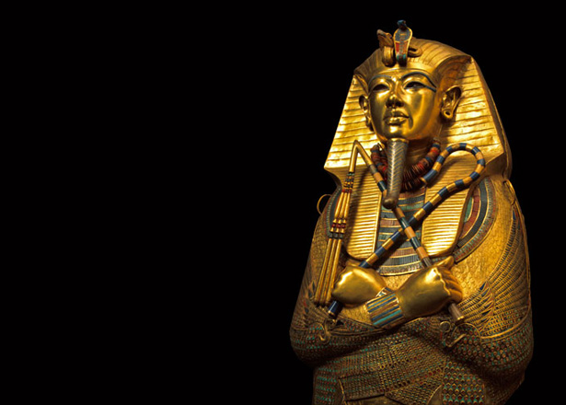
Introduction

Slide 5
Introduction
One of the most difficult problems confronting the orthopedic surgeon is the reconstruction of large bone defects following tumor resection.
A variety of procedures have been advocated for the reconstruction of segmental skeletal defects in this area including:
mega-prosthesis - autogenous cortical bone graft – allograft – free vascularized fibular graft
The use of a vascularized fibular graft -pedicled on the peroneal vessels- has been for few cases as two stage operation reported

Slide 6
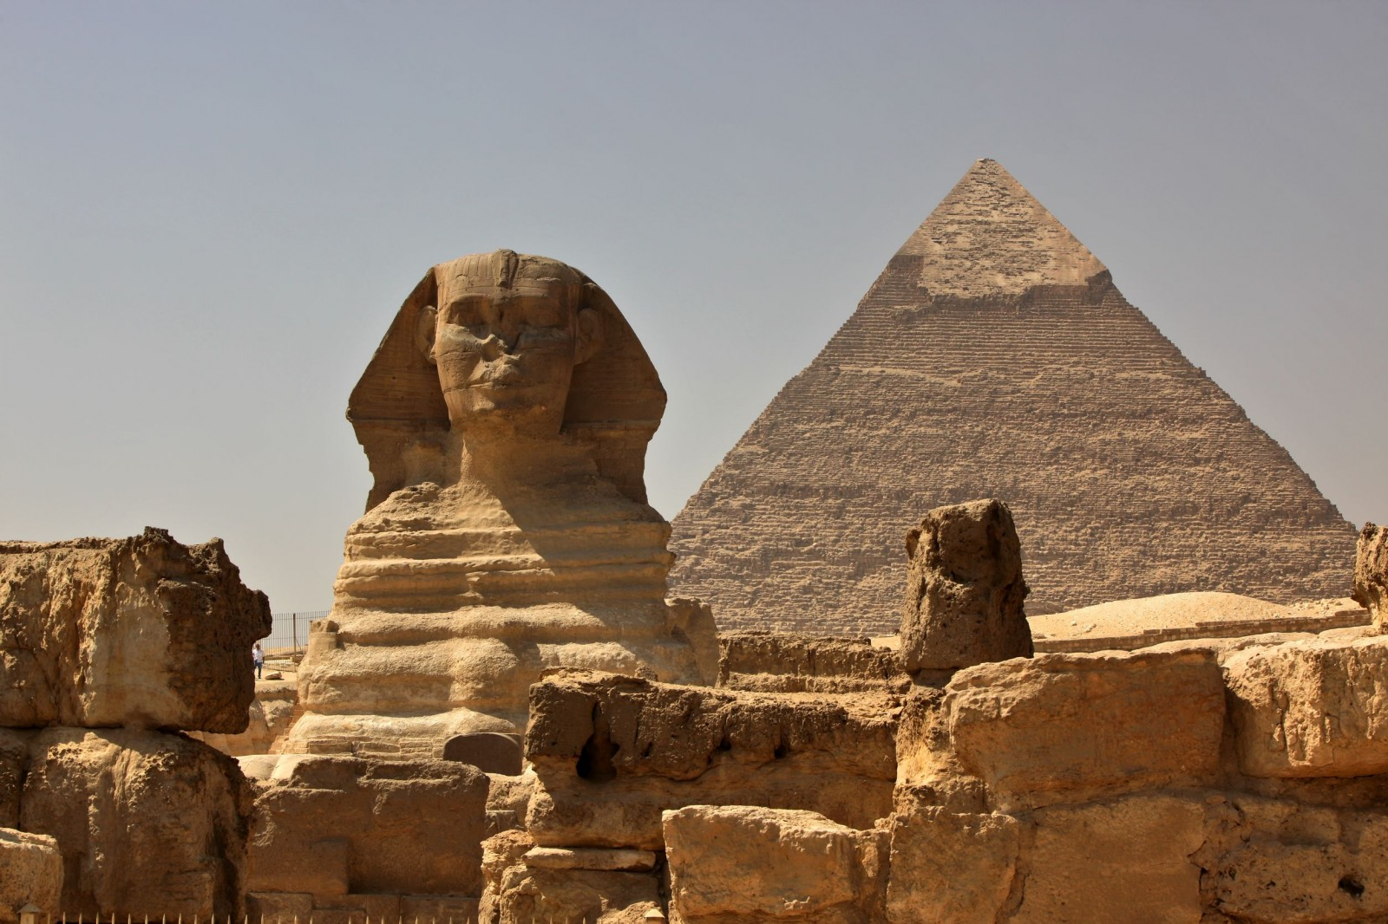
Patients and Methods

Slide 7
Patients and Methods
14 pt. with 1ry MT of the tibia
(8 prox, 4 diaph, 2 dista)
6 M, 8 F
Age: 11-38 (23.2 Yr)
OS 5
EW 4
GCT 5
Primary malignant tumors of the tibia were treated by wide excision. The fibula was mobilized medially with its vascular pedicle to fill the defect.

Slide 8
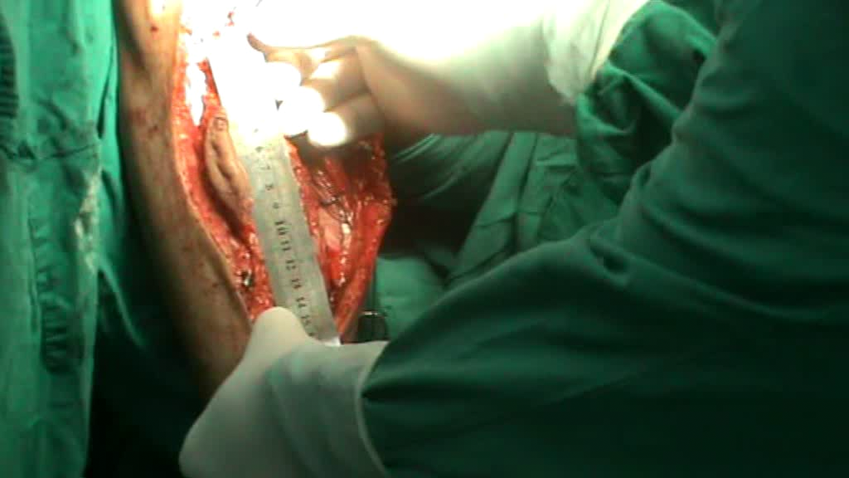

Slide 9
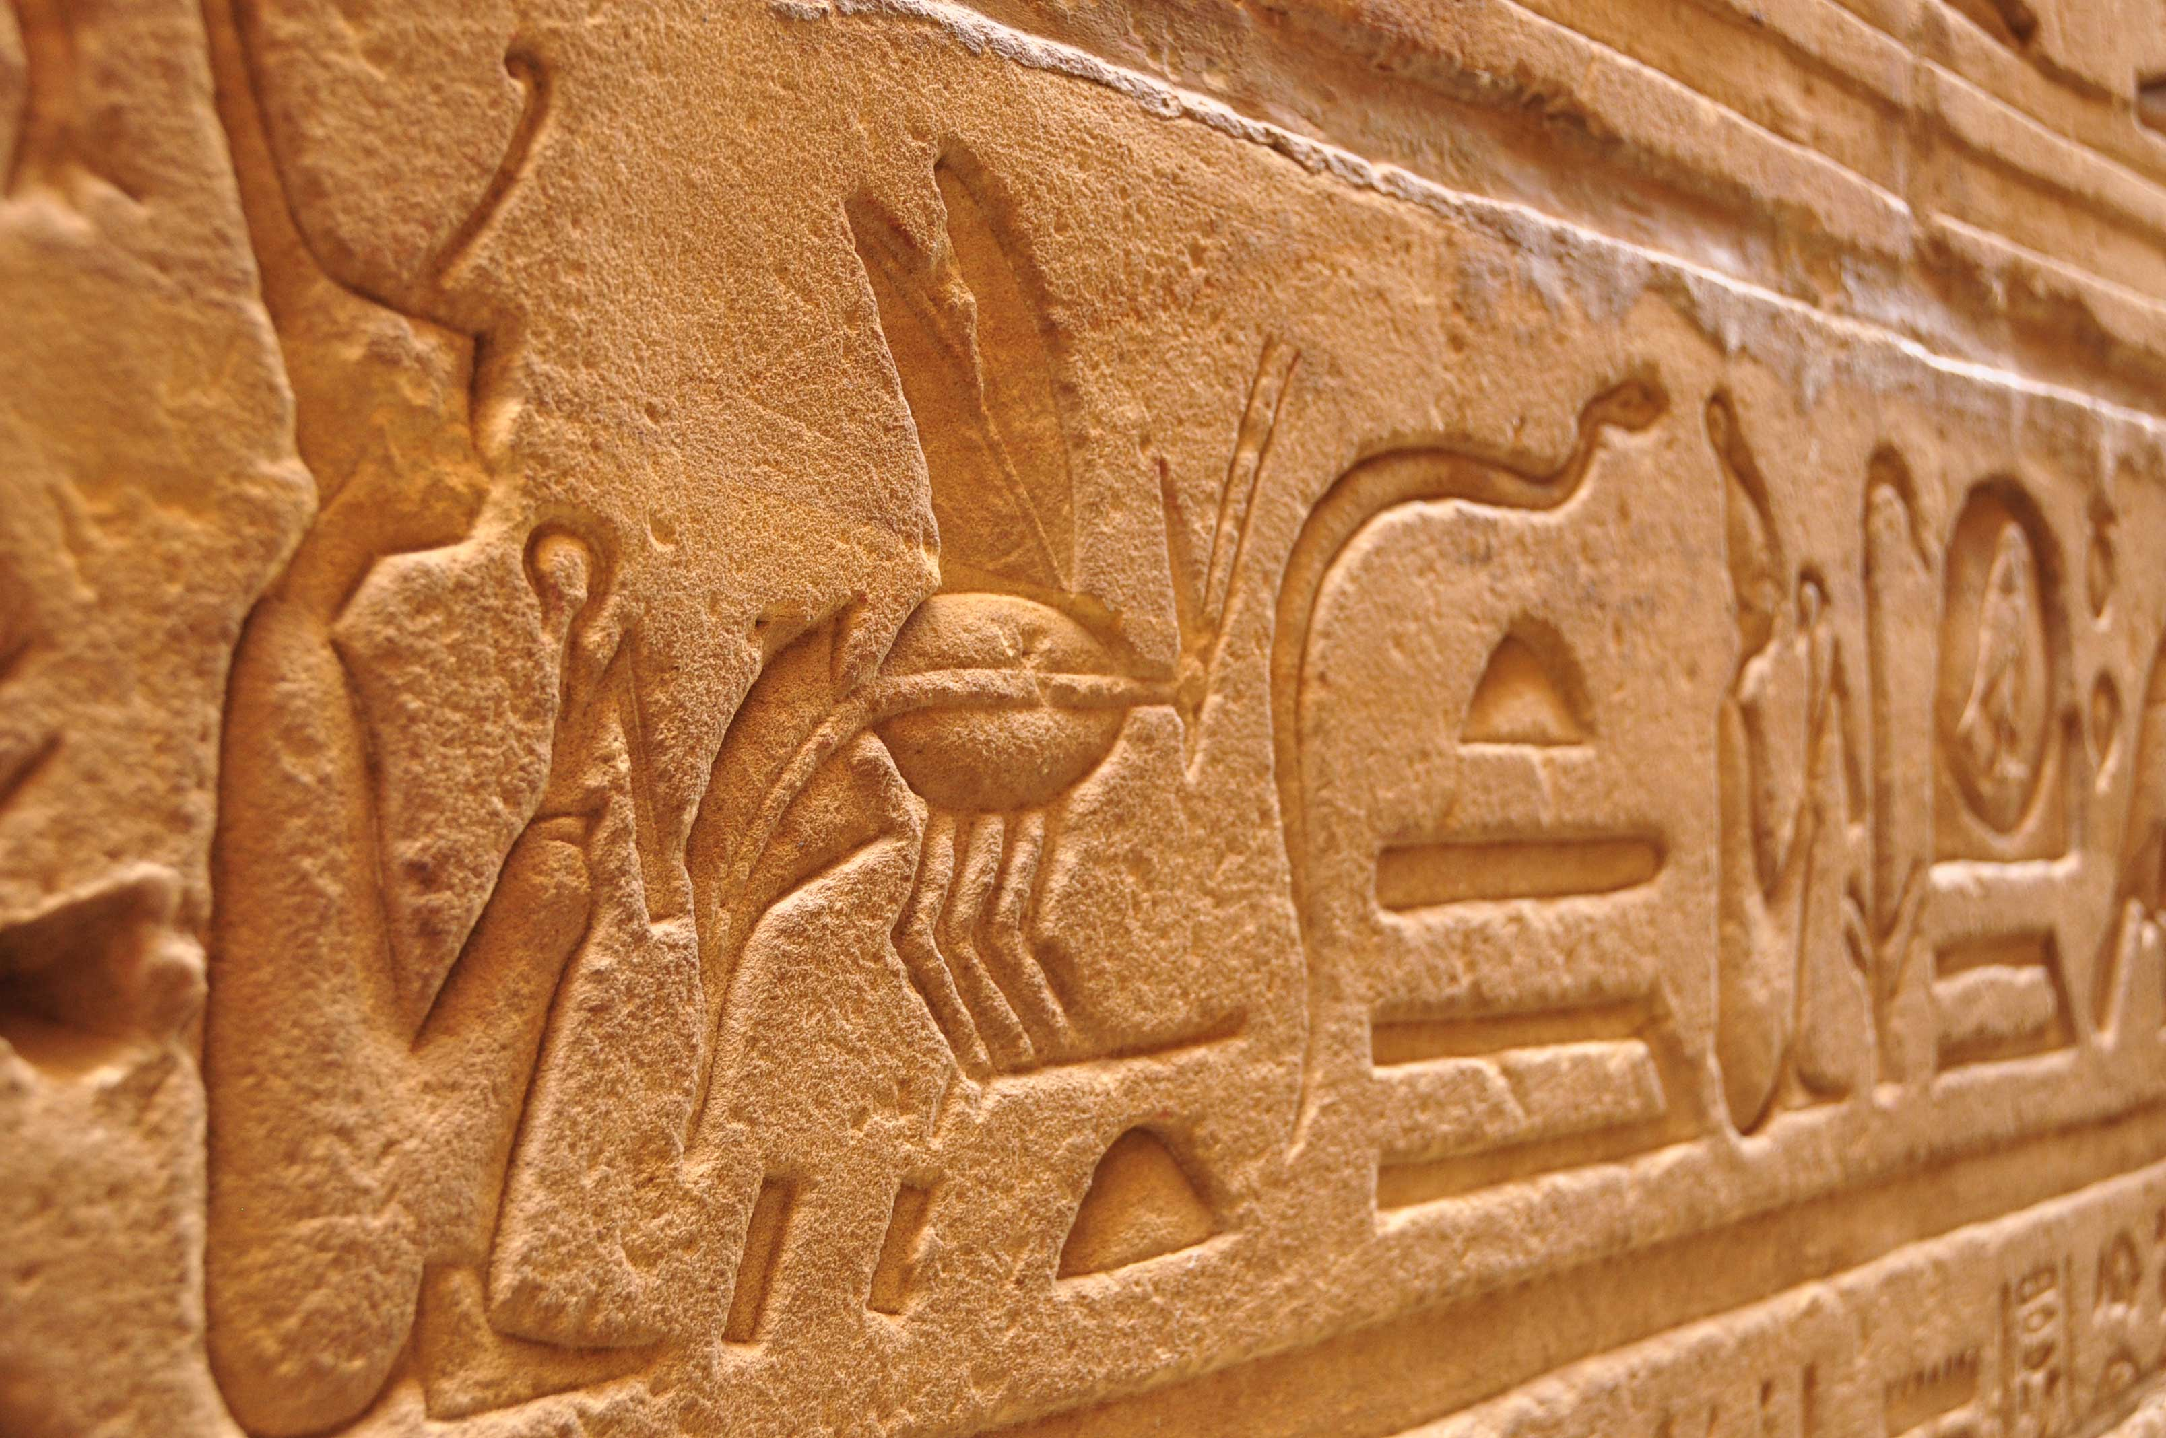
Results

Slide 10
Results
Mean FU period was 31.3 m (17 to 54).
Radiological outcome:
Union was completed: 5 m in pt not receive chemotherapy
9 m in pt receive chemotherapy
Graft hypertrophy reach the size of the tibia in 18 m
Functional Outcome:
9 pt walked without aid.
1 pt Chest metastases
2 pt superficial wound infection
3 pt leg length discrepancy

Slide 11
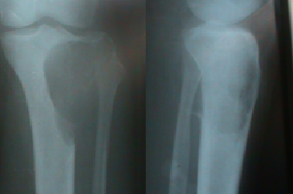
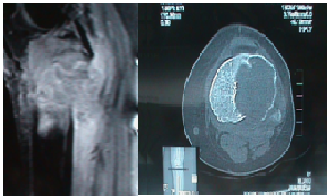

Slide 12
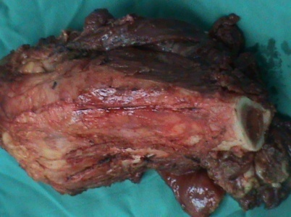
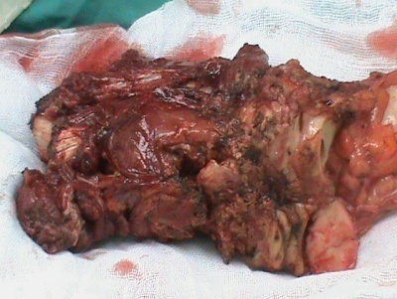
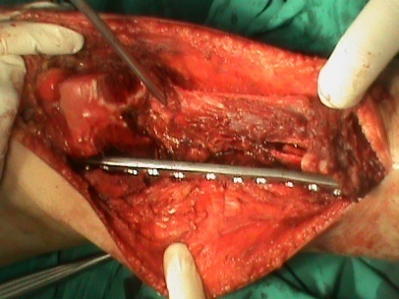
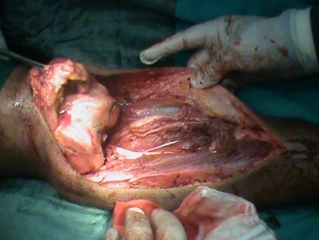

Slide 13
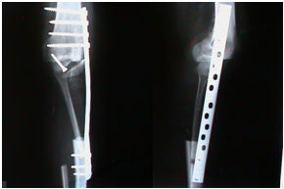
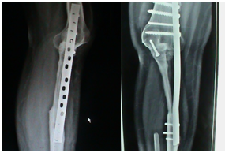

Slide 14
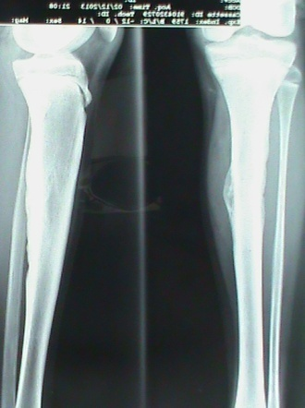
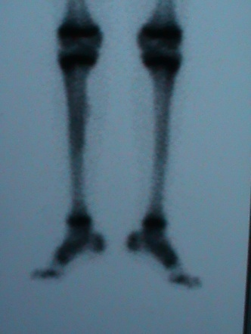
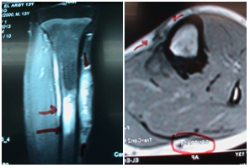

Slide 15
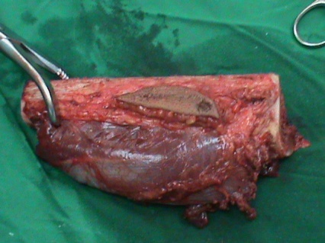
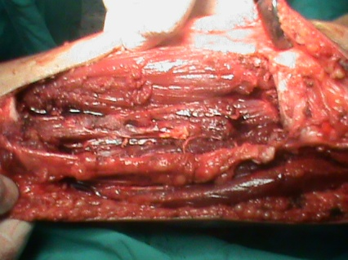
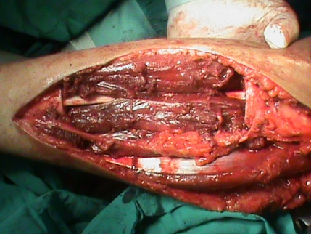

Slide 16
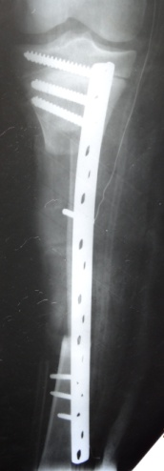
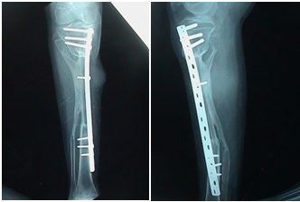
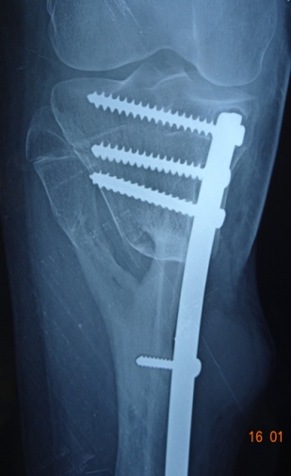

Slide 17
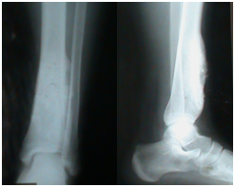
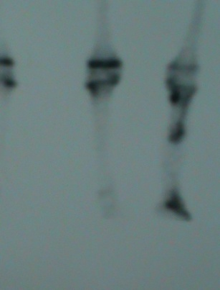
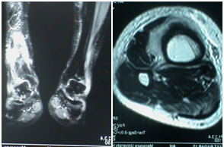

Slide 18
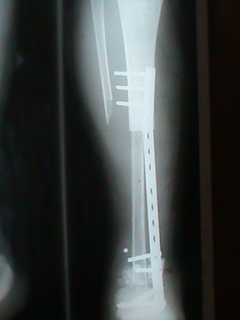
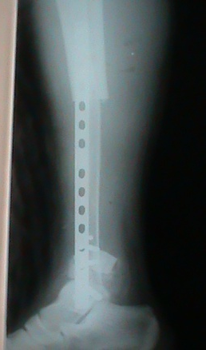
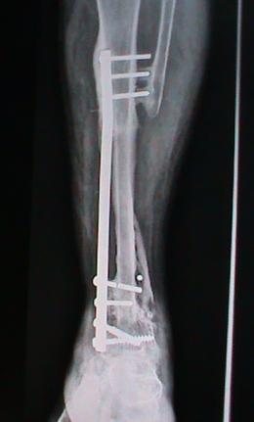
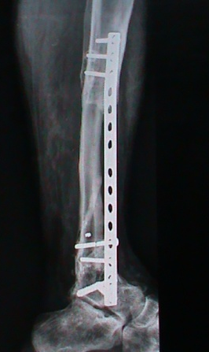

Slide 19
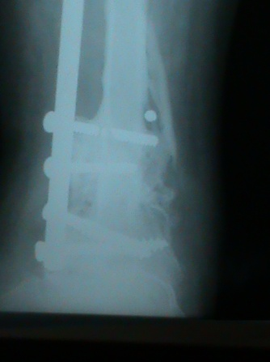
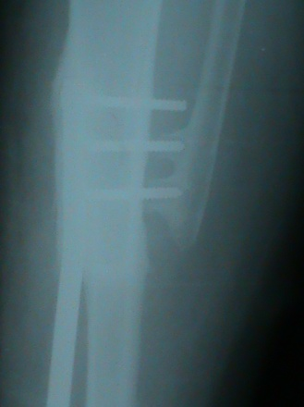
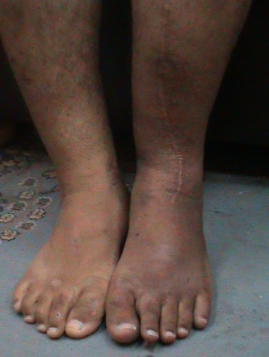

Slide 20
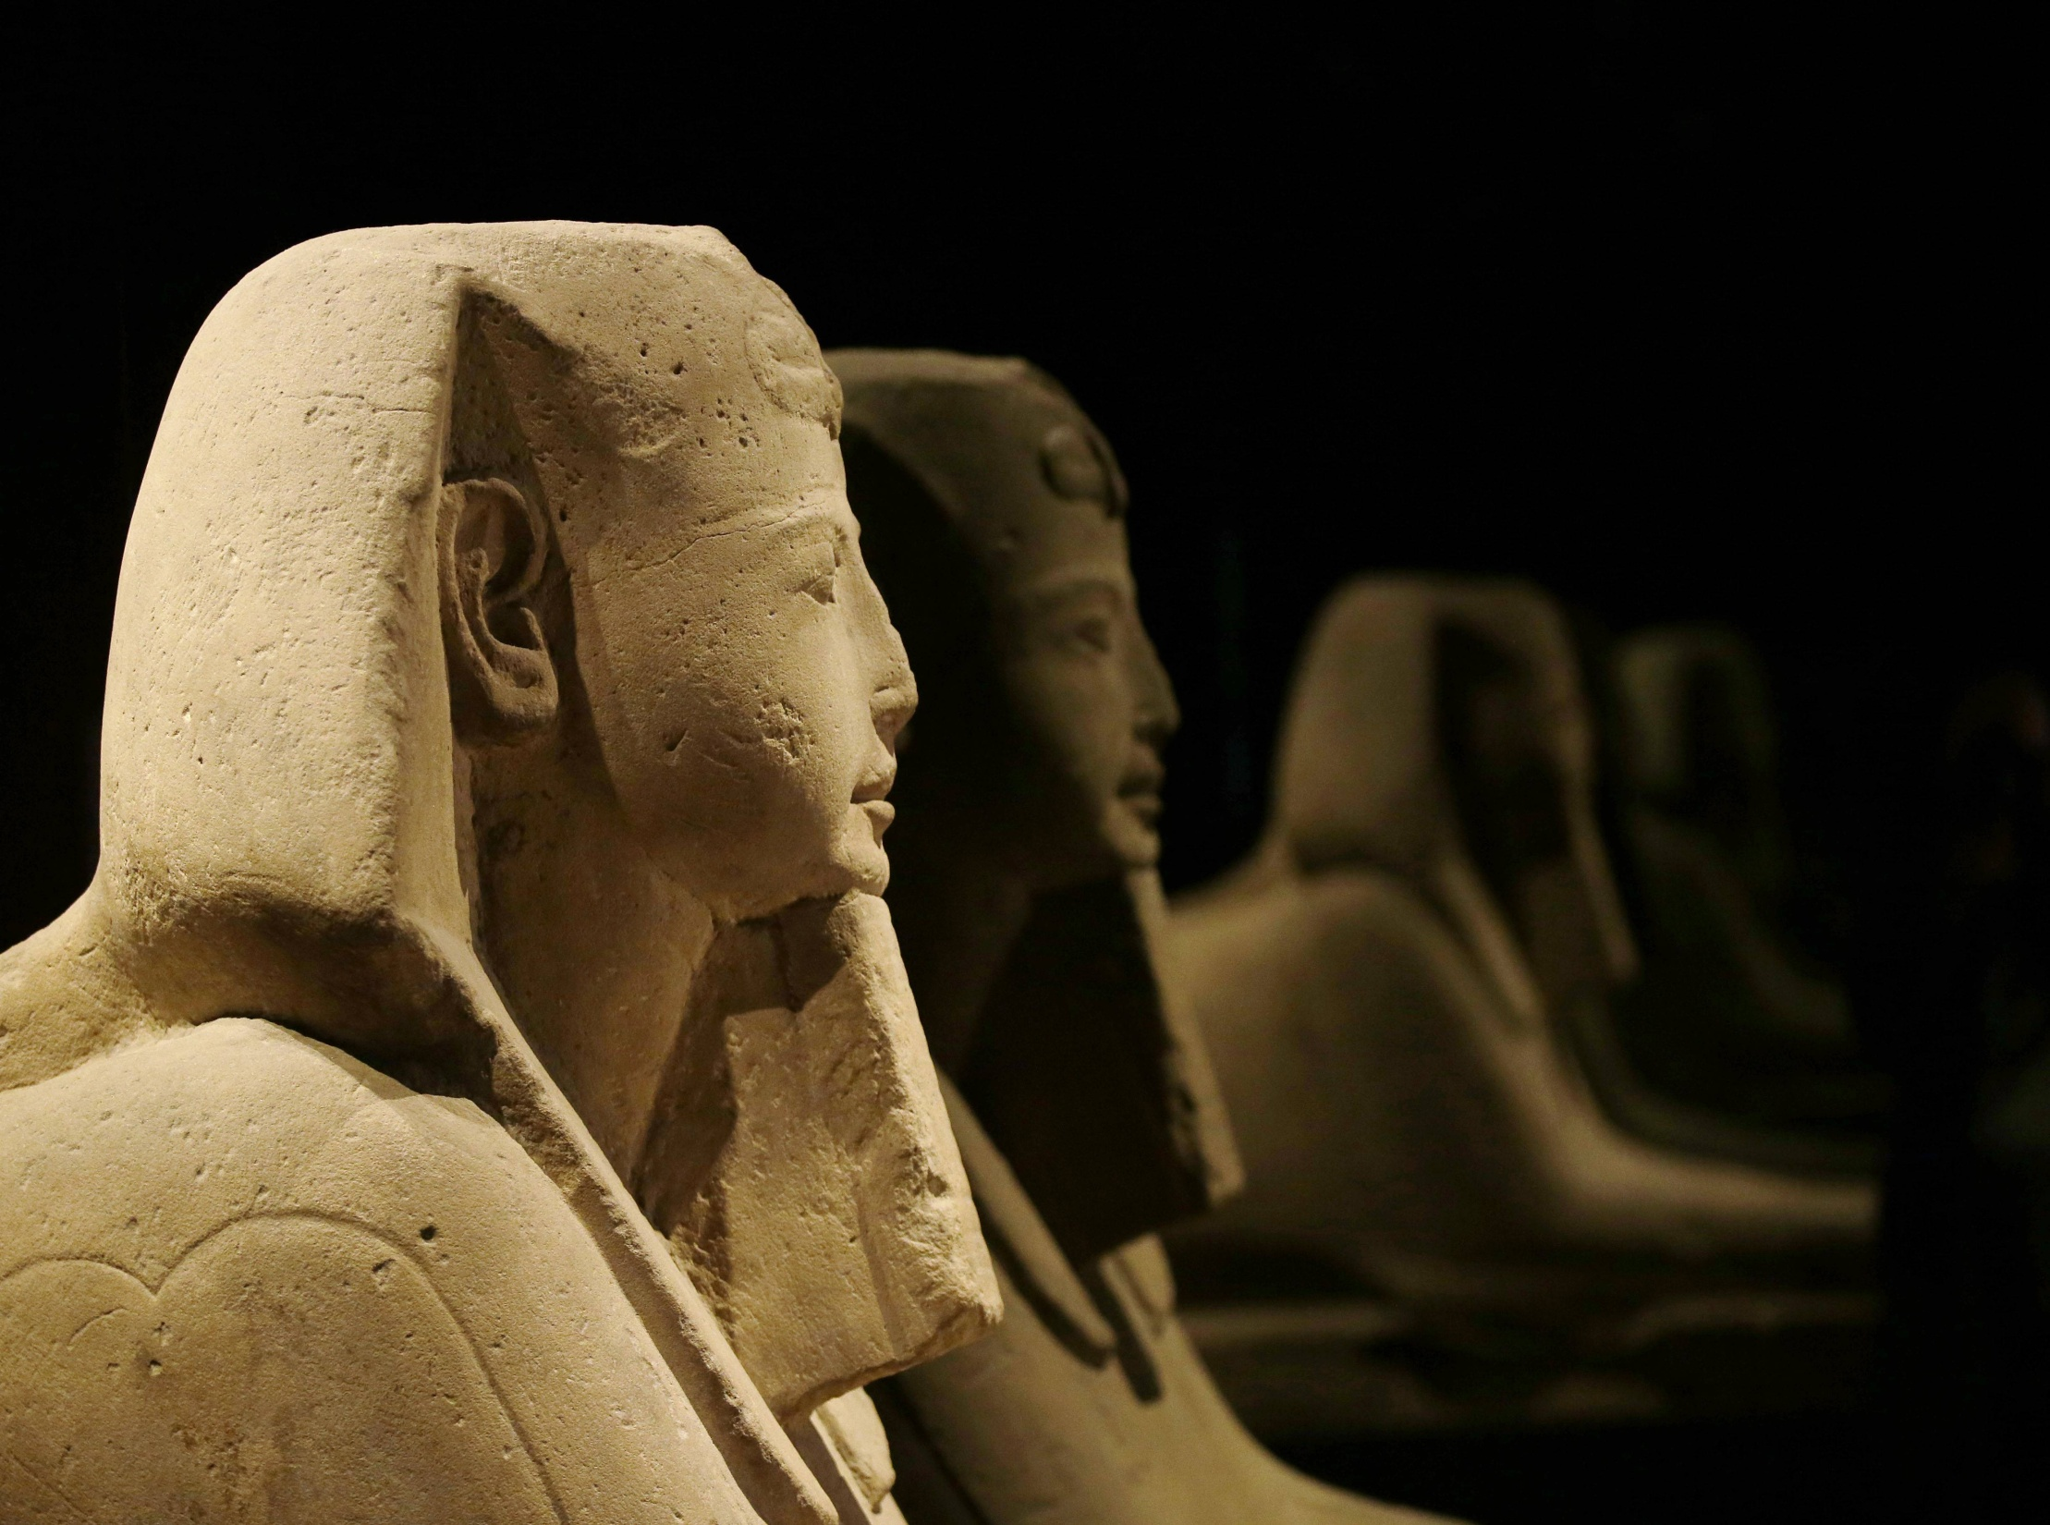
Discussion

Slide 21
Discussion
Various reconstructive techniques have been used for reconstructing of the tibial defects including:
    Large segmental allografts
    Vascularised or avascular autografts
    Extracorporeal irradiation
    Bone transport
    Mega prosthesis

Slide 22
Discussion
When evaluating a reconstruction technique various factors need to be considered including:
    Ease of the procedure
    Its morbidity
    Complications
    Functional outcome
    Durability.

Slide 23
Discussion
Avascular strut allograft is limited by the length of the resection and their availability nonunion, fracture , infection and fear of disease transmission
Distraction osteogenesis prolonged use of external pins.
endo-prostheses deteriorates with time

Slide 24
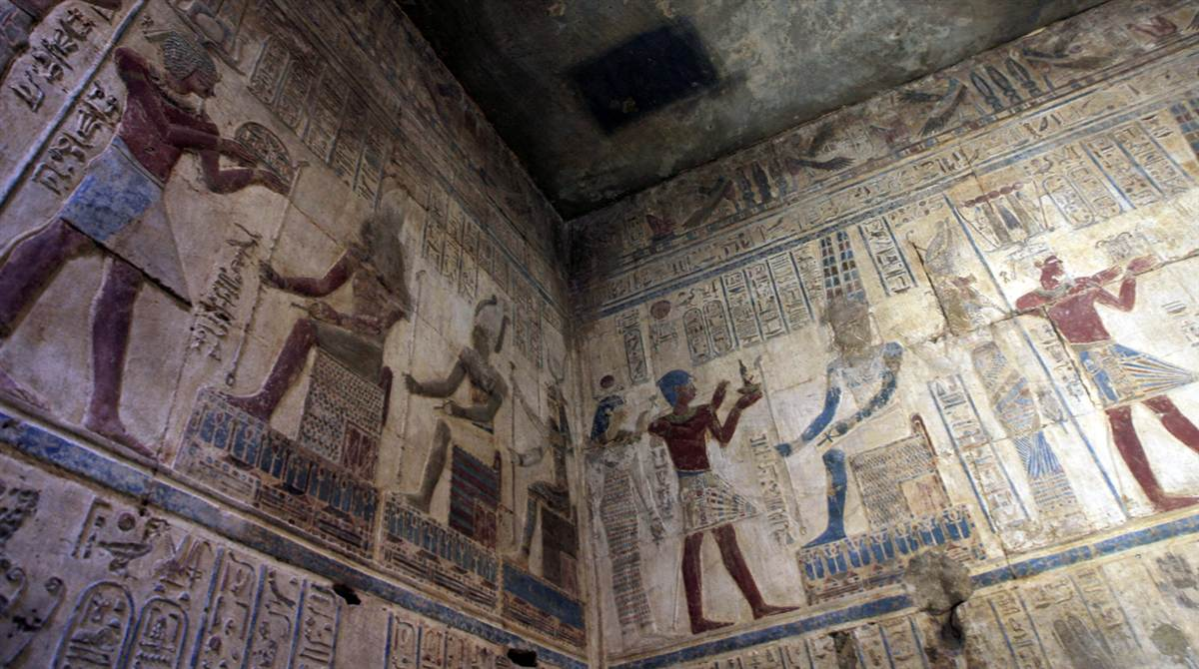
Conclusion

Slide 25
Conclusion
Ipsilateral vascularised fibular transfer is an easy, inexpensive technique that does not require micro-vascular skills.
It is also quicker to perform than transfers requiring vascular anastomosis.
The reduction in volume of the lower leg that follows antero-medial shift of the fibula makes skin closure easier.

Slide 26
Fibular Medialization
Advantages
Disadvantages
Loss of knee mobility
Loss of ankle mobility
Shortening
Bridge tibial defects irrespective of their size
Predictive outcome regarding union and hypertrophy
Inexpensive
Short procedure
Psychologically acceptable

Slide 27


