Slide 1
About OMICS Group
OMICS Group International is an amalgamation of Open Access publications and worldwide international science conferences and events. Established in the year 2007 with the sole aim of making the information on Sciences and technology ‘Open Access’, OMICS Group publishes 400 online open access scholarly journals in all aspects of Science, Engineering, Management and Technology journals. OMICS Group has been instrumental in taking the knowledge on Science & technology to the doorsteps of ordinary men and women. Research Scholars, Students, Libraries, Educational Institutions, Research centers and the industry are main stakeholders that benefitted greatly from this knowledge dissemination. OMICS Group also organizes 300 International conferences annually across the globe, where knowledge transfer takes place through debates, round table discussions, poster presentations, workshops, symposia and exhibitions.
OMICS Group International is an amalgamation of Open Access publications and worldwide international science conferences and events. Established in the year 2007 with the sole aim of making the information on Sciences and technology ‘Open Access’, OMICS Group publishes 400 online open access scholarly journals in all aspects of Science, Engineering, Management and Technology journals. OMICS Group has been instrumental in taking the knowledge on Science & technology to the doorsteps of ordinary men and women. Research Scholars, Students, Libraries, Educational Institutions, Research centers and the industry are main stakeholders that benefitted greatly from this knowledge dissemination. OMICS Group also organizes 300 International conferences annually across the globe, where knowledge transfer takes place through debates, round table discussions, poster presentations, workshops, symposia and exhibitions.

Slide 2
About OMICS Group Conferences
OMICS Group International is a pioneer and leading science event organizer, which publishes around 400 open access journals and conducts over 300 Medical, Clinical, Engineering, Life Sciences, Phrama scientific conferences all over the globe annually with the support of more than 1000 scientific associations and 30,000 editorial board members and 3.5 million followers to its credit.
OMICS Group has organized 500 conferences, workshops and national symposiums across the major cities including San Francisco, Las Vegas, San Antonio, Omaha, Orlando, Raleigh, Santa Clara, Chicago, Philadelphia, Baltimore, United Kingdom, Valencia, Dubai, Beijing, Hyderabad, Bengaluru and Mumbai.
OMICS Group International is a pioneer and leading science event organizer, which publishes around 400 open access journals and conducts over 300 Medical, Clinical, Engineering, Life Sciences, Phrama scientific conferences all over the globe annually with the support of more than 1000 scientific associations and 30,000 editorial board members and 3.5 million followers to its credit.
OMICS Group has organized 500 conferences, workshops and national symposiums across the major cities including San Francisco, Las Vegas, San Antonio, Omaha, Orlando, Raleigh, Santa Clara, Chicago, Philadelphia, Baltimore, United Kingdom, Valencia, Dubai, Beijing, Hyderabad, Bengaluru and Mumbai.

Slide 3





YUZUNCU YIL UNIVERSITY VAN/TURKEY
P
A Comparative Study on Machining Parameters Effects According to Taguchi Design Method By Turning Nickel Based Super Alloys Inconel 600 and Hastelloy X
ABDULLAH ALTIN
PHILADELPHIA-2014

Slide 4
CONTENT
Intent
Literature
Taguchi Method
Experimental Study
Numerical Analysis
Results and Discussion
Conclusions
References

Slide 5
TAGUCHI METHOD
Taguchi, is reached as a result of combining three tools.
To analyze and evaluate the numerical results
Orthogonal experimental design
The S/N (signal / noise) ratio and ANOVA (analysis of variance)

Slide 6
Stages of Taguchi Method
Determining Cutting Conditions
Selection of The Array Ortognal
Turning Tests
S/N Ratio
Anova Analysis
Determination of the most appropriate Cutting Conditions
Conclusions

Slide 7
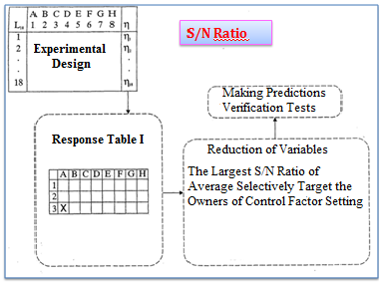
TAGUCHI METHOD-I

Slide 8
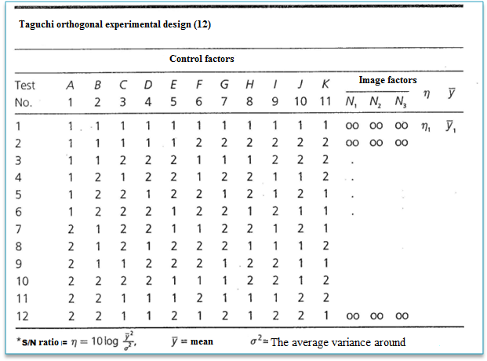
TAGUCHI METHOD-II

Slide 9
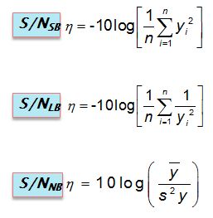
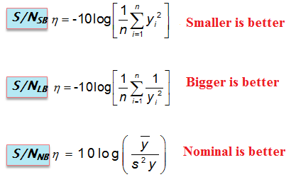
PERFORMANCE CHARACTERISTICS OF TAGUCHI
Taguchi method, the signal/noise (S/N) ratio depends on the performance characteristics of the three basic uses.

Slide 10
An experimental study
An experimental study
Method
Material
Orthogonal design
Cutting conditions
Cutting force and surface roughness measurement
Taguchi Analysis

Slide 11
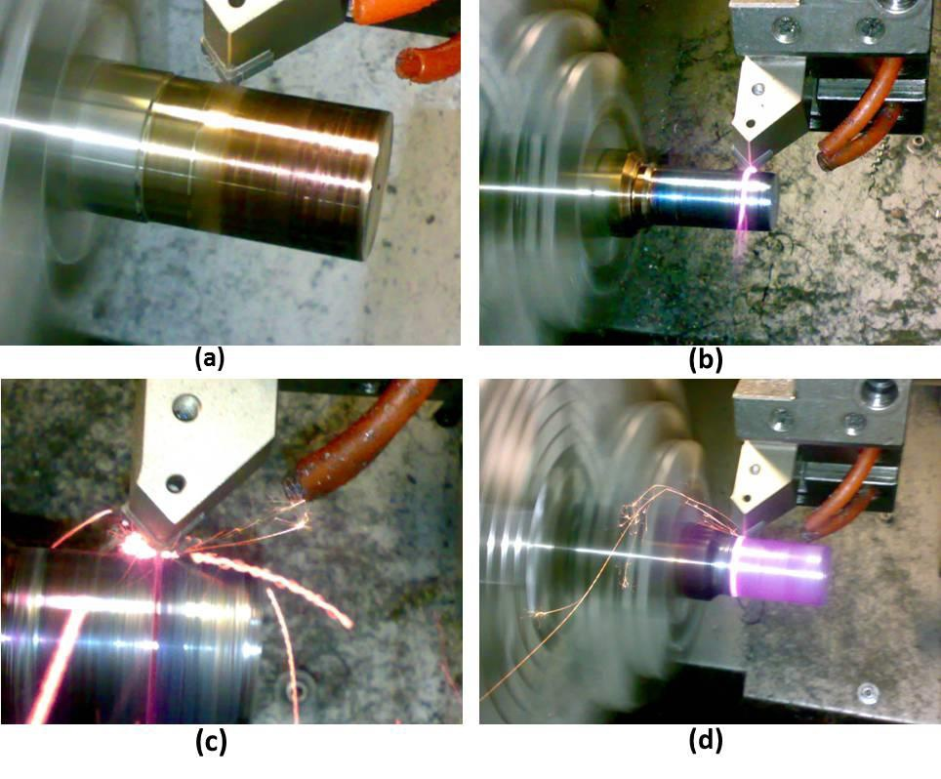
METHOD
METHOD
Control factors
V : Cutting speed
f: Feedrate
: Cutting tool
Out
(Cutting force-Surface fıinish)

Slide 12
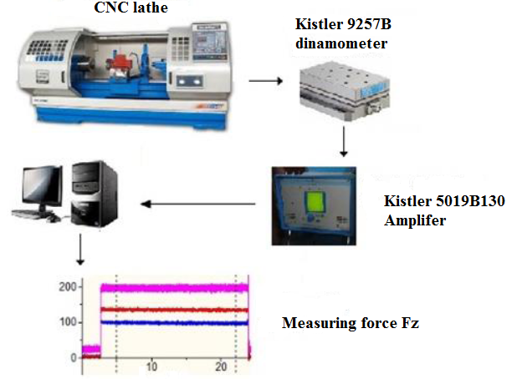

The experimental setup
and surface roughness Ra

Slide 13
MATERİALS
MATERİALS
Inconel 600 is a nickel based super alloy with excellent mechanical properties, corrosion resistance and withstand high temperatures in the aviation industry which need to be used in the manufacture of airframe and engine parts. Non-magnetic and is very resistant to many corrosive environments
Hastelloy X is a nickel-chromium-iron-molybdenum alloy developed for high temperature applications. Hastelloy X is a face-centered cubic (FCC), nickel-based and corrosion-resistant superalloy. The Hastelloy is derived from the strengthening particles, Ni2 (Mo, Cr), which is formed after the two-step age-hardening heat treatment process.

Slide 14
Chemical composition
Elements | Inconel 600 | Hastelloy X
Carbon (C) | 0.15 | 1
Silicon (Si) | 0.10 | 0.08
Chrome (Cr) | 17.50 | 20.5-23
Nickel (Ni) +Cobalt (Co) | 72 | 51
Molybdenum (Mo) |  | 8-10
Manganese (Mn) | 1 | 0.8
Phosphorus (P)
Sulfur (S) | 0.015 | 0.01
Iron (Fe) | 8.23 | 17-20
Bakır (Cu) | 0.5

Slide 15
CUTTING CONDITIONS
Levels | Parameters
 | F (mm/rev) (A) | V (m/min) (B) | Tool (C)
1 | 0.1 | 65 | K313
2 | 0.15 | 80 | KT315
3 |  | 100 | KC9240

Slide 16
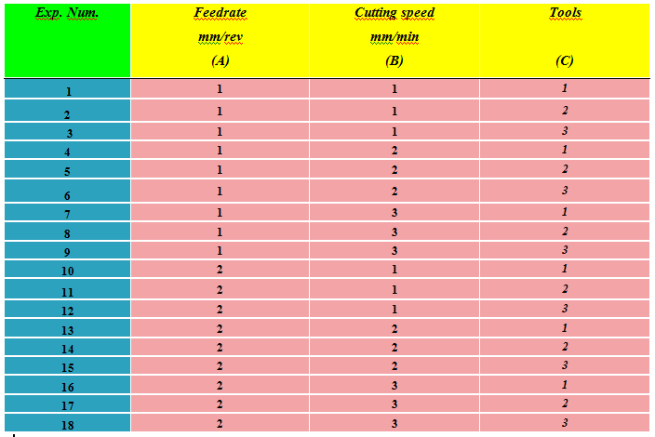
The Experimental setup
The experimental setup
Orthogonal design L18 2x (3)³

Slide 17
Types of cutting tools
Types of cutting tools
Cutting Tools
Covered tools
KT315
KC9240
Uncovered
K313

Slide 18
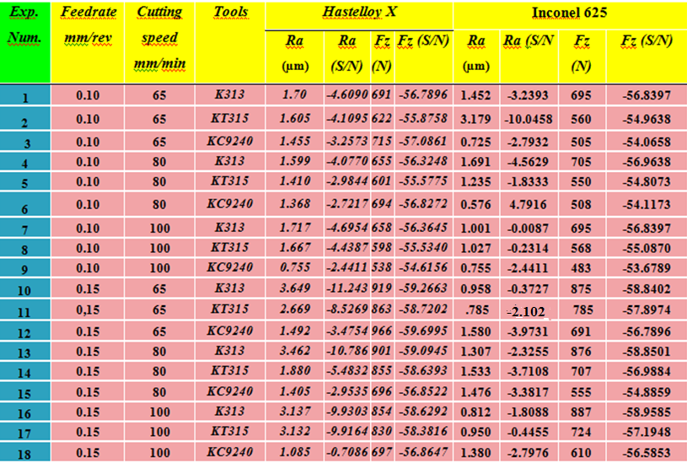
S/N ratio analysis
S/N_{SB}

Slide 19
THE AVERAGE ANSWER SHEET (Ra)
Parameters | Average of levels
 | Inconel 600 |  |  | Hastelloy X
 | I | II | III | I | II | III
A Feedrate (F) | -10.58 | -5.046 |  | -3.703 | -7.002
B Cutting speed (V) | -6.889 | -8.169 | -9.593 | -5.870 | -4.834 | -5.355
C Tools | -7.284 | -7.941 | -8.227 | -7.567 | -5.909 | -2.592

Slide 20
THE AVERAGE ANSWER SHEET
THE AVERAGE ANSWER SHEET (Fx)
Kesme Şartları | Average of levels
 | Inconel 600 |  |  | Hastelloy X
 | I | II | III | I | II | III
A Feedrate (F) | -54.097 | -55.889 |  | -56.110 | -58.460
B Cutting speed (V) | -55.637 | -55.004 | -54.338 | -57.058 | -57.219 | -56.731
C Tools | -56.176 | -53.945 | -56.591 | -57.744 | -57.121 | -56.990

Slide 21
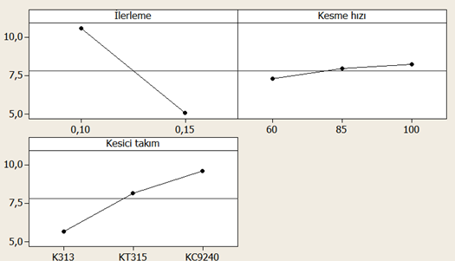
ANOVA ANALYSIS Inconel 600 (Ra)
Taguchi Optimization | Predict |  |  | Correction experiment
Level | A1B3C3 |  |  | A1B3C3
Cutting conditions | 0,10 | 100 | KC940 | 0,10 | 100 | KC9240
Surfage roughness (Ra) | 0.280 |  |  | 0.179
S/N ratio | -11.350 |  |  | -14.942
.
According to Ra’
Feed rate Cutting speed
Average S/N ratio
Cutting tool
S/N Smaller is better

Slide 22
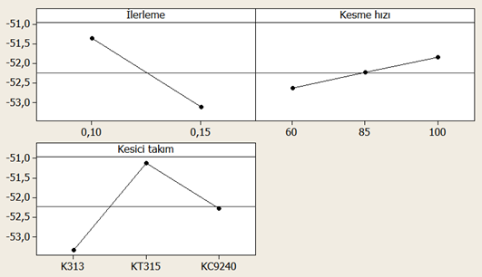
ANOVA ANALYSIS Inconel 600 (Fz)
Taguchi Optimization | Predict |  |  | Correction experiment
Level | A1B3C2 |  |  | A1B3C2
Cutting conditions | 0,10 | 100 | KT315 | 0,10 | 100 | KT315
Surfage roughness (Ra) | 780,389 |  |  | 765
S/N ratio | -57.717 |  |  | -57,673
According to Fz
Feed rate Cutting speed
Average S/N ratio
S/N Smaller is better
Cutting tool

Slide 23
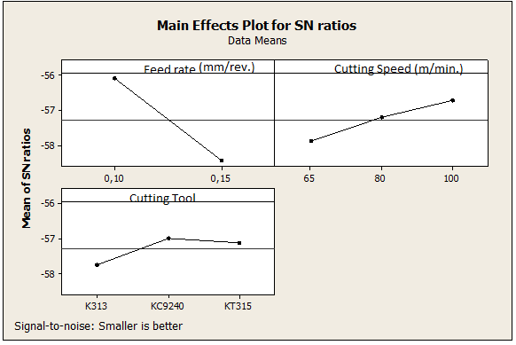
ANOVA ANALYSIS Hastelloy X (Fx)
Taguchi Optimization | Predict |  |  | Correction experiment
Level | A1B3C2 |  |  | A1B3C2
Cutting conditions | 0.10 | 100 | KC9240 | 0.10 | 100 | KC9240
Cutting force | 562 |  |  | 598
S/N ratio | -54.99 |  |  | -55.53
According to Fz
Average S/N ratio
S/N Smaller is better

Slide 24
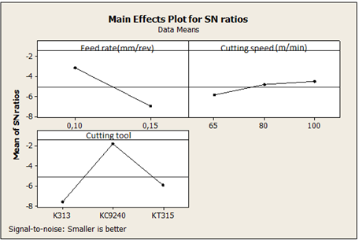
ANOVA ANALYSIS Hastelloy X (Ra)
Taguchi Optimization | Predict |  |  | Correction experiment
Level | A1B3C2 |  |  | A1B3C2
Cutting conditions | 0.10 | 100 | KC9240 | 0.10 | 100 | KC9240
Surface roughness | 1.050 |  |  | 1.667
S/N ratio | -0.423 |  |  | -4.43
According to Ra
Average S/N ratio
S/N Smaller is better

Slide 25
Hastelloy X (Ra)
Table 6. ANOVA results for the main cutting force (Fz) S/N ratio in Inconel 600
Parameters | Degree of freedom (Dof) | Sum of squares | Means of squares | F | P (p<0.05) | Effect of parameter (%)
Feed rate | 1 | 4.1424 | 4.1424 | 56.56 | 0.002 | 33.15
Cutting speed | 2 | 0.18817 | 0.09408 | 1.28 | 0.371 | 1.51
Cutting tool | 2 | 5.04646 | 2.52323 | 34.45 | 0.003 | 40.38
Error | 12 | 0.29294 | 0.07323 |  |  | 2.34
Total | 17 | 12.4974 |  |  |  | 100
Hastelloy X (Fz)
Parameters | Degree of freedom (Dof) | Sum of squares | Means of squares | F | P (p<0.05) | Effect of parameter (%)
Feed rate | 1 | 181805 | 181805 | 57.75 | 0.002 | 65.99
Cutting speed | 2 | 30700 | 15350 | 4.88 | 0.085 | 11.14
Cutting tool | 2 | 13213 | 6607 | 2.1 | 0.238 | 4.80
Error | 12 | 12592 | 3148 |  |  | 4.57
Total | 17 | 275517 |  |  |  | 100

Slide 26
Inconel 600 (Fx)
Parameters | Degree of freedom (Dof) | Sum of squares | Means of squares | F | P (p<0.05)
Feed rate | 1 | 14.457 | 14.4571 | 24.44 | 34.02
Cutting speed | 2 | 5.066 | 2.533 | 4.28 | 11.92
Cutting tool | 2 | 15.872 | 7.9361 | 13.42 | 37.35
Error | 12 | 7.098 | 0.5915 |  | 16.70
Total | 17 | 42.294 |  |  | 100.00
Inconel 600 (Ra)
Parameters | Degree of freedom (Dof) | Sum of squares | Means of squares | F | P (p<0.05)
Feed rate | 1 | 138,24289 | 138,2429 | 28,4011 | 56,13
Cutting speed | 2 | 46,80772 | 23,4039 | 4,8082 | 19,00
Cutting tool | 2 | 2,80624 | 1,4031 | 0,2883 | 01,13
Error | 12 | 58,41029 | 4,8675 |  | 23,71
Total | 17 | 246,26714 |  |  | 100,00

Slide 27
ConclusIons
• Array of parameters by the Taguchi method, the optimization of cutting parameters has been shown an efficient methodology.
• In turning operations average surface roughness and cutting forces can be controlled by three factors (cutting tool, cutting speed and feed rate).
• Using results of analysis of variance (ANOVA) and signal-to–noise (S/N) ratio, effects of parameters on both average surface roughness and cutting forces were statistically investigated according to the "the smaller is better" approach.
• It has seen that while cutting tool (37.35 %) and feed rate (34.02%) has higher effect on cutting force in Inconel 600, the feed rate (65,99%) and cutting speed (11,14) has higher effect on cutting force in Hastelloy X.
• While feed rate (56.13%) and cutting speed (19.00%) has higher effect on average surface roughness ın Inconel 600, cutting tool (40,38 %), and feedrate (33,15%) has higher effect on average surface roughness in Hastelloy X.

Slide 28
REFERENCES
1 P. Ganesan, C.M. Renteria, J.R. Crum, Verstile corrosion resistance of Inconel 625 in various aqueous and chemical processing environments, TMSPittsburgh,Pennsylvania, USA, 1991.
2 Special Metals Corporation Products, INCONEL® alloy 625, www.specialmetals.com/products.
3 H. Bohm, K. Ehrlich, K.H. Kramer, Metall 24 (1970) 139–144.
4 H.K. Kohl, K. Peng, J. Nucl. Mater. 101 (1981) 243–250.
5 W.E. Quist, R. Taggart, D.G. Polonis, Metall. Trans. 2 (1971) 825–832.
6 M. Sundararaman, P. Mukhopadhyay, S. Banerjee, Metall. Trans. A 19 (1988) 453–465.
7 T. Charles, Int. J. Press. Vessels Piping 59 (1994) 41–49.
8 V. Shankar, K. Bhanu Sankar Rao, S.L. Mannan, J. Nucl. Mater. 288 (2001) 222–232.
9 L.E. Shoemaker, in: E.A. Loria (Ed.), Superalloys 718, 625, 706 and Various Derivatives, TMS,Warrendale, PA, 2005, pp. 409–418.
G.H. Gessinger, Powder Metallurgy of Superalloys, Butterworth & Co., London, 1984, pp. 3–15.
11 J.J. Valencia, J. Spirko, R. Schmees, in: E.A. Loria (Ed.), Superalloys 718, 625, 706 and Various Derivates, TMS,Warrendale, PA, 1997, pp. 753–762.
12 S. Sun, M. Brandt, M.S. Dargusch, Characteristics of cutting forces and chi formation in machining of titanium alloys, International Journal of Machine Tools and Manufacture 49 (2009) 561–568.
13 S. Ranganath, A.B. Campbell, D.W. Gorkiewicz, A model to calibrate and predict forces in machining with honed cutting tools or inserts, International Journal of Machine Tools & Manufacture 47 (2007) 820–840.
14 E.S. Topal, C. Cogun, A cutting force induced error elimination method for turning operations, Journal of Materials Processing Technology 170 (2005) 192–203.
15 Montgomery DC. Design and analysis of experiments. 4th ed. New York: Wiley; 1997.
16 Yavaşkan, M.,Taptık, Y ve Urgen, M., Deney tasarımı yontemi ile matkap uclarında performans optimizasyonu, İTÜ Dergisi/d, Cilt 3, no 6, 2004, 117-128
17 Nalbant, M., H. Gokkaya, G. Sur.Application of Taguchi method in the optimization of cutting parameters for surface roughness in turning. Materials and Design 28 (2007): 1379–1385
18 Yang H, Tarng Y.S. Design optimization of cutting parameters for turning operations based on the Taguchi method. J Mater Process
19 R. K. Roy, A primer on the Taguchi method / Ranjit K. Roy, Van Nostrand Reinhold, New York, (1990)
20 G. Tosun, Statistical analysis of process parameters in drilling of AL/SIC P metal matrix composite, International Journal of Advanced Manufacturing Technology, 55 (2011) 5–8, 477–485

Slide 29
Thanks
For listening to me
Dr. Abdullah ALTIN
aaltin@gmail.com
VAN/TURKEY

Slide 30
Let Us Meet Again
We welcome you all to our future conferences of OMICS Group International
Please Visit:
www.omicsgroup.com
www.conferenceseries.com
http://mechanical-aerospace.conferenceseries.com/

