Slide 1


9 th International Congress on
Nutrition and Health
Evaluation of antioxidant activity of wild medicinal plant Ziziphora tenuior L and using plant tissue culture to increase its activity
Dr. Abdulkarim Dakah
Researcher in TACT Company for food complements
and plant oils.
Associated professor in International University for
Sciences and Technology
abdu83alkarim@yahoo.com
00249990582592

Slide 2
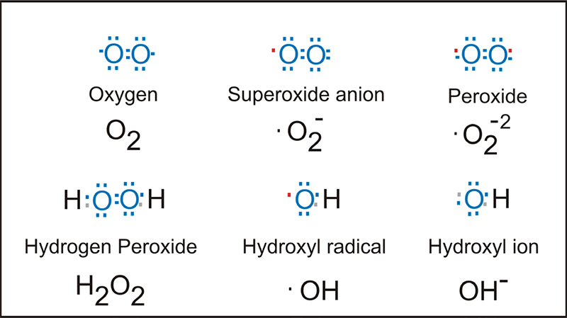
What are the Reactive oxygen species (ROS)?

Slide 3
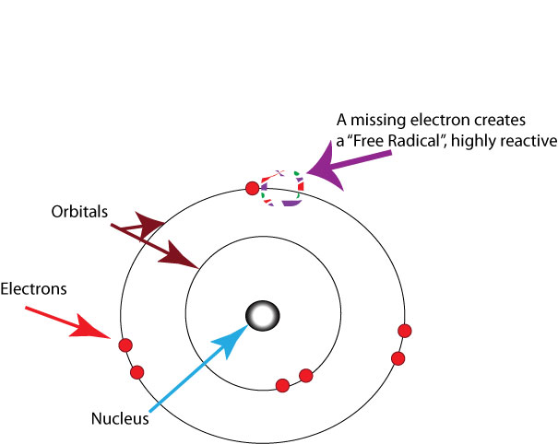

Slide 4
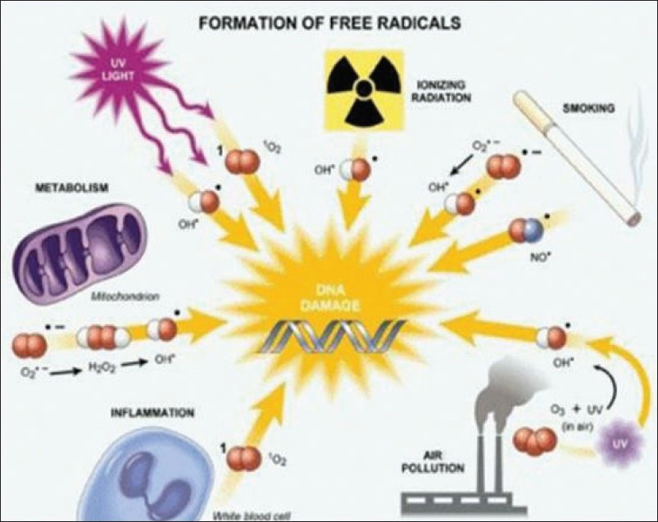

Slide 5
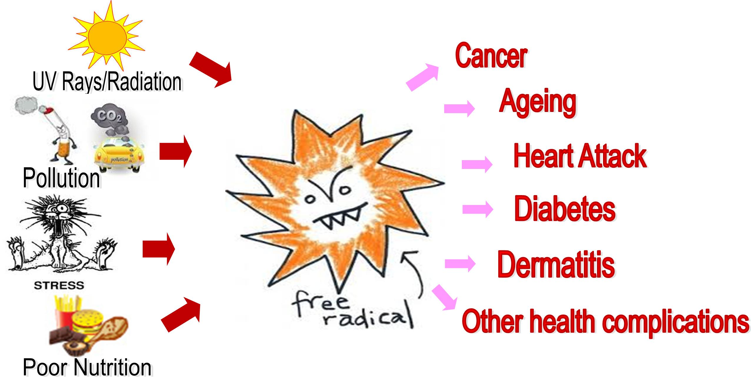
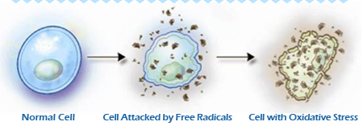
What are the diseases by ROS?

Slide 6
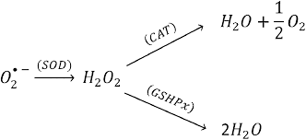
How can we reduce ROS in our body?

Slide 7
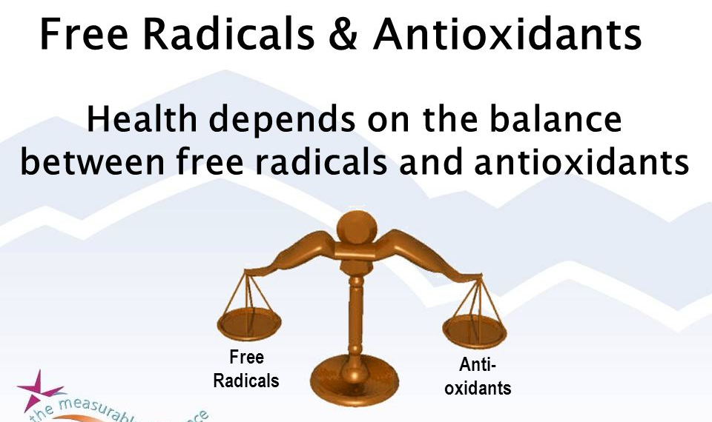

Slide 8
Antioxidant
Free radical

Slide 9
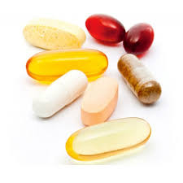

Slide 10
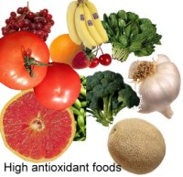

Slide 11
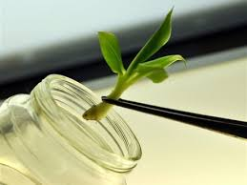
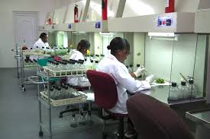
Plant tissue culture and medicinal plants

Slide 12
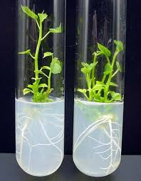
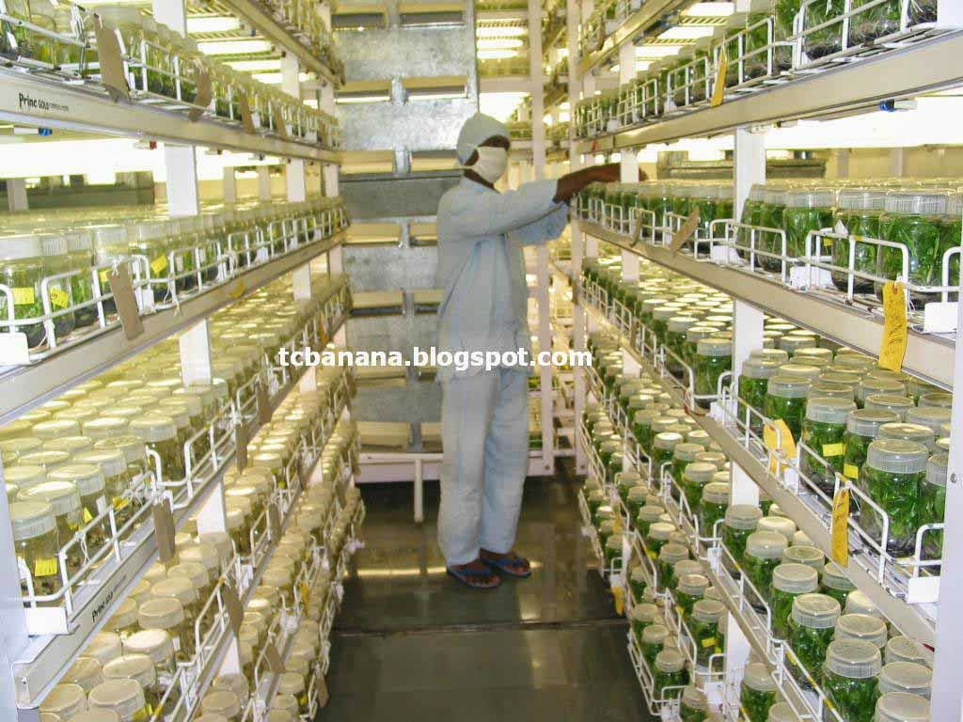
Importance of Plant tissue culture

Slide 13
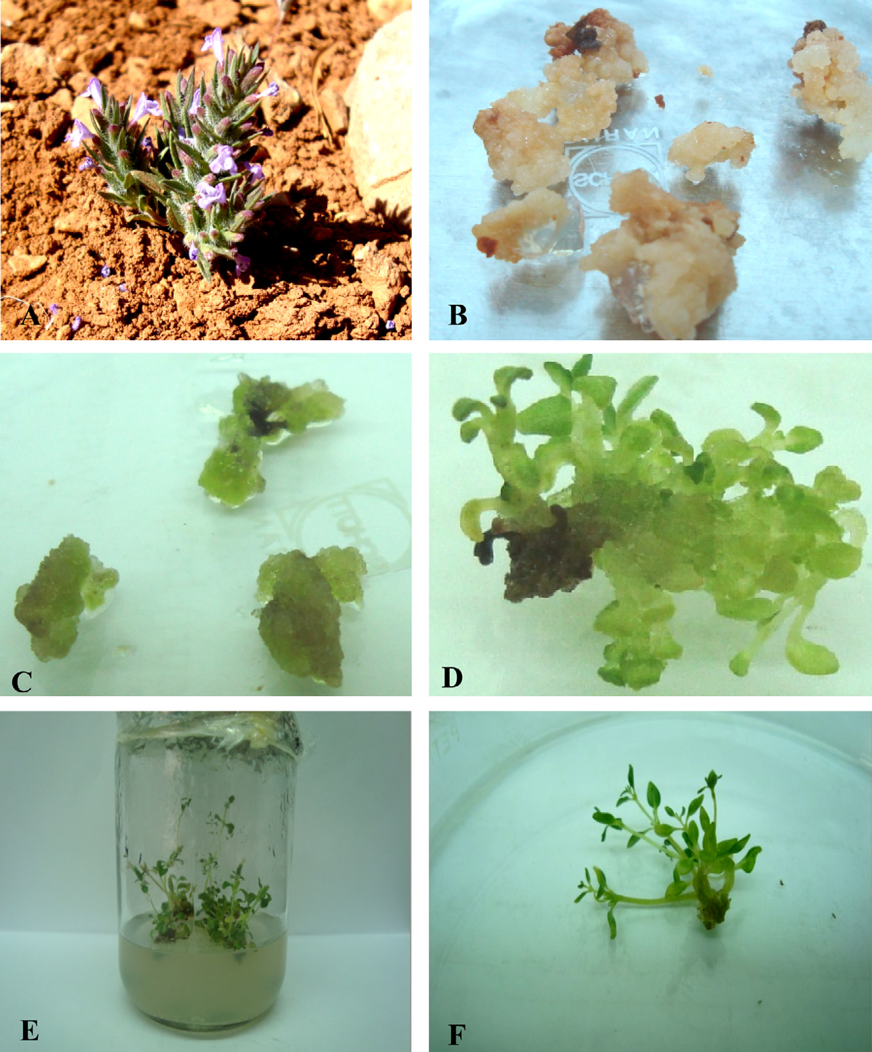
Ziziphora tenuior

Slide 14
Why Z. tenuior?

Slide 16
IC₅₀ (mg/ml) | Extract type (Growth regulators combination)
9.229± 0.144 f | Methanol extract of wild plant
0.516± 0.001 b | Aqueous extract of wild plant
8.712± 0.016 e | Methanol extract of plant (0.5 Kin + 0.1 NAA)
0.399± 0.011 ab | Aqueous extract of plant (0.5 Kin + 0.1 NAA)
8.452± 0.016 d | Methanol extract of plant (1 Kin + 0.1 NAA)
0.369± 0.001 a | Aqueous extract of plant (1 Kin + 0.1 NAA)
8.026± 0.013 c | Methanol extract of plant (1.5 Kin + 0.1 NAA)
0.307± 0.001 a | Aqueous extract of plant (1.5 Kin + 0.1 NAA)
8.832± 0.035 e | Methanol extract of plant (0 Kin + 0 NAA)
0.411± 0.007 ab | Aqueous extract of plant (0 Kin + 0 NAA)

Slide 17
Conclusions
we can use plant tissue culture to increase the active substance.
our results showed that the water extracts of in vitro produced plants showed an increase in antioxidant activity as compared to the starting material (wild plant).

Slide 18
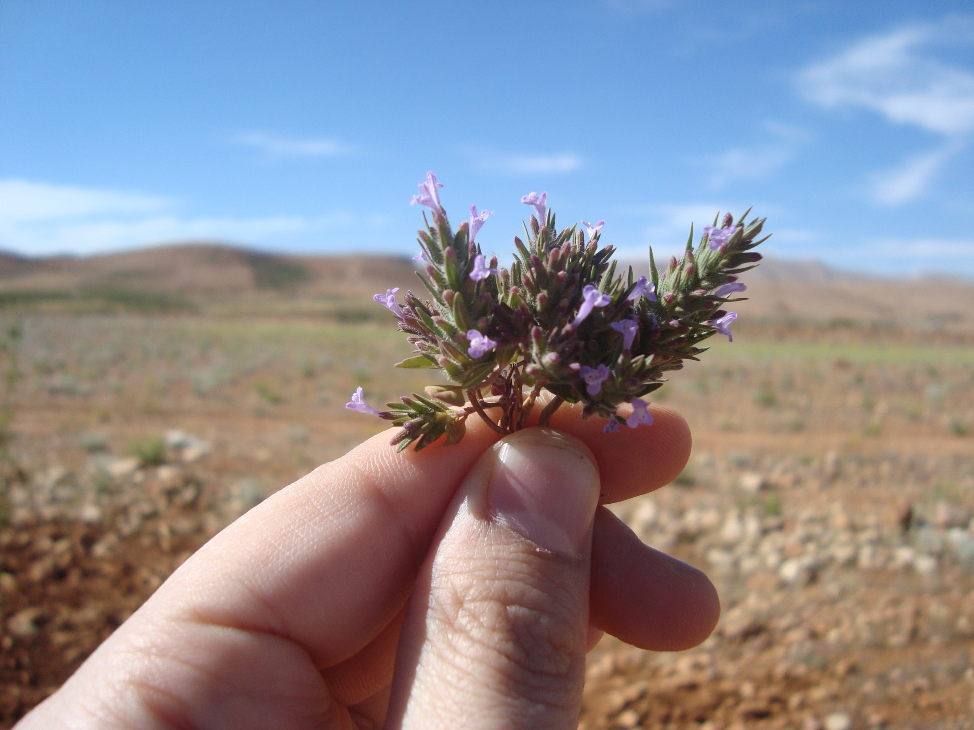
Thank you

