Slide 1

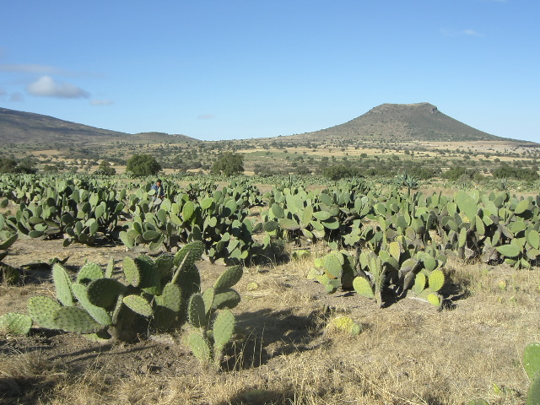
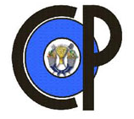
EFFECT OF ENDOMYCORRHIZA (Glomus sp.) AND ORGANIC MATTER ON CACTUS PEAR (Opuntia albicarpa) GROWTH IN TWO SOIL TYPES
Gardezi, A. K., Márquez-Berber, S. R., Figueroa-Sandoval, B., Flores-Magdaleno, H., Martínez-Menes, M; Larqué-Saavedra U. , Almaguer-Vargas, G.

Slide 2
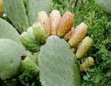
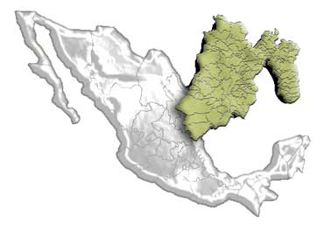
Introduction
There are over 360 species of Opuntia genus.
They have a wide distribution in the Americas.
Mexico is considered one of the two center of origin and dispersion of this genus, and it has the greatest number of species and cultivars of cactus pear in the world.
Opuntia species are cultivated for different purposes.

Slide 3
Introduction
Important in Mexico.
    Culture
    Uses
      Food
      Medicinal
      Industrial
The State of Mexico is the main producer with 42% of the national production.

Slide 4
General Objective
To study the effect of organic matter and endomycorrhiza on cactus pear (Opuntia albicarpa) growth in two soil types under greenhouse conditions.

Slide 5
Materials and methods
The present study was carried out using two soil types from San Luis Potosi State, Mexico. One red (xerosol) and another grey (litosol).
The study lasted 270 days from planting to harvest and was conducted under greenhouse conditions at Colegio de Postgraduados, Montecillo Campus, State of Mexico, in the spring of 2014.

Slide 6
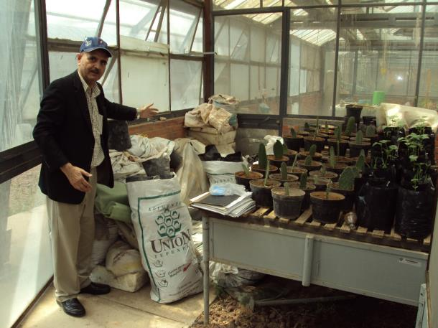
Soil and Greenhouse

Slide 7
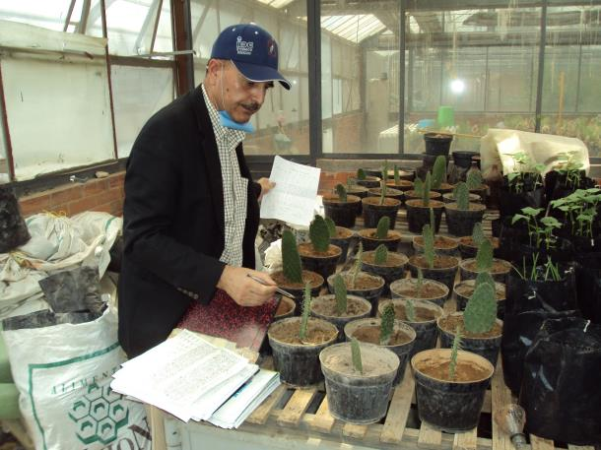
Data Collecting

Slide 8
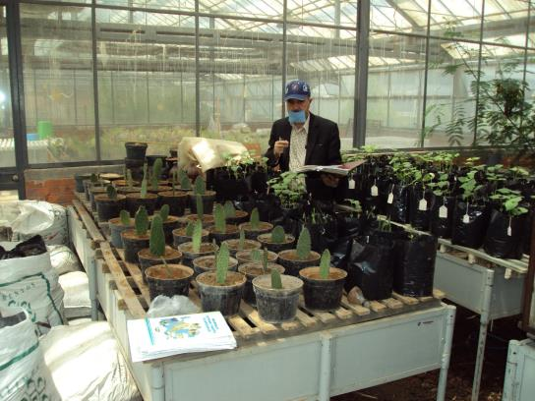
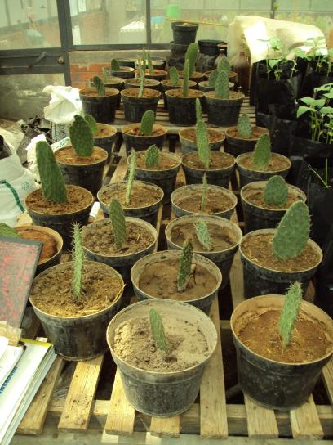
Experimental Site

Slide 9
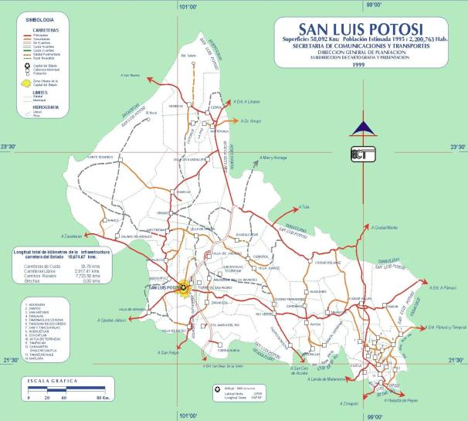
San Luis Potosi State, Mexico.
Soil sampled area

Slide 10
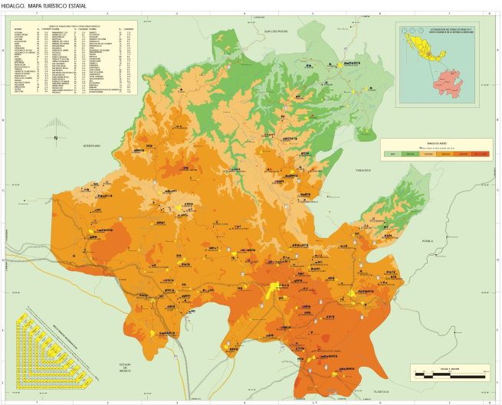
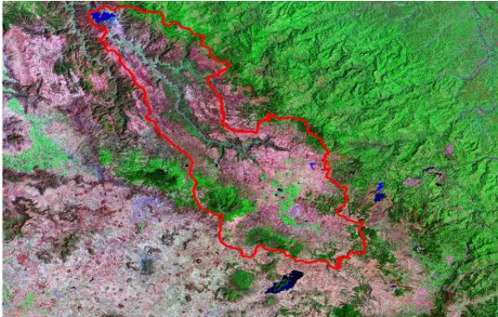
Tulancingo, Hidalgo, Mexico.
Cactus Pear Sampling Area
Irrigation District 028

Slide 11
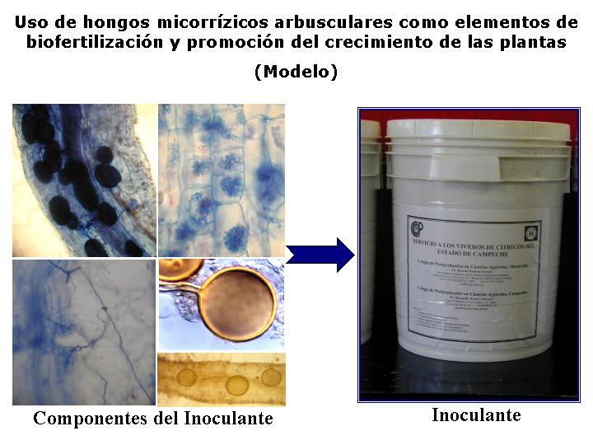
Mycorrhizal Fungi
Inoculant Components
Inoculant

Slide 12
Soil characteristics
Both soil types were collected at the San Luis Potosi State, north Mexico. Grey soil is medium alkaline, the red one is neutral. Both have medium amounts of inorganic nitrogen and a low one of phosphorus. The contents of iron, manganese, and zinc are adequate. Grey soil is deficient in copper, but the red one has sufficient quantity.
The soil organic matter was determined using the Walkey and Black method, for phosphorus, Olsen was used. Interchangeable bases were measured utilizing ammonium acetate pH 7:1 Normal (CH₃COONH₄), and micronutrients with DTPA (from dietilen-triamino-pentaacetic acid).

Slide 13
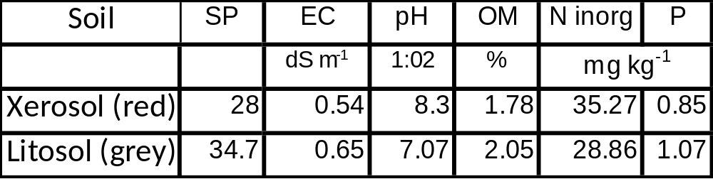
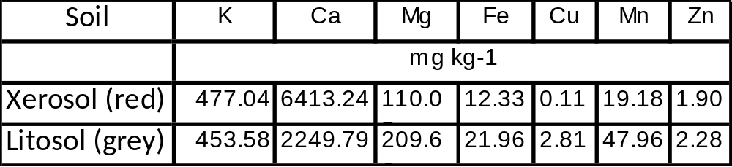
Soil characteristics
Key: SP=Saturation point, EC=Electric conductivity, pH= Hydrogen potential, OM= Organic matter, N inorg= Inorganic nitrogen.

Slide 14
RESULTS AND DISCUSSION

Slide 15
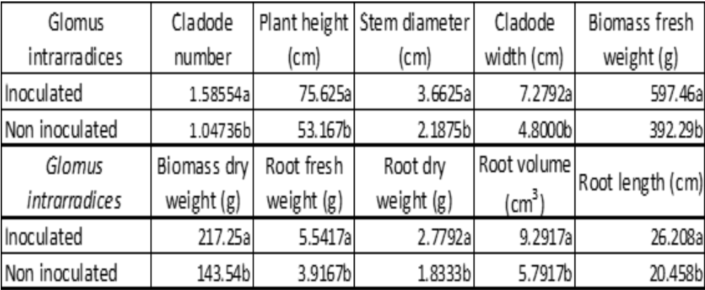
Effect of the inoculation with Glomus intrarradices

Slide 16
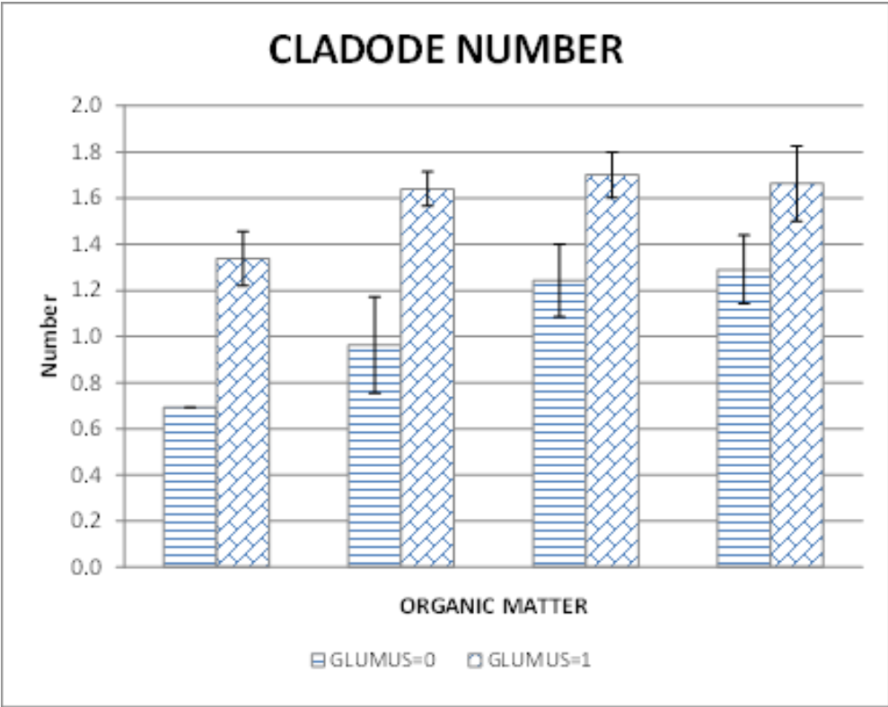
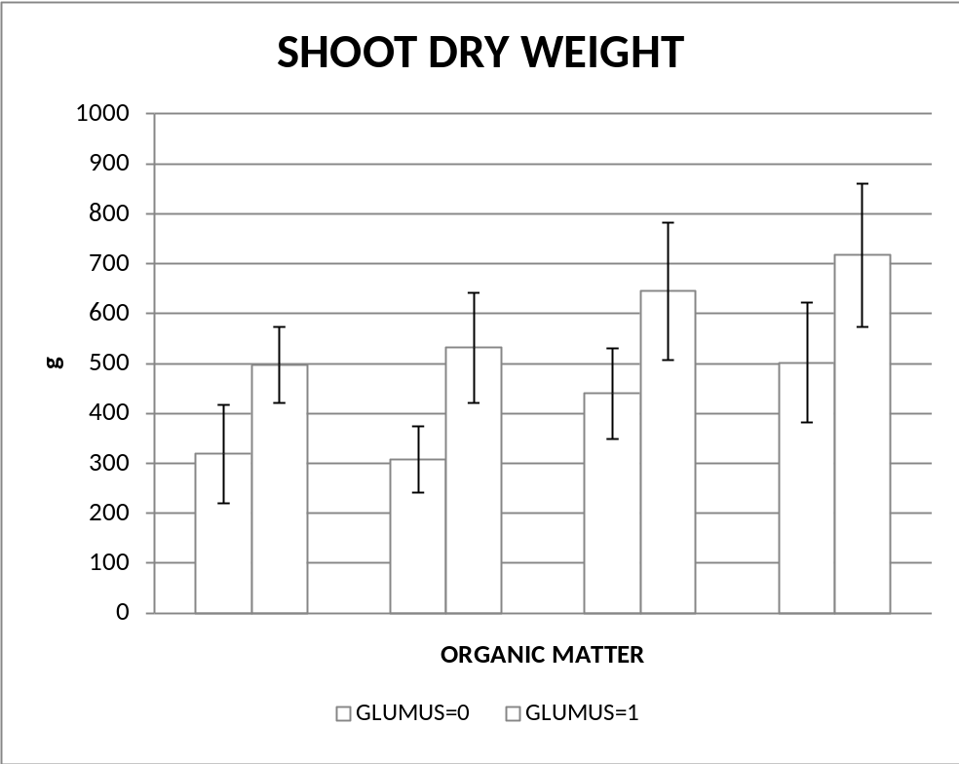
Effect of Inoculation and Organic Matter
The treatments are from left to right: 0, 25, 50, and 75 t ha⁻¹ of organic matter. GLUMUS=0: Noninoculated, GLUMUS=1: Inoculated with Glomus intrarradices.
The treatments are from left to right: 0, 25, 50, and 75 t ha⁻¹ of organic matter. GLUMUS=0: Noninoculated, GLUMUS=1: Inoculated with Glomus intrarradices.

Slide 17
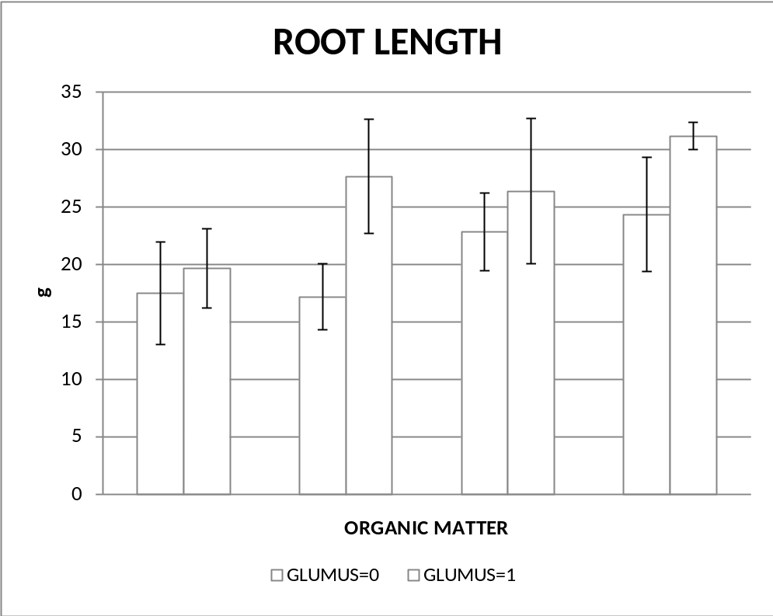
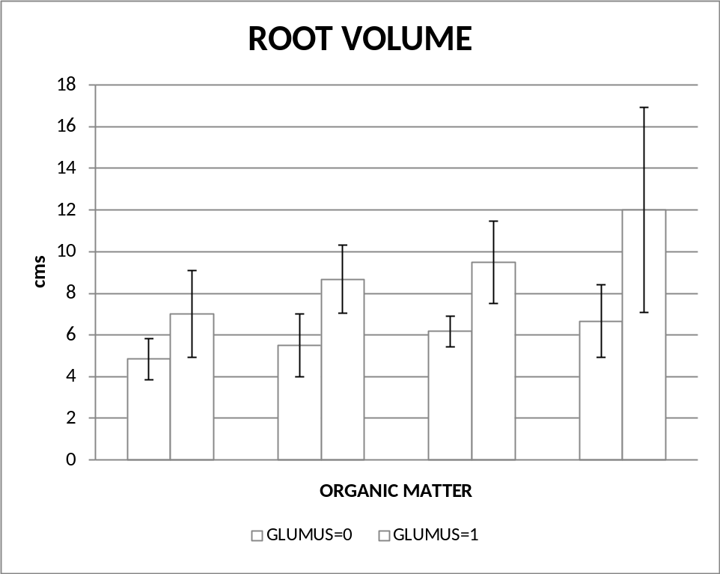
Effect of Inoculation and Organic Matter 2
The treatments are from left to right: 0, 25, 50, and 75 t ha⁻¹ of organic matter. GLUMUS=0: Noninoculated, GLUMUS=1: Inoculated with Glomus intrarradices.
The treatments are from left to right: 0, 25, 50, and 75 t ha⁻¹ of organic matter. GLUMUS=0: Noninoculated, GLUMUS=1: Inoculated with Glomus intrarradices.

Slide 18
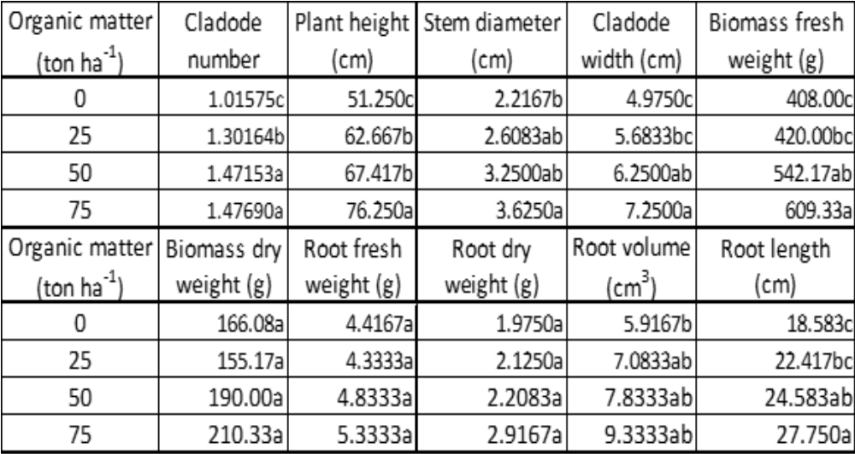
Effect of organic matter

Slide 19
Conclusions
Mycorrhizal inoculation provided higher cactus pear root growth and thus promoted better shoot development. The application of organic matter, as vermicompost, improved plant growth too. The soil type did not affect plant growth. Mycorrhiza can be useful to improve mineral nutrition. These fungi can increase yields, and reduce cost of production in cactus pear plantations. Vermicompost is a better alternative to apply organic matter in this crop.

