Slide 1
About OMICS Group
OMICS Group is an amalgamation of Open Access Publications and worldwide international science conferences and events. Established in the year 2007 with the sole aim of making the information on Sciences and technology ‘Open Access’, OMICS Group publishes 500 online open access scholarly journals in all aspects of Science, Engineering, Management and Technology journals. OMICS Group has been instrumental in taking the knowledge on Science & technology to the doorsteps of ordinary men and women. Research Scholars, Students, Libraries, Educational Institutions, Research centers and the industry are main stakeholders that benefitted greatly from this knowledge dissemination. OMICS Group also organizes 500 International conferences annually across the globe, where knowledge transfer takes place through debates, round table discussions, poster presentations, workshops, symposia and exhibitions.

Slide 2
OMICS International Conferences
OMICS International is a pioneer and leading science event organizer, which publishes around 500 open access journals and conducts over 500 Medical, Clinical, Engineering, Life Sciences, Pharma scientific conferences all over the globe annually with the support of more than 1000 scientific associations and 30,000 editorial board members and 3.5 million followers to its credit.
OMICS Group has organized 500 conferences, workshops and national symposiums across the major cities including San Francisco, Las Vegas, San Antonio, Omaha, Orlando, Raleigh, Santa Clara, Chicago, Philadelphia, Baltimore, United Kingdom, Valencia, Dubai, Beijing, Hyderabad, Bengaluru and Mumbai.

Slide 3
Study of Some Egyptian Plants of Potential Use in Some Cases of Hepatic Disorders
Previous Study:
Notes:
My PhD thesis title is:
Study of Some Egyptian Plants of Potential Use in Some Cases of Hepatic Disorders

Slide 4
Hepatic disorders
Worldwide problem.
Globally, Hepatitis C Virus (HCV) infects an estimated 170 million people, and causes a 500,000 deaths per year due to complications of late-stage liver diseases.
Notes:
Liver diseases is a worldwide problem.
Globally, Hepatitis C Virus (HCV) infects an estimated 170 million people, and causes a 500,000 deaths per year due to complications of late-stage liver diseases

Slide 5
Situation in Egypt
Approximately 20% of Egyptian blood donors are anti-HCV positive.
Other estimates that Egypt has the highest prevalence of HCV worldwide, ranging from 6% to more than 40% among regions and demographic groups.
Notes:
In Egypt, the problem is even more exaggerated.
Approximately 20% of Egyptian blood donors are anti-HCV positive.
Other estimates that Egypt has the highest prevalence of HCV worldwide, ranging from 6% to more than 40% among regions and demographic groups

Slide 6
Cynara scolymus
Marketed Products
Family Asteraceae
Tribe Cynareae
Silybum marianum
Notes:
Most of these marketed products include extract of either:
Cynara scolymus
or
Silybum marianum
Both plants belong to family Asteraceae and tribe Cynareae

Slide 7
Therefore
Tribe Cynareae
Notes:
Therefore there was considerable interest in screening of available Members of the Tribe Cynareae for hepatoprotective activity.

Slide 8
Screening of Some Available Members of the Tribe Cynareae for Hepatoprotective Activity
Journal of Medicinal Plants Research, 7(7); 324-328, 2013.
Notes:
PART I
Hepatoprotective Activity of Some Members of the Tribe Cynareae Growing in Egypt

Slide 9
Hepatoprotective Assay procedures
In-vivo test models
In-vitro test models
Serum level of liver enzymes is raised.
The extent of its control by the antihepatotoxic drug under test is used as a basis for estimation.
Histopathological Examination
Notes:
Hepatoprotective Assay procedures
In-vivo and In-vitro test models were developed for the evaluation of antihepatotoxic activity of plants.
In liver damage Serum level of liver enzymes is raised.
The extent of its control by the antihepatotoxic drug under test is used as a basis for estimation.
Histopathological exiamination of liver tissues of animals is also used as a guide for the degree of injury.

Slide 10
Screening of Some Available Members of the Tribe Cynareae
Members of the family Asteraceae especially tribe Cynarea are known for their efficacy in relieving some liver disorders.
Plants of tribe Cynareae are very common in the Egyptian flora.
This tribe is represented in Egypt by many genera such as Silybum, Cynara, Centaurea, Carduus, Onopordon, …….etc.
Journal of Medicinal Plants Research, 7(7); 324-328, 2013.
Notes:
As we mentioned before, members of the family Asteraceae especially tribe Cynarea are known for their efficacy in relieving some liver disorders.
Plants of tribe Cynareae are very common in the Egyptian flora.
This tribe is represented in Egypt by many genera such as Silybum, Cynara, Centaurea, Carduus, Onopordon, …….and several others.

Slide 11
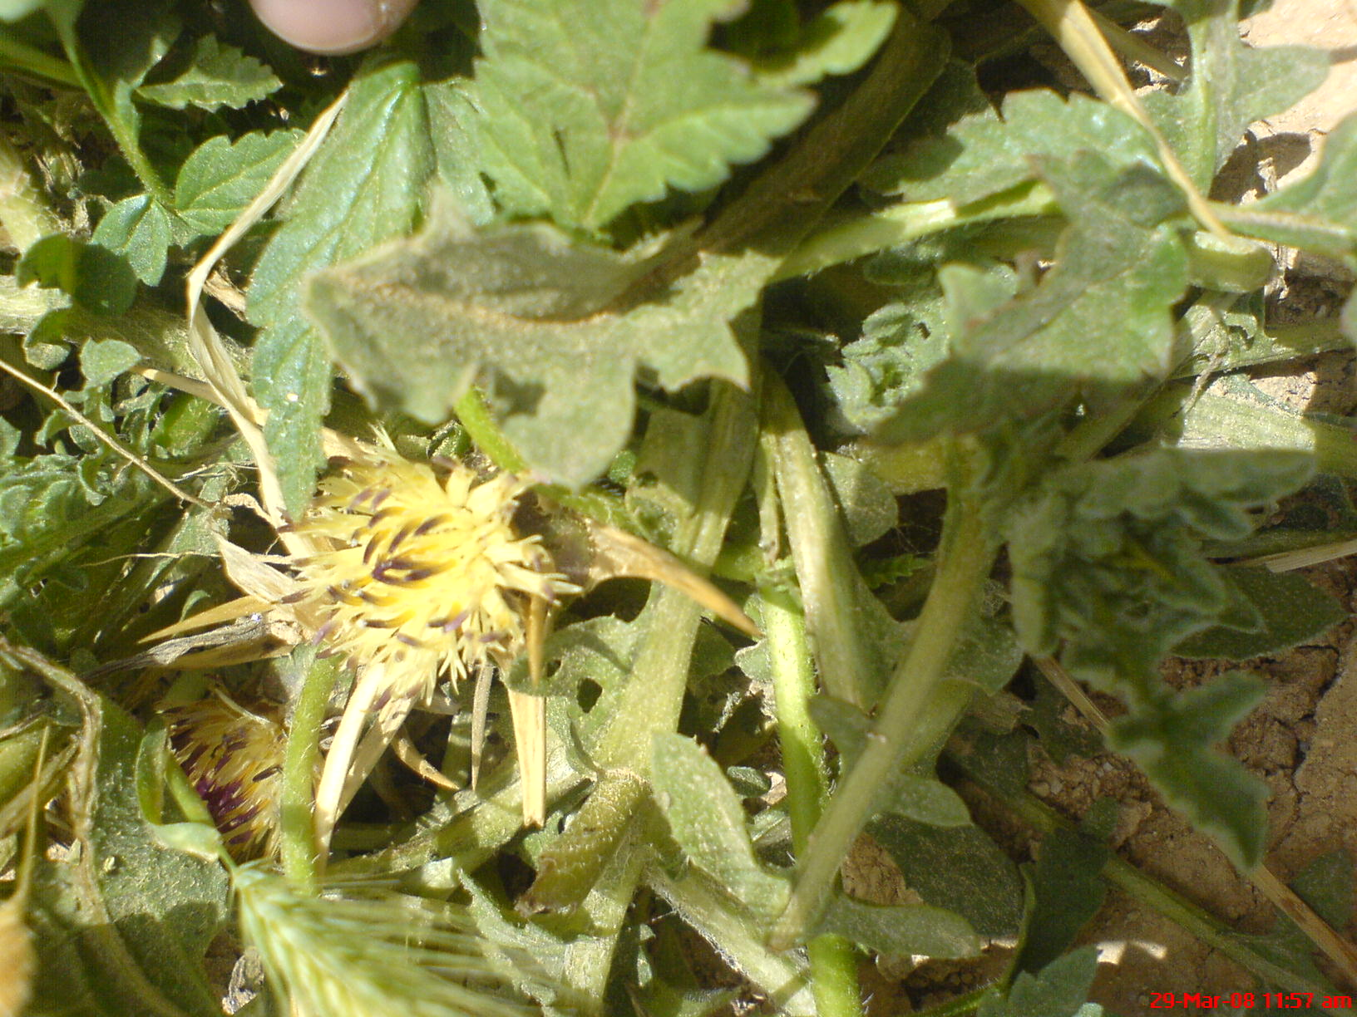
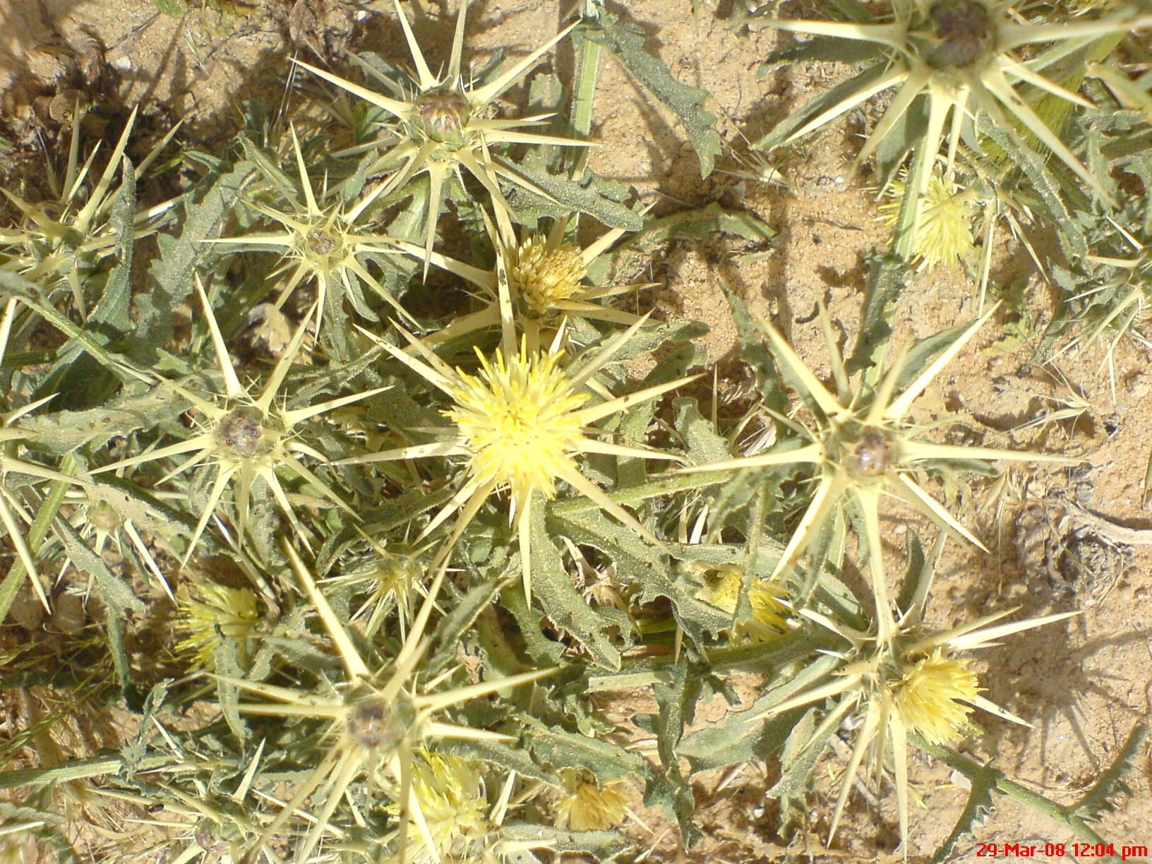
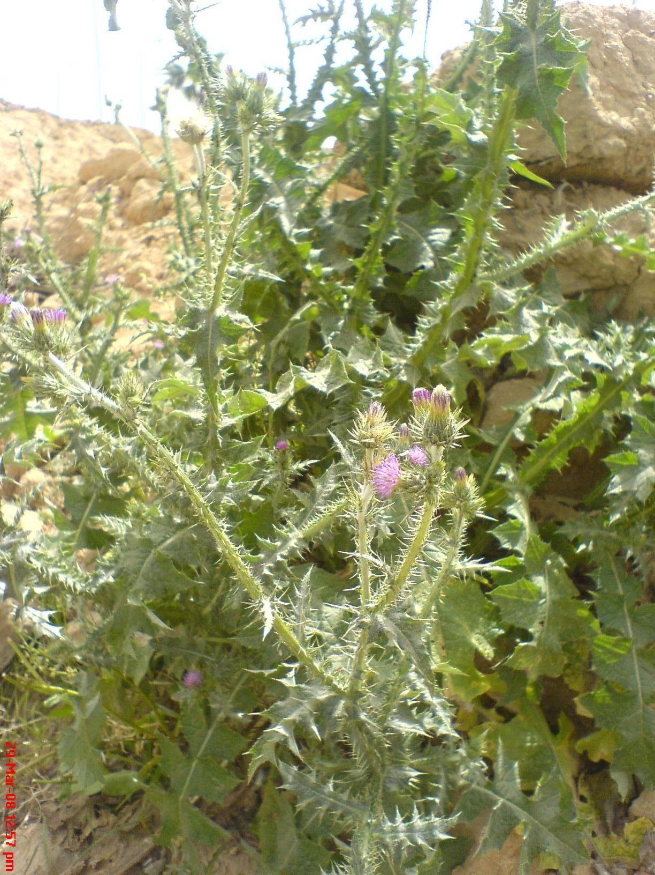
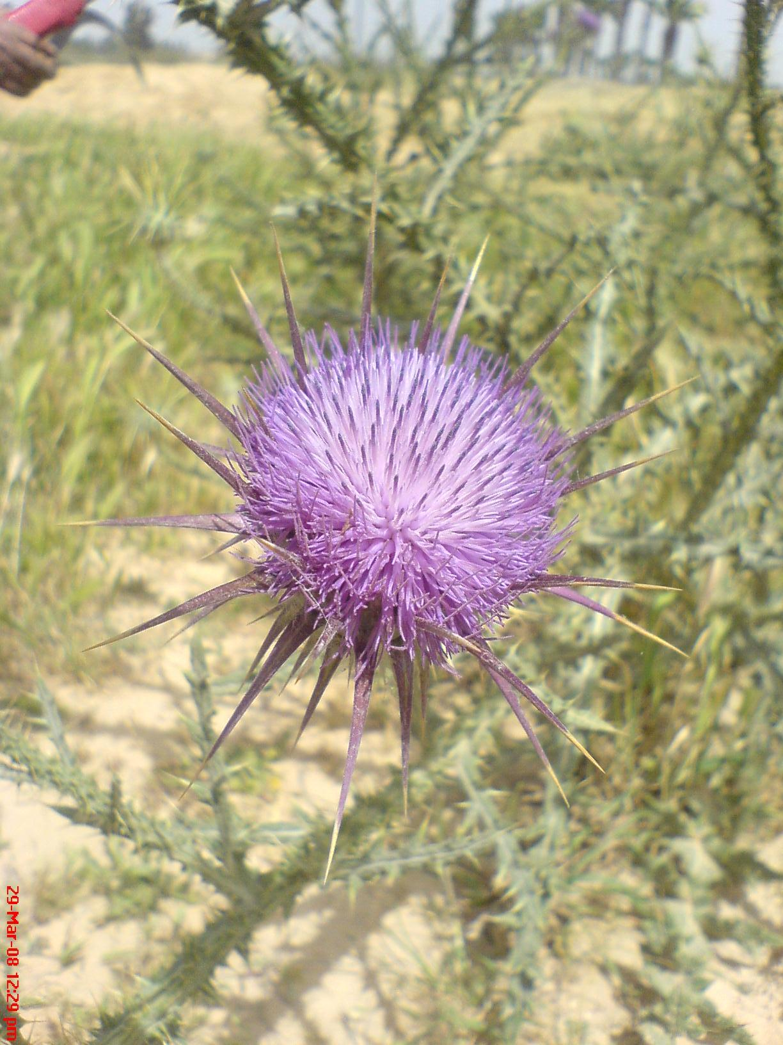
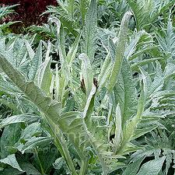
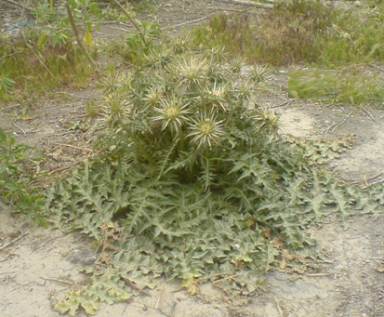
Screening of Some Available Members of the Tribe Cynareae
70 % Alcoholic extract
Cynara cornigera aerial parts
Cynara cornigera seeds
Onopordum alexandrinum aerial parts
Onopordum alexandrinum seeds
Centaurea calcitrapa aerial parts
Centaurea alexandrina aerial parts
Carduus getulus aerial parts
Cynara scolymus leaves
Journal of Medicinal Plants Research, 7(7); 324-328, 2013.
Notes:
In this study we tested the hepatoprotective activity of the 70 % alcoholic Extracts prepared from:
Cynara cornigera aerial parts
Cynara cornigera seeds
Onopordum alexandrinum aerial parts
Onopordum alexandrinum seeds
Centaurea calcitrapa aerial parts
Centaurea alexandrina aerial parts
Carduus getulus ariel parts
Cynara scolymus leaves

Slide 12
In-vivo assay Design
Screening of Some Available Members of the Tribe Cynareae
animals equally divided into 4 groups
Group I
Group II
Group III
Group IV
10 subgroups
Normal Control
Intoxicated Control
Positive Control
Saline
CCl₄
CCl₄
+ silymarin
CCl₄
+ tested extract
Journal of Medicinal Plants Research, 7(7); 324-328, 2013.
Notes:
This in-vivo study was conducted as following:
animals were divided into 4 groups, 6 rats each, in which:
Group I was considered as the normal control group and administered only distilled water intraperitoneally.
Group II was considered as the intoxicated control group as they received 1.25 ml of CCl₄ per kg body weight intraperitoneally as a single dose.
Group III was considered as the positive control group as they administered silymarin at a dose of 10 mg/kg orally for 7 days and CCL4 on day 5 as a single dose.
Group IV was divided into ten subgroups (each of 6 animals). Subgroups 1- 8 were treated with the prepared extracts at 500 mg/kg,
while subgroups 9 and 10 were treated with the aerial parts of Onopordum alexandrinum and Cynara cornigera at 250 mg/kg body weight.
On day 5 they received a single dose of CCL4.

Slide 13
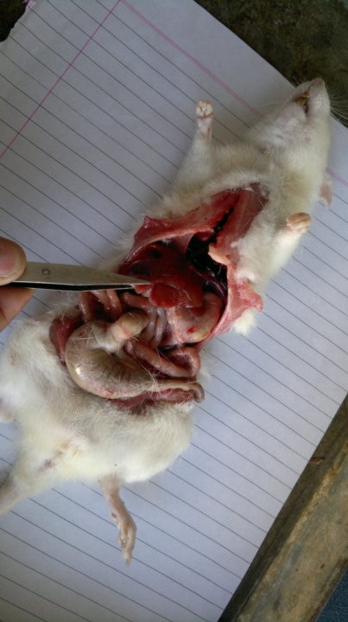
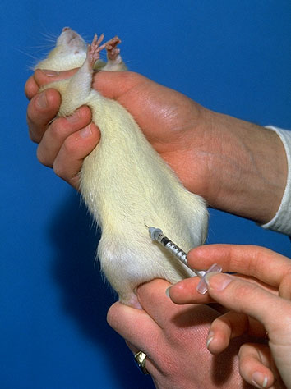
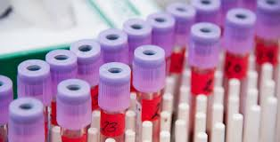
Screening of Some Available Members of the Tribe Cynareae
i.p. CCl₄
Sacrified
Drug Treatment
Day 1
Day 2
Day 3
Day 4
Day 5
Day 6
Day 7
Journal of Medicinal Plants Research, 7(7); 324-328, 2013.
Notes:
Drug treatment was started 5 days prior to CCl₄ i.p. administration and continued till the end of the experiment.
After 48 h of CCl₄ administration, the animals were sacrificed under ether anesthesia. Blood samples were collected by cardiac puncture and the serum was separated for determinination the different bio-chemical parameters.
The liver was then immediately removed; fixed in 10% formalin and kept for histopathological assessment.

Slide 14
Biochemical Parameters
Screening of Some Available Members of the Tribe Cynareae
Alanine Aminotransferase ALT
Aspartate Aminotransferase AST
Alkaline Phosphatase ALP
Total Bilirubin BIL
Journal of Medicinal Plants Research, 7(7); 324-328, 2013.
Notes:
Different Biochemical parameters were Recorded including:
Alanine Aminotransferase
Aspartate Aminotransferase
Alkaline Phosphatase
And
Total Bilirubin

Slide 15
Screening of Some Available Members of the Tribe Cynareae
In order to compare the activity of different tested extracts, a parameter was calculated and named
“% activity compared to silymarin”
AST - SGOT
ALT - SGPT
Biochemical results
ALP
BIL
Considering Silymarin Activity as 100%
Journal of Medicinal Plants Research, 7(7); 324-328, 2013.
Notes:
In order to compare the activity of different tested extracts, a parameter was calculated and named
“% activity compared to silymarin”
Concerning each of the given biochemical parameter
Considering Silymarin Activity as 100%

Slide 16
Screening of Some Available Members of the Tribe Cynareae
Cynara cornigera
aerial parts
Onopordum alexandrinum
aerial parts
Cynara scolymus
leaves
% Activity Compared to
Silymarin
AST- SGOT
ALT - SGPT
ALP
BIL
Onop. alex. Aerial parts
C.calci
C. alex
Card. Get.
C. cor. Aerial parts
C.scol
leaf
Onop. alex. seed
C.cor. seed
Journal of Medicinal Plants Research, 7(7); 324-328, 2013.
Notes:
Best results were due to the treatment with
Extracts of Cynara scolymus leaves,
Onopordum alexandrinum aerial parts,
And Cynara cornigera aerial parts

Slide 17
500 mg/kg
Screening of Some Available Members of the Tribe Cynareae
Cynara cornigera
Onopordon alexandrinum
250 mg/kg
Journal of Medicinal Plants Research, 7(7); 324-328, 2013.
Notes:
Reducing the dose of these active extracts from 500 mg / kg body weight to 250mg/kg body weight also showed hepatoprotective activity.

Slide 18
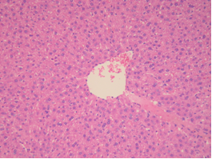
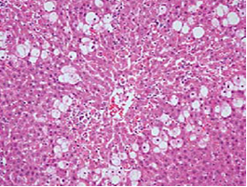
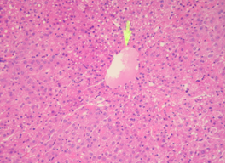
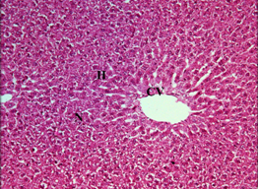
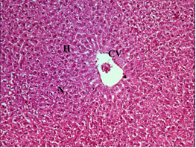
Histopathological Studies
Screening of Some Available Members of the Tribe Cynareae
Biochemical Parameters
Normal
CCl₄
CCl₄ + Silymarin
Marked Protection with Dilation of Sinusoids and Congestion in Central Vein.
Marked Protection with Mild Congestion in Central Vein and Dilated in the Sinusoids.
No Necrosis or Fatty Deposition but had only Minimal Portal Inflammation.
Centrilobular Necrosis and Extensive Fatty changes.
CCl₄ + C. cornigera
CCl₄ + O. alexandrinum
Journal of Medicinal Plants Research, 7(7); 324-328, 2013.
Notes:
The improvement in biochemical parameters after treatment with Cynara cornigera and Onopordum alexandrinum aerial parts were confirmed from the histopathological studies of the corresponding liver tissues.
Sections were done in normal livers,
Livers of rats treated with CCL4 which showed
Centrilobular Necrosis and Extensive Fatty changes
Livers of rats treated with CCL4 and silymarin which showed
No Necrosis or Fatty Deposition but had only Minimal Portal Inflammation.
Livers of rats treated with CCL4 and cynara cornigera that showed
Marked Protection with Dilation of Sinusoids and Congestion in Central Vein.
Livers of rats treated with CCL4 and onopordon alexandrinum that showed
Marked Protection with Mild Congestion in Central Vein and Dilated in the Sinusoids.

Slide 19
Publication
Screening of Some Available Members of the Tribe Cynareae
Evaluation of the hepatoprotective activity of some plants belonging to the tribe Cynareae growing in Egypt.
Samah M. El Sohafy, Saleh I. Alqasoumi, Aly M. Metwally, Abdallah A. Omar, Masouda M. Amer , Mohammed I. Abou Shoer, S. A. El Toumy and Maged S. Abdel-Kader.
Journal of Medicinal Plants Research
Vol. 7(7); 324-328, 2013.
Notes:
The results of this chapter were published under the title:
Evaluation of the hepatoprotective activity of some plants belonging to the tribe Cynareae growing in Egypt.
In the Journal of Medicinal Plants Research , February , 2013.

Slide 20
Biologically Guided Fractionation of Onopordon alexandrinum

Slide 21
Biologically Guided Fractionation
Dried Plant
70% Ethanol
Filtrate
Marc
Drying, Fractionation
Infusion
Onopordon alexandrinum
Aq. Ext.
Drying
Butanol
P. E.
Et. Ac.
But. _{70%}
Aq. _{70%}
But. _{aq}
Aq. _{aq}
Notes:
Plants found to have hepatoprotective activity from the previous screening were fractionated and these fractions were tested for their hepatoprotective activity.
The dried plants were seperately extracted by 70% ethanol.
The filterate was dried and fractionated using petroleum ether, ethyl acetate, butanol successively.
The remaining marc was re extracted using boiling water, dried and fractionated using butanol.

Slide 22
Biologically Guided Fractionation
 |  | Activity compared to Silymarin (% activity)
 |  |  | AST -SGOT | ALT - SGPT | ALP | BIL
 | 500 | 70% alc ext ono I | 74.2297 | 75.9134 | 37.3886 | 86.833
 | 250 | ono II | 24.555 | 45.7602 | 11.8029 | 28.0852
 | 250 | ono III | 46.5722 | 79.9575 | 58.7808 | 61.045
 | 250 | ono IV | 84.7067 | 62.1877 | 30.2983 | 67.7826
Ono | 250 | ono V | 23.8134 | 14.2344 | 8.56031 | 19.8487
 | 500 | ono VI | 89.1397 | 72.1691 | 67.8599 | 87.2531
 | 250 | ono VII | 41.263 | 75.8207 | 26.2527 | 17.3417
 | 250 | onoVIII | 26.3902 | _____ | 33.3696 | 48.4732
Notes:
the biochemical results of the different prepared fractions were compared to that of silymarin.

Slide 23
Onopordon alexandrinum fractions
Biologically Guided Fractionation
70% Alc Extract
Aq Extract
Et Ac
But 70%
But aq
AST - SGOT
% Activity Compared to
Silymarin
ALT - SGPT
ALP
BIL
Notes:
Concerning onopordon alexandrium, he ethyl acetate, the butanol of the 70% alcoholic extracts and the butanol extract of the aqueous extract were the most active.

Slide 24
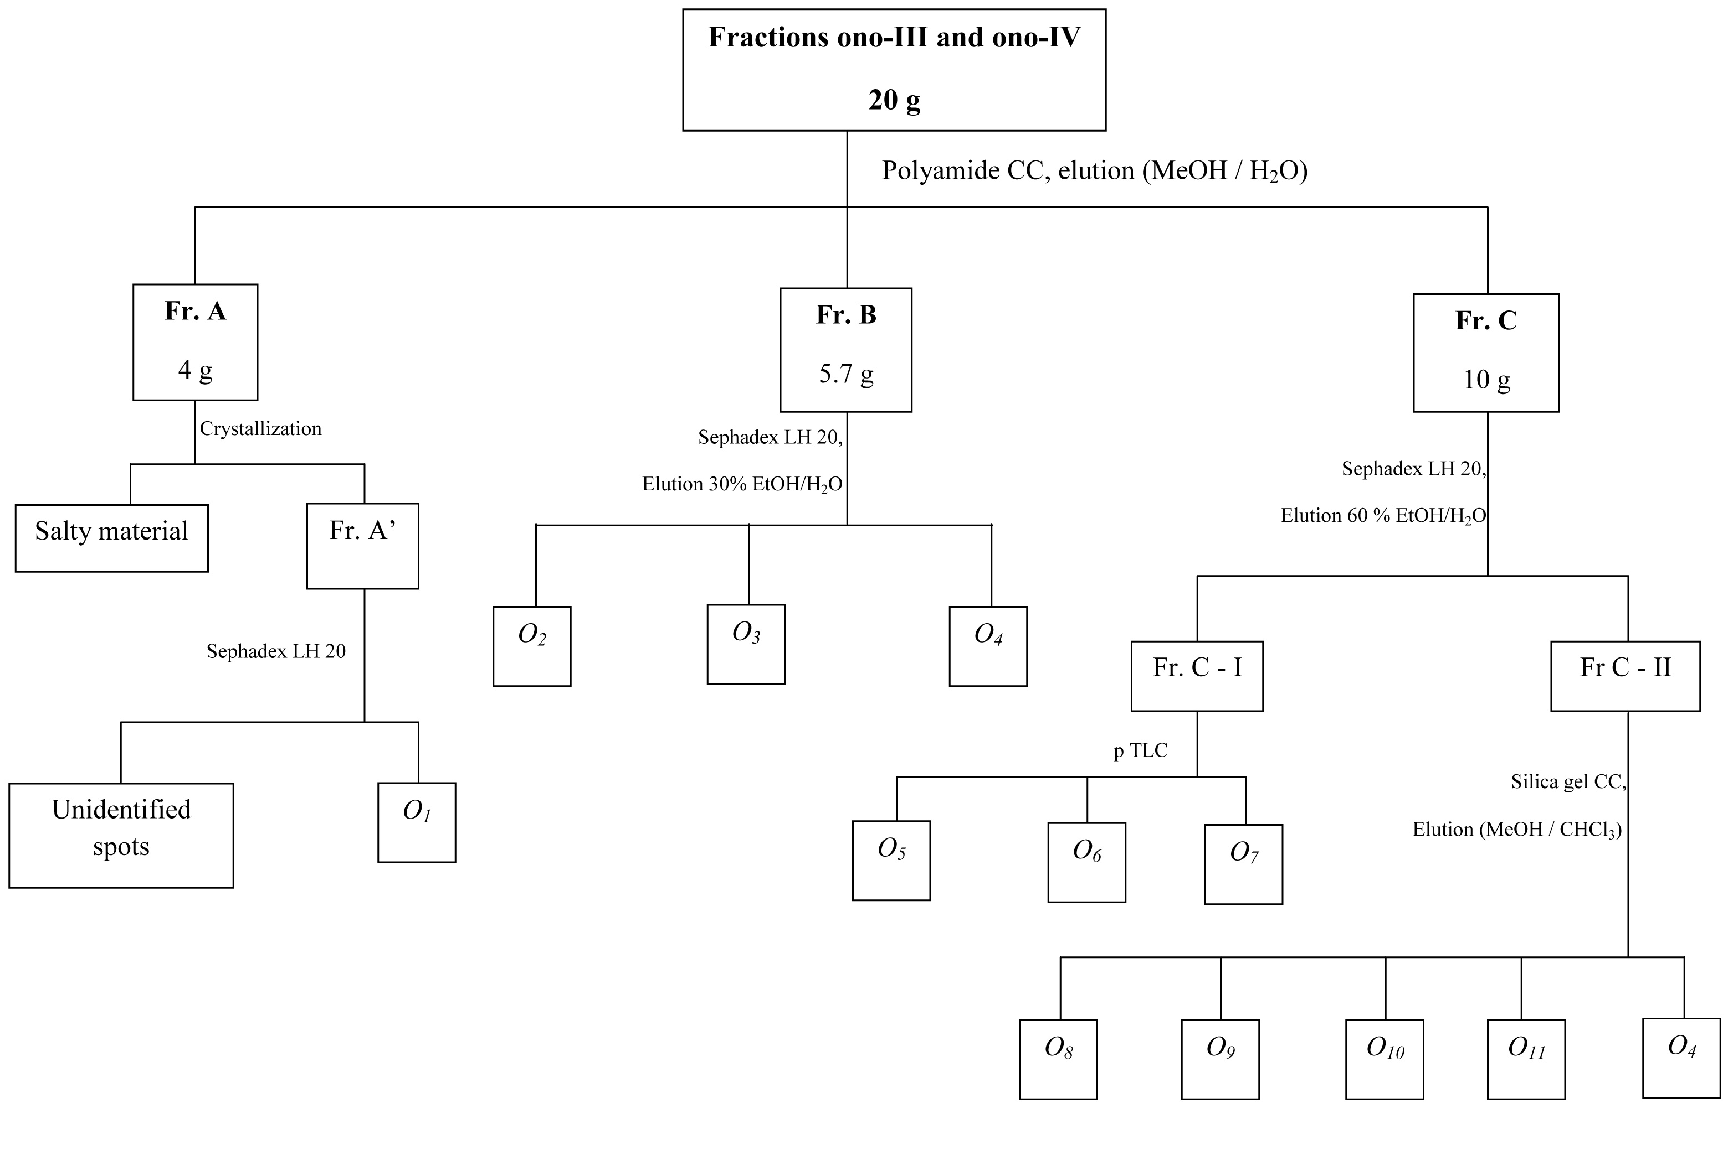
Notes:
11 compounds were isolated from the hepatoprotective fractions of Onopordon alexandrinum:

Slide 25
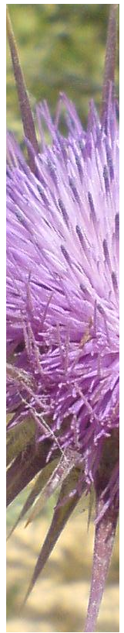
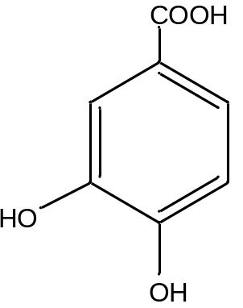
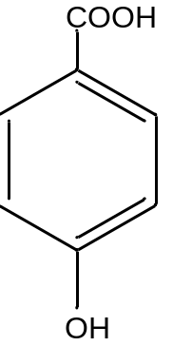
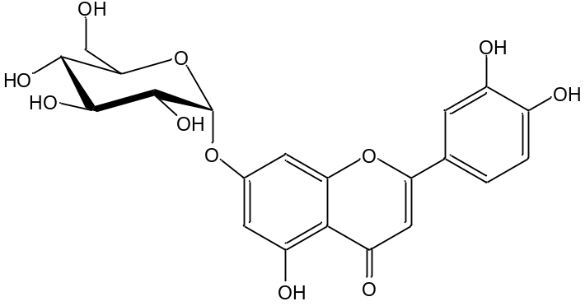
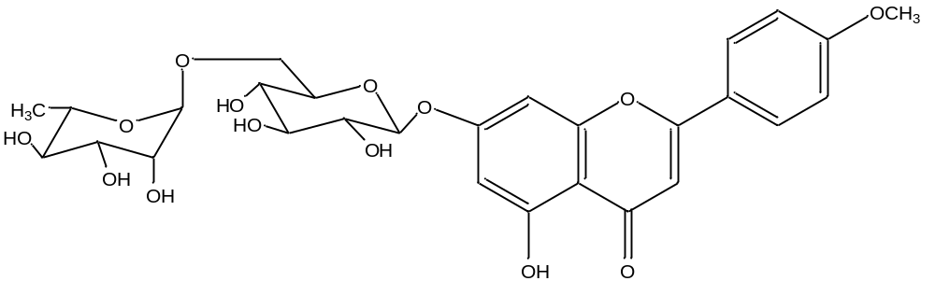
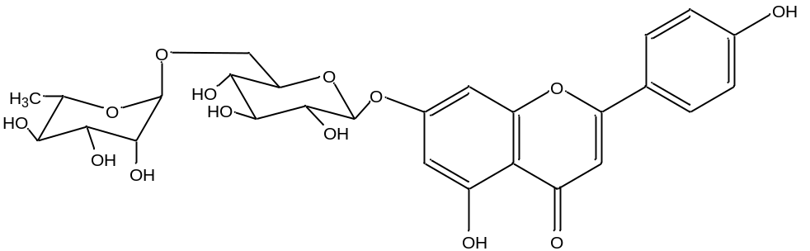
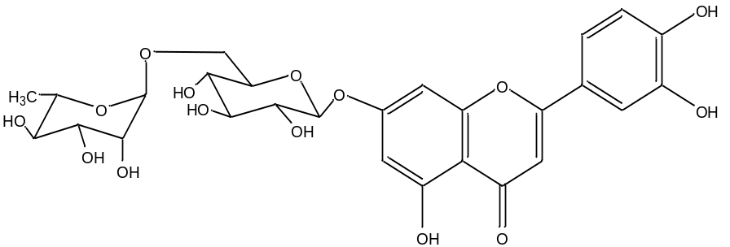
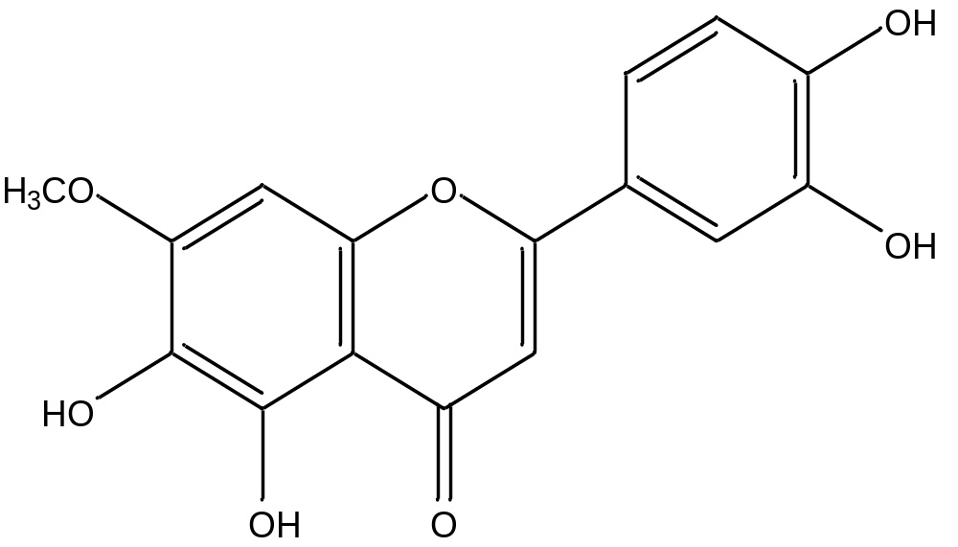
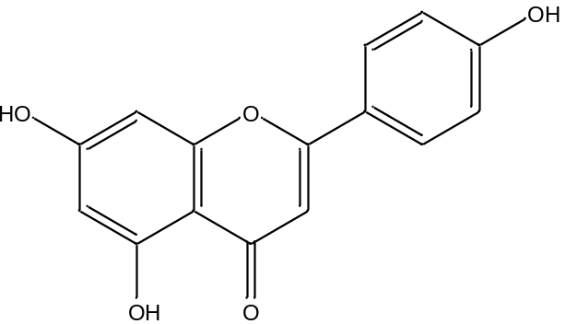
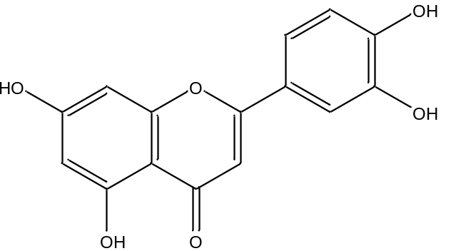
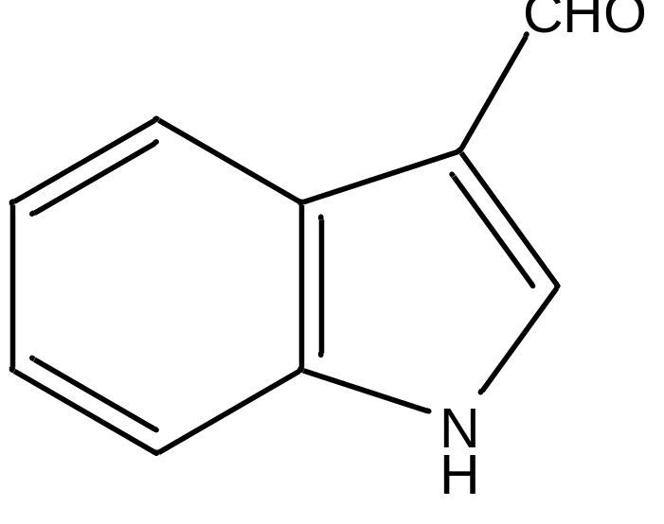
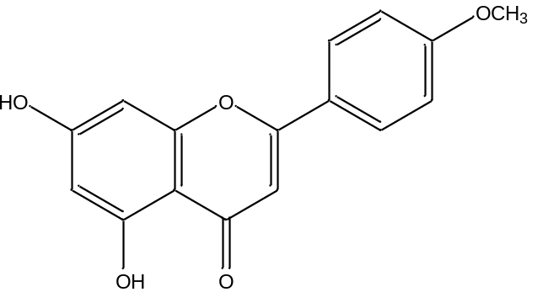
11 compounds …
Onopordon alexandrinum Boiss.
Luteolin-7-O-rutinoside
Apigenin-7-O-rutinoside
Acacetin-7-O-rutinoside
Luteolin-7-O-β-D-glucopyranoside
3, 4- dihydroxy benzoic acid
p- hydroxy benzoic acid
Indole-3-carbaldehyde
Acacetin
Pedalitin
Apigenin
Luteolin
Notes:
These 11 compounds were identified as:

Slide 26
Onopordon alexandrinum Boiss.
Acacetin-7-O-rutinoside
3, 4- dihydroxy benzoic acid
p- hydroxy benzoic acid
Pedalitin
Genus Onopordon
Notes:
It is worth mentioning that this is the first isolation of
Acacetin-7-O-β-D-rutinoside,
3, 4- dihydroxy benzoic acid,
p- hydroxyl benzoic acid and
Pedalitin from Genus Onopordon

Slide 27
Onopordon alexandrinum Boiss.
Indole-3-carbaldehyde
Family Asteraceae
Notes:
In addition this is the first report for the isolation of compound indole-3-carbaldehyde from family asteraceae

Slide 28
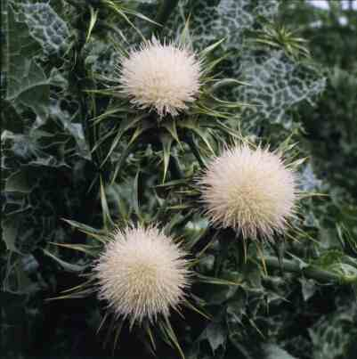
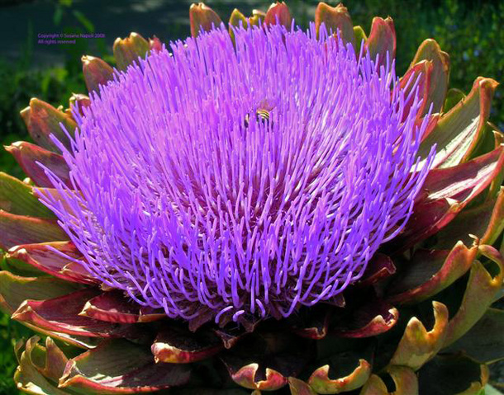
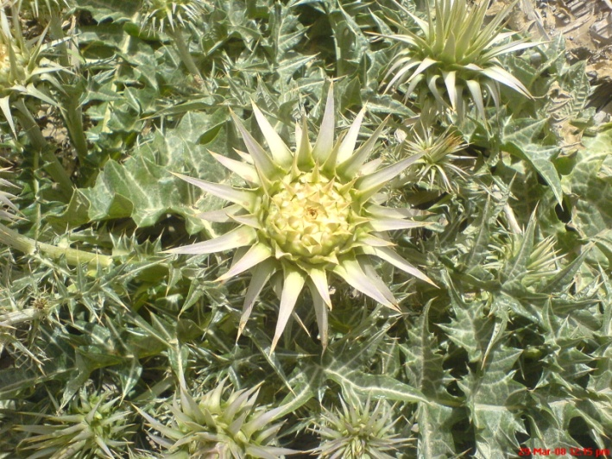
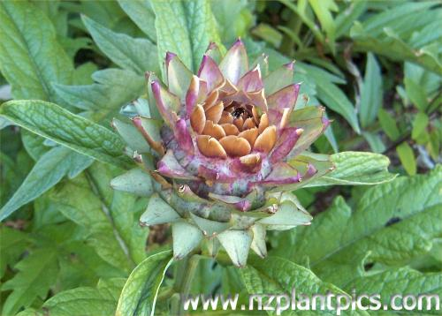
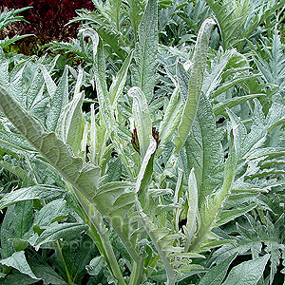
Thank you
Prof. Dr. Abdalla Abdel Raziq Omar
Professor of Pharmacognosy
Alexandria University
Notes:
I would like to express my deepest sense of Gratitude to my supervisor Dr. Aly Metwally, Professor of Pharmacognosy, Faculty of Pharmacy, Alexandria University. Thank you
I was really blessed to have Dr. Abdalla Omar, Professor of Pharmacognosy, Alexandria University as my supervisor. Thank you
I express my deep gratitude and thanks to my supervisor Dr. Masouda Amer, Professor of Pharmacognosy, Alexandria University. Thank you

Slide 29
Compound O₃ …
Acacetin-7-O-rutinoside
Onopordon alexandrinum Boiss. Acacetin-7-O-rutinoside
Notes:
Identification of compound O3

Slide 30
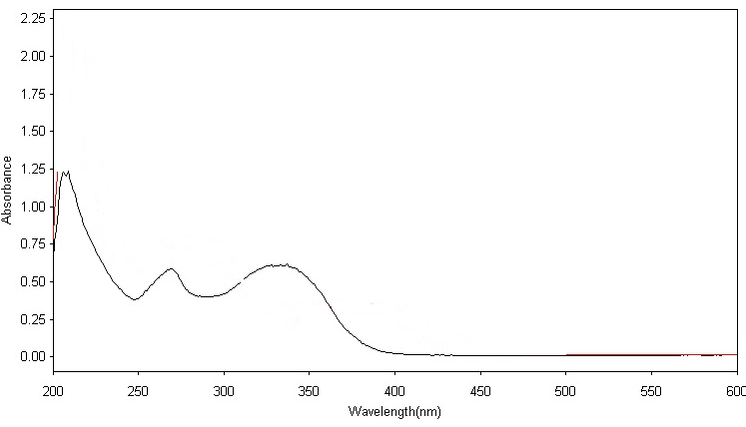
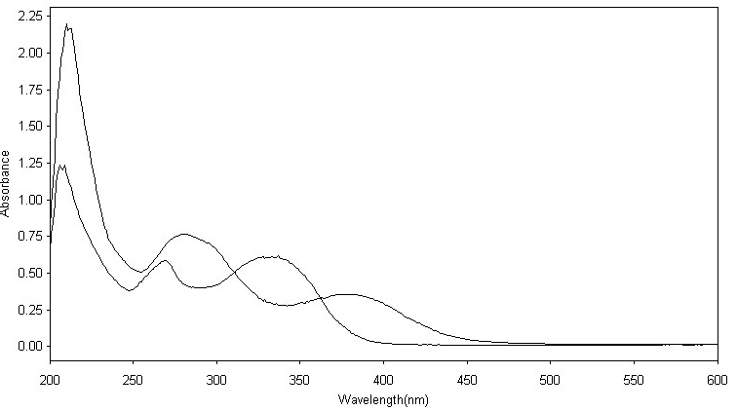
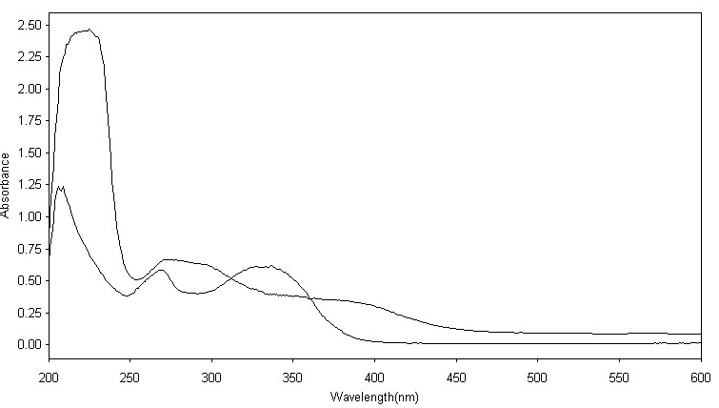
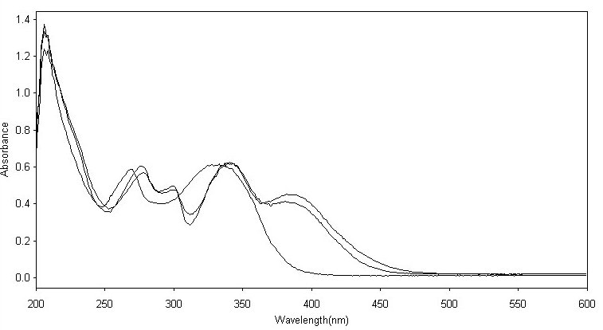
Onopordon alexandrinum Boiss. Acacetin-7-O-rutinoside
UV MeOH
269nm
333 nm
flavone
NaOMe
Substituted 4’-OH
NaOAc
AlCl₃
AlCl₃ / HCl
No free 7-OH
5-OH
Notes:
The UV spectrum of compound O3 in methanol showed two peaks at 269 nm and 333 nm indicating a flavone structure.
The NaOMe spectrum exhibited a large bathochromic shift of band I with a decrease in the intensity of absorption indicating a substituted C-4’ position.
The NaOAc spectrum proved the absence of a free 7-OH group.
The AlCl₃ and the AlCl₃ / HCl indicated the presence of a free 5-OH group.

Slide 31
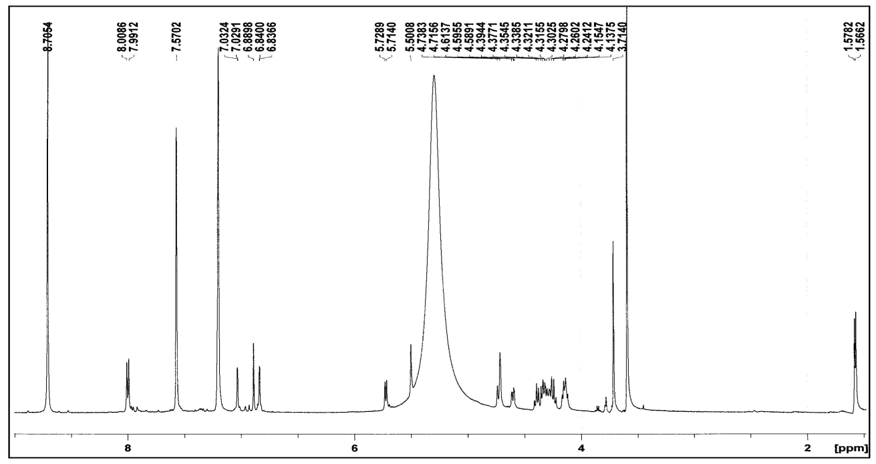
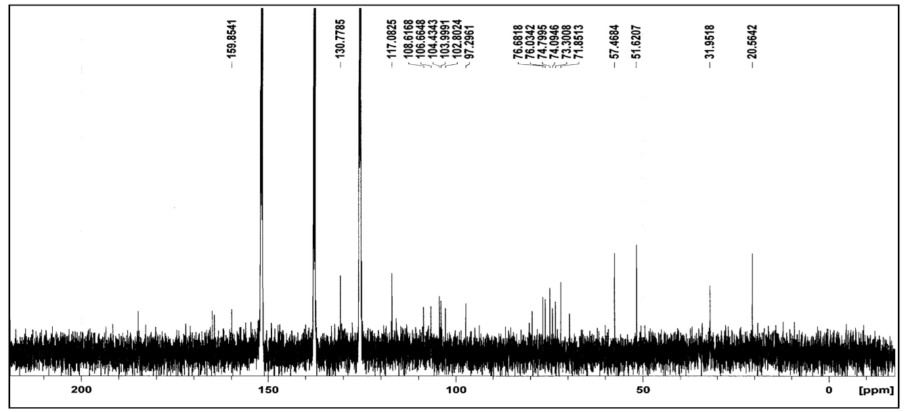
¹H-NMR
Onopordon alexandrinum Boiss. Acacetin-7-O-rutinoside
¹³C-NMR
2 sugar moieties
Notes:
H-NMR revealed signals for a methoxyl group and signals for 7 protons with the same coupling pattern of apigenin.
The ¹H-NMR and the ¹³C-NMR indicated the presence of 2 sugar moieties.

Slide 32
Onopordon alexandrinum Boiss. Acacetin-7-O-rutinoside
¹H-NMR
¹³C-NMR
Notes:
The first sugar moiety was found to be a rhamnose with its anomeric proton appearing as a singlet at 5.5 ppm and C-6”’ methyl as a singlet at 1.56 ppm.
The 2nd sugar moiety was identified as glucose with its anomeric proton appearing as a doublet at 5.7 ppm

Slide 33
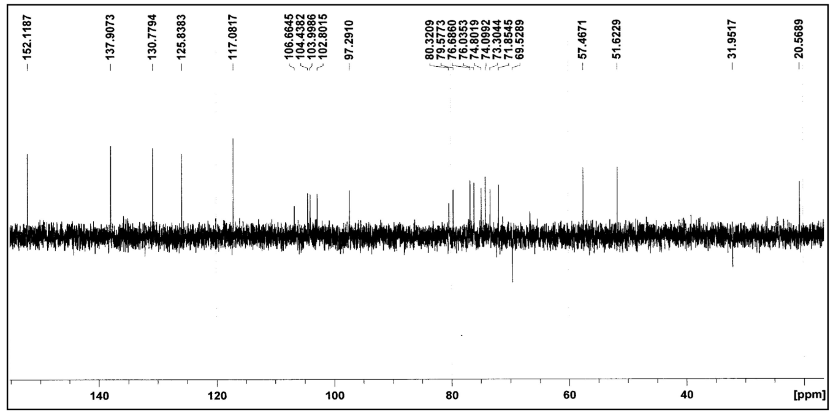
Onopordon alexandrinum Boiss. Acacetin-7-O-rutinoside
C-1”’ Rhamnose
104.43
C-6” Glucose
69.58
Notes:
The up field shift of C-6” of the glucose moiety and the down field shift of the C-1”’ of the rhamnose moiety indicates the position of the interglycosidic linkage which is 1 ”’ linked to 6”

Slide 34
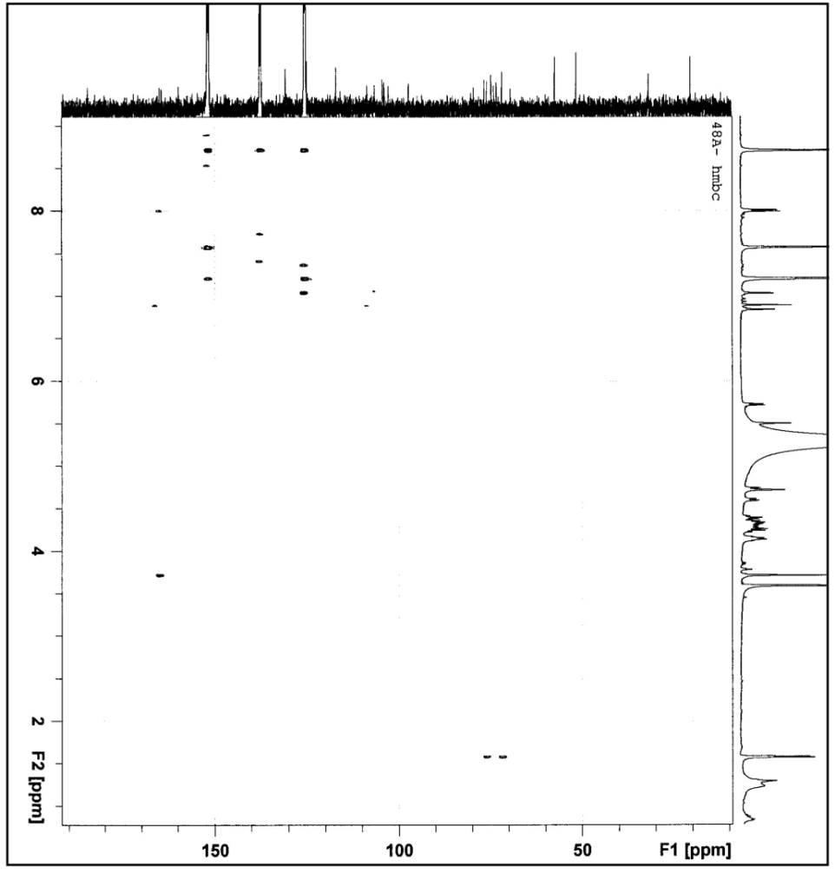
HMBC
Onopordon alexandrinum Boiss. Acacetin-7-O-rutinoside
C-4’
-OCH₃
Notes:
HMBC corelated the protons of the methoxyl group to C-4’ indicating its point of linkage
And therefore the rutinose should be attached at C-7

Slide 35
ESIMS
Onopordon alexandrinum Boiss. Acacetin-7-O-rutinoside
peak at m/z 539 [M+H]⁺
C₂₈H₃₂O₁₅
Notes:
ESIMS showed a peak corresponding to M+H
and compatible with the molecular formula C 28 H 32 O 15

Slide 36
Onopordon alexandrinum Boiss. Acacetin-7-O-rutinoside
Compound O₃ was found to be
Acacetin-7-O-rutinoside.
Its structure was confirmed by comparing its spectral data with those reported in literature.
First report for its isolation from genus Onopordon.
Notes:
Therefore compound O₃ was found to be Acacetin-7-O-rutinoside.
Its structure was confirmed by comparing its spectral data with those reported in literature.
It is worth mentioning that this is the first report for its isolation from genus Onopordon.

Slide 37
Compound O₇ ...
Indole-3-carbaldehyde
Onopordon alexandrinum Boiss. Indole-3-Carbaldehyde

Slide 38
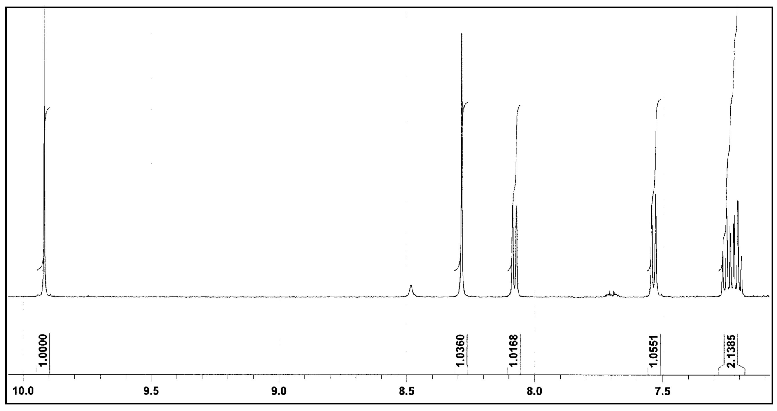
¹H-NMR
Onopordon alexandrinum Boiss. Indole-3-Carbaldehyde
5 aromatic protons
an aldehydic proton
δ 9.91 ppm
Notes:
The ¹H-NMR indicated the presence of 5 aromatic protons and an aldehydic proton

Slide 39
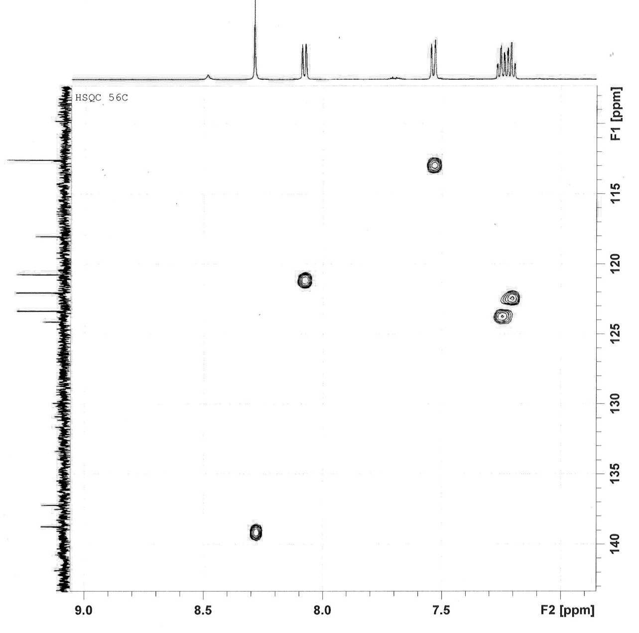
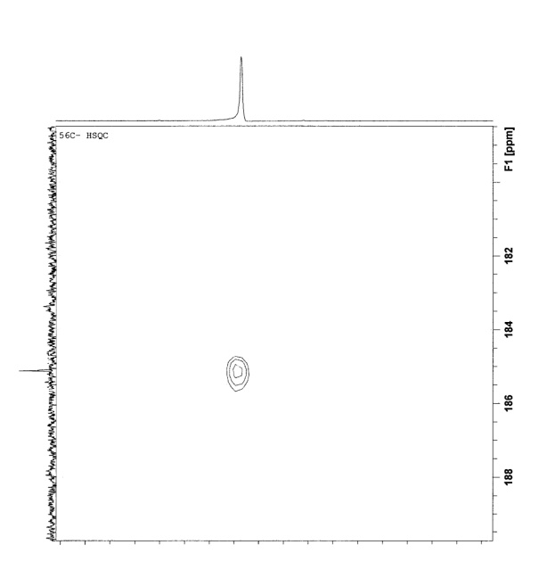
HMQC
Onopordon alexandrinum Boiss. Indole-3-Carbaldehyde
Notes:
HMQC correlated these 5 aromatic protons to their corresponding carbons and the aldehydic proton at δ 9.91 ppm to the carbon at 185 ppm

Slide 40
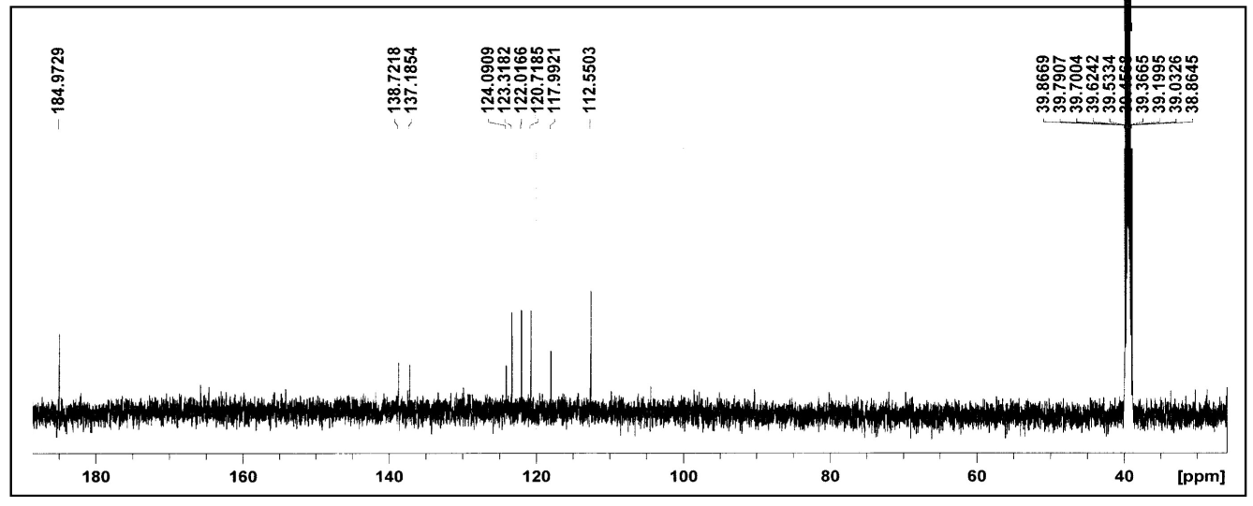
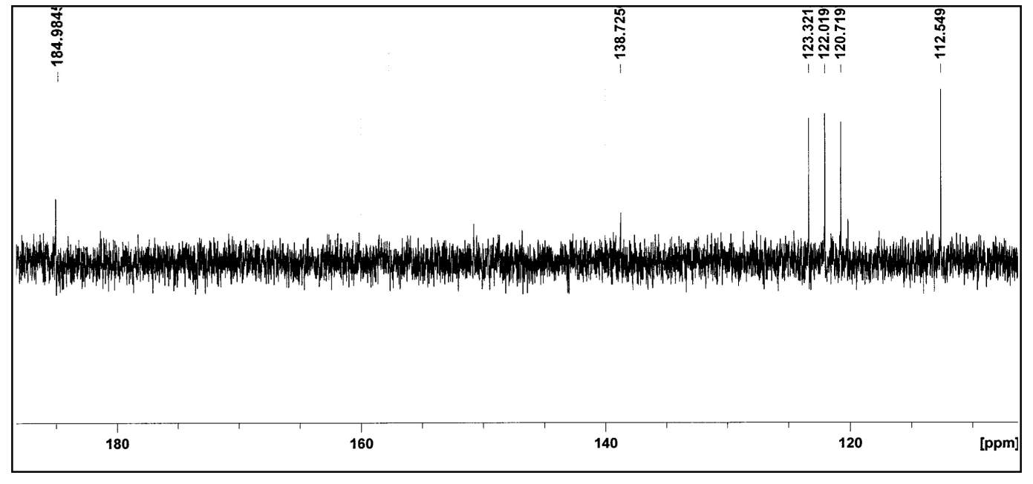
¹³C - NMR
Onopordon alexandrinum Boiss. Indole-3-Carbaldehyde
DEPT
Notes:
This Carbon appeared as a CH in the dept spectrum

Slide 41
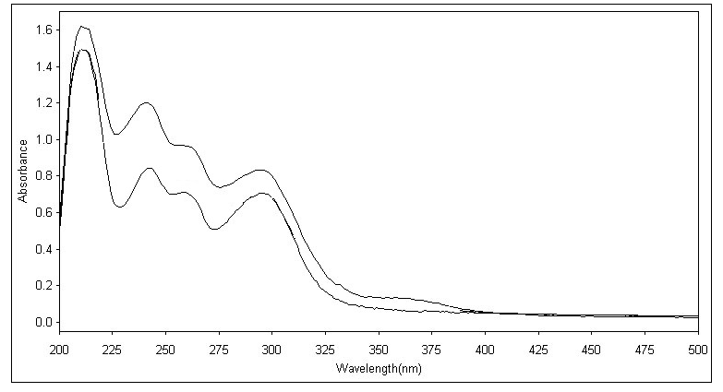
UV compound O₇
Onopordon alexandrinum Boiss. Indole-3-Carbaldehyde
3 absorption bands
242 nm
258 nm
296 nm
Indole Ring
Notes:
The UV spectrum of compound O₇ in MeOH showed three absorption bands at 242, 258 and 296 nm which is typical for an indole ring.

Slide 42
UV compound O₇
Onopordon alexandrinum Boiss. Indole-3-Carbaldehyde
Addition of dil HCl
hyperchromic shift
with no change in the λ_{max} of absorption
Indole Ring
Notes:
In addition, the hyperchromic shift with no change in the λ_{max} of absorption that occurred upon the addition of dil HCl, confirmed the presence of this ring.

Slide 43
ESIMS
Onopordon alexandrinum Boiss. Indole-3-Carbaldehyde
m/z 168 [M+Na]⁺
molecular formula of C₉H₇NO.
The odd M⁺ presence of Nitrogen.
Notes:
The ESIMS showed a peak corresponding to [M+Na]+ indicating a molecular formula of C₉H₇NO.
The odd M⁺ confirmed the presence of Nitrogen.

Slide 44
MS & NMR
Onopordon alexandrinum Boiss. Indole-3-Carbaldehyde
Confirmed the presence of the indole ring.
Notes:
Therefore both the mass spectrometry and the NMR data confirmed the presence of the Indole ring.

Slide 45
Compound O₇
Onopordon alexandrinum Boiss. Indole-3-Carbaldehyde
1H-indole-3-carbaldehyde
Its structure was confirmed by comparing its spectral data with those reported in literature .
This is the first report for the isolation of 1H-indole-3-carbaldehyde from family Asteraceae.
Notes:
From the previously given data, compound O₇ was identified as 1H-indole-3-carbaldehyde.
Its structure was confirmed by comparing its spectral data with those reported in literature.
It is worth mentioning that This is the first report for the isolation of 1H-indole-3-carbaldehyde from family Asteraceae.

Slide 46
Compound O₉ ….
Pedalitin
Onopordon alexandrinum Boiss. Pedalitin
Notes:
Identification of compound O9

Slide 47
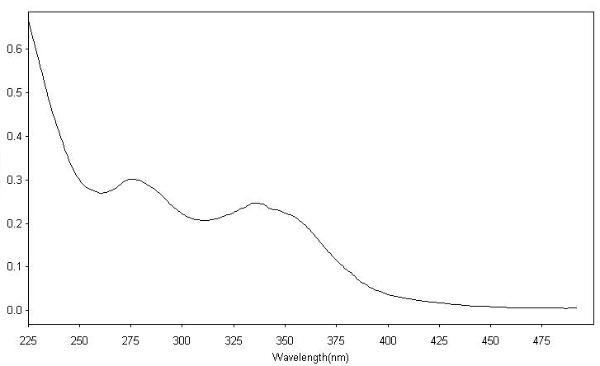
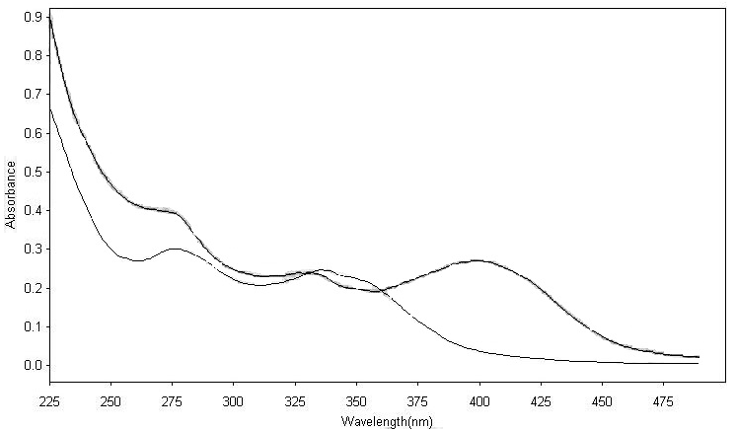
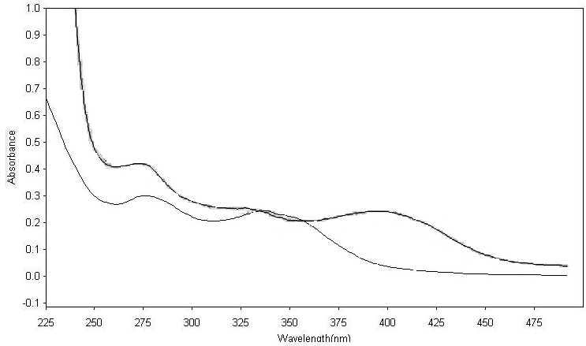
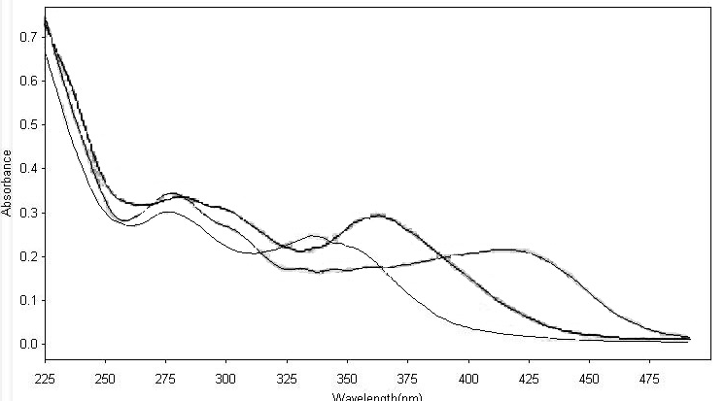
Onopordon alexandrinum Boiss. Pedalitin
UV MeOH
276nm
336 nm
flavone
free 4’-OH
NaOMe
NaOAc
No free 7-OH
AlCl₃
AlCl₃ / HCl
O-dihydroxy
+ 5-OH
A 27 nm bathochromic shift in band I in AlCl₃ / HCl
(relative to the MeOH spectrum)
Oxygenation C-6
Notes:
UV spectrum of compound O₉ in MeOH showed two absorption bands at 276, 336 nm indicating a flavone structure.
The NaOMe spectrum proved the presence of a free 4’-OH group
while that of the NaOAc indicated the absence of a free 7-OH.
The AlCl₃ and AlCl₃ / HCl spectra indicated the presence of ortho dihydroxy group together with a 5-OH group.
A 27 nm bathochromic shift in band I in AlCl₃ / HCl spectrum (relative to the MeOH spectrum) indicated oxygenation at C-6.

Slide 48

Onopordon alexandrinum Boiss. Pedalitin
¹³C-NMR
15 Carbon
-OCH3
Notes:
The ¹³C-NMR indicated the presence of 15 carbon atoms, in addition to a methoxyl group.

Slide 49

¹H-NMR
Onopordon alexandrinum Boiss. Pedalitin
Singlet δ 6.68 ppm
H-3
Singlet δ 6.56 ppm
H-8
5 aromatic protons
Notes:
The ¹H-NMR spectrum revealed the presence of 5 aromatic protons. 2 of which appeared as singlets at δ 6.68 and 6.56 ppm corresponding to H-3, H-8 respectively

Slide 50

HMQC
Onopordon alexandrinum Boiss. Pedalitin
H-3
H-8
C-8
δ 94.12
δ 102.30
C-3
Notes:
HMQC correlated these protons to their corresponding carbons C-3 and C-8 at δ 102.30 and 94.12 ppm respectively.

Slide 51
ESIMS
Onopordon alexandrinum Boiss. Pedalitin
m/z 339
[M+Na]⁺
molecular formula C₁₆H₁₂O₇
Compound O₉
Pedalitin
5, 6, 3’, 4’- tetrahydroxy -7- methoxy flavone
Its structure was confirmed by comparing its spectral data with those reported in literature.
This is the first report for the isolation of Pedalitin from genus Onopordon.
Notes:
The ESIMS showed a peak corresponding to [M+Na]⁺ indicating a molecular formula of C₁₆H₁₂O₇.
Therefore, compound O₉ was identified as 5, 6, 3’, 4’- tetrahydroxy -7- methoxy flavones named pedalitin
Its structure was confirmed by comparing its spectral data with those reported in literature
Referring to literature, this is the first report for the isolation of Pedalitin from genus Onopordon.

Slide 52
Let us meet again..
We welcome you all to our future conferences of OMICS International
4th Annual Conference on European Pharma Congress
June 18-20,2016, Berlin, Germany.
http://europe.pharmaceuticalconferences.com/

