Slide 1
Preparation and characterization of silk/diopside composite nanofibers via electrospinning for tissue engineering applications
Abbas Teimouri
Department of Chemistry, Payame Noor University, Tehran, Iran
a_teimoory@yahoo.com, a_teimouri@pnu.ac.ir

Slide 2
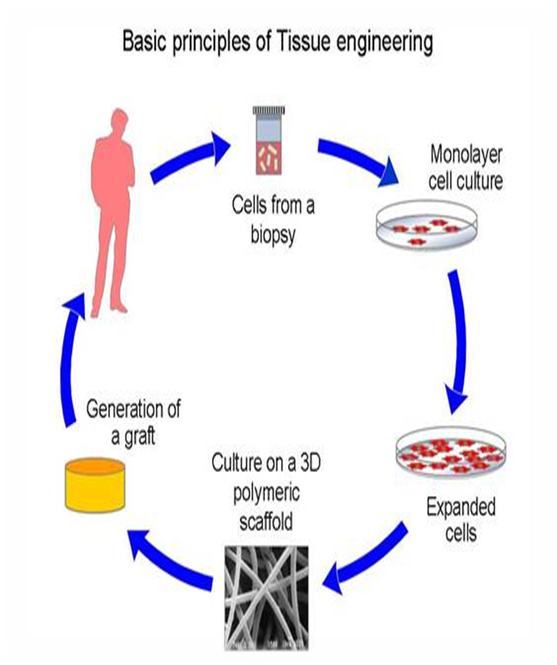
Introduction
Tissue engineering involves the use of a scaffold for the formation of new viable tissue for a medical purpose.
with applications that repair or replace portions of or whole tissues (i.e., bone, etc.).

Slide 3
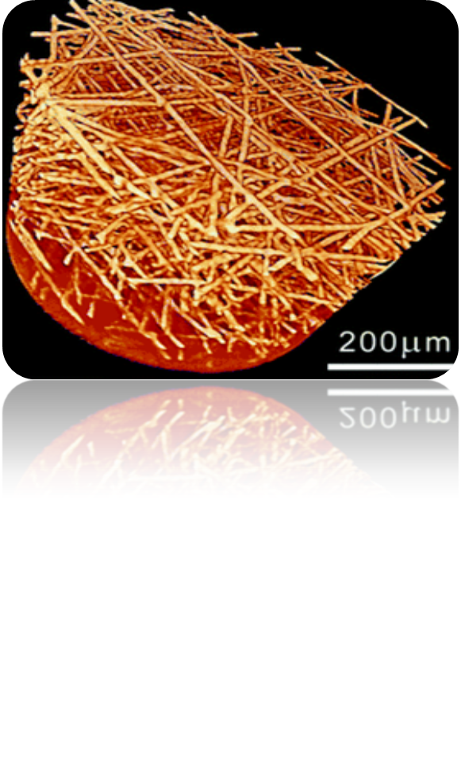
Silk fibroin (SF) is a kind of natural polymers with a great potential in biomedical application. good biocompatibility, biodegradability, high tensile strength, hemostatic properties, non-cytotoxicity,

Slide 4
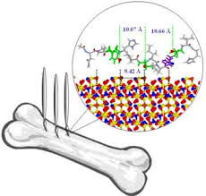
Diopside is advised as an excellent bioactive material for artificial bone and dental root, since it shows more potential of apatite formation ability and higher mechanical strength than hydroxyapatite.
Diopside (CaMgSi2O6) has a fairly high mechanical strength, good bioactivity, excellent bending strength and a good biocompatibility.

Slide 5
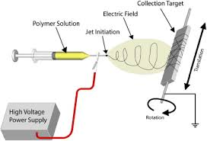
Electrospinning is a new technique to fabricate nanofibrous scaffolds for tissue engineering due to the large surface area to volume ratio, that influences the adhesion, migration, and growth of cells.

Slide 6
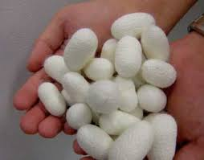
Materials
cocoons of silkworm, Bombyx mori
dialysis cassettes
Calcium nitrate
magnesium chloride
TEOS
Sodium carbonate
LiBr, calcium nitrate
magnesium nitrate
and other solvents

Slide 7
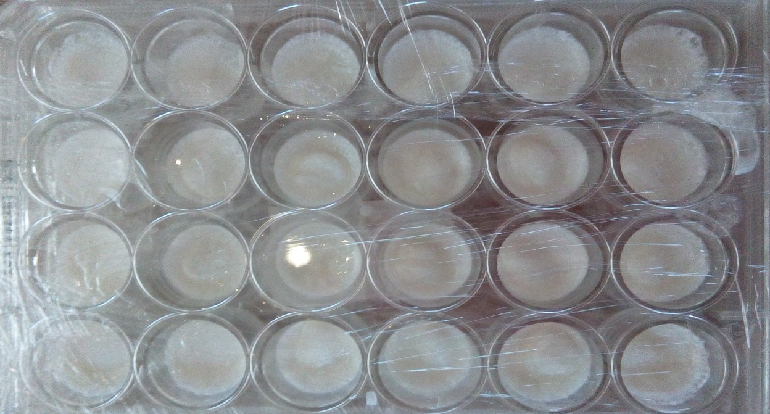
Methods
Silk fibroin (SF) was extracted from silk cocoons according to the protocol designed by Kaplan .
This purified silk fibroin was kept in the temperature of 4º C before use.

Slide 8
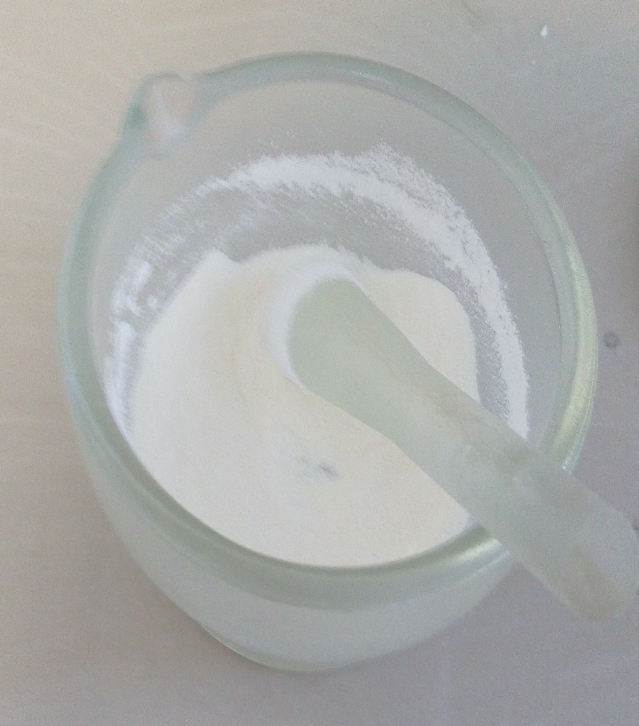
Nano diopside synthesis
The diopside ceramic was prepared through a modified sol-gel method described somewhere else.

Slide 9
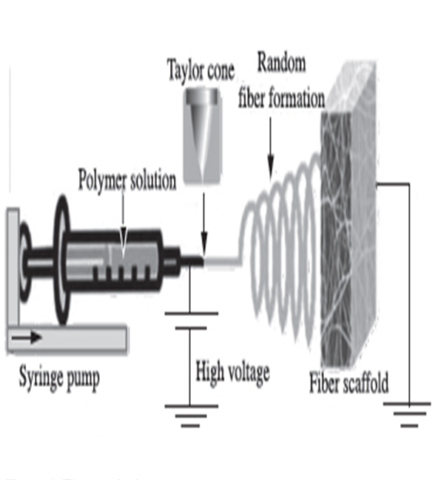
Electrospinning of SF nanofiber
An electrospinning apparatus manufactured was used, and was operated at room temperature.
All solutions were electrospun in the same processing conditions. These solutions were directly electrospun using a typical electrospinning equipment.

Slide 10
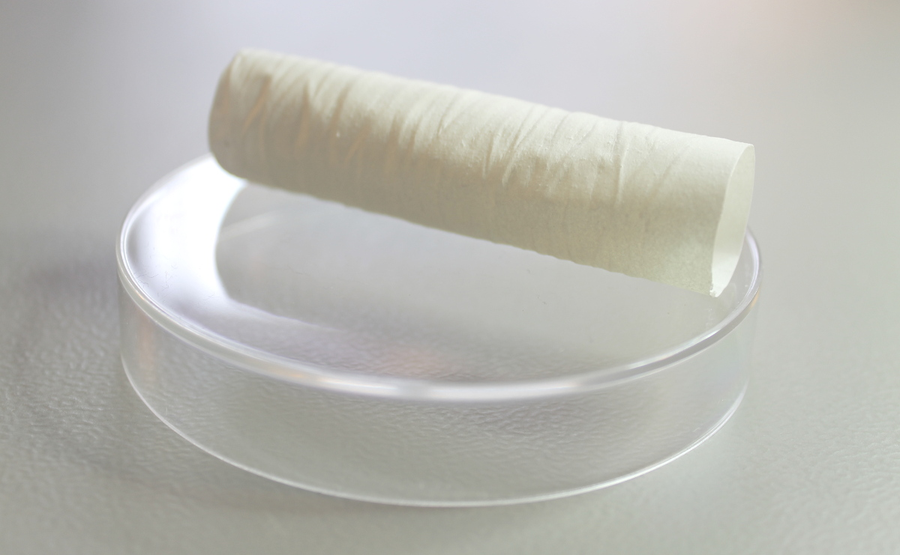
Fabrication of silk fibroin/ nano diopside composite
To form a composite of SF nanofibers and nano diopside, SF nanofibers were immersed in pure methanol for 15 min, and were then dried at room temperature for 24 h.

Slide 11
Characterization
The morphologies of the composite scaffolds was evaluated by scanning electron microscope (SEM(
The samples were analyzed X-ray diffraction (XRD)
FT-IR analysis
BET

Slide 12
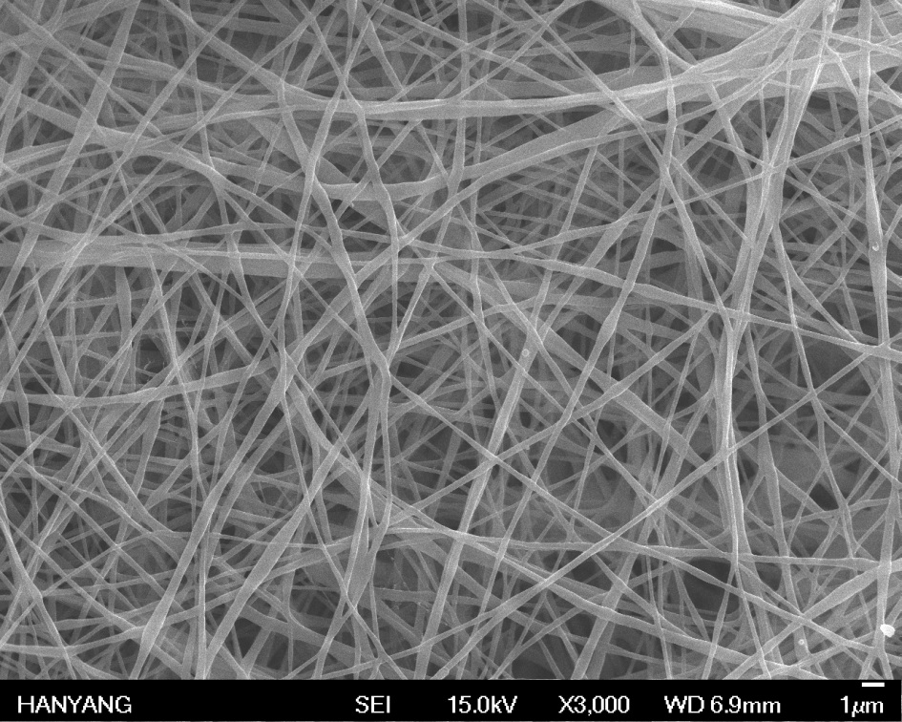
Results and discussion
SEM analysis
Fig shows SEM micrographs of the nanofiber composite scaffolds containing 20wt % of nano diopside.
The average diameter of pure SF nanofibers was measured 108.20 ± 53nm.

Slide 13
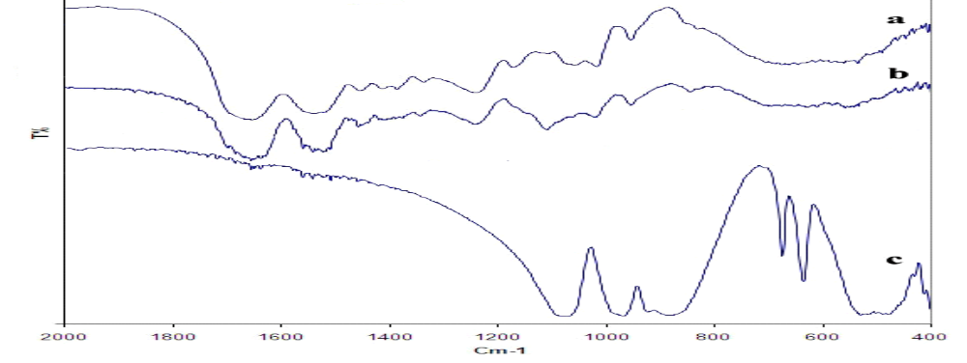
FT-IR analysis
FTIR spectra of pure SF, pure nanodiopside
and Silk fibroin/nanodiopside composite scaffolds
FT-IR spectra of pure SF (a), 20% diopside/SF nanofibrous (b) and diopside nanopowders (c)

Slide 14
The amide I peak, which reflects the stretching of C=O group along the SF backbone, is shifted from 1655 to 1630 cm−1.
The amide II, which originates from N–H deformation, is shifted from 1544 to 1536 cm−1.

Slide 15
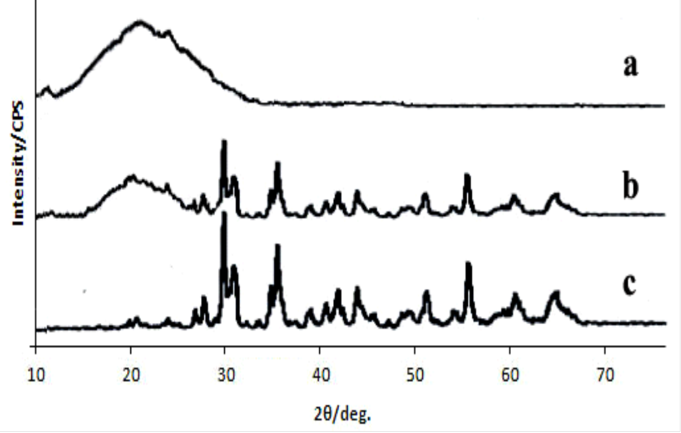
XRD analysis
The XRD patterns of the nanodiopside powder, pure SF and Silk fibroin/nanodiopside composite scaffolds containing 20wt % of nano diopside
(A) XRD patterns of pure SF (a), 20% diopside/SF nanofibrous and diopside nanopowders (c).

Slide 16
nanodiopside showed peaks at 29.9° which are important peak.
nanodiopside reveals had amorphous with little crystallinity.
Diffraction peaks at about 2θ=20°-30° could be attributed to β-sheet (silk II) structure.

Slide 17
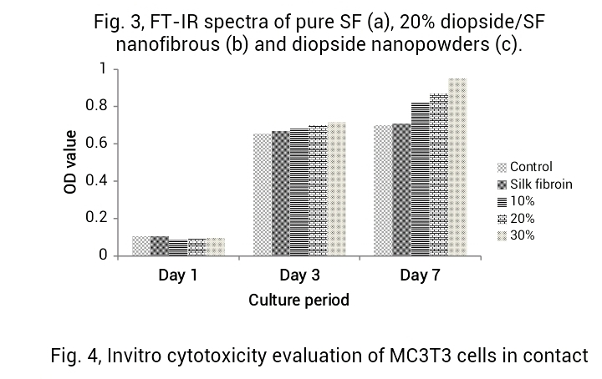
Invitro evaluation of cytotoxicity
The proliferation of MC3T3-E1 cells in contact with nanofibers was assayed after 1, 3 and 7 days of culture period by means of MTT test

Slide 18
Conclusion
Composite silk/nano diopside nanofibrous scaffold was successfully fabricated by electrospinning method
The nanodiopside/ silk scaffolds supported the growth and expansion of cells based on cell adhesion, and morphology in vitro.

Slide 19
References
[1] Q. Zhang, S. Yan, M. Li, Materials. Vol. 2 (2009), p. 2276.
[2] T. C. Holmes, Trends in Biotechnology. 20 (2002), p. 16.
[3] E.Wenk, H. P. Merkle, L. Meinel, Journal of Controlled Release. Vol. 150 (2011), p. 128.
[4] N. Bhardwaj, S.C. Kundu, Carbohydrate Polymers. Vol. 85 (2011), p. 325.
[5] M. Peter, P.T.S. Kumar, N.S. Binulal, S.V. Nair, H. Tamura, R. Jayakumar, Carbohydrate Polymers, Vol. 78 (2009), p. 926.
[6] R. Jayakumar, D. Menon, K. Manzoor, S. Nair, H. Tamura, Carbohydrate Polymers, Vol. 82 (2010), p. 227.
[7] Venugopal J, Ramakrishna S. Appl Biochem Biotechnol. Vol. 125 (2005), p. 147.

Slide 20
[8] K.T. Shalumon, N.S. Binulal, N. Selvamurugan, S.V. Nair, D. Menon, T. Furuike, H. Tamura, R. Jayakumar, Carbohyd. Polym. Vol. 77 (2009), p. 863.
[9] R. Jayakumar, M. Prabaharan, S.V. Nair, H. Tamura, Biotechnol. Adv. Vol. 28 (2010), p. 142.
[10] A. Greiner, J.H. Wendorff, Angew. Chem. Int. Ed. Vol. 46 (2007), p. 5670–5703.
[11] A. Teimouri, L. Ghorbanian, A.N. Chermahini, R. Emadi, Ceramics International, Vol. 40 (2014), p. 6405.
[12] L. Ghorbanian, R. Emadi, S.M. Razavi, H. Shin, A. Teimouri, International journal of biological macromolecules, Vol. 58 (2013), p. 275.
[13] Li G, Li P, Yang XP. Compos Sci Tech. Vol. 68(3-4) (2008), p. 987.

Slide 21
Biography
Abbas Teimouri has completed his PhD at the age of 41 years from Isfahan University of Technology, Isfahan, Iran. He is the associate professor of organic chemistry in Payame Noor University (PNU), Isfahan, Iran. He has published more than 75 papers in reputed journals.
Presenting author details
Full name: Abbas Teimouri
Contact number: Tel. 0098-31-33521804-6, Fax: 0098-31-33521802
Linked In account: Abbas Teimouri
Session name/ number:
Category: (Oral presentation) Biopolymer for tissue engineering

