Slide 1
Phytochemical screening, proximate analysis, lethality studies and anti-tumor potential of Annona muricata L. (soursop) fruit extract in Rattus novergicus
Abbah Okpachi Christopher, m.sc. lecturer
Department of Biochemistry,
Kogi State University,
Anyigba, Nigeria
Conference presentation at
6th Asia-PacificPharma Congress
Ramada Plaza, Kuala Lumpur
Malaysia
July 11th , 2016

Slide 2
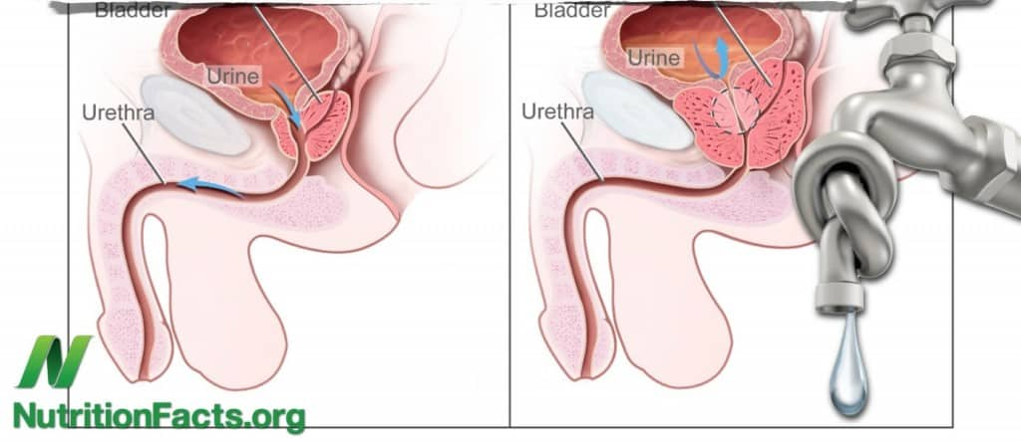
Introduction bph
Benign prostate hyperplasia (BPH) which results in the enlargement of the prostate as men get older is characterized by hyperplasia of prostatic stromal and epithelial cells.
As the prostate enlarges in BPH, it can squeeze down on the urethra, causing partial or complete obstruction of the urethra.

Slide 3

Introduction some statistics
By 2010, BPH was reported to affect about 260 million men globally (Vos et al., 2010)

Slide 4
Introduction some statistics
By 2010, BPH was reported to affect about 260 million men globally (Vos et al., 2010)
and it has also been reported to be one of the 10 most costly diseases of men 50 years or above in the United States (Fenter, 2006).

Slide 5

Introduction symptoms
LUTS
urinary hesitancy
urinary retention*
dysuria
frequent urination
This condition, which has been described as preventive and predictable, has the gravity of being a life altering urinary condition that requires medical intervention (Marks et al., 2006).
*at which point a catheter will be required to be inserted in the bladder to drain the retained urine away.

Slide 6
Introduction etiology
BPH
systemic and local hormonal and vascular alterations
prostatic inflammation
age
Briganti et al., 2009

Slide 7
Introduction etiology
Of these, androgen-estrogen imbalance is the most implicated.
With increase in age, ratio of serum levels of T:E ranges from 120:1 to 80:1
while it reaches down to 8:1 in the prostate (Griffiths et al., 1995).
BPH
systemic and local hormonal and vascular alterations
prostatic inflammation
age
Briganti et al., 2009

Slide 8
Introduction treatment options
invasive therapies
surgery
chemotherapy
alpha blockers
5∝-reductase inhibitors
transurethral microwave thermotherapy, TUMT
transurethral needle ablation, TUNA
Transurethral resection of the prostate,TURP

Slide 9
Introduction treatment options
The trauma,
discomfort,
cost and
side effects of these conventional approaches have informed the search by both sufferers and researchers for alternatives with better risk-benefit profile.

Slide 10
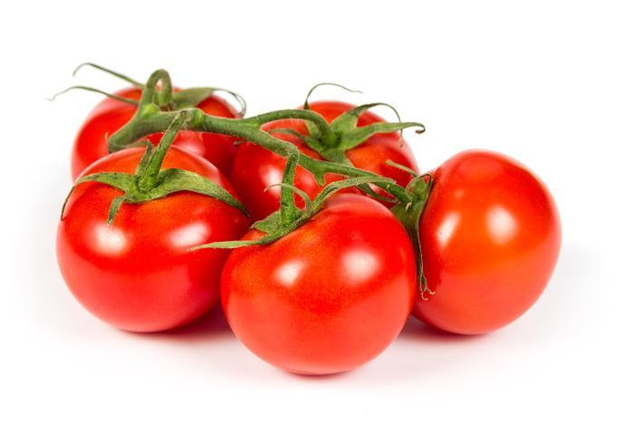
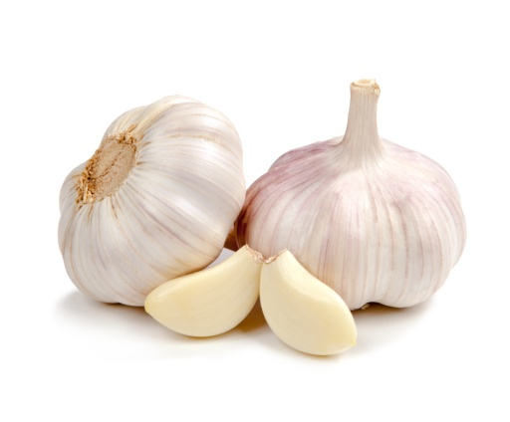
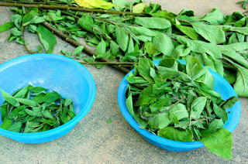
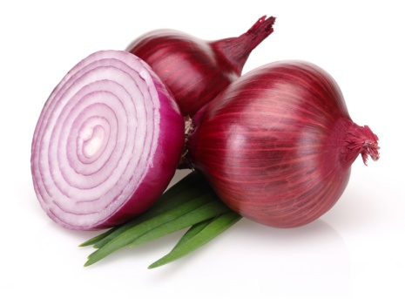
Introduction dietary approach
A number of fruits and dietary supplements have been found useful in the prevention and management of prostate pathologies, especially BPH.
They include coconut (Olapade, 2003; Elom et al., 2007),
tomato, garlic, onions and bitterleaf extracts (Cohen et al., 2000; Elom and Obidoa, 2006; Elom and Obidoa, 2007),
and fluted pumpkin seeds (Ejike and Ezeanyika, 2011).
The Chinese, Japanese and Koreans have been reported to have better prostate and reproductive health than Westerners (Katz, 2002). Numerous studies have hinged this positive finding on diet, especially daily consumption of soy products (Messina, 1994; Kennedy, 1995).

Slide 11
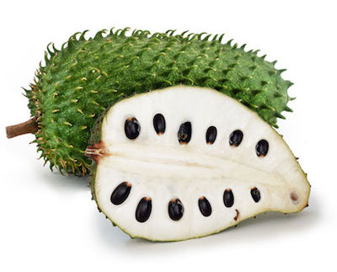
Introduction A.muricata
Although all the morphological parts of the plant have been claimed to be useful in traditional medicine, little attention has been paid to the study of the pulp of A.muricata L. fruit
which is mostly consumed as the delicious part.

Slide 12

AIM
The study was set out to undertake phytochemical screening and proximate analysis of the pulp of A. muricata fruit - soursop;
to determine the acute toxicity of the fruit pulp extract and
its effect on male albino Wistar rats with concurrent induction of experimental benign prostate hyperplasia (BPH).

Slide 13
results
Table 1: Phytochemical constituents of aqueous and n-hexane extracts of Annona muricata fruit pulp.
Phytochemical Aqueous extract N – Hexane extract
Alkaloid - +
Tannins + ++
Flavonoids - +
Saponins - -
Phenolic compounds ++ ++
Resins - +
Steroids + +
Terpenoids + +
KEY
+ = Present
++ = Present (relatively more)
- = Absent

Slide 14
results
Tables 2: Proximate composition of Annona muricata fruit pulp.
Content Sample Percentage
Moisture Fresh Soursop 76.95
Dry Soursop 13.00
Ash Fresh Soursop 0.50
Dry Soursop 1.00
Crude fibre Fresh Soursop 1.00
Dry Soursop 2.20
Protein Fresh Soursop 2.89
Dry Soursop 7.04
Fat Fresh Soursop 2.20
Dry Soursop 3.60
Carbohydrate Fresh Soursop 16.61
Dry Soursop 73.16
Each values is an average of three determinations
From Table 2 above, only moisture content was found to be higher in fresh soursop sample compared to the dry sample; ash, crude fibre, protein, fat and carbohydrate were higher in the dry sample.

Slide 15
results
Table 3: Result of median lethal dose (LD₅₀) determination of the aqueous extract of soursop fruit pulp in rats
Dose (mg/Kg) Number of deaths
10 Nil
100 Nil
1000 Nil
1600 Nil
3200 Nil
5000 Nil
n = 3

Slide 16
results
Table 4: Testosterone, Estradiol, PSA levels and Relative prostate weight from Preventive Studies
TG HC VC SC VS
Testosterone T (ng/ml) 5.594±1.097 5.572±1.207 0.382±0.138* 0.512±0.120* 0.322±0.107*
Estradiol E2 (ng/ml) 1.748 ±0.149 2.058±0.687 0.370±0.031 0.580±0.342 0.518±0.354
T : E2 ratio 3.486±1.017 2.726±2.195 1.058±0.339 0.880±0.860 0.742±0.941
PSA (ng/ml) 0.055±0.017 0.194±0.068* 0.033±0.008 0.022±0.011 0.026±0.006
R.p.w. 0.006±0.001 0.010±0.003* 0.002±0.001 0.004±0.002 0.002±0.001
Values are expressed as mean ± SEM of 5 rats per groups. *Significantly different (p< 0.05) compared to the test group (TG) using Dunnett’s test.
PSA = Prostate specific antigen
R.p.w. = Relative prostate weight
Key:
TG Test Group Inducer + Soursop
HC Hormone Control Inducer Only
VC Vehicle Control Vehicle Only
SC Soursop Control Soursop Only
VS Vehicle + Soursop Vehicle + Soursop

Slide 17
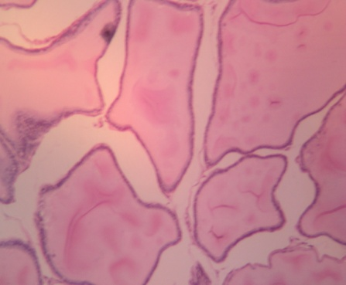
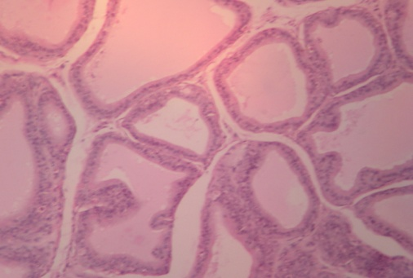
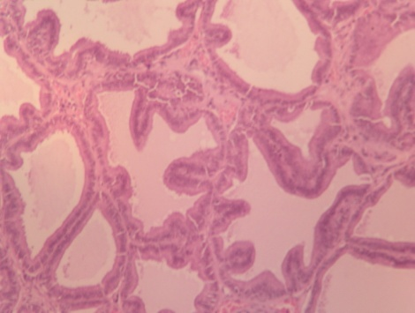
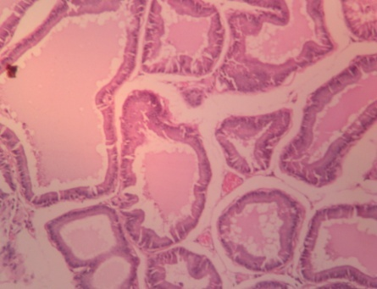
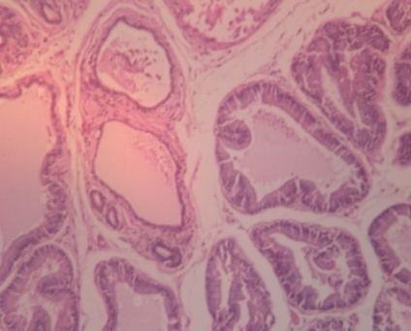
results
A: enlarged glands with lumen distended by secretions – Prostatic Hyperplasia.
B: Treatment was found to reduce the distension and amount of luminal secretions in TG.
C-E: normal sized glands lined by epithelium and enclosing moderate amount of luminal secretions. The surrounding stroma is fibro muscular- Normal prostate.
Image A: Hormone Control, HC
Image B: Test Group, TG
Image C: Vehicle control, VC
Image D: Soursop Control, SC
Micrograph (x100) of prostate tissues
Image E: Vehicle + Soursop Control, VS

Slide 18
DISCUSSION
Phytochemistry
Lethality
Anti-tumor

Slide 19
Discussion Bioactive compounds
Theseare non-nutritive compounds of plants which occur in thousands of forms and structures with many health benefits to man.
Research into elucidating these phytotherapeutic agents is intensifying.
Terpenoids and polyphenols which were among the phytochemicals found in soursop fruit extract have both been reported to have antioxidant and anti-tumor properties (Grabmann, 2005) and in vitro anti-prolifirative effect on cancer cell lines (de Oliverio et al., 2013).

Slide 20
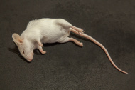

Discussion lethality
The LD₅₀ of aqueous extracts of soursop fruit pulp was found to be >5000mg/kg in albino Wistar rats and as such may be generally regarded as safe (Lorke, 1983; USEPA, 1998).
It is possible that the fruit extract may combine efficacy with little or no toxicity at the dose used and in the species studied.
Efficacy with low or no toxicity is a desired property in ethnopharmacology, and some medicinal plants have been screened as combining these two desired qualities (Omale and Okafor, 2009).

Slide 21
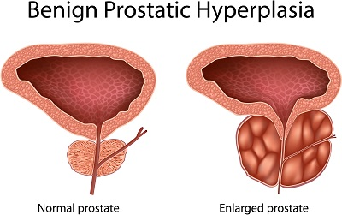
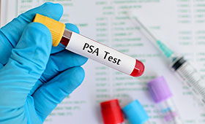
Discussion prostate enlargement
The study reveals a potential of soursop fruit to prevent enlargement of the prostate experimentally,
from the significant reduction (p<0.05) in prostate weight in the treated group, an observation corroborated with by the significant decrease (p<0.05) in serum PSA levels.
In the current study, treatment significantly reduced (p<0.05) the number of cells produced (as evident in the prostate weight) thereby (also) reducing significantly (p<0.05) the serum PSA (Table 4).
This prostate size–PSA level interrelationship has been well documented (Girman, 1998; Praveen, 2013).

Slide 22
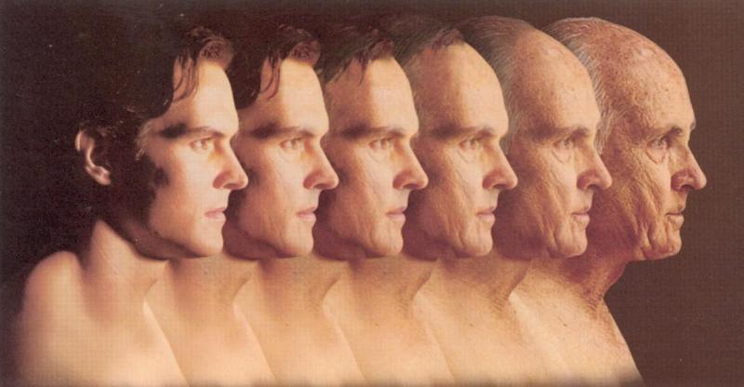
Discussion T:E…AGE
As men age T levels drop while E2 levels go up. This imbalance between the androgenic and non-androgenic hormones has been reported as the cause of BPH (Briganti et al., 2009) and it has been found to be so in BPH patients from clinical studies (Tan et al, 2003; Xiang-Yhu et al., 2010).

Slide 23
Discussion T:E…AGE
In this study, it was observed that A. muricata administration to the group that received concurrent tumor induction improved the T:E2 by not only decreasing serum E levels but also increasing the T levels.
Although HC and TG both received exogenous hormones, it is possible that the slight increase in T levels in the test group may have been due to the ability of the fruit to block the conversion of T to DHT (Dihydrotestosterone) by enzyme 5α-reductase (5αR) (Table 4).

Slide 24
Discussion dht
DHT is 10× more potent than T and is the androgen form that is most implicated in the etiology of BPH (Marks et al., 2006; Praveen, 2013).
This inhibitory property has been found in a number of nutrients and phytochemicals (Hennenfront, 1995; Murray, 1995).
It is important to note that DHT build up is a stimulant for prostate cell proliferation (Elom et al., 2006).

Slide 25
Discussion dht deprivation
The drugs of choice for BPH
Finasteride and
Dutasteride

Slide 26
Discussion dht deprivation
The drugs of choice for BPH
finasteride and
Dutasteride
better alternatives are being sought as a result of side effects which include
libido loss,
hair loss,
gynaecomastia and
rash (Nickel, 2004)

Slide 27
Discussion dht deprivation
The drugs of choice for BPH
finasteride and
Dutasteride
better alternatives are being sought as a result of side effects which include
libido loss,
hair loss,
gynaecomastia and
rash (Nickel, 2004)
are in the 5α-reductase inhibitors class of drugs,
are well known to effect their pharmacological action by depriving prostatic cells of DHT (Marks et al., 2006)
are usually prescribed as preventive treatment for disease progression.

Slide 28
Discussion e2 reduction
In addition, the reduction in E2 in the treated group is quite an exciting observation.
It has been reported that the prostate is an E2 target, where it directly or indirectly promotes prostate growth (Nicholson and Ricke, 2011)
and there is ample evidence on its role in the development and management of BPH particularly by various tissue or cell-specific receptors (Garg et al., 2013).

Slide 29
Discussion serm
Selective estrogen receptor modulators (SERM) have been shown through in vitro and in vivo studies to have pro-apoptotic, anti-proliferative and anti-inflammatory mechanisms in BPH.
They also inhibit different growth factors,
This approach being a very recent one for the management of BPH through targeting E2 reduction mechanisms (Garg et al., 2013).

Slide 30
Discussion T-E2 ratio
Elevation or improvement in T-E2 ratio is a much desired effect in BPH treatment, like in the result with Qianliening capsules, a traditional Chinese medicinal formulation for BPH (Zhou, 2012).
The role of this ratio in BPH development and management has been argued. Younger men have higher T:E2 than older men 50 years or above; no evidence of BPH is seen in men below 30 years and this age range usually has the highest T:E2 ratio.
The current study observed that although not statistically significant (p>0.05) at the dose administered, A. muricata led to an elevation of T:E2 ratio in the group that received both hormones and A. muricata showing a potential to improve this important parameter in BPH management.

Slide 31
Discussion histopathology
The preventive property of soursop against BPH was corroborated by histological evidence in this study (Images A-E).
Hyperplasia was reduced in the tissue of the Test Group: recall that earlier we observed that prostate weight in this group was significantly reduced by A. muricata administration, so also PSA.
Treatment was found to reduce the distension and amount of luminal secretions, making the histological picture of TG closer to the other controls (that were given no hormones) than HC.

Slide 32
Conclusion
As BPH continues to be one of the leading causes of male urinary disorder in the geriatric population and current treatments are suboptimal, the search for better alternatives is more intensified than ever.

Slide 33
Conclusion
As BPH continues to be one of the leading causes of male urinary disorder in the geriatric population and current treatments are suboptimal, the search for better alternatives is more intensified than ever.
In this study, soursop (A. muricata) fruit has shown a significant potential to prevent experimental non-malignant prostatic hyperplasia in rats.

Slide 34
Conclusion
As BPH continues to be one of the leading causes of male urinary disorder in the geriatric population and current treatments are suboptimal, the search for better alternatives is more intensified than ever.
In this study, soursop (A. muricata) fruit has shown a significant potential to prevent experimental non-malignant prostatic hyperplasia in rats.
The mechanism by which it effects this action is a subject for further studies, especially DHT deprivation, E2 reduction and effect of selective estrogen receptor modulators.

Slide 35
Trimakase!!
(Malay)
Thank you!

