Slide 1

New serological biomarkers of celiac disease: The neo-epitope tTg/mTg story
Prof. Aaron Lerner^{1,2}, Dr. Torsten Matthias²
5th European Immunology Conference, July 21-23, Berlin, Germany
B. Rappaport School of Medicine, Technion-Israel institute of Technology, Haifa, Israel. aaronlerner1948@gmail.com
AESKU.Kipp Institute, Wendelsheim, Germany. matthias@aesku.com

Slide 2
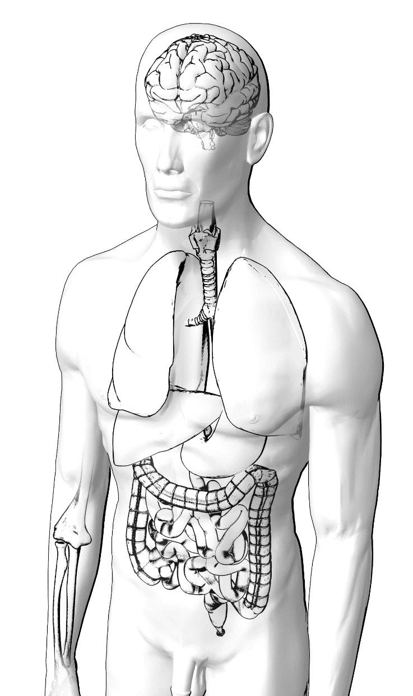
Human Transglutaminase Family
The TG family
TG1: keratinocyte transglutaminase
TG2: tissue transglutaminase
TG3: epidermal transglutaminase
TG4: prostate transglutaminase
TG5: transglutaminase 5
TG6: neuronal transglutaminase
TG7: transglutaminase 7
FXIII: blood coagulation factor XIII
B4.2: inactive structural protein
Functions
Post translational modifier of proteins:
Cross-linking
Deamidation
Autoimmune Diseases
Celiac Disease
Dermatitis Herpetiformis
Gluten Ataxia
[adapted and modified from www.zedira.de]

Slide 3
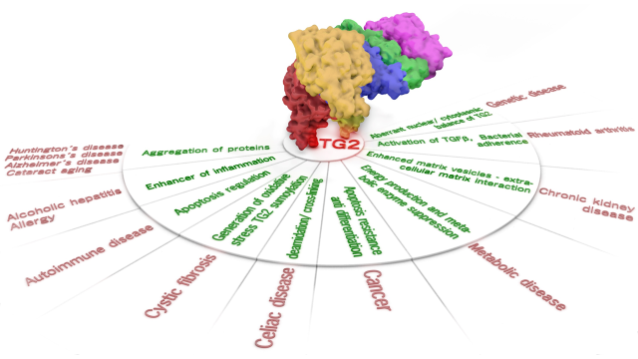
Tissue Transglutaminase (TG2) :central role in biological processes and diseases
Lerner A, Neidhöfer S, Matthias T. Transglutaminase 2 and anti transglutaminase 2 autoantibodies in celiac disease and beyond: Part A: TG2 double-edged sword: gut and extraintestinal involvement. Immunome Research, 2015;11:101-105.

Slide 4
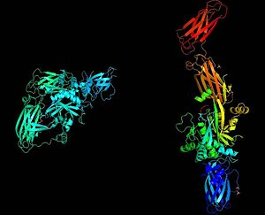
Compact (inactive) and extended (active) conformations of tTG

Slide 5
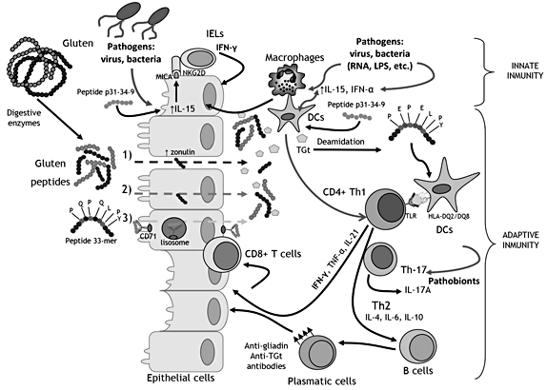
Schematic representation of the proposed model for CD pathogenesis
mTg
Adapted and modified from: Sanz Y. Microbiome and Gluten. Ann Nutr Metab. 2015;67 Suppl 2:28-41

Slide 6
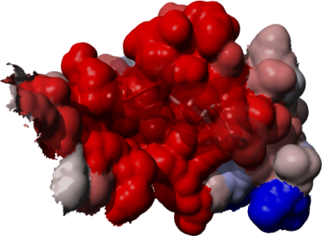
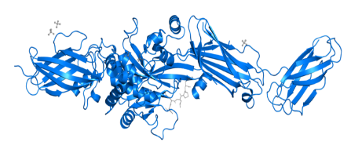
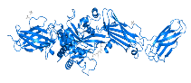
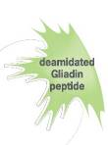
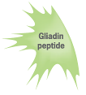
Antibodies in Celiac Disease
Anti-tTg neo-epitope antibodies
Anti-tTg antibodies
Gliadin
Anti-DGP antibodies
Enzyme
Crosslinking by tTg
[PDB ID 2Q3Z]
Deamidation
Crosslinking
Neo-epitope
(glutamic acid glutamine)
neutral
Gliadin peptide
Glutamine rich
25%
75%
Courtesy of Dr. Christian Meesters, AESKU.KIPP Institute 2012//
A. Lerner et al., Antibodies against neo-epitope tTg complexed to gliadin are different and more reliable then anti-tTg for the diagnosis of pediatric celiac disese (Journal of immunological Methods 429 (2016) 15-20)

Slide 7
Overall immunoreactivity in PCD patients
p<0.001
p<0.001
p<0.001
A significantly higher OD activity was detected for tTg neo-epitope IgA, IgG and IgA+ IgG than for tTg
A. Lerner et al., Antibodies against neo-epitope tTg complexed to gliadin are different and more reliable then anti-tTg for the diagnosis of pediatric celiac disese (Journal of immunological Methods 429 (2016) 15-20)

Slide 8

Diagnostic power of neo-epitopes
n=198 pediatric samples of an actual study
ELISA | sensitivity | specificity | AUC | Correlation | P
hTG2 IgG | 12.12 | 98.99 | 0.56 | .0.2601 | <0.001
hTG2 IgA | 58.59 | 98.99 | 0.79 | 0.4692 | <0.001
tTg neo IgG | 77.78 | 97.98 | 0.88 | 0.5334 | <0.001
hTG2 Check | 79.8 | 98.99 | 0.89 | 0.6093 | <0.001
tTg neo IgA | 86.87 | 98.99 | 0.93 | 0.6165 | <0.001
tTg neo check | 97.98 | 100 | 0.99 | 0.6492 | <0.001
EMA IgA | 90.2 | 94.1 | 0.94 | 0.8098 | <0.001
EMA IgG | 55.7 | 99.3 | 0.78 | 0.5996 | <0.001
tTg showed the highest sensitivity in its combined version IgA + IgG (Check)
A. Lerner et al., Antibodies against neo-epitope tTg complexed to gliadin are different and more reliable then anti-tTg for the diagnosis of pediatric celiac disese (Journal of immunological Methods 429 (2016) 15-20)

Slide 9
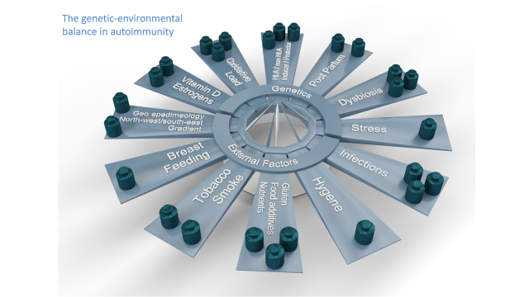
The genetic environmental balance in autoimmunity

Slide 10
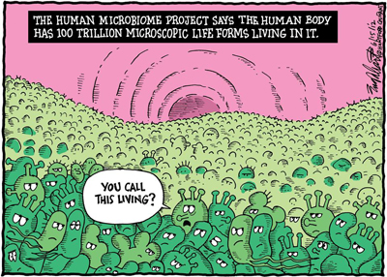
The human microbiome
http://www.longevityreporter.org

Slide 11
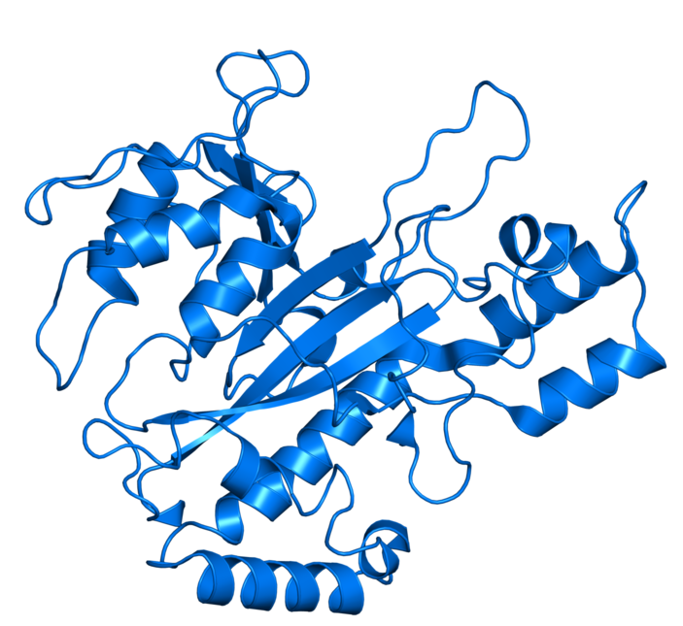
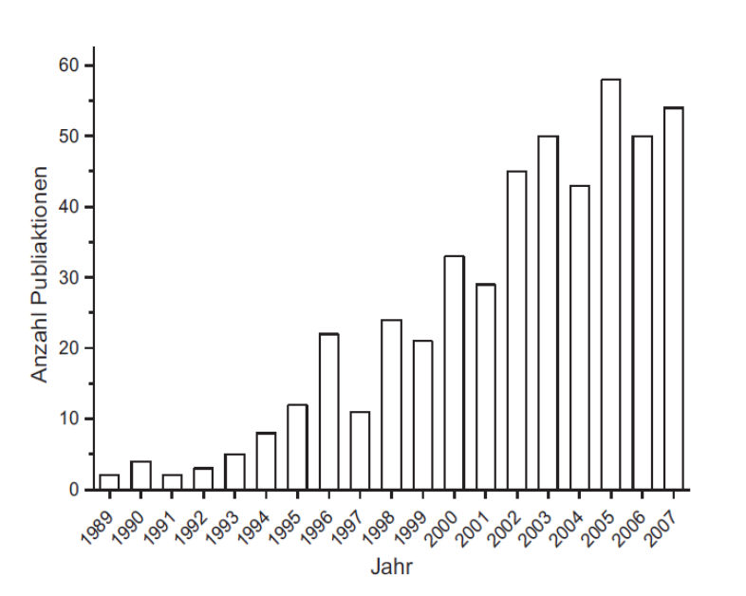
Microbiological transglutaminase (mTg)
PDB ID: 1IU4
Molecular weight: 38 kDa
Most of the identified mTgs derived from Streptomycetes (ubiquitary living soil microorganisms)
Comparable enzymatic activity as tTg
Difference to tTg:
  Ca²⁺ independent protein
  Lower substrate specificity
Increase of publications about ``microbial transglutaminase`` after discovery in 1989.
Andou et al. 1993, Duran et al. 1998, Pasternack 1998, Umezawa et al. 2002, Lin et al. 2006, Liu et al. 2006, Langston et al. 2007, Cui et al. 2007, Horiguchi et al. 1997, Schmidt et al. 1998

Slide 12
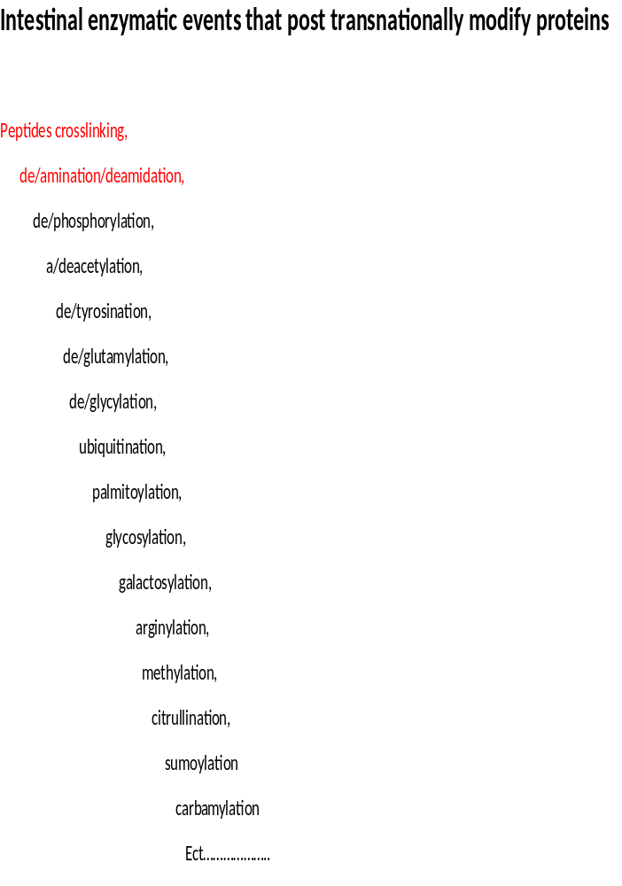
Lerner A et al. Dysbiosis may trigger autoimmune diseases via inappropriate posttranslational modification of host proteins. Frontiers in Microbiology, 2016. // Lerner A et al. Intestinal dysbiotic transglutaminases are potential environmental drivers of systemic autoimmunogenesis. Submitted, Frontiers in Microbiology, 2016.
Intestinal enzymatic events that post translationally modify proteins

Slide 13
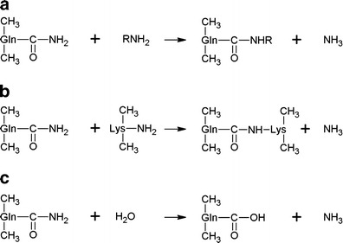
The reactions catalysed by transglutaminase include:
Reactions catalyzed by transglutaminase
A. acyl-transfer reaction;
B. cross-linking reaction between Gln and Lys residues of proteins or peptides.
C. deamidation
Folia Microbiol (Praha). 2014; 59(3): 241–250.
Microbial transglutaminase and its application in the food industry. A review
Marek Kieliszek, Anna Misiewicz.

Slide 14

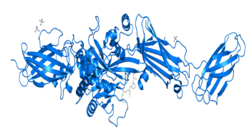
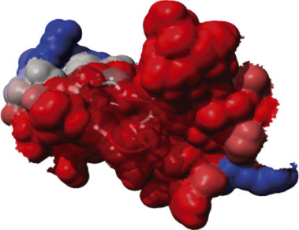

A schematic presentation of the interplay between gliadin, tTg and mTg enzymes and their corresponding complexes and specific antibodies.
A Lerner, P Jeremias, S Neidhöfer, T Matthias. Antibodies against neo-epitope tTg complexed to gliadin are different and more reliable then anti-tTg for the diagnosis of pediatric celiac disease. J Immunol Methods. 2016;429:15-20.
Anti-tTg antibodies
Anti-tTg neo-epitope antibodies
Gliadin
Anti-DGP antibodies
Enzyme
Crosslinking by tTg
[PDB ID 2Q3Z]
Deamidation
(glutamic acid glutamine)
neutral
Crosslinking by mTg
Gliadin peptide
Glutamine rich
25%
75%
Anti-mTg neo-epitope antibodies
Courtesy of Dr. Christian Meesters, AESKU.KIPP Institut 2012

Slide 15
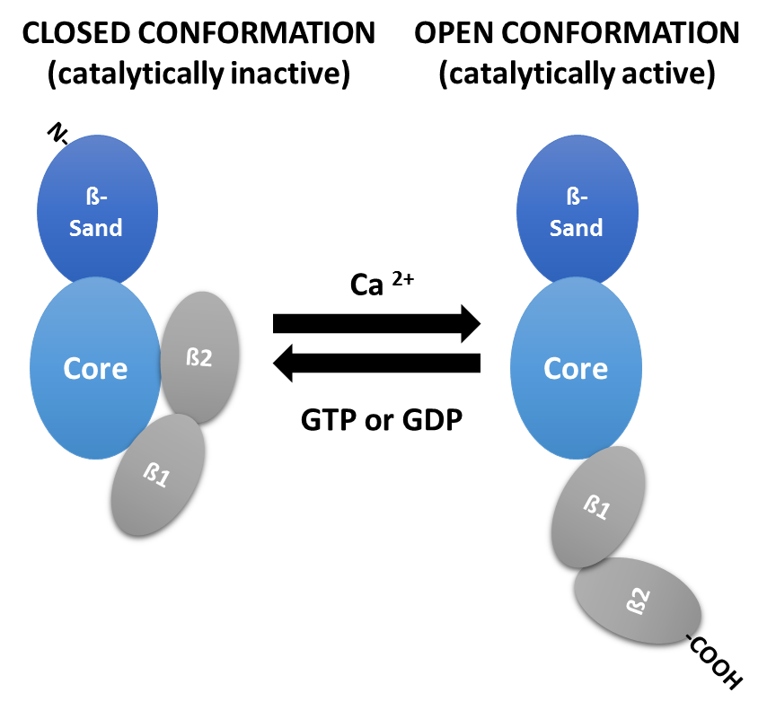
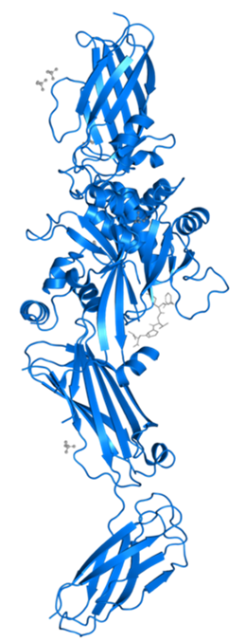
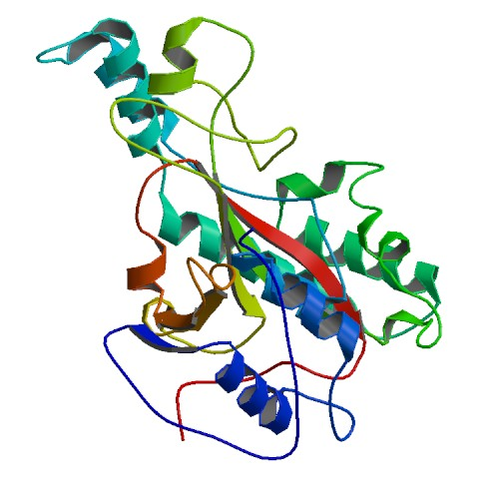
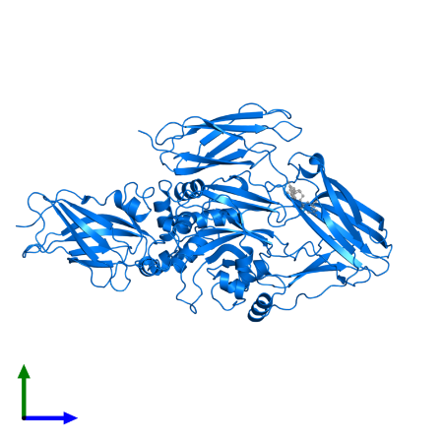
The different conformational states of tTg and mTg and their effects on cells
tTg
mTg
α-hel
4 DOMAINS
α-hel
1 DOMAIN
β-st
α-hel
PDBID: 4PYG
PDB ID: 1IU4
PDBID: 2Q3Z
Crosslinking
Ca²⁺ independent
Nucleotide independent
Nucleotide-bond
Crosslinking deficient
Nucleotide-free
Crosslinking active
PROMOTES CELL GROWTH AND SURVIVAL
INDUCES CELL DEATH
Singh, Jingwen Zhang, Yilun Ma, Richard A. Cerione and Marc A. Antonyak; The Different Conformational States of Tissue Transglutaminase Have Opposing Affects on Cell Viability Garima, JBC Papers in Press on February 18, 2016

Slide 16
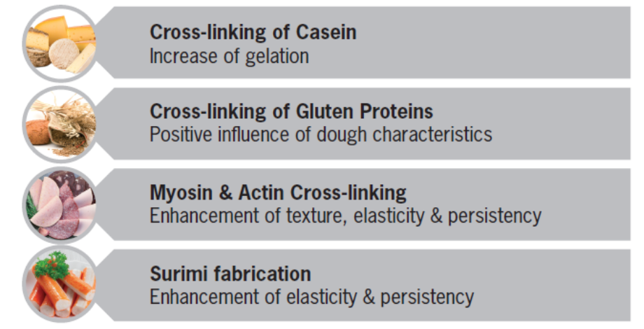
Folia Microbiol (Praha). 2014; 59(3): 241–250.
Microbial transglutaminase and its application in the food industry. A review Marek Kieliszek, Anna Misiewicz.
Application of mTgase on food processing
Source | Product | Effect | Reference
Meat | Restructured meat | Restructured meat texture and appearance, increased hardness | Kuraishi et al. (1997); Motoki and Seguro (1998); Trespalacios and Pla (2007)
Fish | Fish paste, restructured product | Increased hardness | Téllez-Luis et al. (2002)
Milk | Cream, deserts, milk drinks, dressings | Improved quality and texture | Lauber et al. (2000); Şanlı et al. (2011)
Casein | Cross linked protein | Allergenicity reduction | Lauber et al. (2000); Ozer et al. (2007)
Wheat | Baked foods | Improved texture and high volume | Gerrard et al. (2001)
Gelatin | Sweet foods | Low calorie foods with good texture and elasticity | Giosafatto et al. (2012)
Mahta Mirzaei et al. 2011 // M. Griffin et al. 2002

Slide 17
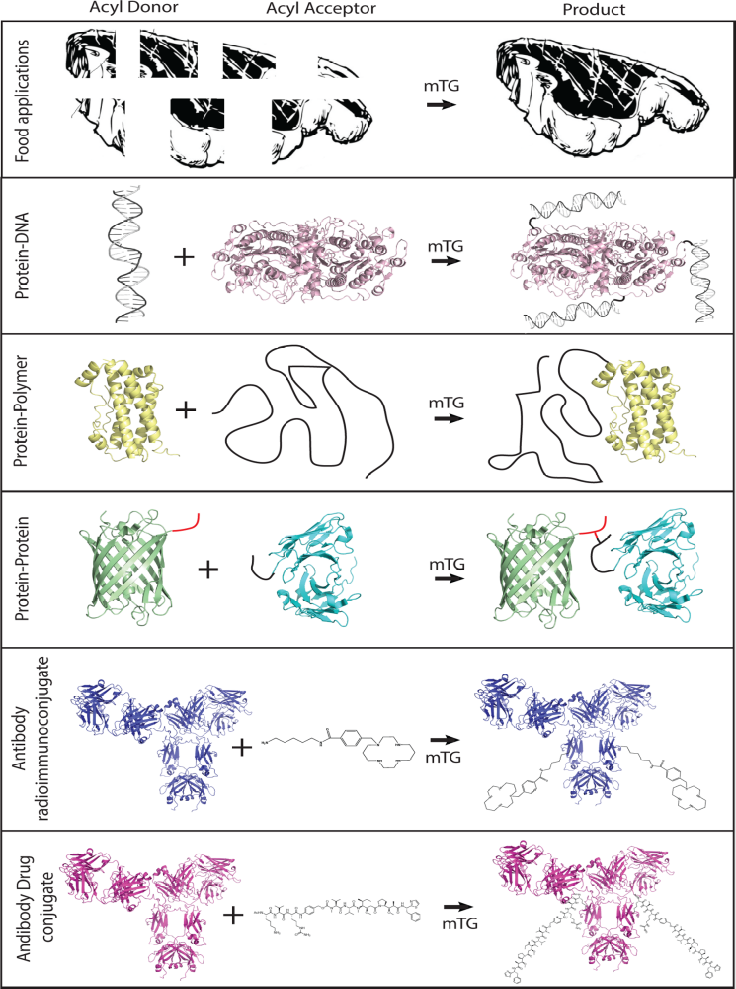
Examples of mTg application versality
Acyl Donor + Acyl Acceptor
Product
Food applications
Protein-DNA
Protein-Polymer
Protein-Protein
Antibody
radioimmunoconjugate
Antibody Drug
conjugate
Pavel Strop. Versatility of Microbial Transglutaminase. Bioconjugate. Chem. 2014, 25, 855−862

Slide 18
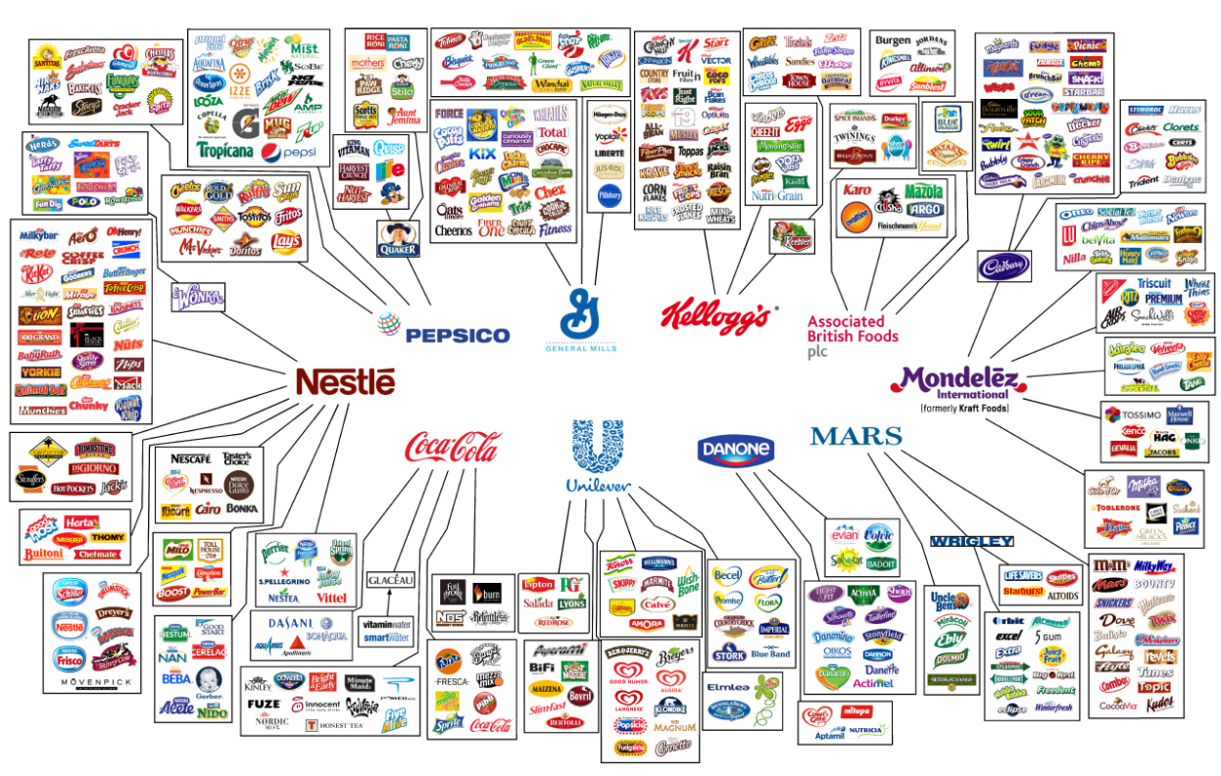
The change in modern nutrition!
www.onegreenplanet.org

Slide 19
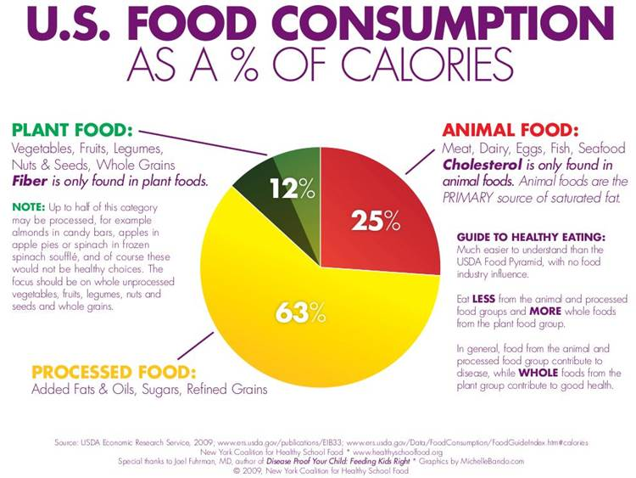
Change in nutrition responsible for increasing CD numbers?
http://draxe.com/charts-american-diet/

Slide 20
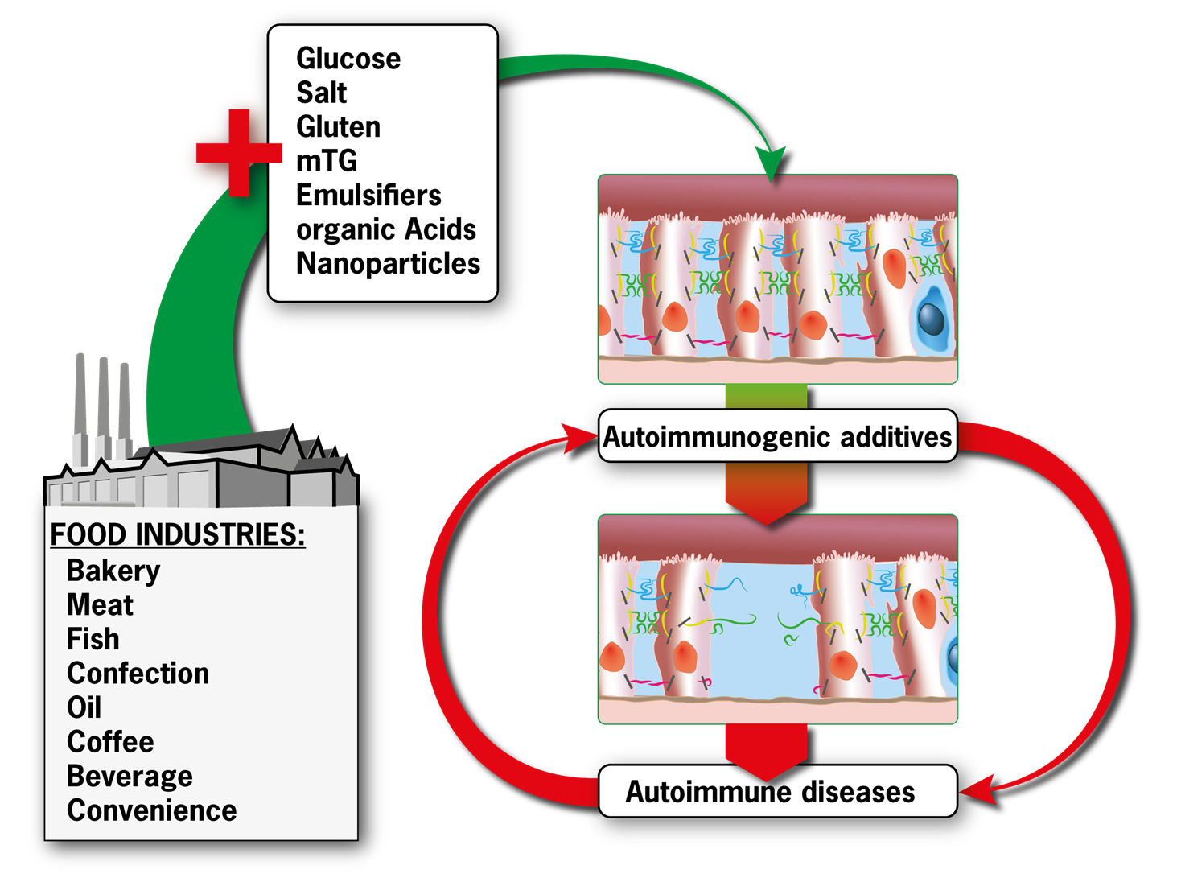
Lerner A, Matthias T. Changes in intestinal tight junction permeability associated with industrial food additives explain the rising incidence of autoimmune disease. Autoimmun Rev. 2015;14:479-89
Change in nutrition responsible for the increasing numbers of ADs?

Slide 21
Mechanisms of food additives to increase intestinal permeability
Food additives | Net % increase/year | Mechanism of TJ integrity breaching
Glucose | 2.9±2.8 | Change in distribution of ZO-1, claudin-1, E cadherin. Perijunctional cytoskeleton condensation.
Salt | 7.1±5.3 | Increased phosphorylation of myosin light chain, contraction of the perijunctional actomyosin ring, loss of function of claudin 2 and 15.
Organic solvents | -2.9±9.3 | Alterations in TJ proteins, dissociates the PTP1B-E-cadherin-beta-catenin complex
Emulsifiers | 6±8.4 | P-glycoprotein inhibition, decrease the hydrophobicity of the mucus layer, actine disbandment and structural separation of TJ, change the distribution of ZO-1 and actine.
Gluten | 1.8±0.4 | Rearrangement of the cytoskeleton through the zonulin pathway, reduces F-actin content, interaction between occludin and Zo-1 is compromised, zonulin release is leading to PKC-mediated cytoskeleton reorganization, zonulin release by binding to the CXCR3 receptor in intestinal cells, in a MYD88-dependent pathway and subsequent transactivation of EGFR by PAR2.
Microbial transglutaminase | 21.9±7.4 | Increases luminal microbial load, Hypothesis: cross-linking TJ proteins, imitating emulsifiers and nanoparticles functions.
Nanoparticles | 25.8±21.5 | Redistribution of ZO-1 TJ proteins, clustering of integrin α(V)β(3) along the cell border, F-actin reorganization and claudin 4 down regulation, open epithelial TJ via C-Jun Nh2-terminal kinase-dependent pathway, TJ electrostatic interactions
Lerner A, Matthias T. Changes in intestinal tight junction permeability associated with industrial food additives explain the rising incidence of autoimmune disease. Autoimmun Rev. 2015;14:479-89

Slide 22
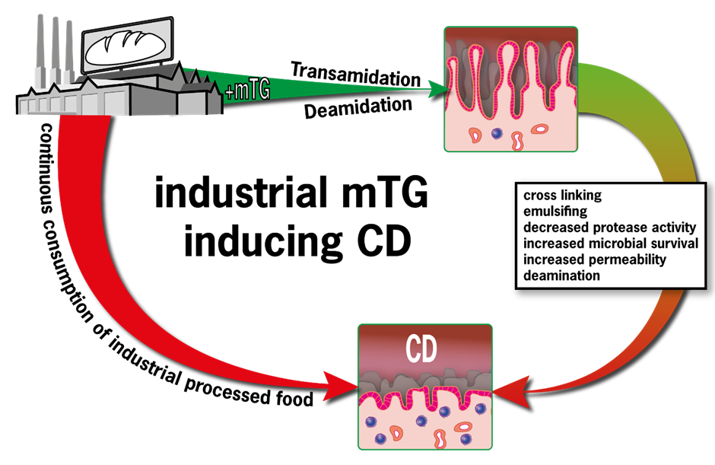
Microbial transglutaminase & Celiac Disease
Increase of baked goods enzyme cost/year
Average CD incidence net increase in western countries/ year
Increased consumption of food industry mTg may explain the surge in CD incidence
Lerner A, Matthias T. Possible association between celiac disease and bacterial transglutaminase in food processing: a hypothesis. Nutr Rev. 2015; 73: 544-552. // Lerner A, Matthias T. Possible association between celiac disease and bacterial transglutaminase in food processing: a hypothesis. Nutr Rev. 2015; 73: 544-552.

Slide 23
Levels of IgG, IgA, IgM antibodies (ELISA units) against raw and processed food antigens
Raw and processed food antibodies
Processed/raw | IgG |  | IgA |  | IgM
 | processed | Raw | processed | Raw | processed | Raw
Doughnut | 118 |  | 130 |  | 42
wheat |  | 68 |  | 85 |  | 32
barley |  | 10 |  | 6 |  | 6
yeast |  | 14 |  | 10 |  | 6
soy |  | 18 |  | 16 |  | 6
Cake | 138 |  | 134 |  | 58
wheat |  | 66 |  | 84 |  | 32
egg |  | 12 |  | 10 |  | 4
corn |  | 10 |  | 8 |  | 10
milk |  | 34 |  | 54 |  | 18
Cereal | 124 |  | 138 |  | 54
wheat |  | 64 |  | 84 |  | 30
oat |  | 60 |  | 42 |  | 20
corn |  | 10 |  | 8 |  | 6
rice |  | 8 |  | 6 |  | 4
barley |  | 9 |  | 7 |  | 6
milk |  | 34 |  | 52 |  | 12
Vojdani A. Detection of IgE, IgG, IgA and IgM antibodies against raw and processed food antigens. Nutr Metab (Lond). 2009;6:22.

Slide 24
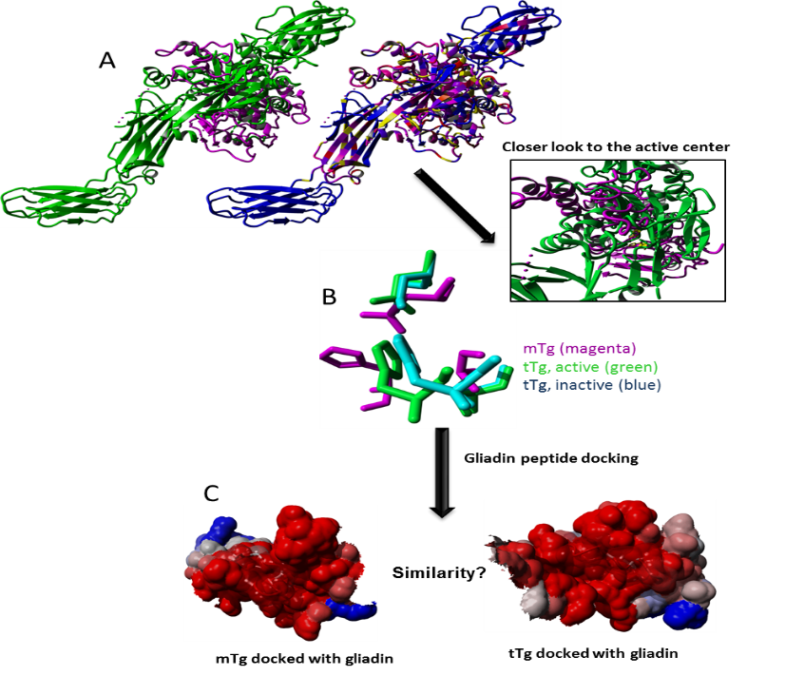
Similarity between mTg and tTg?
3D structure alignment of mTg and tTg
Yellow=conserved segments.
Structural alignment of mTg and tTg on their catalytical triade.
Cys 64 – Asp 255 – His 274
Cys 277 – His 335 – Asp - 358
[Pictures produced with YASARA, Courtesy of Dr. Christian Meesters, AESKU.KIPP Institute 2012]

Slide 25
Docking of gliadin peptide (PDB-ID: 1NNA) with mTg (left side) and tTg (right side). The arisen complexes got stained among their electrostatic profile; red = negative charges.
Similarity between mTg and tTg?
[Pictures produced with YASARA, Courtesy of Dr. Christian Meesters, AESKU.KIPP Institute 2012]

Slide 26
Immunoreactivity of the mTg/ tTg neo-epitope anti IgA and IgG and the single compounds mTg, tTg and gliadin (not complexed to gliadin complexes) anti IgA and IgG.
Sera immunoreactivity of the neo-epitopes
IgA sera immunoreactivity
IgG sera immunoreactivity

Slide 27
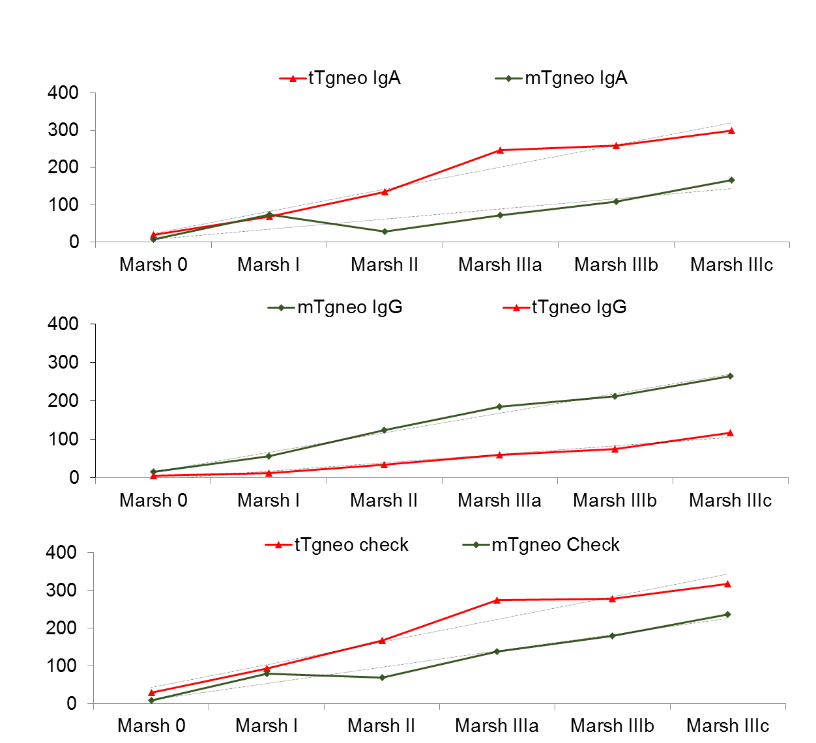
Antibodies`activity in relation to the degree of intestinal damage in CD
Antibody | Correlation coefficient r | P
tTg neo check | 0.6492 | <0.0001
tTg neo IgA | 0.6165 | <0.0001
mTg neo IgG | 0.5633 | <0.0001
tTg neo IgG | 0.5334 | <0.0001
mTg neo check | 0.5127 | <0.0001
mTg neo IgA | 0.3018 | 0.003
U/ml
Intestinal damage

Slide 28
Competition ELISA (human IgA)
Gliadin
DGP
tTg
mTg neo-epitope
tTg neo-epitope
*
**
Competition to the “IgA neo-epitope” showed a decrease in response
if transglutaminases complexed with gliadin peptides were added
* p<0.05 // ** p< 0.005

Slide 29
Diagnostic power of neo-epitopes
n=198 pediatric samples (CD=99 , N=99)
ELISA | sensitivity | specificity | AUC
mTg neo IgA | 64.65 | 98.99 | 0.82
tTg neo IgG | 77.78 | 98.0 | 0.88
mTg neo Check | 90.91 | 87.88 | 0.89
hTG2 Check | 79.8 | 98.99 | 0.89
tTg neo IgA | 88.89 | 98.99 | 0.94
mTg neo IgG | 94.96 | 93.94 | 0.95
tTg neo check | 97.98 | 98.99 | 0.98
mTg neo-epitope IgG had higher sensitivity than tTg neo-epitope IgG
tTg neo-epitope showed the highest sensitivity in its combined version IgA + IgG (Check)

Slide 30
Schematic representation of the proposed model for CD pathogenesis
mTg
Adapted and modified from: Sanz Y. Microbiome and Gluten. Ann Nutr Metab. 2015;67 Suppl 2:28-41

Slide 31
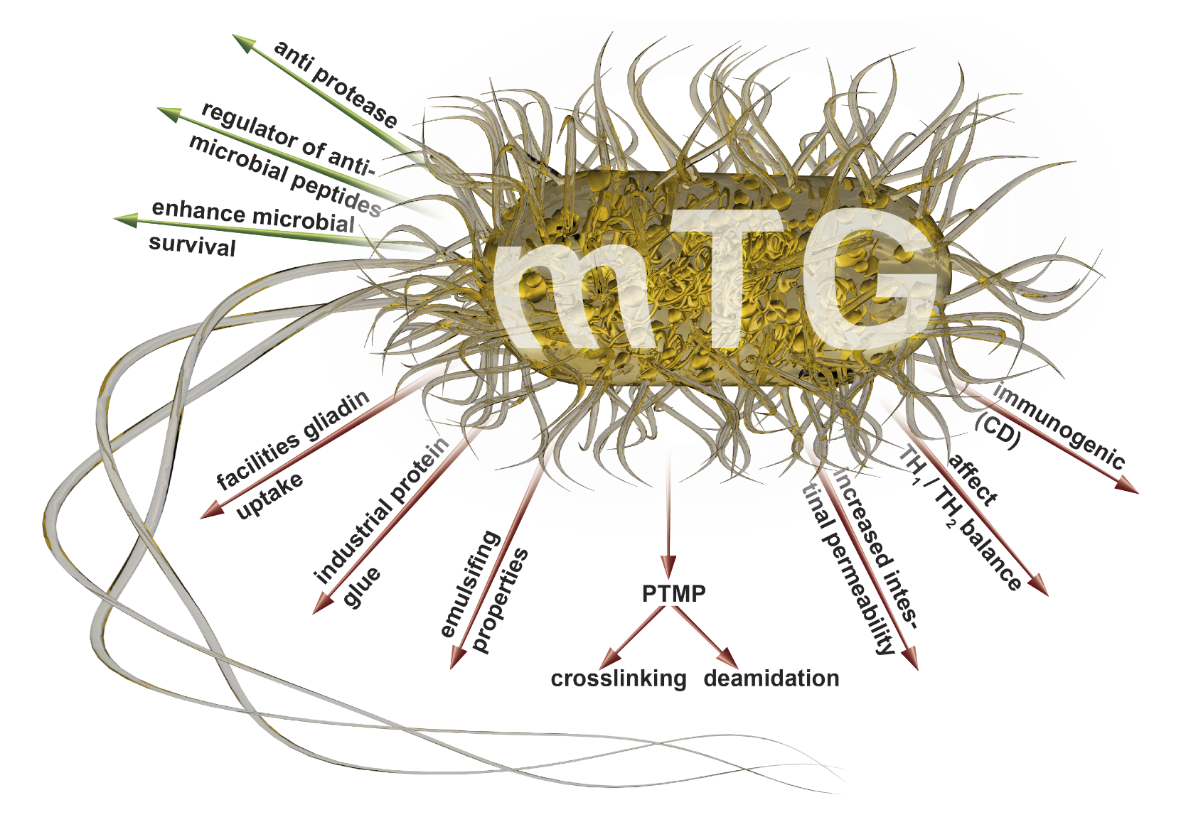
Luminal (green) and systemic (red) effects of the mTg that might drive autoimmunity
Effects of mTg that might drive autoimmunity
Intestinal dysbiotic transglutaminases are potential environmental drivers of systemic autoimmunogenesis
Aaron Lerner, Rustam Aminov, Torsten Matthias. Frontiers in Microbiology, 2016

Slide 32
Yew SE et al.. Development of a probiotic delivery system from agrowastes, soy protein isolate, and microbial transglutaminase. J Food Sci. 2011;76:H108-15. //Lerner A, Matthias T. Possible association between celiac disease and bacterial transglutaminase in food processing: a hypothesis. Nutr Rev. 2015;73:544-552.// Intestinal dysbiotic transglutaminases are potential environmental drivers of systemic autoimmunogenesis Lerner A, Aminov R, Matthias T. Front in Microbiol, 2016 submitted.
Effects of mTg that might drive autoimmunity
It is tempting to estimate the amount and activity of mTg that reside in the human gut during daily life. Three sources can be envision: from the industrial processed food, from the ingestion of probiotic and from the micro/dysbiota luminal residents. Based on the following observations, a hypothetical estimate can be suggested:
Each kilogram of food treated with microbial transglutaminase contains about 50–100mg of microbial transglutaminase.
Examples of the mean yield of bacteria used by the industries for mTg production is Streptoverticillium sp 1.43 unit/ml, Streptoverticillium mobaraense (ajinomoto “wild type”) 1.25unit/ml or 22 unit/mg and Escherichia coli 19.55 unit/mg.
No information to my knowledge, is available, on the amount of tTg secreted in the human gut lumen, however Tgase activity is depicted in the human jejunum.
As a result of the increasing use of microbial transglutaminase in the food industry, the common Western diet now contains large amounts of microbial transglutaminase, with the maximum daily intake ranging up to 15 mg.
Assuming additive effect of a daily intake of 10⁸ viable human originated probiota (Bifidobacterium bifidum/longum/adolescentis/infantis) , as probiotics, that secret mTg to the 100 trillion bacteria constituting the human microbiome, with their mTg load, one can reach a substantial continuous mTg activity residing constantly in the human intestinal lumen.
Interestingly enough, mTg crosslinking can be used as a new probiotic carrier for enhanced gastrointestinal transit and storage.

Slide 33
Conclusions
tTg is the autoantigen of CD and plays a pivotal role in PTM of the gliadin and CD autoimmunogenesis
tTg is essential for human and mTg for bacterial survival
mTg & tTg are capable to deamidate and crosslink proteins, including gliadin
mTg is Ca⁺² independent, less substrate specific, secreted by the luminal microbes and is a heavily used industrial food additive.
CD patients are immunoreactive to the neo-epitopes mTg and tTg. Both antibodies represents new bio-markers for CD diagnosis.

Slide 34
True/false, reality/imagination interplay
mTg parameters | Industrial producers | Processed food products | Human effects
Activity | None | Yes | Intestinal luman
Toxic | No | ? | ?
Immunogenic | No | Yes | Yes
Allergic | No | Yes | Yes
pathogenic | no | ? | ?

Slide 35
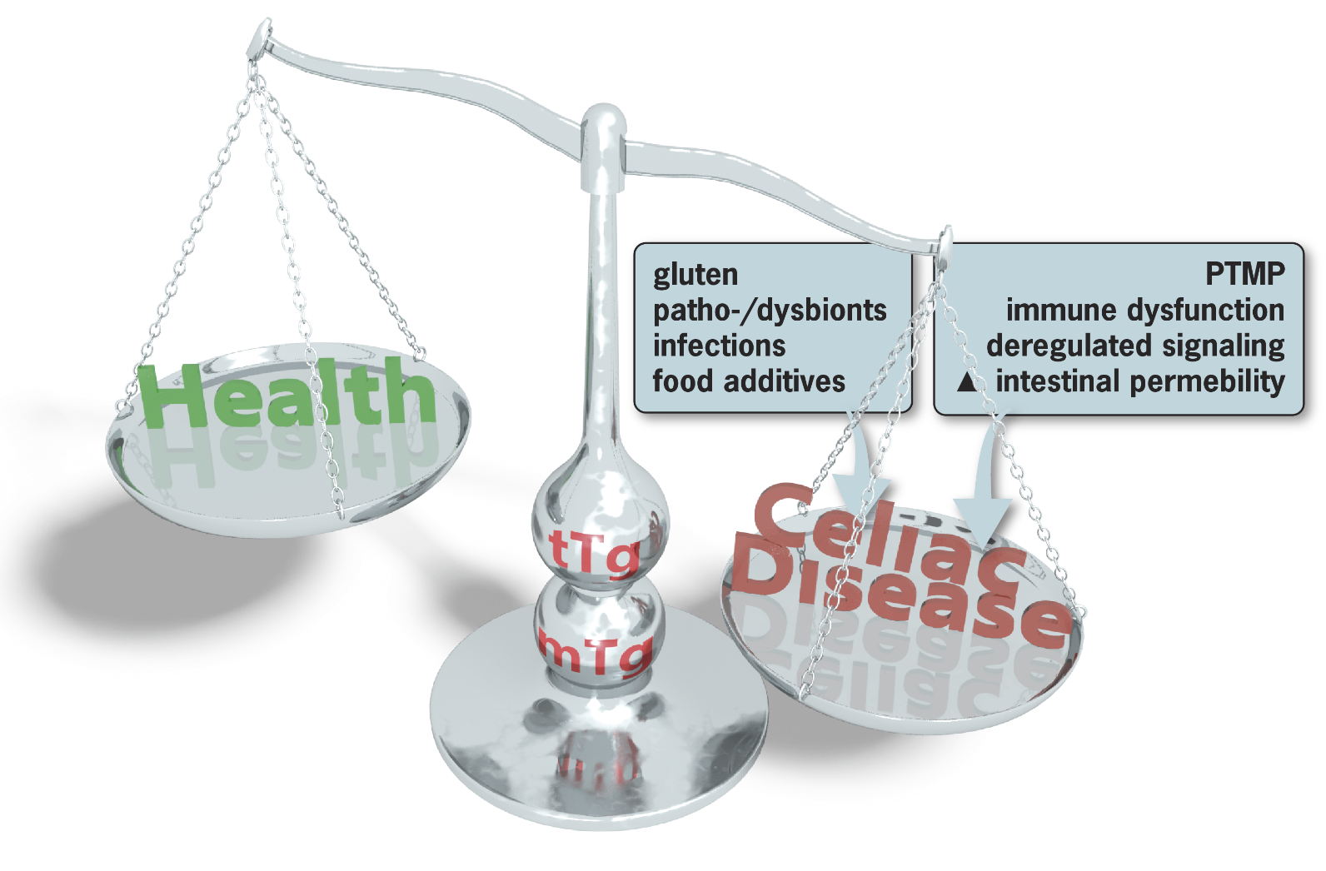
Lerner A, Matthias T. Possible association between celiac disease and bacterial transglutaminase in food processing: a hypothesis. Nutr Rev. 2015;73:544-552.
Environmental and pathophysiological aspects involving tTg & mTg in CD

Slide 36


Slide 37
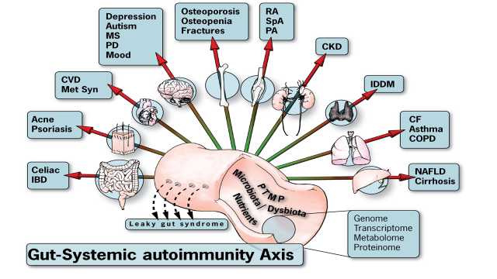
Lerner A et al. Rheumatoid arthritis-celiac disease relationship: joints get that gut feeling. Autoimm Rev. 2015:14:1038-47.
Lerner A et al. Gut- bone cross talks and implications in celiac disease. Internat J of Celiac disease 2016;4:19-23
Lerner A et al. The gut-gut axis:// Cohabitation of celiac, Crohn’s disease and IgA deficiency. Internat J Celiac Dis. 2016;4:68-70. Lerner A et al. GUT-the Trojan horse in remote organs’ autoimmunity. Journal of Clinical & Cellular Immunology, 2016;7:401.
Gut-Systemic autoimmunity Axis

Slide 38
Small bowel organoid
CD animal model
Subepithelial mTg deposits
Reactive, innate immunity
Immunogenicity of mTg products
ADs serum biobanks
HLA presentation of mTg treated peptides
Intestinal permeability and
TJ functions
Looking for scientific cooperation
aaronlerner1948@gmail.com
matthias@aesku.com
+49-6734-9622-0

Slide 39
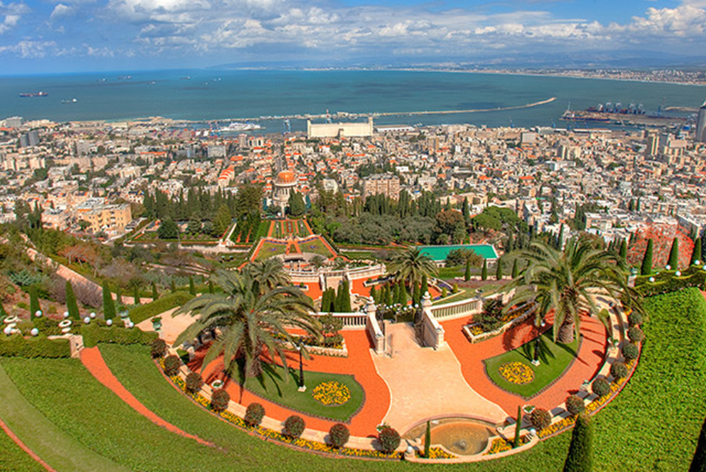
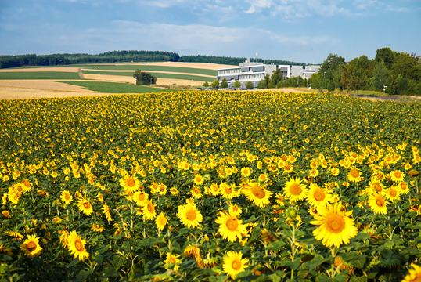
The AESKU.KIPP Institute, Wendelsheim, Germany
Dr. T. Matthias
Dr. S. Neidhöfer
P. Jeremias
T. Barth
Dr. S. Reuter
Dr. P. Trinder
Dr. K. Prager
A. Neu
THANKS TO
Carmel Medical Center,
Technion-Israel Institute of Technology
B. Rappaport School of Medicine
Haifa, Israel

Slide 40
mTg-neo-epitope check diagnostic performance in CD and other ADs, compare to controls
Diseases # Tested # positive AESKULISA
Celiac Disease 99 97 (97.9%)
Celiac Disease (GFD) 5 0 (0%)
Disease control (total) 1037 87 (8.4%)
IBD 52 7 (13.5%)
Rheumatoid Arthritis 575 54 (9.4%)
Vasculitis 58 5 (8.6%)
Adult Healthy donors 264 7 (2.7%)
Pediatric Healthy Donors 88 14 (15.9%) mTg-neo-epitope check diagnostic performance
Pos Neg Total
AESKULISA mTg-neo-epitope check Pos 97 2 99
Neg 87 950 1037
Total 184 952 1136
Area under the Curve: 0.95
Sensitivity: 97.98 %
Specificity: 91.61 %
The mTg-gliadin complexes were separated by size fractionation.
Defolding and digesting experiments were performed to prove the complex formation as well as the stability of the immunopotent epitopes after treatment of the complexes.
The ELISA antigenic complexes are not linear and the 3D confirmation carry the antigenic epitopes.

