Slide 1
Pollination community structure revisited: a critical examination of networking statistics and a proposed modeling technique to permit cross-site networking comparisons of field data
Andrew Moldenke
Dept of Botany & Plant Pathology
Oregon State University
Corvallis, OR USA 97331
moldenka@science.oregonstate.edu

Slide 2
Overview 1
Foodwebs
Pollination interactions
Recent popularity (R-bipartite)

Slide 3
Overview 2
Serious conceptual limitations
empty matrix cells & rare species & ‘specialists’
density dependence & density independence
competition and extinction analysis
Potential better approach
Primacy of ‘niche-overlap’ statistic

Slide 4
Foodweb analysis
The past 25 years the emphasis has shifted from
a descriptive who-eats-whom….
to an analysis of ecosystem stability
in terms of:
1) species extinction,
2) conservation mitigation, and
3) climate change.

Slide 5
Most recently
Foodweb analysis has been expressed in terms of networking statistics, all collated for researchers as R-bipartite on the web.

Slide 6
Most recently
Several dozen fascinating papers using R-bipartite have been published on pollinator networking, but they all suffer from certain fundamental methodological problems and the unsubstantiated tendency to interpret competitive or extinction consequences directly from the superficial networking statistics.

Slide 7

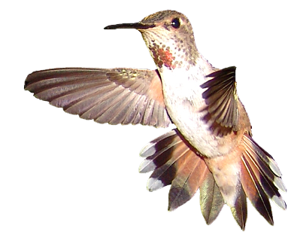
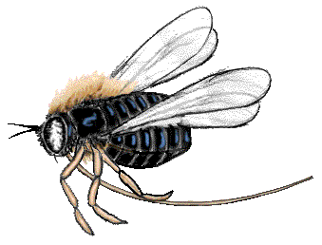
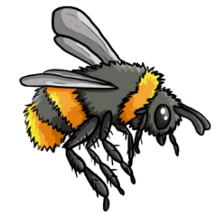







Interaction Network
Number of plant species = 95
Number of pollinator species = 248
Number of potential different interactions = 23,560
(# flowers x # pollinators)

Slide 8
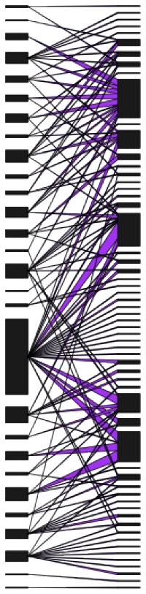
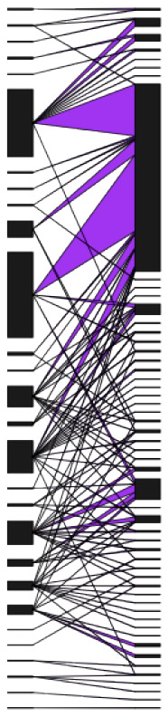
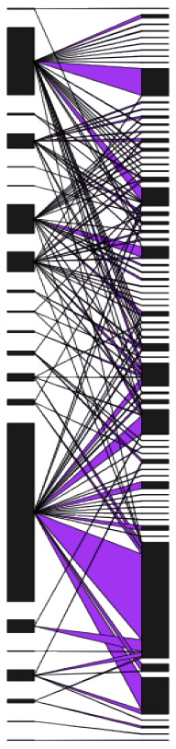
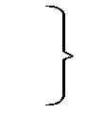
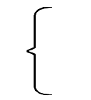
R-bipartite networking representation
Bombus
mixtus
Sedum
spathulifolium
Lots of bugs
and plants CnE
One dominant
bug CB
One dominant
plant CRS

Slide 9
Necessity to transform data
In our studies of 25 subalpine meadows in Oregon, I found that all 19 of the most widely used networking statistics were auto-correlated.
All samples sizes must be made equivalent to those of other comparable studies BEFORE analyses can be run.

Slide 10
Basic lessons
Lesson #1) pollination interactions are very
diverse (i.e., species rich)
The next slide is the representation of a tiny subalpine meadow (ca. 100m x 30m) and it contains 2 dozen plants and 5 dozen potential pollen vectors (1700 interaction cells).

Slide 11
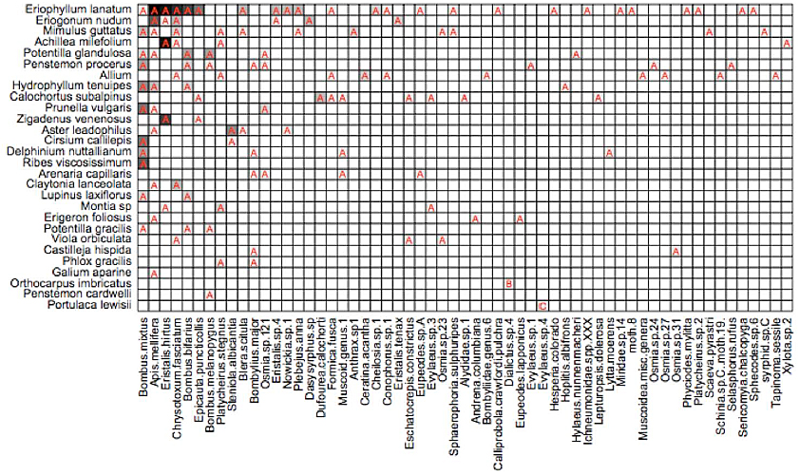
Matrix representation of interactions
Rows and columns are ordered by decreasing abundance
Plant species
Cone Edge Network 2011
Pollinator species

Slide 12
Basic lessons
Lesson #2) you can see that most of the potential interaction combinations are blank
(= not observed)
Most of the interactions that have been observed are
between the most abundant species of plants and the
most abundant species of insects

Slide 13
Matrix representation of interactions
Rows and columns are ordered by decreasing abundance
Plant species
Cone Edge Network 2011
Pollinator species

Slide 14
Basic lessons
Lesson #3) The majority of foodweb interactions between uncommon plants and uncommon insects imply specificity, i.e., that the insect is a specialist visitor of only 1 species of plant.
(35/58 = 60% vector species have abundances <4)
But in fact, there are only 2 actual specialists.

Slide 15
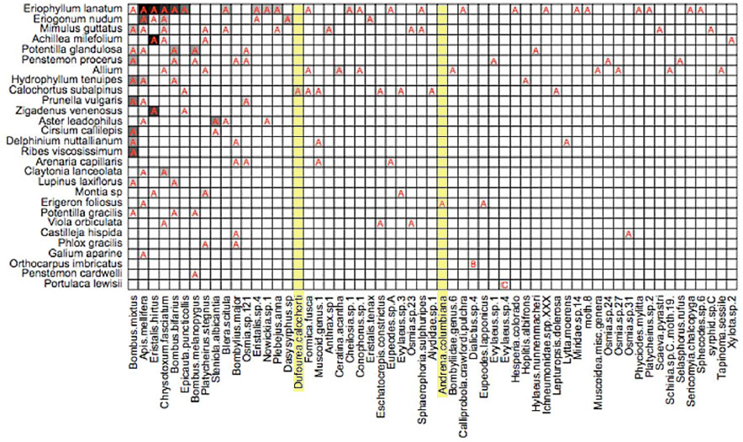
Matrix representation of interactions

Slide 16


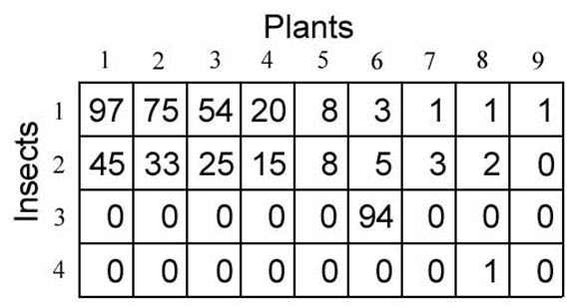
Obvious solution
Make more
observations!
Then it would be
obvious if the rare vector was a specialist or not!
1 tiny web:

Slide 17
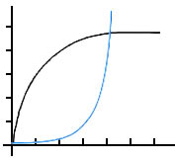
Basic lessons
Lesson #4) The more you observe/collect, the greater the species richness of pollinators in your samples.
However, the blank matrix cells still do not fill in be-cause richness increases even more rapidly than the observations of generalist pollinators -- so the apparent numbers of specialists increases
(true of everywhere I have studied, and most of the study sites reported in the literature)
Species area curve does not approach a horizontal
asymptote. There are always a few very common species, fewer moderately common ones, and very many uncommon species.

Slide 18
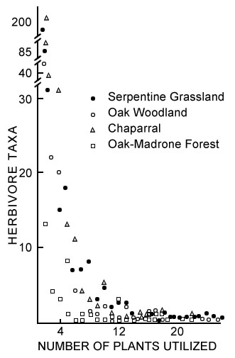
negative logarithmic curve
When measuring abundance, 68% of vectors are found only 1-4 times per site, even when the total count is well in excess of 10,000-25,000.
So the more you make observations, the more rare species you encounter!

Slide 19
Specialized vector feeders
Determination of vector specificity must be made independently from field data because your small sample subset does not encompass the variability of the possible habitats.
For North America we have a good general idea of the feeding preferences of native bees
(bees = most likely group for genetically-determined specialists; but also there are herbivore/host-plant specialization to consider)

Slide 20
Specialized vector feeders
In fact for western N America where I have worked, specialist-feeding bees vary from 5-55% of the local bee fauna) (Moldenke, 1978)
The highest richness of specialist-feeding bees is in the southwestern deserts; it is usually <<20% in most other plant communities.
BUT:

Slide 21
Lesson #5) Really: in most habitats everybody is a generalist
(or potentially a generalist)
When looking at your data, with the notable exception of a few specialist bees, all other vectors are potentially generalists.
Basic lessons

Slide 22
So, the basic model should be a null model of generalists
Interactions between generalist vectors feeding upon generalist plants is simply the product of:
vector density x plant density
(with a few exceptions due to specialized morphology and behavior)
Then compare the predictions of the null generalist model with the field observations to determine how well you have in fact described the system.
(Note: most manuscripts convert their matrices to presence/absence rather than numerical density data – converting emphasizes the biases we just discussed, it does NOT diminish them – keep the matrices quantitative!!)

Slide 23
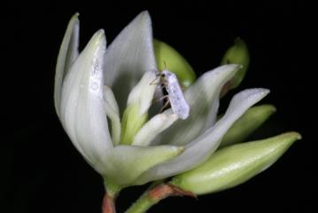
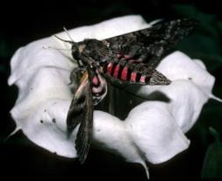
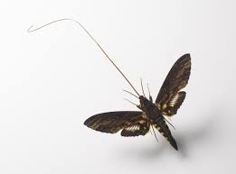
Programming exceptions into the null generalist model
VECTORS:
Flight times not overlapping blooming times
Too big to alight on/enter into the flower
Inappropriate tongue length
Known specialist-feeders
on only a single genus

Slide 24
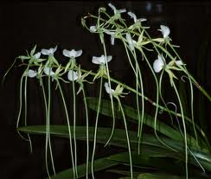
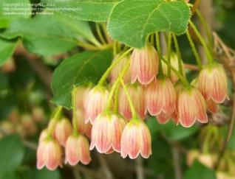

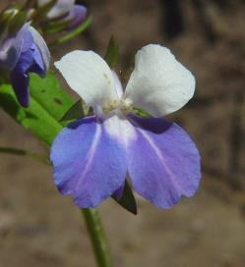
Programming exceptions into the null generalist model
PLANTS:
Tubular flowers (tongue-length of vectors)
Upside-down flowers
Closed flowers
Darkly colored flowers
Nocturnal flowers
(1, or more than 1, exclusionary floral device)

Slide 25
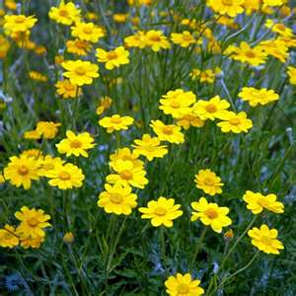
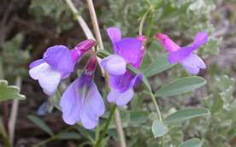
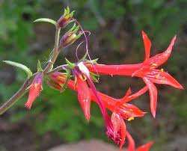
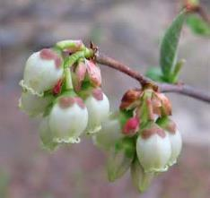
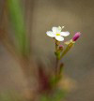
Different guilds of flowers
GENERALIST FLOWER (any pollinator morphology)
-- open dish 34 %
SPECIALIST FLOWER (exclusion types)
-- closed flower 9 %
-- long tubular flower 25 %
-- hanging flower 7 %
-- dark red/purple color 11 %
-- tiny flower 17 %
(weak = practically no pollinator support)
-- etc. (nocturnal; really weird, etc) trace %

Slide 26
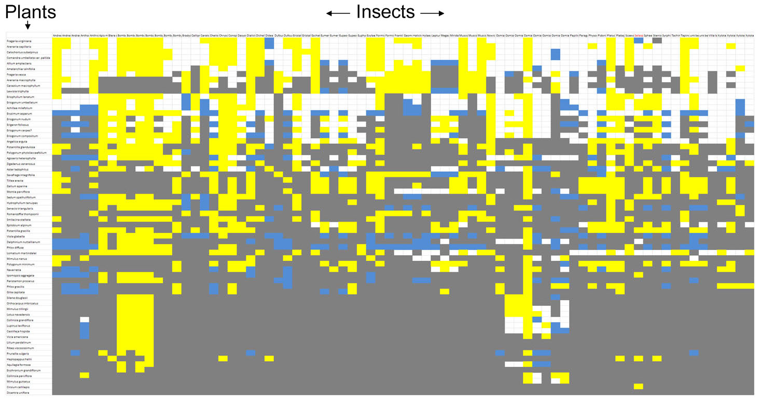
So, we can then combine the density-independent exclusionary covariates of the bugs and the plants with the density-dependent null matrix of ‘everyone is a generalist’ – this is what we get as a prediction of matrix
Yellow = highly probable
White = likely
Blue = unlikely
Gray = highly unlikely

Slide 27
Therefore, to correct pitfalls in the literature
Field Data Matrix
  (observational data)
  Normalized Probability Matrix
  (transformed observational data)
Null Generalist Matrix
(transformed field data * density dependence)
Exclusionary behavior/morphology Matrix
  (density-independent p & v covariates)
Null * Exclusionary = Covariate Matrix
(dens-dependent * dens-independent)
Then, simulation model with inter-annual variability
(at each step you compare the predictions with the actual observations and appropriately adjust the model)

Slide 28
So, as the American hamburger advertisements say –
“Where is the beef?”
With this approach to describing and analyzing pollination interactions, it is easy to see that the density-independent factors with which individual species of plants and vectors compete through time are defined and quantified by the ‘Exclusionary Matrix’.

Slide 29
Simulation modeling
The exclusionary matrix is the paramount driver through time -- densities fluctuate, immigration occurs, local extinction of vector populations occur -- but the most important interactions between species are those which determine the most potentially intensely competing species regardless of densities
(the smaller portions of the matrix with both exclusive and overlapping plant/vector combinations = ‘modules’)

Slide 30



Competition and local extinction
The most heuristic statistic is the matrix-adaptation of the Shannon Diversity Index called the ‘niche-overlap index’, when I first proposed it in 1975.
It quantifies how any 2 species differ/overlap in their use of resources:
plants using ratio of unique/generalist pollen vectors
insects using unique/generalist plants
thereby, quantitatively defining the modules of the entire community with the most likely direct competitive interactions.

Slide 31
Niche overlap
For vectors:
# food resources utilized by vector_{i} (but not by vector_{j})
total # food sources of vector_{i}
Produces a unique value for each cell in the entire non-symmetric matrix
Values range from = 0 (nothing uniquely visited, or vector species are indistinguishable, i.e., 2 different species of bumblebees) to = 1
(vector species are completely unique, do not share any food resources, i.e., a tumbling flower-beetle and a mason bee).
(d_{ij}) =

Slide 32
Biological consequences of networking
Competition and extinction are not direct consequences of networking; networking analysis only helps to better delineate the potential for direct competition.
Many other factors are likely to overwhelm simple foodweb interactions relative to species persistence (examples: nest-site availability, disease, annual weather variation).

Slide 33
Take-home messages about pollination networking
1) The biological consequences are best approached with quantitative (NOT binary +/-) matrices.
2) Field samples must always be scaled to samples with equal size, richness or matrix volume in order to be compared (R-bipartite stats are mostly auto-correlated with N, or SR).
3) Density-independent matrix covariates must be separated from density-dependent ones and are most easily quantified and tested for predictive value in the sequential method just presented.
4) Niche-overlap values for individual plants and vectors have the most importance for productive adaptation to competitive studies.

Slide 34
REFERENCE:
Once the modeling is complete all the data, both original and transformed, together with all the covariates and the history of tweeking the model, will be available at the homepage of the Andrews Forest Long Term Ecological Research (LTER) site
andrewsforest@oregonstate.edu

