Slide 1
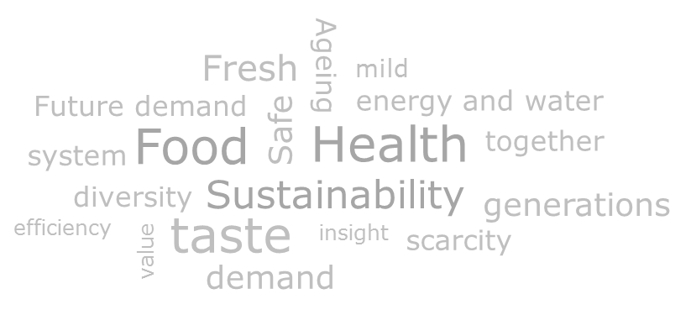
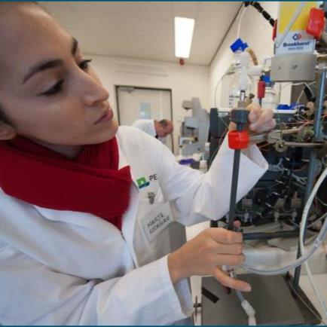

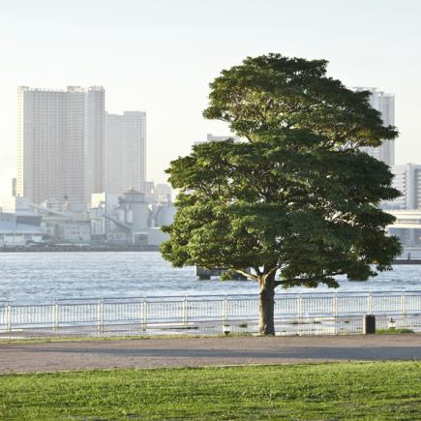
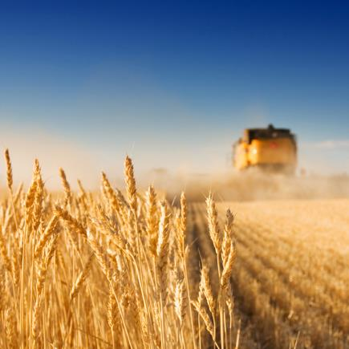
4th international conference on Food Processing and Technology
Concepts for more healthy and
sustainable food (ingredients)
Atze Jan van der Goot
London, 11 August 2015

Slide 2
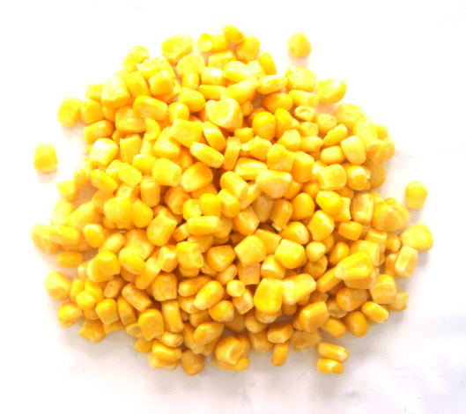
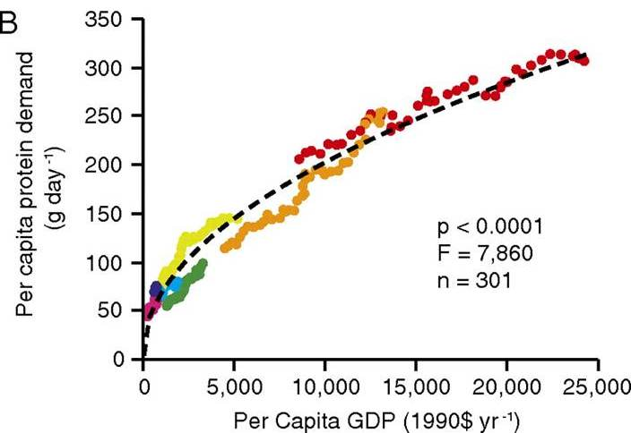

Food production today
Food industry¹
  14% of all energy use
  10% of all water
  Produces 10% of all waste
Diet becomes more inefficient with increasing welfare with respect to energy consumption and raw material use
Tilman, 2011
¹Poynton, 2006

Slide 3
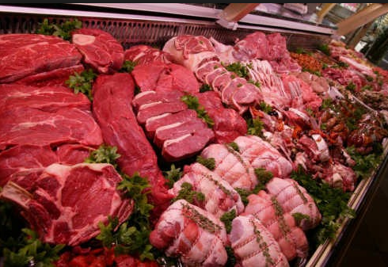
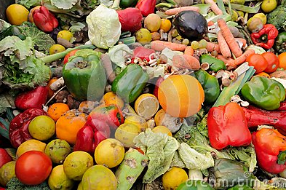
Causes of inefficiencies
Consumption of animal products and use of components from animal origin
  Protein conversion from plant to animal is not efficient
Production of highly refined ingredients
  Low yield (60%), energy, water and chemicals consumption
Waste production

Slide 4

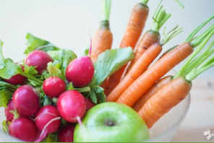
Solutions
Towards reduced consumption of products from animal origin
  Direct replacement by plant-products
  Role of structured plant-based products
Towards ingredient production with higher efficiency
  Reduced use of energy, water and chemicals
  Making the right ingredients instead of ingredients with general applicability
  Smaller and dedicated processes
Producing less waste
  presenting food in a different manner

Slide 5
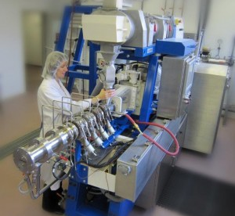
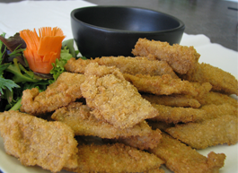
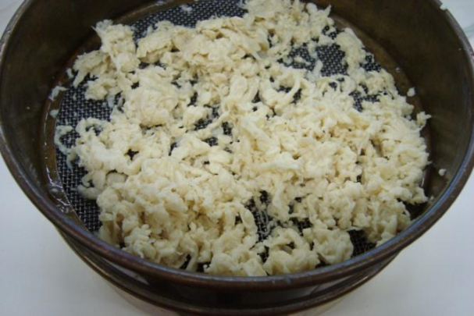


A fibrous materials to mimic meat
Extrusion
Alginate technology
  CaCl₂ addition upon mixing
Methods based on mixing process
Making structures is not the same as mixing ingredients

Slide 6
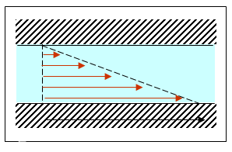
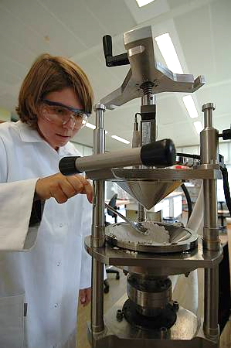
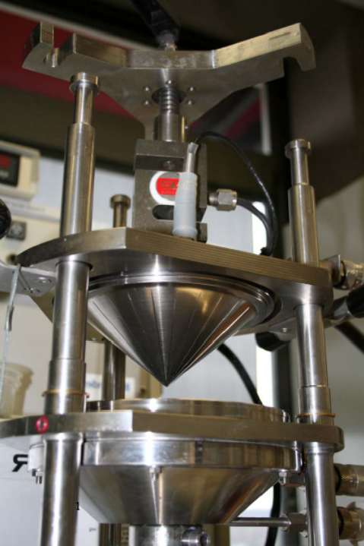
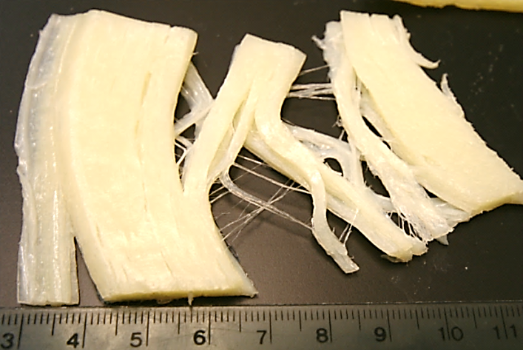
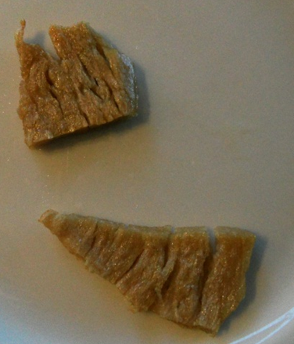
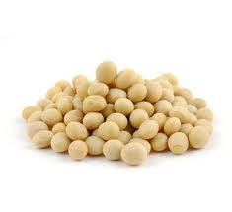
Shear-induced structuring is a tool to make fibrous protein structures

Slide 7
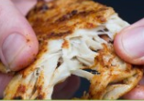


Summary production meat alternatives
Current products made by extrusion are of high quality
    Structure resembles meat already
Shear-induced structuring is a promising method to make anisotropic and fibrous materials from dairy and plant proteins
  Energy efficient
    Structuring rather than modifying a mixing process
    Mild process
Not all ingredients have good structuring potential (also for extrusion)
  SPC soy protein concentrate
  SPI-WG soy protein isolate – wheat gluten

Slide 8
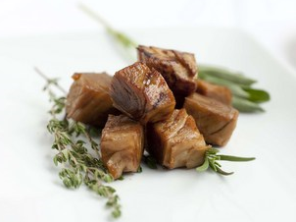
Are plant based protein foods sustainable?
Exergy consumption in production of 1 kg
A meat analogue is not always more sustainable than meat
Outcomes confirmed in other studies
(Apaiah et al., 2006)

Slide 9
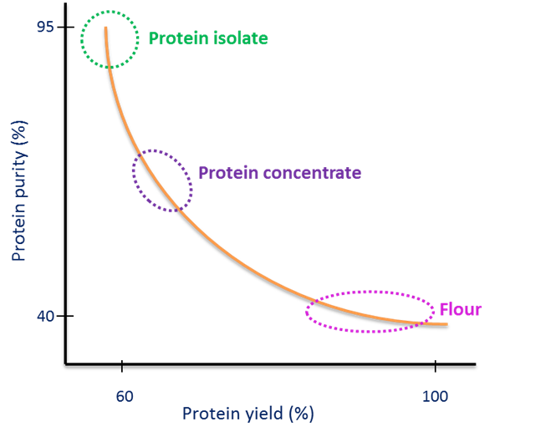
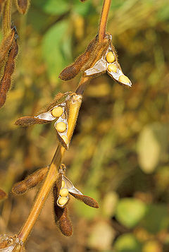
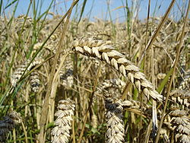
Plant materials as a source for ingredients
Plant materials contain a wide variety of ingredients.
Animal products: protein-fat
Crop, DM% | Protein | Carbohydr. | Lipids | Ash
Lupine | 40.4% | 45.1% | 10.9% | 3.7%
Soybean | 39.9% | 33.0% | 21.8% | 5.3%
Fababean | 29.3% | 65.5% | 1.7% | 3.5%
Mung bean | 28.3% | 66.1% | 1.8% | 3.8%
Cowpea | 26.7% | 68.2% | 1.4% | 3.7%
Pea | 25.6% | 68.4% | 1.9% | 4.1%
Wheat | 15.4% | 79.9% | 2.8% | 2.0%
Maize | 10.5% | 82.9% | 5.3% | 1.3%
Potato | 9.8% | 84.6% | 0.4% | 5.2%

Slide 10
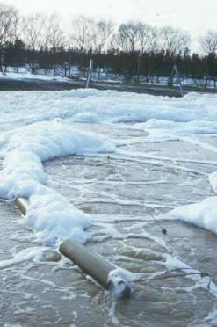
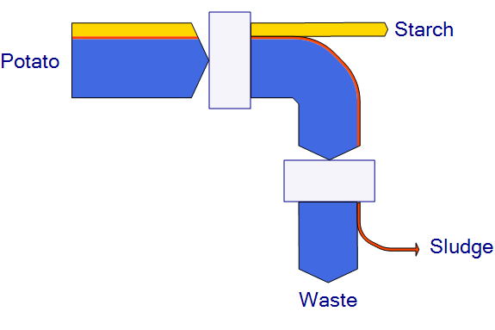
(Ingredient) production
1e generation
Production of one single ingredient; remaining materials was waste
Advantages
  Well-defined ingredients
  Global sourcing and exchangeability
  Safe

Slide 11
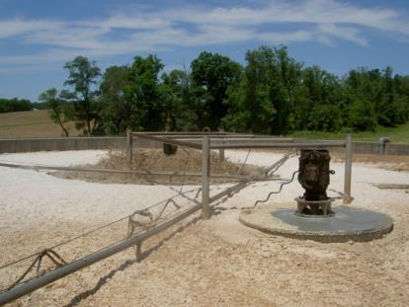
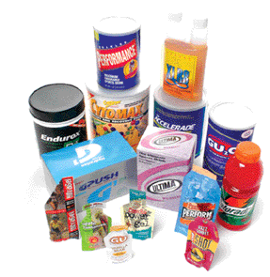
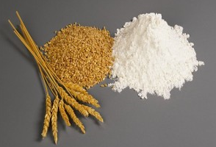

Ingredient production
1st generation
Production of single ingredient; rest is waste
2nd generation
Production of single ingredient + waste (water) treatment)
3rd generation
Use of all (at least more) ingredients from one single source
  Starch and proteins

Slide 12
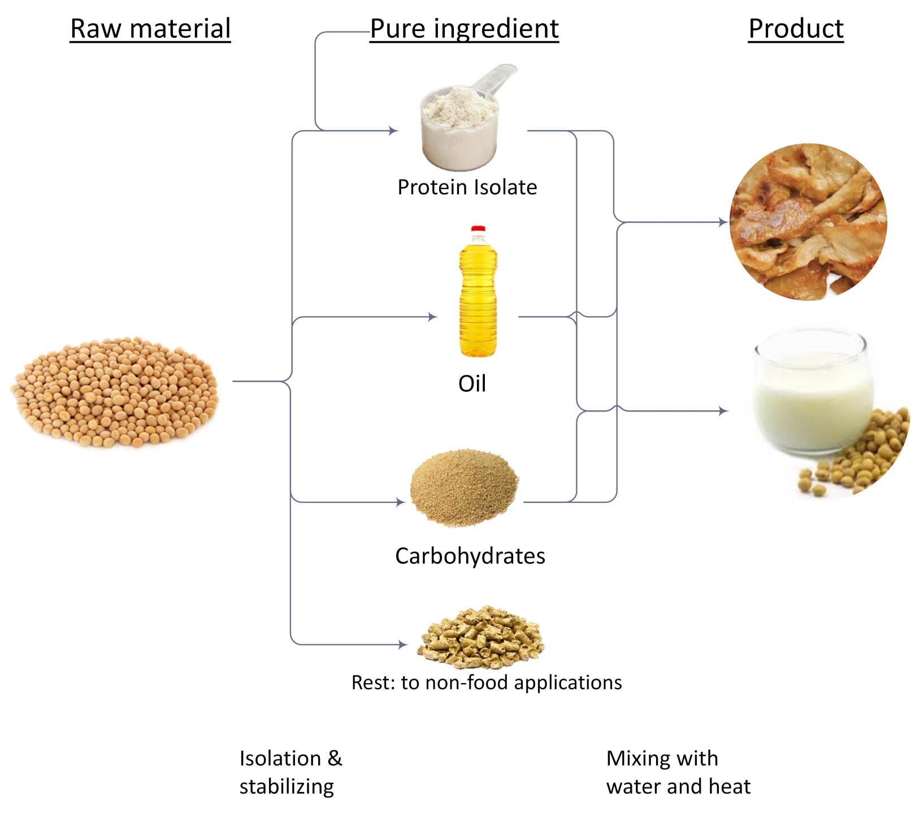
But still: focus on purity

Slide 13
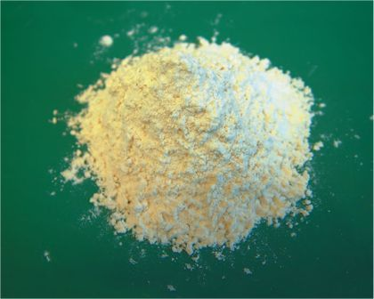
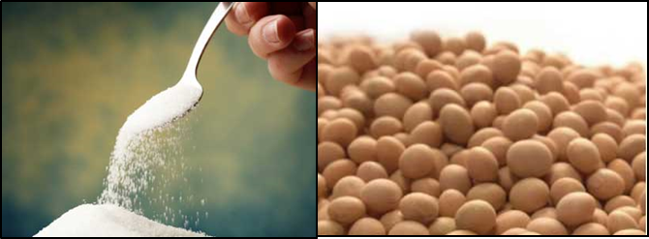
Do we need pure ingredients for food production?
It is convenient during production
  Well defined, stable ingredients
  Quality control
  Supply chain management
But:
  Hardly any food product consists of 1 single pure ingredient
  Structures present in natural materials and presence of complex molecules might possess interesting properties
    Carbohydrate-protein complexes for emulsification

Slide 14
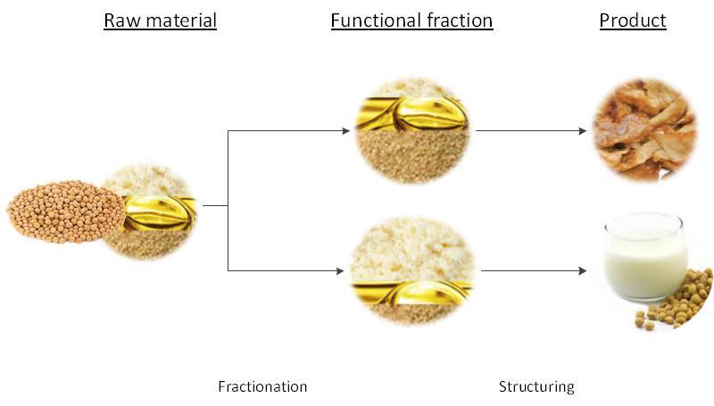
Towards functional ingredients

Slide 15
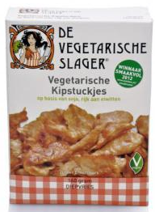
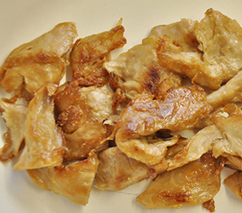
A closer look at the meat alternative ingredients
SPC (65% protein+35 % carbohydrates) + water
  Obtained through removal of oil and soluble ingredients
  Fibrous structures in shearing device and extruders
SPI (>90% protein)+ water
  Extensive purification procedure
  Does not give fibrous structures in shearing device or extruder
  Functional properties for structuring are less good than SPC
Less purified ingredients have better functional properties
for making meat alternatives!

Slide 16
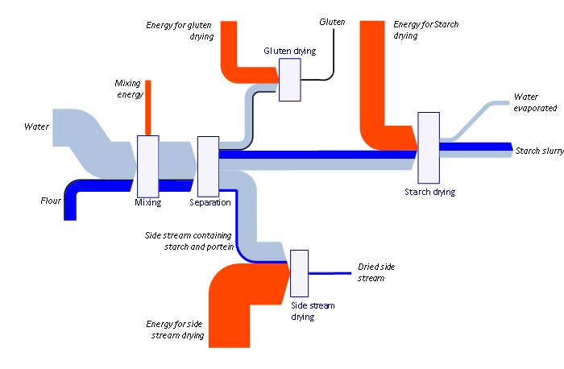
Less focus on purity: new processing options
Wheat fractionation
High in water and thus in energy
Part of flour lost in waste water → waste water treatment and loss of raw material
Simplified process lay-out
Width of the arrows indicates size of the streams
E. Van der Zalm, PhD thesis, Wageningen un., 2011

Slide 17
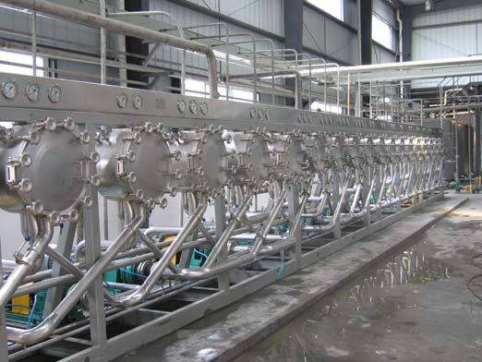
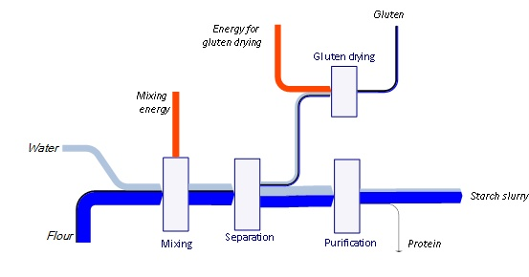
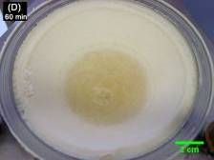
A new method
E. Van der Zalm, PhD thesis, Wageningen Univ., 2011
Graphs have the same scales

Slide 18

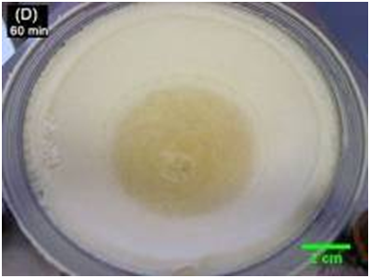
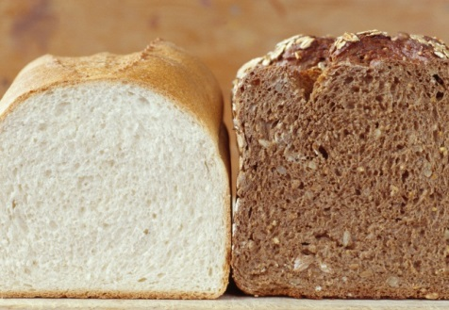
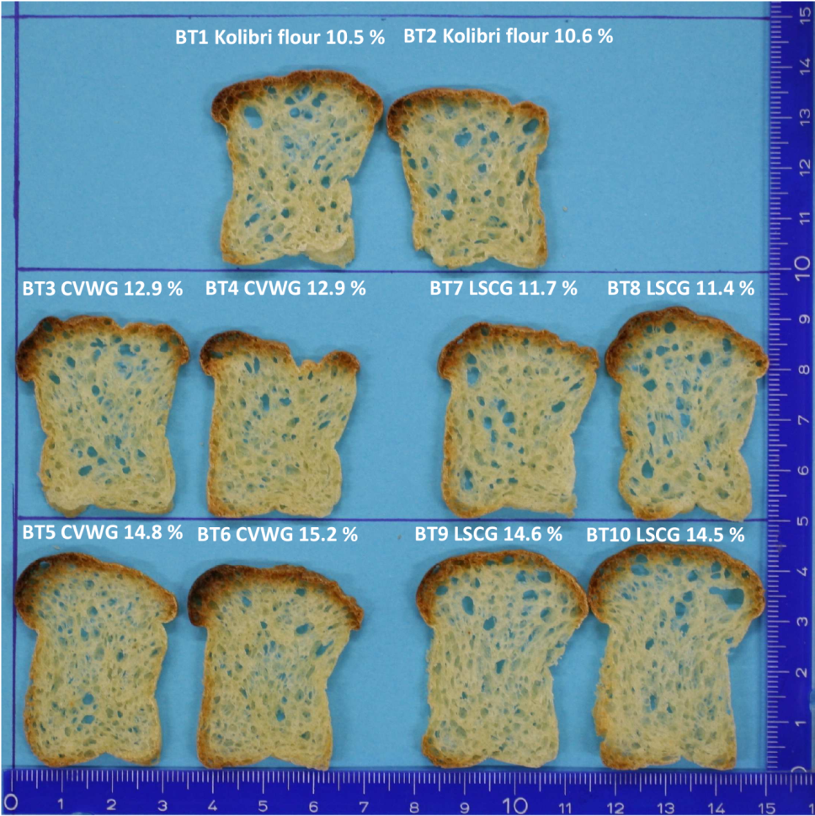
And coupling to application
Shear separation leads to
- 60% Protein (vs 80% vital wheat gluten)
- Starch with 2% protein (vs 0.2 commercial starch)
- Much better functional properties
Separation near application
- efficient use of material
- less drying
- water used in separation can be used in application
Focus on functionality rather than purity

Slide 19
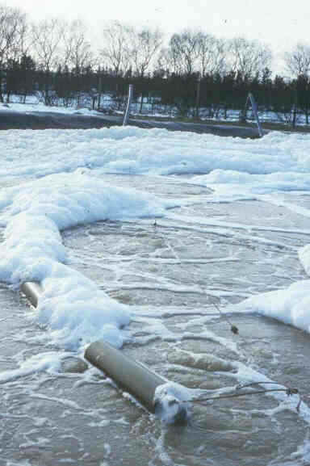

Food (ingredient) production
1st generation
Isolation of primary product, disposal of all other components with waste water
2nd generation
Waste water treatment through anaerobic/aerobic digestions
3rd generation
Isolation of all components for
high-value products
4th generation...
Functional fractions
No dilution, milder conditions, less focus on purity: possibly healthier ingredients
  Dedicated, smaller processes close to application

Slide 20
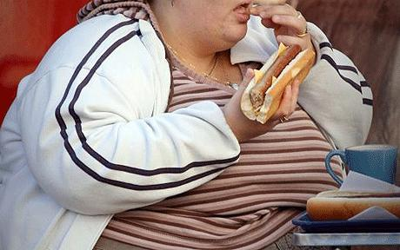
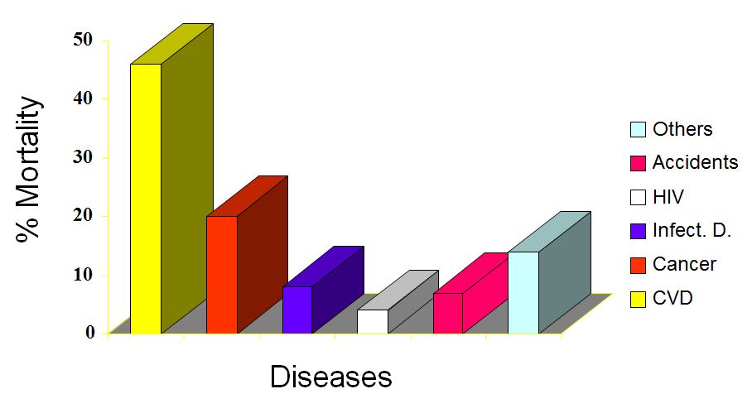
Staple foods and highly refined ingredients
Production of agro products is focused on yield rather than nutritional value
Highly refined ingredients lack micronutrients
Malnutrition and obesity
Starch as thickener
  Highly refined: loss of nutritional value “empty calories”
  Less purification
    Fibres, vitamins, minerals
    Overall health effect to be determined

Slide 21
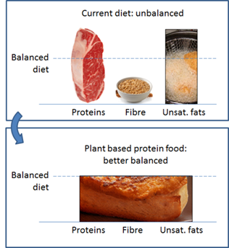
Health and meat alternatives
Soy concentrate in stead of soy protein isolate
Health benefits (?)
  More fibres
  Less (animal) proteins
    Actual consumption of protein exceeds the need (about 30%)
Polysaccharide advantages in structuring processes
Towards functional fractions rather than pure ingredients

Slide 22


Products and Processes of the Future
A need exists for more healthy products produced in a sustainable manner
Positive developments plant-based meat alternatives
  Alternatives for cheese, egg, fish etc
  Ingredient production should be sustainable
Production of healthy food ingredients in a sustainable manner is possible!
  Less focus on purity (functionality, mixing flours instead of separation)
Large changes in process chain design and increased interaction between ingredients production and structuring/assembly process
Requires significant scientific efforts to understand the behaviour of those complex food and biomaterials

Slide 23

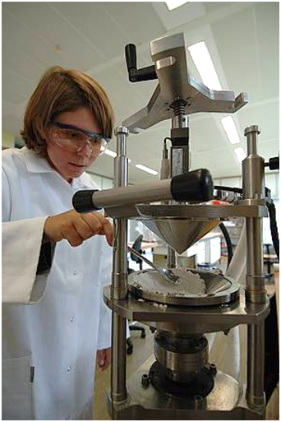


Towards sustainable and healthy foods
Thanks to:
Remko Boom Maarten Schutyser
Georgios D. Stefanidis Jaap Keijer
Costas Nikiforidis George Krintiras
Kasia Grabowska Jacqueline Berghout
Pascalle Pelgrom Marlies Geerts
Birgit Dekker Lena Jankowiak
Jarno Gieteling Jos Sewalt
And others..
Workshop WU and TU Delft
Many MSc and BSc students
www.wageningenur.nl/foodstructuring
Atzejan.vandergoot@wur.nl

