Slide 1



About OMICS Group
OMICS Group International is an amalgamation of Open Access publications and worldwide international science conferences and events. Established in the year 2007 with the sole aim of making the information on Sciences and technology ‘Open Access’, OMICS Group publishes 500 online open access scholarly journals in all aspects of Science, Engineering, Management and Technology journals. OMICS Group has been instrumental in taking the knowledge on Science & technology to the doorsteps of ordinary men and women. Research Scholars, Students, Libraries, Educational Institutions, Research centers and the industry are main stakeholders that benefitted greatly from this knowledge dissemination. OMICS International also organizes 500 International conferences annually across the globe, where knowledge transfer takes place through debates, round table discussions, poster presentations, workshops, symposia and exhibitions.

Slide 2
About OMICS International Conferences
About OMICS Group
OMICS International is a pioneer and leading science event organizer, which publishes around 500 open access journals and conducts over 300 Medical, Clinical, Engineering, Life Sciences, Pharma scientific conferences all over the globe annually with the support of more than 1000 scientific associations and 30,000 editorial board members and 3.5 million followers to its credit.
OMICS International has organized 500 conferences, workshops and national symposiums across the major cities including San Francisco, Las Vegas, San Antonio, Omaha, Orlando, Raleigh, Santa Clara, Chicago, Philadelphia, Baltimore, United Kingdom, Valencia, Dubai, Beijing, Hyderabad, Bengaluru and Mumbai.

Slide 3

Isolation, Identification and Evaluation of Highly Cellulases Producing Trichoderma Isolates from Egypt
A.I. Fahmi¹, R.A. Eissa¹, K.A. El-Halfawi², H.A. Hamza² and M.S. Helwa¹
1- Genetics Department, Faculty of Agriculture, Menoufia University
2. Institute of Genetic Engineering and Biotechnology Research, University of Sadat City

Slide 4
Introduction
Lignocellulosic materials are cheap renewable resources available in large quantities including various agricultural residues, fruit and vegetable wastes, woods, municipal solid wastes, wastes from the pulp and paper industry.

Slide 5
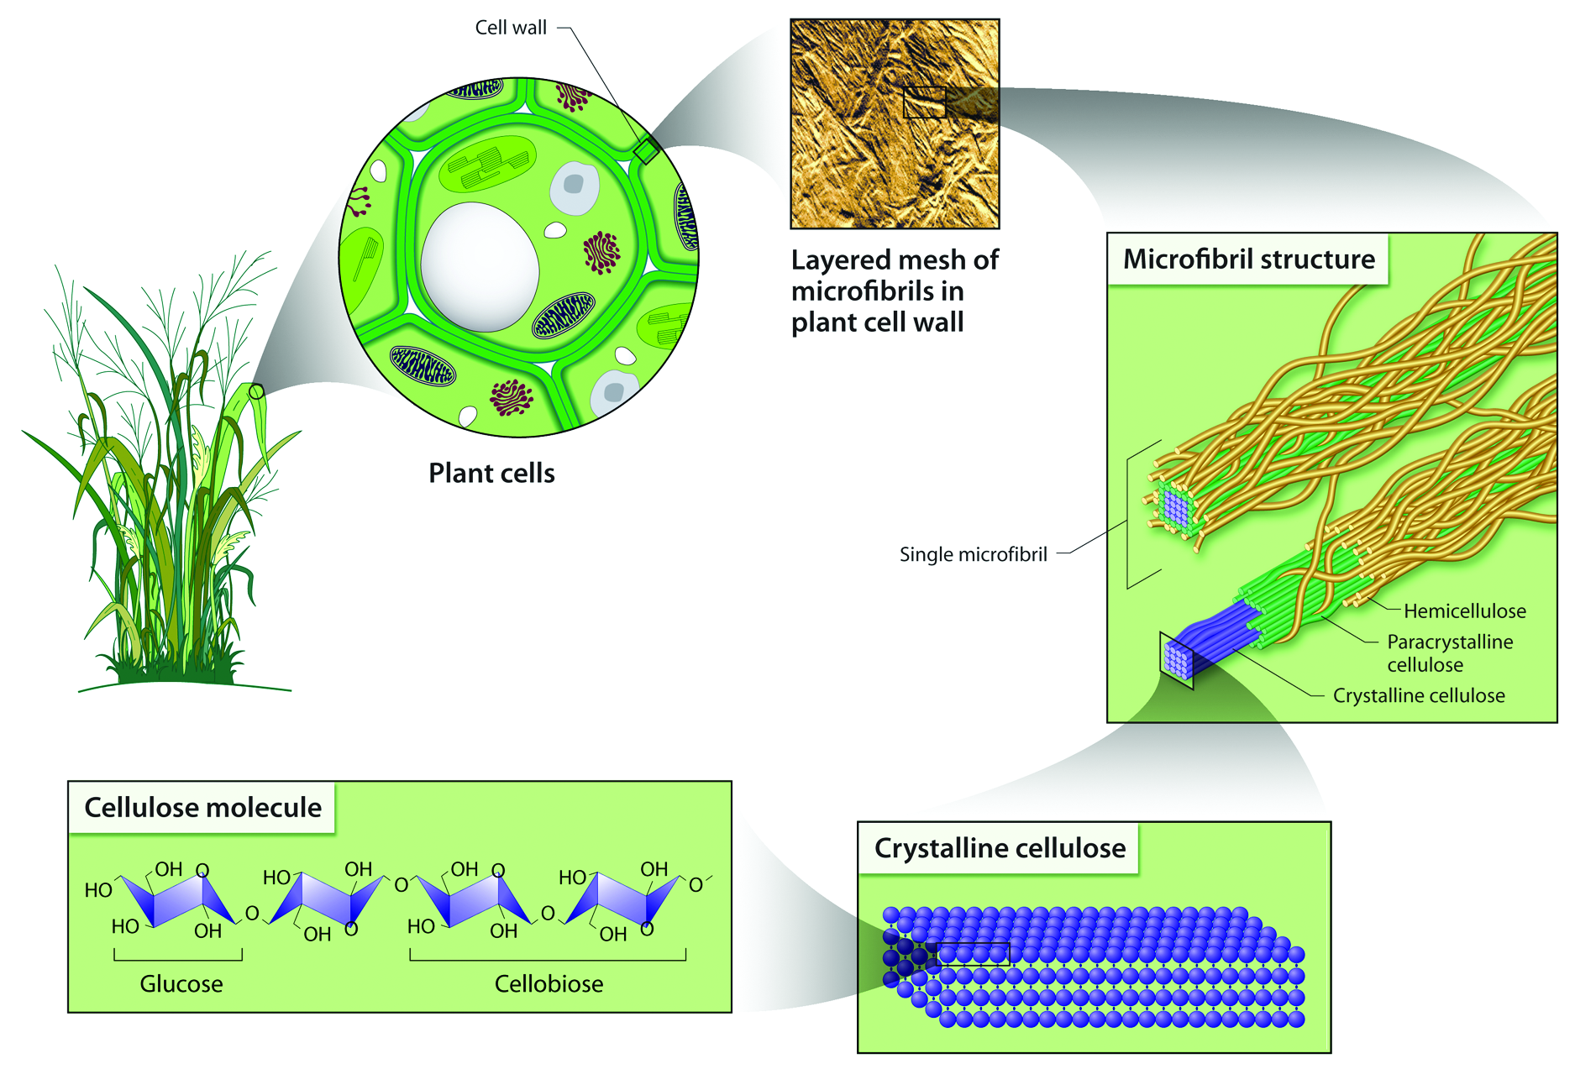
Introduction
One of these important cellulosic materials is rice straw which is a major agricultural waste in rice-growing countries. Rice straw still a waste till now all over the world and especially in Egypt.

Slide 6
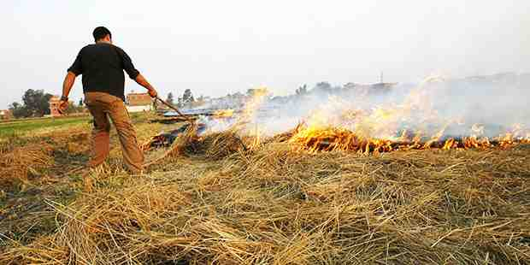
Rice straw viability in comparison with the others four major crops residues in Egypt.
Un utilized amount (%) | Un utilized amount (million tons/ year) | Current usage | Production (million tons/year) | Crop residues
62 % | 3.1 | Few amount for animal fodder and Composting | 5.0 | Rice straw
1 % | 0.082 | Almost totally used as animal fodder | 8.2 | Wheat straw
10 % | 0.67 | Almost totally used as animal fodder | 6.7 | Maize residues
14.4 % | 0.69 | Used as fuel in sugar factories | 4.8 | Sugar cane residues
50 % | 0.65 | Fuel in rural area | 1.3 | Cotton stalks

Slide 7
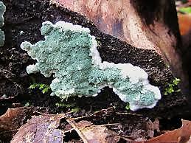
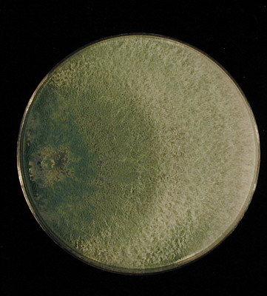
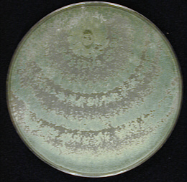
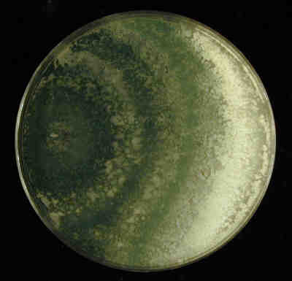
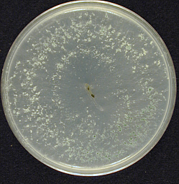
Trichoderma Spp. are evolutionary “factories” of cellulolytic enzymes

Slide 8
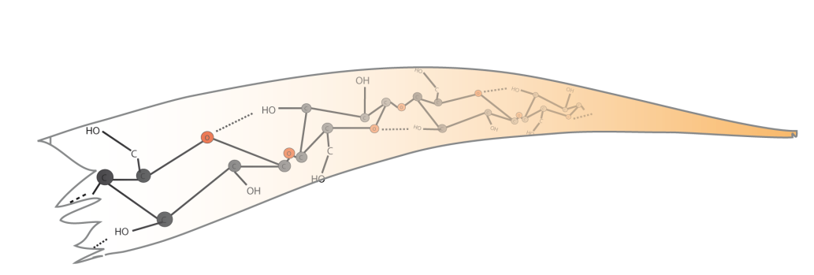
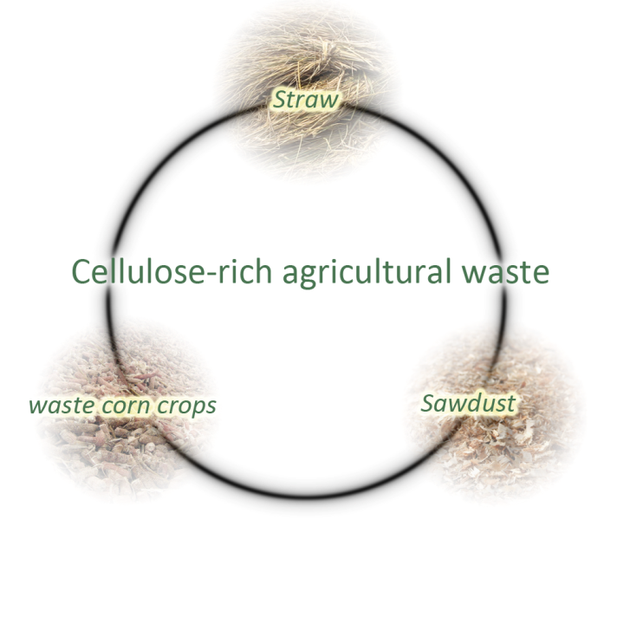
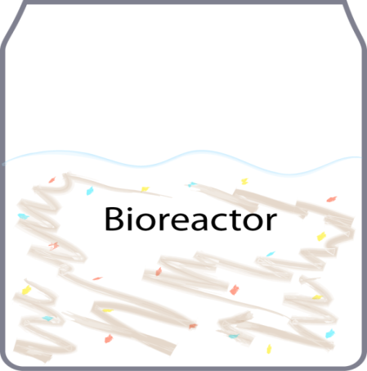
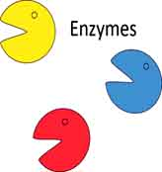
Cellulose, the major fraction of lignocellulosic biomass, can be hydrolyzed to glucose by cellulase enzymes
Fermentation / Biofuel
Chemical industry

Slide 9
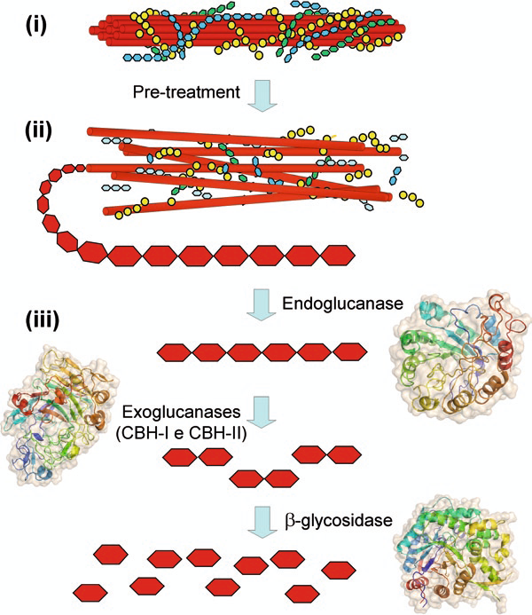
Cellulases are enzymatic complex, that comprises exo-β-1,4-glucanases (EC 3.2.1.91), endo- β -1,4-glucanases (EC 3.2.1.4) and β -1,4-glucanases (EC 3.2.1.21), that act synergistically in the hydrolysis of β-1,4-glycosidic bonds present in cellulose polymers

Slide 10
Objectives
1) Characterization of some Trichoderma isolates morphologically and molecularly.
2) Evaluation and selection of the best isolates for producing cellulases enzymes.

Slide 11
Samples collection
* Samples were Collected from six governorates of Egypt
* Samples type :
- Decomposed rice straw
- Decomposed Wheat straw
- Decomposed tree leaves
- Garden soil
- Field soil

Slide 12
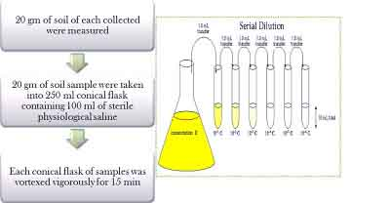
Isolation of Trichoderma sp.
It was made through a serial dilution technique on PDA media.

Slide 13
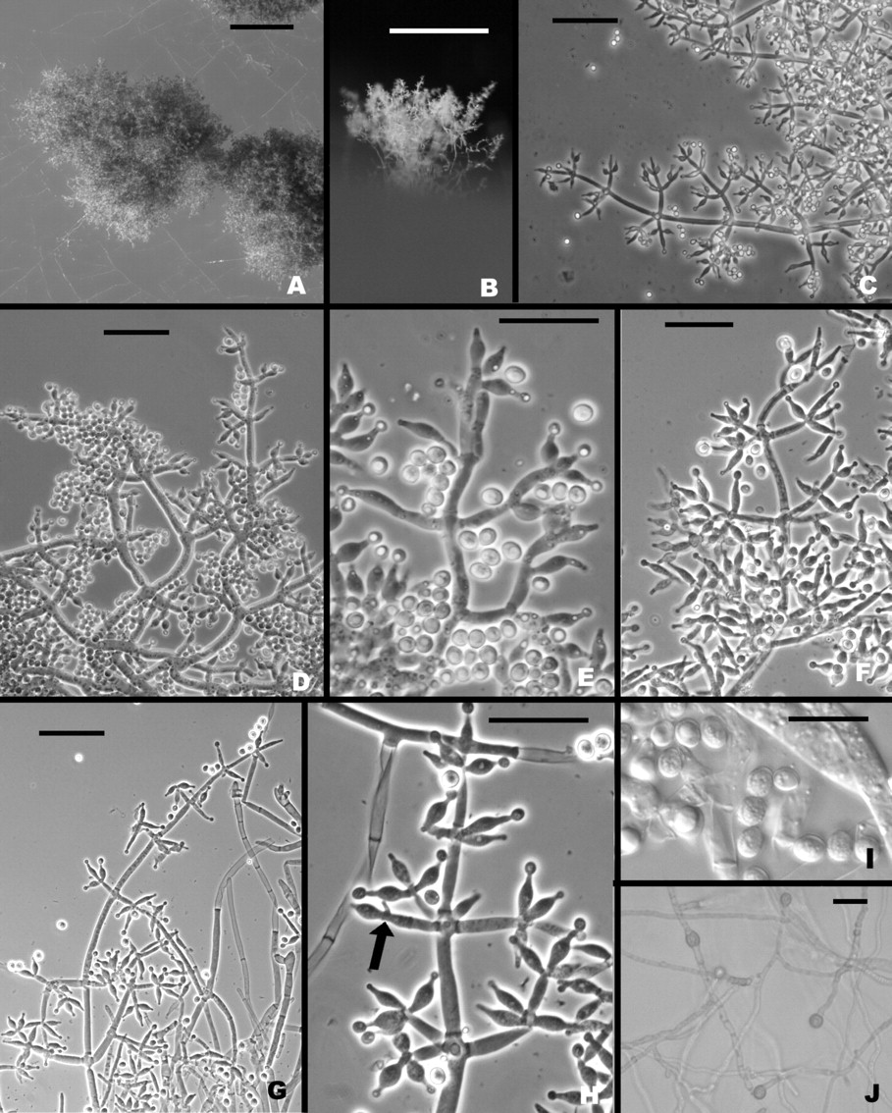
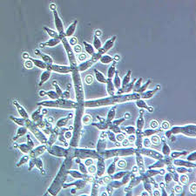
Morphological Characterization of 27 isolates
based on conidiophore branching pattern and conidium morphology key provided by Rifai (1969), Barnett (1998) and Bissett (1991)

Slide 14
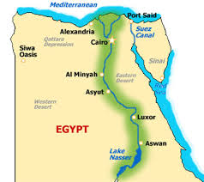
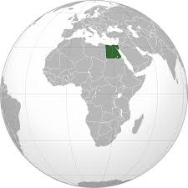
Egypt

Slide 15
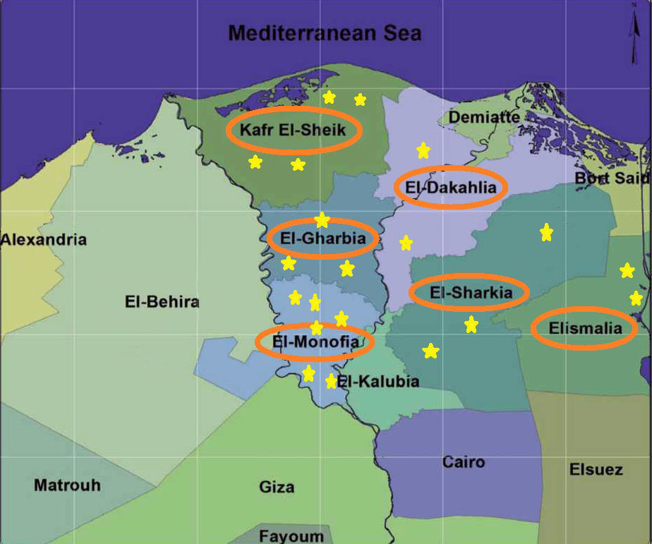
T. harzianum | T10
T. asperellum | T31
T. Koningii | T20
T. harzianum | T32
T. harzianum | T24
T. viride | T25
T. koningii | T3
T. hamatum | T19
T. harzianum | T42
T. harzianum | T14
T. reesei | T17
T. harzianum | T40
T. harzianum | T1
T. Viride | T2
T. hamatum | T18
T. harzianum | T21
T. harzianum | T41
T. hamatum | T44
T. viride | T26
T. koningii | T43
Nile delta of Egypt

Slide 16
Molecular identification of 11 isolates
Analysis of the internal transcribed spacer (ITS) 1 and 2 of ribosomal DNA (rDNA)
1. DNA extraction
2. PCR amplification of ITS1-5.8S- ITS2 rDNA region using the primer pair: ITS-1 (5'-TCC GTA GGT GAA CCT GCG G-3')
ITS-4 (5'-TCC TCC GCT TAT TGA TAT GC-3')
3. Sequencing of amplified DNA fragments
4. The sequences of ITS1-5.8S-ITS2 regions were manually aligned using Molecular Evolutionary Genetics Analysis (MEGA4 version 5.10.)
5. The sequencing data were compared against the Gene Bank database (http://www.ncbi.nlm.nih.gov/BLAST/)
6. Sequences were will submitted to GenBank

Slide 17
Some isolates used in this study and the accession of the aligned species for ITS1-5.8S-ITS2 sequence in GenBank
Isolate | Alignments Description | Max score | Query coverage | E value | Max identification | Accession
T. harzianum (T1) | Trichoderma harzianum MRSA | 1022 | 100 % | 0.0 | 99 % | HG008049.1
T. koningiopsis (T3) | Trichoderma koningiopsis NIB | 992 | 100 % | 0.0 | 99 % | KM246760.1
T. Harzianum (T10) | Trichoderma harzianum ThHP14 | 680 | 100 % | 0.0 | 100 % | KP064225.1
T. harzianum (T14) | Trichoderma harzianum TAAU4 | 1003 | 100 % | 0.0 | 100 % | KM875463.1
T. harzianum (T24) | Trichoderma harzianum RIFA 61B | 1009 | 100 % | 0.0 | 100 % | KF624792.1
T. Viride (T26) | Trichoderma viride T9 | 1046 | 98 % | 0.0 | 100 % | HQ259986.1
T. harzianum (T27) | Trichoderma harzianum RIFA 61B | 1009 | 100 % | 0.0 | 100 % | KF624792.1
T. Virens (T28) | Trichoderma virens N | 1005 | 100 % | 0.0 | 100 % | KP671477.1
T. Asperellum (T29) | Trichoderma asperellum T12 | 989 | 99 % | 0.0 | 100 % | KP671477.1
T. Asperellum (T31) | Trichoderma asperellum T12 | 989 | 99 % | 0.0 | 100 % | KP671477.1
T. viride (T22) | Trichoderma viride EGF17 | 1036 | 100 % | 0.0 | 100 % | KJ406563.1

Slide 18
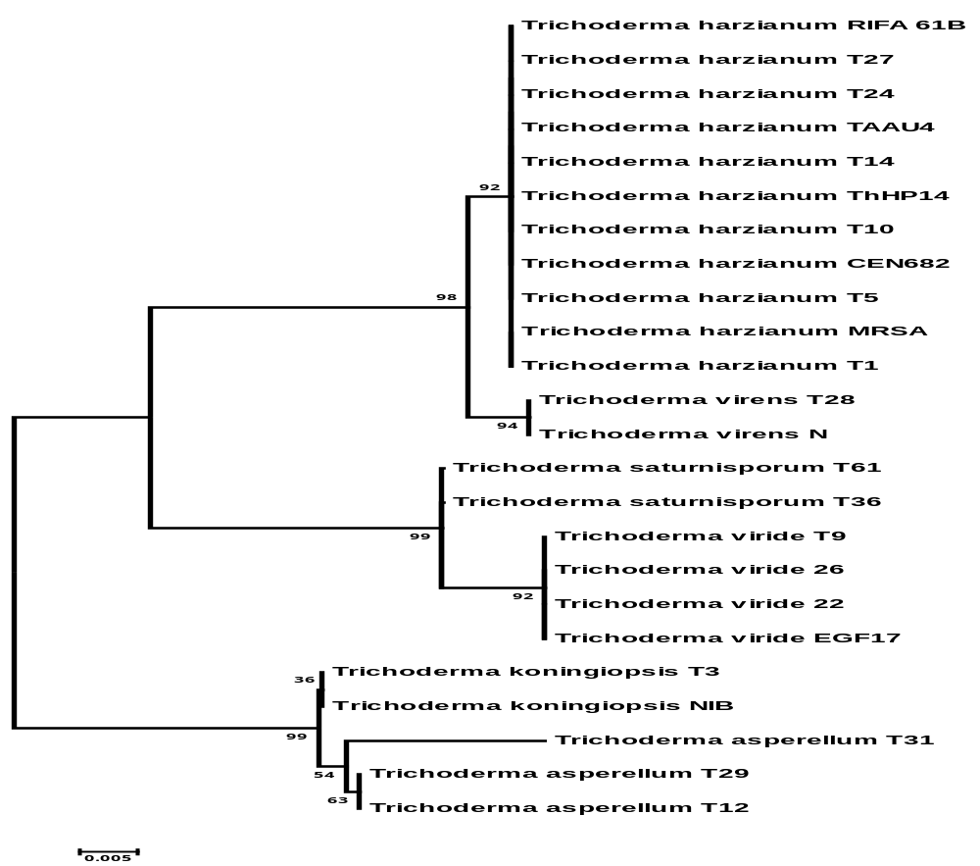
Evolutionary relationships of 11 taxa
The evolutionary history was inferred using the Neighbor-Joining method Phylogenetic analyses were conducted in MEGA4

Slide 19
Screening of Trichoderma isolates for cellulolytic activity
1. Cellulose azure agar test
2. Plate-clearing assay:
  a. Swollen cellulose
  b. Avicel
3. Dye staining of carboxymethylcellulose agar (CMC agar test)

Slide 20
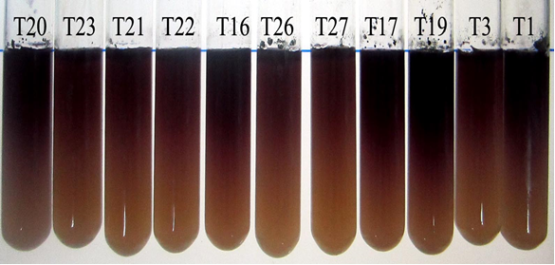
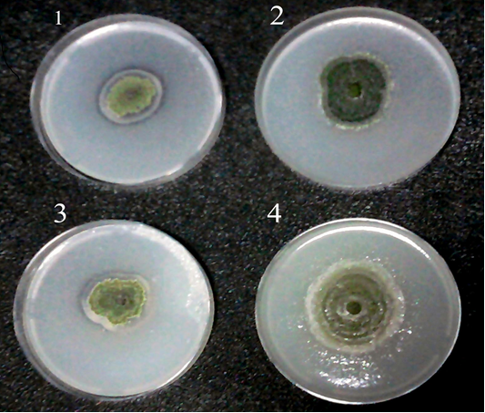
Changes of color cellulose-azure assays
clear zones around fungal colonies

Slide 21
Trichoderma isolates | Clear zones diameter (cm) |  | Yellow zone CMC | Cellulose Azure
 | Swollen cellulose | Avicel
T.1 | 5.30 ª | 5.43 ª | 5.33 ^{fgh} | 9
T.2 | 4.83 ^{bcd} | 4.63 ^{cdef} | 5.40 ^{fg} | 10
T.3 | 4.20 ^{g} | 3.73 ^{ij} | 4.97 ^{ghij} | 8
T.10 | 2.06 ^{k} | 1.73 ^{lmn} | 5.97 ^{de} | 9
T.14 | 4.77 ^{cde} | 4.63 ^{cdef} | 6.67 ^{ab} | 10
T.16 | 4.67 ^{cdef} | 3.73 ^{ij} | 4.17 ^{l} | 9
T.17 | 3.73 ^{hi} | 5.03 ^{abc} | 6.50 ^{abc} | 10
T.18 | 5.10 ^{abc} | 5.00 ^{abcd} | 6.30 ^{bcd} | 10
T.19 | 4.80 ^{cde} | 4.73 ^{cdef} | 6.70 ^{ab} | 10
T.20 | 4.23 ^{fg} | 4.47 ^{efg} | 6.67 ^{ab} | 10
T.21 | 3.60 ^{hi} | 3.33 ^{j} | 3.20 ^{m} | 8
T.22 | 3.57 ^{i} | 3.97 ^{hi} | 5.63 ^{ef} | 8
T.23 | 4.37 ^{efg} | 4.50 ^{ef} | 6.20 ^{cd} | 9
T.24 | 5.40 ª | 5.45 ª | 6.53 ^{abc} | 10
T.25 | 2.07 ^{k} | 1.73 ^{lmn} | 5.10 ^{ghi} | 8
T.26 | 4.20 ^{g} | 1.30 ^{n} | 6.17 ^{cd} | 7
T.27 | 2.00 ^{k} | 1.97 ^{kl} | 5.20 ^{fghi} | 7
T.28 | 2.00 ^{k} | 3.77 ^{ij} | 4.37 ^{kl} | 8
T.29 | 4.43 ^{defg} | 4.65 ^{def} | 6.00 ^{de} | 10
T.30 | 2.00 ^{k} | 1.8 ^{lm} | 2.80 ^{m} | 8
T.31 | 4.03 ^{gh} | 4.03 ^{ghi} | 6.77 ª | 10
T.32 | 5.10 ^{abc} | 5.23 ^{ab} | 4.93 ^{hij} | 10
T.40 | 3.00 ^{j} | 1.37 ^{mn} | 4.27 ^{l} | 9
T.41 | 1.36 ^{l} | 2.27 ^{k} | 6.03 ^{de} | 7
T.42 | 4.70 ^{cde} | 4.33 ^{fgh} | 5.10 ^{ghi} | 8
T.43 | 5.27 ^{ab} | 5.3 ª | 4.53 ^{jkl} | 10
T.44 | 5.00 ^{abc} | 4.8 ^{bcde} | 4.77 ^{ijk} | 10
Plate-clearing assay with Phosphoric acid-swollen cellulose and avicel as the sole source of carbon, Dye staining of carboxymethylcellulose agar (CMC agar) and Intensity of blue azure dye released by growen on cellulose- azure agar medium for 27 Trichoderma isolates

Slide 22
Tricoderma isolates that showed high cellolytic ability.
Trichoderma code | Species name
T1 | Trichoderma harzianum
T14 | Trichoderma harzianum
T17 | Trichoderma reesei
T18 | Trichoderma hamatum
T19 | Trichoderma hamatum
T20 | Trichoderma koningii
T24 | Trichoderma harzianum
T31 | Trichoderma asperellum
T32 | Trichoderma harzianum
T43 | Trichoderma koningii
T44 | Trichoderma hamatum

Slide 23
Screening of Trichoderma isolates for cellulase production
1. Cellulase production by Submerged fermentation (SMF).
2. Cellulase production by Solid state fermentation (SSF).

Slide 24
Cellulase production by
Submerged fermentation (SMF).
The submerged cultivation was carried out in 250ml flasks containing 100ml of Mandel’s medium with microcrystalline cellulose powder which was used as the sole source of carbon at a concentration of 1%.
Flasks were inoculated with conidial suspension to provide a final concentration of 1×10⁶ conidia per ml and incubated with agitation (160 rpm), at 28 ◦C, for 6 days.

Slide 25
Determining of cellulase activity
1. Total cellulase activity by FPase activity (DNS method) .
2. Activity of individual cellulases:
  a. β-Glucosidase using cellobiose substrate (GOD method).
  b. Carboxymethyl cellulase (CMCase) using CMC substrate.
3. Free sugar determination in culture filtrate.
4. Total protein concentration determination in culture filtrate.

Slide 26
Enzyme activities and extracellular protein of Trichoderma isolate produced in submerged fermentation (SMF) cultures
Total Protein (mg/ml) | Free sugar (mg/ml) | Enzymes activities (IU/ml) |  |  | Isolates
 |  | β-glucosidase | CMCase | FPase
0.18 ^{cd} | 0.01 ^{i} | 0.14 ^{b} | 0.86 ^{fg} | 0.29 ^{i} | T1
0.30 ª | 0.01 ^{i} | 0.09 ^{c} | 0.83 ^{gh} | 0.40 ^{g} | T14
0.05 ^{e} | 1.82 ^{b} | 0.02 ^{d} | 1.09 ^{d} | 0.34 ^{h} | T17
0.21 ^{be} | 1.77 ^{c} | 0.12 ^{b} | 1.18 ^{c} | 0.59 ^{d} | T18
0.33 ª | 0.20 ^{h} | 0.00 ^{d} | 0.88 ^{f} | 0.64 ^{c} | T19
0.09 ^{e} | 0.19 ^{h} | 0.07 ^{c} | 0.81 ^{h} | 0.51 ^{e} | T20
0.14 ^{d} | 0.43 ^{g} | 0.25 ª | 1.28 ^{b} | 0.85 ^{b} | T24
0.18 ^{cd} | 2.95 ª | 0.13 ^{b} | 0.74 ^{i} | 0.46 ^{f} | T31
0.14 ^{d} | 0.87 ^{f} | 0.01 ^{d} | 1.21 ^{c} | 0.66 ^{c} | T32
0.23 ^{b} | 1.17 ^{e} | 0.01 ^{d} | 1.32 ª | 0.57 ^{d} | T43
0.32 ª | 1.59 ^{d} | 0.09 ^{c} | 1.01 ^{e} | 1.17 ª | T44

Slide 27
Enzyme specific activities of Trichoderma isolate produced in submerged fermentation (SMF) cultures.
Isolates | Specific activity (Umg⁻¹ protein)
 | FPase | CMCase | β-glucosidase
T1 | 1.63 ^{j} | 4.80 ^{e} | 0.79 ^{b}
T14 | 1.32 ^{k} | 2.77 ^{h} | 0.29 ^{f}
T17 | 6.87 ª | 21.72 ª | 0.36 ^{e}
T18 | 2.81 ^{f} | 5.61 ^{d} | 0.59 ^{d}
T19 | 1.95 ^{i} | 2.67 ^{h} | 0.002 ^{i}
T20 | 5.69 ^{c} | 9.03 ^{b} | 0.74 ^{c}
T24 | 6.06 ª | 9.15 ^{b} | 1.81 ª
T31 | 2.53 ^{g} | 4.13 ^{f} | 0.72 ^{c}
T32 | 4.72 ^{d} | 8.67 ^{c} | 0.10 ^{g}
T43 | 2.47 ^{h} | 5.73 ^{d} | 0.05 ^{h}
T44 | 3.67 ^{e} | 3.15 ^{g} | 0.27 ^{f}

Slide 28
Cellulase production by
Solid state fermentation (SSF).
Pretreatment of rice straw.
Solid-state fermentation cultures.

Slide 29
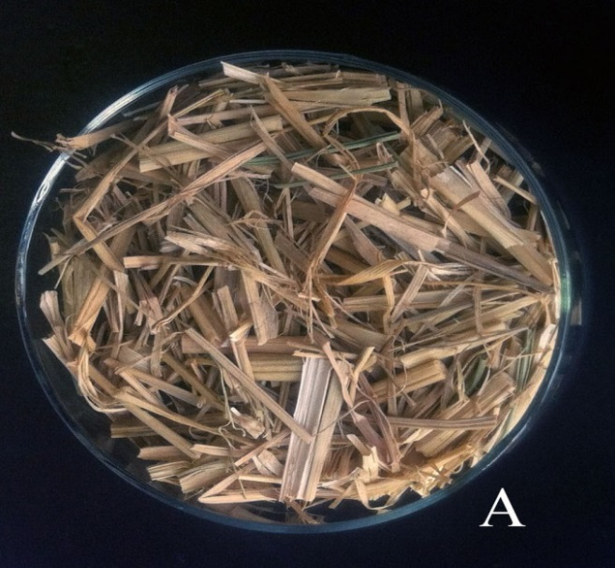
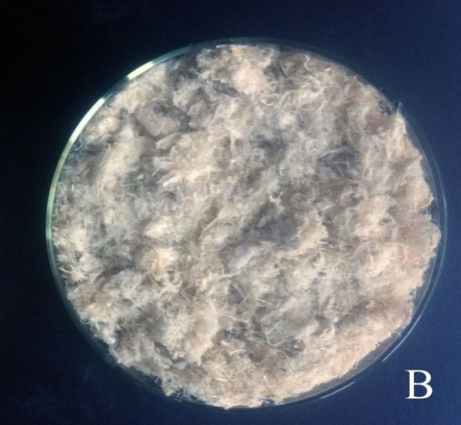
Rice straw was pretreated with Microwave and alkali according to the method of Zhu et al. (2005)
Pretreatment of rice straw:
Alkali Treatment:
1% NaOH
Microwave Treatment :
Frequency : 2450 MHz
Irradiation power: 700 W
Treatment time: 30 min.
Before |  | After
38.8 % | Cellulose | ↑ 69.2 %
20 % | Hemicellulose | 10.2 % ↓
13.6 % | Lignin | 4.9 % ↓

Slide 30
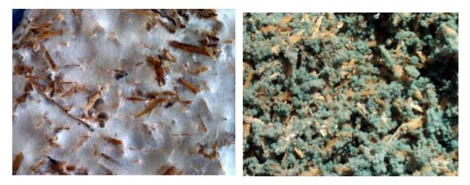
Solid-State fermentation cultures.
The solid-state culturing was performed in 250 ml flasks.
Each flask contained 3 g of mass of pretreated rice straw and 12 ml basal salt solution (MS) 80% humidity.
autoclaved at 121◦C for 30 min.
Each flask was then inoculated with a final concentration of 1×10⁷ conidia per gram of pretreated rice straw.
The flasks were incubated at 30 ◦C with a relative humidity of 90% for 12 days.

Slide 31
Extraction of the enzymes after incubation
50 ml of distilled water were added, mixed.
incubated under agitation for 1h at 30 ◦C, at 150 rpm.
filtered, using dampened cheese cloth.
The filtrates were centrifuged at 5000 rpm (4◦C) for 15 min to remove spores of the organism.
the clear supernatant were used as crude enzyme extracts for enzyme assay.
The filtrate was stored at 4 ◦C until assay for enzymes activities.

Slide 32
Determining of cellulase activity
1. Total cellulase activity by FPase activity (DNS method) .
2. Activity of individual cellulases:
  a. β-Glucosidase using cellobiose substrate (GOD method).
  b. Carboxymethyl cellulase (CMCase) using CMC substrate.
3. Free sugar determination in culture filtrate.

Slide 33
Enzyme activities and extracellular protein of Trichoderma isolate produced in solid state fermentation (SSF) cultures.
Free sugar (mg/g) | Enzymes activities (IU/g) |  |  | Isolates
 | β-glucosidase | CMCase | FPase
15.29 ^{h} | 0.55 ^{e} | 2.40 ^{d} | 0.04 ^{h} | T1
38.5 ^{e} | 3.56 ª | 2.45 ^{cd} | 1.75 ª | T14
62.06 ^{b} | 0.08 ^{i} | 2.51 ^{c} | 0.48 ^{e} | T17
37.82 ^{e} | 0.33 ^{g} | 8.44 ª | 1.55 ^{b} | T18
49.67 ^{c} | 0.83 ^{cd} | 0.18 ^{j} | 1.12 ^{c} | T19
86.89 ª | 0.90 ^{c} | 0.30 ^{i} | 1.53 ^{b} | T20
35.34 ^{f} | 0.76 ^{d} | 1.04 ^{g} | 0.71 ^{d} | T24
16.6 ^{h} | 0.22 ^{h} | 1.89 ^{e} | 0.13 ^{g} | T31
19.26 ^{g} | 0.43 ^{f} | 1.75 ^{f} | 0.38 ^{f} | T32
4.073 ^{i} | 0.46 ^{f} | 3.50 ^{b} | 0.33 ^{f} | T43
45.57 ^{d} | 1.05 ^{b} | 0.79 ^{h} | 0.53 ^{e} | T44

Slide 34
Hydrolysis percentage of treated rice straw
in solid state fermentation by Tricoderma isolates.
The residues of SSF were collected by filtration and washed extensively with distilled water.
dried at 65◦C to maintain constant weight and weighed .
calculation of hydrolysis percent for RS.

Slide 35
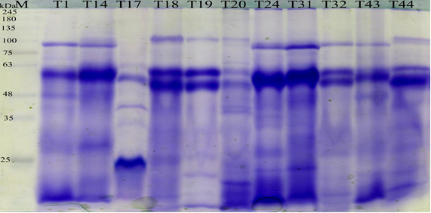
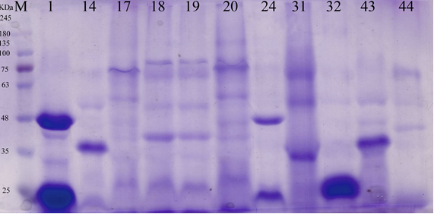
Sodium Dodecyl Sulfate-Polyacrylamide Gel Electrophoresis (SDS-PAGE) analysis
Extracellular protein ofTrichoderma isolates that grown in solid-state cultures and submerged cultures were recovered from culture supernatant and analyzed by electrophoresis in denaturing conditions
M, maker (in kDa)
lane 1-12 crude protein of (SMF)
M, maker (in kDa)
lane 1-12 crude protein of (SSF)

Slide 36
Conclusion
T14, T17, T19, T24, T31and T44 isolates were the highest for producing cellulases enzymes.
They could be recommended for biotechnological applications.

Slide 37

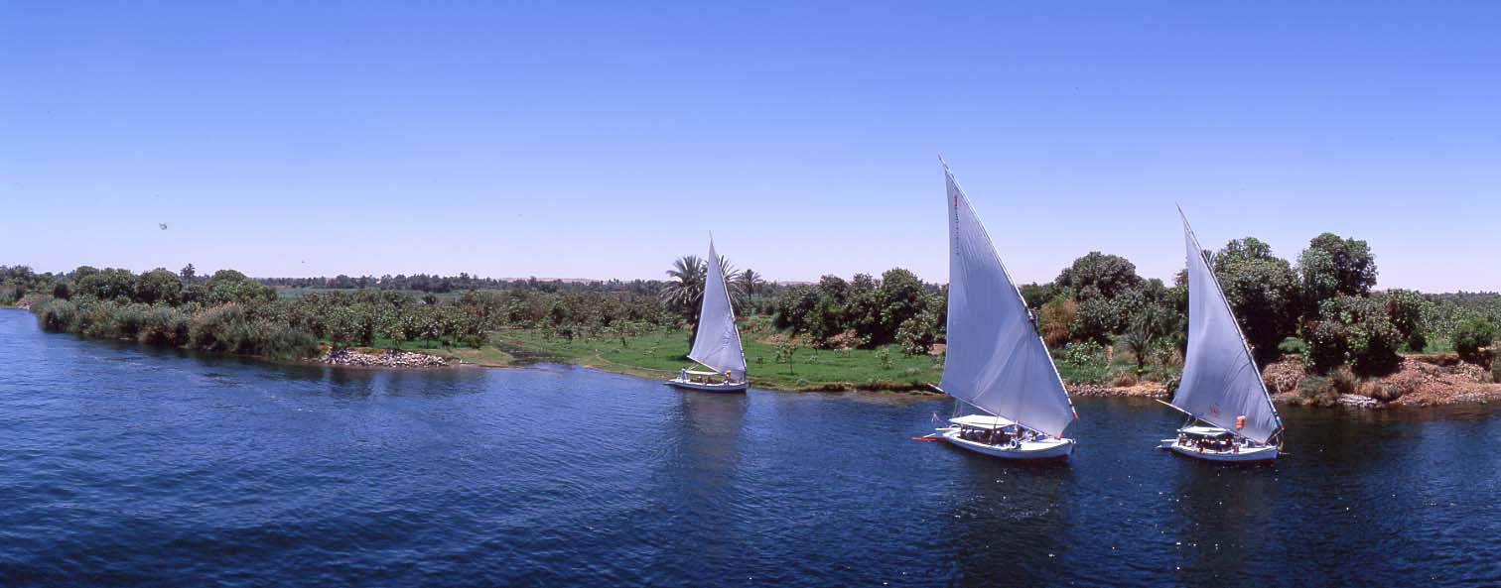
THANK YOU

Slide 38
Let Us Meet Again
We welcome you all to our future conferences of
OMICS International
Please Visit:
www.metabolomicsconference.com
www.conferenceseries.com
http://www.conferenceseries.com/clinical-research-conferences.php

