Slide 1
About OMICS Group
OMICS Group International is an amalgamation of Open Access publications and worldwide international science conferences and events. Established in the year 2007 with the sole aim of making the information on Sciences and technology ‘Open Access’, OMICS Group publishes 400 online open access scholarly journals in all aspects of Science, Engineering, Management and Technology journals. OMICS Group has been instrumental in taking the knowledge on Science & technology to the doorsteps of ordinary men and women. Research Scholars, Students, Libraries, Educational Institutions, Research centers and the industry are main stakeholders that benefitted greatly from this knowledge dissemination. OMICS Group also organizes 300 International conferences annually across the globe, where knowledge transfer takes place through debates, round table discussions, poster presentations, workshops, symposia and exhibitions.

Slide 2
About OMICS Group Conferences
OMICS Group International is a pioneer and leading science event organizer, which publishes around 400 open access journals and conducts over 300 Medical, Clinical, Engineering, Life Sciences, Phrama scientific conferences all over the globe annually with the support of more than 1000 scientific associations and 30,000 editorial board members and 3.5 million followers to its credit.
OMICS Group has organized 500 conferences, workshops and national symposiums across the major cities including San Francisco, Las Vegas, San Antonio, Omaha, Orlando, Raleigh, Santa Clara, Chicago, Philadelphia, Baltimore, United Kingdom, Valencia, Dubai, Beijing, Hyderabad, Bengaluru and Mumbai.

Slide 3

Laser [213-nm] depth-profiling studies of Ni/V ratios in asphaltenes (soft samples) following liquid nitrogen pre-treatment
Presented by: Dr. Avin Pillay, A&S Chemistry Dept

Slide 4
What are Asphaltenes?
Crude oils contain asphaltenes, which are a sticky, tar-like substance
Asphaltenes contain nickel and vanadium, which reflect the source rock and environment from which the crude oil originates. This is important for Geochemical research. The Ni/V ratio can be obtained by a technique called ICP-MS. Generally V levels are higher than those for Ni.

Slide 5
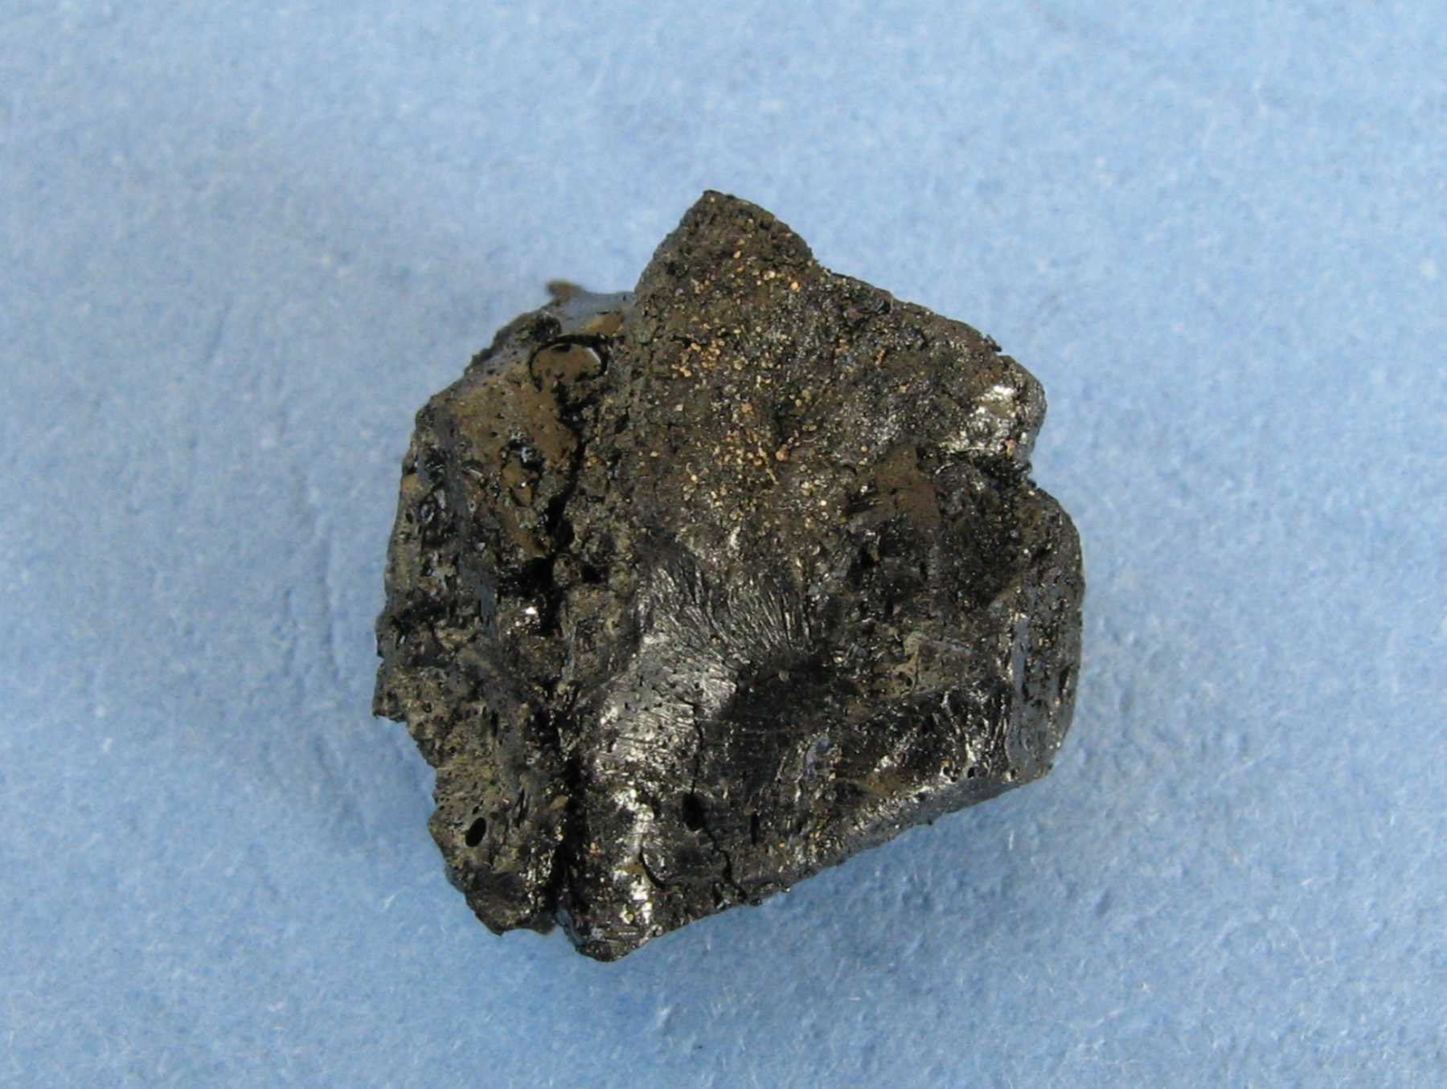
Typical Asphaltene Sample

Slide 6
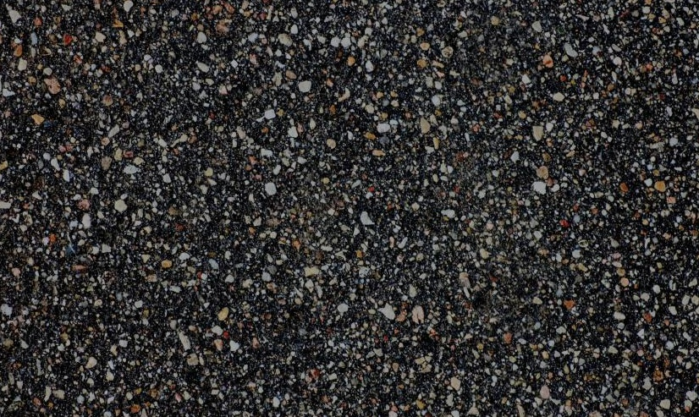
Asphalt + Gravel = Roads

Slide 7
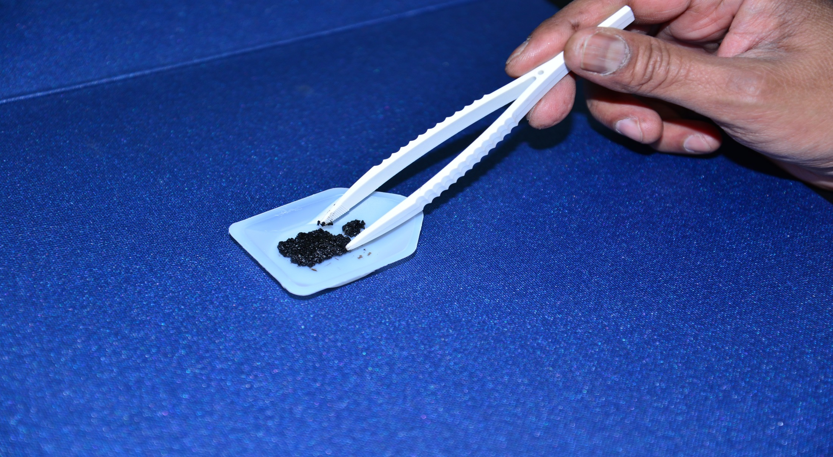
Natural sample of Asphaltene - flaky

Slide 8
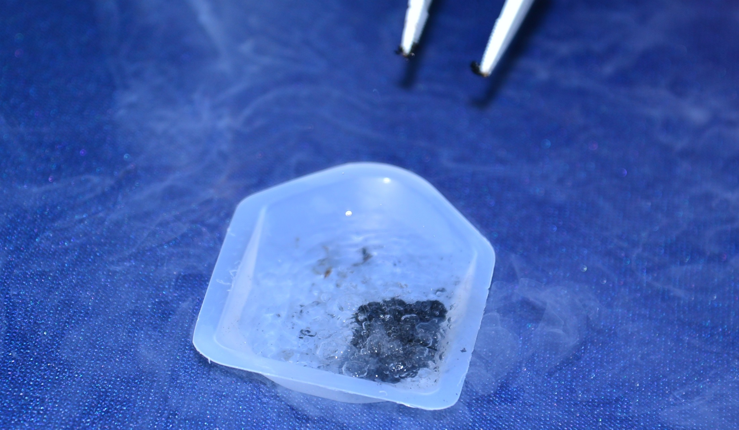
Liquid Nitrogen Pre-treatment of sample

Slide 9
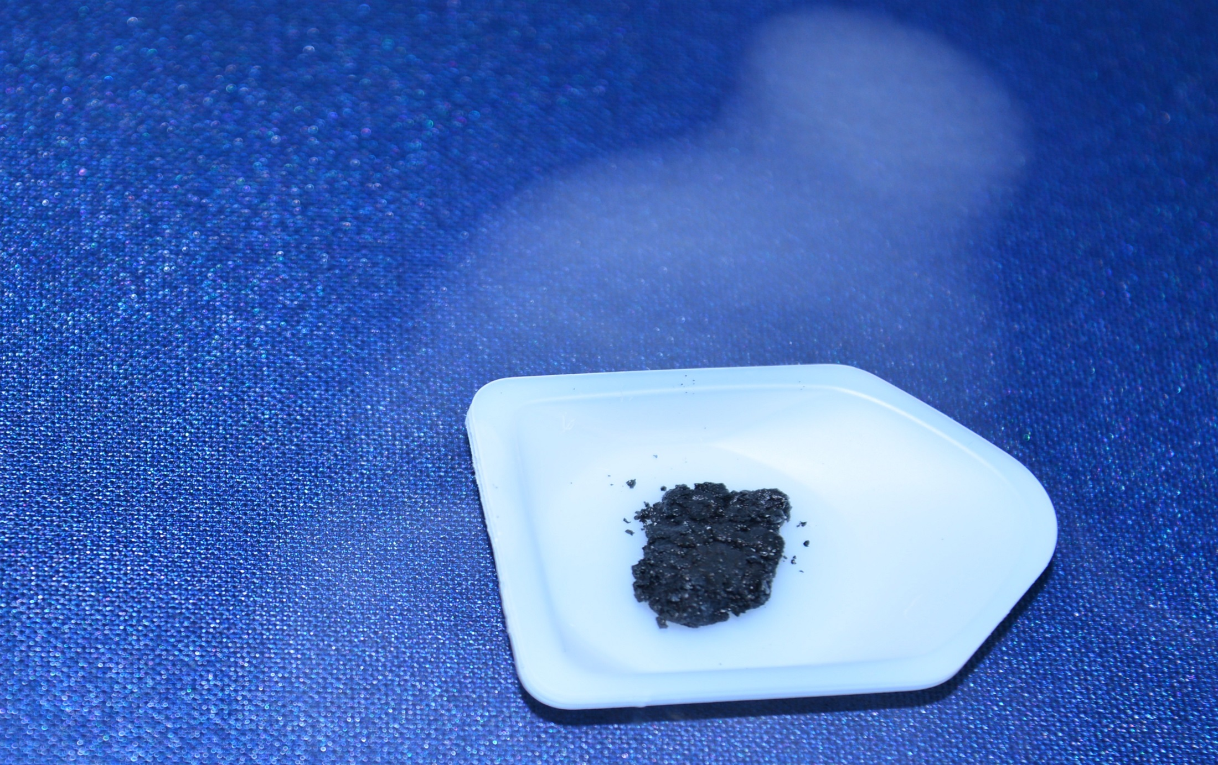
Solidified Asphaltene Sample

Slide 10
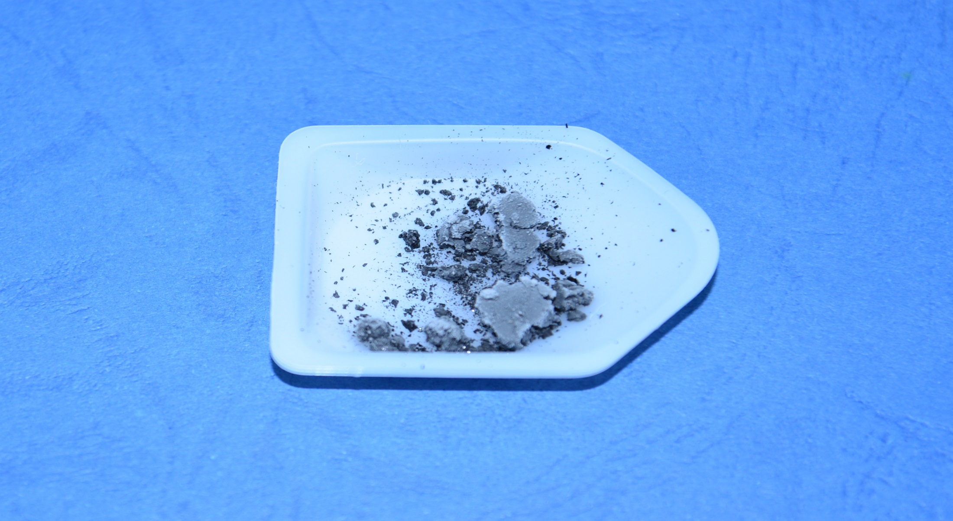
Brittle Asphaltene sample

Slide 11
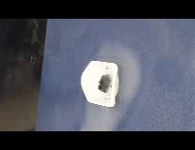
Solidified Asphaltene Sample

Slide 12
What is ICP-MS
It is a highly sensitive technique that can give concentration data at the ng/kg level.
It has the following advantages:
Quick analysis
Accurate data
Easy to handle
Sample automation

Slide 13
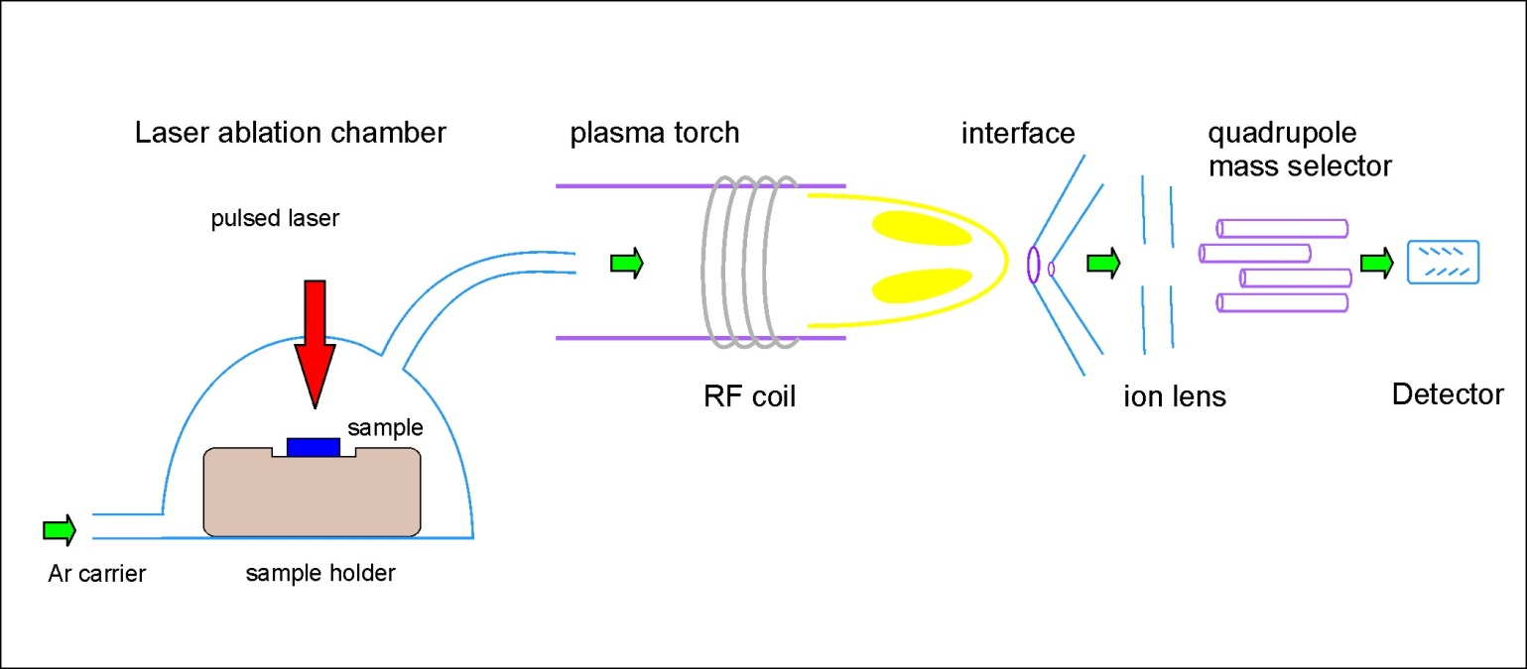
Laser Ablation ICP-MS

Slide 14
Validation of ICP-MS
Element | Certified value (ppb) | Measurement 1 Fluka 70007 (ppb) | Relative Error | Measurement 2 Fluka 70007 (ppb) | Relative Error
Be | 10 | 10.20 | +2.0% | 10.75 | +7.5%
Mg | 10 | 9.32 | -6.8% | 9.92 | -0.80%
Co | 10 | 9.74 | -2.6% | 9.98 | -0.2%
Ni | 10 | 9.93 | -0.70% | 10.10 | +1.0%
In | 10 | 9.94 | -0.60% | 9.94 | -0.60%
Pb | 10 | 10.70 | +7.0% | 11.19 | +11.2%
Bi | 10 | 10.06 | +0.60% | 10.36 | +3.6%

Slide 15
Laser Ablation
Laser ablation is a tool that can penetrate a solid sample at different depths and provide elemental information.
This type of analysis is called depth-profiling

Slide 16
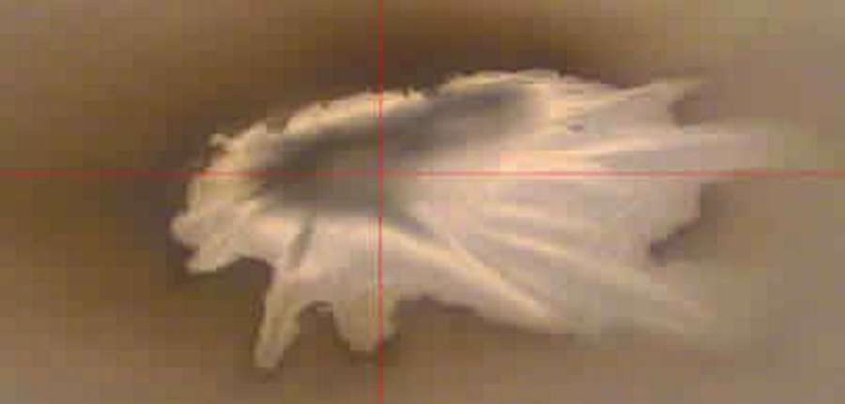
Screen-shot of “splashing” effects in a gelatinous or soft sample

Slide 17
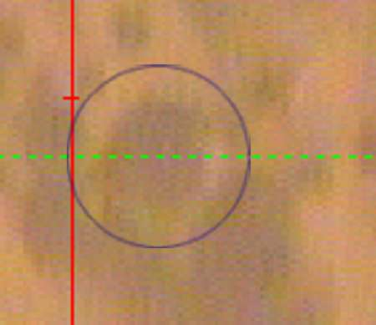
Screen shot of crater-formation

Slide 18
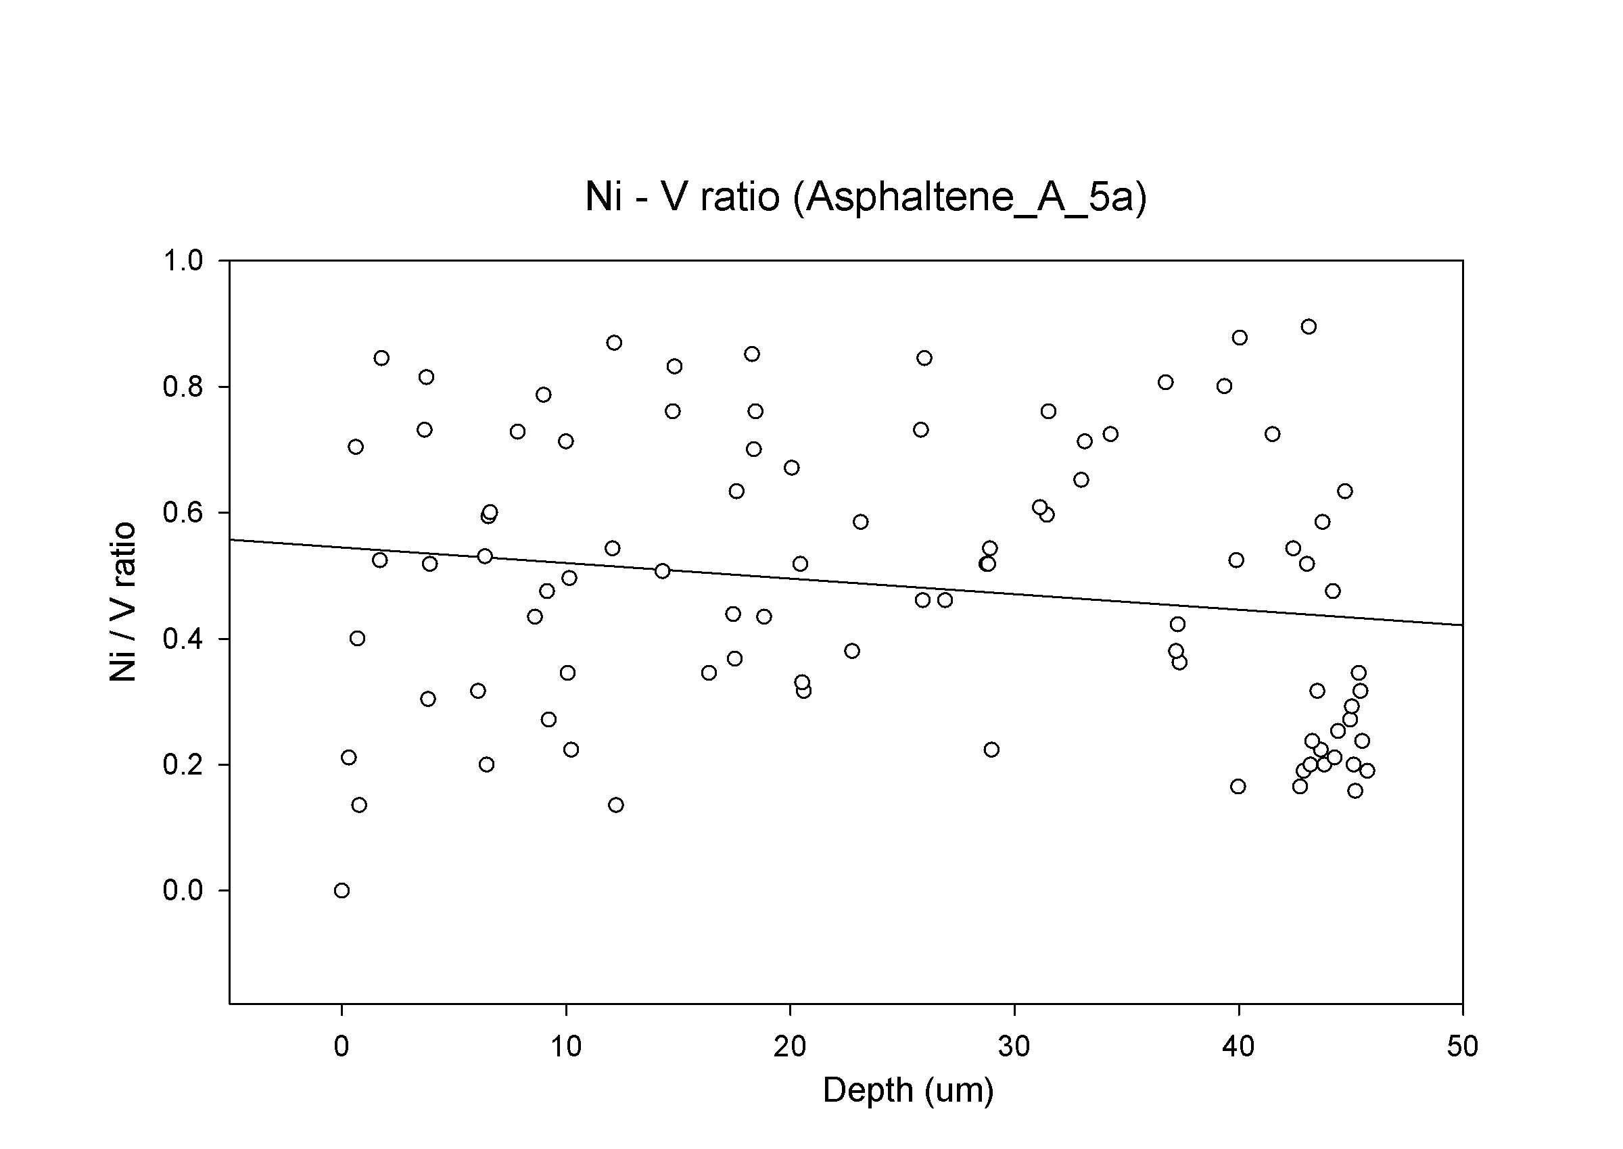
Ni/V Ratio vs Laser Depth

Slide 19
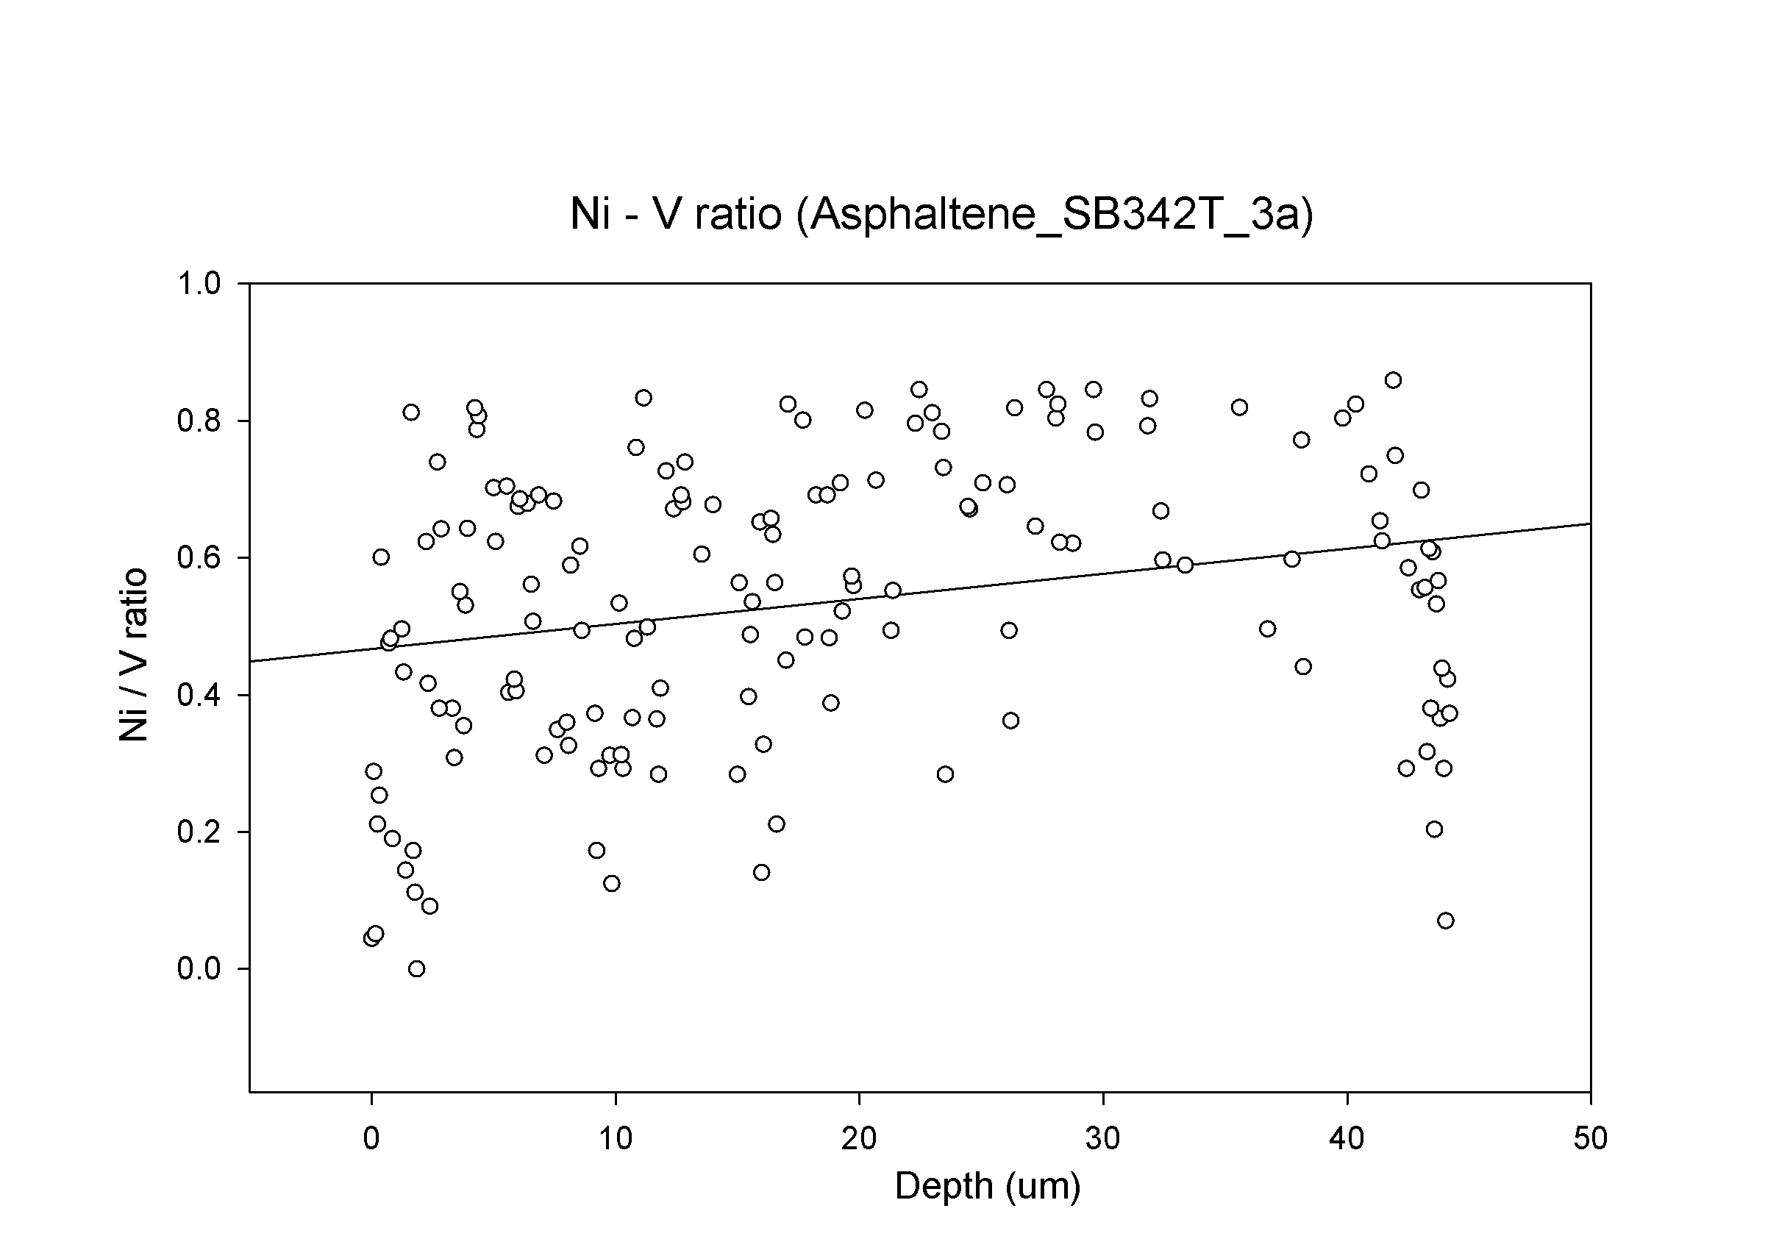
Ni/V Ratio vs Laser Depth

Slide 20
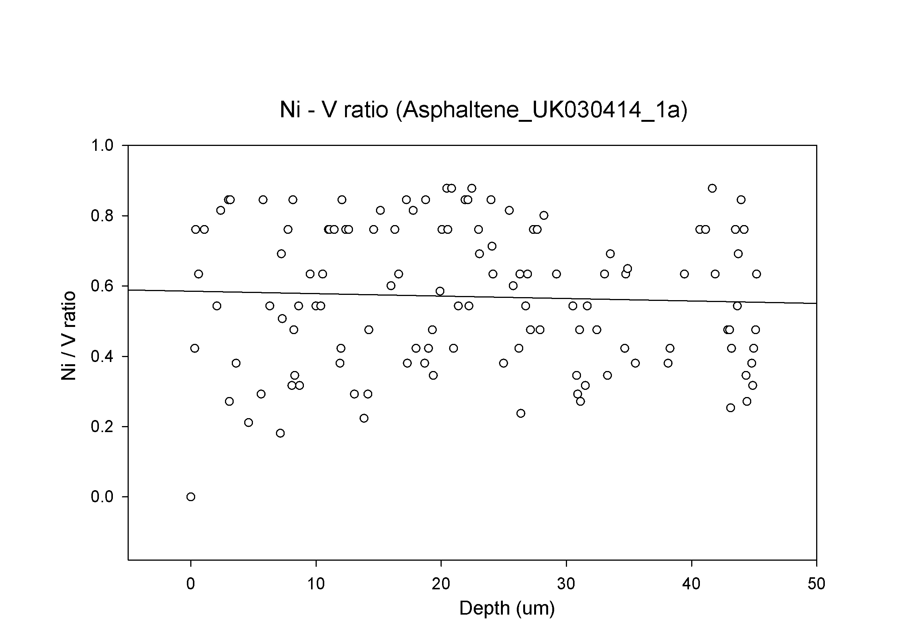
Ni/V Ratio vs Laser Depth

Slide 21
Digested Asphaltenes
For Abu Dhabi oilfields a Ni/V ratio of 0.5 is ideal
Digested samples produced values reflecting much higher nickel content
This indicated there was some nickel contamination due to nickel casings of the pipelines.
In laser ablation studies we can remove the outliers, in heterogeneous samples.

Slide 22
THANK YOU
The Petroleum Institute and technical staff of the Chemistry Department is gratefully acknowledged
Collaborators: Mr Sasi Stephen; Mr Amr Abd Elhameed

Slide 23
Let Us Meet Again
We welcome you all to our future conferences of OMICS Group International
Please Visit:
http://materialsscience.conferenceseries.com/
Contact us at
materialsscience.conference@omicsgroup.us
materialsscience@omicsgroup.com

