Slide 1

INTRACELLULAR DETECTION
OF INFECTIOUS PATHOGENS
IN SPERM CELLS
Speaker: Dr. Angelos Gritzapis, Biologist - Immunologist
This study was funded by and conducted in the diagnostic and research laboratories of Locus Medicus SA, Athens, Greece

Slide 2
A.D. Gritzapis¹ PhD, K. Makarounis² MD, M. Leventopoulos¹ PhD, E. Nossi¹, D. Nikolopoulos¹, G. Georgoulias³ MD, V. Kapetanios⁴ MD, V Tsilivakos¹ MD, PhD
1: Dept. of Cellular Biology and Immunology, Locus Medicus SA, Athens, Greece
2: Urology clinic, Locus Medicus SA, Athens, Greece
3: Dept. of Microbiology, Locus Medicus SA, Athens, Greece
4: Gynecology & Obstetrics clinic, Locus Medicus SA, Athens, Greece

Slide 3
THE THREE MAIN GOALS OF THIS STUDY:
Treatment of male factor subfertility.
Prevention of miscarriages due to immunogenic embryos from infected spermatozoa.
Prevention of vertically-inherited congenital infections from spermatozoa.

Slide 4
OBSERVATIONS LEADING TO THE PRIMARY CONCEPTUAL IDEA
Every Day Observations in a subfertility clinic
Miscarriages occur slightly more often during winter.
Women that interact professionally with many people such as teachers, are dominant in the subfertility group.(Perros et al. 2011)
Data from bibliography
Increment of NK percentage in the peripheral blood of women with a history of miscarriages (Coulam et al. 1995).
The main cell population that makes implantation (trophoblasts) is potential targets of NK cells as they conventionally lack MHC-I expression.
NK cells are the first line of defense against virally infected cells.

Slide 5
QUESTION I
What is the consequence of NK cell increment?
Difficulty in conception?
Miscarriages of the first trimester?
Both?
Michou et al., Fertility & Sterility 2003

Slide 6
Group I. Consecutive spontaneous aborters [n=25; mean age, 30.4 ±4.1 years; median (range) of abortions, 3 (2–5); mean infertility duration, 2.4±1.35 years]
Group II. Sporadic spontaneous aborters [n=30; mean age,34.7±5.3 years; median (range) of abortions, 2 (1–3); mean infertility duration, 5.03±2.81 years]
Group III. Infertile (n=33; mean age, 35.4±5.4 years; mean infertility duration, 9.32 ±4.65 years)
Group IV. Fertile controls (n=11; mean age, 32.5±3.9 years)

Slide 8
CONCLUSION
An absolute number of peripheral blood NK cells could be used rather as an indicator of difficulty of conception than as a risk factor for miscarriage.

Slide 9
QUESTION II
Which is the causative force of NK increment in the peripheral blood of women with a history of subfertility?
Are there genital microbial infections?
Are there subclinical viral infections?
Thomas D. et al., Αm J Reprod Immunol 2005
Herpesviruses related to the increase of NK cell concentration in the peripheral blood in women with a history of subfertility.

Slide 11
CONCLUSION
Assuming that all women under study remained asymptomatic, these data suggest that subclinical herpesvirus viremia may be an important cause of immunostimulation in women with a history of subfertility by increasing the concentration of NK cells in the peripheral blood.

Slide 12
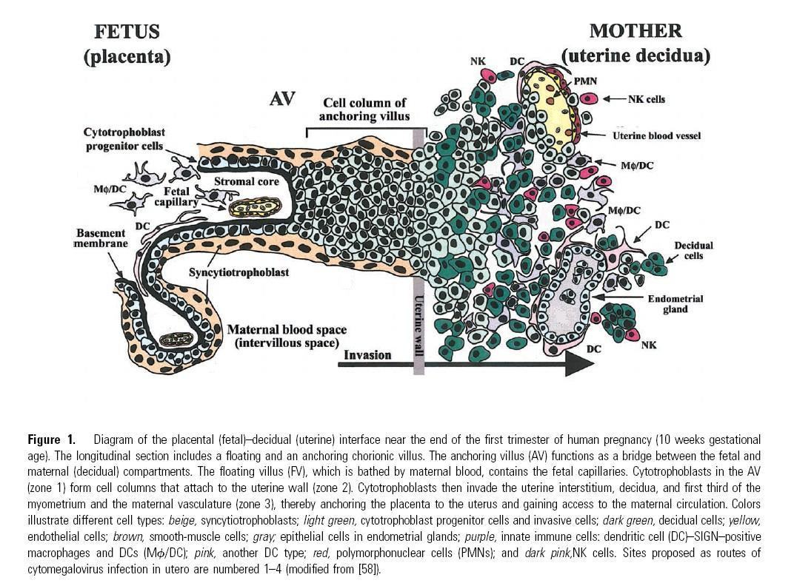
But why are NK cells destructive at the level of the decidua?
Cells of the internal trophoblast diffuse in the endometrial stroma at the implantation site. Furthermore, they emigrate into the lumen of endometrial vessels in order to regulate blood pressure and subsequently the diffusion of oxygen towards the embryo (endothelium is red)

Slide 13
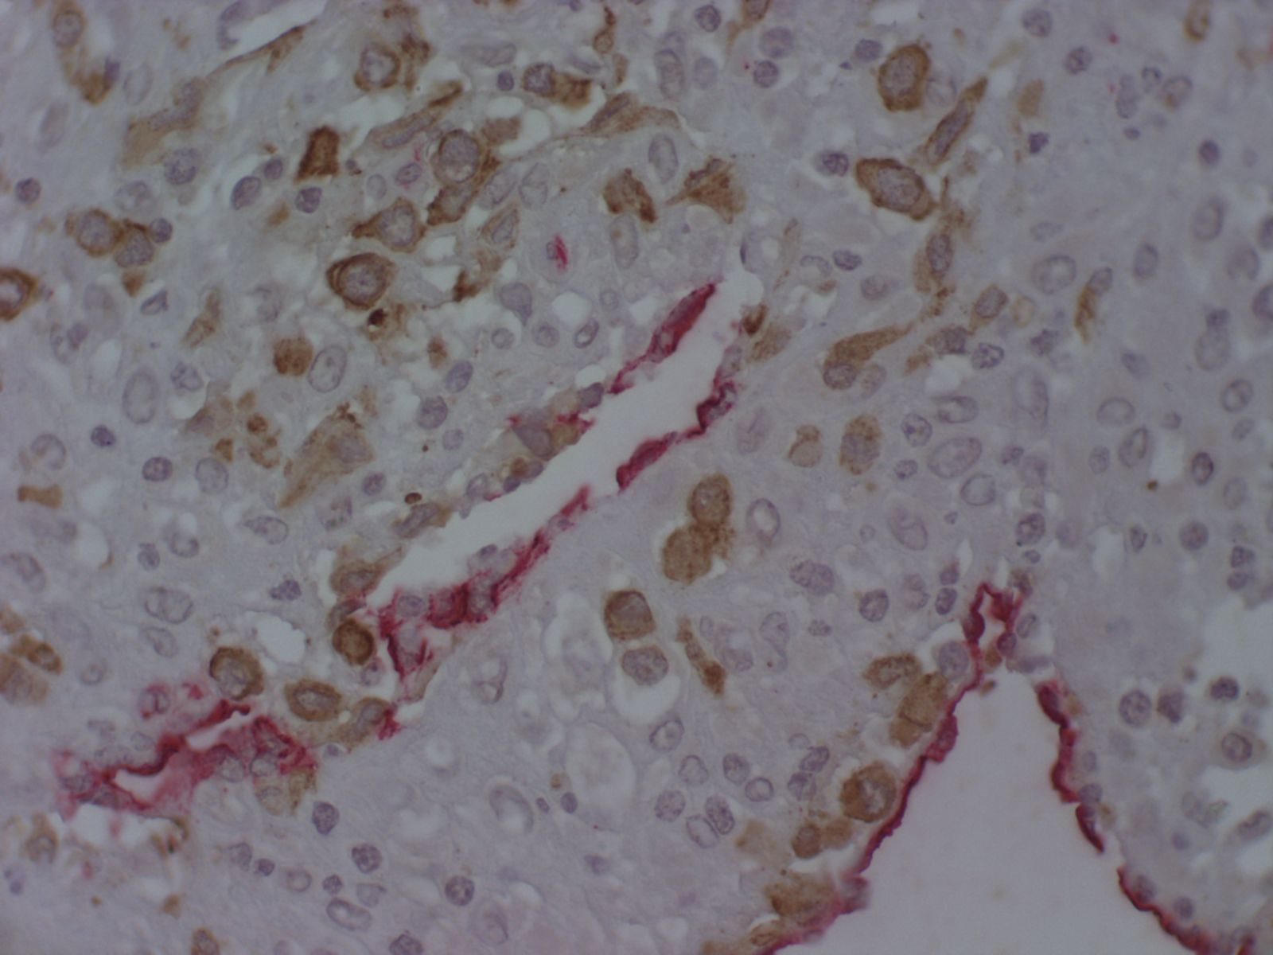
Intermediate trophoblast invasion of decidual vessels and stroma. Anti–cytokeratin 8–18 immunoperoxidase staining for intermediate trophoblastic cells (brown), anti–CD34 for vessels and surface epithelium. Immunoalkaline phosphatase (red), x40.
Cells of the internal trophoblast diffuse in the endometrial stroma at the implantation site. Furthermore, they emigrate into the lumen of endometrial vessels in order to regulate blood pressure and subsequently the diffusion of oxygen towards the embryo (endothelium is red)

Slide 14
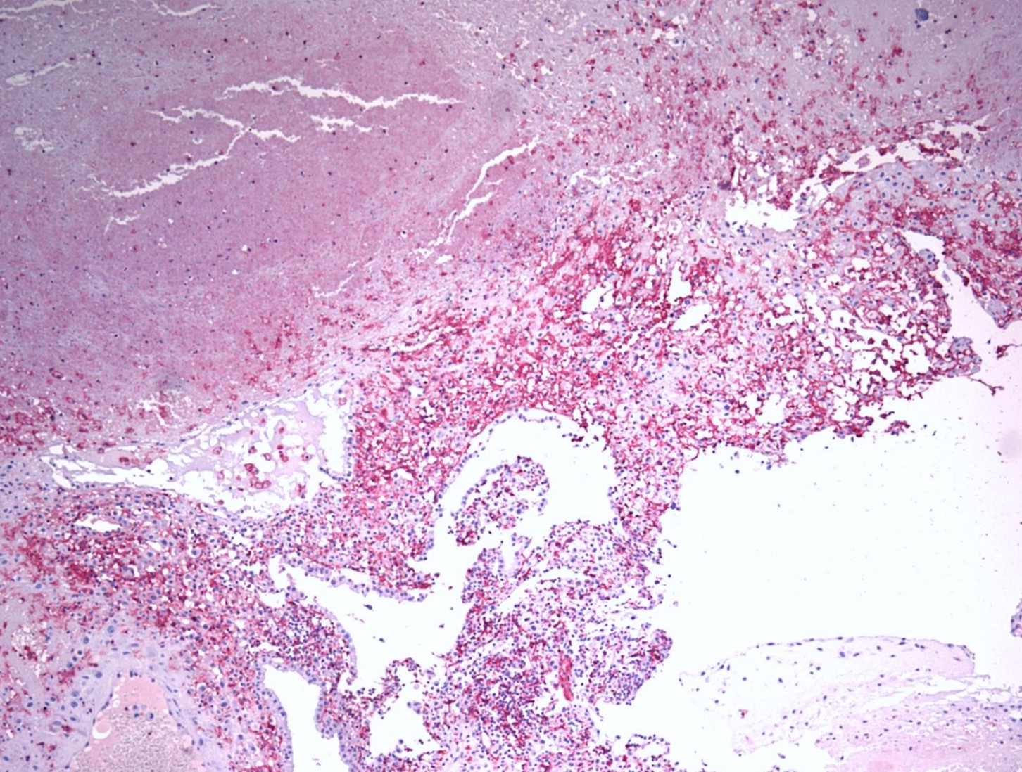
Necrosis of decidua. Immunostaining anti–cytokeratin 8–18. Immunoalkaline phosphatase x40.
In the case of first trimester miscarriages due to immunologic factors necrosis presents

Slide 15
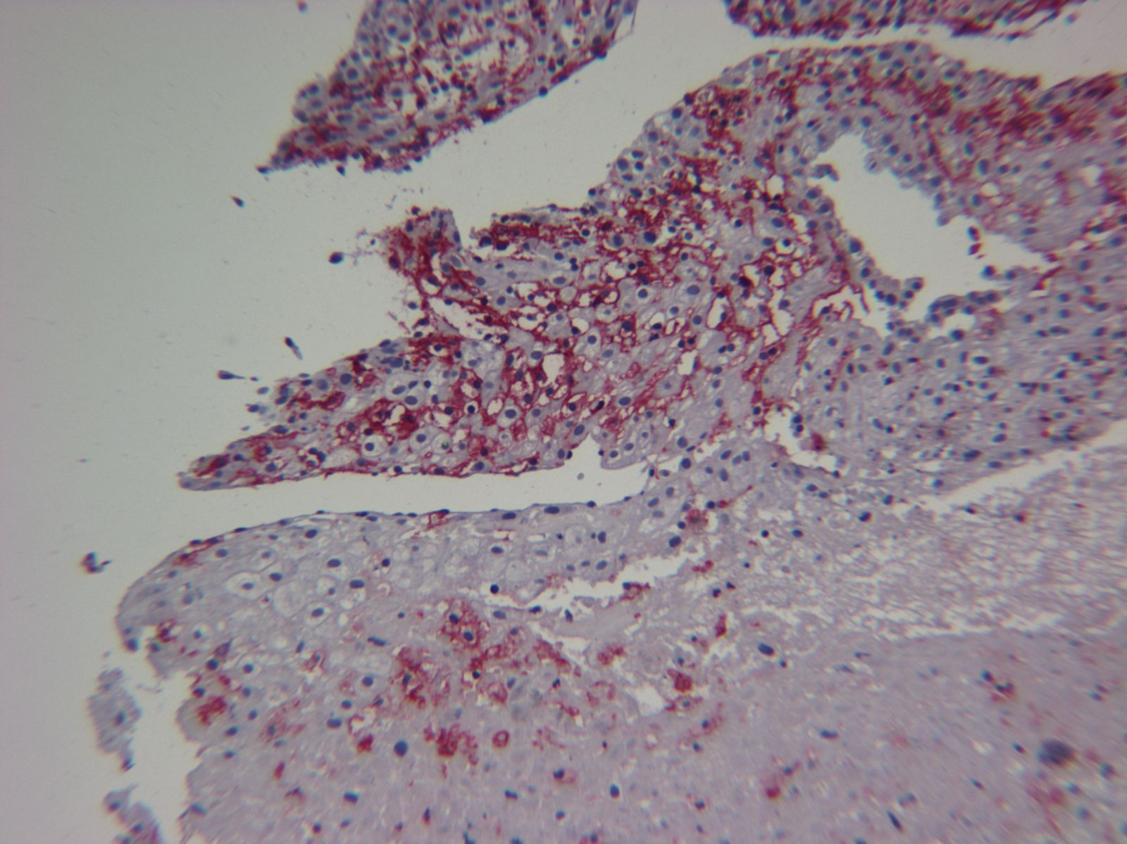
Necrosis of decidua. NK cells with cytotoxic activity. Immunostaining with anti–CD16. Immunoalkaline phosphatase x40.
At the border of necrosis in a mixture with the cells of intermediate trophoblast, NK cells are diffuse (anti CD16+) and have a tropism against cells of the intermediate trophoblast.

Slide 16
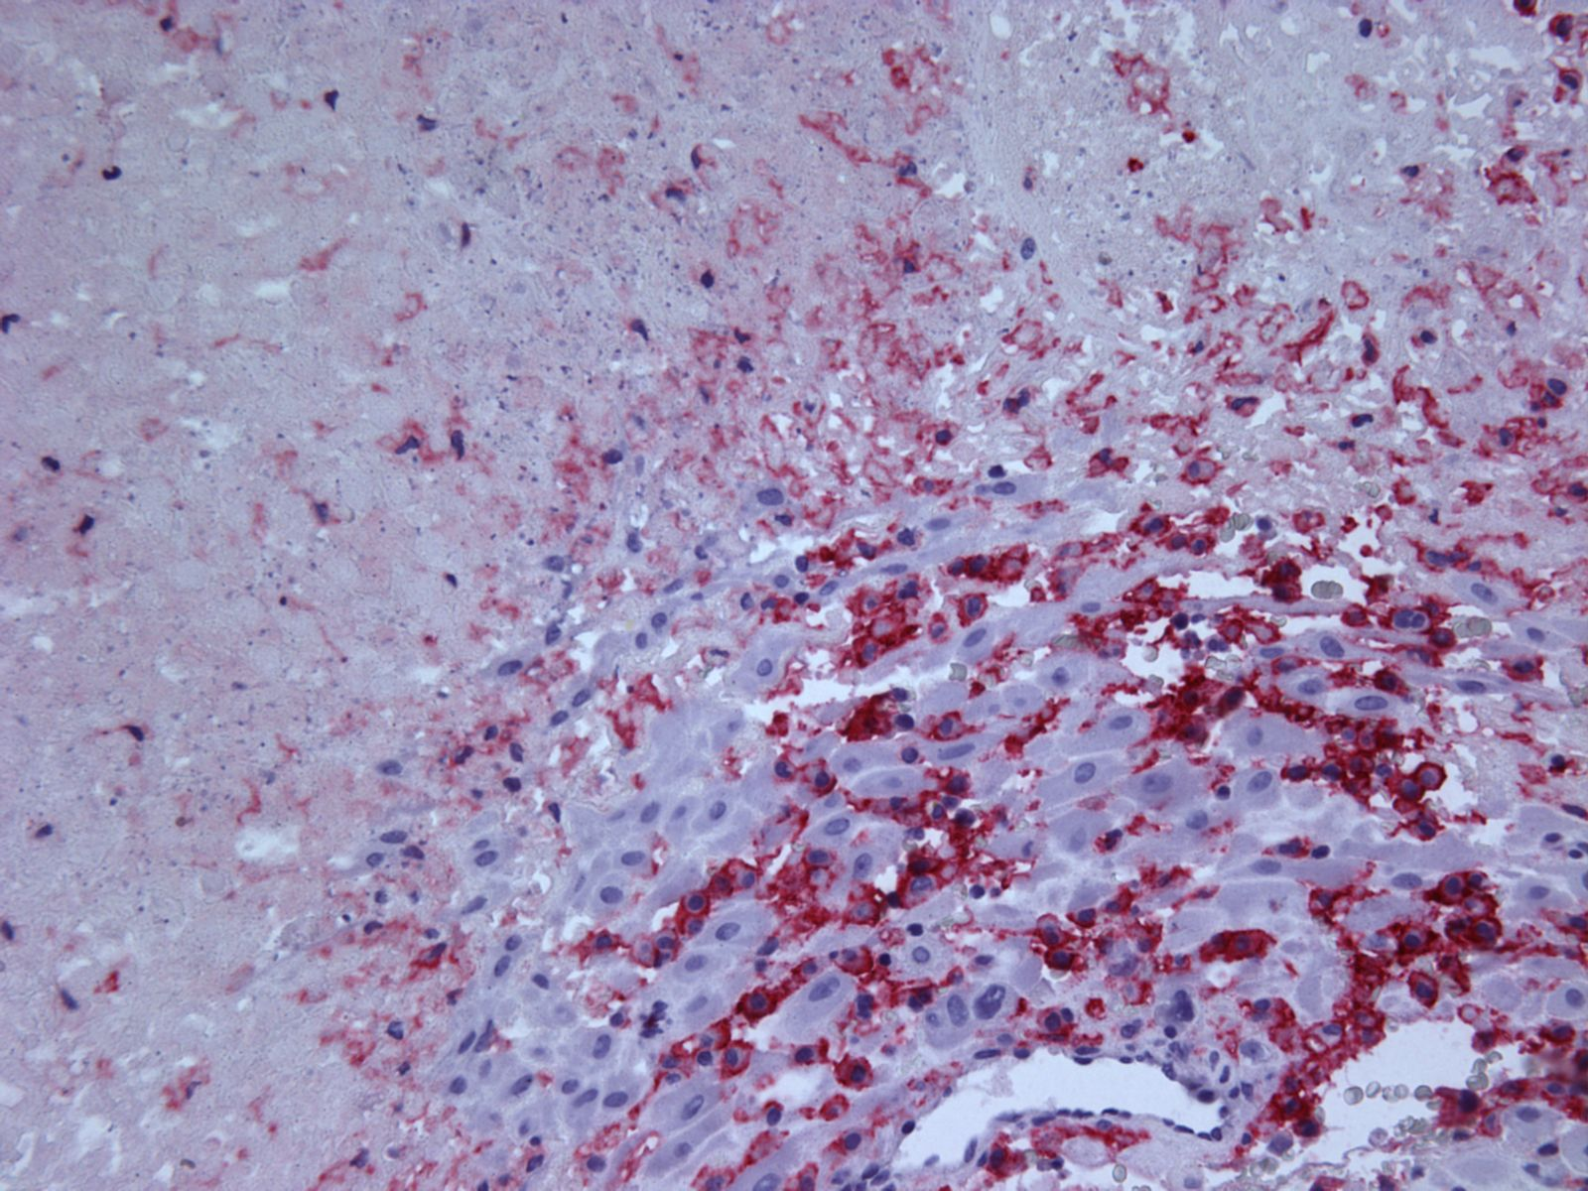
The border of decidual necrosis. NK cells with Anti–CD16⁺ , Immunoalkaline phosphatase, x40.

Slide 17
HISTOLOGICAL EVALUATION OF MISCARRIAGES OF THE FIRST TRIMESTER OF GESTATION
NK tropism against embryonic cells of the intermediate trophoblast and correlation with necrosis at the implantation sites characterizes the histologic appearance of miscarriage for immunological reasons. Surprisingly, the same phenomenon appears even in cases with normal NK cell concentration in peripheral blood!
Consequently, embryonic cells could be immunogenic!
DO THEY CONTAIN VIRUSES?

Slide 18
PCR Herpesviruses evaluation in chorionic villi, decidua distant from the implantation site, and sperm
Couple | HSV 1-2 |  |  | EBV |  |  | CMV
1 | + | - | + | + | - | + | + | - | +
2 | + | - | + | - | - | - | + | - | +
3 | + | + | - | - | + | + | - | + | -
4 | - | - | + | - | - | + | + | - | +
5 | - | - | + | - | - | + | + | - | +
6 | - | + | - | - | - | - | + | + | +
7 | - | - | - | - | - | - | + | + | +
Yellow: Chorionic villus
Red: Decidua without embryonic cells
Green: Washed spermatozoa

Slide 19
WASHING PROCEDURE FOR REMOVAL OF INFECTED SPERM CELLS

Slide 20
DIRECT DETECTION OF VIRUSES IN SPERM
Viruses are present in sperm
Viruses are still present even after sperm enrichment
Liarmakopoulou M: “The presence of herpes viruses in the semen of infertile couple, following two density gradient method’’ Masters, University of Leeds, 2004 (DISTINCTION, Financial award)
Michou et al., ANDROLOGIA 2012

Slide 21
Regarding the localization of pathogens, the PCR assay can not distinguish between seminal plasma and sperm cells or identify the infected cells.
This is very important as the interior of the spermatozoa but not the membrane, flows into the ovule.
So, a direct and high throughput assay is needed, as for example HBV is already detected in sperm cells by FISH (Huang et al, 2003).

Slide 22
FLOW CYTOMETRY PROTOCOL
Sperm liquefaction
centrifugation
Fixation with 4% PFA.
Membrane permeabilization with saponin and DMSO.
DNase I treatment for 30 min at 37oC as the DNA in sperm cells is very dense.
Incubation with monoclonal antibodies against intracellular pathogens (i.e. Chlamydia trachomatis, clone: Herpes Simplex Virus-HSV, Cytomegalovirus-CMV, Human Papiloma Virus-HPV).
Acquisition in a flow cytometer.

Slide 23
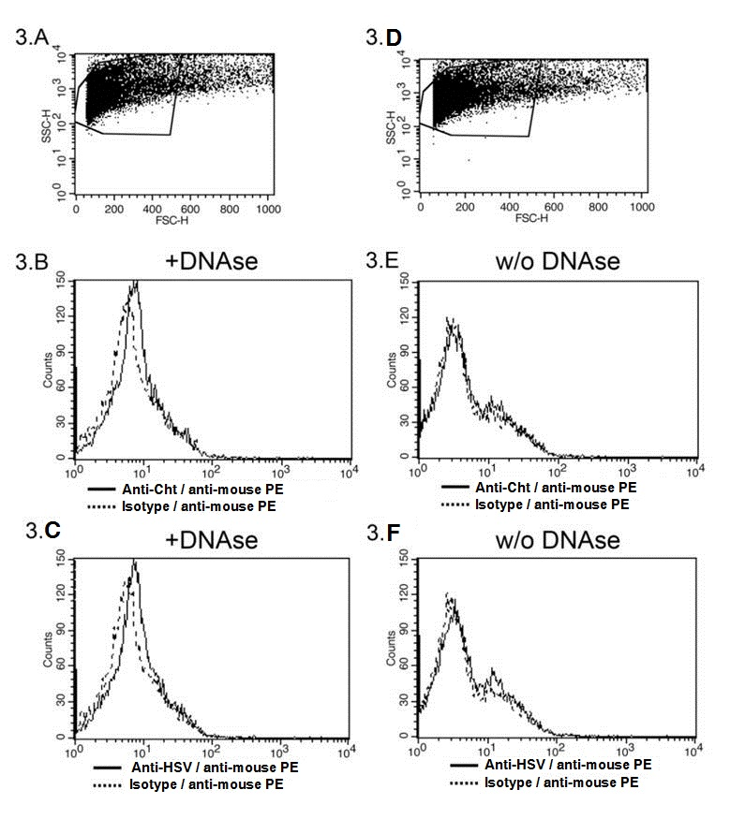

Slide 24
ADNANTAGES OF FLOW CYTOMETRIC METHOD OVER PCR
Evaluation of the intracellular presence of pathogens.
Greater sensitivity as Taq inhibitors should be suppressed by dilutions (Garolla et al. 2013). This can explain the discrepancy between PCR and flow cytometry.
Information on the identity of infected cells.
Lower cost.

Slide 25
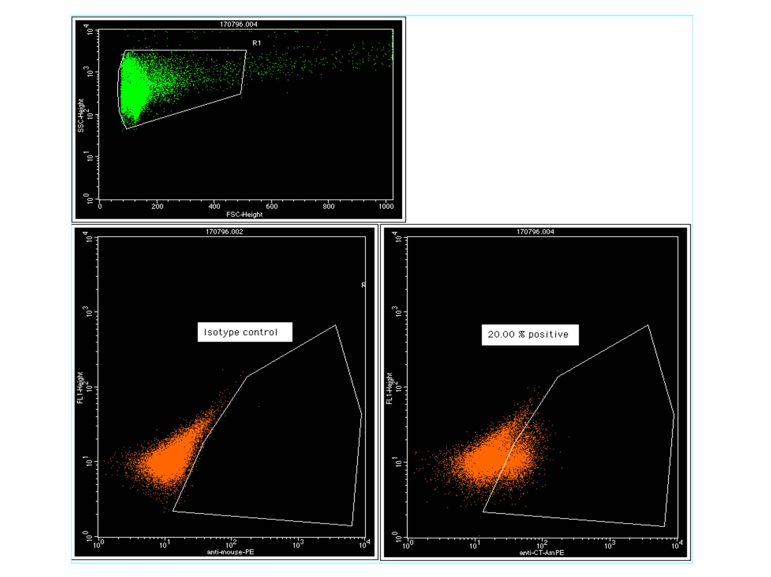

Slide 26
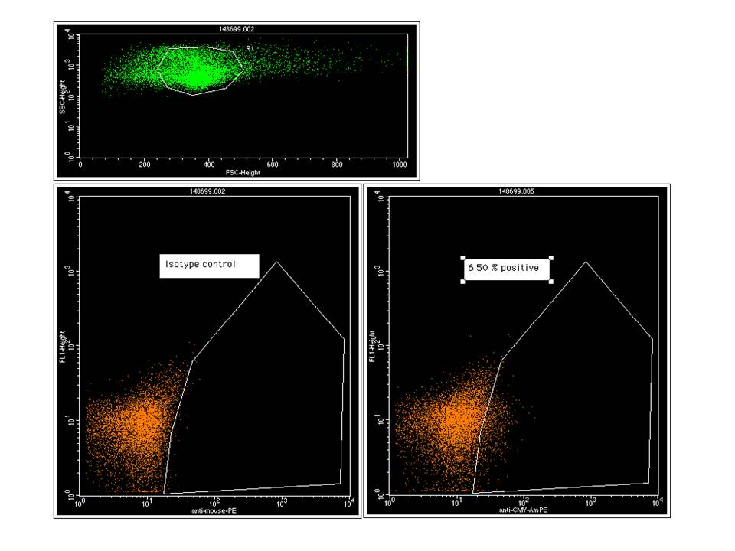

Slide 27
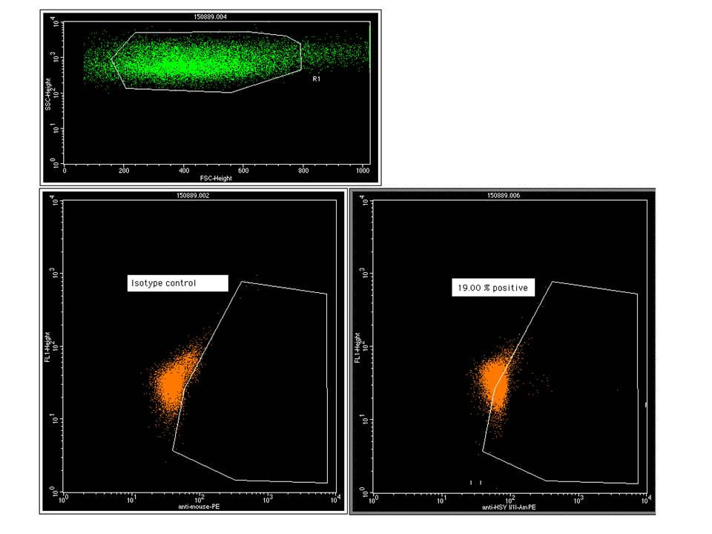

Slide 28
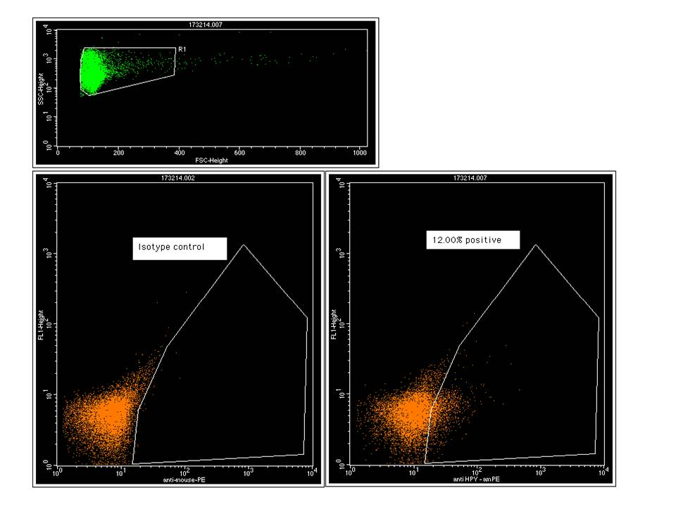

Slide 29
PREVALENCE OF PATHOGENS IN SUBFERTILE POPULATION

Slide 31
There is no correlation between virus presence and sperm morphology.
But there is correlation between sperm abnormalities and Chlamydia trachomatis presence in the interior of sperm cells. The abnormalities in the midpiece of sperm cells, are statistically reduced after treatment with antibiotics.

Slide 36
POTENTIAL CONSEQUENCES OF THE EXISTENCE OF VIRUS IN THE INTERIOR OF SPERMATOZOA
Incapability of conception due to
  abnormalities of spermatozoa.
  very early rejection of the fetus before the next menstruation, is misinterpreted as infertility.
Early miscarriage of the fetus with the histologic image described previously, with or without NK increase in the periphery.
Because of the neurotropic properties of Herpesviruses, it is possible that congenital anomalies occur due to them.

Slide 37
In case of fetal survival, there is a strong possibility that T and B cell clones, which normally recognize virus antigens, will be deleted according to the self-tolerance theory during thymic education.
As a result, the newborn organism would be tolerized against intracellular pathogens and therefore more susceptible to them in the future.

Slide 38
SPERM BANKS
The fact that miscarriage is possible due to the intracellular presence of virus, makes their detection by sperm banks necessary.
In addition, the seasonal fluctuation of their presence, makes testing of every sample given by the same donor equally necessary.

Slide 39
Artificial Insemination Techniques (ART) – In vitro Fertilization (IVF)
The high economic and psychological cost of a miscarriage after either ART or IVF, makes intra Sperm Pathogen Immunophenotyping (SPI test) of great importance.

Slide 40

Thank you for your attention.

