Slide 1
About OMICS Group
OMICS Group International is an amalgamation of Open Access publications and worldwide international science conferences and events. Established in the year 2007 with the sole aim of making the information on Sciences and technology ‘Open Access’, OMICS Group publishes 400 online open access scholarly journals in all aspects of Science, Engineering, Management and Technology journals. OMICS Group has been instrumental in taking the knowledge on Science & technology to the doorsteps of ordinary men and women. Research Scholars, Students, Libraries, Educational Institutions, Research centers and the industry are main stakeholders that benefitted greatly from this knowledge dissemination. OMICS Group also organizes 300 International conferences annually across the globe, where knowledge transfer takes place through debates, round table discussions, poster presentations, workshops, symposia and exhibitions.

Slide 2
About OMICS Group Conferences
OMICS Group International is a pioneer and leading science event organizer, which publishes around 400 open access journals and conducts over 300 Medical, Clinical, Engineering, Life Sciences, Phrama scientific conferences all over the globe annually with the support of more than 1000 scientific associations and 30,000 editorial board members and 3.5 million followers to its credit.
OMICS Group has organized 500 conferences, workshops and national symposiums across the major cities including San Francisco, Las Vegas, San Antonio, Omaha, Orlando, Raleigh, Santa Clara, Chicago, Philadelphia, Baltimore, United Kingdom, Valencia, Dubai, Beijing, Hyderabad, Bengaluru and Mumbai.

Slide 3

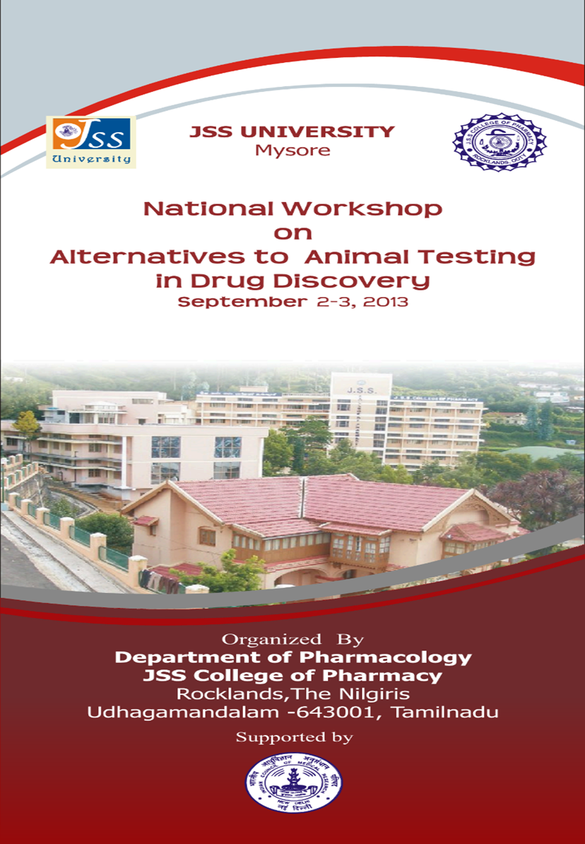
Synthesis and evaluation of some novel thiazolidinedione derivatives as PPAR- α/γ dual agonists
Dr. Praveen T.K., M.Pharm., Ph.D.,
Assistant Professor
Dept. of Pharmacology
J.S.S. College of Pharmacy
Ootacamund 643 001
The Nilgiris, Tamilnadu, India.
Email: praveentk7812@gmail.com

Slide 4
Introduction
TZDs are reported to reverse insulin resistance without stimulating the release of insulin from β-cells.
They reduce hepatic glucose production and increase peripheral utilization of glucose thus reducing both preload and after load on β-cells.
The clinically used TZDs suffered with some serious side effects like, Idiosyncratic hepatotoxicity, fluid retention, edema, congestive heart failure, weight gain, bone fracture, bladder cancer, etc.,
As a result of which troglitazone was banned, rosiglitazone was restricted and the pioglitazone label was updated for the risk of bladder cancer.

Slide 5
Recent advances in understanding the structure and function of PPARs, however, has led to more rationalized approaches to develop these agents.
Some of these approaches includes;
  PPAR-α/γ dual agonists
  PPAR-δ/γ dual agonists
  PPARpan agonists
  Selective PPAR-γ modulators and partial agonists

Slide 6
Advantages of PPAR-α/γ dual agonists (glitazars)
In general, type 2 diabetic patients suffer from both hyperglycemia and dyslipidemia.
The major cause of mortality in these patients is atherosclerotic macrovascular diseases.
Activation of different PPAR subtypes leads to a broad spectrum of metabolic effects that may be complementary.
PPAR-γ activation improves insulin sensitivity
PPAR-α activation stimulate lipid oxidation and reduce adiposity.

Slide 7
PPAR-α/γdual agonists, therefore, have been postulated to improve insulin resistance, hyperglycemia and alleviate atherogenic dyslipidemia.
In addition, PPAR-α agonists stimulate lipid oxidation and decrease adiposity and thus, counter the PPAR-γ mediated weight gain through its adipogenic affects.

Slide 8
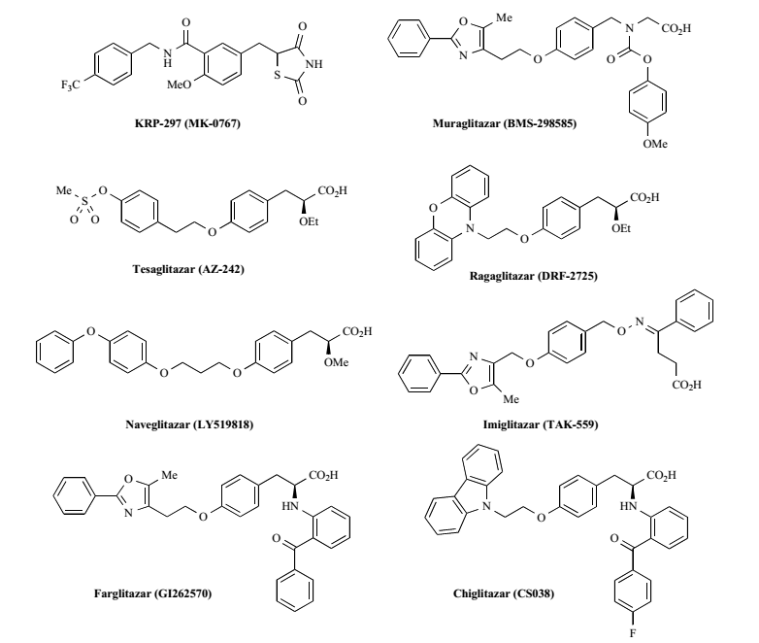

Slide 9
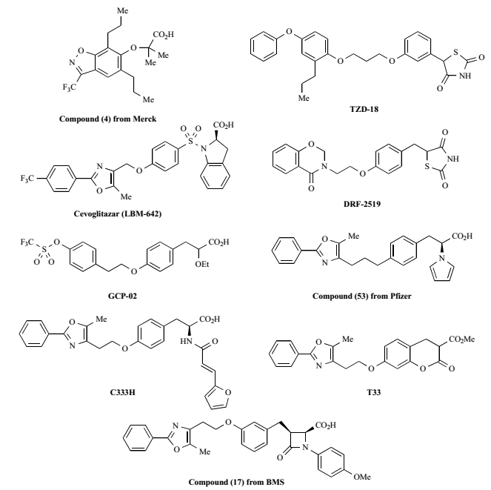

Slide 10
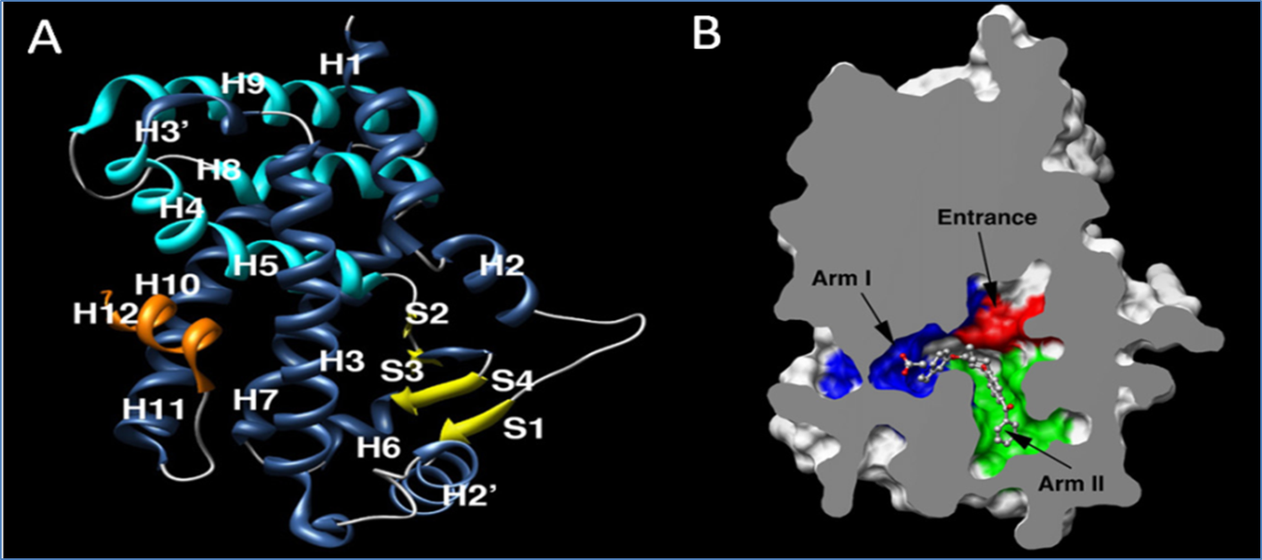
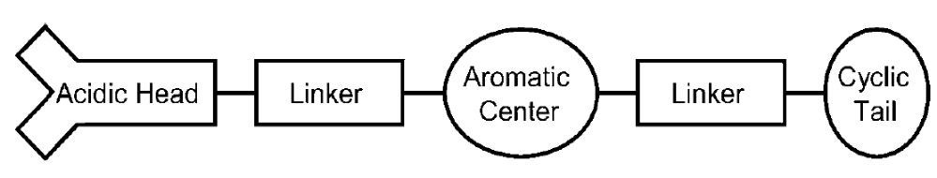
Ligand receptor interaction

Slide 11
In the present study some novel 5-(4-(3-phenoxypropoxy)benzylidene)thiazolidine-2,4-dione derivatives were designed, synthesized and evaluated using in silico, in vitro and in vivo techniques for their potential PPAR-α/γ dual agonistic activities.

Slide 12
Docking Studies
(Glide, version 5.7, Schrödinger, LLC, New York, 2011.)
Ligand preparation (257 molecules)
2D to 3D structures
Chiralitiy corrections
Charges neutralized
Ionization and tautomeric states
The energy minimization
Protein preparation
2PRG (PPAR-γ) and 3G8I (PPAR-α)
Corrected for bond orders, formal charges, missing hydrogen atoms, etc.
Water molecules beyond 5 Å were removed
Generation of ionization states
The energy minimization
Receptor grid generation
Docking
(XP, OPLS-2005)
Validation of docking programme
(RMSD and H-bonding)
Post docking analysis

Slide 13
Validation of docking programme
a
b
a
b
Conformational and H-Bonding interaction comparison of rosiglitazone (a) (RMSD=0.4930 Å) and Aleglitazar (RMSD=0.1735Å)

Slide 14
The docking scores for the synthesized molecules (10a-k) along with their XP descriptor terms (PPAR-γ)
Ligand code |  | GScore | Lip EvdW | PhobEn | Phob EnHB | PhobEn PairHB | HBond | Electro | Sitemap | LowMW | RotPenal
Docking | Synthesis
C114 | 10a | -11.5 | -6.8 | 0 | -1 | 0 | -2.2 | -1.1 | -0.5 | -0.3 | 0.4
C130 | 10b | -14.2 | -7.9 | 0 | -1 | -2 | -1.9 | -1 | -0.5 | -0.2 | 0.2
C116 | 10c | -13.1 | -6.7 | 0 | -1 | -2 | -2.1 | -1 | -0.5 | -0.1 | 0.2
C162 | 10d | -12.2 | -7.3 | 0 | 0 | -2 | -1.8 | -0.8 | -0.5 | -0.2 | 0.3
C164 | 10e | -12.5 | -7.3 | 0 | 0 | -2 | -2 | -0.8 | -0.5 | -0.2 | 0.3
C224 | 10f | -11.1 | -7.2 | 0 | -1 | 0 | -2.1 | -0.7 | -0.5 | -0.1 | 0.3
C160 | 10g | -10.5 | -7 | 0 | -1 | 0 | -2 | -0.5 | -0.3 | 0 | 0.3
C190 | 10h | -13.5 | -6.3 | 0 | -1 | -2 | -2 | -0.9 | -1.3 | -0.2 | 0.2
C220 | 10i | -11.6 | -7.2 | 0 | -1 | 0 | -2.1 | -1.3 | -0.4 | 0 | 0.3
C216 | 10j | -11.9 | -6.6 | 0 | 0 | -2 | -2.1 | -0.9 | -0.5 | 0 | 0.2
C222 | 10k | -11.2 | -7.1 | 0 | -1 | 0 | -2.1 | -0.6 | -0.7 | 0 | 0.3
Rosiglitazone |  | -10.7 | -6.7 | 0 | -1 | 0 | -2 | -0.6 | -0.5 | -0.3 | 0.4
Aleglitazar |  | -10.1 | -8.1 | -0.1 | 0 | 0 | -1.1 | -0.8 | -0.2 | 0 | 0.3
Bezafibrate |  | -9.6 | -6.2 | -0.1 | 0 | -1.3 | -1.1 | -0.3 | -0.5 | -0.3 | 0.3
GScore = 0.065*vdW + 0.130*Coul + Lipo + Hbond + Metal + BuryP + RotB + Site

Slide 15
The docking scores for the synthesized molecules (10a-k) along with their XP descriptor terms (PPAR-α)
Ligand code |  | GScore | Lip EvdW | PhobEn | Phob EnHB | PhobEn PairHB | HBond | Electro | Sitemap | LowMW | RotPen
Docking | Synthesis
C114 | 10a | -8.3 | -6.5 | -0.6 | 0 | 0 | -0.6 | -0.2 | -0.5 | -0.3 | 0.4
C130 | 10b | -11.9 | -7.5 | -0.8 | 0 | -2 | -1.1 | -0.4 | -0.2 | -0.2 | 0.2
C116 | 10c | -10.5 | -6.1 | -0.2 | 0 | -2 | -1.2 | -0.8 | -0.3 | -0.1 | 0.2
C162 | 10d | -11.1 | -7 | -0.5 | 0 | -2 | -1.2 | -0.3 | -0.2 | -0.2 | 0.3
C164 | 10e | -11.5 | -7 | -0.7 | 0 | -2 | -1.4 | -0.4 | -0.2 | -0.2 | 0.3
C224 | 10f | -9.2 | -6.8 | 0 | 0 | 0 | -1.3 | -0.7 | -0.6 | -0.1 | 0.3
C160 | 10g | -9.3 | -7.8 | -0.3 | 0 | 0 | -0.5 | -0.3 | -0.6 | 0 | 0.3
C190 | 10h | -10.9 | -6.1 | -0.4 | 0 | -2 | -1.2 | -0.3 | -1 | -0.2 | 0.2
C220 | 10i | -10.6 | -6.5 | -0.2 | 0 | -2 | -1.3 | -0.4 | -0.5 | 0 | 0.2
C216 | 10j | -10.6 | -6.2 | -0.4 | 0 | -2 | -1.3 | -0.4 | -0.5 | 0 | 0.2
C222 | 10k | -9.3 | -6.7 | 0 | 0 | 0 | -1.3 | -0.6 | -1 | 0 | 0.3
Rosiglitazone |  | -8 | -5.8 | -0.5 | 0 | -2 | -1.1 | -0.6 | -0.5 | -0.3 | 0.3
Aleglitazar |  | -13.2 | -8.7 | -0.5 | 0 | -2 | -1.5 | -0.6 | -0.1 | 0 | 0.2
Bezafibrate |  | -9.7 | -6.5 | -0.2 | 0 | -2 | -1.7 | -0.4 | -0.5 | -0.3 | 0.3
GScore = 0.065*vdW + 0.130*Coul + Lipo + Hbond + Metal + BuryP + RotB + Site

Slide 16
Per-residue interaction plot of 10a-k with PPAR-γ LBD residues

Slide 17
Per-residue interaction plot of 10a-k with PPAR-α LBD residues

Slide 18
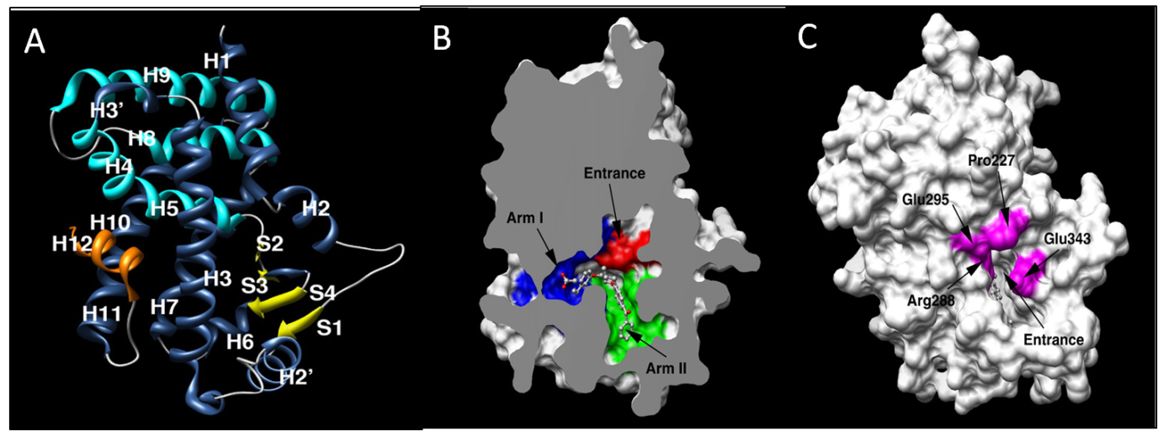
Hydrogen bonding interactions

Slide 19
Hydrogen bonding interactions 10a-k with LBD of PPAR-γ
 | Arm-I |  |  |  |  | Arm-II
 | Ser 289 | His 323 | His 449 | Tyr 473 | Gln 286
10 a | √ | √ | √ | √ | √ | Tail
10 b | √ | √ | √ | √ | √ | Tail
10c | √ | √ | √ | √ | √ | Tail
10d | √ | √ | √ | √ | √ | Tail
10e | √ | √ | √ | √ | √ | Tail
10f | √ | √ | √ | X | √ | Tail
10g | √ | √ | √ | X | √ | Tail
10h | √ | √ | √ | √ | √ | Tail
10i | √ | √ | √ | X | √ | Tail
10j | √ | √ | √ | √ | √ | Tail
10k | √ | √ | √ | X | √ | Tail
Rosiglitazone | √ | √ | √ | √ | √ | Tail
Aleglitazar | √ | √ | X | √ | X | Tail

Slide 20
Hydrogen bonding interactions 10a-k with LBD of PPAR-α
 | Arm-I |  |  |  | Arm-II | Entrance
 | Tyr 314 | His 440 | Tyr 464 | Ser 280 |  | Ala 333
10 a | X | X | X | X | Head | √
10 b | √ | √ | √ | X | Tail
10c | √ | √ | √ | X | Tail
10d | √ | √ | √ | X | Tail
10e | √ | √ | √ | X | Tail
10f | √ | X | X | √ | Tail
10g | X | X | X | X | Head | √
10h | √ | √ | √ | X | Tail
10i | √ | √ | √ | X | Tail
10j | √ | √ | √ | X | Tail
10k | √ | X | X | √ | Tail
Rosiglitazone | X | X | X | X | Head | √
Aleglitazar | √ | √ | √ | X | Tail

Slide 21
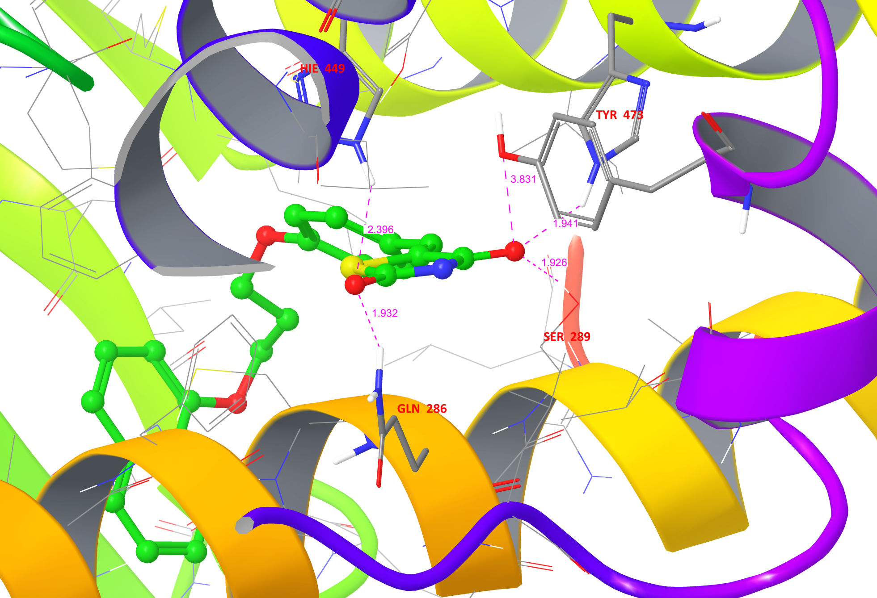
Hydrogen bonding interactions of 10b with LBD of PPAR-γ

Slide 22
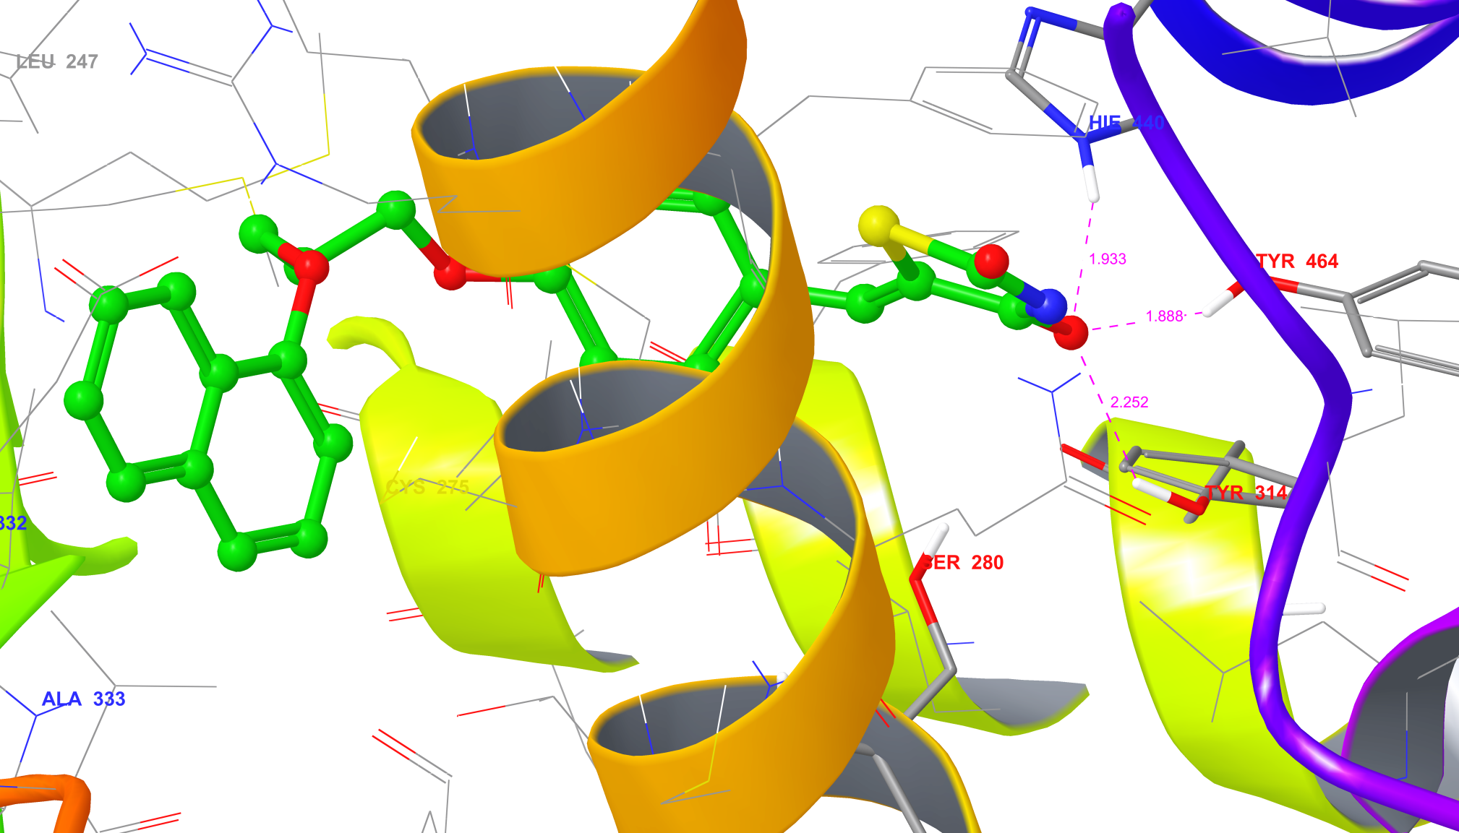
Hydrogen bonding interactions of 10b with LBD of PPAR-α

Slide 23
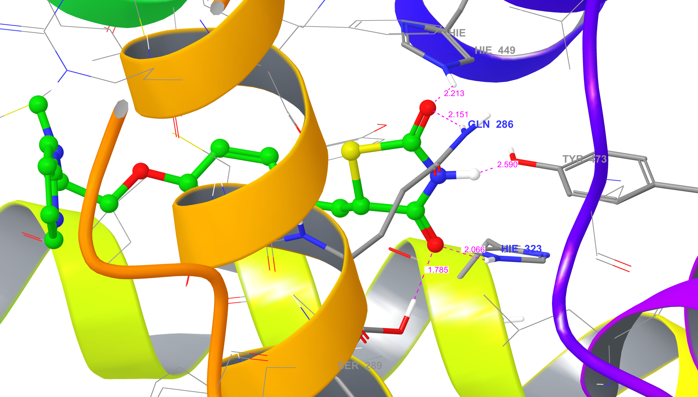
Hydrogen bonding interactions of Rosiglitazone with LBD of PPAR-γ

Slide 24
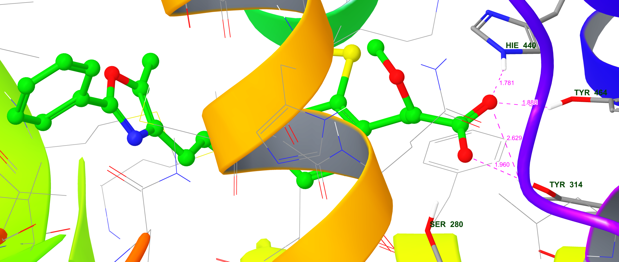
Hydrogen bonding interactions Aleglitazar with LBD of PPAR-α

Slide 25
The H-bond interaction analysis of compounds 10a-k with both PPAR-α and γ LBD domain show different patterns of H-bond interactions.
Among these the compounds 10b, 10c, 10d, 10e, 10h and 10i show exactly similar H-bond interactions as that of the full agonists, aleglitazar and rosiglitazone for PPAR-α and γ, respectively.
These molecules, therefore, may have a dual agonistic potentials.

Slide 26
ADMET-Analysis
Compound | mol MW | donorHB | accptHB | QPpolrz | QPlogPC16 | QPlogPoct | QPlogPw
10a | 355.408 | 1 | 4.5 | 36.591 | 12.444 | 16.119 | 8.779
10b | 405.467 | 1 | 4.5 | 42.797 | 14.324 | 18.351 | 9.414
10c | 434.304 | 1 | 4.5 | 38.255 | 13.189 | 16.896 | 8.548
10d | 397.488 | 1 | 4.5 | 41.802 | 13.811 | 17.727 | 8.158
10e | 397.488 | 1 | 4.5 | 41.81 | 13.803 | 17.679 | 8.103
10f | 434.85 | 1 | 5.5 | 39.676 | 14.041 | 18.407 | 9.704
10g | 439.568 | 1 | 4.5 | 45.26 | 14.245 | 19.102 | 7.75
10h | 391.389 | 1 | 4.5 | 37.159 | 11.629 | 16.551 | 8.34
10i | 452.294 | 1 | 4.5 | 38.625 | 12.788 | 17.16 | 8.36
10j | 452.294 | 1 | 4.5 | 38.651 | 12.834 | 17.191 | 8.348
10k | 452.294 | 1 | 4.5 | 38.535 | 12.782 | 17.132 | 8.329
Allowed | <500 | 0 – 6 | 2 –20 | 13–70.0 Å | 4–18 | 8–35 | 4 – 45
mol MW: Molecular weight; donorHB: Estimated number of donor hydrogen bonds; accptHB: Estimated number of acceptor hydrogen bonds; QPpolrz: Predicted polarizability in cubic angstroms; QPlogPC16: Predicted hexadecane/gas partition coefficient; QPlogPoct: Predicted octanol/gas partition coefficient; QPlogPw: Predicted water/gas partition coefficient

Slide 27
ADMET-Analysis…
Compound | QPlogPo/w | QPlogS | QPlogHERG | QPPCaco | QPlogBB | QPPMDCK
10a | 4.003 | -5.329 | -6.556 | 580.483 | -1.203 | 417.263
10b | 4.96 | -6.501 | -7.109 | 580.482 | -1.251 | 417.262
10c | 4.575 | -6.189 | -6.488 | 580.484 | -1.048 | 1107.925
10d | 5.049 | -6.501 | -6.573 | 580.488 | -1.386 | 417.267
10e | 5.05 | -6.721 | -6.699 | 580.482 | -1.429 | 417.261
10f | 3.795 | -6.132 | -6.402 | 78.444 | -2.185 | 103.664
10g | 5.63 | -6.979 | -6.038 | 580.486 | -1.341 | 417.259
10h | 4.475 | -6.062 | -6.301 | 580.482 | -0.996 | 1362.957
10i | 4.805 | -6.475 | -6.321 | 580.482 | -0.942 | 1878.126
10j | 4.822 | -6.549 | -6.356 | 580.483 | -0.945 | 1961.492
10k | 4.81 | -6.554 | -6.357 | 580.484 | -0.945 | 1999.39
Allowed | 2 – 6.5 | –6.5 – 0.5 | Concern below-5 | <25 poor, >500 great | –3 – 1.2 | <25 poor, >500 great
QPlogPo/w: Predicted octanol/water partition coefﬁcient; QPlogS: Predicted aqueous solubility, QPlogHERG: Predicted IC50 value for blockage of HERG K+ channels; QPPCaco: Predicted apparent Caco-2 cell permeability in nm/sec; QPlogBB: Predicted brain/blood partition coefﬁcient; QPPMDCK: Predicted apparent MDCK cell permeability in nm/sec.

Slide 28
ADMET-Analysis…
Compound | QPlogKp | #metab | QPlogKhsa | PercentHumanOralAbs | RuleOfFve | RuleOfThree
10a | -1.869 | 2 | 0.412 | 100 | 0 | 0
10b | -1.622 | 2 | 0.786 | 100 | 0 | 1
10c | -2.039 | 2 | 0.553 | 100 | 0 | 1
10d | -1.874 | 6 | 0.803 | 93.016 | 1 | 1
10e | -1.918 | 3 | 0.808 | 93.025 | 1 | 1
10f | -3.789 | 3 | 0.472 | 83.072 | 0 | 1
10g | -2.118 | 2 | 1.092 | 96.418 | 1 | 1
10h | -2.136 | 2 | 0.497 | 100 | 0 | 1
10i | -2.151 | 2 | 0.6 | 100 | 0 | 1
10j | -2.162 | 2 | 0.602 | 100 | 0 | 1
10k | -2.173 | 3 | 0.596 | 100 | 0 | 1
Allowed | –8 – –1.0 | 1 – 8 | –1.5 – 1.5 | <25% is poor | Max. is 4 | Max. is 3
QPlogKp: Predicted skin permeability, logKp; #metab: Number of likely metabolic reactions; QPlogKhsa: Prediction of binding to human serum albumin; PercentHumanOralAbs: Predicted human oral absorption on 0 to 100% scale; RuleOfFive: Number of violations of Lipinski’s rule of five; RuleOfThree: Number of violations of Jorgensen’s rule of three

Slide 29
Synthesis of
5-(4-(3-phenoxypropoxy)benzylidene)thiazolidine-2,4-dione derivatives

Slide 30
Scheme 1
Synthesis of (E)-5-(4-hydroxybenzylidene)thiazolidine-2,4-dione

Slide 31
  Scheme-2
  Synthesis of 3-phenoxypropan-1-ol derivatives
a: R1=H, R2=H, R3=H, R4=H, R5=H; b: R1=H, R2=H, R3=H, R4&R5=C6H5; c: R1=H, R2=H, R3=Br, R4=H, R5=H; d: R1=C3H7, R2=H, R3=H, R4=H, R5=H; e: R1=H, R2=H, R3=C3H7, R4=H, R5=H; f: R1=H, R2=NO2, R3=Cl, R4=H, R5=H; g: R1=C3H7, R2=H, R3=H, R4=H, R5=C3H7; h: R1=H, R2=F, R3=H, R4=F, R5=H; i: R1=Br, R2=H, R3=F, R4=H, R5=H; j: R1=F, R2=H, R3=Br, R4=H, R5=H; k: R1=H, R2=Br, R3=H, R4=F, R5=H

Slide 32
Scheme 3
Synthesis of (Z)-5-(4-(3-phenoxypropoxy)benzylidene)thiazolidine-2,4-dione

Slide 33
Scheme-4
Synthesis of (Z)-5-(4-(3-phenoxypropoxy)benzylidene)thiazolidine-2,4-dione

Slide 34
Scheme-5
Synthesis of 5-(4-(3-phenoxypropoxy) benzylidene) thiazolidine-2,4-dione derivatives
a: R1=H, R2=H, R3=H, R4=H, R5=H; b: R1=H, R2=H, R3=H, R4&R5=C6H5; c: R1=H, R2=H, R3=Br, R4=H, R5=H; d: R1=C3H7, R2=H, R3=H, R4=H, R5=H; e: R1=H, R2=H, R3=C3H7, R4=H, R5=H; f: R1=H, R2=NO2, R3=Cl, R4=H, R5=H; g: R1=C3H7, R2=H, R3=H, R4=H, R5=C3H7; h: R1=H, R2=F, R3=H, R4=F, R5=H; i: R1=Br, R2=H, R3=F, R4=H, R5=H; j: R1=F, R2=H, R3=Br, R4=H, R5=H; k: R1=H, R2=Br, R3=H, R4=F, R5=H

Slide 35
Details of synthesized 5-(4-(3-phenoxypropoxy)benzylidene)thiazolidine-2,4-dione derivatives
 | Name | Mol. formula | m.wt. | m.p.
10a | (Z)-5-(4-(3-phenoxypropoxy)benzylidene)thiazolidine-2,4-dione | C₁₃H₁₇NO₄S | 355.41 | 140-142˚C
10b | (Z)-5-(4-(3-(naphthalen-1-yloxy)propoxy)benzylidene)thiazolidine-2,4-dione | C₂₃H₁₉NO₄S | 405.47 | 175-177˚C
10c | (Z)-5-(4-(3-(4-bromophenoxy)propoxy)benzylidene)thiazolidine-2,4-dione | C₁₉H₁₆BrNO₄S | 434.30 | 180-182˚C
10d | (Z)-5-(4-(3-(2-propylphenoxy)propoxy)benzylidene)thiazolidine-2,4-dione | C₂₂H₂₃NO₄S | 397.49 | 153-155˚C
10e | (Z)-5-(4-(3-(4-propylphenoxy)propoxy)benzylidene)thiazolidine-2,4-dione | C₂₂H₂₃NO₄S | 397.49 | 145-147˚C
10f | (Z)-5-(4-(3-(4-chloro-3-nitrophenoxy)propoxy)benzylidene) thiazolidin e-2,4-dione | C₁₉H₁₅ClN₂O₆S | 434.85 | 163-165˚C
10g | (Z)-5-(4-(3-(2,6-diisopropylphenoxy)propoxy)benzylidene)thiazolidine-2,4-dione | C₂₅H₂₉NO₄S | 439.57 | 146-148˚C
10h | (Z)-5-(4-(3-(3,5-difluorophenoxy)propoxy)benzylidene)thiazolidine-2,4-dione | C₁₉H₁₅F₂NO₄S | 391.39 | 168-170˚C
10i | (Z)-5-(4-(3-(2-bromo-4-fluorophenoxy)propoxy)benzylidene)thiazolidine-2,4-dione | C₁₉H₁₅BrFNO₄S | 452.29 | 173-175˚C
10j | (Z)-5-(4-(3-(4-bromo-2-fluorophenoxy)propoxy)benzylidene)thiazolidine-2,4-dione | C₁₉H₁₅BrFNO₄S | 452.29 | 154-156˚C
10k | (Z)-5-(4-(3-(3-bromo-5-fluorophenoxy)propoxy)benzylidene)thiazolidine-2,4-dione | C₁₉H₁₅BrFNO₄S | 452.29 | 192-194˚C

Slide 36
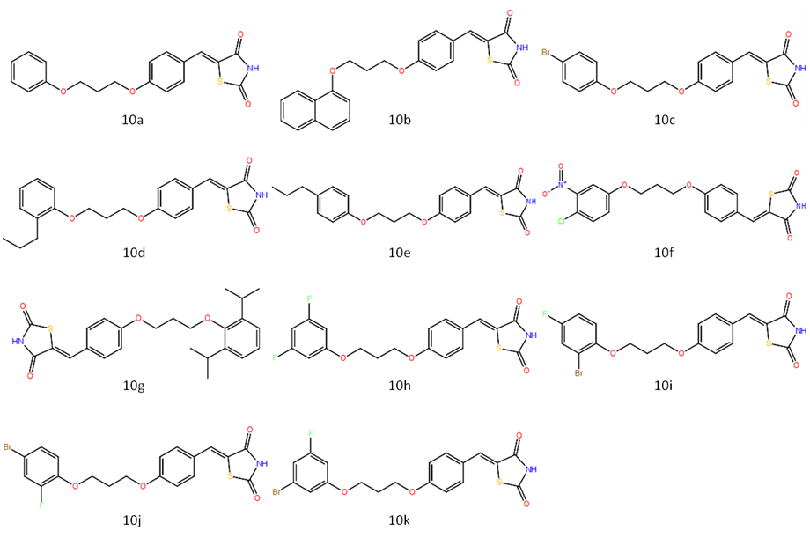
Structures of synthesized 5-(4-(3-phenoxypropoxy)benzylidene)thiazolidine-2,4-dione derivatives

Slide 37
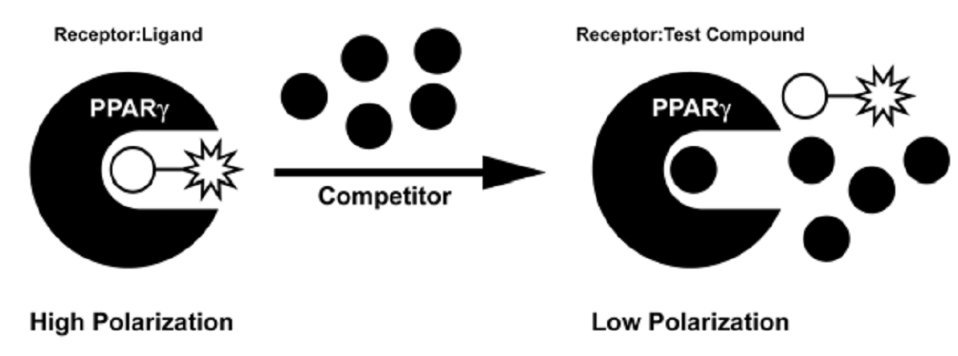
PPAR competitive binding assays
 | Test/Std | Control | Blank
Test/std sample | 20 µl | --- | ---
Fluormone™ Pan-PPAR Green | 10 μl | 10 μl | 10 μl
PPAR-γ-LBD | 10 μl | 10 μl | ---
Assay buffer | --- | 20 μl | 30 μl
The plate was incubated at room temperature for 3 h and the fluorescent emission signal of each well was recorded at 495 nm and 520 nm.
Test-500µM, Rosiglitazone-200µM; Benzafibrate-200µM

Slide 38
PPAR competitive binding assays
Compound | IC₅₀ (nM)
 | PPAR-γ | PPAR-α
10a | 460 ± 5.2 | 340 ± 2.7
10b | 320 ± 3.9 | 234 ± 3.3
10c | 380 ± 6.7 | 418 ± 8.5
10d | 465 ± 8.1 | 687 ± 7.4
10e | 483 ± 3.9 | 732 ± 9.5
10f | 1056 ± 8.1 | 1979 ± 10.6
10g | 889 ± 5.0 | 1045 ± 11.7
10h | 964 ± 6.2 | 1084 ± 9.0
10i | 850 ± 10.1 | 933 ± 7.5
10j | 704 ± 11.5 | 893 ± 11.7
10k | 2540 ± 15.9 | 1745 ± 12.4
Rosiglitazone | 140 ± 3.1 | ----
Benzafibrate | ---- | 52 ± 2.8
Values are mean ± SD, n=3.

Slide 39
Adipogenesis assay in 3T3-L1 preadipocyte
3T3-L1 preadipocytes
(Maintenance medium)
Treated with differential medium
(2 days)
Treated with progression medium
(2 days)
Treated with progression media with or without test compounds/Rosiglitazone (10 µM )
(9 days)
Cells were fixed with 10% formal buffered saline and stained with Oil Red O
Extracted with isopropanol and read at 520 nM

Slide 40
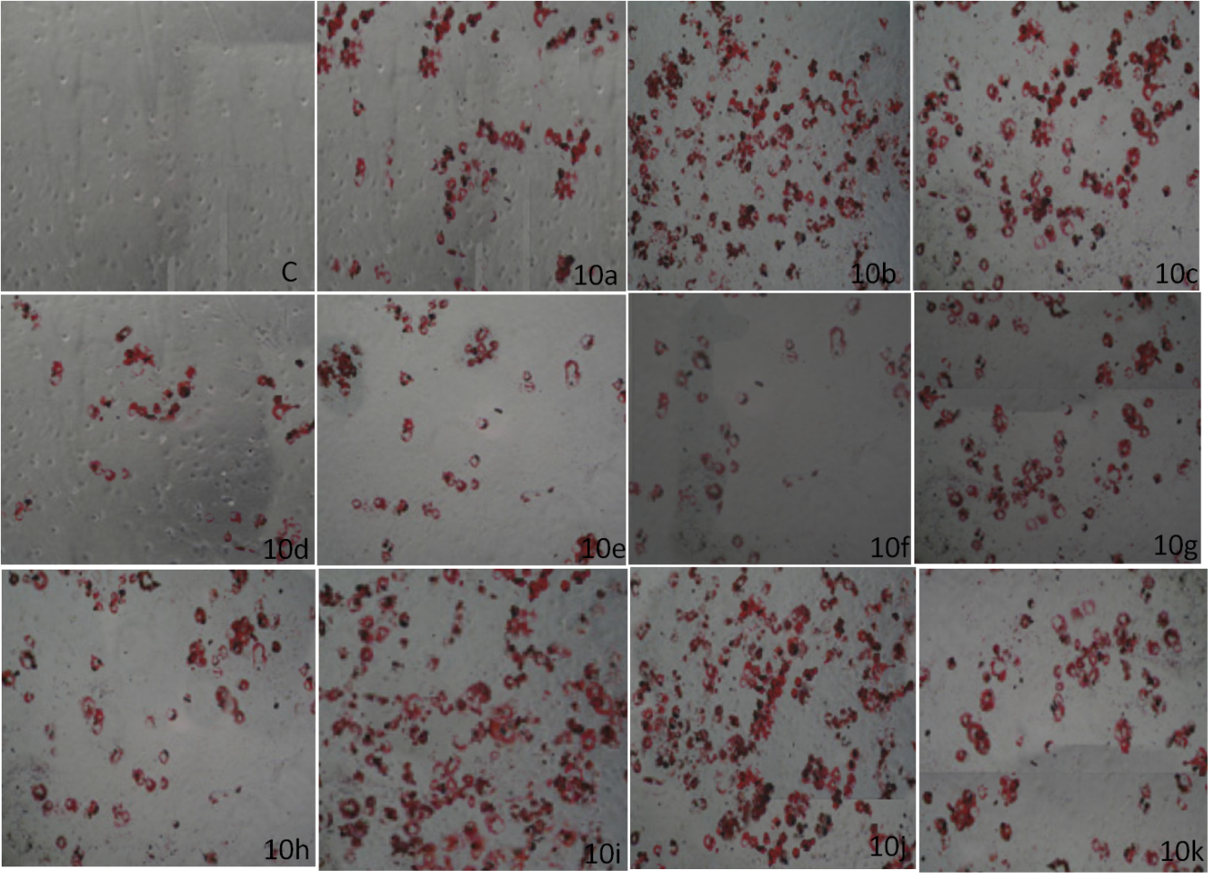
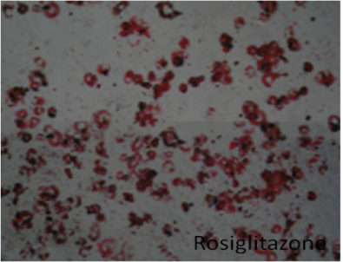
Adipogenesis assay in 3T3-L1 preadipocyte
Effect of compounds 10a-k on 3T3-L1 preadipocyte differentiation (Oil Red-O staining, 10X)

Slide 41
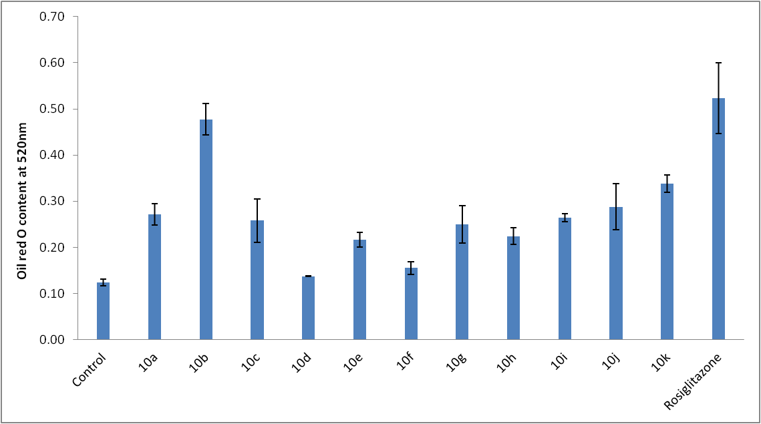
Adipogenesis assay in 3T3-L1 preadipocyte
Effect of compounds 10a-k on fat accumulation in 3T3-L1 preadipocyte

Slide 42
Acute oral toxicity study in mice
Acute oral toxicity of compound 10b was carried out as per the OECD 423.
A limit test at a dose of 2000 mg/kg, p.o., was carried out using 6 female mice (3 animals per test) per test compound
Toxicity was assessed by recording abnormal clinical signs, mortality, body weight changes, and gross necropsy changes.

Slide 43
Acute oral toxicity study in mice
Dose | Mice no | Sex | Body weight (g) |  |  |  |  | No. dead/ No. tested
 |  |  | Initial | Day 8 | Weight change (day 8 – Initial) | Day 15 | Weight change (day 15 – Initial)
Compound 10b
2000 mg/kg | M1 | F | 31 | 34 | 3 | 35 | 4 | 0/6
 | M2 | F | 30 | 32 | 2 | 33 | 3
 | M3 | F | 28 | 29 | 1 | 30 | 2
 | M4 | F | 27 | 29 | 2 | 30 | 3
 | M5 | F | 27 | 29 | 2 | 30 | 3
 | M6 | F | 28 | 31 | 3 | 31 | 3
GHS category 5 (LD₅₀ >2000mg/kg).

Slide 44
In vivo antidiabetic activity against STZ and high fat diet induced diabesity in mice
Diabesity was induced in mice by administering STZ (45 mg/kg, i.p.) and feeding with high fat diet (70% standard diet, 12% lard, 9% yolk powder, 9% plantation white sugar) for a period of 6 weeks.
Group 1: Normal (Vehicle 10 ml/kg, p.o.)
Group 2: Control (Vehicle 10 ml/kg, p.o.)
Group 3: Compound 10b (10 mg/kg,p.o.)
Group 4: Compound 10b (50 mg/kg,p.o.)
Group 5: Compound 10b (100 mg/kg,p.o.)
Group 6: Rosiglitazone (10 mg/kg,p.o.)
All the animals received their assigned treatment for a period of 1 month .
Parameters assessed: Body weight, food intake, fasting serum glucose, cholesterol, triglyceride and organ weights (Liver, kidney, heart and RPF)

Slide 45
In vivo antidiabetic activity of 10b against STZ and high fat diet induced diabesity in mice
 | Body weights (g) |  |  |  |  | Average Food intake (g/mice/day)
 | Week-0 | Week-1 | Week-2 | Week-3 | Week-4
Normal@ | 32.5 ± 1.5 | 32.8 ± 1.5 | 33.2 ± 1.5 | 33.6 ± 1.4 | 34.1 ± 1.4 | 2.95 ± 0.29
Control@ | 33.1 ± 1.0 | 33.8 ± 1.0 | 34.9 ± 0.9 | 36.0 ± 1.0# | 37.2 ± 1.0# | 4.4 ± 0.25#
10b (10 mg/kg) | 33.8 ± 0.9 | 34.5 ± 0.9 | 35.4 ± 0.8 | 36.3 ± 0.9 | 37.2 ± 0.9 | 4.16 ± 0.35
10b (50 mg/kg) | 33.3 ± 1.2 | 34.0 ± 1.3 | 34.6 ± 1.3 | 35.4 ± 1.3 | 36.1 ± 1.3 | 4.32 ± 0.24
10b (100 mg/kg) | 32.8 ± 1.4 | 33.5 ± 1.4 | 34.1 ± 1.3 | 34.7 ± 1.3 | 35.4 ± 1.3* | 4.12 ± 0.18
Rosi (10 mg/kg) | 33.9 ± 0.9 | 34.7 ± 0.9 | 35.8 ± 0.9 | 36.1 ±0.9 | 37.1 ± 0.9 | 4.32 ± 0.38
Values are mean ± SD, n=6, *: p<0.05 when compared to Group 2 (control), #: p<0.05 when compared to Group 1 (normal).Rosi: Rosiglitazone, @: treated with vehicle (10 ml/kg, p.o.).

Slide 46
Effect of 10b on serum biochemistry and organ weights of mice induced with diabesity
Group | 1: Normal | 2: Control | Group 3 | Group 4 | Group 5 | Group 6
Treatment | Vehicle 10 ml/kg, | Vehicle 10 ml/kg, | 10b 10 mg/kg | 10b 50 mg/kg | 10b 100 mg/kg | Rosi 10 mg/kg
Serum glucose (mg/dl) | 98.6 ± 7.2 | 325.6 ± 13.3# | 301.6 ± 12.9* | 265.4 ± 10.9* | 213.7 ± 13.5* | 243.1 ± 9.1*
Triglyceride (mg/dl) | 40.1 ± 5.9 | 104.2 ± 6.2# | 81.5 ± 10.4* | 84.8 ± 7.5* | 66.9 ± 9.1* | 85.6 ± 6.8*
Cholesterol (mg/dl) | 48.0 ± 7.6 | 116.0 ± 22.2# | 84.9 ± 14.2* | 73.7 ± 12.0* | 55.6 ± 8.3* | 81.6 ± 8.2*
Liver weight (g) | 1.883 ± 0.10 | 2.000 ± 0.32 | 2.167 ± 0.29 | 2.000 ± 0.27 | 2.100 ± 0.31 | 1.917 ± 0.22
Kidney weight (g) | 0.696 ± 0.06 | 0.715 ± 0.07 | 0.709 ± 0.05 | 0.671 ± 0.03 | 0.699 ± 0.04 | 0.713 ± 0.05
Heart weight (g) | 0.194 ± 0.01 | 0.197 ± 0.01 | 0.202 ± 0.02 | 0.200 ± 0.02 | 0.203 ± 0.01 | 0.194 ± 0.02
RPF weight (g) | 0.307 ± 0.01 | 0.395 ± 0.03# | 0.321 ± 0.02* | 0.349 ± 0.02* | 0.332 ± 0.02* | 0.423 ± 0.04
Values are mean ± SD, n=6, *: p<0.05 when compared to Group 2 (control), #: p<0.05 when compared to Group 1 (normal). Rosi: Rosiglitazone, RPF: Retroperitoneal fat

Slide 47
Summary and conclusion
A total of 224 glitazones were designed and subjected to docking studies against PPAR-α and γ LBD.
Based on the glide scores and synthetic considerations, a total of eleven 5-(4-(3-phenoxypropoxy)benzylidene) thiazolidine-2,4-dione derivatives (10a-k), were selected and synthesized.
In the in silico and in vitro PPAR-γ and PPAR-α binding studies the compounds 10a, 10b, 10c and 10d show good dual agonistic activity.
The adipogenesis assay results shows PPAR-γ agonistic activity for all the synthesized compounds.
Among these, compounds 10b [(Z)-5-(4-(3-(naphthalen-1-yloxy)propoxy)benzylidene)thiazolidine-2,4-dione], shows the highest concentration of fat accumulation and it was comparable to the standard, rosiglitazone.

Slide 48
Compound 10b, in the in vivo antidiabetic study at the tested oral doses of 10, 50 and 100 mg/kg, significantly reduced the STZ and high fat diet induced elevation in serum glucose, triglyceride, total cholesterol levels and retroperitoneal fat mass.
When compared to Rosiglitazone (10 mg/kg, p.o), Compound 10b, shows a significant effects on the retroperitoneal fat mass and body weight changes indicating its dual agonistic activity.
In conclusion, the present study is able to identify some potential glitazones with PPAR dual agonistic activities.

Slide 49
Thank you

Slide 50
Let Us Meet Again
We welcome you to join at 4th International Conference on Medicinal Chemistry & Computer Aided Drug Designing
November 02-04 Atlanta, USA
Please Visit:
http://medicinalchemistry.pharmaceuticalconferences.com/
Regards
Adam Benson
medchem@conferenceseries.net

