Slide 1
I always remind myself of the famous quote,
“look behind you at what you have already accomplished look up and believe that the sky is the limit look down to make sure you are on the right path look ahead and claim success in every thing you do.”

Slide 2

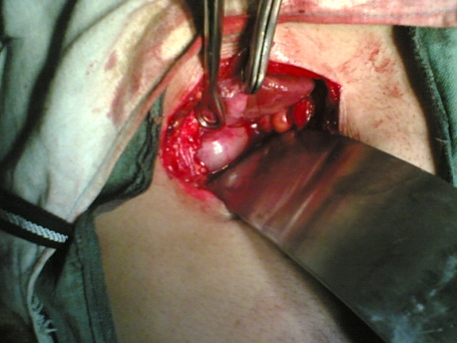
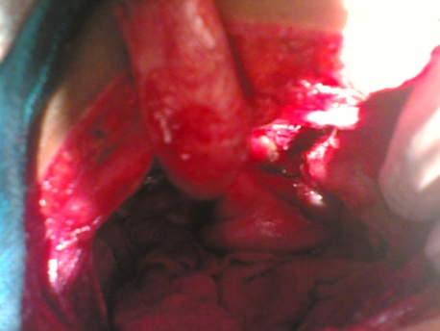
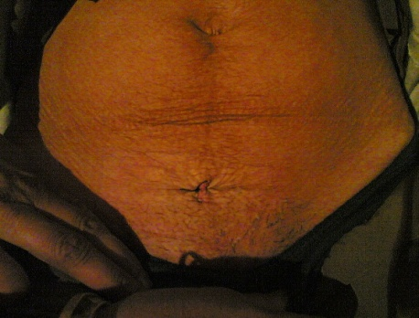
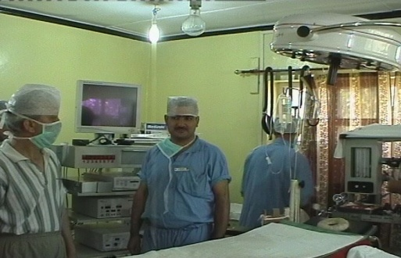
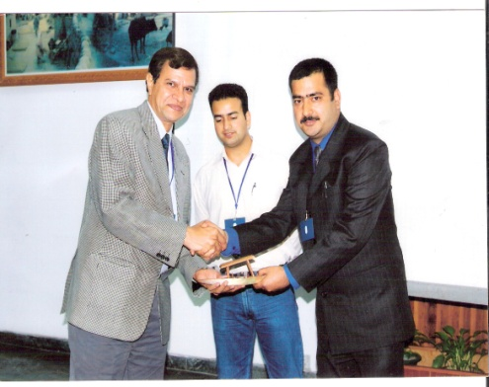
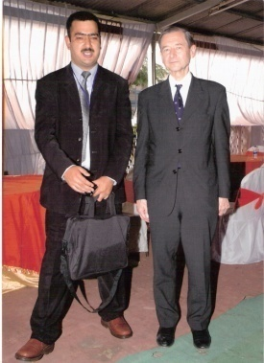
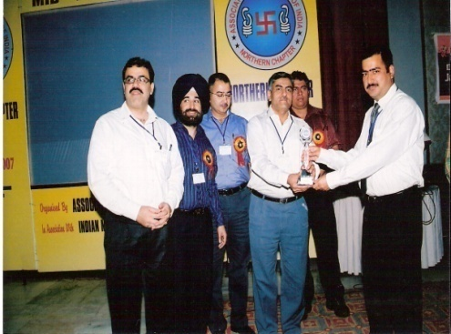
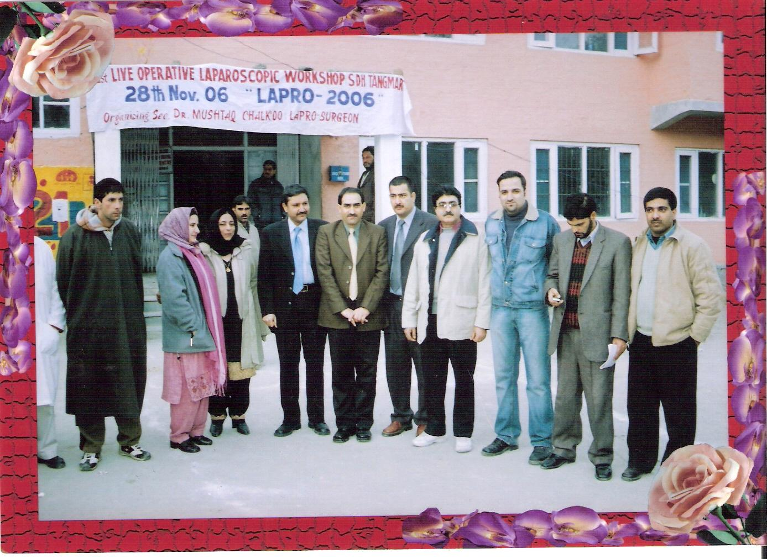
SUB DISTRICT HOSPITAL
TANGMARG-GULMARG

Slide 3
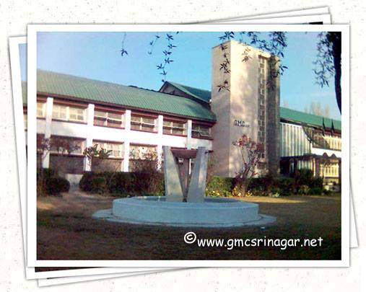
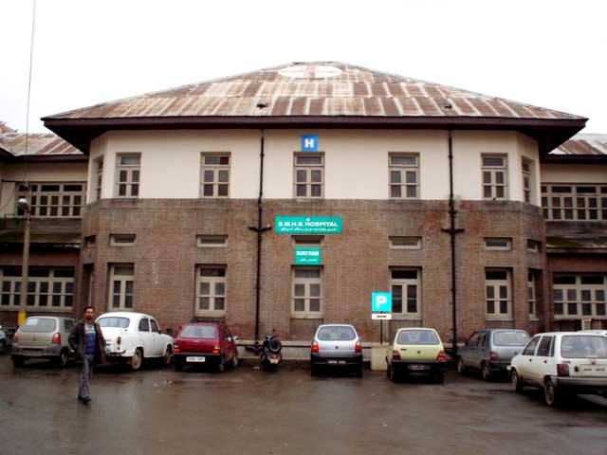
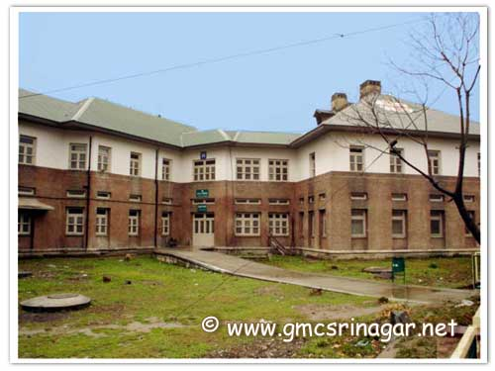
CHALKOO @ GMC SRINAGAR

Slide 4
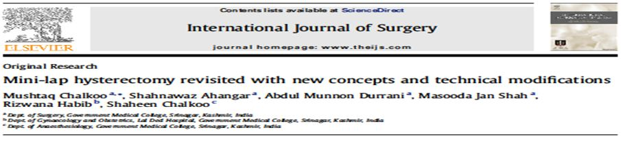
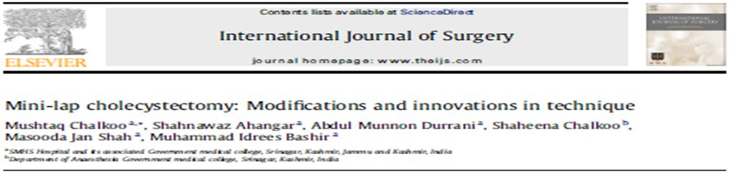

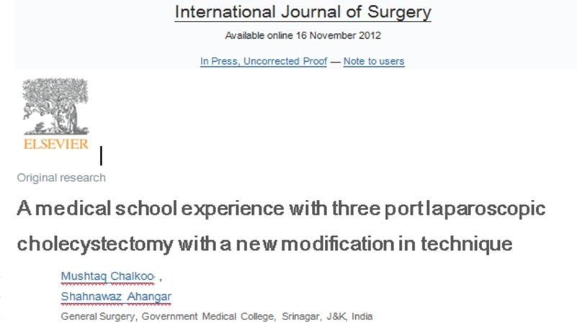


CAREER HIGHLIGHTS
RESEARCH
THE CHALKOO CONCEPTS
THE CHALKOO TECHNIQUE
DR.MUSHTAQ CHALKOO
ASSISTANT PROFESSOR
GMC SGR
WWW.MUSHTAQCHALK OO.WEBS.COM
THE CHALKOO MODIFICATION
MY XPRESSIONS
THE CHALKOO’S POINT

Slide 5
A medical school experience with three port laparoscopic cholecystectomy with a new modification in technique
“The Chalkoo’s Modification”
M. Chalkoo et al. / International Journal of Surgery xxx (2012) 1-4
Dr Mushtaq Chalkoo
SR.Consultant Laparoscopic And Minimal Access Surgeon,
Govt. Medical College, SMHS and Associated Hospitals, Srinagar.
Reviewer: IJS London.
IJS-Case reports London
Laparoscopy Faculty,Webmed Central UK
Malaysian Journal Of Surgery
Pakistani Journal of Surgery
N. American Journal of Surgery
Surgical Science

Slide 6
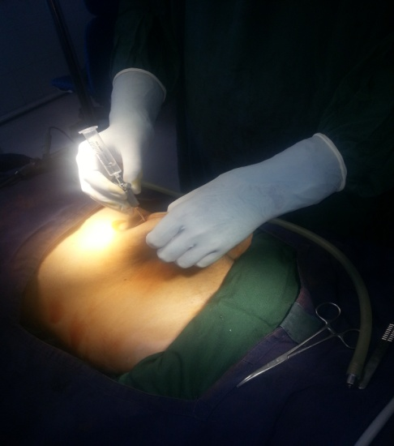
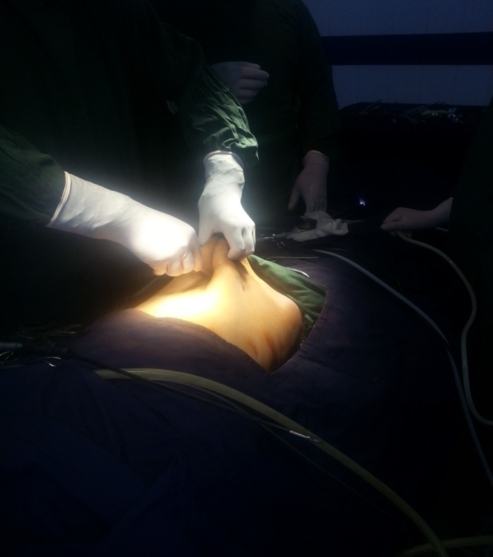
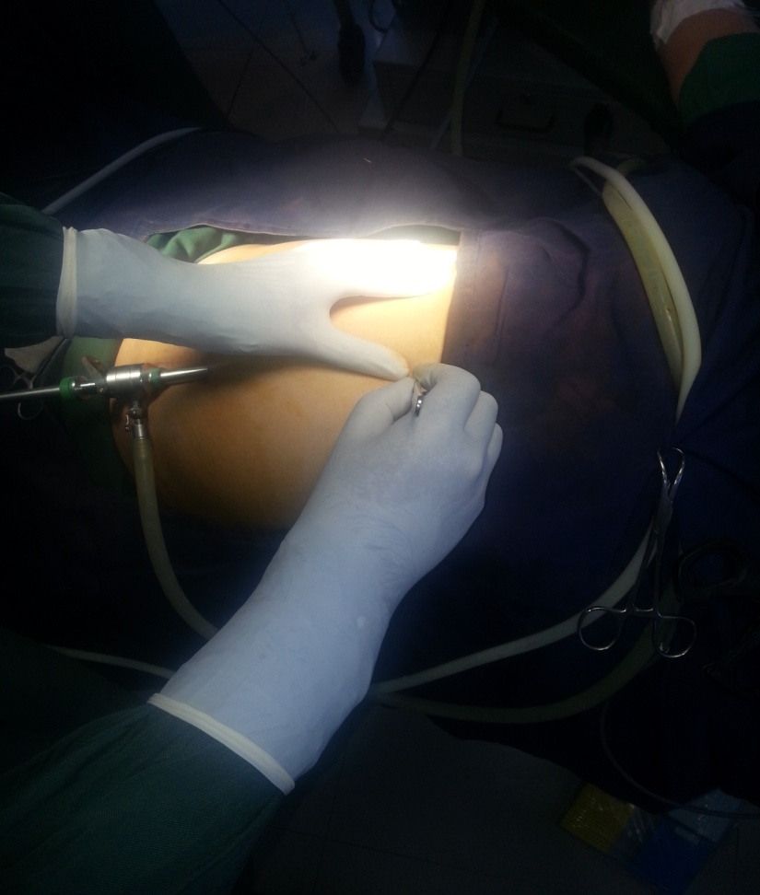
Chalkoo’s Modification For Three Port Lapchole

Slide 7
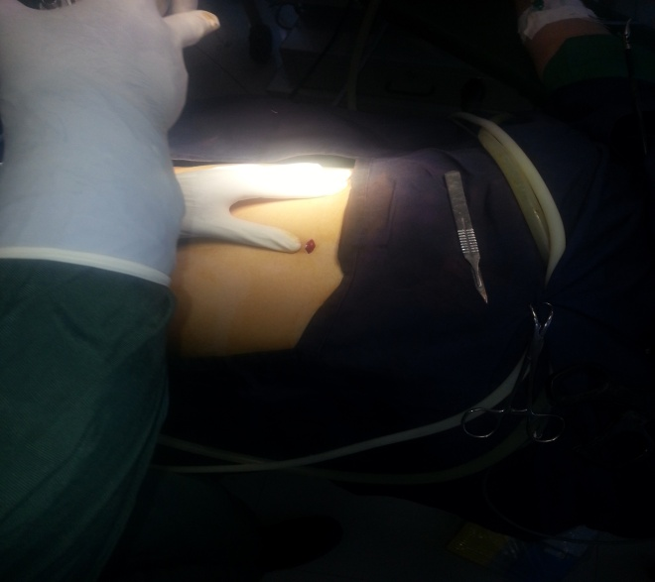
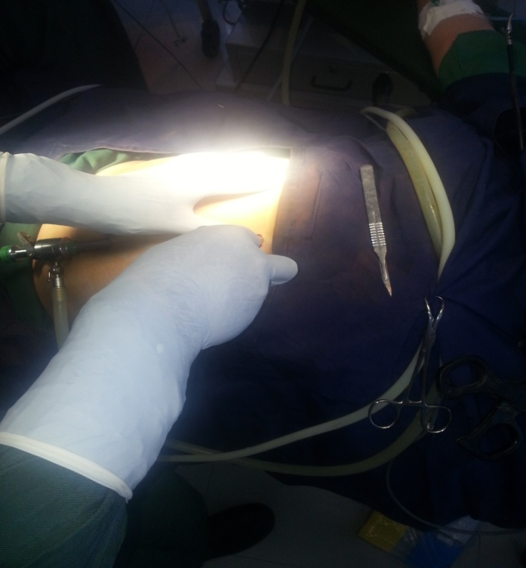
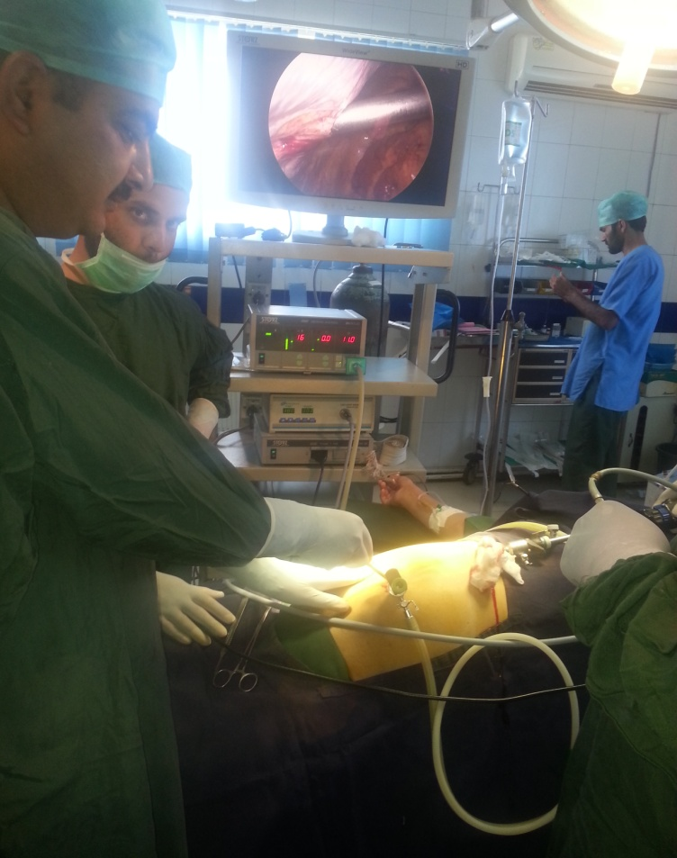
Chalkoo’s Modification For Three Port Lapchole

Slide 8
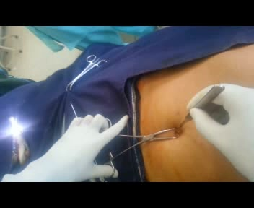
Chalkoo’s Modification For Three Port Lapchole

Slide 9

Performing your original search, indian journal of surgery,is fourth port really required for laparoscopic cholecystectomy dr mushtaq chalkoo, in PMC will retrieve 0 records.
Indian J Surg. 2010 October; 72(5): 373–376.
Published online 2010 November 18. doi: 10.1007/s12262-010-0154-9
PMCID: PMC3077134
Is Fourth Port Really Required in Laparoscopic Cholecystectomy?
Mushtaq Chalkoo, Shahnawaz Ahangar, and Abdul Munnon Durrani
Author information ► Article notes ► Copyright and License information ►
Go to:
Abstract
Since the advent of four-port laparoscopic cholecystectomy, many modifications regarding port number and size have been tried. The feasibility of three-port technique has been found comparable to the conventional four-port laparoscopic cholecystectomy. To assess the feasibility and safety of three-port laparoscopic cholecystectomy in a prospective study. Between March 2007 and March 2009, fifty patients with cholelithiasis aged between 15 and 56 years underwent three-port cholecystectomy in a prospective study in Government medical college, Srinagar.

Slide 10
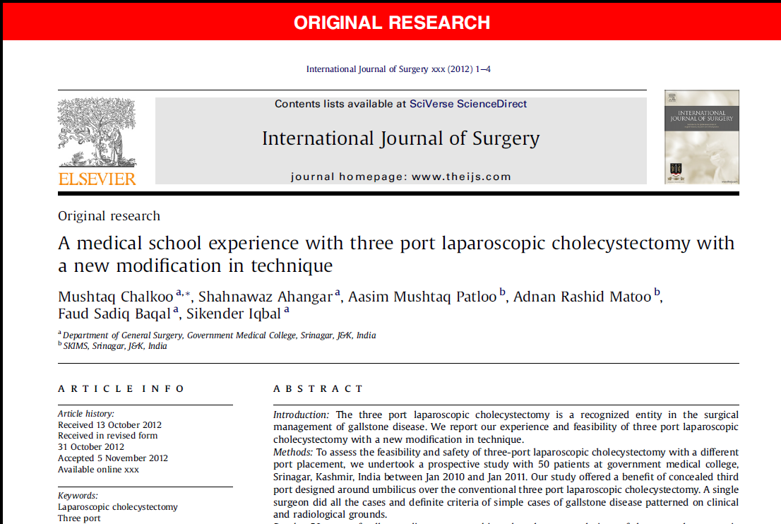

Slide 11
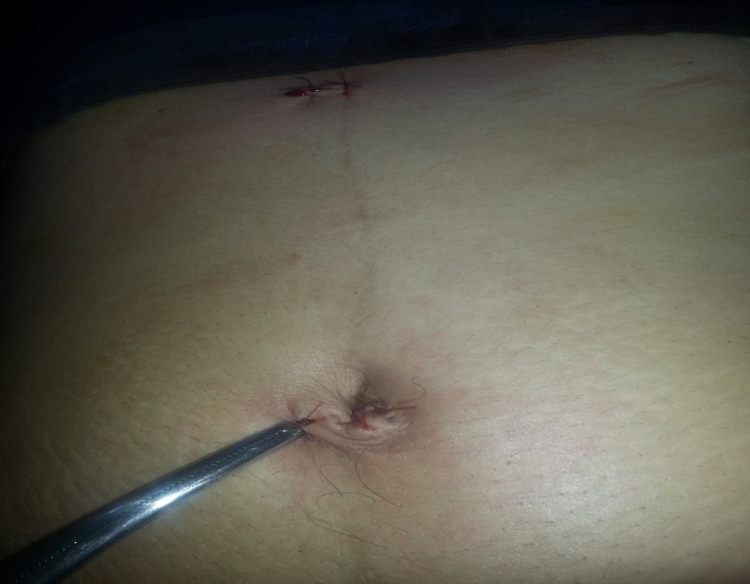
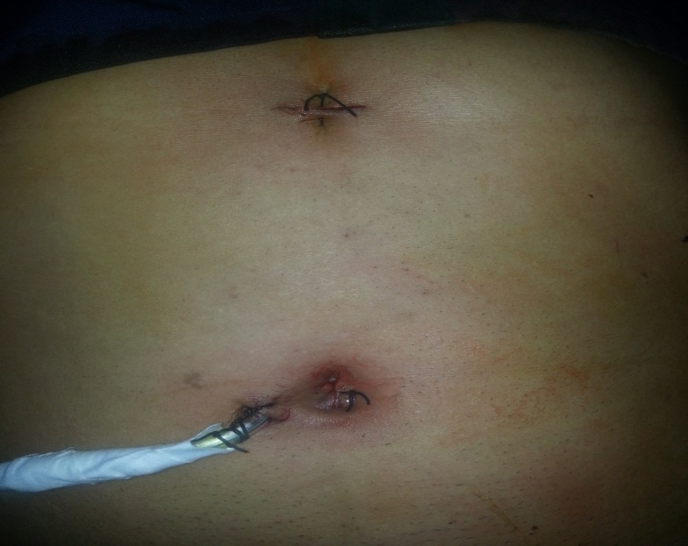
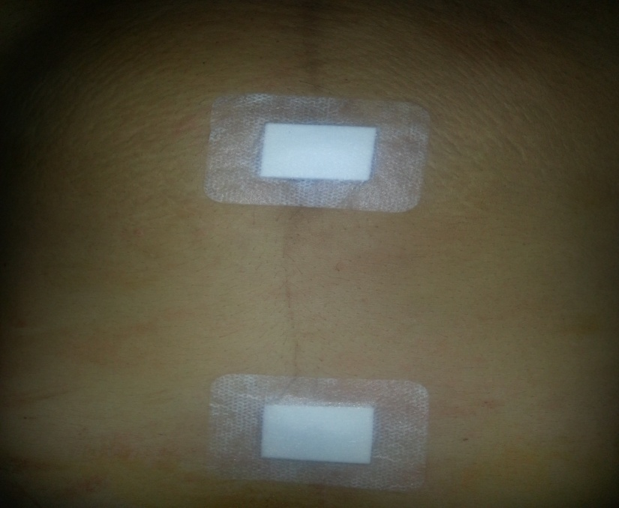
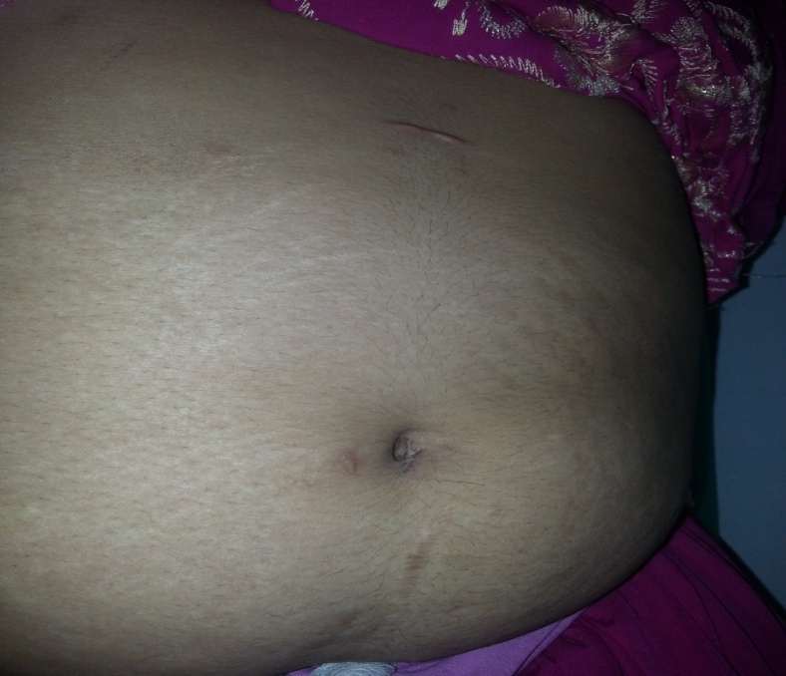
Chalkoo’s Modification For Three Port Lapchole

Slide 12
A Book on Life
Thanks

