Slide 1



INGUINAL HERNIA REPAIR WITH LOCAL
ANESTHESIA IN THE OUTPATIENT, BEING SAFE,
EFFECTIVE, EASY TO PERFORM, YET HAVING A LOWER COST
Flavio Antonio de Sá Ribeiro
flavioasribeiro@bol.com.br

Slide 2
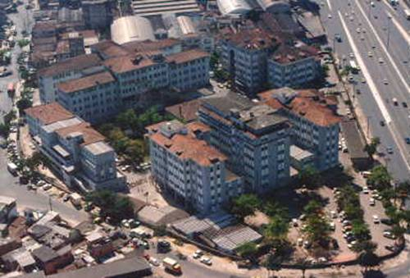
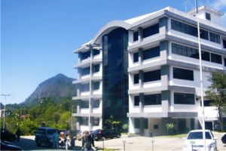

Slide 3


Inguinal hernia repair with local anesthesia in the outpatient
Eliane Mansur, surgeon from brazil, Batangafo, República Centro Africana, 08 de março de 2007.
“Foi realizada uma avaliação inicial das patologias cirúrgicas mais freqüentes, sendo identificado uma alta prevalência e incidência de hérnia inguinal (HI) e de prolapso uterino, e/ou fístula vesico-vaginal.”

Slide 4
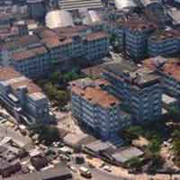
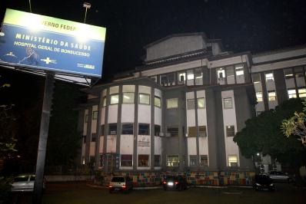
Inguinal hernia repair with local anesthesia in the outpatient

Slide 5
Inguinal hernia repair with local anesthesia in the outpatient
November 2004 to march 2013
1042 patients – all local anesthesia
651 right
363 left
28 bilateral
96% male
4% female
Age – 16 to 68 (median 35)
Lichtenstein surgery
Huskisson pain scale
Residents (first and second year) do the surgery
Junior or senior staff supervision
Anesthesist in surgery center but not in the room
Oximetry, cardiac monitor, arterial pressure non invasive

Slide 6
Inguinal hernia repair with local anesthesia in the outpatient
ASA < = II
< 70 years old
BMI < 30kg/m2
Patient’s refusal
Psychiatric disorder
Irreducible or recurrent hernia
All patients underwent elective surgery

Slide 7
Inguinal hernia repair with local anesthesia in the outpatient
Midazolam 10 to 1 mg
Tenoxican 20 mg
Meperidine 100mg
Cefazoline 1g
Local Anesthesia
Ropivacaine 0,75% 20ml
Lidocaine 2% 20ml
Adrenalina 0,1% 0,4ml
H2O 30ml

Slide 8
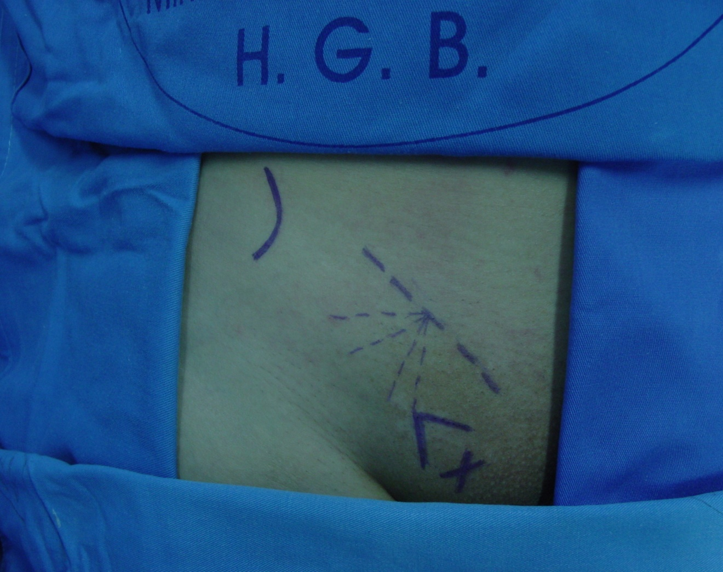
Inguinal hernia repair with local anesthesia in the outpatient
10 ml
Esp.IASup
5 ml
5 ml
5 ml

Slide 9
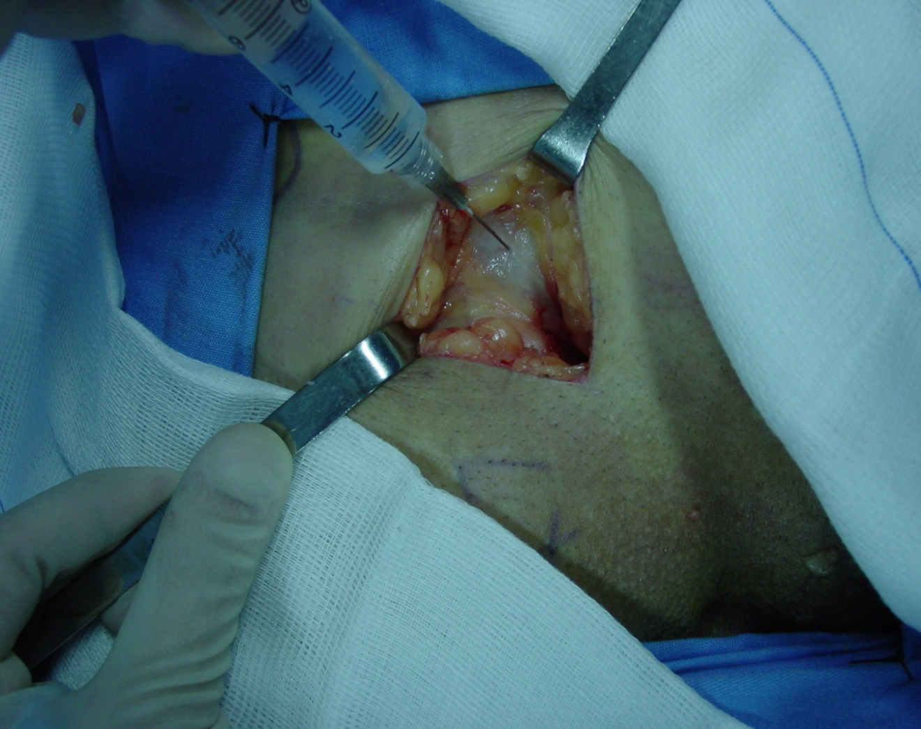
Inguinal hernia repair with local anesthesia in the outpatient
Ap. O Ext
5 ml

Slide 10
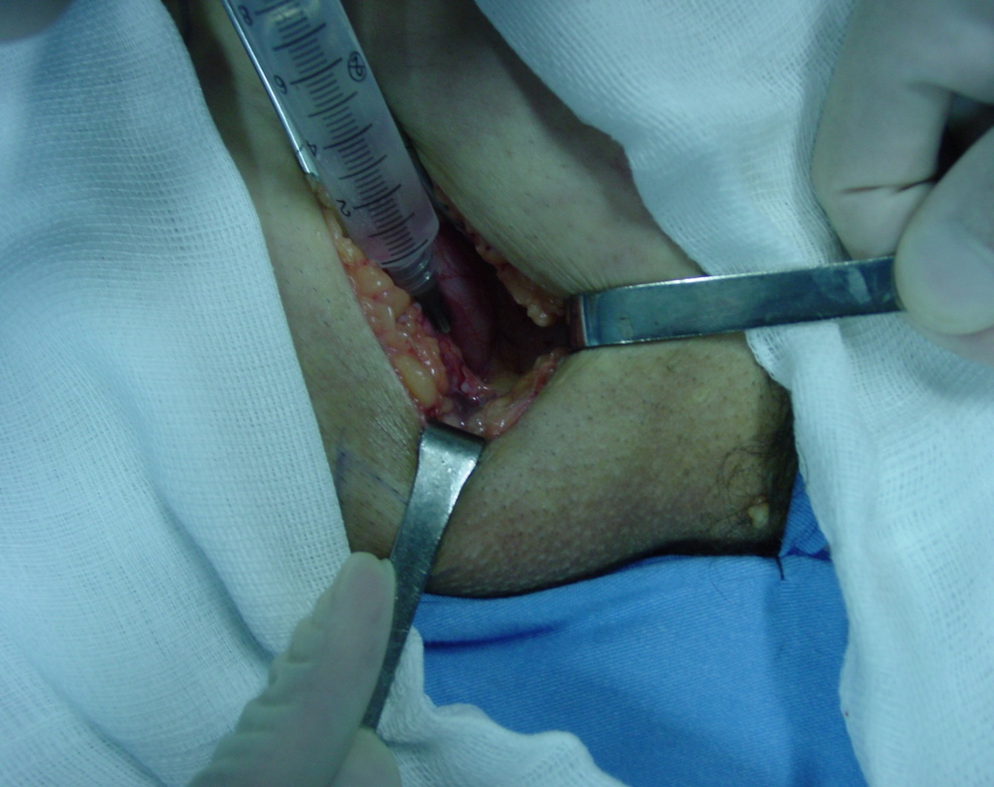
Inguinal hernia repair with local anesthesia in the outpatient
Púbis
5 ml

Slide 11
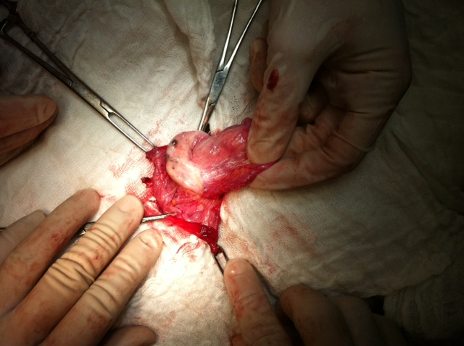

Slide 12
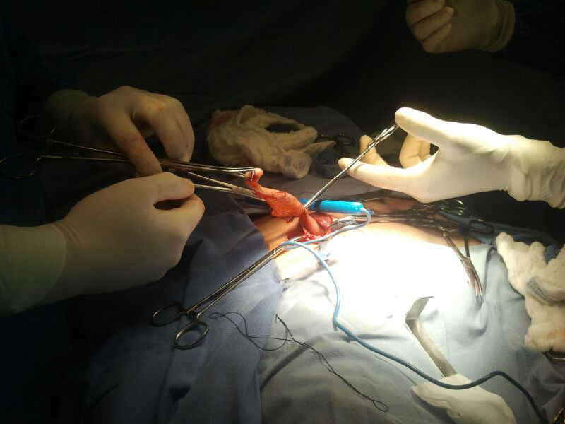

Slide 13
Inguinal hernia repair with local anesthesia in the outpatient
Results:
All Operations were Completed successfully
No case there was need to change the anesthesic method
Surgical time equal
No cases of drugs adverse efects
No need for hospital admissions

Slide 14
Inguinal hernia repair with local anesthesia in the outpatient
Huskisson pain scale:
1 – no pain
10 – severe pain
972 patients - no pain
70 patients have related pain
Grade 2 - 47 patients
Grade 3 - 11 patients
Grade 4 - 8 patients
Grade 6 - 4 patients

Slide 15
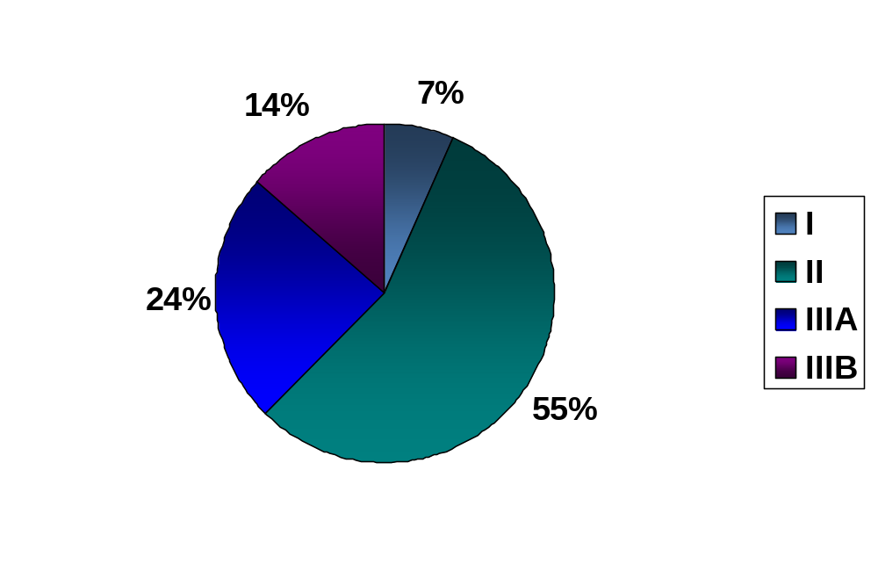
Inguinal hernia repair with local anesthesia in the outpatient
Nyhus

Slide 16

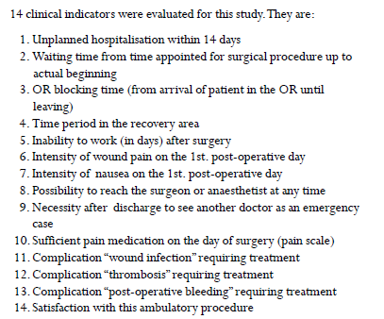


Slide 17
Inguinal hernia repair with local anesthesia in the outpatient
All outpatients
Oral analgesics for 04 days
No pain complains for more 96%
Satisfaction 100%
Work after 2 to 14 days
Drive after 15 days
Walk after 30 days
Exercises after 3 months

Slide 18
Inguinal hernia repair with local anesthesia in the outpatient
No more waiting list
Femural hernia, umbilical hernia, epigastric hernia, pilonical cist in the same programe –no waiting list also

Slide 19
Resultados
RJ Patients
HFB Patients
Total: 5.451 Patients
Total: 1042 Patients

Slide 20
Results
Hospitalizationg Average time/RJ
Dias
Average time/RJ: 2,2 days
Average Time/HFB: 6 hours

Slide 21
Results
Sirurgycal Complications/HFB
Hernial Site/HFB

Slide 22
Results
Valor Total: R$ 2.677.244,26

Slide 23
Results
Valor serviços: R$ 1.850.857,19
(69% do valor total)

Slide 24
Results
Valor médio internação:R$ 491,15

Slide 25
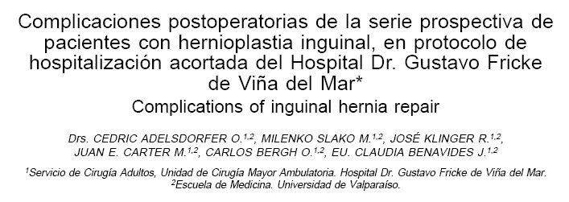
Inguinal hernia repair with local anesthesia in the outpatient

Slide 26
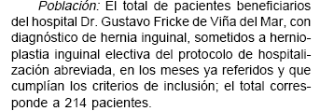
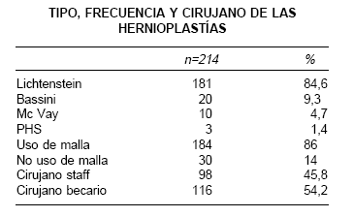
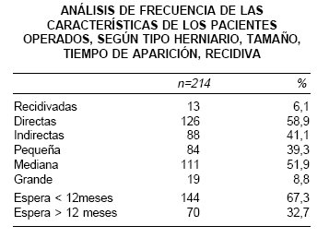
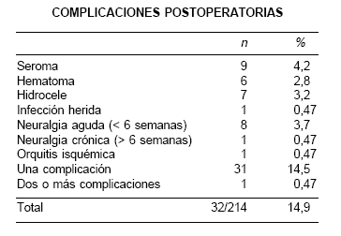
Inguinal hernia repair with local anesthesia in the outpatient

Slide 27

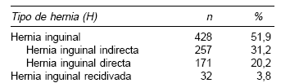
Inguinal hernia repair with local anesthesia in the outpatient

Slide 28

Inguinal hernia repair with local anesthesia in the outpatient

Slide 29
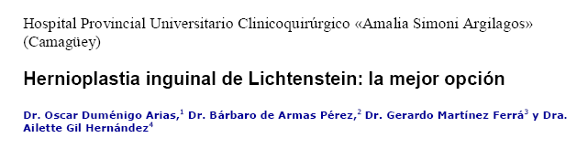
Inguinal hernia repair with local anesthesia in the outpatient

Slide 30
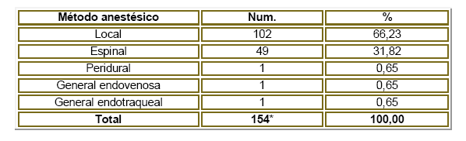
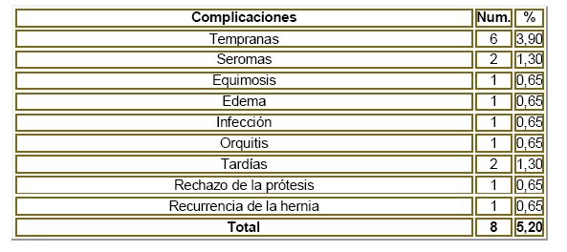
Inguinal hernia repair with local anesthesia in the outpatient

Slide 31



Inguinal hernia repair with local anesthesia in the outpatient

Slide 32
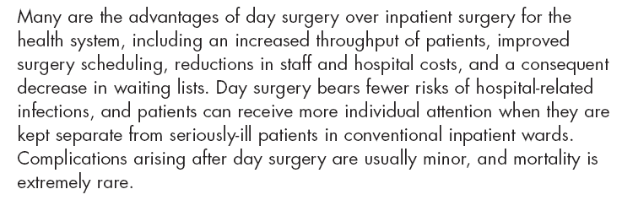
Inguinal hernia repair with local anesthesia in the outpatient

Slide 33
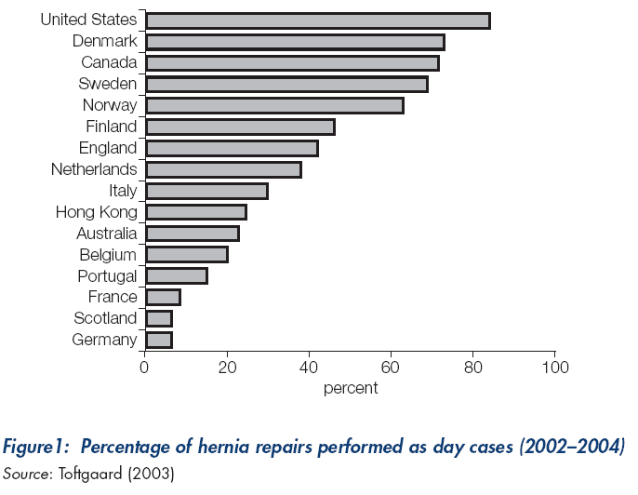

Slide 34
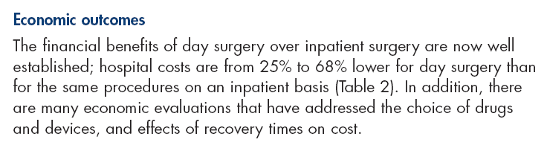
Inguinal hernia repair with local anesthesia in the outpatient

Slide 35

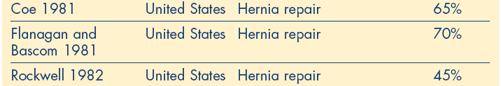
Inguinal hernia repair with local anesthesia in the outpatient

Slide 36
Inguinal hernia repair with local anesthesia in the outpatient
Savings in outpatient cost in HFB with local anesthesia only:
75 to 85%

Slide 37
Inguinal hernia repair with local anesthesia in the outpatient
Conclusion:
Safety with local anesthesia
Quick to mobilize the patient
Easy to learn and to do
Easy to reproduce
Cheaper

Slide 38



