Slide 1
About Omics Group
OMICS Group International through its Open Access Initiative is committed to make genuine and reliable contributions to the scientific community. OMICS Group hosts over 400 leading-edge peer reviewed Open Access Journals and organize over 300 International Conferences annually all over the world. OMICS Publishing Group journals have over 3 million readers and the fame and success of the same can be attributed to the strong editorial board which contains over 30000 eminent personalities that ensure a rapid, quality and quick review process.

Slide 2
About Omics Group conferences
OMICS Group signed an agreement with more than 1000 International Societies to make healthcare information Open Access. OMICS Group Conferences make the perfect platform for global networking as it brings together renowned speakers and scientists across the globe to a most exciting and memorable scientific event filled with much enlightening interactive sessions, world class exhibitions and poster presentations
Omics group has organised 500 conferences, workshops and national symposium across the major cities including SanFrancisco,Omaha,Orlado,Rayleigh,SantaClara,Chicago,Philadelphia,Unitedkingdom,Baltimore,SanAntanio,Dubai,Hyderabad,Bangaluru and Mumbai.

Slide 3
Methods of attachment for single crystal silicon (SCSi)
Douglas R. McCarter
McCarter Machine ,Inc. dba
McCarter Technology, Inc.
Laporte Texas
www.mccarteret.com
Lasers, Optics & Photonics
October 7-9, 2013
Notes:
I would like to thank Dr. Pheffer from Munich Germany that recommend that I join the OMICS Group. Dr. Pheffer is the Editor-in-Chief of AOT, a new journal that I am on the editorial board.

Slide 4
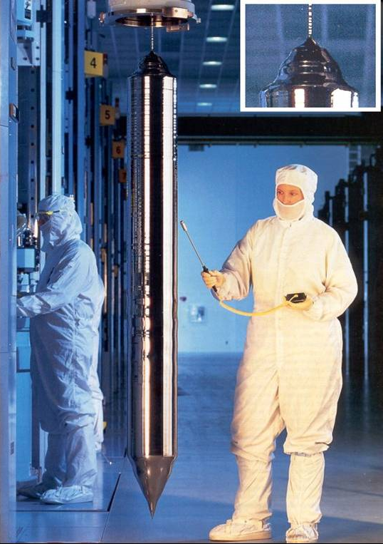
Background
SCSi is a Brittle Material
  Keep in compression
How to attach?
  Direct bonding
  Threaded inserts
Required Bond Properties
  Minimum induced stress/strain
  CTE close to SCSi
  Thermal stability over large ΔT
  Very low outgassing
  Bond strength ≥ SCSi strength
  High creep strength
  Production repeatability
  Low cost
Notes:
Because single xtal Si is a brittle material, it is essential to make sure attachments load the Si in compression
Direct bonding is possible, but threaded inserts are the best way
Bonding materials and methods are required to have the properties listed

Slide 5
Inserts
Threaded Inserts Required for Attachments
  Best match is Fe/39Ni
    CTE close over wide temperature range
  How to bond?
    Frit most widely used
      Extensive testing
        Mechanical
        Thermal
    Polymers
      Subject to creep
      Outgassing
    No solder heritage
Frit Bonded Application
Silicon Substrate with Threaded Insert
Metal Substructure
Notes:
Since Si can’t be tapped without leaving damage, bonded in threaded inserts are used. The material used is Invar 39. It has a good thermal expansion match in the range of -80°C to +300°C.
Possible bond methods:
- Frit: McCarter experience - Mech, Therm, vibe testing. Also many cooled mirrors
- Polymers - Cheap, but large CTE mismatch, creep, outgassing
- Solders used for semiconductors but brittle interface and diffusion requires multilayer barriers But no heritage here

Slide 6
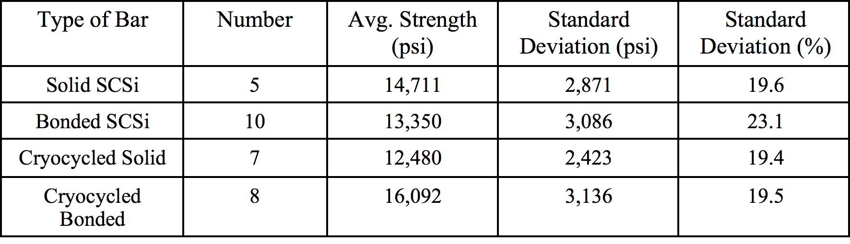
McCarter Bonding History
Notes:
Si to Si frit bond 4-point bend test showed bond strength comparable to Si strength - both improved slightly after cryo exposure
Bonded inserts with slight taper were tested by pushing on the bigger end of the insert to keep the Si in compression. Fracture was typically in the Si and average load was ~350 lbs
The frits are McCarter proprietary. The 3 shown have different bonding temperatures but all have excellent CTE match to Si

Slide 7
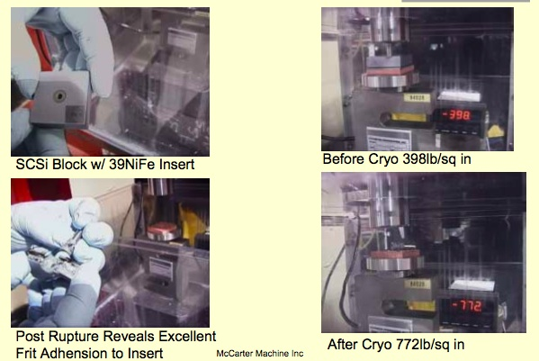
Frit Bond Strength After Cryogenic Dip
Notes:
As with Si to Si bonds, strength improves after cryo exposure
Illustrated breaking loads are not necessarily typical

Slide 8
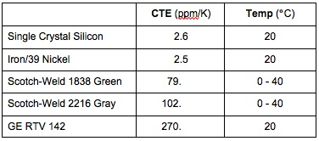
Polymers
Primarily Epoxies
  Scotch-Weld EC-2216 gray - most common
  Scotch-Weld 1838 green - lower CTE
  Others available
Silicones
  GE RTV 142
Polymer Bond Issues
  Creep
  High CTE
  Bond-line thickness control
  Component placement control
Polymer Bonds Rejected
Notes:
It’s clear that there is great mismatch between CTE’s of Si & polymers. Increasing bond thickness to allow some resilience only increases chance for creep
Assembly is not easily repeatable due to difficulty in control of adhesive placement.

Slide 9
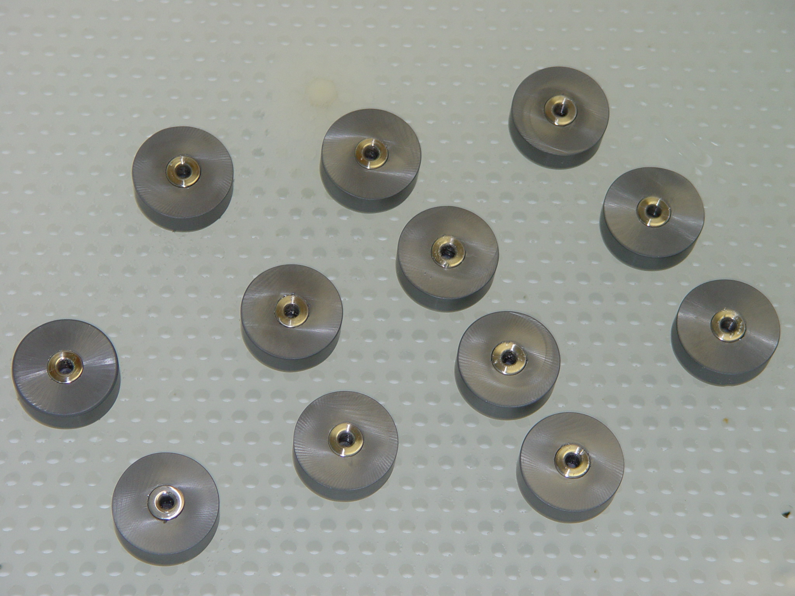
Methods of Attachment Plan
Tests Performed After Bonding
  Helium tightness at 8psi under water
  Push test to fracture
Designations
  MoA-A
    Ti film on insert
    GK frit
  MoA-B
    Ti/Ni/Au film on both
    Direct Bond
  MoA-C
    Ti/Ni/Au film + GK frit on insert
    GC frit on SCSi
  MoA-D
    Ti/Ni/Au film on both
    80Au/20Sn solder
MoA Samples
(Fit check of Insert to Silicon)
3 of each
Notes:
Same configuration for 4 different bonding methods. Three specimens of each type
1st test - He leak test with specimen under water & 8 psi He
2nd test - push test as before
The thin films are designed to be barriers to diffusion. Gold diffuses readily into Si and forms a brittle intermetallic phase, but gold is the easiest to solder.

Slide 10
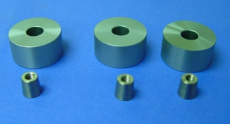
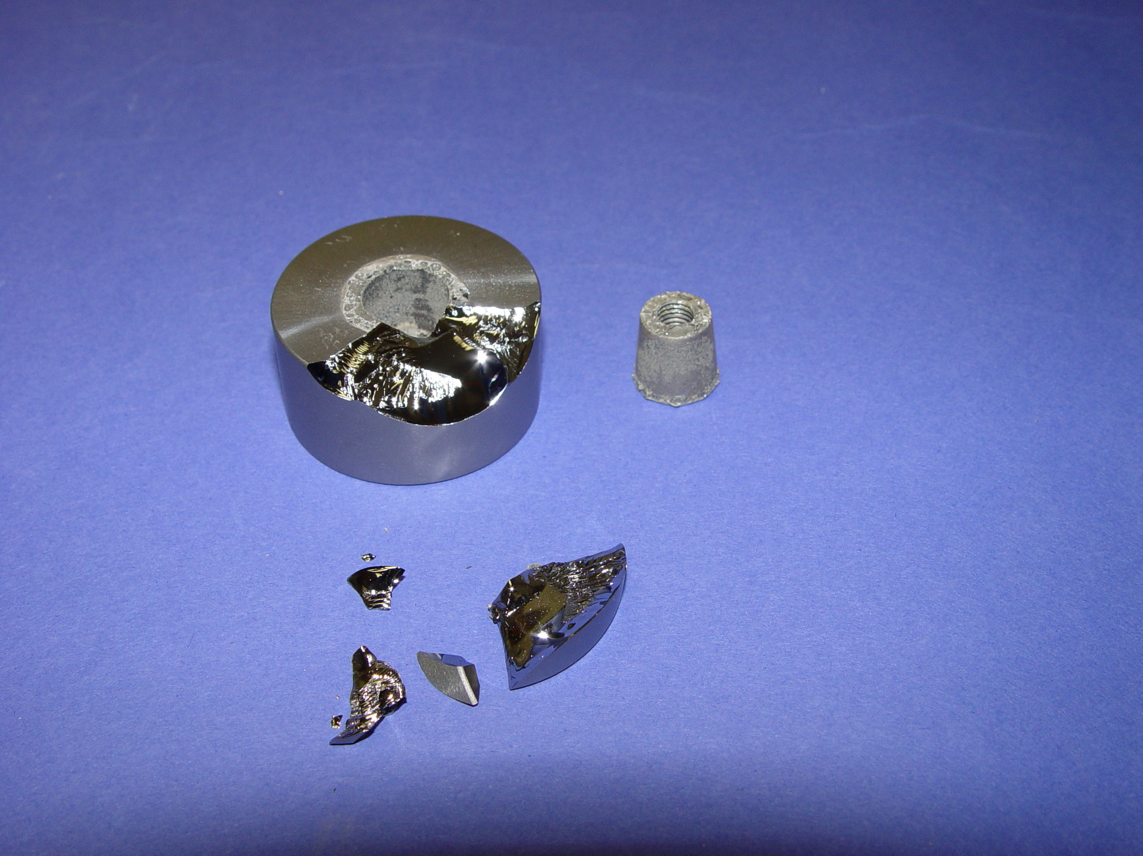
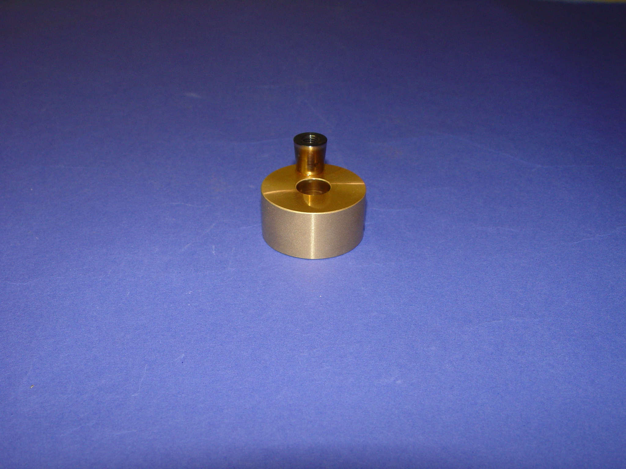
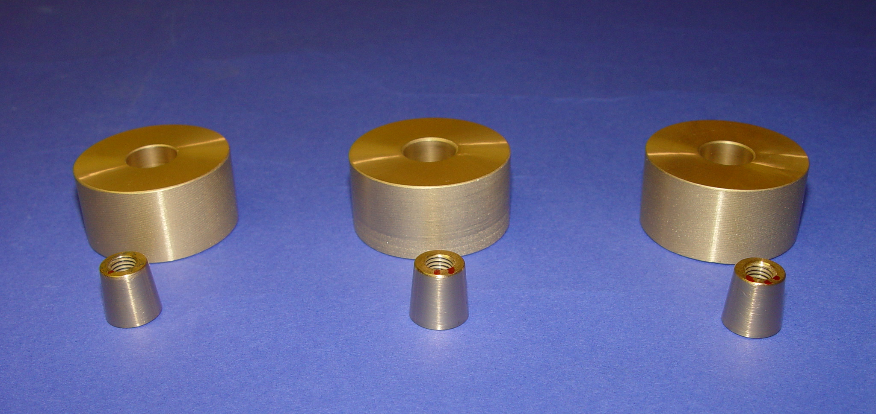
Results - A/B
MoA-A - Titanium/Frit Bond
  Breaking load/He sealing similar to prior
    350 pounds
    Not completely sealed
MoA-B - Au Film Solder Bond
  3 failures
    2 separated in sealing test @ 8 psi
    Third failed in push test setup
MoA-A
MoA-A After Push Test
MoA-B
MoA-B After
Notes:
A - In every way just like prior testing with no advantage gained by the Ti film
B - Little or no bonding

Slide 11
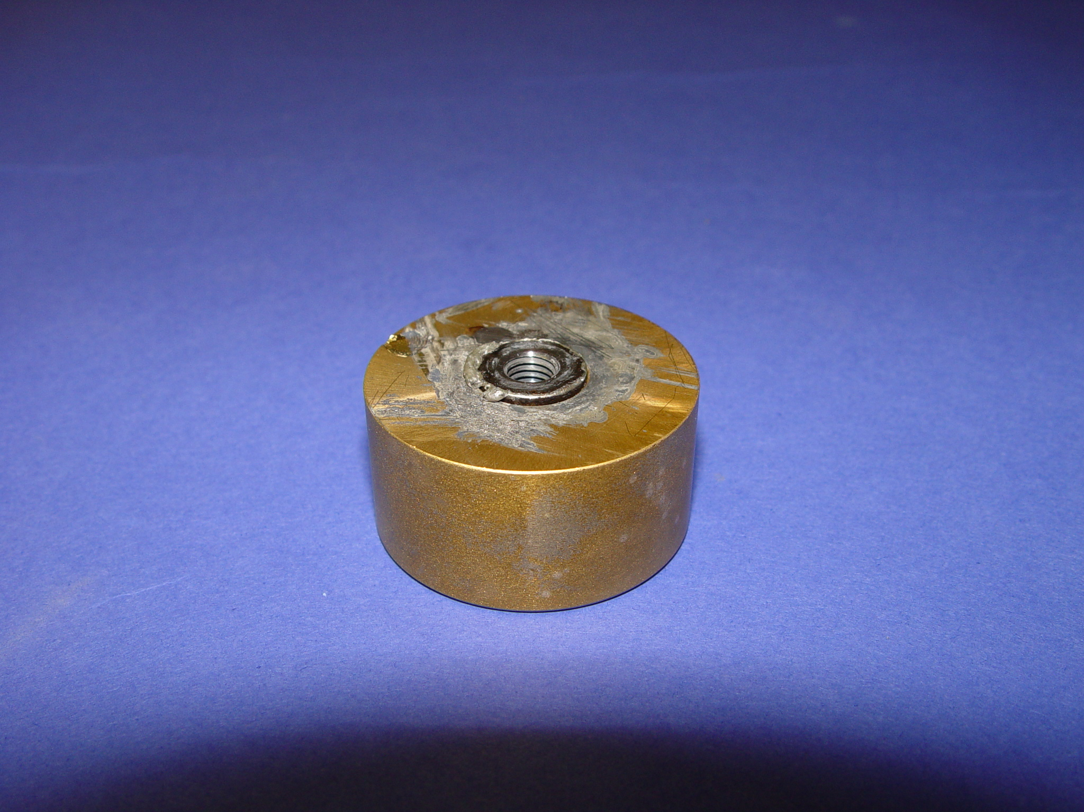
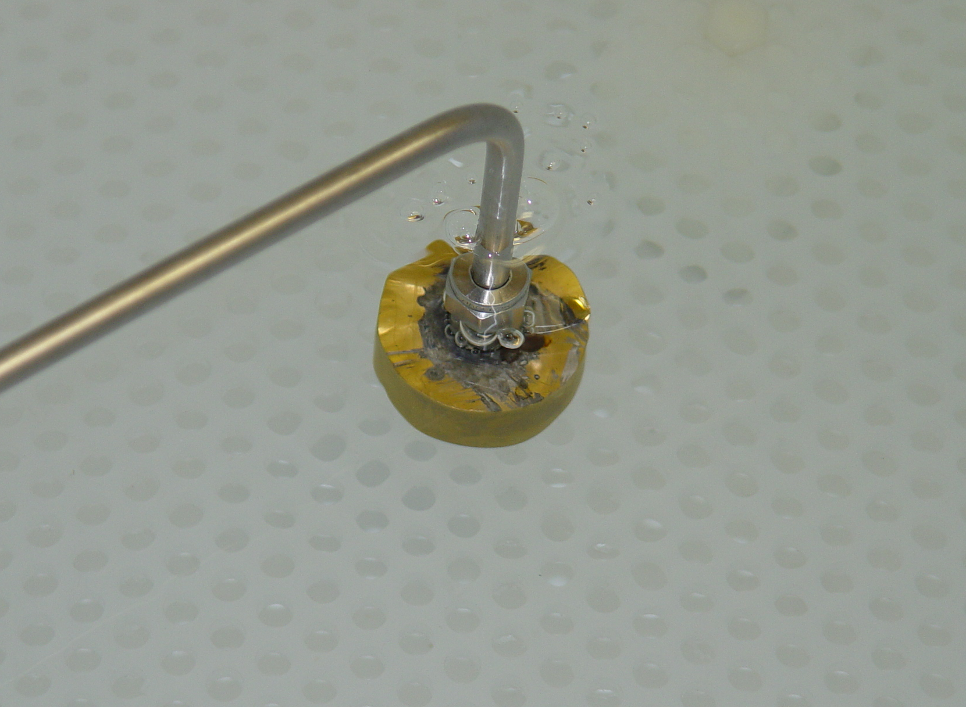
Results - D
MoA-D - 80Au/20Sn Solder Bond
  Complete failure
MoA-D After Solder
MoA-D Sample
MoA-D Testing 8psi
Notes:
Vendor had great difficulty with the one specimen and returned the other two without attempting to solder

Slide 12
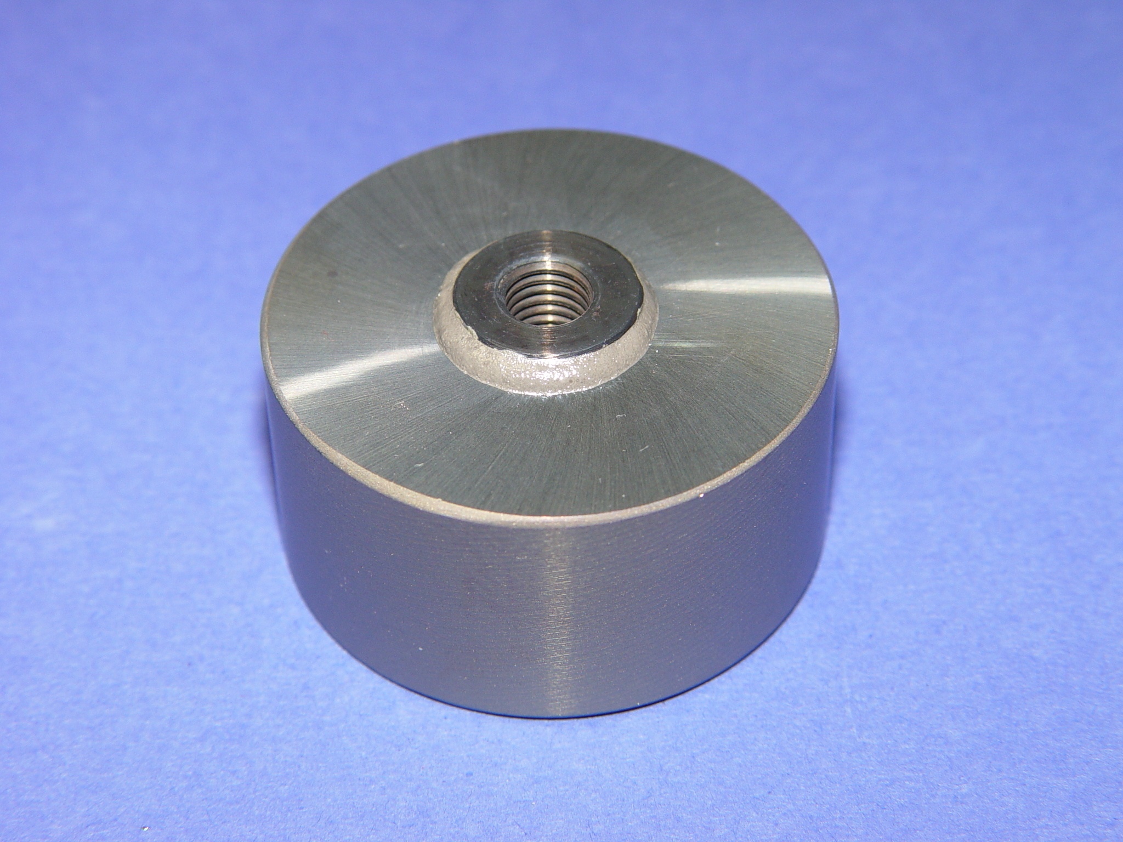
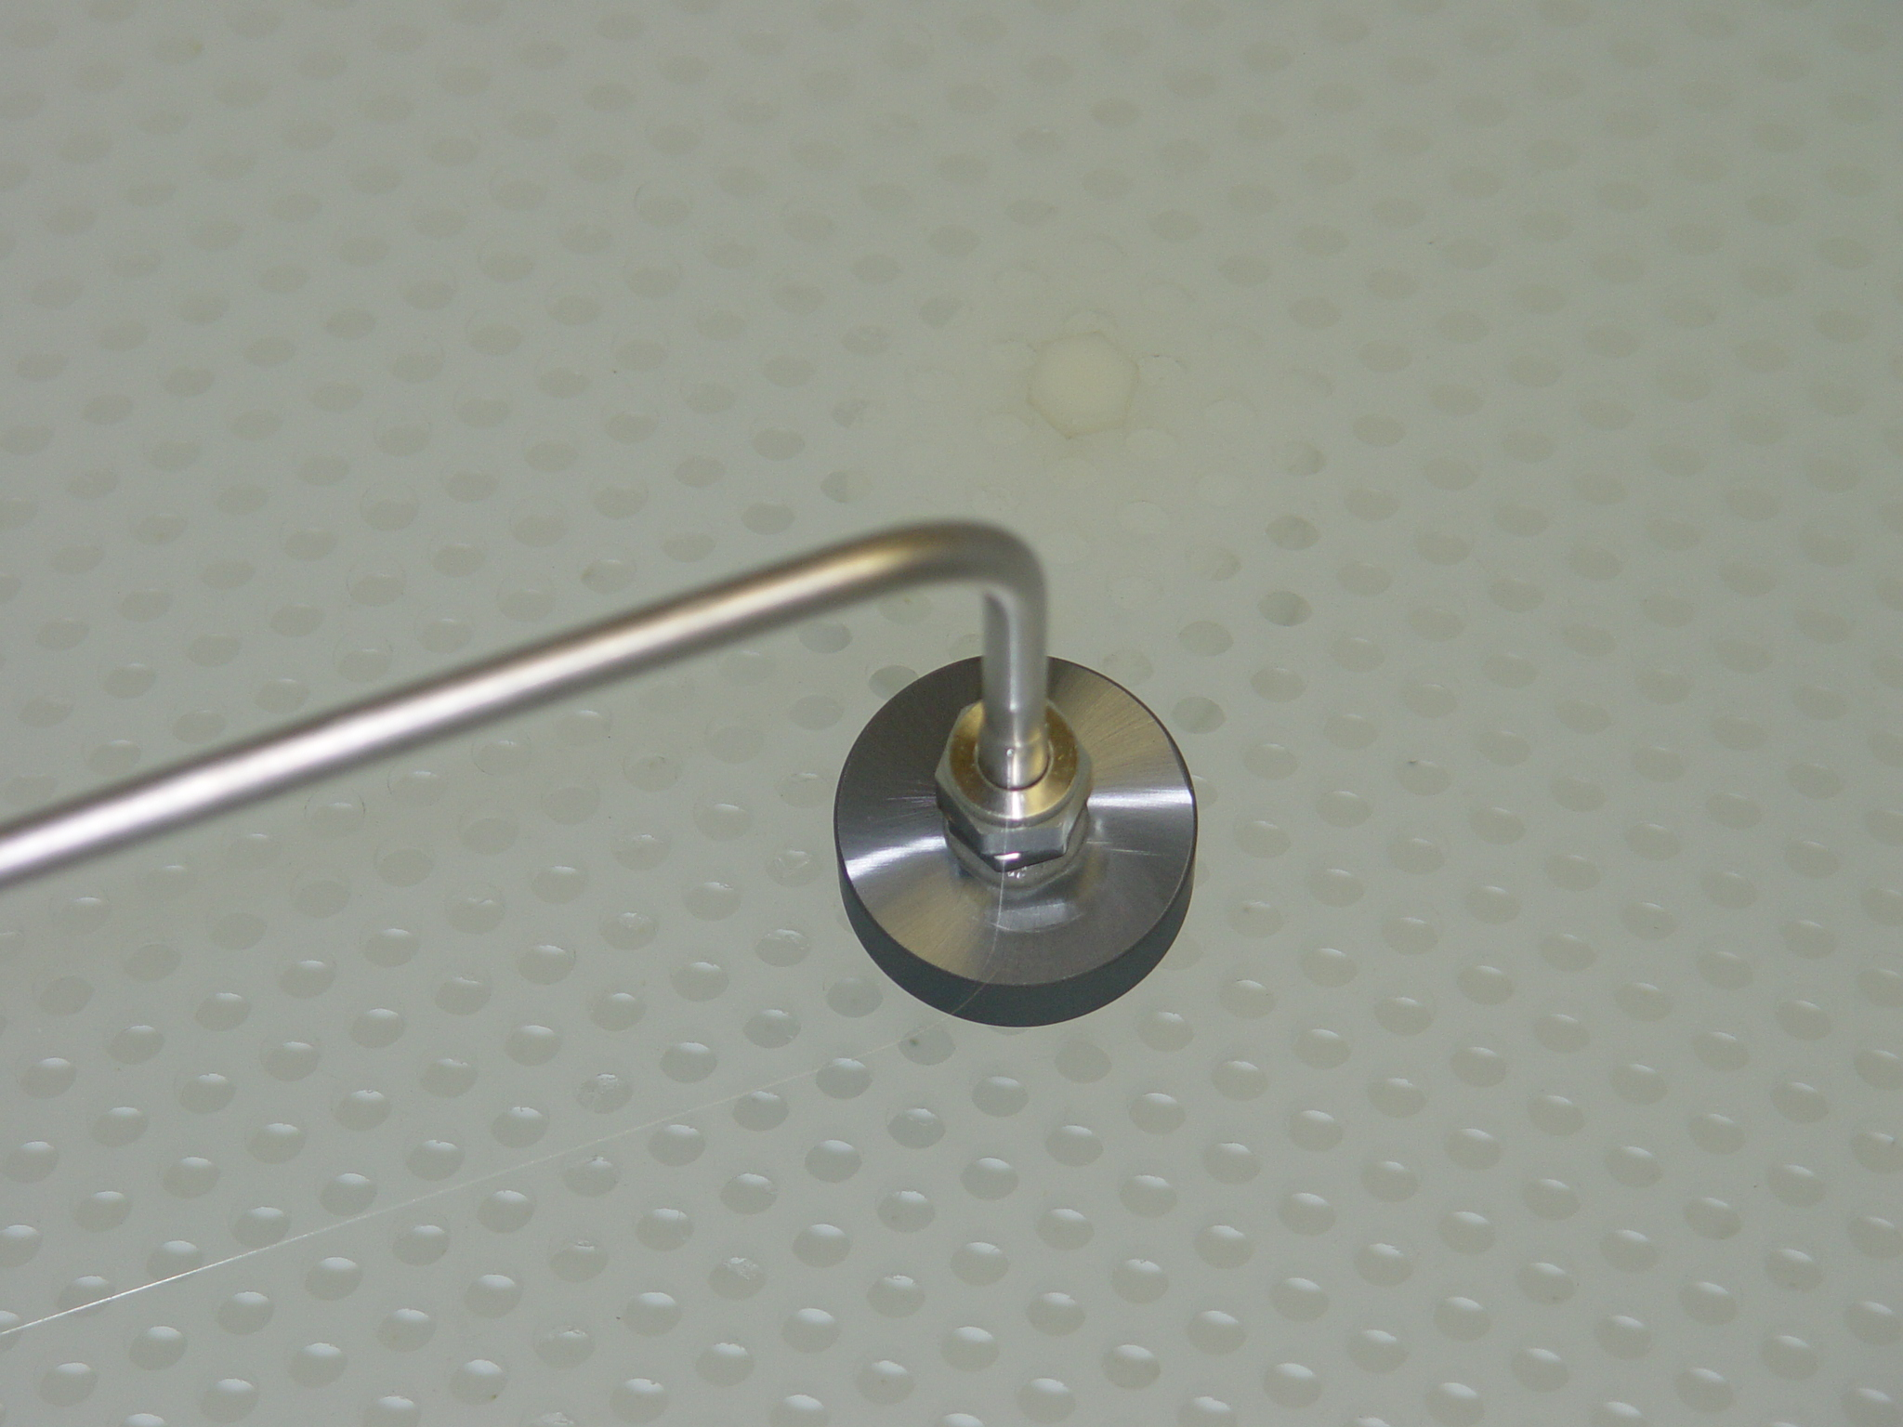
Results - C
MoA-C – Ti/Ni/Au Thin film Plus Frit Bond
  All specimens leak tight
  Strength similar to prior results
    ~ 450 lbs this test
    ~350 lbs prior
MoA-C Sample
MoA-C Testing 8psi
Notes:
Multilayer film on inserts improves performance, but is not cost effective for the small improvement

Slide 13
MoA Test Summary
Polymers Not Tested
Solder
  Gold film specimens all failed
  80Au/20Sn failed
Frit
  With Ti film
    Similar strength to prior results
    Not completely He tight
  With Au film
    Strength ≥ to prior results
    He leak tight at 8psi
Notes:
With all the disadvantages of polymers, they were not included in the test program
Gold solders may work well for semiconductors, but did not work at all in the 2 methods chosen. The configuration is difficult, but may be made to work with further development
With the McCarter’s wealth of experience with frit bonding, these tests showed that with additional film(s) on the insert, there could be some improvement in strength and sealability, but not enough to warrant the extra cost involved

Slide 14
COMPARISON of METHODS
Comparison of bond qualities
Note: Qualitative ratings - not quantitative
COST
STRENGTH
CREEP
JOINT
STABILITY
CTE
PROD'N
LOCAL
MAT'L
APPL'N
LIT'URE
ACTUAL
RESIST
INTEG'Y
CRYO
HI TEMP
MATCH
OUTGAS
REPEAT
STRAIN
FRIT
1
2
3
2
1
1
1
1
1
1
1
1
SOLDER
3
3
2
3
2
3
3
3
3
2
3
2
EPOXY
2
1
1
1
3
2
2
2
2
3
2
3
1 = Most desirable 2 = Somewhat desirable 3 = Least desirable
Notes:
It is clear from this table, hopefully not biased, that frit is superior to both solder and epoxy, with solder the least desirable method

Slide 15
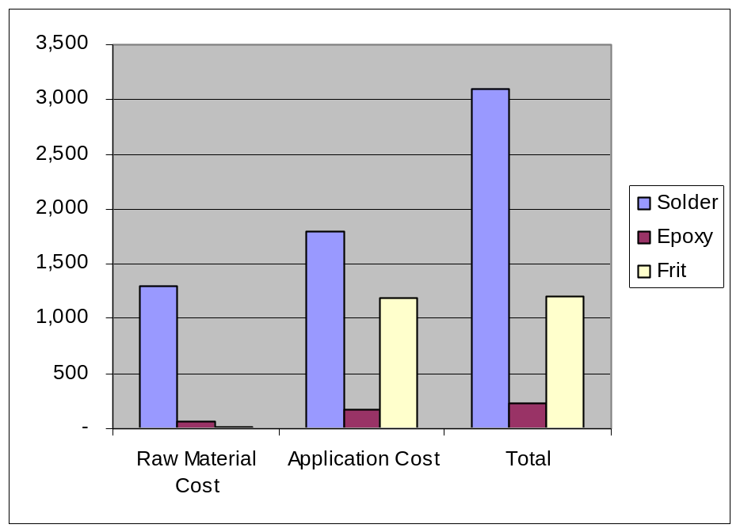
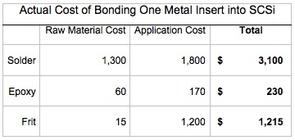
Bonding Cost Comparison
  Frit - McCarter proprietary GK
  Solder - 80/20 Au/Sn
  Epoxy - 3M EC-2216
Notes:
These charts show the relative costs of the raw materials and application for the 3 types of bonding methods
While the total cost of frit bonding is not inexpensive, it only 40% of the solder cost - and is a reliable, strong bond

Slide 16
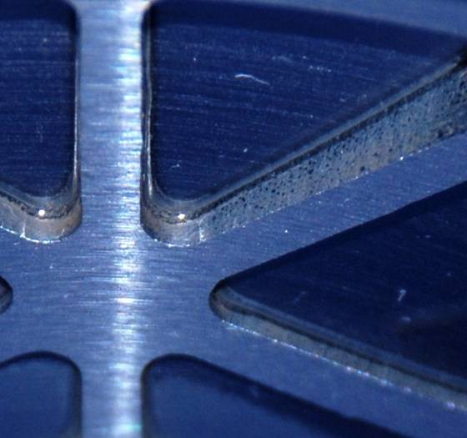
CONCLUSIONS
Frit Bonding is Method/Material of Choice
  Proven most predictable & reliable
Solder Not Acceptable
  Difficulty of application
  Limited temperature range
  Costly
Polymers Not Acceptable
  Least reliable
    Low creep strength
    High CTE mismatch - local strain
    Poor production repeatability
Frit Bonded Application
Silicon to Silicon
www.mccarteret.com
Notes:
The figure shows the back of a mirror where the abrasive water jet lightweight core has been successfully frit bonded to a meniscus faceplate. A mirror with a simpler core and flat backplate was fabricated 6 years ago and has been proven stable by Dave Content at GSFC to λ/500 rms over that time. It was also tested to 90K with a change from cold to RT of only λ/19 rms for 80% clear aperture.
The frit bonding process has also been proven for SiC, fused quartz and other brittle materials.

Slide 17
Let Us Meet Again
We welcome all to our future group conferences of Omics group international
Please visit:
www.omicsgroup.com
www.Conferenceseries.com
http://optics.conferenceseries.com/

