Slide 1
About OMICS Group
OMICS Group International is an amalgamation of Open Access publications and worldwide international science conferences and events. Established in the year 2007 with the sole aim of making the information on Sciences and technology ‘Open Access’, OMICS Group publishes 400 online open access scholarly journals in all aspects of Science, Engineering, Management and Technology journals. OMICS Group has been instrumental in taking the knowledge on Science & technology to the doorsteps of ordinary men and women. Research Scholars, Students, Libraries, Educational Institutions, Research centers and the industry are main stakeholders that benefitted greatly from this knowledge dissemination. OMICS Group also organizes 300 International conferences annually across the globe, where knowledge transfer takes place through debates, round table discussions, poster presentations, workshops, symposia and exhibitions.

Slide 2
About OMICS Group Conferences
OMICS Group International is a pioneer and leading science event organizer, which publishes around 400 open access journals and conducts over 300 Medical, Clinical, Engineering, Life Sciences, Phrama scientific conferences all over the globe annually with the support of more than 1000 scientific associations and 30,000 editorial board members and 3.5 million followers to its credit.
OMICS Group has organized 500 conferences, workshops and national symposiums across the major cities including San Francisco, Las Vegas, San Antonio, Omaha, Orlando, Raleigh, Santa Clara, Chicago, Philadelphia, Baltimore, United Kingdom, Valencia, Dubai, Beijing, Hyderabad, Bengaluru and Mumbai.

Slide 3

Harnessing Human N-type Ca²⁺ Channel Receptor by Identifying the Atomic Hotspot Regions for Its Structure-Based Blocker Design
C. Gopi Mohan, Ph.D.
Associate Professor
Amrita Centre for Nanosciences & Molecular Medicine
Amrita Vishwa Vidyapeetham University,
Kochi, Kerala State.
http://www.amrita.edu/acns/
E-Mail: cgmohan@aims.amrita.edu
cgopimohan@yahoo.com
2nd International Conference on Medicinal Chemistry & Computer-Aided Drug Designing
Las Vegas, USA (October 15-17, 2013)

Slide 4
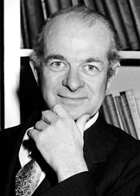
“We may, I believe, anticipate that the chemist of the future who is interested in the structures of proteins, nucleic acids, polysaccharides, and other complex substances with higher molecular weights will come to rely upon a new structural chemistry, involving precise geometrical relationships among the atoms in the molecules and the rigorous application of the new structural principles, and that great progress will be made, through this technique, in the attack, by chemical methods, on the problems of biology and medicine.”
-Linus Pauling, Nobel Lecture, 1954

Slide 5
Omics revolution
Bioinformatics: alive and kicking
“Bioinformatics has become too central to biology to be left to specialist bioinformaticians. Biologists are all bioinformaticians now”
physicoinformatics
Bioinformaticians: gone by 2012
Bioinformatics: stronger than ever
Lincoln D Stein; Genome Biology 2008, 9:114

Slide 6
Omics revolution
Pharmacoinformatics
Bioinformatics
Chemoinformatics
Proper Integration of Bio-Chemo Informatics towards Drug Discovery Program

Slide 7
Strategies of Molecular Modeling
Ligand Based
Structure Based
SAR, 2D,
3D-QSAR
Crystal structure
analysis
Homology
Modeling
Lead Identification
Computational analysis of Protein-ligand
interactions
In silico ADMET
Fragment based Ligand modifications for
better affinity
Phramacophore model
Lead Optimization
Database screening
Prioritization of Hits

Slide 8
Harnessing Human N-type Ca²⁺ Channel Receptor by Identifying the Atomic Hotspot Regions for its Structure-Based Blocker Design
Important Druggable target for Pain and Stroke Disease

Slide 9
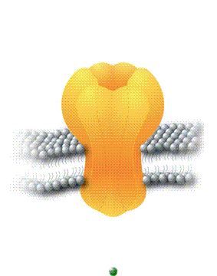
Introduction
Free intracellular Ca²⁺ is an essential element for life and is the most common signal transduction element in cells
Contraction
Secretion
Regulate
Intracellular processes
Membrane depolarization
Neuro-transmission
Chronic Pain
Cerebral Ataxia
Mood disorders
Migrane
Cardiovascular diseases
Muscle disorders
Epilepsy
Gene expression

Slide 10
Classification of Calcium Channels
Types of calcium channel/ Activation threshold | Calcium Channel α₁ subunit genes | Tissue expression | Disease cause
L-type/High | Ca_{v}1.1, Ca_{v}1.2, Ca_{v}1.3, Ca_{v}1.4 (α_{1C’} α_{1D’} α_{1S’} α_{1F}) | neurons, endocrine, skeletal muscle, cardiovascular system | cardiac disorders
P-and Q-type/ High | Ca_{v}2.1 (α_{1A}) | neurons | epilepsy, migraine symptoms
N-type/High | Ca_{v}2.2 (α_{1B}) | neurons | pain
R-type/ High | Ca_{v}2.3 (α_{1E}) | neurons | diabetes symptoms
T-type/Low | Ca_{v}3.1, Ca_{v}3.2 , Ca_{v}3.3(α_{1G’} α_{1H’} α_{1I}) | neurons, smooth muscle, sinoatrial node | arrhythmias, epilepsy, pain, fertility?

Slide 11
Current N-type calcium channel blockers
Drug | Use | Stage | Side Effects
Ziconotide/ PrialtTM | Neuropathic pain, cancer pain | Clinical | Hypotension, sedation, confusion, unruly behavior
Morphine | Chronic, neuropathic and inflammatory pain | Clinical | Constipation, narcotic and addictive effects, development of tolerance
NMED160 | Chronic, neuropathic pain, Posttherpetic neuralgia, diabetic neuropathy | Phase II | None identified
NMED1077 | Chronic, neuropathic pain, Posttherpetic neuralgia, diabetic neuropathy | Completed Phase III | None identified
ω-Conotoxin CVID | Neuropathic pain | Phase II | Unknown
4-Benzoxyaniline | Neuropathic pain | Pre-clinical | Unknown
ZC-88 | Neuropathic pain | Pre-clinical | Unknown

Slide 12
Structure of N-type calcium channel blockers
NMED160
Morphine
4-Benzoxyaniline
ZC-88
Ziconoitide

Slide 13
Importance of Present Study
N-type Ca²⁺ channel (NCC) small organic molecule blockers inhibitory activity is within sub-micromolar to molar range.
Not comparable to peptide based NCC blockers- Ziconotide (nanomolar range).
Unique selectivity over other types of channels improves the safety window and efficacy in humans.
Structural core: Pharmacophore model necessary for potent N-type blocker is not identified till date.
Potent and selective N-type organic blockers need to be identified than the currently available peptide drugs with better clinical efficacy and safety profiles.

Slide 14
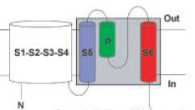
  Calcium (Ca²⁺), potassium (K⁺) and sodium (Na⁺) ion channels assemble in the membranes to form functional tetramers.
  K⁺ channels are formed by four α-subunit monomers while for Na⁺ and Ca²⁺ channels, a single α-subunit polypeptide with four internal hydrophobic repeats folds to form a functional tetrameric structure.
  Each repeat contains six transmembrane segments (TMSs)-S1–S6, constituting two functional domains that include the voltage-sensing module (S1–S4) and the pore-forming module (S5–P–S6).
  S5–P–S6 segments confer pore
  properties including selectivity,
  blocker specificity, and conductance.

Slide 15
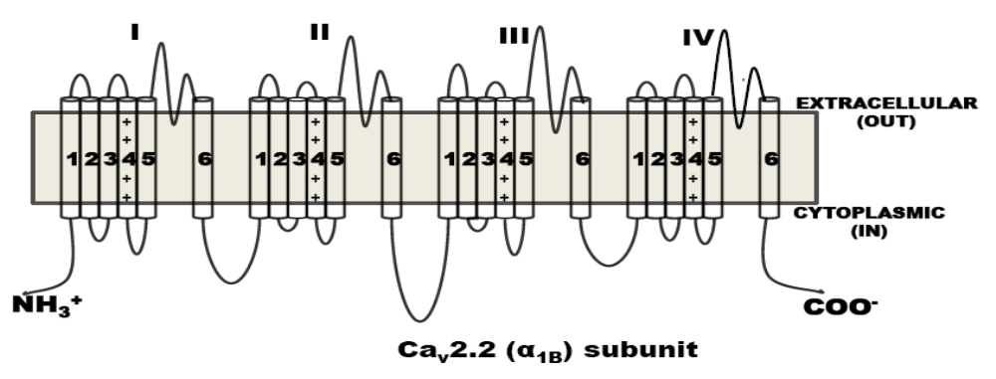
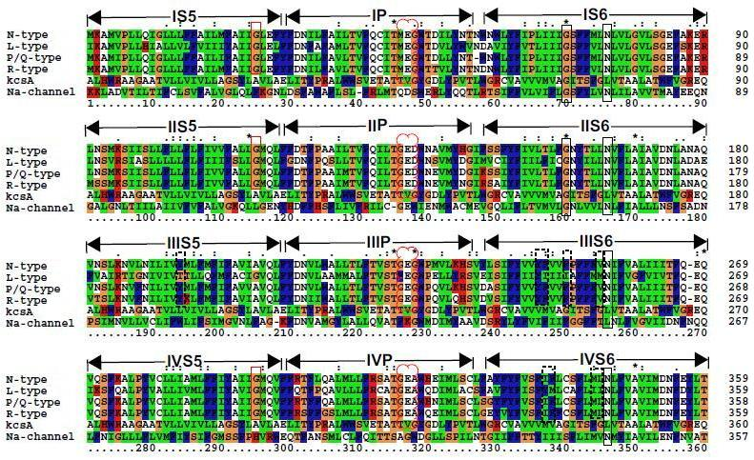
Multiple sequence alignment of different Ca²⁺ channels

Slide 16
Biological Significance of S5–P–S6 TM segments
In the S5 segment, Ca²⁺ channel receptors and Na⁺ channel receptor have a similar conserved motif, [FY]-[AS]-x(2)-G-M-QL-F, which significantly differs from that of the K⁺ channel receptors. In Na⁺ channel receptor, mutation of Leu to Val of TM segment repeat III resulted in the complete loss of function.
The pore regions of Ca²⁺ and Na⁺ channels showed
similar conserved motifs, i.e., F-[QR]-x(2)-T-x-E-x-W
and F-[RQ]-x(2)-[TC]-x-[EDKA]-x-[W/I].
In Ca²⁺ channel receptors, when EEEE (E from each repeat at I, II, III and IV) was mutated to EEKA, Na⁺ permeability was increased by 15-fold.
Purnima, G.; Philip, E.B.; Chittibabu, G. Conserved motifs in voltage-sensing and pore-forming modules of
voltage-gated ion channel proteins, Biochem. Biophy. Res. Commu. 2007, 352, 292-298.

Slide 17
The conserved residues Thr and Trp at the pore TMSs of Ca²⁺ channel receptors and corresponding conserved residues in Na⁺ channel receptors have important functions in pharmaceutical applications as these channels have local anesthetic receptors.
In the case of K⁺ channel receptors mutations in the pore-forming domains were shown to be responsible for various diseases such as long QT syndrome (LQT), benign familial neonatal convulsions (BFNCs), Jervell and Lange-Nielsen (JLN), Romano–Ward (RW).
Mutations in the residues essential for K⁺ selectivity such as Thr, Ile, Gly and Tyr of the pore region led to LQT syndrome.
In VGCCs a point mutation of Ile to Thr of repeat II in the S6 segment caused retinal disorder by shifting the voltage dependence of channel activation.

Slide 18
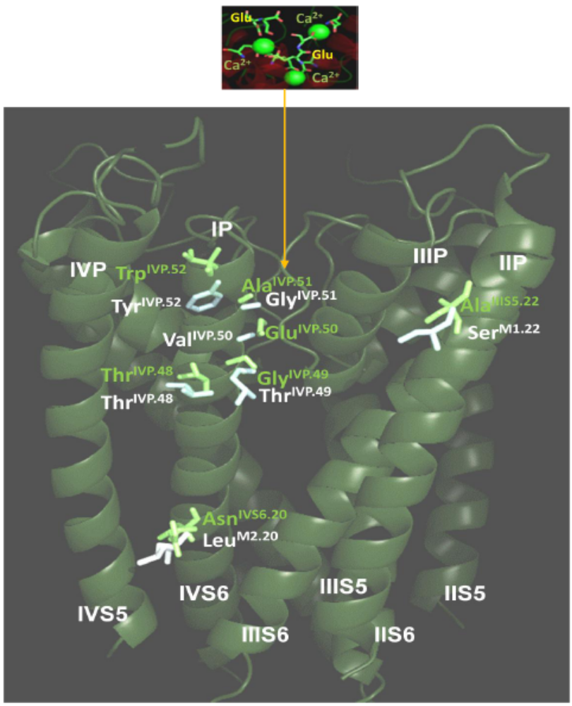
Homology model of N-type Ca²⁺ Channel at (S5–P–S6) TMhs

Slide 19
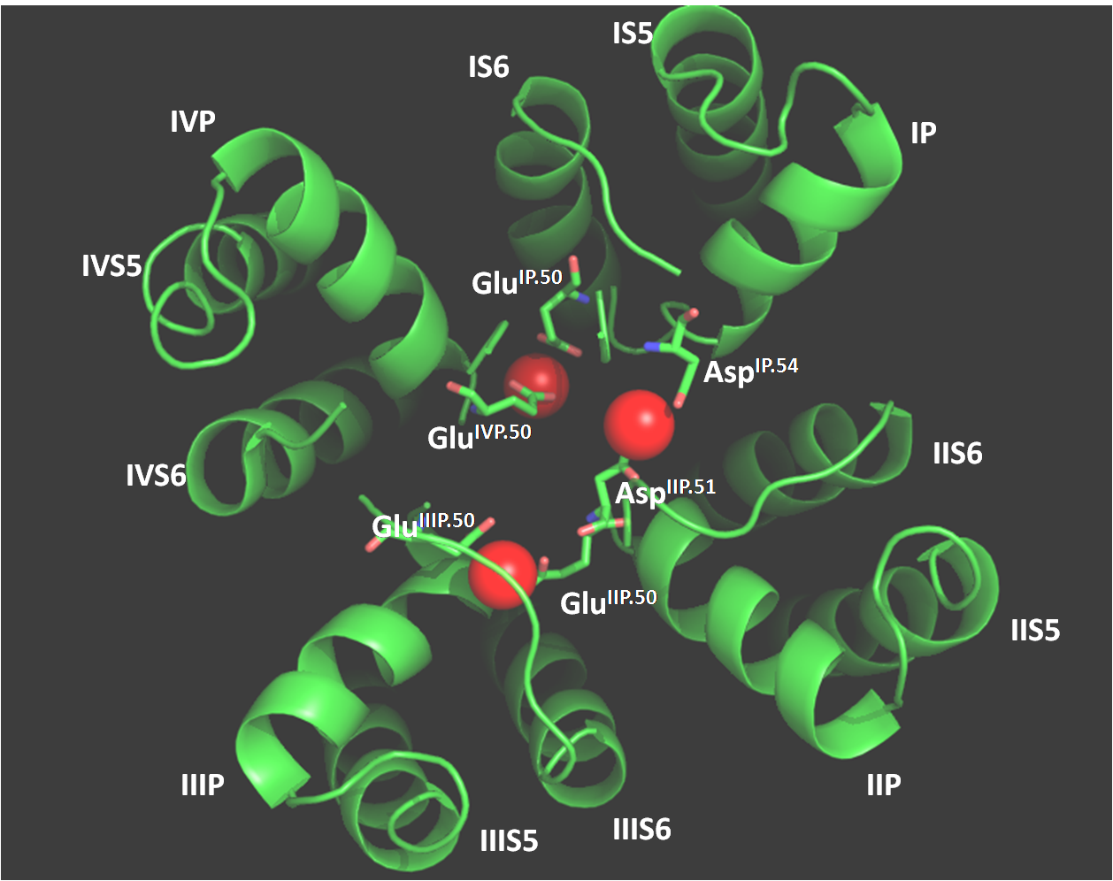
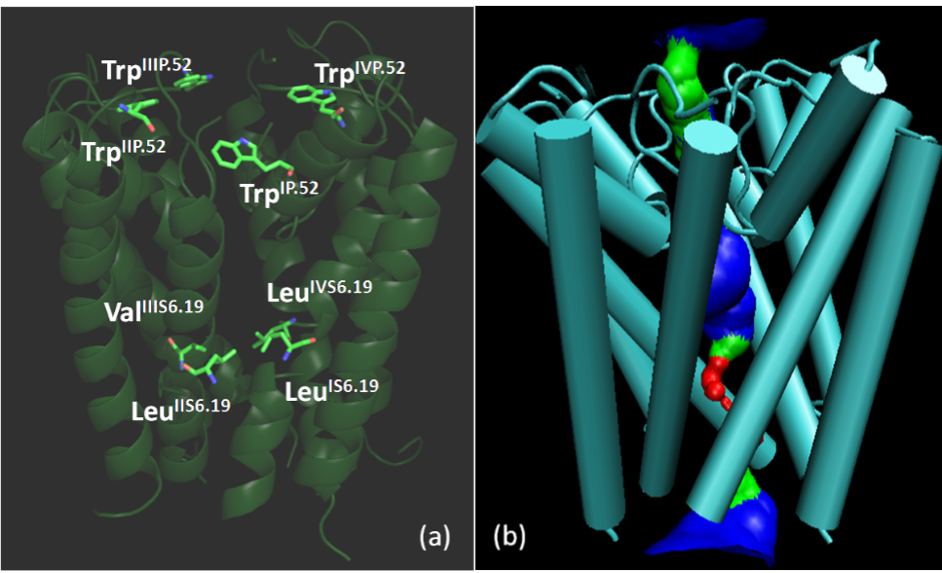
Ca²⁺ ion selectivity filter was highlighted as
top view in N-type Ca²⁺ channel model.
Hydrophobic gating regions
of N-type Ca²⁺ channel

Slide 20
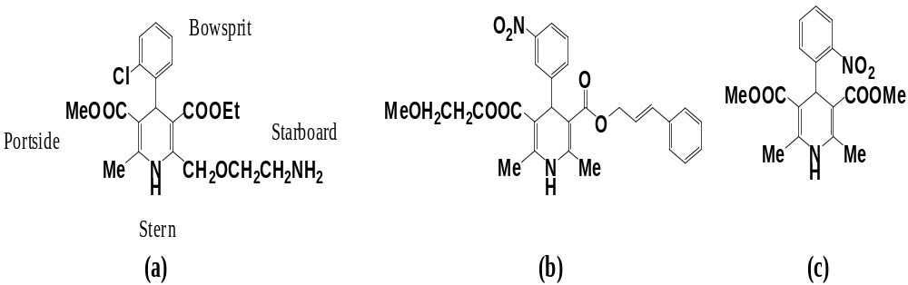
Dihydropyridine docking and interaction analysis
Amlodipine-R
Clinidipine-R
Nifedipine
Docking score analysis of NCC-Dihydropyridine analogues
Dihydropyridines | Glide score (kcal/mol) | Gold fitness score
(R)-Amlodipine | -7.14 | 61.23
(R)-Cilnidipine | -5.95 | 59.51
Nifedipine | -5.34 | 50.63
Correlation coefficient of docking scores: 0.87

Slide 21
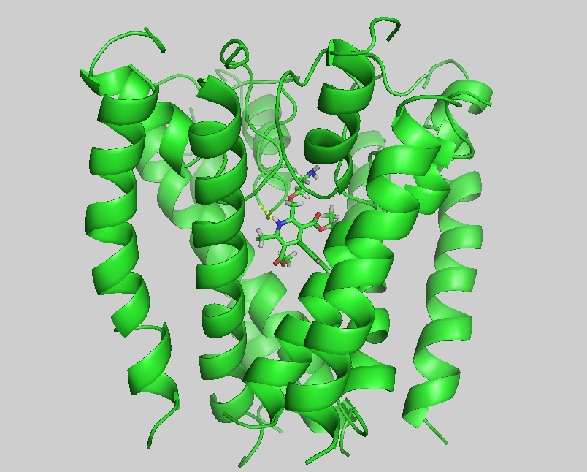
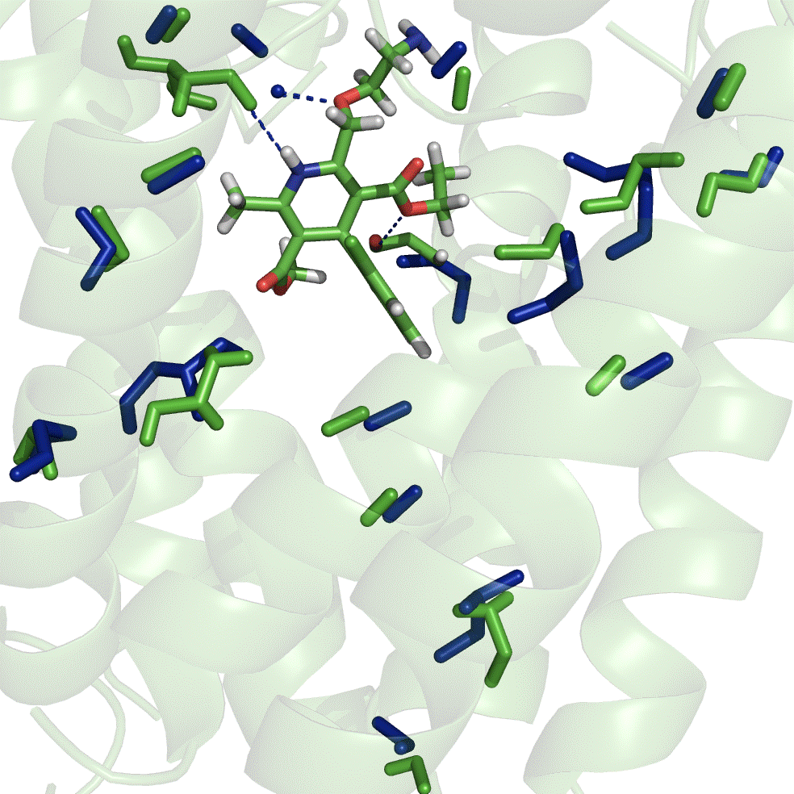
Amlodipine-R in complex with N-type
Ca²⁺ Channel (GOLD docking program)
Ile^{IVS6.11}
Thr^{IVP.48}
Thr^{IIIP.48}
Met^{IIIS5.18}
Tyr^{IVS6.11}
Thr^{IIIP.48}
Gln^{IIIS5.18}
Thr^{IVP.48}
Ca²⁺
Phe^{IIIS6.11}
Phe^{IVS6.12}
Ile^{IIIS6.11}
Met^{IVS6.12}
Tyr^{IIIS6.10}
Met^{IVS6.18}
Phe^{IIIS6.14}
Tyr^{IIIS6.10}
Ile^{IVS6.18}
Ile^{IIIS6.14}
Leu^{IVS6.19}
Asn^{IIS6.15}
Leu^{IVS6.19}
Asn^{IIS6.15}
Tyr^{IIIS5.14}
Phe^{IIIS6.18}
Thr^{IIIS5.14}
Asn^{IVS6.20}
Met^{IIIS6.18}
Asn^{IVS6.20}
Val^{IIIS6.19}
Met^{IIIS6.19}
Ile^{IIS6.25}
Ile^{IIS6.25}

Slide 22
Calcium ion permeability study
POREWALKER, APBS and HOLE program used to identify NCC pore radius

Slide 23
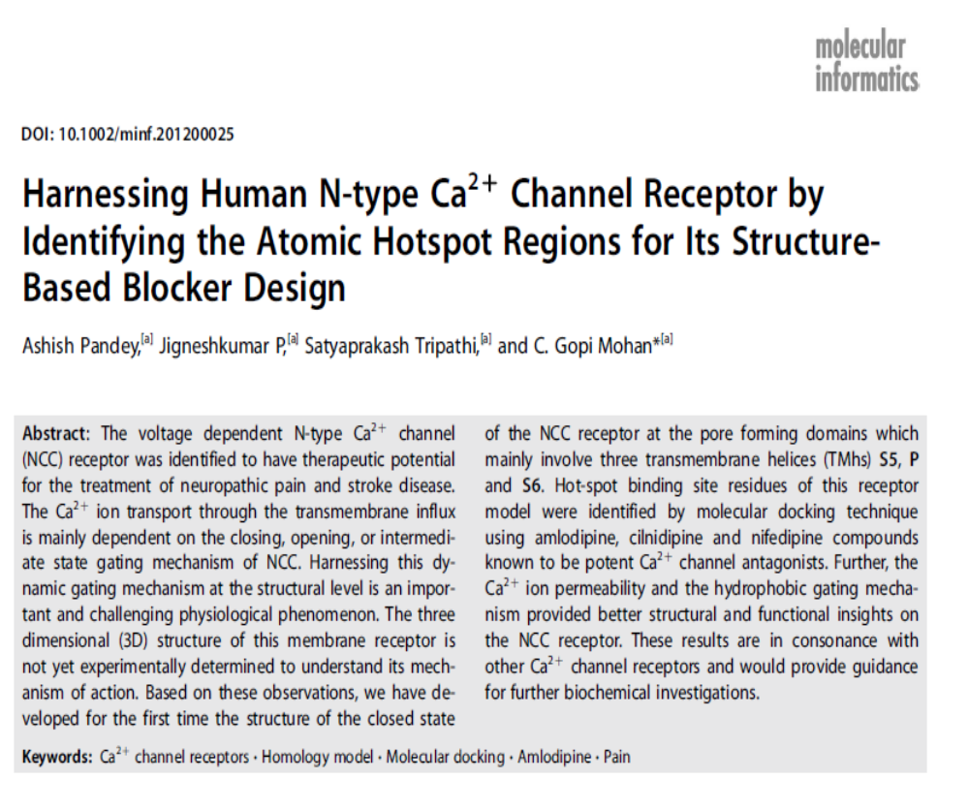

Slide 24
CONCLUSIONS
The knowledge of the 3D-structure of the channel receptors, will enhance understanding of the mechanism of N-type Ca²⁺ Channel (NCC) blockade.
NCC is an important druggable target for the treatment of Pain & Stroke disease.
We have developed dynamic homology model for the first time for NCC receptor at the pore forming domains, to identify its key molecular structural requirements for maximum channel blocking activity.
Some new hydrogen bonding interactions in the NCC-amlodipine dynamic model include Ile^{IVS6.11(369)}, Asn^{IIS6.15(147)}, Ala^{IVP.47(289)} and Phe^{IIIS6.14(271)}, in which Phe^{IIIS6.14(271)} and Ile^{IVS6.11(369)} belongs to ligand sensing residues blocking activity.

Slide 25
NCC dynamic model created this way can be used to gain insight into channel structure, and receptor/ligand binding dynamics which are not accessible by static homology models.
Ion permeation analysis enabled us to understand in detail the channel gating, selectivity filter and closed conformational state of the NCC receptor.
The models can also serve as a structural frame for conducting site-directed mutagenesis and docking studies or as a footing for encouraging novel strategies in developing new drugs to treat ion-channel disorders.

Slide 26
Acknowledgements
Director, Amrita Centre for Nanosciences and Molecular Medicine, Kochi, Kerala State
Ph.D. students:
Mr. Shikhar Gupta, NIPER Ms. Jane Jose
Mr. Ashish K. Pandey, NIPER Ms. Anju CP
(NCC Ph.D. work) Ms. Anu Melge
M.Tech. Students: Faiza B, Shruti K, Shraddha P
Indo-Finland Collaborators:
Dr. Adyary Fallareo and Prof. Pia Vuorela
University of Helsinki, Finland

Slide 27
Questions or Comments
Thank you

Slide 28
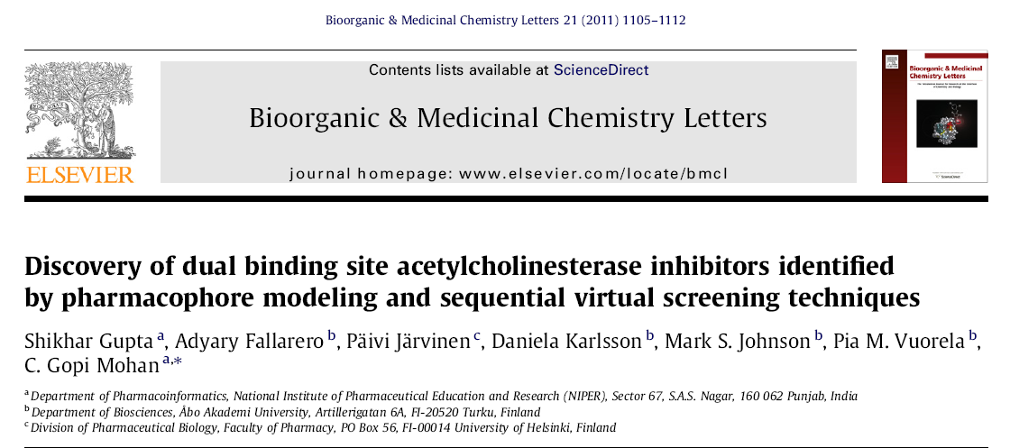
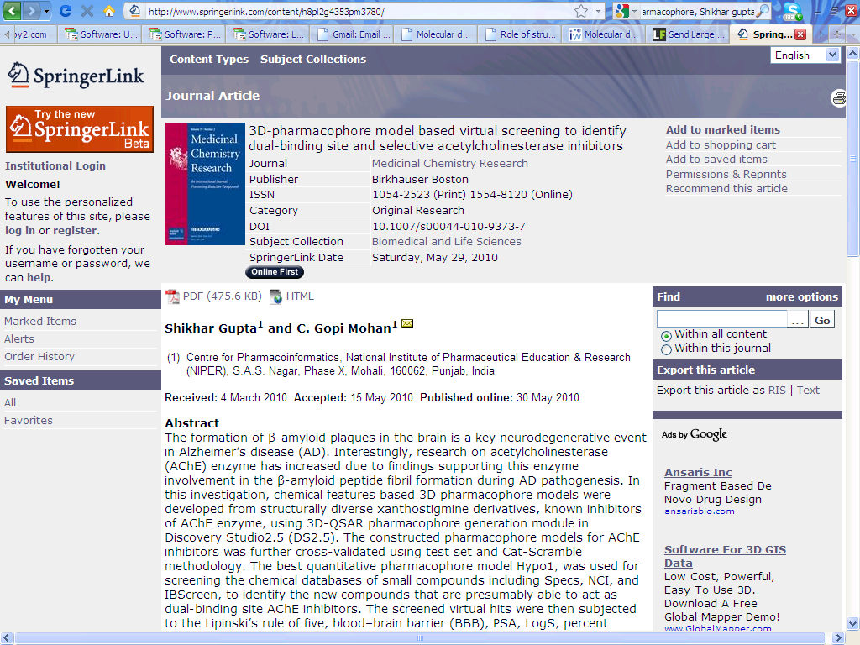
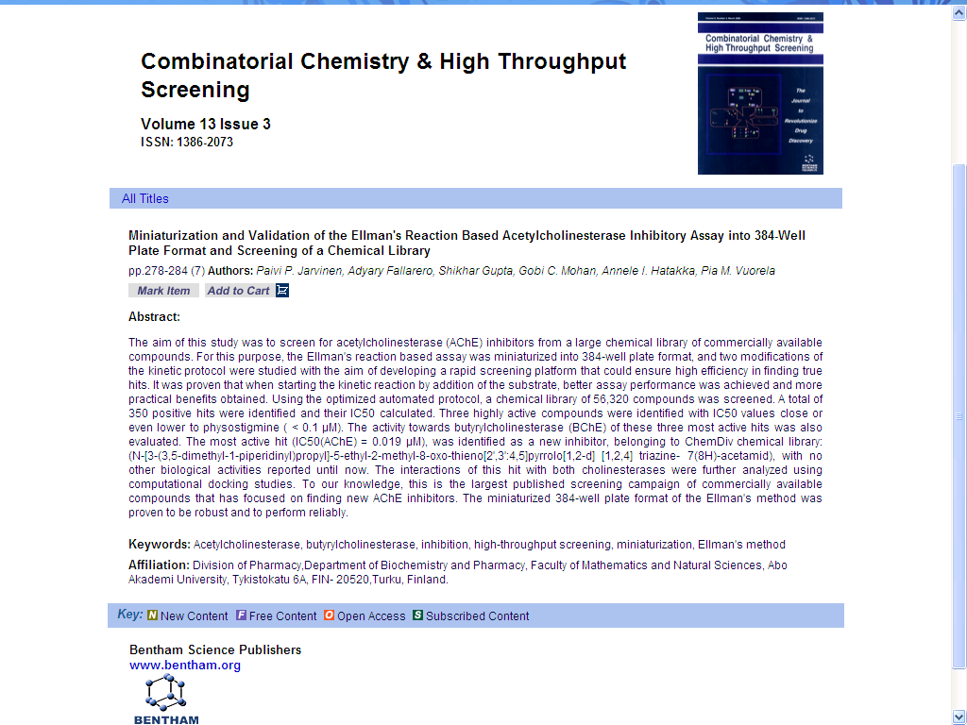
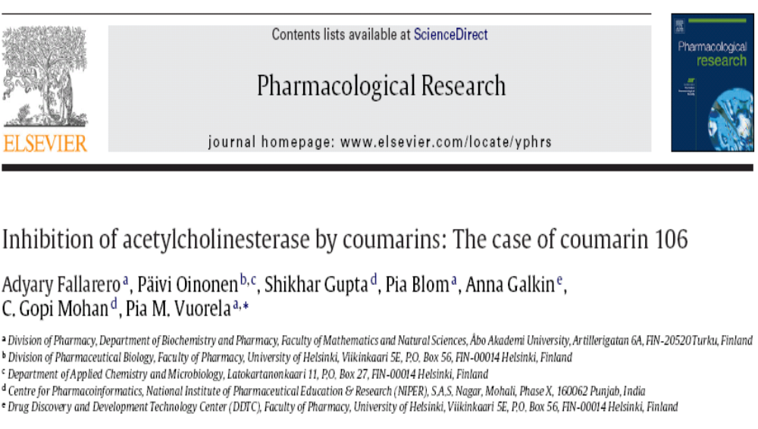

Slide 29
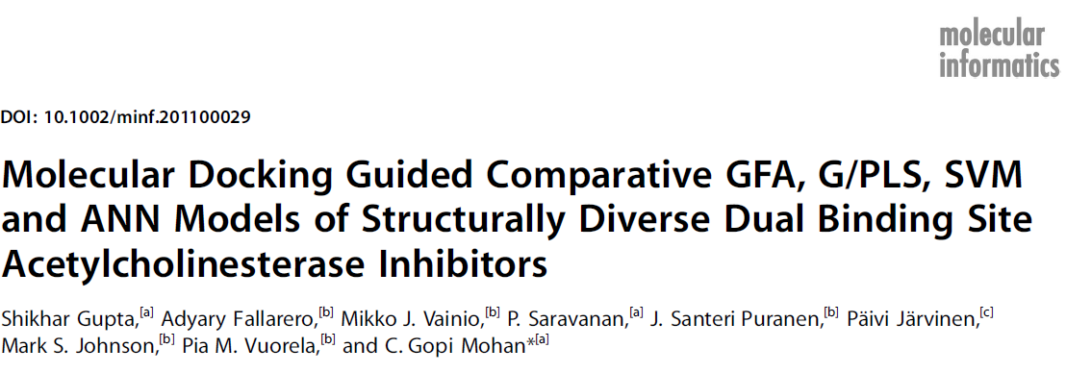
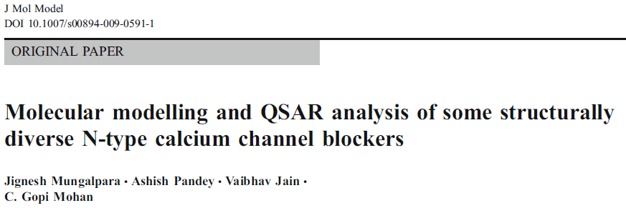
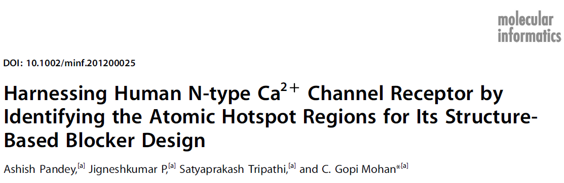
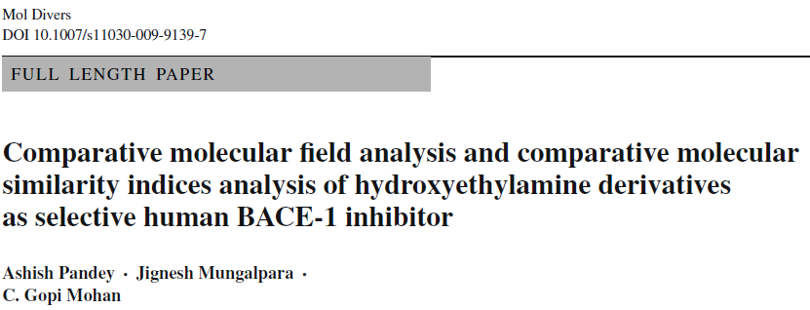
Pain Research

Slide 30
Let Us Meet Again
We welcome you to join at 4th International Conference on Medicinal Chemistry & Computer Aided Drug Designing
November 02-04 Atlanta, USA
Please Visit:
http://medicinalchemistry.pharmaceuticalconferences.com/
Regards
Adam Benson
medchem@conferenceseries.net

