Slide 1
The Rational Design of Intestinal Targeted Drugs
Kevin J. Filipski
April 8, 2013

Slide 2
Outline
Intro to Intestinal Targeting
Strategies for small molecule gut targeting
Examples
Challenges

Slide 3
Why Tissue Targeting?
Increase the concentration of active drug at the desired site of action versus anti-tissue
Done for safety
  The concentration of drug needed for desired effect would lead to undesired effect in another region of body
  Undesired effect can arise from:
    Off-target activity, e.g. hERG
    On-target activity, e.g. statin action on HMG-CoA reductase in muscle causing myalgia and rhabdomyolysis
  Can increase therapeutic index by decreasing drug concentration at undesired site

Slide 4
Reasons to Target the Intestine
Target located within small or large intestine and want to increase safety margin
  Inflammatory disease – Crohn’s disease, ulcerative colitis, IBS
  Metabolic disease – obesity, diabetes
  Infectious disease
Increase Duration of Action – e.g. cycling
Targets can be:
  Luminal – within lumen or receptor on lumen side of enterocyte
  Intracellular – Within enterocyte
  Basolateral side of enterocyte – intestinal tissues

Slide 5
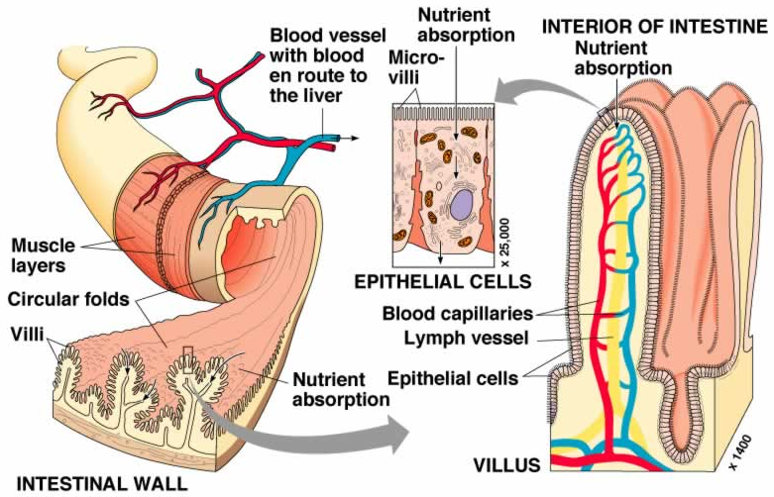
Anatomy of Small Intestine
Marieb, E. N. In: Human Anatomy & Physiology, 6th Ed., Pearson Education, Inc., Upper Saddle River, NJ, 2004, p. 909.

Slide 6
How to Design an Oral Systemic Drug
F = F_{a} x F_{g} x F_{h}
Oral dose
Liver
F = oral bioavailability
F_{a} = fraction absorbed
F_{g} = fraction escaping gut metabolism
F_{h} = fraction escaping hepatic metabolism
Bile duct
EHC
Systemic
circulation
Intestine lumen
Dissolution
Passive diffusion
  Transcellular
  Paracellular
Active Transport
  Uptake (Influx; solute carrier, SLC transporters; e.g. PEPT1, OATP, MCT1, OCT)
  Efflux (ATP Binding Cassette, ABC transporters; e.g. Pgp, BCRP, MRP1-6)
Gut Metabolism (CYPs, UGTs, esterases, etc.)
Liver Metabolism (CYPs, UGTs, esterases, etc.)
Biliary Excretion / Extra-Hepatic Circulation (EHC)
  Uptake transporters on Sinusoidal Membrane (OATPs, OCT1)
  Efflux transporters on Canalicular Membrane (MRP2, MDR1, BCRP)
Portal blood system
Enterocyte
courtesy of Varma Manthena

Slide 7
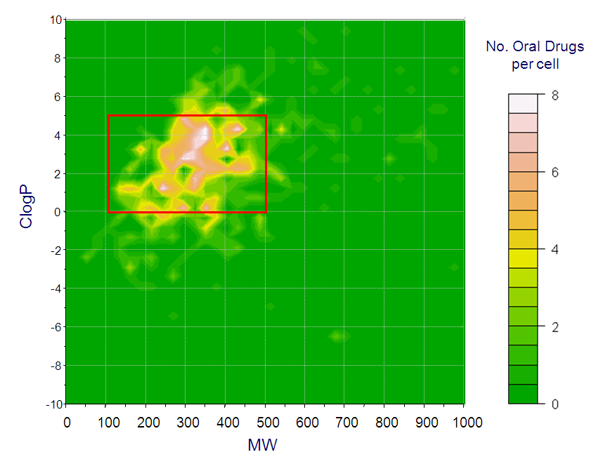
Ideal Physicochemical Properties for an Oral Systemic Drug
F = F_{a} x F_{g} x F_{h}
Ideal Oral Drug Space:
  MW ≤ 500
  LogP ≤ 5
  Hydrogen Bond Donor (HBD) ≤ 5
  Hydrogen Bond Acceptor (HBA) ≤ 10
  Rotatable Bond (RB) ≤ 10
  PSA ≤ 140
Lipinski, C.A.; et al. Adv Drug Deliv Rev, 1997, 23(1–3), 3-25.
Veber, D.F.; et al. J Med Chem, 2002, 45(12), 2615-2623.
Wenlock, M.C.; et al. J Med Chem, 2003, 46(7), 1250-1256.
Leeson, P.D.; et al. J Med Chem, 2004, 47(25), 6338-6348.
Leeson, P.D.; Oprea, T.I. In: Drug Design Strategies Quantitative Approaches, Livingstone, D.J.; Davis, A.M.; Eds.; Royal Society of Chemistry: Cambridge, UK, 2012; Vol. 13, pp 35-59.
Varma, M.V.; et al. J Med Chem, 2010, 53(3), 1098-1108.
Paolini, G.V.; et al. Nat Biotechnol, 2006, 24(7), 805-815.

Slide 8

How to Design an Intestinally-Targeted (Non-Systemic) Oral Small Molecule Drug
F = F_{a} x F_{g} x F_{h}
Limit absorption
  Low Permeability – Large, Polar chemical space
    and uptake transporter substrate ?
  Low Solubility
  Enterocyte efflux – Substrate for P-glycoprotein
Increase clearance
  High metabolism (Soft Drugs) – Increased lipophilicity
    Luminal metabolism
    Intestinal metabolism
    Liver metabolism
  Biliary excretion
Prodrugs
Formulation Approaches
Oral dose
Liver
Bile duct
EHC
Systemic
circulation
Intestine lumen
X
X
Portal blood system
Enterocyte

Slide 9
How to Design an Intestinally-Targeted Oral Small Molecule Drug
Approach Chosen Depends On:
  Location of intestinal target
  Location of anti-tissue
  Nature of the chemical substrate – size, lipophilicity, charge, etc.
  Desired PK/PD
May need combination of approaches
Range of Gut Specificity from essentially no systemic absorption to moderately absorption impaired

Slide 10
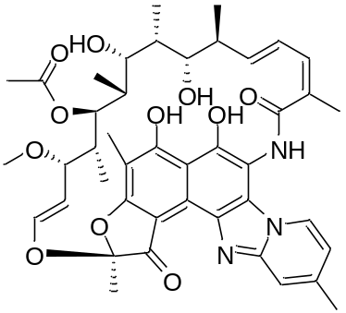
Example 1: Low Absorption – Luminal Target
Oral dose
Liver
Bile duct
MW
HBA
PSA
786
11
198
EHC
Systemic
circulation
rifaximin
Intestine lumen
X
Portal blood system
Enterocyte
Antibacterial for traveler’s diarrhea and hepatic encephalopathy
0.4% F_{a}; ≥99% recovered in feces
Low Solubility, Low Permeability (partially zwitterionic)
Site of action is within intestinal lumen
Permeable across bacterial cell wall; need balance of polarity

Slide 11
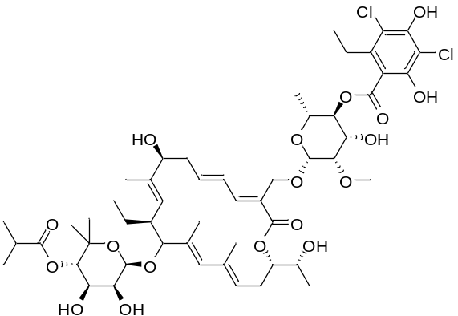
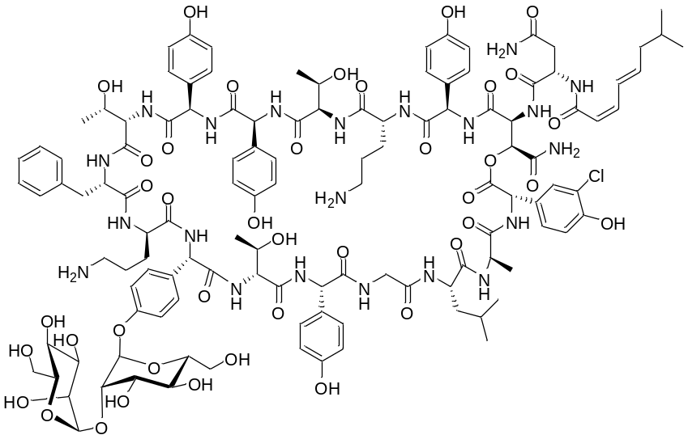
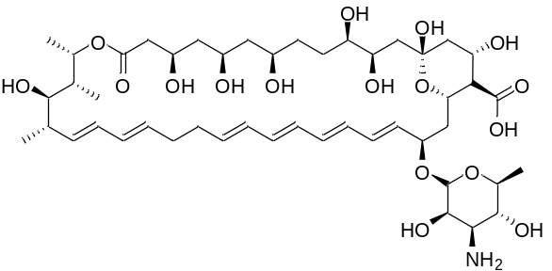
Other Examples: Low Absorption – Luminal Targets
MW
HBD
HBA
PSA
RB
1058
7
15
267
15
fidaxomicin
ramoplanin
MW
HBD
HBA
PSA
RB
2254
40
41
1000
35
nystatin
MW
HBD
HBA
PSA
cLogP
926
13
17
320
–3.3

Slide 12
High Absorption and High Metabolism – Soft Drug
Soft Drug – purposefully designed to undergo facile metabolism to inactive metabolites
Converse of Prodrug
Useful if
  mechanism requires brief period of action (e.g. agonism)
  slow off rate or covalent modification
  target allows lipophilic drug
Oral dose
Liver
Bile duct
EHC
Systemic
circulation
Intestine lumen
Portal blood system
Enterocyte

Slide 13
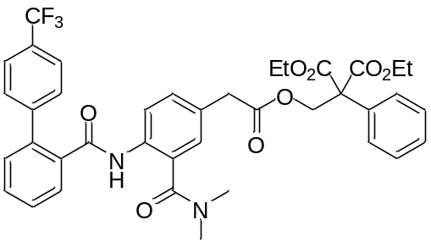
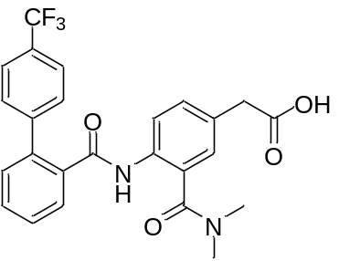
Example 2: High Absorption and High Metabolism – Soft Drug
Stable to Gut Carboxylesterases
granotapide
(phase 2)
X
metabolite
MW
cLogP
719
6.0
Unstable to Liver Carboxylesterases
MW
cLogP
470
3.2
ApoB secretion inhibition:
IC₅₀ = 9.5 nM
ApoB secretion inhibition:
IC₅₀ > 30,000 nM
MTP = microsomal triglyceride transport protein
MTP in enterocytes absorbs dietary lipids and assembles lipids into chylomicrons
MTP in liver forms and secretes cholesterol and triglycerides
Early systemic inhibitors showed liver enzyme elevation due to hepatic MTP inhibition causing liver fat accumulation
Granotapide stable in enterocytes to carboxylesterases but gets rapidly cleaved to acid in liver; inactive
Evidence of >1000-fold activity between gut : liver

Slide 14
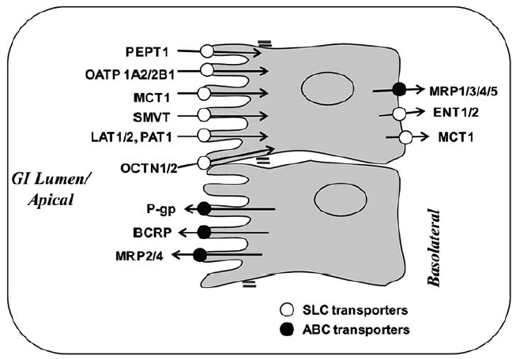
Intestinal Transporter Approach
758 transporters in human genome
45 transporters identified from
proteins isolated from mouse brush
border membranes
Transporters on enterocytes:
  Evolutionary force to get useful molecules in & keep harmful molecules out
Different knowledge of specific transporters – direction, surface, known substrates, pharmacophore models, assays, expression, species differences
Varma, M.V.; et al. Curr Drug Metab, 2010, 11(9), 730-742.

Slide 15
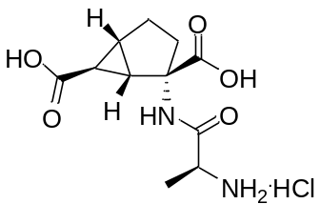
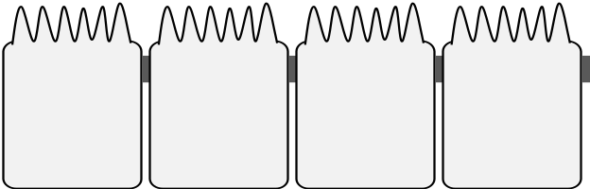
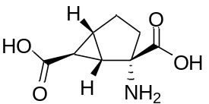
Example 3: Transporters – Uptake
Apical uptake transporter substrate with low permeability
Not substrate for basolateral uptake transporter
Blood
Enterocytes
LY544344 (prodrug)
(phase 2)
Eglumegad (active species)
(phase 2)
Poorly permeable drug
Substrate for uptake transporter
Intestine
Lumen
cLogP
–3.6
cLogP
–1.5
mGlu 2/3 receptor agonist, eglumegad, potent and selective
Limited absorption, poorly permeable
Prodrug, LY544344 is a substrate for apical uptake transporter PEPT1
High levels of eglumegad in intestinal tissue
  also systemically exposed, neither are gut targeted
PEPT1 - low affinity, high-capacity
Endogenous substrates are di- and tri- peptides

Slide 16
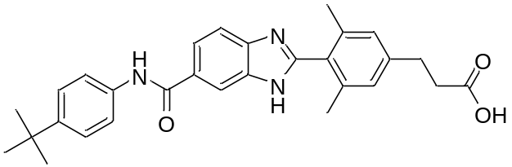
Example 4: Transporters – Efflux
Novartis
(preclinical)
Ratio of Drug Concentrations in Rat:
[duodenum : portal] = 23 (2 h); 122 (17 h)
[jejunum : portal] = 42 (2 h); 280 (17 h)
Diacylglycerol acyltransferase 1 (DGAT1) in enterocyte catalyzes triglyceride synthesis; inhibition hypothesized for obesity
Try to avoid DGAT1 inhibition in skin and sebaceous gland
High gut : portal vein concentration ratio
Pgp substrate
Triglyceride lowering efficacy driven by exposure within gut wall
  plasma concentrations below biochemical potency
Do see high blood levels with superpharmacological dose - saturation

Slide 17
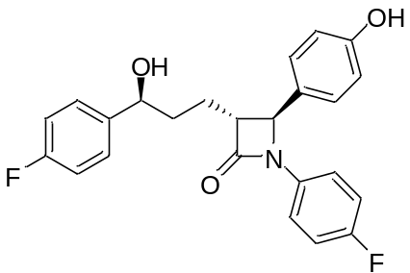
Example 5: Transporters – Biliary Excretion
Anti-tissue can not be liver or gallbladder
Oral dose
Liver
ezetimibe
Bile duct
EHC
Systemic
circulation
Intestine lumen
Portal blood system
NPC1L1 transports dietary & biliary
cholesterol through apical surface
of enterocytes
Ezetimibe limits cholesterol absorption by
inhibiting Niemann-Pick C1-like 1 (NPC1L1)
Ezetimibe is glucuronidated in enterocytes and hepatocytes
Conjugate excreted into bile, cleaved & reabsorbed = Enterohepatic Recirculation
90% excreted in feces
Enterocyte

Slide 18
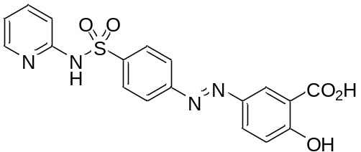
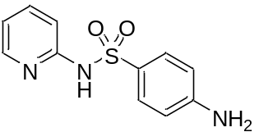
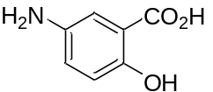
Example 6: Prodrugs
Prodrug needs to avoid absorption, then site-specific release of active species
Common for colonic-targeting
Cleaved by Microflora
+
sulfasalazine
(prodrug)
sulfapyridine
5-aminosalacylic acid (5-ASA)
5-ASA is treatment for ulcerative colitis, Crohn’s disease
5-ASA and sulfapyridine are readily absorbed in upper GI
Sulfasalazine prodrug has low absorption (F_{a} < 20%) in upper GI
80% of dose gets to colon, where azoreductases of microflora cleave to active species

Slide 19
Challenges
Combination of strategies may be necessary
Measuring concentrations difficult
  Preclinically: luminal and enterocyte possible but high error
  Clinically: luminal possible but invasive
For transporter strategy, drug-drug and food-drug interactions, saturation, species differences
Lipophilic compounds have low solubility
Increased PK and safety characterization work for prodrugs
Difficult to achieve concentration multiples systemically in regulatory safety studies

Slide 20
Conclusions
Several approaches to consider
Limit absorption by pushing toward large, polar chemical space
Increase metabolism by pushing toward large, lipophilic chemical space
Potential for increased number of disease-modifying targets within the intestinal
  Importance of microbiome
  Roux-en-Y gastric bypass often results in remission of diabetes within days

Slide 21
Co-Contributors
Kimberly O. Cameron
Roger B. Ruggeri
Cardiovascular, Metabolic, and Endocrine Diseases Chemistry, Pfizer Worldwide R & D, Cambridge, MA, USA
Manthena V. Varma
Ayman F. El-Kattan
Theunis C. Goosen
Pharmacokinetics, Dynamics, and Metabolism, Pfizer Worldwide R & D, Groton, CT, USA
Catherine M. Ambler
Pharmaceutical Sciences, Pfizer Worldwide R & D, Groton, CT, USA

