Slide 1
About Omics Group
OMICS Group International through its Open Access Initiative is committed to make genuine and reliable contributions to the scientific community. OMICS Group hosts over 400 leading-edge peer reviewed Open Access Journals and organize over 300 International Conferences annually all over the world. OMICS Publishing Group journals have over 3 million readers and the fame and success of the same can be attributed to the strong editorial board which contains over 30000 eminent personalities that ensure a rapid, quality and quick review process.

Slide 2
About Omics Group conferences
OMICS Group signed an agreement with more than 1000 International Societies to make healthcare information Open Access. OMICS Group Conferences make the perfect platform for global networking as it brings together renowned speakers and scientists across the globe to a most exciting and memorable scientific event filled with much enlightening interactive sessions, world class exhibitions and poster presentations
Omics group has organised 500 conferences, workshops and national symposium across the major cities including SanFrancisco,Omaha,Orlado,Rayleigh,SantaClara,Chicago,Philadelphia,Unitedkingdom,Baltimore,SanAntanio,Dubai,Hyderabad,Bangaluru and Mumbai.

Slide 3

NSYSU
Optics-2013 (International Conference and Exhibition on Lasers, Optics and Photonics ) San Antonio , Oct-7-9, 2013
Mechanical & Micro-Mechanical Engineering
Some defects induced by laser beam
P. S. Wei
Professor
Department of Mechanical and Electro-Mechanical Engineering
National Sun Yat-Sen University
Kaohsiung, Taiwan 80424, ROC
E-mail: pswei@mail.nsysu.edu.tw
Heat Transfer Lab for Manufacturing and Materials Processing

Slide 4
Content
NSYSU
Mechanical & Micro-Mechanical Engineering
Abstract
Introduction
Experimental setup
Results and discussion
Measurements of rippling, humping and spiking
Estimation of spiking tendency
Estimation of humping and spiking pitches
Tendency for keyhole collapse and blockage of incident flux
Conclusions
References
Heat Transfer Lab for Manufacturing and Materials Processing

Slide 5
Abstract
NSYSU
Mechanical & Micro-Mechanical Engineering
This presentation deals with (1) defects of surface rippling and humping and root spiking after solidification, and (2) incapability of laser keyhole welding or drilling. Two topics are closely related to keyhole formation. In this work, rippling, humping and spiking are measured and scaled. Mechanism of incapability of drilling is also presented.
Heat Transfer Lab for Manufacturing and Materials Processing

Slide 6
Introduction
NSYSU
Mechanical & Micro-Mechanical Engineering
Surface rippling and humping are often accompanied with solute segregation, porosity, crack, deformation, etc.
Spiking is accompanied with cold shut and porosity.
Incapability of drilling results from collapse of the induced keyhole.
Heat Transfer Lab for Manufacturing and Materials Processing

Slide 7
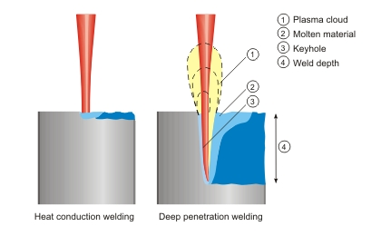
(continued)
NSYSU
Mechanical & Micro-Mechanical Engineering
Laser welding or melting (http://www.rofin.com/en/applications/laser_welding/welding_methods/)
Heat Transfer Lab for Manufacturing and Materials Processing

Slide 8
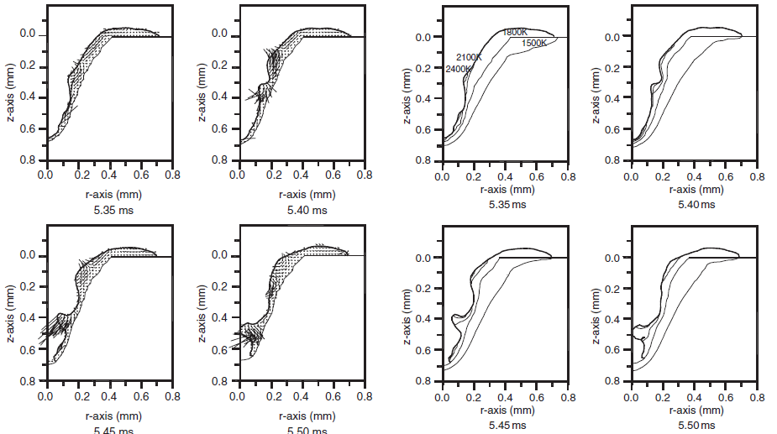
(continued)
NSYSU
(a)
Mechanical & Micro-Mechanical Engineering
()
Keyhole formation and its collapse and blockage of incident flux during spot laser welding (Lee et al. 2012)
Heat Transfer Lab for Manufacturing and Materials Processing
(c)

Slide 9
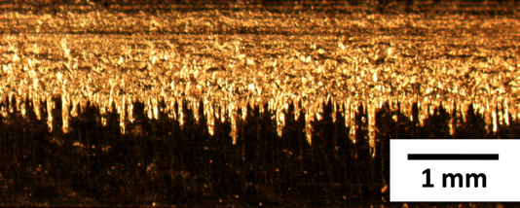
(continued)
NSYSU
Mechanical & Micro-Mechanical Engineering
Image of a longitudinal section of single-mode ﬁbre laser
weld with severe penetration spiking (Cho et al. 2009)
Heat Transfer Lab for Manufacturing and Materials Processing
(c)

Slide 10
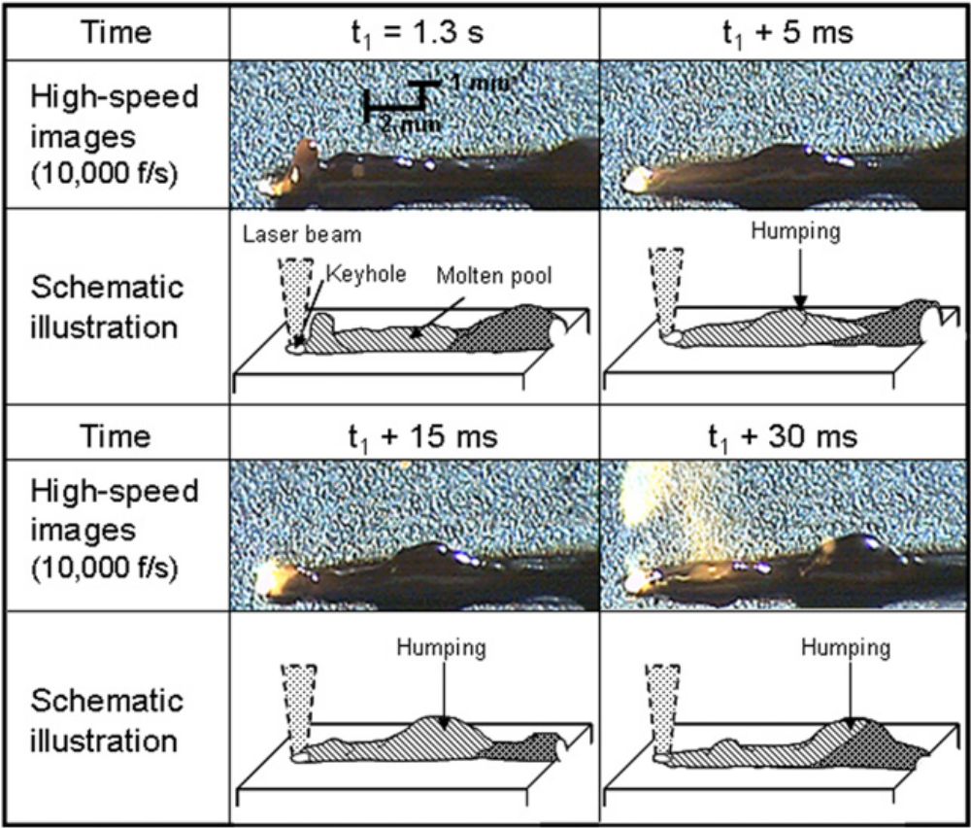
(continued)
NSYSU
(a)
Mechanical & Micro-Mechanical Engineering
High-speed video observation results and schematic illustrations of humping weld bead formation at 130 μm spot diameter in laser keyhole welding of stainless steel (Kawahito et al. 2007)
Heat Transfer Lab for Manufacturing and Materials Processing
(c)

Slide 11
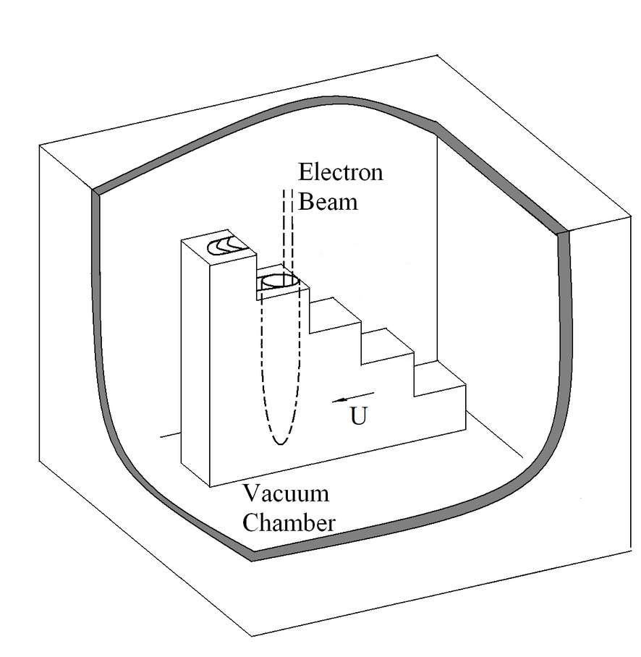
Experimental setup
NSYSU
(a)
Mechanical & Micro-Mechanical Engineering
Acceleration voltage 55 kV
Welding current 20 mA
Scanning speed 15-30 mm/s
Al 6061, 1050, 1100, 5083,
and SS 304
(b)
Beam focusing effects can be studied by using a ladder-shaped fixture
Heat Transfer Lab for Manufacturing and Materials Processing
(c)

Slide 12
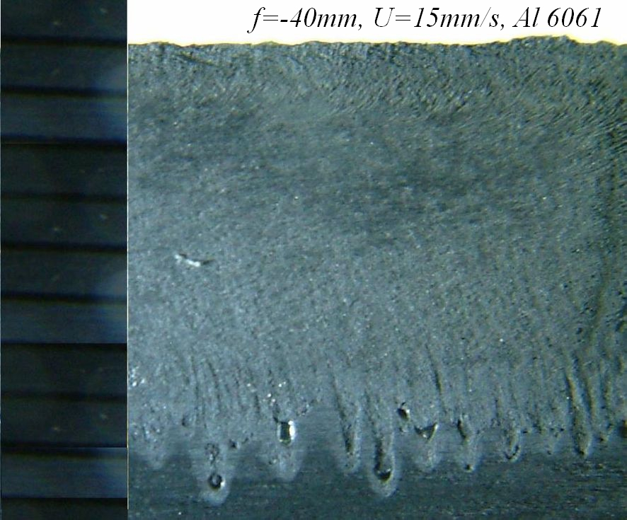
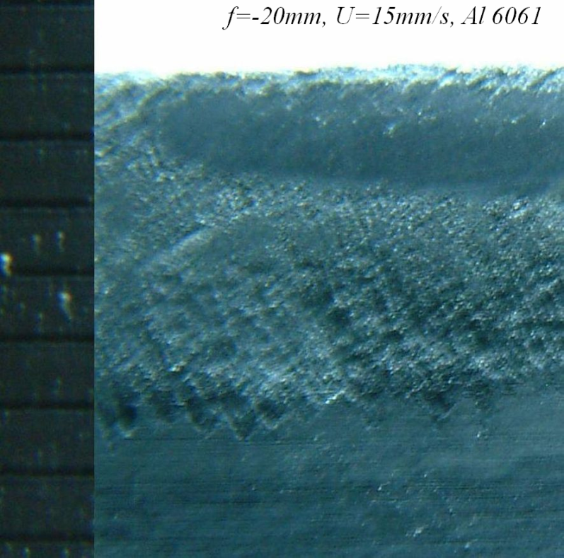
Results and Discussion
NSYSU
Mechanical & Micro-Mechanical Engineering
Spiking is decreased by raising focal spot location. Porosity can also be seen near the spiking tip
Heat Transfer Lab for Manufacturing and Materials Processing

Slide 13
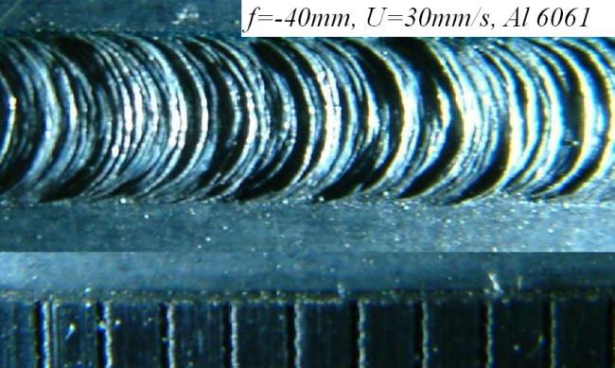
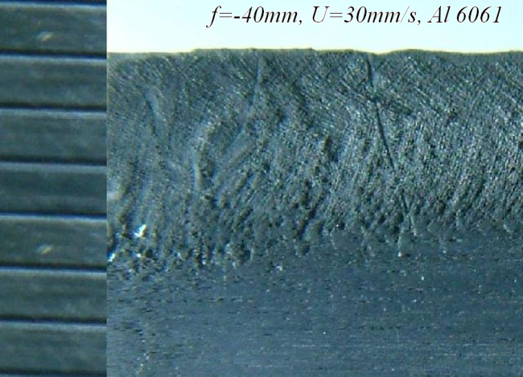
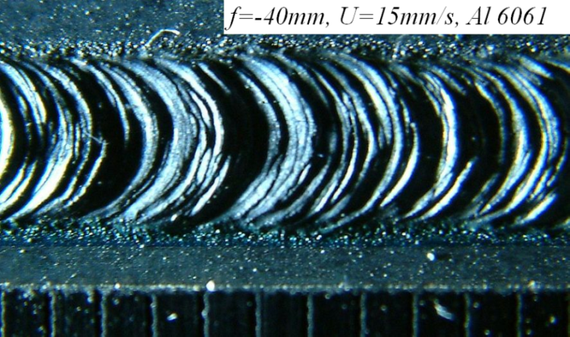

(continued)
NSYSU
Mechanical & Micro-Mechanical Engineering
Rippling and spiking are decreased by increasing welding speed.
Porosity can also be seen near the spiking tip
Heat Transfer Lab for Manufacturing and Materials Processing

Slide 14
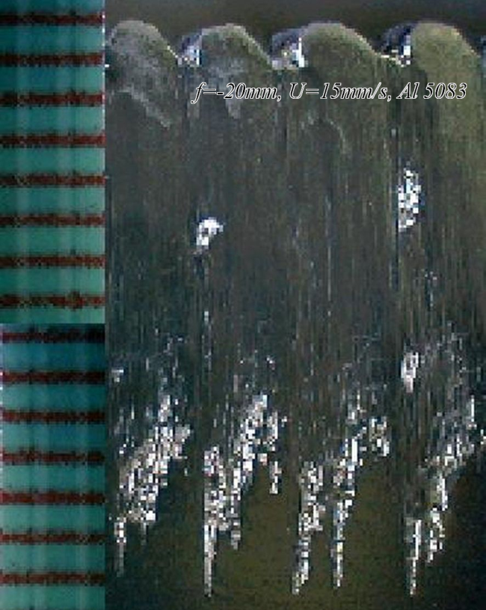
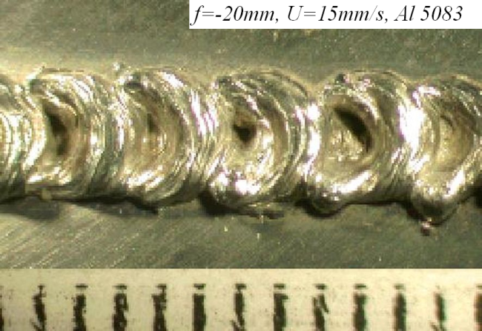
(continued)
NSYSU
Mechanical & Micro-Mechanical Engineering
Spiking and humping becomes severe in Al 5083 containing volatile solute Mg
Heat Transfer Lab for Manufacturing and Materials Processing

Slide 15
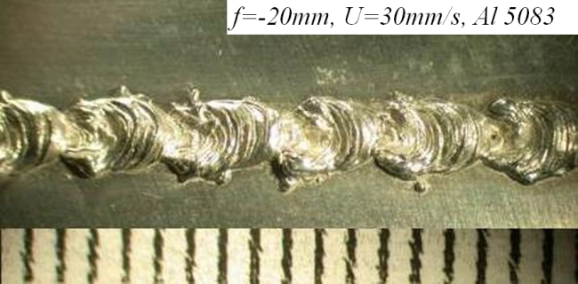
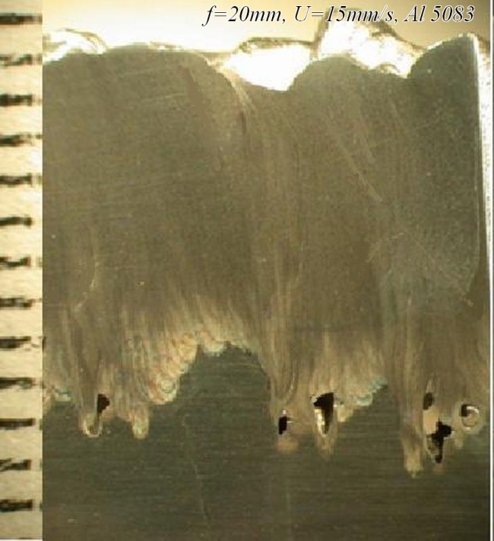
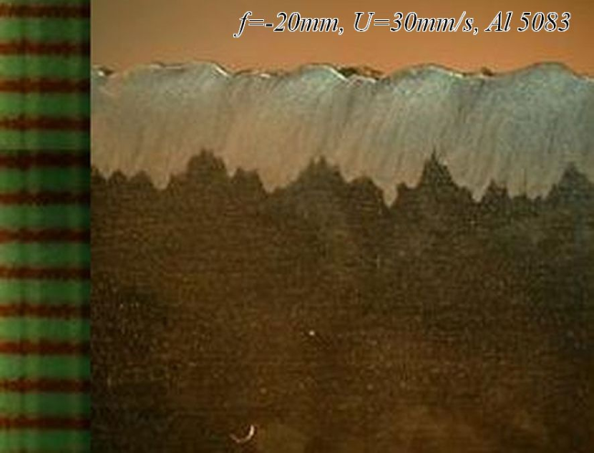
(continued)
NSYSU
Mechanical & Micro-Mechanical Engineering
Spiking and humping are decreased by increasing welding speed and raising focal location. Porosity can also be seen near the spiking tip
Heat Transfer Lab for Manufacturing and Materials Processing

Slide 16
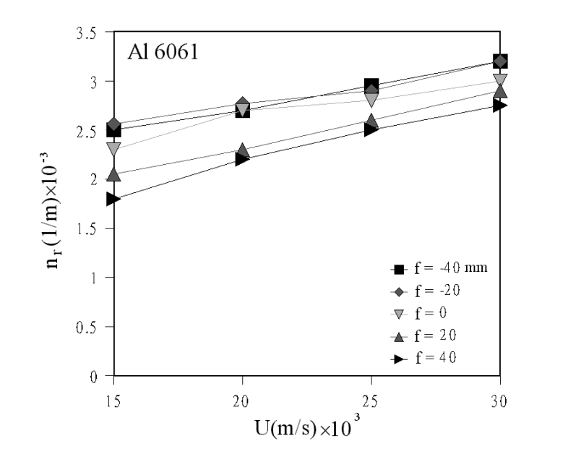
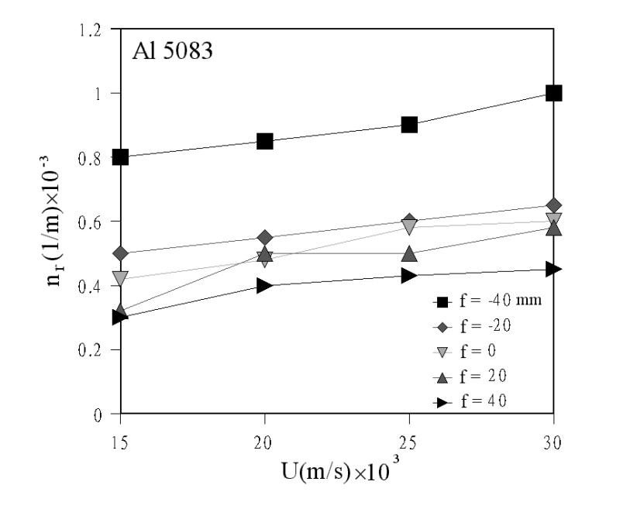
NSYSU
Measurements of rippling, humping and spiking
Mechanical & Micro-Mechanical Engineering
Pitches of rippling and humping are decreased by increasing welding speed , lowering the focal spot location, and welding of Al 6061
Heat Transfer Lab for Manufacturing and Materials Processing

Slide 17
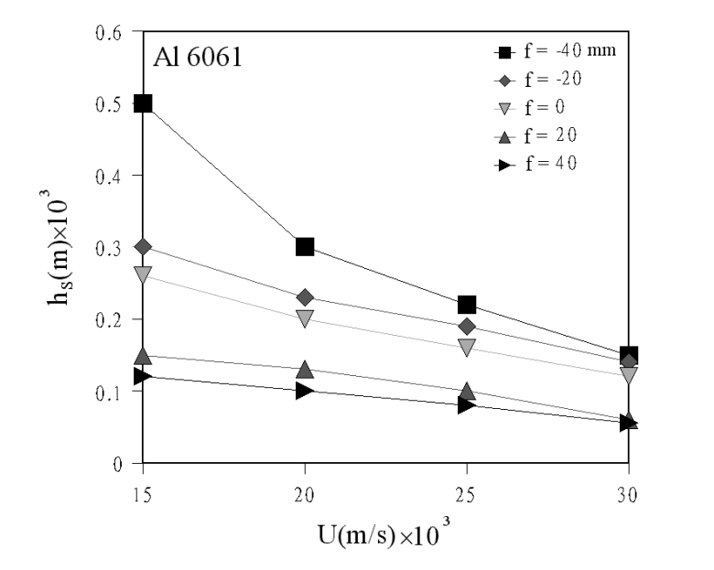
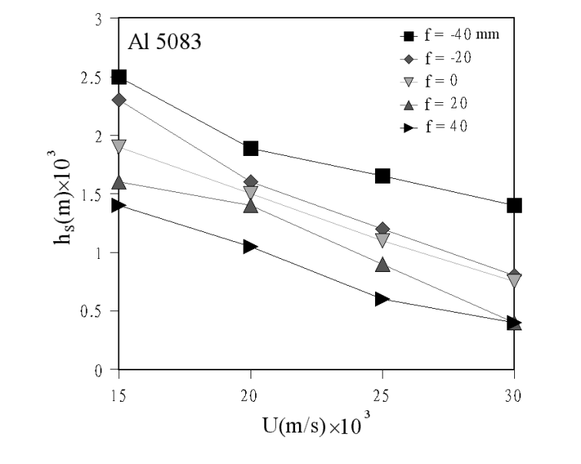
(continued)
NSYSU
Mechanical & Micro-Mechanical Engineering
Spiking amplitude is decreased by increasing welding speed, raising focal spot location, and welding of Al 6061
Heat Transfer Lab for Manufacturing and Materials Processing

Slide 18
Estimation of spiking tendency
NSYSU
Mechanical & Micro-Mechanical Engineering
Incident flux is, respectively, balanced by heating and melting of incoming solid near the keyhole base and along welding direction
Spiking amplitude can be scaled as a product of penetration velocity with time period to produce a spike
melting efficiency representing percentage of beam energy used to heat and
melt incoming solid in welding direction
transfer efficiency represents fraction of beam energy absorbed by the keyhole.
Heat Transfer Lab for Manufacturing and Materials Processing

Slide 19
(continued)
NSYSU
Mechanical & Micro-Mechanical Engineering
Spiking tendency by combing previous equations then gives
where melting efficiency is
Heat Transfer Lab for Manufacturing and Materials Processing

Slide 20
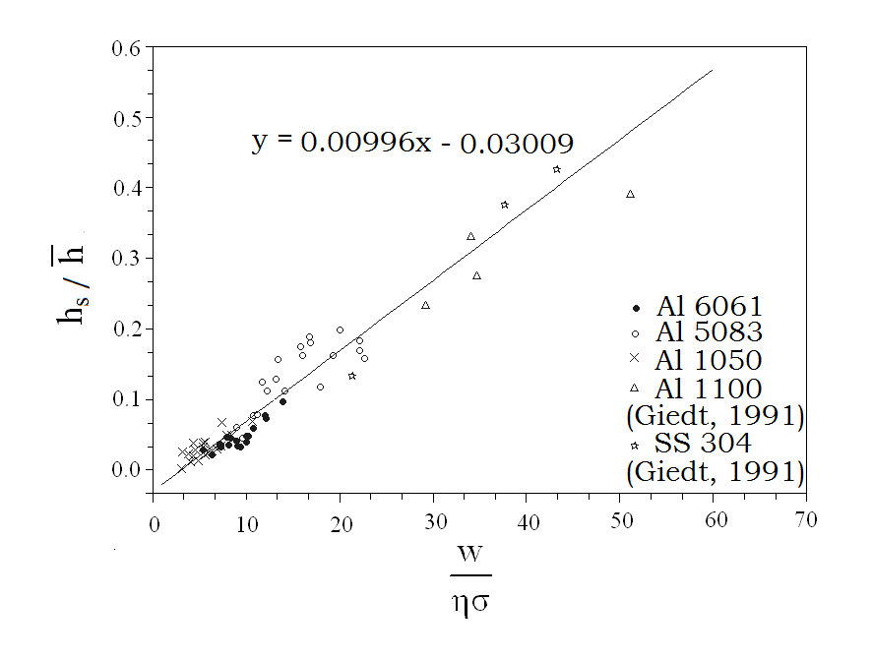
(continued)
NSYSU
Mechanical & Micro-Mechanical Engineering
A comparison between measured and scaled spiking tendency for different materials and working conditions
Heat Transfer Lab for Manufacturing and Materials Processing

Slide 21
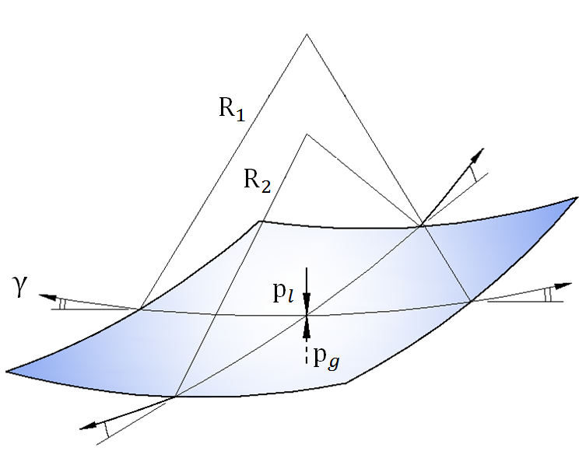
,
Scaling of humping and spiking pitches
NSYSU
Mechanical & Micro-Mechanical Engineering
Different surface patterns are determined by Young-Laplace equation
which reflects that pressures acting on an interface element from two phases are balanced by capillary pressure or normal component of surface tension around the element boundary.
Normal stress balance (Young-Laplace equation)
Heat Transfer Lab for Manufacturing and Materials Processing

Slide 22

NSYSU
(continued)
Mechanical & Micro-Mechanical Engineering
Scaling Young-Laplace equation at the free surface gives pressure difference between the center and edge of the molten pool
Bernoulli equation for liquid flow gives difference in pressures
Thermocapillary force and its scaling gives surface liquid speed
Heat Transfer Lab for Manufacturing and Materials Processing

Slide 23
NSYSU
(continued)
Mechanical & Micro-Mechanical Engineering
Combining previous equations gives average pitch of humping or spiking for alloys without volatile elements
Average pitch of humping or spiking for alloys containing volatile elements
Heat Transfer Lab for Manufacturing and Materials Processing

Slide 24
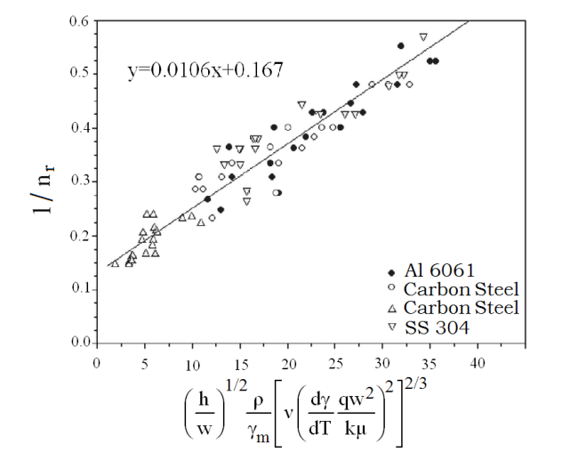
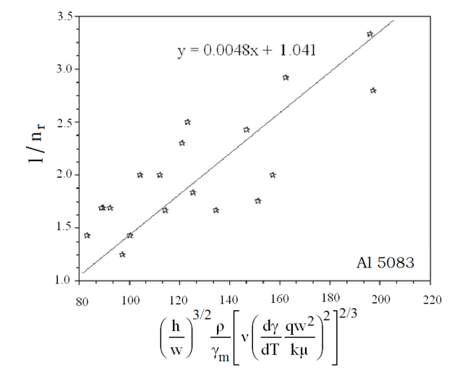
(continued)
NSYSU
Mechanical & Micro-Mechanical Engineering
A comparison between measured and scaled pitches of ripples and humps for different materials and working conditions
Heat Transfer Lab for Manufacturing and Materials Processing

Slide 25
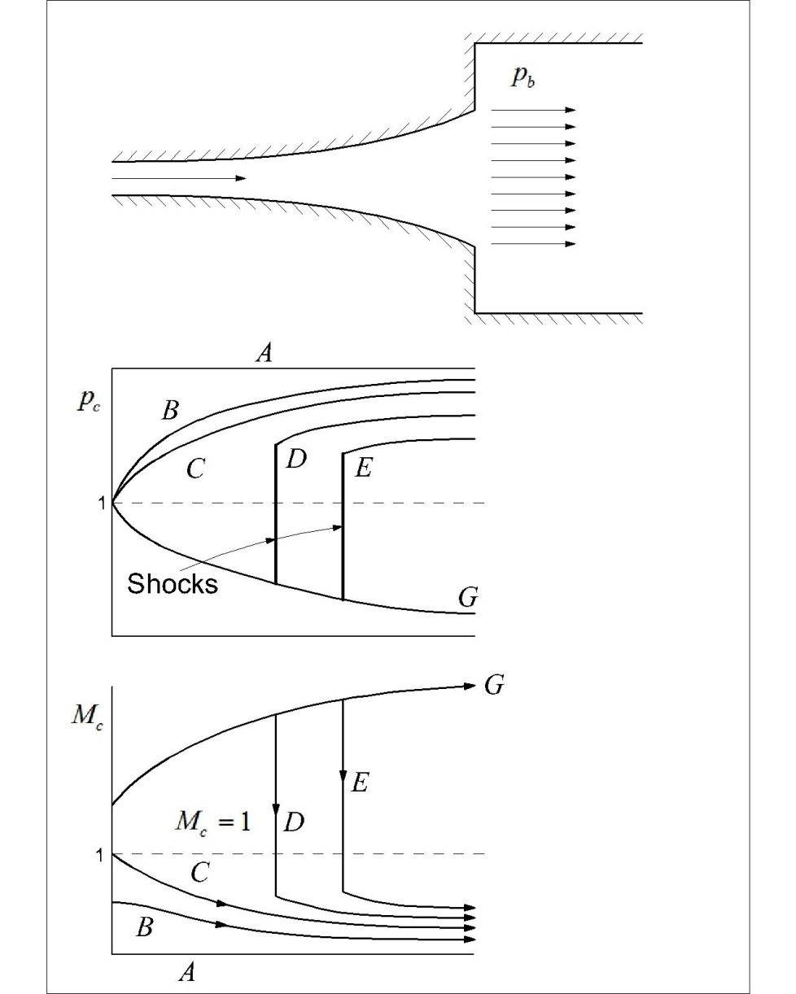
Tendency for keyhole collapse
NSYSU
Mechanical & Micro-Mechanical Engineering
Back pressure induces gas flow
Lowering back pressure decreases gas pressure and increases gas velocity
A further decrease in back pressure in case D gives rise to a shock wave, which increases gas pressure in downstream locations
The shock wave moves toward keyhole opening as back pressure further decreases
Shock wave disappears in keyhole by further reducing back pressure in case G.
Well-known characteristics of a compressible flow in a divergent nozzle
Heat Transfer Lab for Manufacturing and Materials Processing

Slide 26
(continued)
NSYSU
Mechanical & Micro-Mechanical Engineering
Consider Young-Laplace equation
Provided that
The higher the gas pressure, the easier and smaller the pore
can be formed
Existence of a shock wave, which gives rise to high pressure
in downward locations, readily results in pore formation
Heat Transfer Lab for Manufacturing and Materials Processing

Slide 27
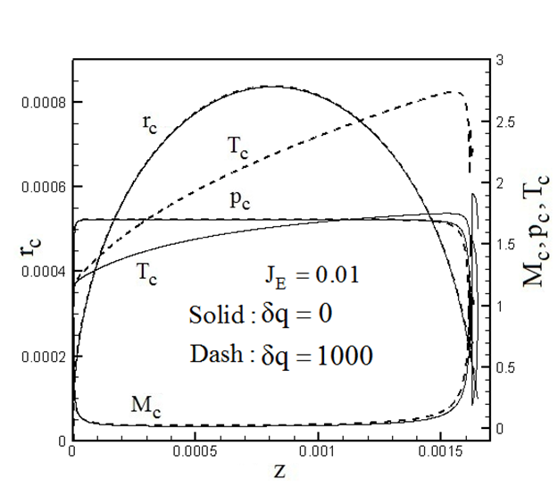
(continued)
NSYSU
Mechanical & Micro-Mechanical Engineering
Keyhole collapse for subsonic flow and existence of a shock wave
Heat Transfer Lab for Manufacturing and Materials Processing

Slide 28
Conclusions
NSYSU
Mechanical & Micro-Mechanical Engineering
Amplitude of spiking and humping are enhanced by lowering the focal spot location and reducing welding speed. It can be successfully scaled.
Tendency for incapability of drilling or keyhole welding is enhanced for a subsonic vapor flow in the keyhole, or existence of a shock wave.
Theoretical analysis is beneficial for understanding and controlling of practical problems.
Heat Transfer Lab for Manufacturing and Materials Processing

Slide 29
References
NSYSU
Mechanical & Micro-Mechanical Engineering
Bejan, A., 1995, Convection Heat Transfer, New York: Wiley
Lee, J. Y., Ko, S. H., Farson, D. F., and Yoo, C. D., 2002, J. Physics D: Applied Physics, Vol. 35, pp. 1570-1576.
Mohanty, P. S., and Mazumder, J., 1998, Metall. Mater. Trans. B, 29, 1269-1279.
Wei, P. S., Chuang, K. C., DebRoy, T., and Ku, J. S., 2011,Journal of Physics D: Applied Physics, Vol. 44, 245501
Wei, P. S., Chuang, K.C., Ku, J. S., and DebRoy, T., 2012, IEEE Transactions on Components, Packaging and Manufacturing Technology, Vol. 2, pp. 383-394.
Cho, J. H., Farson, D. F., and Reiter, M. J., 2009, Journal of Physics D, Applied Physics, Vol. 42, pp. 115501(8 pp)
Kawahito, Y., Mizutani M., and Katayama, S., 2007, J. Physics D: Appl. Phys., Vol. 40, pp. 5854-5859.
Heat Transfer Lab for Manufacturing and Materials Processing

Slide 30
NSYSU
Mechanical & Micro-Mechanical Engineering
Thank you for your attention!
Heat Transfer Lab for Manufacturing and Materials Processing

Slide 31
Let Us Meet Again
We welcome all to our future group conferences of Omics group international
Please visit:
www.omicsgroup.com
www.Conferenceseries.com
http://optics.conferenceseries.com/

