Slide 1
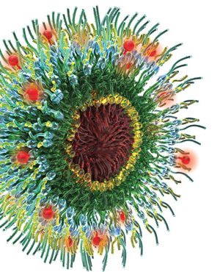

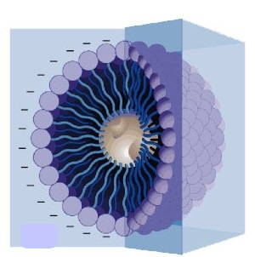
Polymeric micelle based formulation for delivery of docetaxel: Development and evaluation
Hema A. Nair, Megha Marwah

Slide 2
The Burden of Cancer Worldwide : A few figures and facts
Cancer is among the leading causes of death worldwide.
There were an estimated 14.1 million cancer cases around the world in 2014, of these 7.4 million cases were in men and 6.7 million in women.
This number is expected to increase to 24 million by 2035.
Among men, the 5 most common sites of cancer diagnosed include lung, prostate, colorectum, stomach, and liver.
Among women the 5 most common sites diagnosed are breast, colorectum, lung, cervix, and stomach cancer.

Slide 3
Treatment options
Surgery
Radiation
Chemotherapy

Slide 4
Side effects of Chemotherapy
Anaemia
Nausea and vomiting
Appetite Changes
Bleeding
Constipation
Diarrhoea
Fatigue
Hair Loss
Infection
Infertility
Mouth and throat changes
Nervous system changes
Pain
Sexual changes
Skin and nail changes
Urinary, Kidney and Bladder changes

Slide 5
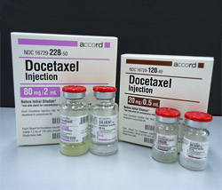
Docetaxel Trihydrate
Docetaxel is a second generation antineoplastic agent belonging to the taxoid family.
Acts by disrupting the microtubular network in cells that is essential for mitotic and interphase cellular functions.
Efficacious in the treatment of cancers of breast and prostrate, non small cell lung carcinoma, gastric adenocarcinoma and head and neck cancers.
The recommended therapy for docetaxel is 6 cycles given once every three weeks, each at the dose of 60 – 110 mg/m² administered iv over 1- 3 hrs.

Slide 6
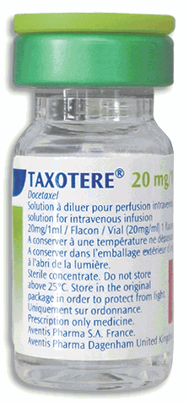
Docetaxel trihydrate–a formidable challenge to formulation scientists
due to poor water solubility
DRAWBACKS
TAXOTERE®
Docetaxel solution made using Polysorbate 80
Polysorbate 80 triggered hypersensitivity reactions necessitates use of steroids
Polysorbate 80 triggered accumulative fluid retention, resulting in weight gain, peripheral oedema and, occasionally, pleural or pericardial effusions
Incomplete treatment with docetaxel due to dose limiting toxicity
Lack of targeting leading to off-target toxicity
Several attempts at designing alternative vehicles including nanosystems for delivery of docetaxel

Slide 7
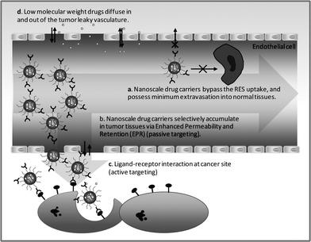
Why nanosystems
Achieve targeting, thereby reducing the concentration at nonspecific sites and decreasing systemic toxicities associated with the same.
Improve solubility of hydrophobic drugs thereby facilitating their parenteral administration.
Has potential to provide with controlled release aiding in maintaining constant therapeutic dose at site of action.
Can also help increase half-life of drug by reducing its clearance.
Can serve to increase drug stability by protecting it from the harsh invivo environment.
Nanotechnology also helps accomplish drug delivery across the blood brain barrier (BBB).

Slide 8
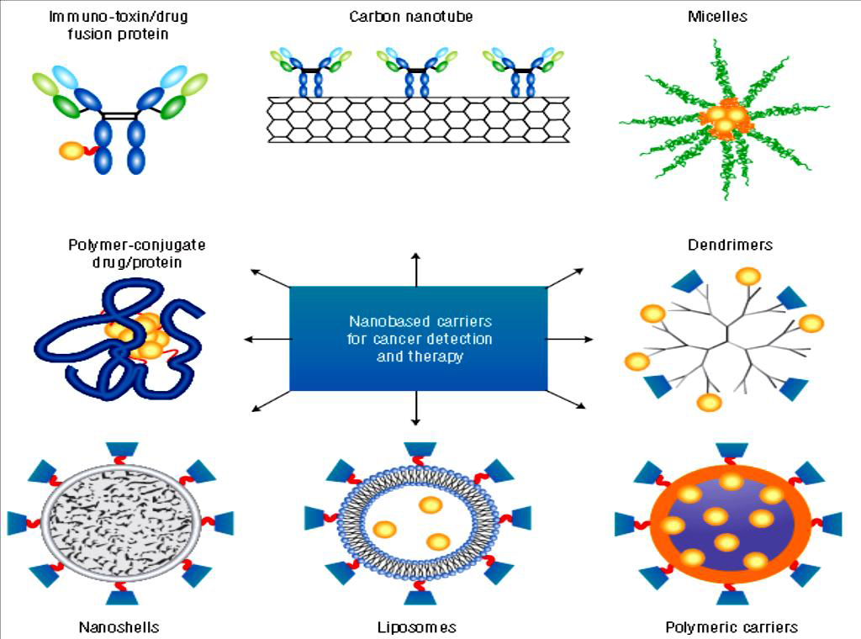

Slide 9
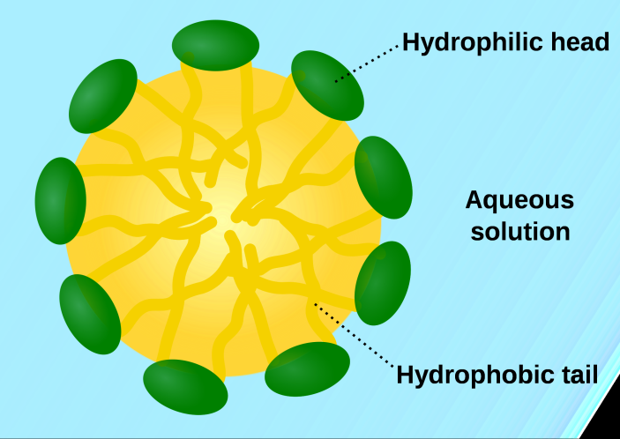
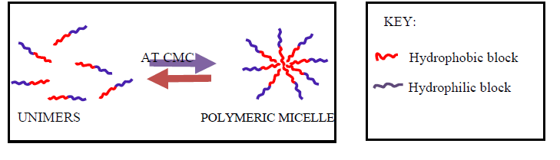
ALTERNATIVE : POLYMERIC MICELLAR SYSTEMS

Slide 10
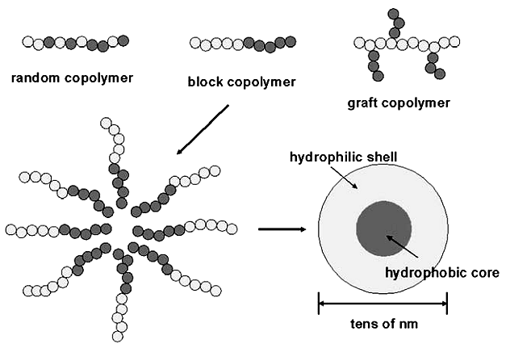
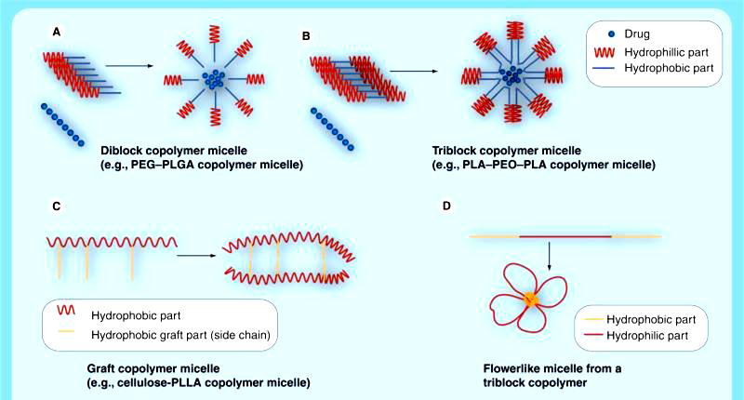
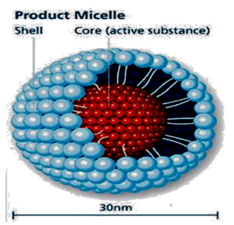
Polymeric Micelles
Nonionic surfactant micelles
Polymeric micelles

Slide 11
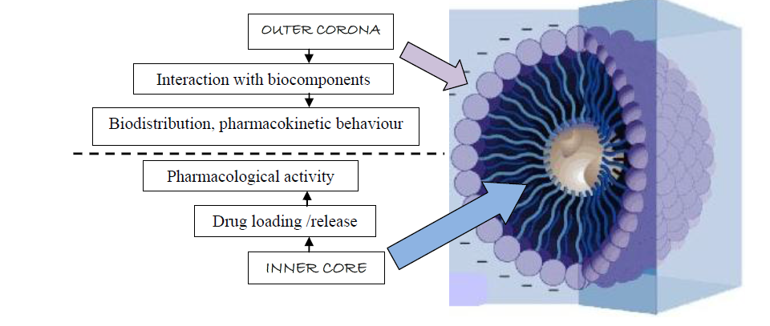
Why Polymeric micelles:
Small size: The size of polymeric micelles is usually
in the range of 10 to 200nm.
Solubilisation of hydrophobic drugs
Cargo protection
Separated functionality
Low toxicity
Low CMC : withstand dilution in body fluids

Slide 12



CHEMICAL CLASS,
CATEGORY OF COPOLYMERS
1. Polyether
PEO-PPO
2. Polyester
a.PEG-Polylactides
b.PEG-Polylactones.
3. Polyaminoethers
PEG-Polyaminoacids
Examples:
EXAMPLES
Pluronic F68, F127, P105.
a. PEG-PDLLA,
PEG-PLGA
b. PEG-PCL
PEG-PAsp, PEG-PHis
GENERAL STRUCTURE

Slide 13
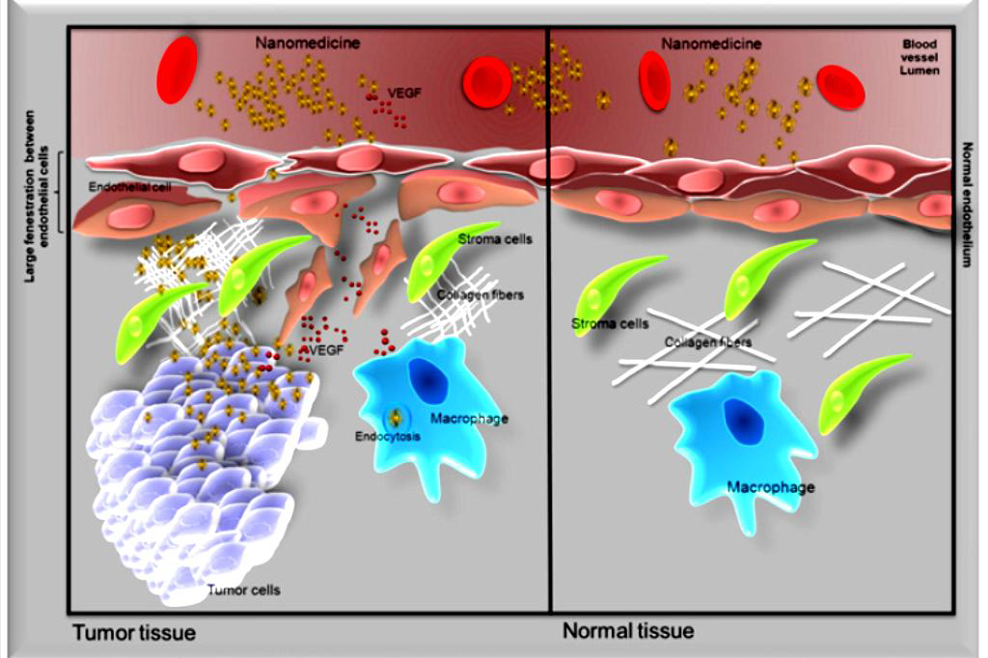
OBJECTIVE OF STUDY: To synthesize biodegradable amphiphilic
POLYETHYLENE GLYCOL – POLYCAPROLACTONE copolymers and employ the same for development of micelle based nanocarrier system for docetaxel offering following advantages over existing therapy:
Use of biodegradable polymers in aqueous vehicle in place of polysorbate 80
Patient compliant treatment
Small size of micelles confers
passive targeting abilities
through Enhanced Permeation
and Retention Effect

Slide 14

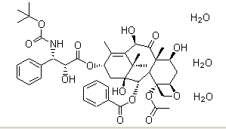
Above CMC
PCL
PEG
PEG-PCL copolymer
Crystallinity and hydrophobicity- barriers to biodegradability
Reduced crystallinity and hence improved biodegradability
Drug loaded Polymeric Micelle
DOCETAXEL
TRIHYDRATE
IMPROVED SOLUBILIZATION TARGETING POTENTIAL

Slide 15
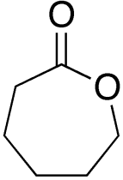
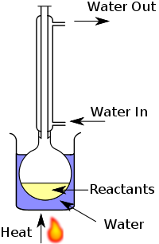
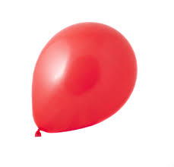


SYNTHESIS OF Polyethylene Glycol- Polycaprolactone (PEG-PCL) BLOCK COPOLYMERS
I
mPEG2000 + Caprolactone monomer + catalyst at 160˚C
II
III
IV
N2 gas
PEG-PCL linear
diblock copolymers
Stannous Octate
Block copolymers employing four different ratios of PEG: Monomer (ε-caprolactone) were synthesized by ring opening bulk polymerization reaction.
Completion of reaction was monitored by Thin Layer Chromatography (TLC).

Slide 16
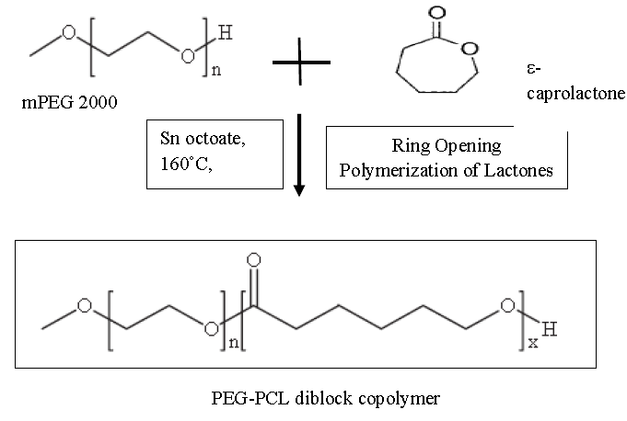
CHARACTERISATION OF SYNTHESIZED BLOCK COPOLYMERS:
1. IR spectroscopy
for identification
4. XRD for determination of crystallinity
3. Critical
Micelle
Concentration
(CMC): Pyrene
Fluorescent
probe method
2. H1-NMR spectroscopy for number average molecular weight determination

Slide 17
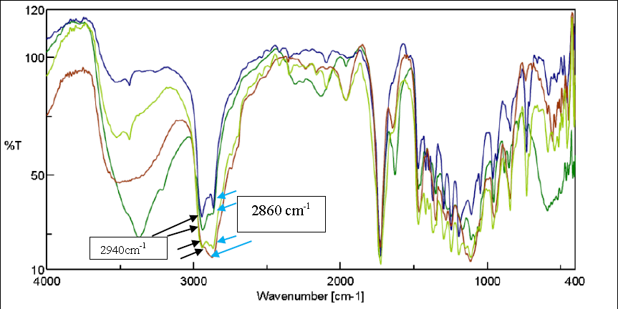
CHARACTERISATION OF SYNTHESIZED BLOCK COPOLYMERS:
1.Identification by Infrared Spectroscopy :
1725-1732 cm⁻¹
C=O stretch of ester
C-H stretch of caprolactone subunit
C-H stretch of PEG subunit
Synthesized polymer IV
Synthesized polymer II
Synthesized polymer III
Synthesized polymer I

Slide 18
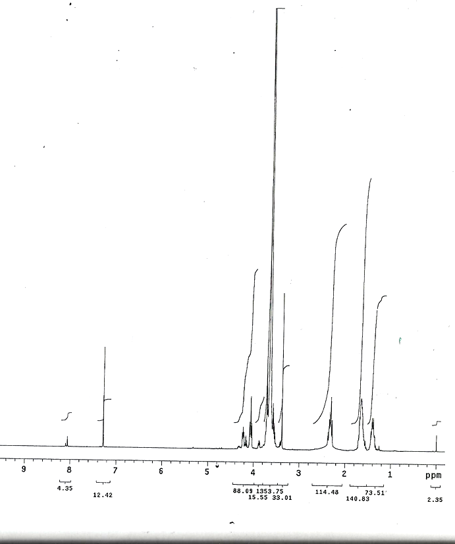
2. Identification and Determination of Number Average Molecular Weight (Mn) and HLB by H1-NMR Spectroscopy: Mercury Plus 300 MHz NMR Spectrometer, VARIAN, USA
HLB=
20X (MnPEG/
MnCopolymer)
POLYMER | I | II | III | IV
Mn PEG Mn _{PCL} | 1430.50 432.69 | 1329.51 882.46 | 1556.70 2049.49 | 1557.36 2979.73
Mn _{copolymer} | 1863.2 | 2211.98 | 3606.19 | 4537.09
HLB | 15.35 | 12.02 | 8.632 | 6.86

Slide 19
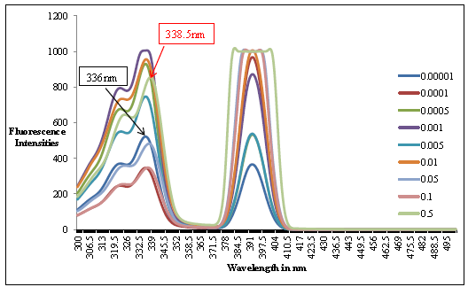
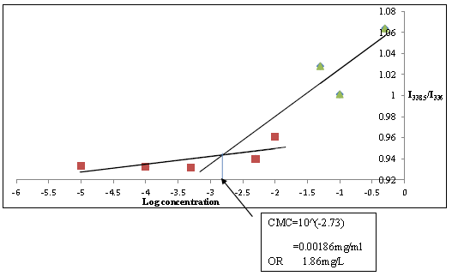
CHARACTERISATION OF SYNTHESIZED COPOLYMERS:
3. Determination of CMC : Pyrene fluorescent probe method
Excitation spectra of pyrene in Polymer IV at different concentrations
And
Plot of I₃₃₉/I₃₃₆ versus log concentration
CMC = 10^(-2.33) = 0.00186 mg/ml
POLYMER | I | II | III | IV
CMC (mg/L) | 22.38 | 12.5 | 2.81 | 1.86

Slide 20
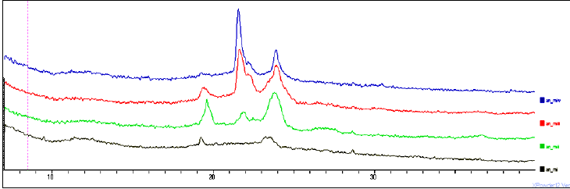
4. X-Ray Diffraction analysis of synthesized copolymers:
Philips P Analytical X’pert Pro X ray diffractometer
** PEG block
*
* PCL block
*
*
**
*
IV
INTENSITY
**
*
*
III
**
**
II
I
2θ
Peaks at 19˚ and 23˚: correspond to PEG block
Peaks at 22˚ and 24˚: correspond to PCL block
PCL block crystallinity increases and PEG block crystallinity decreases across polymers I through IV.

Slide 21
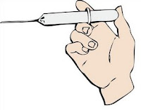
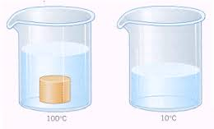
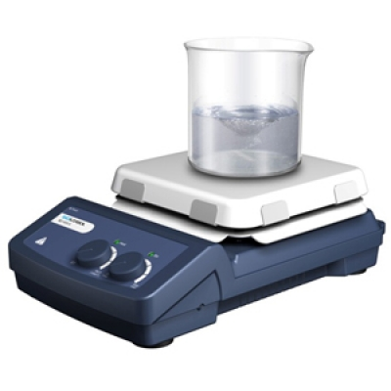
FORMULATION OF MICELLAR SYSTEMS
Polymeric micelles
Dropwise addition of a solution of polymer(s) and drug in acetone
Bath sonication
Water, heated to 40˚C
Micellar dispersions were subjected to lyophilization in presence of hydroxypropyl beta cyclodextrin (HPBCD) as cryoprotectant.
.

Slide 22
CHARACTERISATION OF MICELLAR DISPERSIONS
Polymeric micelles:
CHARACTERISATION
Micelle size and Zeta potential: Zetasizer
Drug loading and entrapment efficiency
Morphology: TEM

Slide 23
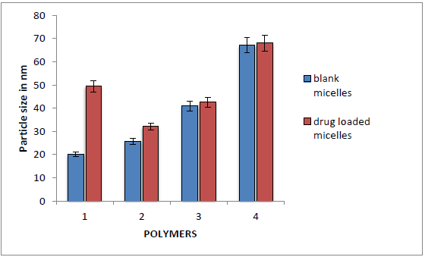
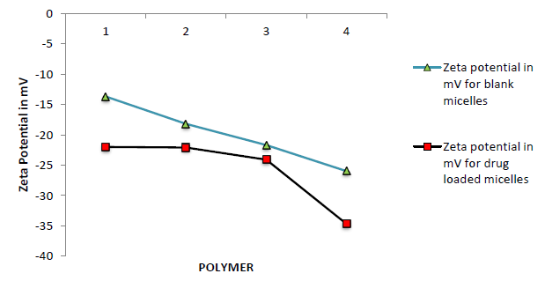
EVALUATION OF MICELLAR DISPERSIONS
Micelle Size and Zeta Potential:
Zetasizer Nano ZS (Malvern)
POLYMER/ PARAMETER |  | I | II | III | IV
Micelle Size (in nm) | BLANK | 19.98 | 25.8 | 40.95 | 67.11
 | DRUG LOADED | 49.49 | 32.05 | 42.52 | 68.03
Polydispersity Index (PI) | BLANK | 0.409 | 0.404 | 0.413 | 0.308
 | DRUG LOADED | 0.499 | 0.479 | 0.389 | 0.209
Zeta Potential (in mV) | BLANK | -13.7 | -18.2 | -21.7 | -26
 | DRUG LOADED | -22.0 | -22.1 | -24.1 | -34.7

Slide 24
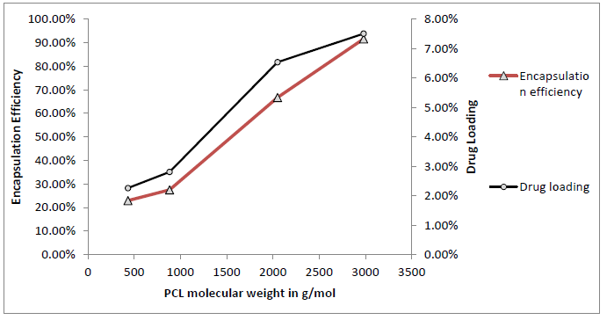
2. Drug loading and entrapment efficiency of simple and mixed micelles:
Micellar dispersion – Dilution and Analysis
Centrifugation
Dilution and Analysis of supernatant
POLYMER/ PARAMETER | I | II | III | IV
Drug loading (% w/w) | 2.25 | 2.8 | 6.54 | 7.51
Entrapment Efficiency (%w/w) | 22.92 | 27.48 | 66.74 | 91.64
HLB | 15.35 | 12.02 | 8.632 | 6.86
Drug loading and encapsulation efficiency of micelles formulated from synthesized polymers

Slide 25
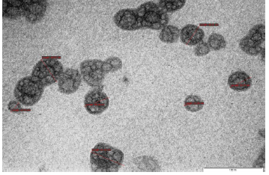
3. Morphology Of Micelles: TEM
Transmission Electron Microscope (Philips CM200)
TEM IMAGE OF MICELLES PREPARED USING POLYMER IV (Scale: 100nm)

Slide 26
IN VITRO RELEASE STUDIES: SIMPLE AND MIXED MICELLES
Micellar Dispersion/ Drug solution in dialysis bag MWCO: 12000Da
Receptor medium: PEG 400 : PBS ; 75 : 25 v/v
Gentle stirring at 37ºC on a stirring mantle
Aliquotes analysed by validated HPLC method

Slide 27
IN VITRO CYTOTOXICITY STUDIES
A 549 cell line : Adenocarcinomic human alveolar basal epithelial cells
Sulforhodamine B (SRB) assay for viable cells

Slide 28
SUMMARY
Amphiphilic block copolymers tailored to suit needs.
Extremely low CMC values capable of withstanding dilution in bloodstream possible.
Small size imparts passive targeting properties (Enhanced Permeation and Retention Effect).
Polymeric micelles containing biodegradable ester linkage have the potential to avert side effects vis-à-vis Taxotere® (marketed drug solution of docetaxel).
Polymeric micelles hold good potential for delivery of cytotoxic agents.

Slide 29
ACKNOWLEDGEMENTS
Acknowledgements:
We would like to thank Dr. Juvekar and Mr. Subroto at ACTREC for helping us with cell line work.
We would also like to express our gratitude towards Mrs. Nutan Agadi at IIT for conducting NMR studies, Glenmark for DSC analysis, Mr. Nilesh Kulkarni at TIFR for XRD studies.
Special thanks to Mr.Milind Tikle at Dept. of Chem., Mumbai University for helping with spectrofluorimetric analysis for determination of CMC.

Slide 30
Potential for vaccine delivery?

Slide 31
KEY FEATURES OF POLYMERIC MICELLAR SYSTEMS WHICH MAKE THEM
SUITABLE FOR VACCINE DELIVERY:
Due to their small size (generally <100 nm) they particularly facilitate the antigen delivery to antigen presenting cells (APCs), such as dendritic cells (DCs) in the draining lymph nodes.
Micelles are capable of targeting DCs by traveling through lymphatics directly to lymph nodes, promoting germinal centre formation
They can also easily display suitable surface properties (nature, surface charge) through the appropriate choice of biocompatible hydrophilic segments of the micelle corona.
Through appropriate chemical design of the hydrophobic and hydrophilic blocks (presence of reactive groups, cationic moieties,…), a variety of additional immunostimulatory molecules (such as Toll Like Receptor (TLR) ligands, mannose receptor ligands,…) can be easily incorporated in these systems in a controlled fashion, to induce an enhanced activation of the DCs.

Slide 32
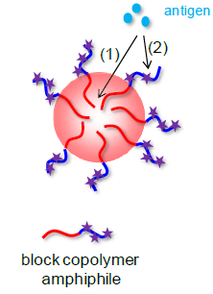
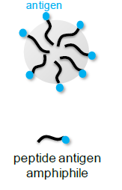
Two main types of micellar nanocarriers for vaccine delivery
Amphiphilic block copolymers used for self-assembly into micelles while an antigenic peptide is associated to the latter through either encapsulation or surface coupling
Peptide amphiphile self-adjuvant system, wherein the antigenic peptide is used as the hydrophilic head-group and covalently bound to a hydrophobic moiety (typically alkyl tail) for self-assembly into micelles

Slide 33
A few Studies……POLYMERIC MICELLAR SYSTEMS
Polymeric micellar system | Antigen | Finding
PEG-b-poly(propylene sulfide) block copolymer | Ovalbumin | 2.4-fold OVA-specific CD8+ T cells in the blood and higher (1.7-fold) interferon gamma levels from splenocytes upon restimulation than in mice immunized with free OVA with CpG as adjuvant.
Cationic polyethyleneimine (PEI) – stearic acid based micelles | Hydrophobic melanoma peptide antigen Trp2 | Trp2-loaded micelles accumulated preferentially in the medulla and paracortex of the draining lymph nodes and were present at negligible levels in the systemic circulation. Mice immunized with Trp2-loaded micelles showed significantly higher Trp2-specific cytotoxic T lymphocyte activity than mice immunized with free Trp2 or a mixture of Trp2 and empty micelles.
Micelles based on chitosan modified with hydrophobic phenyl alanine bearing mannose moieties – for triggering mannose-receptor mediated endocytosis in APCs. | Plasmid DNA encoding hepatitis B surface antigen (pHBsAg) | Enhanced cell uptake (RAW 264.7 and DC 2.4 cells) and high in vitro transfection efficiency Intradermal immunization of BALB/c mice indicated that polyplexes with the plasmid DNA encoding pHBsAg induced significantly higher serum antibody titer in comparison to naked pHBsAg

Slide 34
PEPTIDE MICELLAR SYSTEM
Pepetide based micellar system | Finding
Peptide epitopes selected from the HSV envelope glycoproteins B and D (gB and gD), that had their N-terminus modified with hydrophobic moieties containing a double C18 alkyl chain | The cytokine production triggered by the gB and gD micelles in mouse (RAW 264.7) and human (U937) macrophages increased compared to the production triggered by the pure gB and gD peptides

Slide 35
THANK YOU
FOR
PATIENT
LISTENING

