Slide 1
Mapping population & genotype/serotype diversity: game changers in designing viral vaccines
Dr. Urmila Kulkarni-Kale, FMASc
Bioinformatics Centre
Savitribai Phule Pune University
Pune 411007. India
urmila@bioinfo.net.in
Urmila.kulkarni.kale@gmail.com

Slide 2
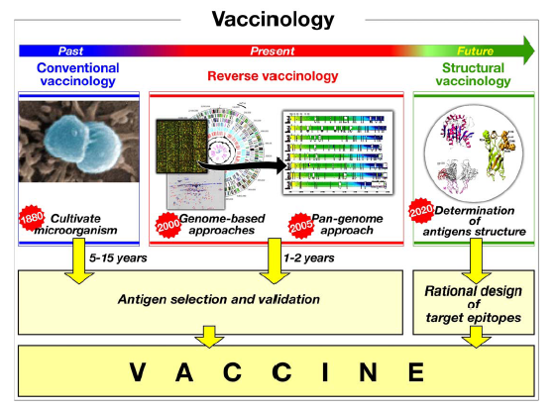
Reverse Vaccinology Approach
Serruto & Rappuoli, FE BS Letters, 580 (2006) 2985–2992

Slide 3
Genome 2 Vaccinome:
Opportunities & Challenges
Genomics &
Comparative genomics
Organisation
Annotation
Comparisons
Data mining
Sequence analysis
Molecular phylogeny
Geno/serotyping
Structural coverage
Epitope prediction algorithms
Limited true positive datasets
Validation of predictions
Need for true negative data
Kulkarni-Kale et al., CBIO, 2012. Volume 7 (4), 454-466.
Study of variation/
conservation across
taxonomic hierarchy
Bioinformatics &
Structural genomics
Immunoinformatics

Slide 4
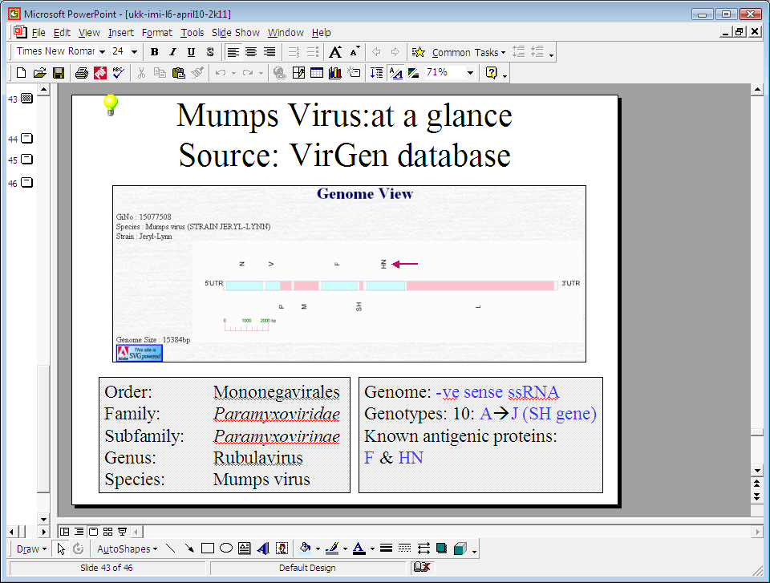
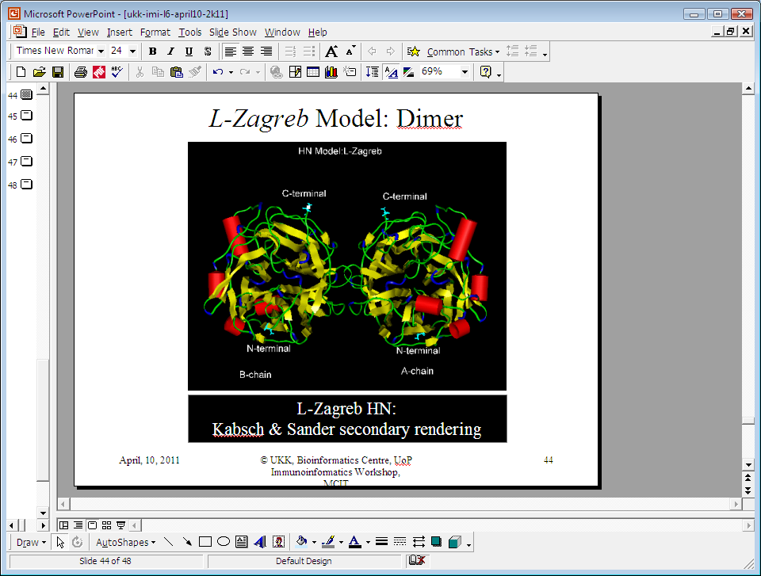
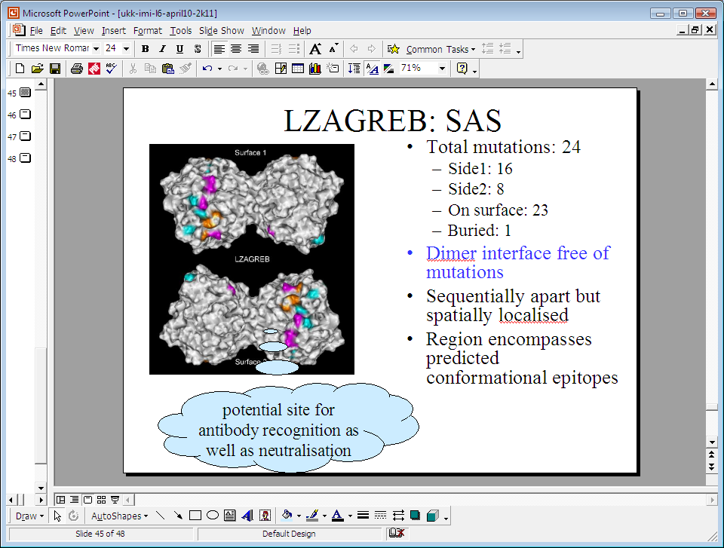
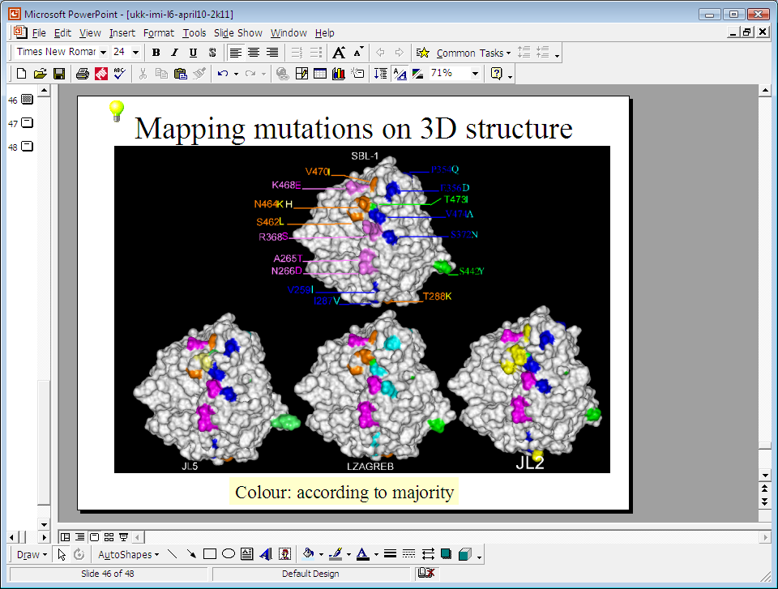
Mumps Virus: antigenic diversity & strain specificity
Funded by: Serum Institute of India, Pune
Kulkarni-Kale et al., 2007, Virology, 359(2):436-46.

Slide 5
Study of variations at different levels of Biocomplexity
How similar is similar?
How different is different?
Strains/isolates of a virus
Serotypes/genotypes of a virus
Viruses that belong to same genus
Viruses that belong to same family
  Correlate: genotype with phenotype
Implications in:
Host-Virus interactions
Rational design of vaccines & drugs
Development of diagnostics

Slide 6
Molecular Phylogeny Analysis (MPA): permits study of similarities within the group and differences between the groups
Integral part of sequence analysis in bioinformatics
Applications:
  Evolution of gene(s) in a group of species
  Evolution of species
  Assignment of genotype/serotype, strains
  Map emergence of drug resistance
  Prioritization of vaccine candidates

Slide 7
MPA: steps
Types of models
  Distance based (UPGMA, NJ)
  Character based (Maximum parsimony)
  Probabilistic (Likelihood)
Define a question
A set of sequences
Multiple sequence alignments
Selection of a model
Use of clustering method(s)
Generate consensus tree
Statistical models to assess tree topology(ies)
Analysis of inferred tree(s) Assign geno-/serotypes

Slide 8
Limitations of MPA methods
Positions of IN-DELs in MSA impact model of evolution
  Errors in alignment increases as sequence similarity decreases
  Assumption of character-based MPA methods
    Sites evolve independently
Different methods result into different trees
  Becomes a matter of interpretation
Need to repeat analysis with every New sequence
  Time consuming and tedious
Size of data in post-genomic era
Computational complexity and memory requirements
Time requirements (as length & number of sequences increase)
Size of data in post-genomic era
Computational complexity and memory requirements
Time requirements (as length & number of sequences increase)

Slide 9
Alternate Alignment-free Methods for MPA
Composition vector based CVTree Method
(Qi et al., 2004)
Feature Frequency Profile (FFP)
(Sims et al., 2008)
Advantages
  Simple, faster
  Applications demonstrated for clustering & phylogeny
Disadvantages
  Takes only frequency in account (not the context)
  Misclassification and alternate tree topology

Slide 10
Proposed RTD-based approach
Based on the concept of Return Time Distribution in stochastic modeling
Return Time (RT): Time required for the reappearance of particular state without its appearance in between
Alignment free

Slide 11
Computing RTD for ‘A’
Return Time (RT): Time required for the reappearance of particular state without its appearance in between.
CTACACAACTTTGCGGGTAGCCGGAAACATTGTGAATGCGGTGAACA
1-1-0-10-5-0-0-1-5-0-7-0-1
Return times for ‘A’
RTD for ‘A’ in above sample sequence
Return time for A (X) | Frequency (F)
0 | 5
1 | 4
5 | 2
7 | 1
10 | 1
Parameters of RTD for ‘A’
μ(A) = 2.38 and σ(A) = 3.27
Similarly, compute μ and σ of RTDs of T, G and C, for k=1.

Slide 12
RT→RTD →Distance matrix
The frequency distribution of all such observed RT is termed as RTD of that nucleotide
Read sequence(s)
Derive RT & RTD at given value of k
Derive parameters of RTD:
µ & σ
Compute distance matrix
Derive NJ tree
View tree & analyse tree topology
Numeric vector of size 2*4^{k}
comprising of μ and σ of 4^{k} possible RTDs
D_{ij} = (∑ [G_{irμ} - G_{jrμ}]² + ∑ [G_{irσ} - G_{jrσ}]²)^{1/2}

Slide 13
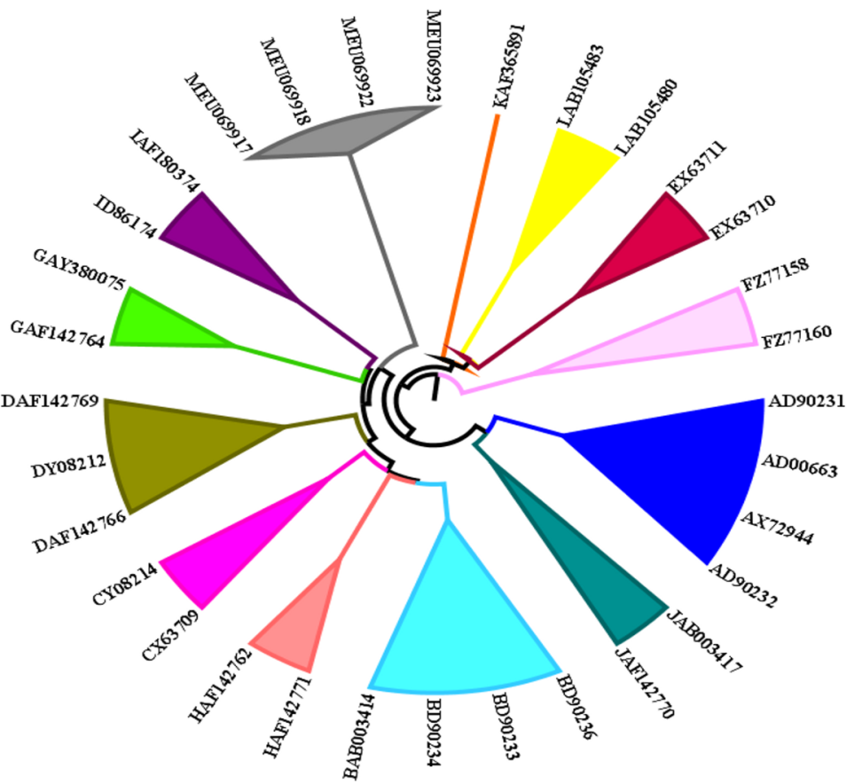
Clustering of Mumps Viruses using sequences of SH & RTD at K=4
Reference data: Mumps Virus: Known genotypes (A-L)

Slide 14
RTD → MPA → Genotyping
Datasets–
Reference
Test
Optimise k
using reference dataset
Read sequence(s)
Derive RTD at chosen value of k
Derive parameters of RTD:
µ & σ
Compute distance matrix
Derive NJ tree
Compute min-max & distance range using Reference data
Predict genotype
Numeric vector of size 2*4^{k}
comprising μ and σ of 4^{k} possible RTDs
D_{ij} = (∑ [G_{irμ} - G_{jrμ}]² + ∑ [G_{irσ} - G_{jrσ}]²)^{1/2}
Compute -
sensitivity,
specificity

Slide 15
Mumps: Datasets used
Data source: GenBank
Reference dataset:
28 sequences of known genotypes
Test dataset 1:
96 entries with known genotypes
Test dataset 2:
380 entries
True negative dataset:
Non-SH Mumps sequences
Non-Mumps SH sequences
Non-Mumps, Non-SH sequences
Genotype | Reference dataset | Test dataset 1 | Test dataset 2
A | 4 | - | 22
B | 4 | - | 63
C | 2 | 3 | 9
D | 3 | - | 32
E | 2 | - | 1
F | 2 | 49 | 8
G | 2 | 20 | 158
H | 2 | 11 | 26
I | 2 | - | 15
J | 2 | 13 | 44
K | 1 | - | -
L | 2 | - | 2
Total | 28 | 96 | 380

Slide 16
Clustering of SH using RTD at K=4
Reference data
Test dataset 2

Slide 17
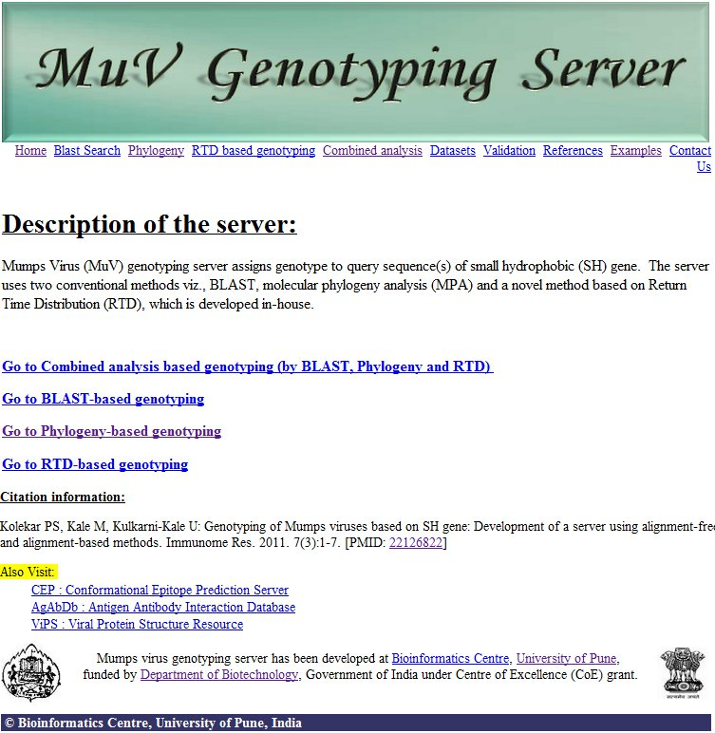
Genotyping of Mumps viruses
Known genotypes: 15
Input : SH gene
Optimum k=4
Sensitivity : 98.95%
Specificity : 100%
Kolekar et al (2011) Immunome Res, 7(3):1-7
Available at: http://bioinfo.net.in/muv/homepage.html

Slide 18
RTD for MPA, Serotyping, Genotyping, & Clustering
SH gene sequence
Mumps Genotyping server
Whole genome
Dengue Subtyper
WNV Genotyping

Slide 19
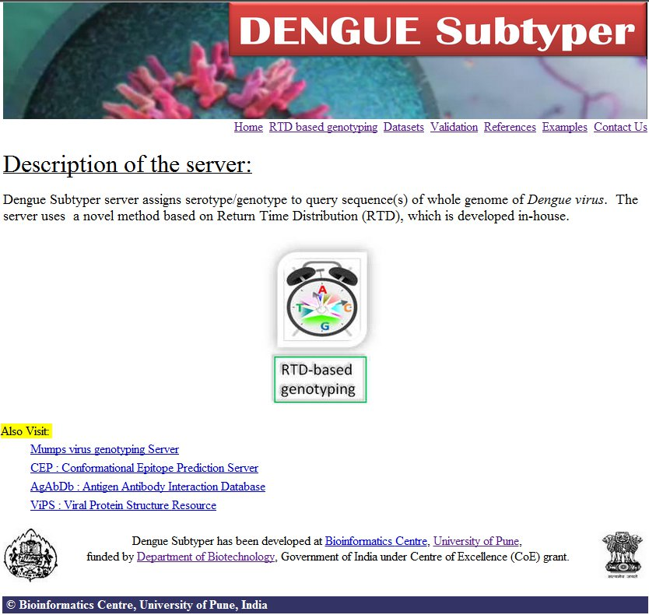
Subtyping of Dengue viruses
Input : Whole genome
Optimum k=5
Sensitivity : 100%
Specificity : 100%
Kolekar et al (2012) Mol Phyl Evol . Molecular Phylogenetice & Evolution. 2012 Nov;65(2):510-22.
Available at: http://bioinfo.net.in/dengue/homepage.html

Slide 20
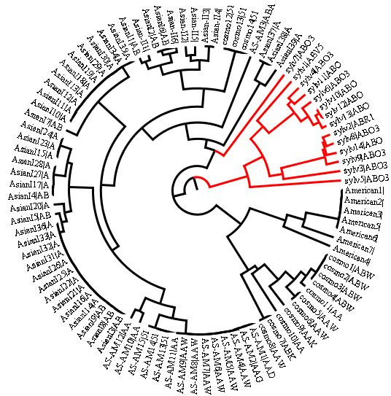
RTD-based clustering of urban and sylvatic DENV-2 using sequences of Envelope glycoprotein (egp)
Dengue-2 virus serotype is divided into 6 genotypes viz. American, American-Asian, Asian-I, Asian-II, Cosmopolitan and sylvatic.
These genotypes are categorized into urban (endemic/epidemic) and sylvatic types based on their host transmission.
Urban viruses infects humans while sylvatic viruses infects non-human hosts.
RTD-based informative residues viz. N, I and R obtained by WEKA helps in clustering of Dengue-2 wrt host specificity at K=1.

Slide 21
Application of RTD to predict host-specificity
RT of R mapped on 3D structure of E protein
RTD of R residue in non-sylvatic genotypes
R2
R9
R57
R73
R89
9
R99
R188
R210
R286
R288
6
47
15
15
88
21
75
1
R323
R345
R350
R407
R410
R471
K247 in non-sylvatic DENV-2
genotypes is critical for infectivity
in humans; while Sylvatic strains shows K247R mutation
34
21
4
56
2
60
RTD of R residue in Sylvatic genotype
3
R93
5
R2
6
R9
47
R57
R73
15
R89
R99
88
R188
R210
R286
1
R288
15
21
75
36
18
34
R323
21
R345
4
R350
56
R407
R410
R471
R247
2
60
Figure shows mapping of R residues
on the E protein structure [1TG8] of
American strain (Tonga/EKB194/1974)]
Known epitopes, Ligand-binding residues & receptor-binding residues, Evolutionary trace residues reported to be binding site and novel are shown.

Slide 22
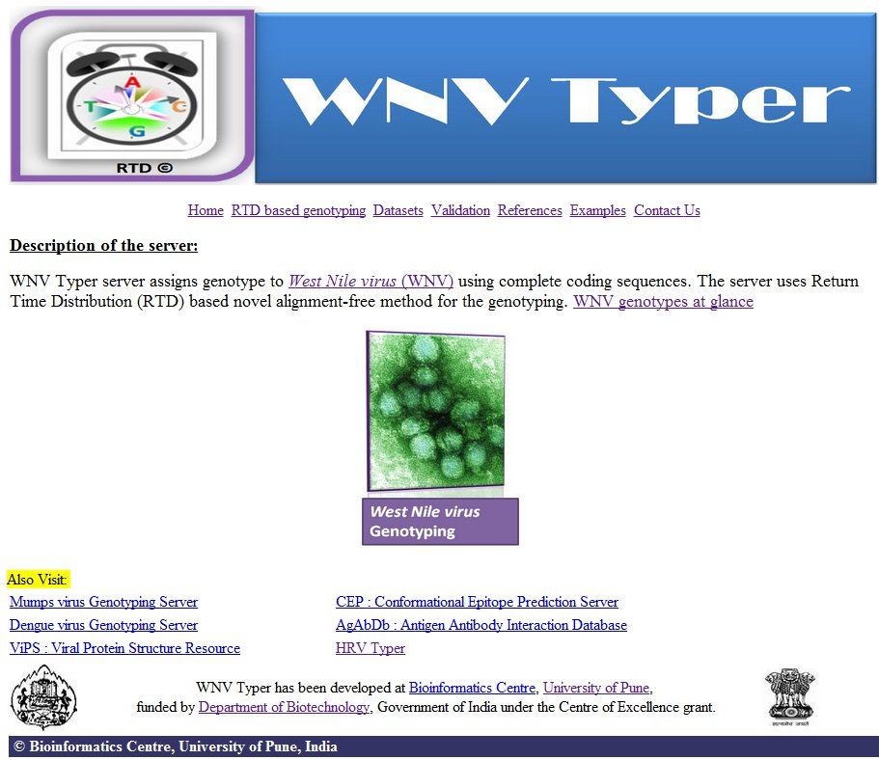
Genotyping of West nile viruses
Input : Whole genome
Optimum k=7
Sensitivity : 100%
Specificity : 100%
Kolekar et. Al., Journal of Virological Methods 2014. 198:41-55.
Available at: http://bioinfo.net.in/wnv/homepage.html

Slide 23
RTD for MPA, Genotyping, Serotyping, & Clustering
SH gene sequence
Mumps Genotyping server
Whole genome
Dengue Subtyper
WNV Genotyping
Protein sequence
HRV typer
Dengue host-specificity
HRV drug resistance

Slide 24
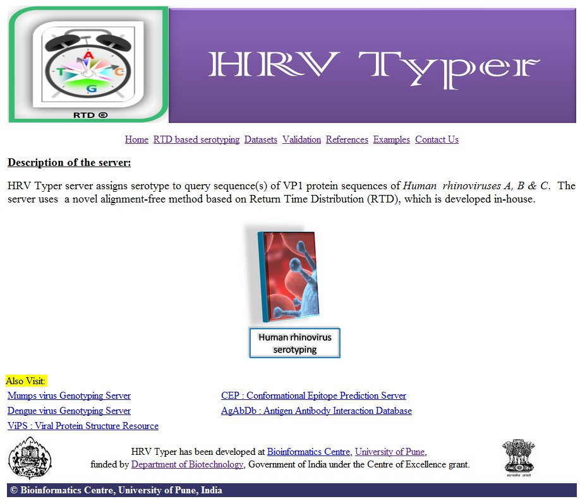
Genotyping of Human rhinoviruses
Input : VP1 protein
Optimum k=1
Sensitivity : 100%
Specificity : 100%
Manuscript under revision
Available at: http://bioinfo.net.in/hrv/homepage.html

Slide 25
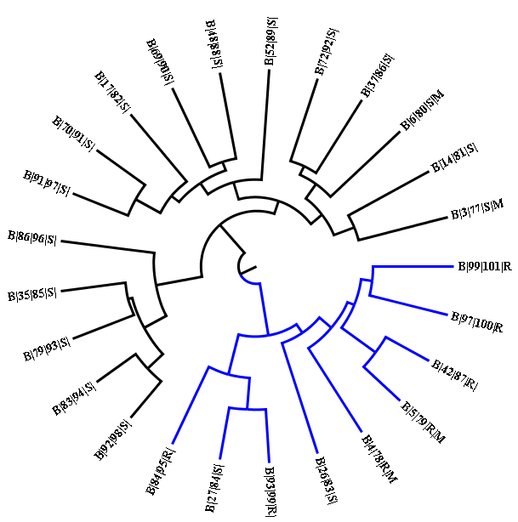
RTD-based clustering of HRV-B using VP1 (k=1)
Clustering of drug-resistant & sensitive serotypes
HRV-B serotypes are subdivided into Pleconaril–sensitive and resistant serotypes (B-4, -5, -42, -84,-93, -97 and –84) serotypes.
RTD-based informative residues viz. F,P,R,E,S,L,I obtained by WEKA- improves discrimination of pleconaril-sensitive & resistant serotypes.

Slide 26
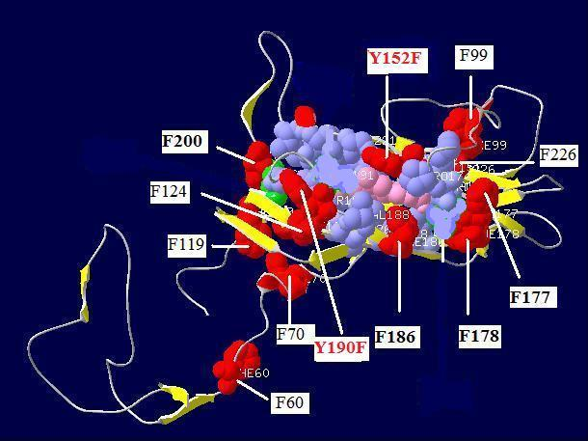
Computation of RTD for F residue and mapping on 3D structure of VP1
RTD of F residue in pleconaril-sensitive serotype
F60
F70
F99
F119
F124
F177
F178
F186
F200
F226
9
28
19
4
52
0
7
13
5
RTD of F residue in pleconaril-resistant serotype
F60
F70
F99
F119
F124
F177
F178
F186
F200
F226
9
28
19
4
0
7
5
27
24
3
9
F152
F190
Pleconaril
Drug-binding site
Figure shows mapping of F residues on the VP1 structure of HRVB-14 serotype [1NCQA].
Phe (F) residues are localized at and near drug (pleconaril)- binding site are shown.

Slide 27
Population genomics: Rhinoviruses

Slide 28
Genome organization
Genome Characteristics:
  The genome contains a 5’-UTR, an open reading frame and a 3’-UTR.
  Genome encodes 4 structural and 7 non-structural proteins.
Structural proteins:VP1-VP4
Non-structural proteins: 2A(proteinase: cleaves P1/P2 junction, shutoff of cap-dependent translation), 2B, 2C & 3A (vesicle formation & negative strand synthesis),3B VPg (primer for 3D polymerase), 3C (proteinase), 3D (RNA-dependent RNA polymerase)

Slide 29
Materials: Software(s)/program(s)/server(s) used
Multiple sequence alignment
MUSCLE program in MEGA 5.05
GUIDANCE server: confidence scores for alignments (Penn et al., 2010).
Inference of genetically distinct clusters
STRUCTURE 2.3.3
Recombination & selection pressure analysis
Recombination: RDP4
Selection pressure: Site methods: SLAC,FEL, IFEL; Branch-site methods: MEME, BSR
LIAN 3.5

Slide 30
Results: HRV clusters obtained at k=7
7 distinct lineages includes:
HRV-B(Magenta)
4 sublevel subpopulations within HRV-A viz. pure A (blue), A1( yellow ),A2 (red) ,A3 (green):
A3 represents newly proposed HRV-D (subpopulation A3).
2 sublevel subpopulations within HRV-C viz. HRV-C1 (Orange) & HRV-C2 (Cyan).
Figure 2 - Seven clusters of Rhinoviruses obtained by Bayesian-based approach using admixture model at K=7. The A1, A2, A3, C1 and C2 show the admixed individuals. They are color coded based on the proportion of membership scores with respective sub-populations. Waman et al., 2014

Slide 31
Results: Key highlights
Genetic diversity using STRUCTURE program
Rhinovirus species is an ensemble of seven genetically distinct lineages
HRV-A : four lineages, HRV-C: two lineages, HRV-B is homogeneous
Evidence of recombination
Intra-species recombination is prominent in HRV-A and –C and lead to diversification.
Inter-species recombination is limited to HRV-C members
Evidence of episodic positive selection
Episodic positive selection was detected and corroborates with the antigenicity.
It was found responsible for emergence of new lineages in HRV-A
Waman et al., 2014

Slide 32
Post-genomic Rational Vaccine Design
Perform genome-based comparisons
Genotype and/or Serotype populations
Study viral population for emergence of new subtypes
Map epitopes & mutations on 3D structures
Prioritize candidate vaccine

Slide 33
Publications
Waman VP, Kolekar PS, Kale MM, Kulkarni-Kale U (2014) Population Structure and Evolution of Rhinoviruses. PLoS ONE 9(2): e88981. doi:10.1371/journal.pone.0088981
Kolekar P, Hake N, Kale M, Kulkarni-Kale U, WNV Typer: A server for genotyping of West Nile viruses using an alignment-free method based on a return time distribution. Journal of Virological Methods 2014. 198:41-55.
Kolekar P, Kale M, Kulkarni-Kale U. Alignment-free distance measure based on return time distribution for sequence analysis: applications to clustering, molecular phylogeny and subtyping. Molecular Phylogenetice & Evolution. 2012 Nov;65(2):510-22.
Kulkarni-Kale, U, Waman, V., Raskar, S, Mehta, S, & Saxena, S (2012) Genome to vaccinome: role of bioinformatics, immunoinformatics & comparative genomics. Current Bioinformatics, 7(4), 454-466.
Kolekar PS, Kale M, Kulkarni-Kale U. Genotyping of Mumps viruses based on SH gene: Development of a server using alignment-free and alignment-based methods. Immunome Research. 2011 Nov 30;7(3):1-7.
Kolekar, P. S., Kale M. M. and Kulkarni-Kale, U., "‘Inter-Arrival Time’ Inspired Algorithm and its Application in Clustering and Molecular Phylogeny", AIP Conference Proceedings (2010). 1298(1):307-312. ISBN 978-0-7354-0854-8. [Conference proceedings]
Kolekar, P. S., Kale M. M. and Kulkarni-Kale, U., (2011). Molecular Evolution & Phylogeny: What, When, Why & How?, Computational Biology and Applied Bioinformatics, Heitor Silverio Lopes and Leonardo Magalhães Cruz (Ed.), ISBN: 978-953-307-629-4, InTech Publishers. [Book Chapter]

Slide 34
Acknowledgements
PhD Students:
  Mr. Pandurang Kolekar
  Ms. Vaishali Waman
  Ms. Sunitha Manjari (CDAC)
Collaborators:
  Dr. Mohan Kale, Statistics Dept., SPPU
  Dr. Elin Kure, Radium Hospital, Oslo, Norway
  Dr. Sangeeta Sawant, Bioinformatics Centre, SPPU
Funding:
CoE: Dept. of Biotechnology (DBT), Govt. of India (GoI)
CoE: Dept. of Electronics & Information Technology (DeitY), MCIT, GoI
INCP: Indo Norwegian Collaboration Program
UGC UPE Phase II
DST PURSE program
DBT-BINC & DBT-BET fellowship programs

