Slide 1
Biopolymer Production and its application in the field of Aquaculture
Dr. D. Latha
Associate Professor
School of Biological Science
CMS College of Science and Commerce
Coimbatore
Email: lathagangolly@rediffmail.com
Phone: 09486240862

Slide 2
POLYMERS
Types of polymers
Man-made or synthetic - Non-renewable sources
Nylon, Rubber, plastic
Natural or Biopolymers- Renewable sources.
Chitin, PLA, PHB
Plastics - High tensile strength , mouldability, durability, economic oblige
Disposal problems
Land fills

Slide 3
Marine environment
Recycling
Microbial Biopolymenr
Bacillus megaterium by French Microbiologist Lemoigne in 1926.
Idiophase of the growth
Acts as carbon and energy source.
Upstream process not cost effective.

Slide 4
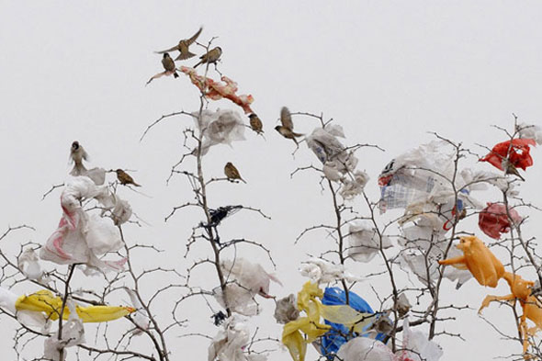
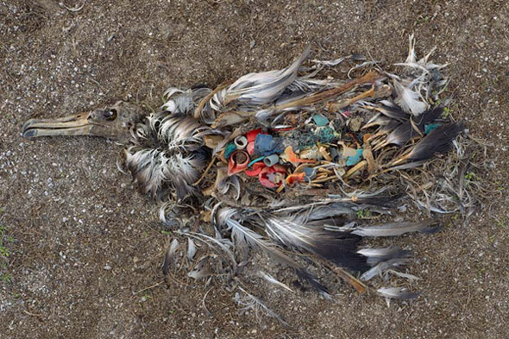
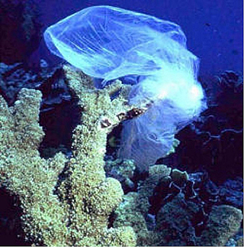
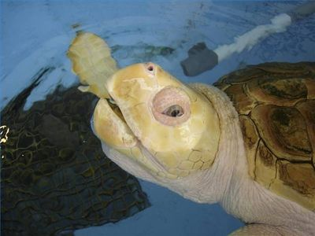

Slide 5
Identification of PHB accumulating bacteria by phenotypic methods.
Optimization of time course, carbon source and nitrogen source for PHB accumulation.
Extraction and estimation of PHB by using less expensive substrates.
In-vivo challenge test in Aquaculture.

Slide 6
Collection of bacterial culture from MTCC and its revival.
Isolation of the Bacillus sp. from the soil.
Rapid screening of native bacterial isolates for PHB production (Juan et al., 1998 ).
Sl.No. | Bacterial cultures | MTCC No.
1 | Bacillus circulans | 2301
2 | Bacillus licheniformis | 2617
3 | Bacillus pumilus | 1067
4 | Bacillus sphaericus | 4394
5 | Bacillus thuringiensis | 1953

Slide 7
Morphological, biochemical, physiological and molecular characterization.
Microscopy (Burdon et al., 1942)
Optimization of time course
Disruption of cells by chemical methods and PHB estimation (Law and Slepecky, 1969)
Chloroform – Sodium hypochlorite extraction

Slide 8
Estimation of PHB using less expensive substrates
Agro industrial wastes
Rice bran and Wheat bran
Forestry residue
Saw dust
Application of PHB in the aquaculture field
In-vivo challenge test

Slide 9
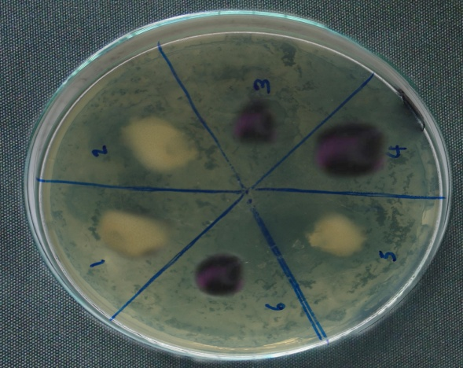
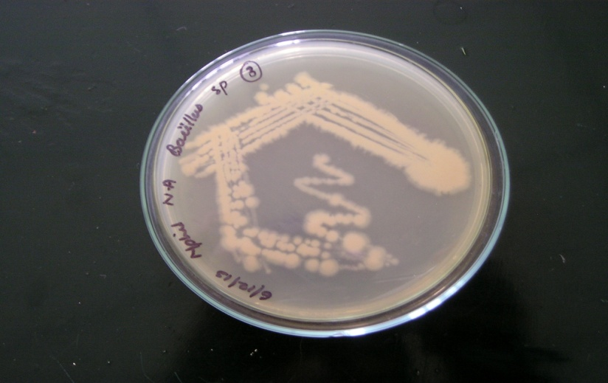
RESULTS
Isolation of Bacillus sp. from soil sample.
Rapid screening test
Morphological characterization

Slide 10
S.No | Biochemical test | B1 | B2 | B3 | B4 | B5 | B6 | B7 | B8 | B9 | B10
1. | Indole test | - | - | - | - | - | - | - | - | - | -
2. | Methyl red test | - | - | - | - | - | - | - | - | + | -
3. | Voges Proskauer test | + | + | + | - | + | + | + | + | - | +
4. | Citrate utilization test | - | + | + | - | - | + | - | - | - | -
5. | Urease test | - | - | - | + | + | - | - | - | - | +
6. | Catalase test | + | + | + | + | + | + | + | + | + | +
7. | Oxidase test | + | + | + | + | + | + | + | + | + | +
 | Physiological test
8. | Starch hydrolysis test | + | + | + | + | + | + | + | + | + | +
9. | Casein hydrolysis test | + | + | + | + | + | + | + | + | + | +
10. | Arginin hydrolysis test | + | + | + | + | + | + | + | + | + | +
11. | Tween 20 hydrolysis test | + | + | + | + | + | + | + | + | + | +

Slide 11
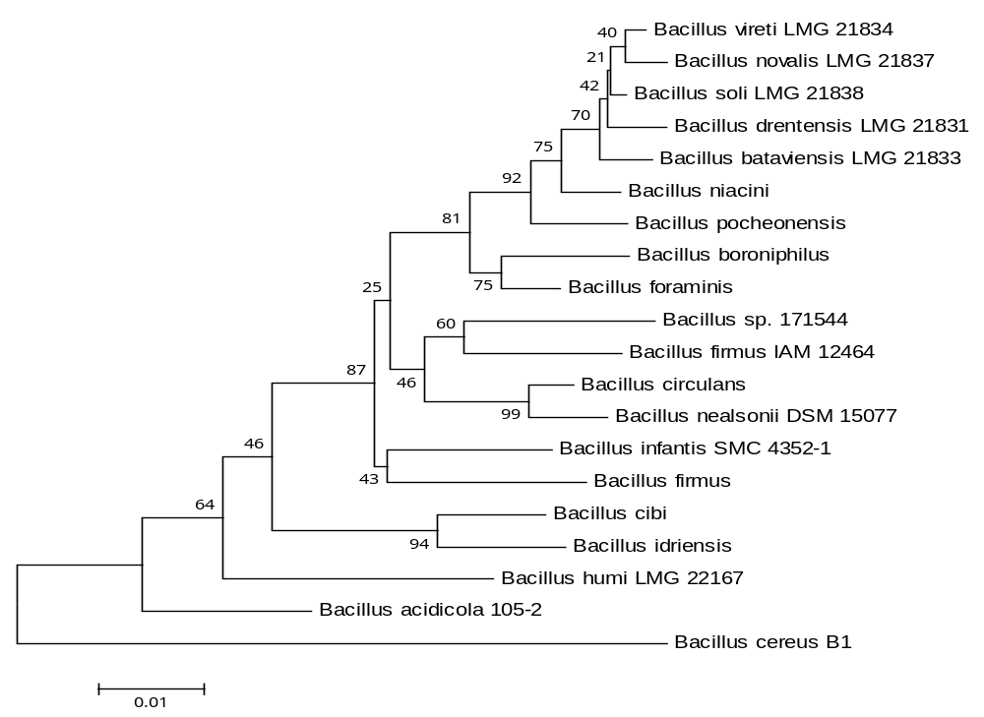
Molecular characterization

Slide 12
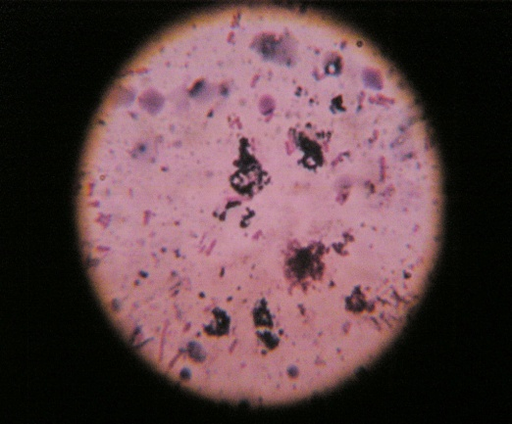
Microscopy (Burdon, 1946)
Sudan Black Staining

Slide 13
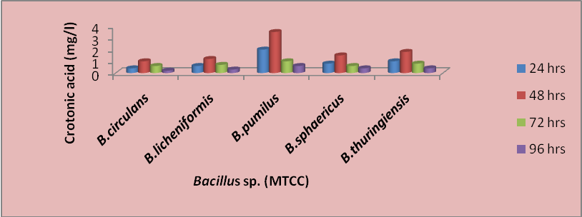
Optimization of time course for PHB production

Slide 14
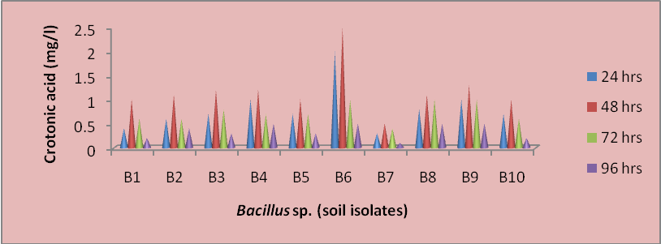

Slide 15
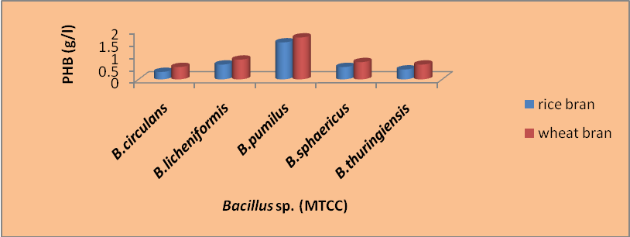
Accumulation of PHB in agro industrial wastes

Slide 16
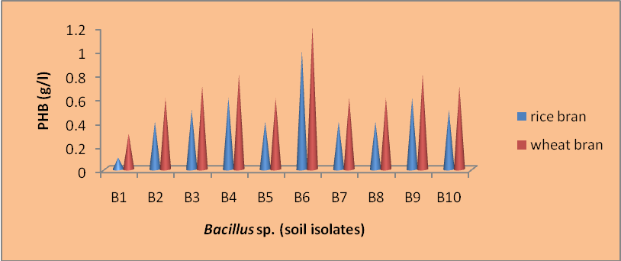

Slide 17
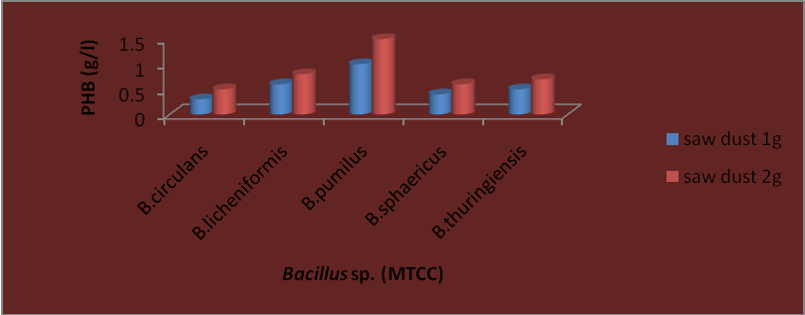
Accumulation of PHB in forestry residue

Slide 18
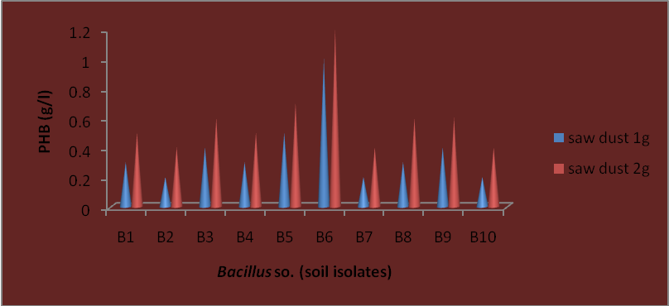
In-vivo challenge test

Slide 19
Conclusion

Slide 20
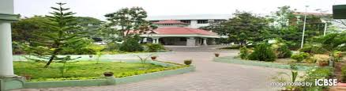
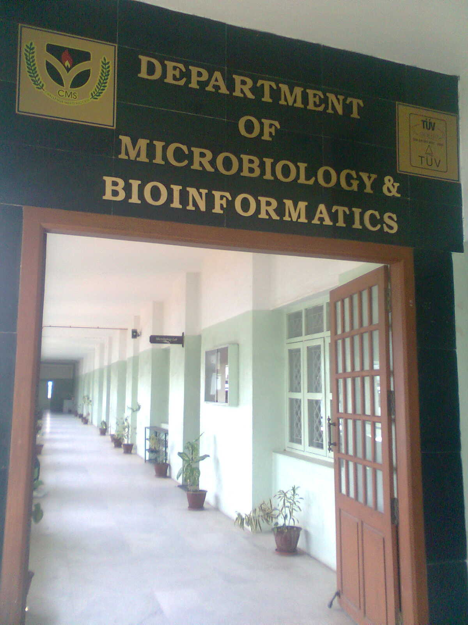
Thank you

