Slide 1

Immune modulation for Atherosclerosis Potential Therapeutic option for cardiovascular diseases
Lakshmi Mundkur
Thrombosis Research Institute- Bangalore , India

Slide 2
Cardiovascular Diseases
coronary heart disease, cerebrovascular disease, peripheral arterial disease
17.5 million people die each year from CVDs, an estimated 31% of all deaths worldwide.
80% of all CVD deaths are due to heart attacks and strokes.
>75% of CVD deaths occur in low-income and middle-income countries.
The RISK of DYING EARLY FROM Coronary Artery disease IS TWICE As HIGH among South Asian compared to general population
WHO -2015 AND NHS –UK

Slide 3
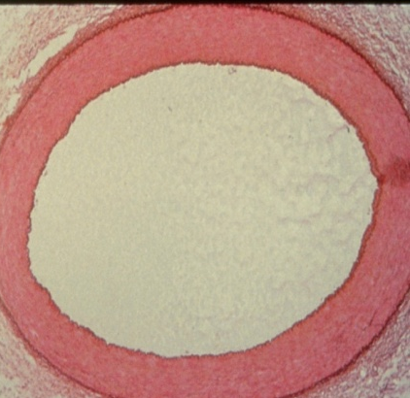
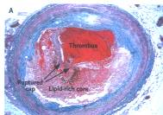

Atherosclerosis
Normal Artery
  slow progressive disease
  remains asymptomatic for decades
Sudden Heart attack
Angina
Plaque rupture
30-40% occlusion
80-90% occlusion
J Autoimmun, 2012, Nat Med 2003, NEJM 1999,
NEJM 2012, ATVB 2011

Slide 4
Atherosclerosis
A Major Paradigm Shift
500 publications in major international journals
Atheroma is a chronic inflammatory disease where lipids and chronic infection play a critical role
Both innate and adoptive immunity are involved
Immune modulation have the potential of protecting against atherosclerosis
New possibilities for significant cost effective reduction of CVD burden

Slide 5
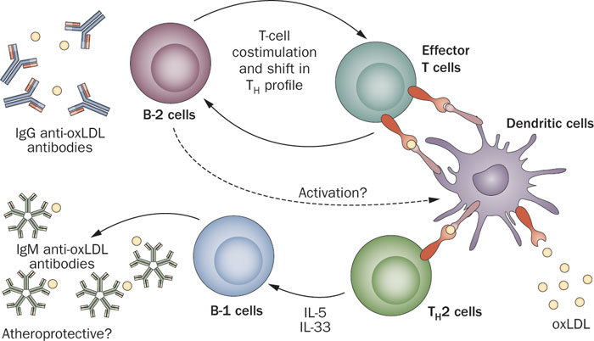
Immune system in Atherosclerosis
Chyu et al. Discovery medicine 2011, Mundkur et.al CDT-2010

Slide 6
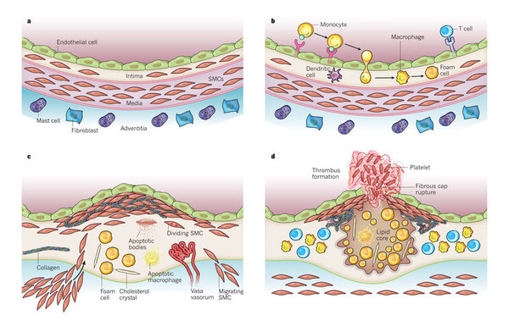
Atherosclerosis
Libby and Hansson Nature 2011

Slide 7
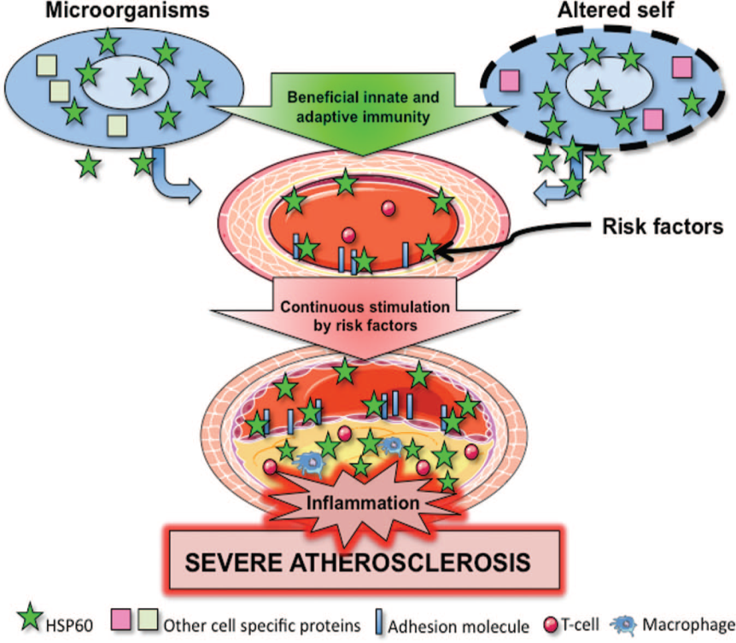
Autoimmune concept of Atherosclerosis
Atherogenesis begins as a qualitative change to intact endothelial cells- (oxidative ,hemodynamic, risk factors)
      Changes their permeability to promote the entry and retention of monocytes and LDL
Oxidation of LDL exposes neo epitopes in ApoB100 and LDL
Classical risk factors / Infection modify the expression of HSP60 on the surface of arterial endothelial cells (ECs)
T cells reactive to Oxidized lipoproteins and HSP are seen the early plaques
Nabel et. Al NEJM 2012, Gruntman et al ATVB 2011

Slide 8
Immune modulation for atherosclerosis
Innate immunity
Adaptive Th1 immunity
Antiinflammatory immunity
Humoral immunity
Anti-ox LDL Abs
TNF-α
IL-10 & TGF-b
IL-1
IFN- γ
Regulation
IL-18
Inflammation
Antiinflammation
Fibrosis
SMC proliferation
Plaque stability
MØ activation
Endothelial activation
Radicals, Proteinases
Prothrombotic state
Restoring tolerance to auto antigens and reduce inflammation

Slide 9
Why an Immune based therapy ?
Current treatments and prevention include
  Lifestyle changes
  Reduction in risk factors
More than 90% of sudden heart attacks are due to
  Rupture of atherosclerotic plaque
No treatments available for
  preventing plaque rupture
  stabilizing a vulnerable plaque
Target the cause of the disease rather than risk factors to get additional effects
The Global Economic Burden of Noncommunicable Diseases (World Economic Forum, Geneva, 2011.

Slide 10
TRI- Approach
Hypothesis
Multiple antigens would confer better protection compared to
single antigens.
Infection and molecular mimicry plays a very important role in
the development of atherosclerosis
Approach
Use peptides as antigen
Express multiple peptides in a single protein scaffold
Oral dosing to induce tolerance
Sutcliffe MJ, .Nat Struct Biol. 1994,Lu X,. J Biol Chem. 1996.

Slide 11
Selection Of Epitopes
T cell epitopes promiscuous MHC binding
Self-antigens
  ApoB 100* (AA 688-707 )
  Human HSP60,- (AA 153-163) molecular mimicry with CMV early proteins
Proteins from pathogens
  Chlamydia pneumonia ,CMV, P gingivalis (molecular mimicry with HSP60 and ApoB)
Protein scaffold Dendroaspin
Short-chain neurotoxin homolog from Elapidae snakes, with no neurotoxicity
Novel arrangement of loops-
  Can be modified to incorporate further
  functional amino acid sequences

Slide 12
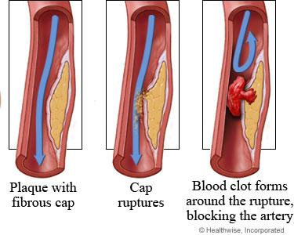
Focus of Immune Therapy
Focus of Vaccine Development
Development
Stabilization
Progression
Plaque Rupture
Unmet Clinical need
Major cause of ACS, Stroke

Slide 13

Experimental Design
Animal models
Mice-Gene knock out C57/BL6
    ApoE-/-, LDL r-/-, ApoB48 LDLr-/-)
Rabbits
    New Zealand White rabbits
Disease Development
Age 5-6 weeks
10 weeks HFD
Tolerance
Sacrifice -10 weeks HFD
Age-18 weeks
Disease Progression
10 weeks HFD
2 weeks
10 weeks HFD
Age 5-6 weeks
Tolerance
Sacrifice -22 weeks HFD
Age-28 weeks

Slide 14
Combination of peptides -enhanced protection
ApoB : ↓ lipid and macrophage
HSP60 : reduction in CD4 and SMC
ApoB + HSP60
Macrophage infiltration (77%) and TNF-α (64%)
↑ Treg cells in and TGF-β in plaque
No difference in lipids levels
Xinjie et al. Atherosclerosis 2010, Mundkur et al. J .vaccine 2013, , PLOS one 2013

Slide 15
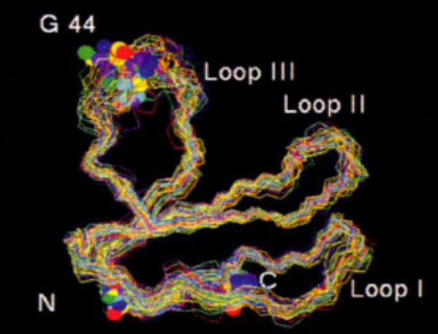
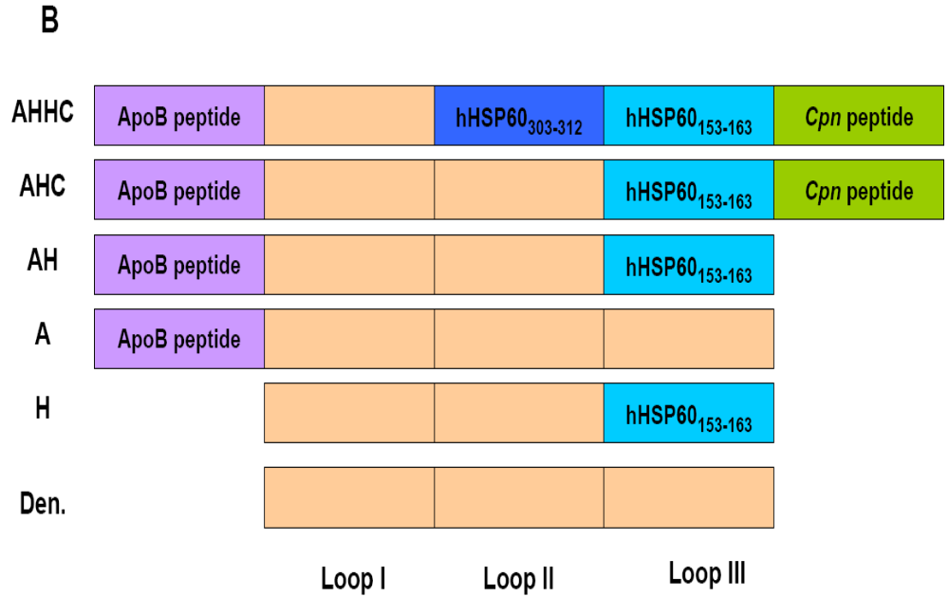
Improve efficacy by introducing the peptides into Dendroaspin
Peptides linked to the N –terminal, loop2,3
and C terminal end of dendroaspin
Recombinant construct was expressed
in Escherichia coli and purified
C
N
AHHC - 42.81 %
AHC - 51.82 %
AH - 40.3 %
A - 22.8 %
H - 20.8 %
Lu et al Atherosclerosis 2012,

Slide 16
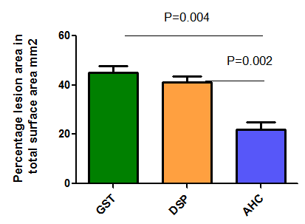
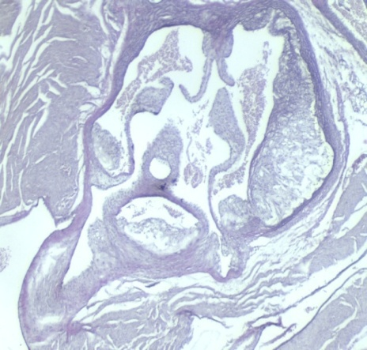
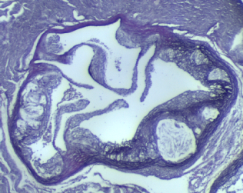
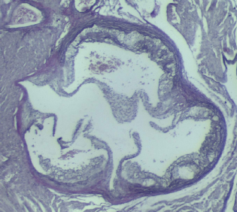
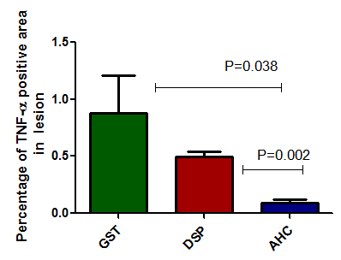
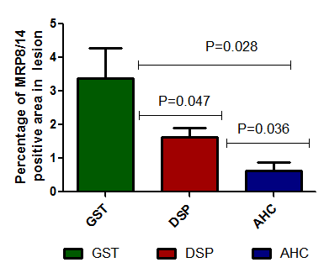
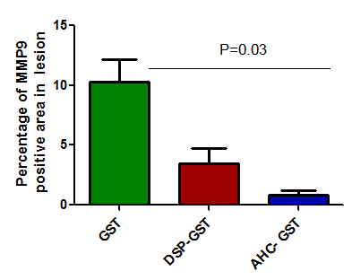
Oral tolerance to AHC
Control
DSP
AHC
DSP
51.2%
Control DSP AHC
Reduction in inflammatory markers
TNF-α – 83.6%
MMP9 - 91.7%
MRP8/14 - 61.2 %
Control DSP AHC
Control DSP AHC
Control DSP AHC

Slide 17
Increase in Expression of regulatory markers in aorta
Control
DSP
AHC
IL10
TGF-β
Collagen

Slide 18
Mechanism of Protection
Antigen specific Tolerance to the peptides
Increase in Foxp3 +ve and CTLA4+ve cells in Lymphoid organs
Increase in CD11c ⁺ 11b ⁺ 103⁺ tolerogenic Dendritic cells
Antigen specific regulatory cell function
Reduction in proliferation of peptide specific T cells by
31.02% for ApoB, 27.6% for HSp60 and 25% for Cpn peptides
Increase in regulatory cells in aorta
Reduction in Th17 and Th1 cells in aorta,spleen and peripheral circulation
Mundkur et al Int journal of cardiology 2014
Mundkur et al Int journal of cardiology 2014

Slide 19
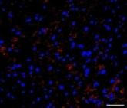
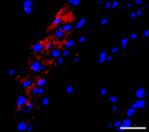
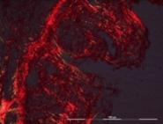
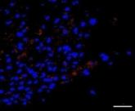
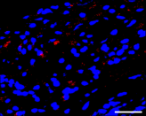
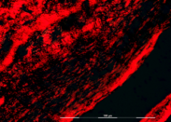
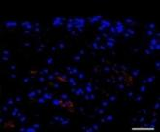
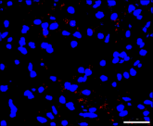
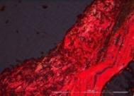
Rabbit model of Atherosclerosis
Macrophage
Collagen
MMP9
Macrophages
48.6% reduction in lesion
Reduction in
Macrophage infiltration
Plaque MMP9
48.6% in lesion
Increase in collagen
Increased Treg activity
CON
DSP
AHC
Reduction in plaque inflammation and
increase in regulatory response
Sheena and Mundkur Canadian journal of cardiology 2015

Slide 20
Effect of immune modulation in
Disease Progression
10 weeks HFD
2 weeks HFD
10 weeks HFD
Age 5-6 weeks
Tolerance
Sacrifice -22 weeks HFD
Age-28 weeks

Slide 21
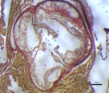
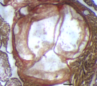
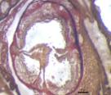
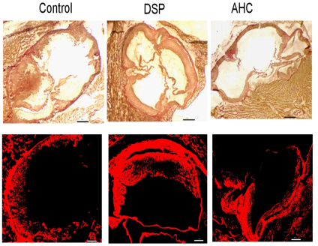
Plaque stabilization
Mice
Control
DSP
AHC
Reduction in necrotic core in the lesion ( p=0.001)
Reduction in MMP9 (p=0.006)
reduction in Apoptosis as observed by TUNEL, (P=0.037)
Reduction in Tissue factor expression ( P<0.001)
increase in collagen content
Rabbits
MMP9
Apoptosis
AHC treatment showed markers of stabilization in mice

Slide 22
Immune Therapy for Atherosclerosis
Summary
Reduces development of Atherosclerosis
  Mice Apob48 /LDLr-/- ( 51%)
  Rabbits ( 48.6%)
Controls plaque progression
Induces markers of plaque stabilization in mice and Rabbits
Reduction in inflammation
Increase in immune regulatory cells and cytokines in plaque

Slide 23
Preliminary Toxicity studies
Acute toxicity test
20×, 100X and 200x administered as a single dose
Clinical signs of toxicity and mortality were not observed during 15 days
Sub chronic toxicity
1X 5 X and 10 X - 5 doses
No clinical signs of toxicity observed 15 and 30 days
Chronic toxicity
1X 5 X for 28 day daily dosing
No clinical signs of toxicity observed

Slide 24
Immune Therapy for Atherosclerosis
Challenges ahead
Long term effect of immune therapy?
Potentiating of immune tolerance?
Translation in human?
Delivery methods
Clinical Development of the molecule

Slide 25
Acknowledgements
Prof V V Kakkar – Scientific Chairman Thrombosis Research Intitute
Prof Xinjie Lu- Collaborator, TRI- London
Scientific Staff- TRI- Bangalore
Department of Biotechnology- Govt .of India- Program Grant
Tata social welfare trust

Slide 26

THANK YOU

Slide 27
Clinical studies
Summary
Patients with coronary artery disease
Higher Th17 cells
Higher IL17 and IL6 levels
Lower Treg cells
Imbalance in Th17/Treg ratio
Th17/Treg ratio showed an association with MI with an odds ratio of 2.92 (95% CI: 1.73-4.92), P<0.001
PBMC showed reactivity to Ox-LDL and HSP60 with an expansion of Th17 cells

Slide 28
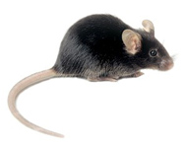

Mechanism ?
Regulatory Immune response
Treg
Immune Tolerance
Reduced inflammation
and Atherosclerosis
High fat diet
Adaptive immune response to self antigens
Restoring tolerance
Autoimmunity
Regulation
Autoimmune response

Slide 29
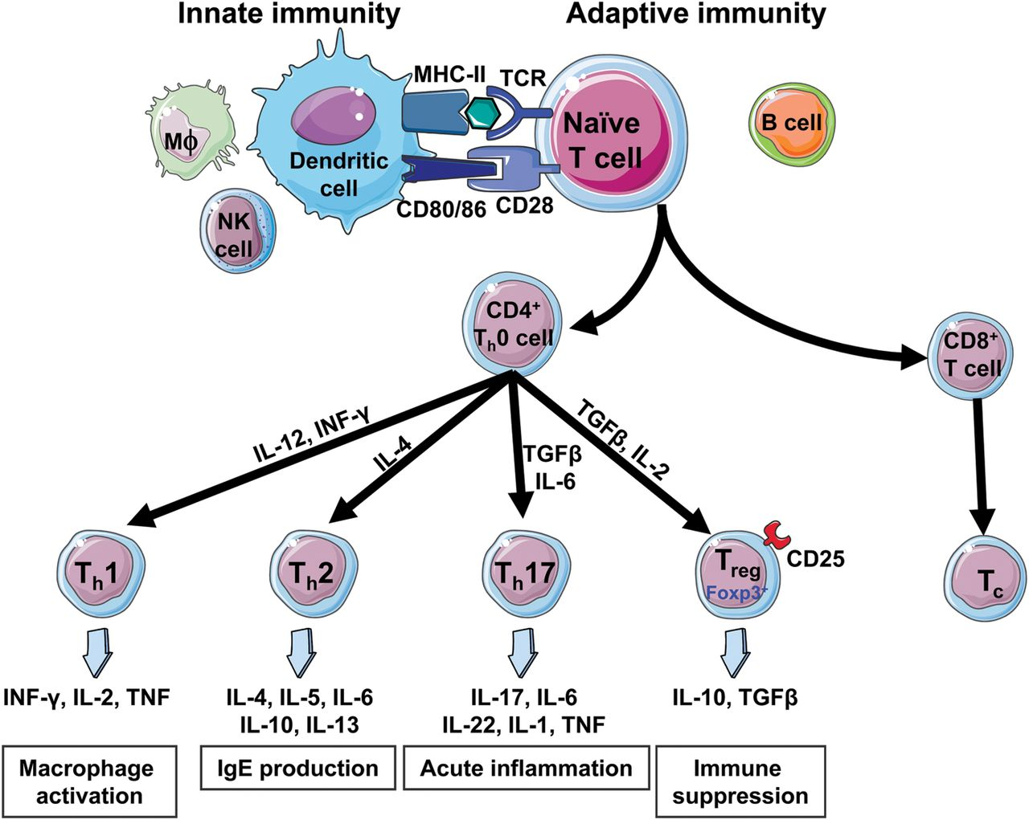

Slide 30
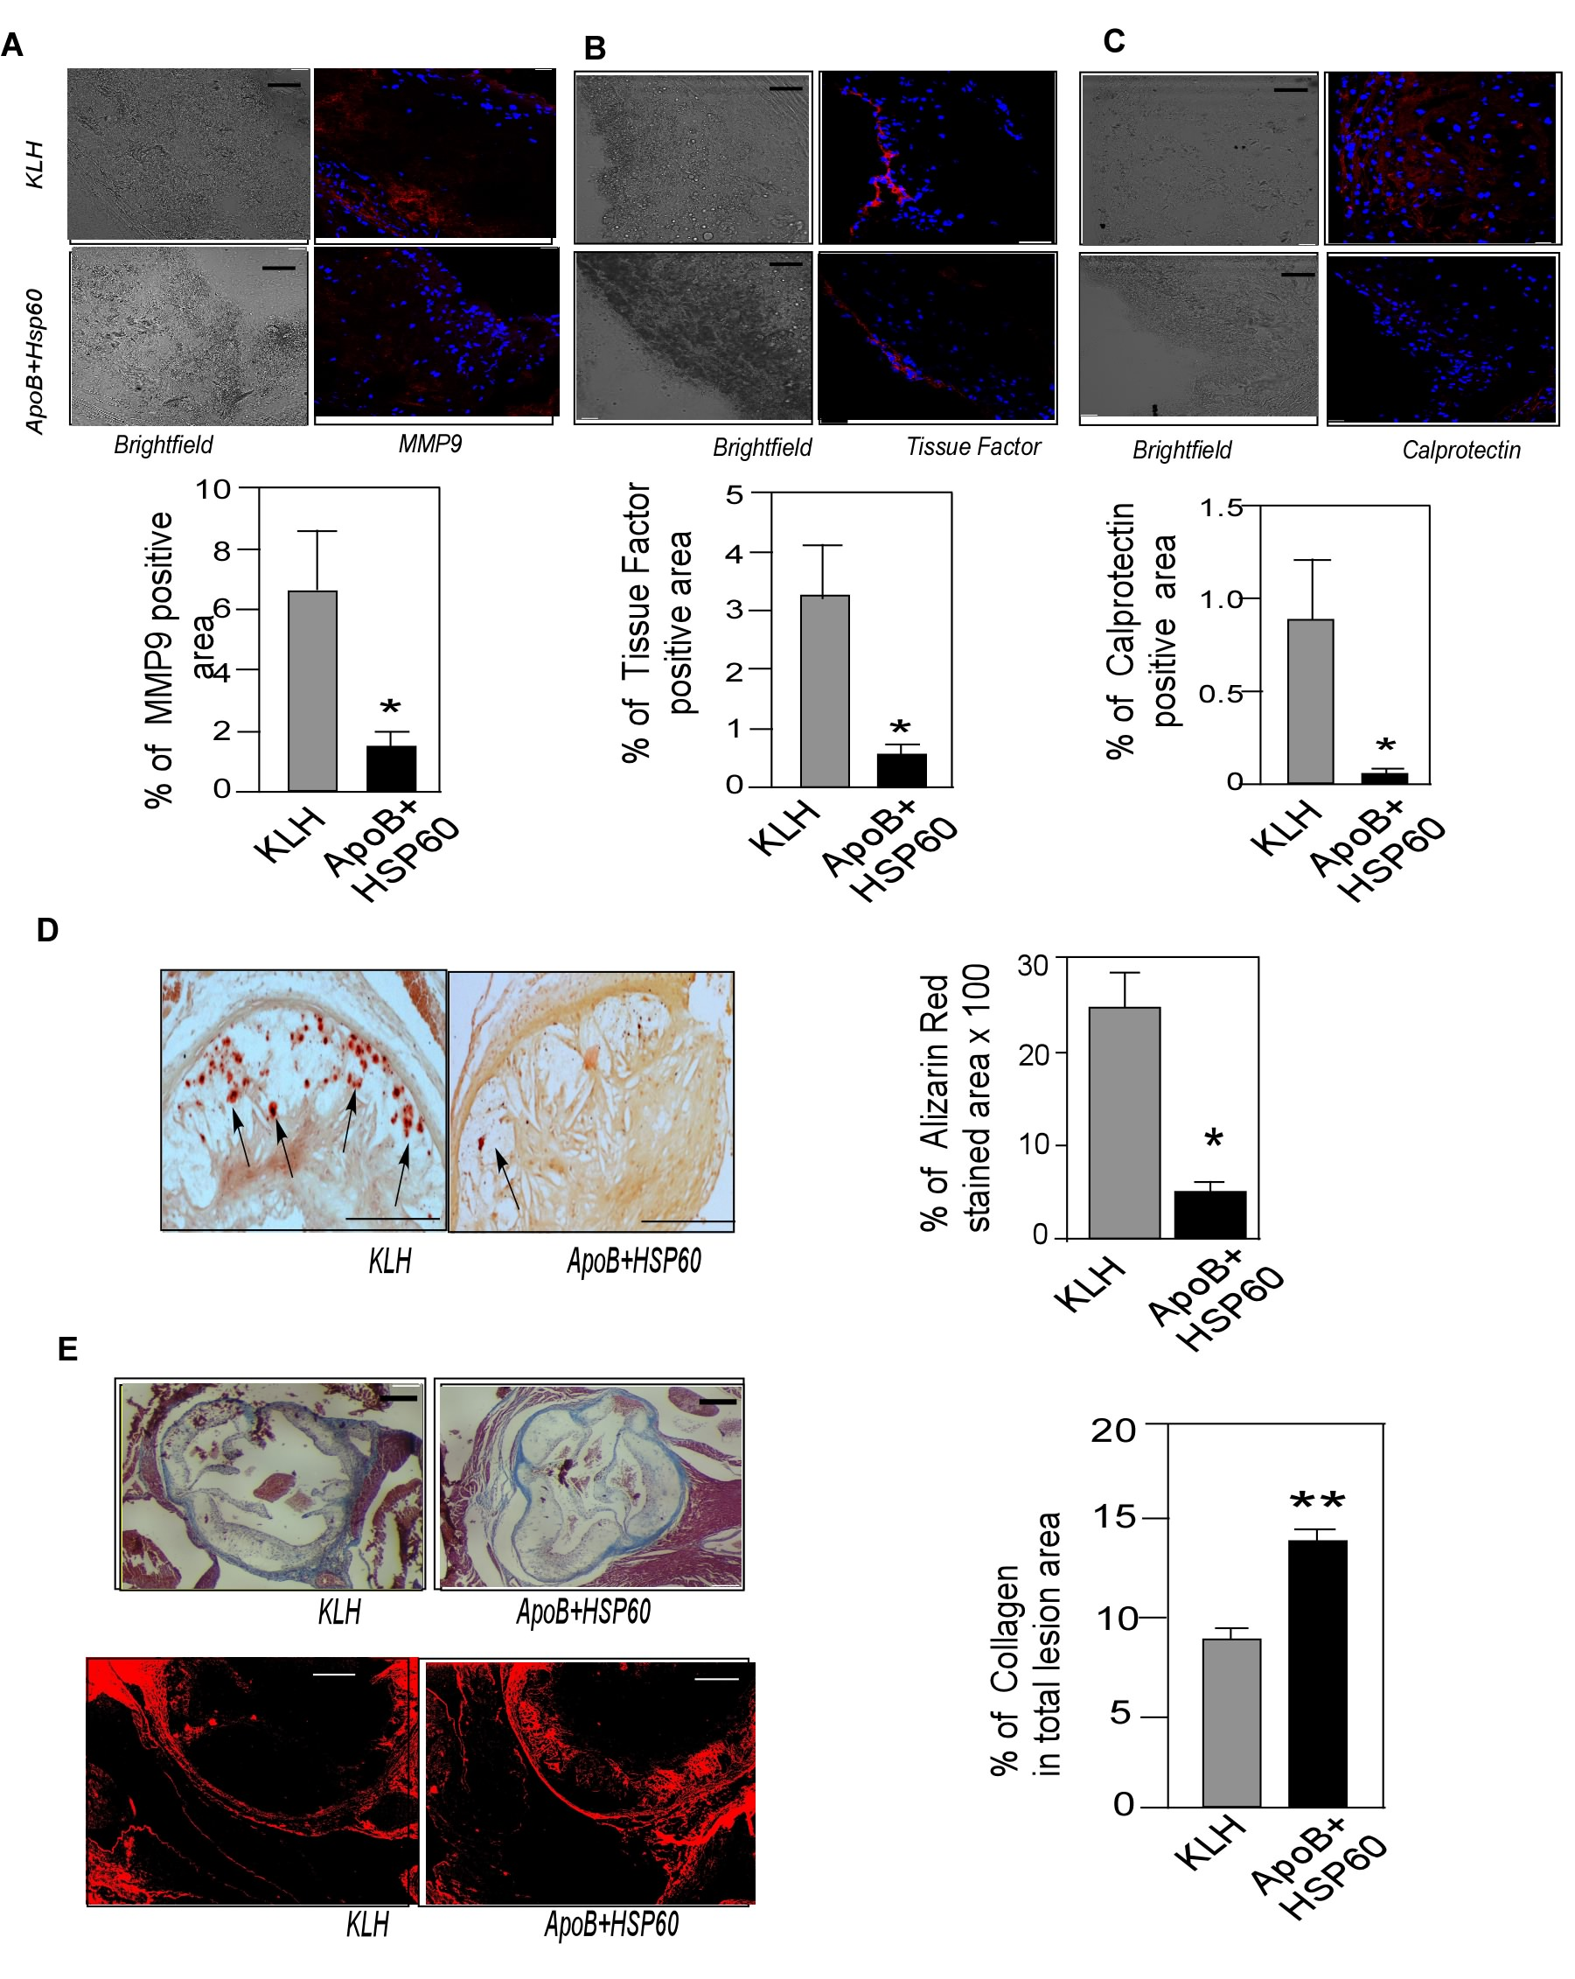
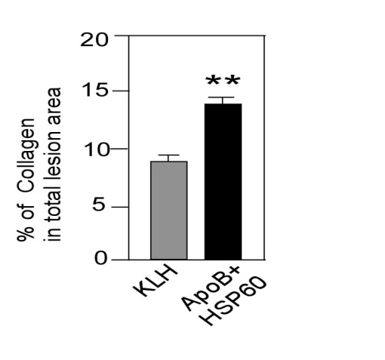
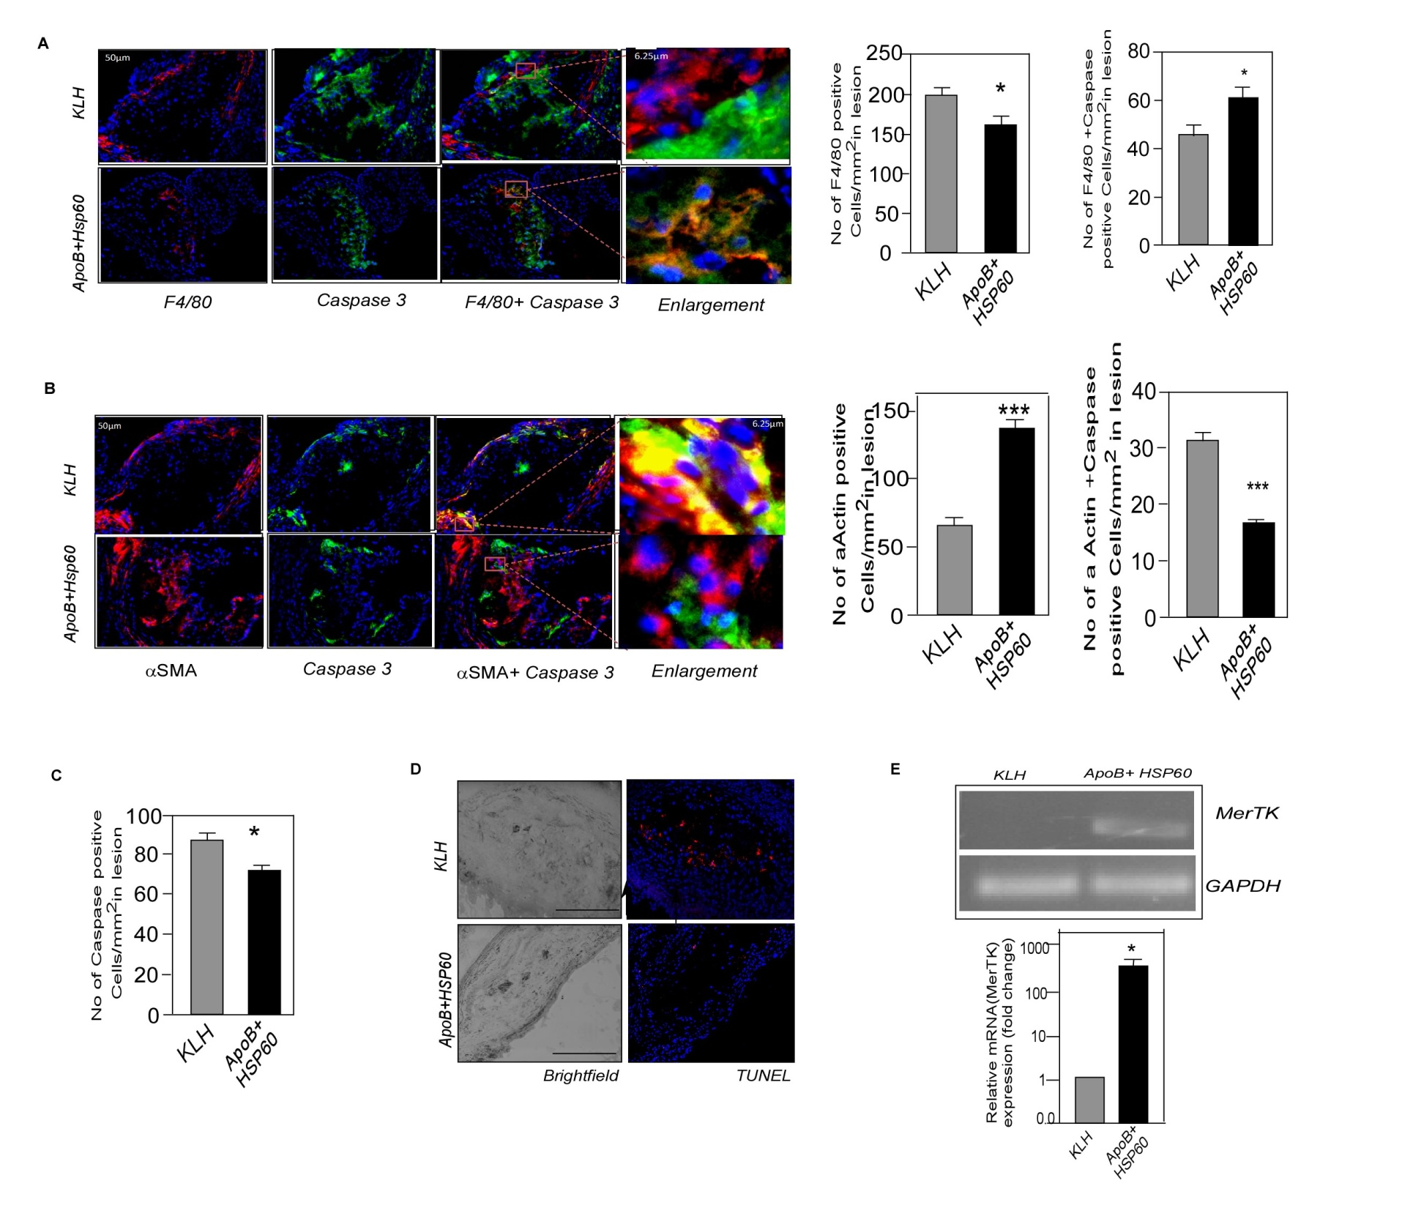
Tolerance to ApoB and HSP60 peptides – Plaque Stabilization
Increase in collagen content
Decrease in SMC apoptosis in treated animals
*
Mundkur et al Plos-One 2013

Slide 31
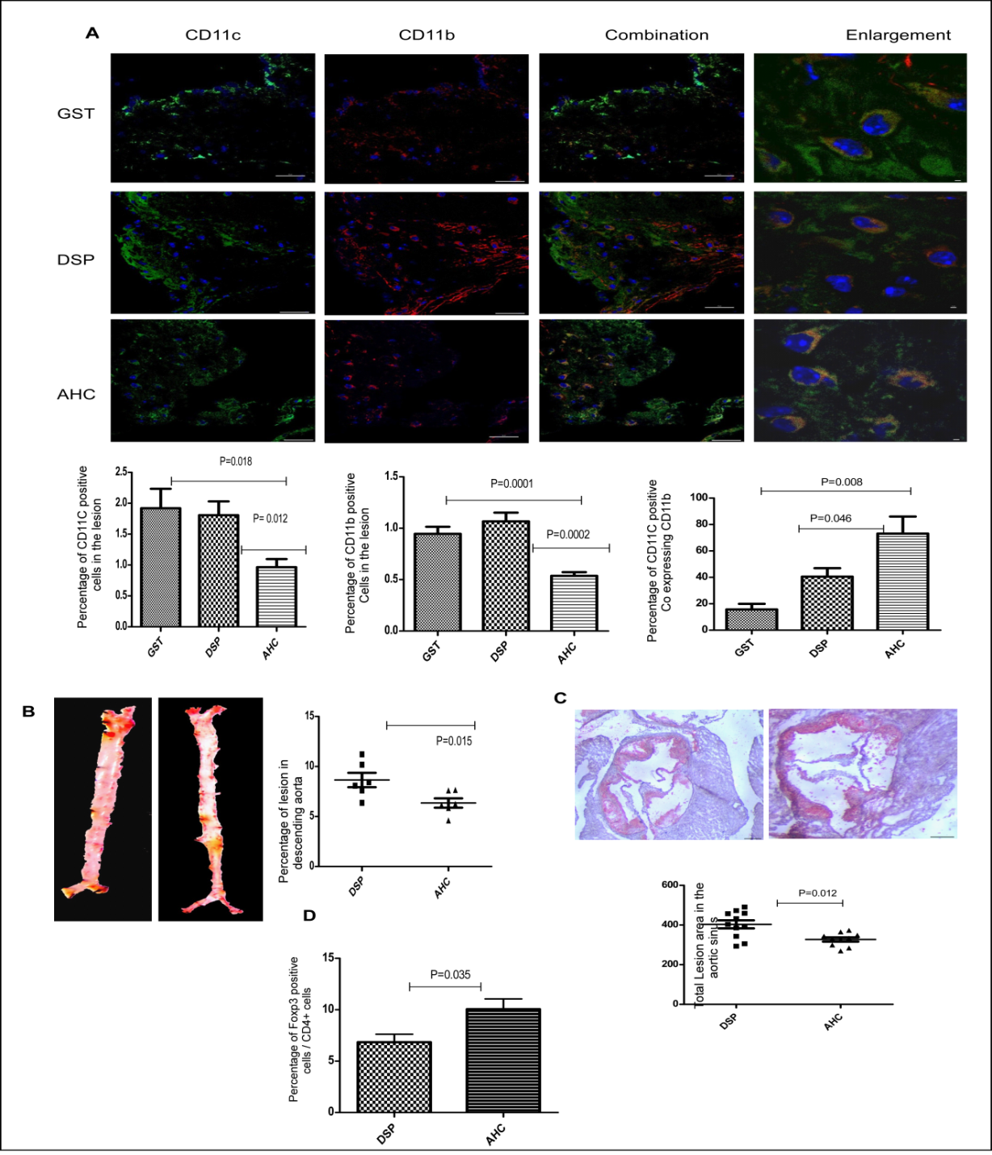
Oral tolerance to recombinant multi antigenic construct
Increase in CD11c⁺CD11b⁺
cells in plaque
Increase in Treg markers in
plaque
Adoptive transfer of
CD11c+ve cells from
AHC tolerized mice
18.7 % reduction in
lesion in sinus
Mundkur et al Int journal of cardiology 2014

Slide 32
Immunotherapy for Atherosclerosis
Several groups
Lund University, Sweden
Cedars-Sinai Heart Institute, USA
Leiden, University, Netherlands.
Karolinska Hospital Sweden
Medical University of Vienna, Austria
Therapeutic approach
    Protein- peptide
    DNA vaccination.
    Passive Immunization.
Selection of antigens.
  Oxidized phospholipids
  bacterial and viral proteins
  Heat shock proteins
  Beta 2-glycoprotein – 1
  Cholesterol ester transfer protein (CETP)

Slide 33
Animal Models
Plasma cholesterol of mice is primarily packaged in the HDL fraction
Low ApoB levels
Elimination of ligand (Apoe-/-) or a receptor (Ldlr-/-) increase ApoB levels
High cholesterol diet increases plasma apoB-lipoprotein levels to an even greater degree, -accelerated plaque formation in the major arteries.
Mice have apoB-48 which can clear lipoproteins other receptors in addition to the LDLR
ApoB ^{tm2Sgy}/Ldlr ^{tm1Her/J} which express only ApoB 100 and are Ldlr-/-
HFD increases plasma lipid levels to a very high level (5X normal)

