Slide 1

Designing vaccines against visceral leishmaniasis: Importance of liposomes
Prof. Nahid Ali
CSIR-Indian Institute of Chemical Biology
4, Raja S.C. Mullick Road
Kolkata 700032

Slide 2
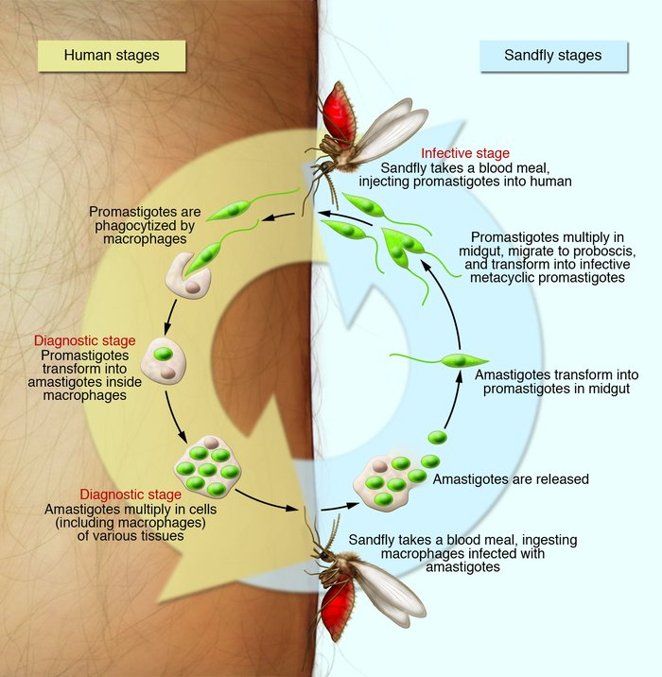
Visceral Leishmaniasis (VL)
(Kala-azar)
Caused by Leishmania donovani and L. infantum
Approximately 300 000 new visceral cases occur annually (90% in Bangladesh, Brazil, Ethiopia, India, Nepal, South Sudan and Sudan)
Fatal without treatment
The estimated number of deaths from visceral leishmaniasis ranges from 20 000 to 50 000 annually…….3rd WHO Report on neglected tropical Disease, 2015
The Parasite-Life Cycle

Slide 3
Why We Need a Vaccine against Kala-azar????
Limitations of current control measures-
Vector control: Inefficient, non practical, increases environmental and health hazard
Diagnosis: mass field adaptable accurate diagnostic method is lacking, invasive methods of diagnosis, no diagnostic tool to detect PKDL
Treatment: Limited options, wide spread drug resistance, toxic and some are very costly
No vaccine against Human VL is available

Slide 4
What are the challenges in vaccine development strategies???
Problems:-
Protein must not only be protected from extracellular degradation but needs to be targeted to the relevant immune cells.
Antigens alone are generally weak immunogens and require an adjuvant to induce protective immunity.
For diseases such as leishmaniasis, the cellular immune response comprising primarily Th1 and CD8 effector T cells has been shown to be critical for mediating protection against infection.
Currently licensed adjuvants (for example aluminium hydroxide and the oil-in-water emulsion MF59), primarily elicit humoral responses without stimulating cellular immunity.

Slide 5
Aim:-
To design an appropriate antigen delivery along with immunopotentiating adjuvants to stimulate broad humoral and T cell-mediated immunity to improve vaccine strategies against intracellular pathogens like Leishmania .

Slide 6
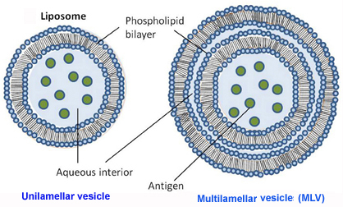
Liposomes as antigen delivery system
Liposomes — spherical, self-closed microscopic structures formed by one or several concentric lipid bilayers with an aqueous phase inside and between the lipid bilayers.
Attractive biological properties of liposomes:
 Safe, biocompatible, completely biodegradable, non-toxic and flexible.
 Can entrap water-soluble (hydrophilic) agents in their internal water compartment and water-insoluble (hydrophobic) agents into the membrane for their efficient delivery to APCs in vivo.
 Protects from the inactivating effect of external conditions/ degradation.
 Modulate the immune response towards entrapped proteins/ peptides or to other antigens.
 Sustained release.
.
Gregory et al. Front Cell Infect Microbiol. 2013

Slide 7
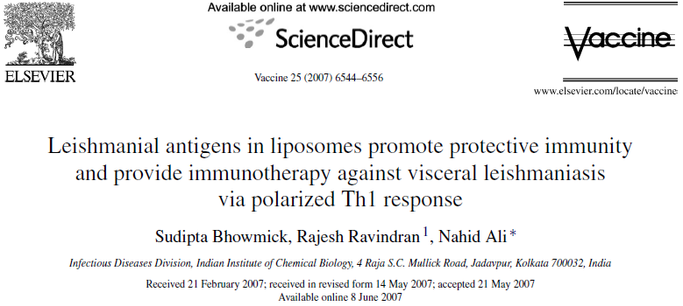
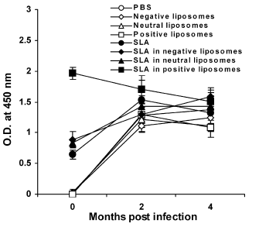
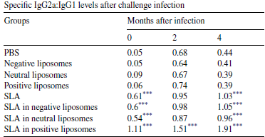
 IgG2a levels are dependent on IFN-γ, whereas IgG1 levels correlate
with IL-4.We, therefore, analyzed the isotype responses to SLA following immunization and challenge infection and determined the ratio of IgG2a:IgG1 as a measure of Th1:Th2 balance.
 As shown in Table , SLA in positive liposomes
group had the highest ratio (1.11) after immunization and after infection (1.51 and 1.91 at 2 and 4 months, respectively) demonstrating a skewing towards Th1 response.
 Immunization with SLA in positive liposomes stimulated the maximum level of IgG, significantly higher than the other vaccinated groups
(p < 0.001).
Fig :-Serum samples were collected immediately after last booster and 2 and 4 months after infection and assayed for SLA specific IgG antibodies by ELISA with a serum dilution of 1:1000.
Table :-Serum samples were collected after immunization, 2 and 4 months after infection. IgG2a:IgG1 levels represent the ratio of the absorbances at 450 nm of specific antibodies from each group with 1:1000 diluted serums by ELISA. *** p < 0.001, vs. the control groups.

Slide 8
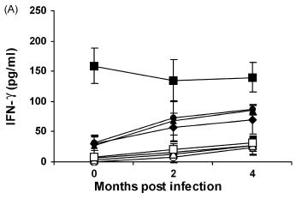
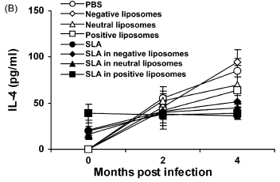
Induction of IFN-γ, IL-4 in SLA-liposomes vaccinated mice
 As a measure of Th1:Th2 bias, the IFN-γ:IL-4 ratio was highest in SLA in positive liposomes immunized mice (4.12±0.35 after immunization, 3.65±0.78 at 2 and 3.55±0.29 at 4 months). Lower but similar ratios were observed in mice immunized
with free SLA and SLA in neutral and negative liposomes, reflecting the IgG2a:IgG1
Fig:- Cytokine levels in immunized mice before and after L. donovani infection. Splenocytes were cultured, stimulated with SLA and 72 h later concentrations of released IFN-γ(A) and IL-4 (B) in the culture supernatants were determined after immunization and challenge infection.

Slide 9
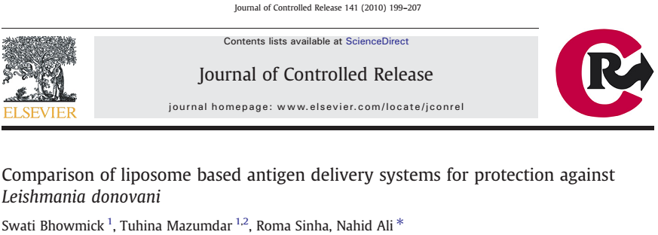
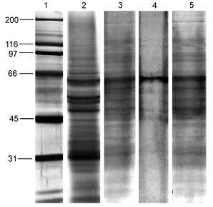
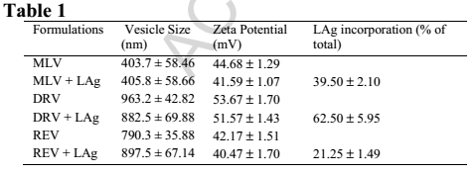
Physico-chemical characteristics of the delivery systems
Fig. 1.SDS-PAGE of LAg, free and incorporated in three different liposome preparations; lane 1, Marker (molecular weights are given in left), lane 2, LAg; lane 3, LAg in MLV; lane 4, LAg in REV; lane 5, LAg in DRV
 In this study we compared the vaccine potentiality of three cationic liposomal formulations with LAg and the best vesicle was evaluated for long-term protection against VL.
 Mice were immunized with LAg encapsulated in multilamellar vesicles (MLV), dehydration–rehydration vesicles (DRV) and reverse-phase evaporation vesicles (REV) and were challenged ten days after vaccination.

Slide 10
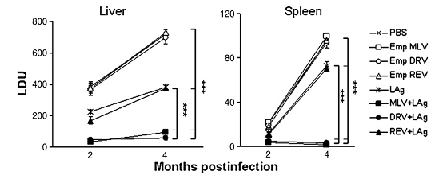
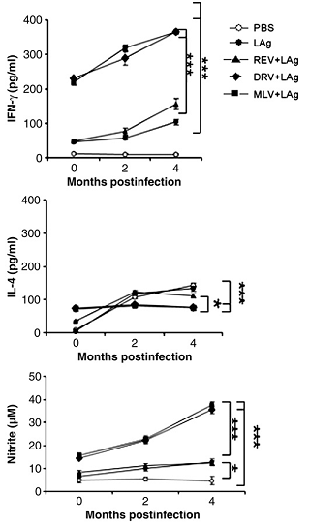
Evaluation of cytokine response & protective efficacy of LAg in association with MLV, REV or DRV liposomes
A.
B.
B.
Fig A:Comparison of protective immunity of LAg in MLV, DRV and REV in susceptible BALB/c mice. Mice were immunized and boosted twice in two week intervals with PBS, empty REV, DRV or MLV liposomes, LAg alone or encapsulated in REV, DRV or MLV liposomes. The parasite burden in the liver and spleen were determined 2 and 4 months postinfection.
B. Comparison of LAg in MLV, DRV and REV to influence the production of Ag-specific cytokines and NO in spleen culture supernatants. Groups of mice were vaccinated and spleens were isolated before or after infection. Splenocytes were pulsed with LAg (10μg/ml). Seventy two hours later, supernatants were harvested and stored at−70 °C for estimation of IFN-γ, IL-4 and NO.

Slide 11
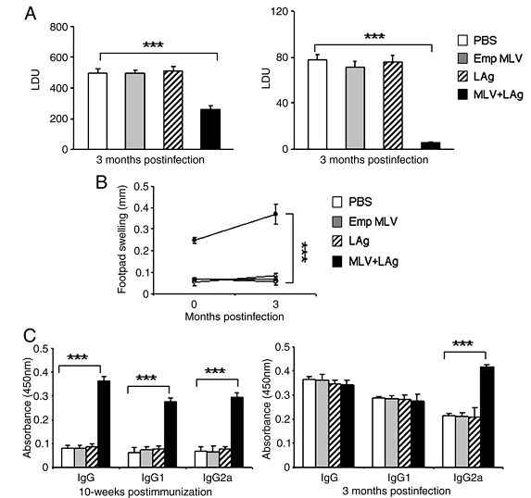
LAg in MLV liposomes demonstrates durable
protective immunity
Fig. LAg in MLV liposomes demonstrates durable protection against L. donovani in BALB/c mice. Animals were immunized i.p. and boosted twice at two- week intervals with PBS, empty liposomes, LAg free or entrapped in liposomes and challenged 10 weeks after vaccination. (A) Parasite burden in the liver and spleen were determined at 3 months postchallenge. Data represent LDU ± SEM. (B) Footpad swelling was determined before and after infectious challenge. (C) Serum IgG, IgG1 and IgG2a were analyzed through ELISA in vaccinated animals with and without L. donovani infection.

Slide 12
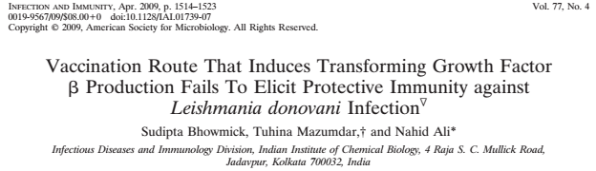
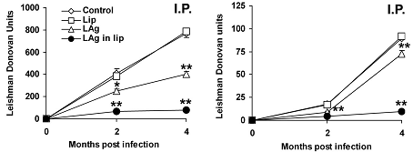
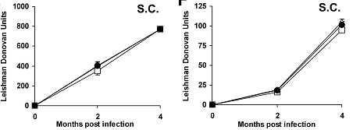
Liver
Spleen
 BALB/c mice immunized intraperitoneally (i.p.) with LAg, either free or encapsulated in liposomes, were protected against challenge infection, whereas mice immunized by the subcutaneous (s.c.) is not protected.
Fig. Clinical outcomes following L. donovani challenge in BALB/c mice immunized via two different routes. Mice were immunized three times with 20µg of LAg, alone or entrapped in liposomes, at 2-week intervals through the i.p. and s.c routes.

Slide 13
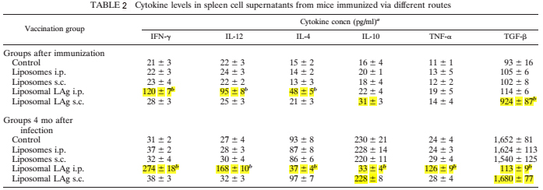
Production of antigen-specific TGF-βfollowing vaccination
by the nonprotective s.c. route
Table 2 shows that following liposomal LAg vaccination, splenocytes from i.p. immunized mice produced significant amounts of IFN-γ, IL-12, and IL-4 in comparison to controls as well as s.c. immunized mice. In contrast, the level of TGF-βwas elevated eight fold in s.c. immunized mice compared to controls and i.p. immunized mice , indicating a preferential increase in antigen specific TGF-βproduction in response to the non protective s.c. route.
 Production of antigen-specific TGF-β following liposomal vaccination results in vaccine failure in s.c. route

Slide 14
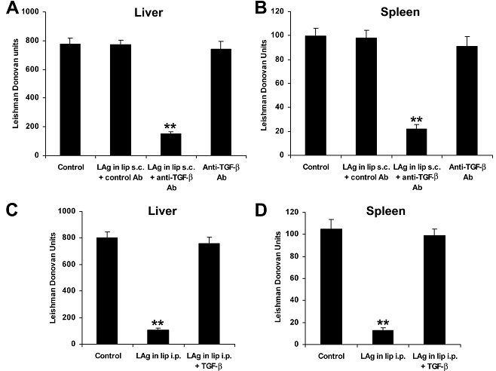
Neutralization of TGF-β during vaccination induces protection whereas the addition of TGF-β causes vaccine failure
Fig:-In vivo effects of anti-TGF-β antibody (Ab) and TGF-β during vaccination via non-protective s.c. and protective i.p. routes. Mice were vaccinated three times with liposomal LAg with 100 ug of anti-TGF-β or control antibody at 2-week intervals through the s.c. route (A,B)and with liposomal LAg, alone or in combination with 5 ug TGF-β, at 2-week intervals through the i.p. route (C,D).Control groups received nothing or anti-TGF-β antibody. Ten days after the last immunization, the mice were challenged intravenously with L. donovani. After 4 months, parasite loads in the liver and spleen were measured and expressed in Leishman Donovan
units.

Slide 15
COMBINING VACCINE DELIVERY SYSTEM WITH IMMUNOMODULATOR
 The success of liposomal Ag delivery was largely through i.p. immunization, a route not favored for clinical use.
 To overcome this limitation and optimize the route of immunization, we chose an immunopotentiator Monophosphoryl lipid A-trehalose dicorynomycolate (MPL-TDM) - a FDA-approved TLR4 agonist to promote liposomal Ag vaccination through s.c. route.
 MPL signals via TLR-4 and promotes IFN-γ production by Ag specific CD4+ T-cells to enhance the immune response toward a Th1 profile.

Slide 16
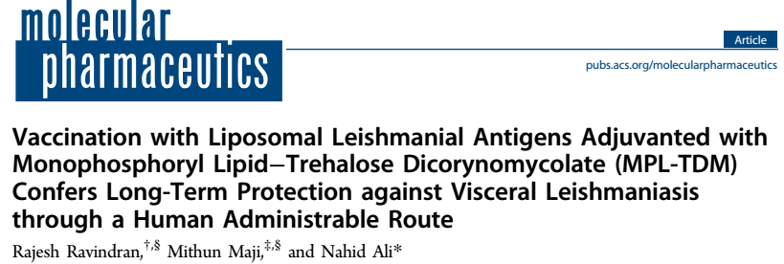
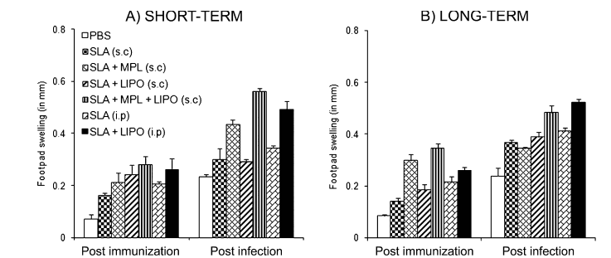
Liposomal SLA + MPL-TDM represent a good vaccine formulation for the induction of robust DTH response in both short and long-term studies.
Fig 2. DTH responses in BALB/c mice post-immunization and post-infection in short-term (A) and long-term (B) studies. Groups of four mice were immunized intraperitoneally or subcutaneously with free SLA or SLA entrapped in cationic liposomes, MPL-TDM mixed with SLA alone, or SLA entrapped in cationic liposomes through a subcutaneous route; control mice received only PBS. Ten days, short-term protection (A), or 12 weeks, long-term protection (B), after the last immunization, and 4 months post-infection SLA-specific DTH responses were measured.

Slide 17
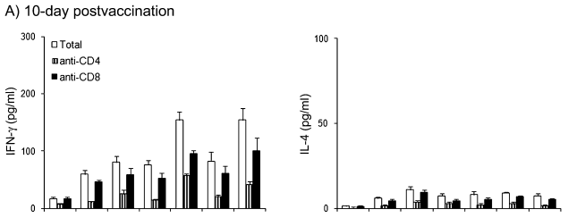
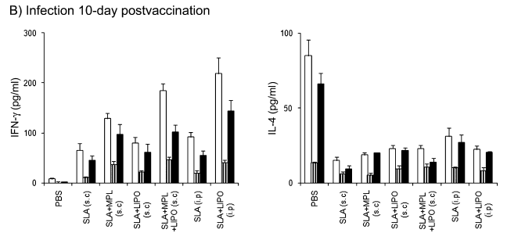
CD4⁺and CD8⁺T Cell Responses in Immunized Animals
Fig. Durable antigen specific protective cytokine responses against visceral leishmaniasis. Spleen cells of mice vaccinated at 12 weeks with free SLA or SLA entrapped in cationic liposomes through intraperitoneal or subcutaneous routes, MPL-TDM mixed with SLA alone or SLA entrapped in cationic liposomes through subcutaneous routes, or PBS control were harvested before and after infection with L. donovani, treated with anti-CD4⁺or anti-CD8⁺monoclonal antibodies, and stimulated with SLA (10μg/mL) for 72 h. Figures represent total, CD4⁺and CD8⁺T cell production of IFN-γ and IL-4 before (A) and after (B) infection.

Slide 18
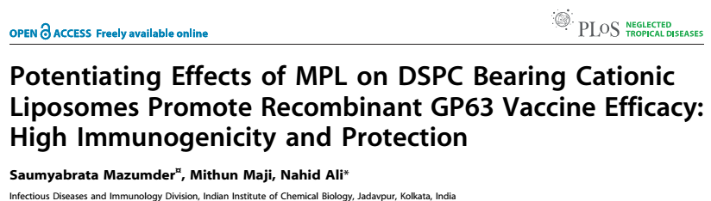
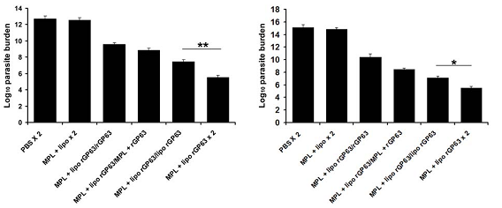
Evaluation of protection against L. donovani challenge in mice vaccinated with different vaccine regimens.
Liver
Spleen
Fig. Evaluation of protection against L.donovani challenge in mice vaccinated with different vaccine regimens. Quantification of single viable cell was determined by limiting dilution assay performed 3 months after infection on the cells isolated from liver (A) and spleen (B).
 Mice boosted with rGP63 adjuvanted with both cationic DSPC liposomes and MPL-TDM had, 2 and , 1.5-log-fold reduced parasite burden in liver and spleen respectively (3 months post-infection) compared to mice boosted with liposomal rGP63 alone.

Slide 19
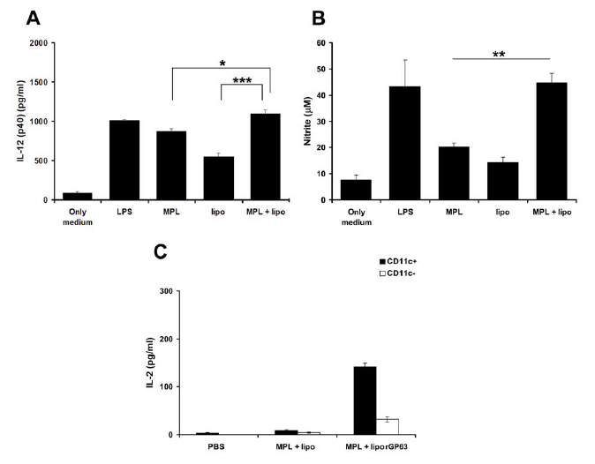
Activation of Bone Marrow Derived Dendritic Cells (BMDCs) and Ag presenting capacity of LN CD11c⁺ cells
Fig:-A. Bone-marrow derived DCs were isolated and stimulated with LPS (1mg/ml), liposomes (50mM), MPL-TDM (100 ng /ml) and combination of liposomes (50mM) and MPL-TDM (100 ng/ml). On activation of BMDCs the release of (A) IL-12 (p40) and (B) NO were measured subsequently. (C) Ag-presenting capacity of CD11c+ and CD11c –cells isolated from mice immunized with PBS, MPL-TDM plus liposomes, and liposomal rGP63 plus MPL-TDM in terms of IL-2 production
.

Slide 20
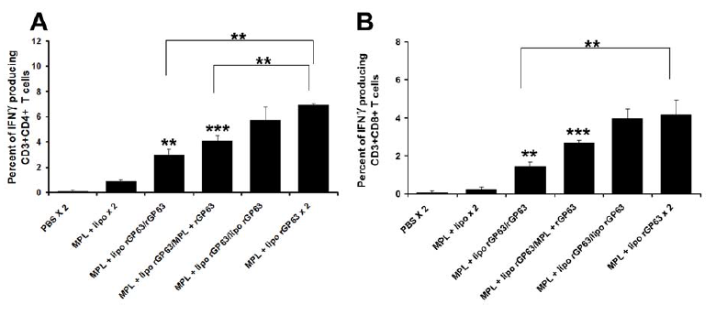
Flow cytometric analysis of rgp63-specific IFN-γ producing CD4 ⁺ and CD8 ⁺ T cells after challenge infection
Flow cytometric analysis of rGP63-specific IFN-γ producing CD4+and CD8+ T cells. BALB/c mice were primed with liposomal rGP63 plus MPL-TDM, followed by boosting with either rGP63 alone, in association with MPL-TDM, or liposomes, or both before challenge infection. Splenocytes were isolated from vaccinated mice and the expression of IFN-γ producing CD4+ (A) and CD8+ T (B) was studied in the presence of rGP63

Slide 21
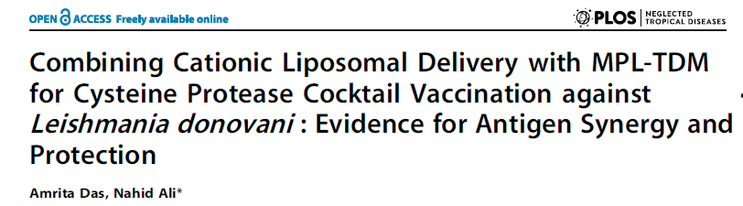
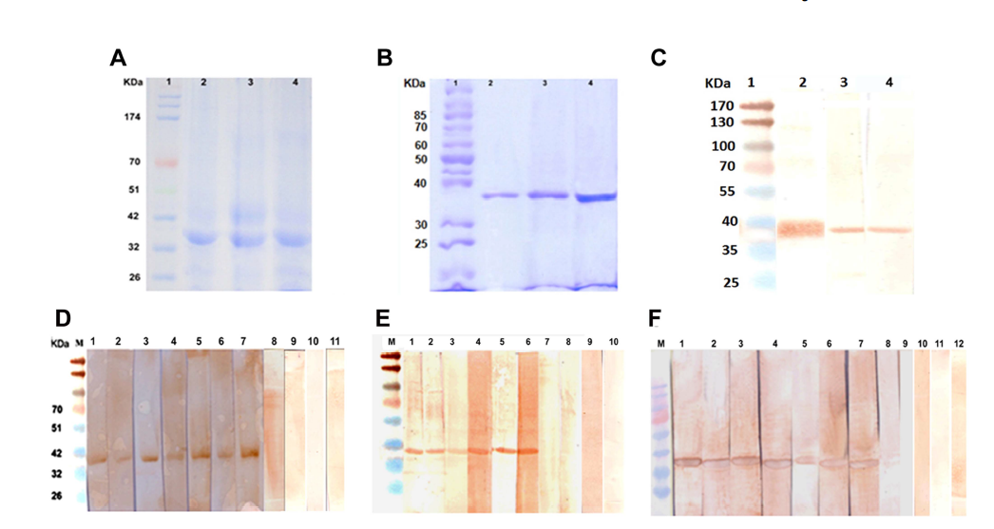
Clan CA
(Papain family)
CPA, CPB, CPC
Plays crucial role in parasitic survival, replication, autophagy, metacyclogenesis and host-parasite interaction
Have been identified as putative vaccine candidates against leishmaniasis that needs further investigation
Cloning and expression and purification of CPA, CPB and CPC.

Slide 22
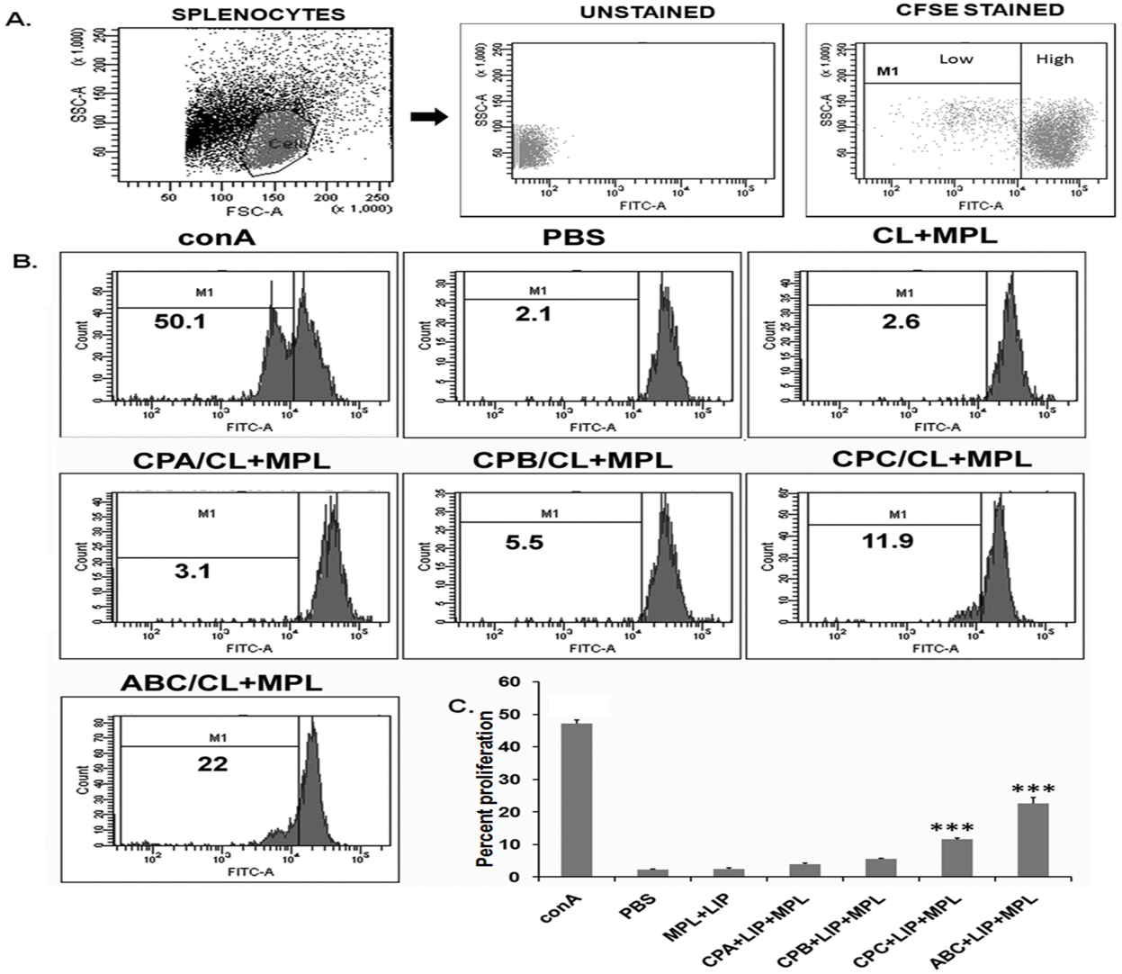
Proliferative response in hamsters vaccinated with liposomal CPs with MPL-TDM
 Antigen-specific lymphoproliferation was highest with triple antigen cocktail CPs while proliferation of CPC was best in comparision to individual CP group.
Fig:- Splenocytes from immunized animals were labeled with CFSE (2 mM) and restimulated in vitro for 5 days with 5 mg/ml of specific antigen or 2.5 mg/ml ConA. Antigen-specific splenocyte proliferation of individual animals was analyzed by flow cytometry and CFSE dilution on gated cells. A, Gating strategy for hamster lymphocytes and CFSE high and CFSE low populations. B, Representative histogram showing percent proliferation, calculated in the indicated region (bar). C, the bar graphs show mean percent proliferation of the lymophocytes, which is inversely proportional to cell divisions.

Slide 23
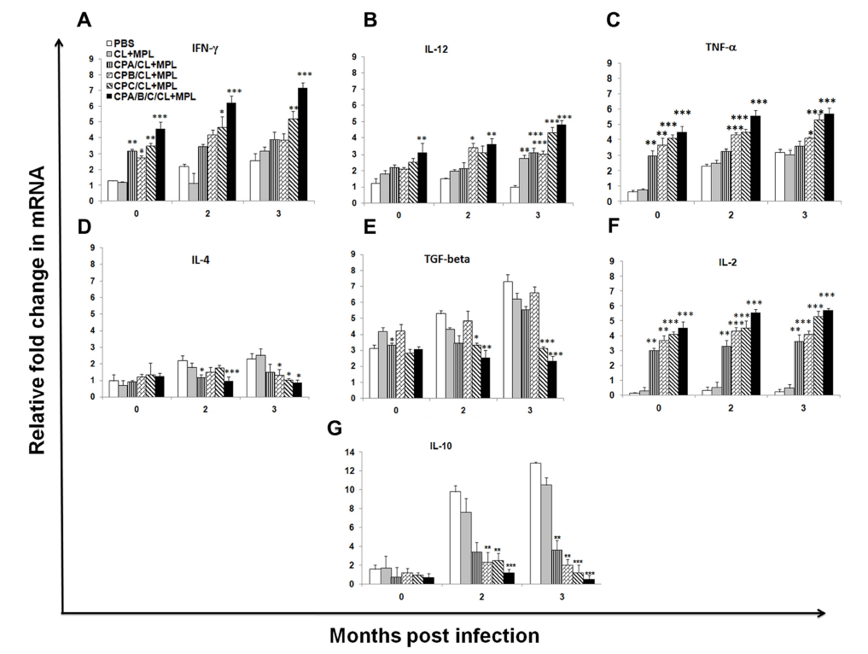
Th1/Th2 cytokine profiles of immunized hamsters at different time intervals pre- and post-infection by quantitative realtime PCR
 Liposomal CPs + MPL-TDM induces
A Th1 cytokine response while Th2 response is suppressed
Fig:-Fold change in mRNA expression profiles of A, IFN-c; B, IL-12; C, TNF-a; D, IL-4; E, TGF-b; F, IL-2; G, IL-10. Each gene was normalized to the housekeeping gene (Hypoxanthine-guanine phosphoribosyltransferase, HGPRT) to avoid variations between different samples.

Slide 24
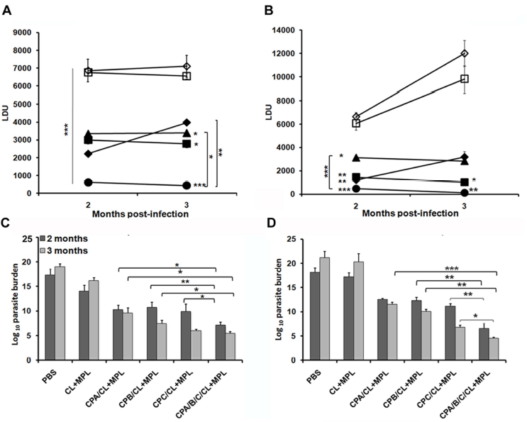
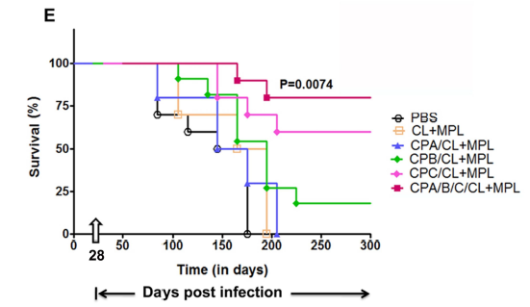
Protection and survival against L. donovani infection in immunized hamsters
Liver
Spleen
 Liposomal CPs impart protective immunity against VL . Cocktail antigens in the lipo-adjuvant formulation imparts the best protection and survivability in hamsters from challenge L. donovani infection. CPC imparts the best protection and survivability among the individual groups of CPs.
Fig:-A–D, kinetics of liver (A) and spleen (B) parasite burden by LDU, liver LDA (C) and spleen LDA (D) of hamsters 2 and 3 months after intracardiac challenge of 26107 virulent L. donovani promastigotes. E, Kaplan-Meier survival curves comparing survivality in different groups of vaccinated hamsters.

Slide 25

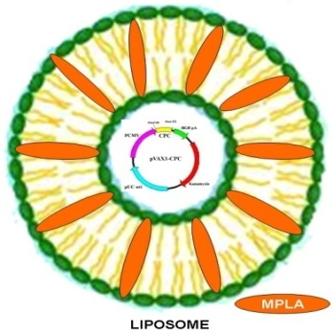
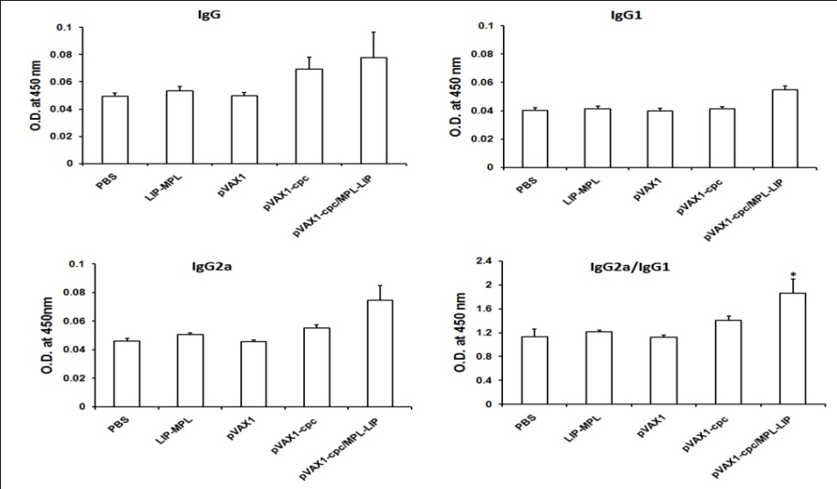
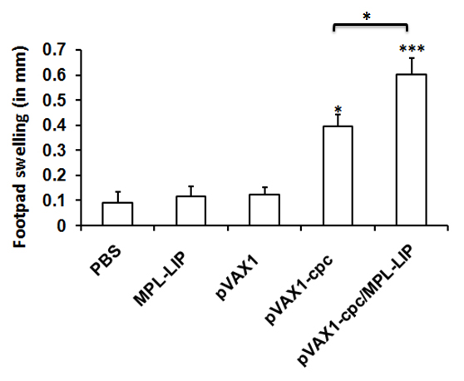
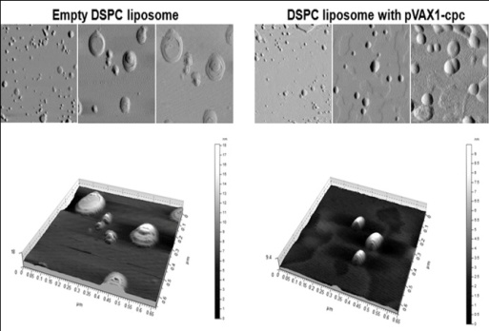
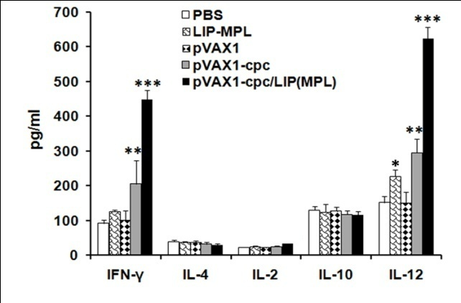
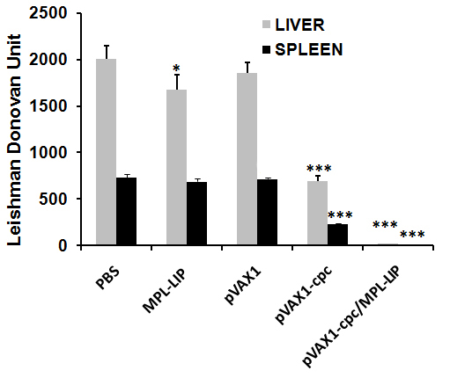
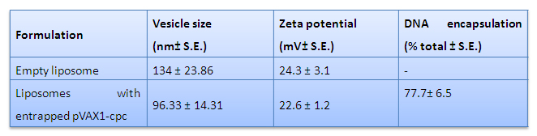
MPLA incorporated cationic liposome- A new tool of vaccination
Both humoral as well as cell mediated immunity is induced and liposomal CPC DNA vaccine imparted excellent protection against VL
Patent applied:
Application No: 3864/DEL/2014; Filing Date 23/12/2014
Application No: PCT/IN2015/000186; 28/04/2015

Slide 26
CONCLUSION
Cationic multilamellar vesicles (MLV) when used as vaccine carrier for protein antigens induced sustained immunity against virulent challenge with Leishmania donovani.
Immunization with this liposomal vaccine demonstrated success when administered intraperitoneally but failed when delivered through subcutaneous route.
In vitro and in vivo studies confirmed the role of TGF-β in vaccine failure.
Immunization within liposomal leishmanial antigens adjuvanted with Monophosphoryl lipid-trihalose dicorynomycolate (MPL-TDM) induced high levels of short and long-term protective immunity through subcutaneous route.
This cationic liposome + MPL-TDM represents a good vaccine formulation for recombinant antigens, gp63 and cysteine proteases, for induction of innate and adaptive immunity for durable protection.
MPLA incorporated cationic liposomal CPC DNA vaccine induced both humoral as well as cell mediated immunity and imparted excellent protection against VL.

Slide 27




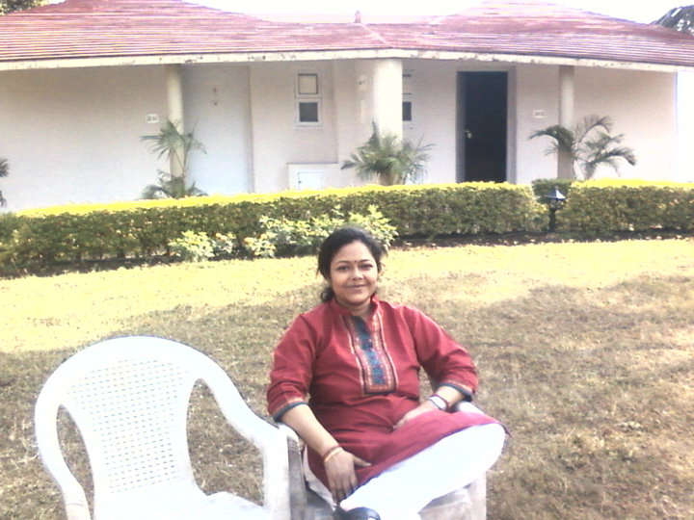

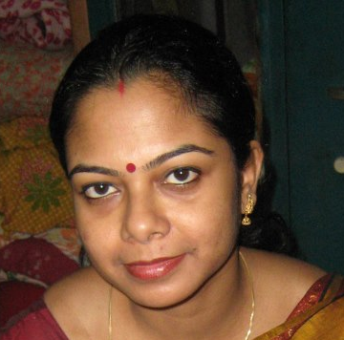
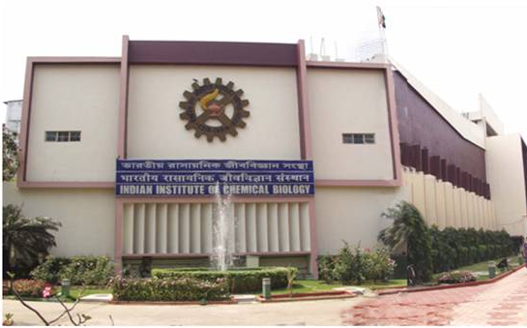


I Acknowledge and Thank
My students
Funding Agencies
Tuhina
Rajesh
Swati
Our Institute
Saumyabrata
Sudipta
Amrita
Mithun

Slide 28


