Slide 1

Outer Membrane Vesicles: A Novel Particles for Next Generation Vaccine
Hemanta Koley, MSc PhD
Scientist
Division of Bacteriology,
National Institute of Cholera and Enteric Diseases
P-33 CIT Road, Scheme-XM, Beliaghata,
Kolkata, India
Hemanta Koley MSc, PhD, Scientist, Bacteriology

Slide 2
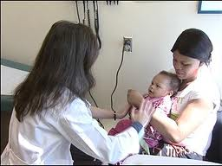
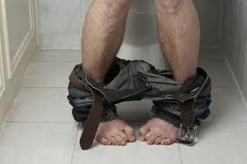

What is Shigellosis?
Shigellosis, diarrhoea with blood also known as bacillary dysentery or Marlow Syndrome, is a food borne illness caused by infection of bacteria, Shigella.
Shigellosis rarely occurs in animals other than humans, But physiological or surgical manipulation, it is possible to make shigellosis to the animal beings.
Shigella was discovered over 100 years ago by the Japanese microbiologist, Kiyoshi Shiga.

Slide 3
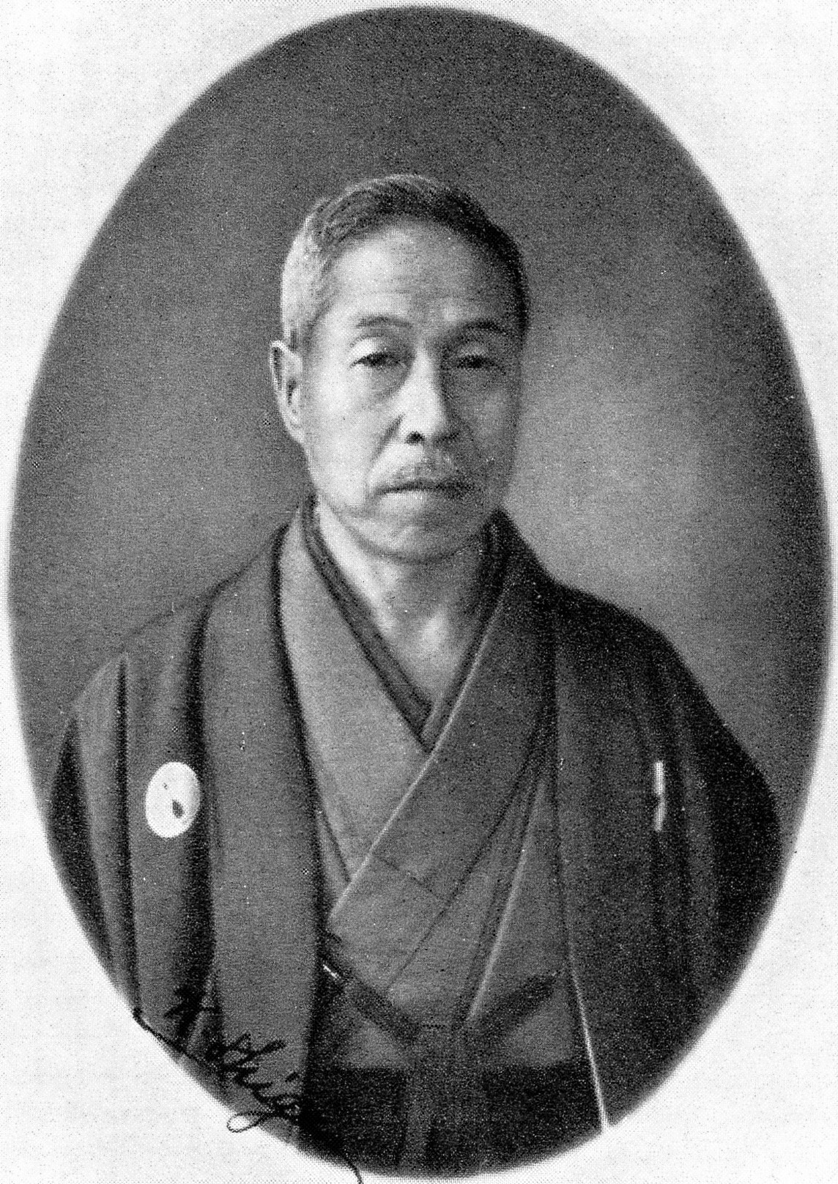
Dr. Kiyoshi Shiga: Discoverer of the Dysentery Bacillus
Dr Kiyoshi Shiga was a Japanese physician and bacteriologist. He became famous for the discovery of Shigella dysenteriae, the bacillus causing dysentery, in 1897, during a severe epidemic in which more than 90,000 cases were reported, with a mortality rate approaching 30%. The bacterium Shigella was thus named after him, as well as the shiga toxin, which is produced by the Shigella dysenteriae .
Born: February 7, 1871, Sendai, Miyagi Prefecture, Japan
Died: January 25, 1957, Tokyo, Japan
Education: University of Tokyo

Slide 4
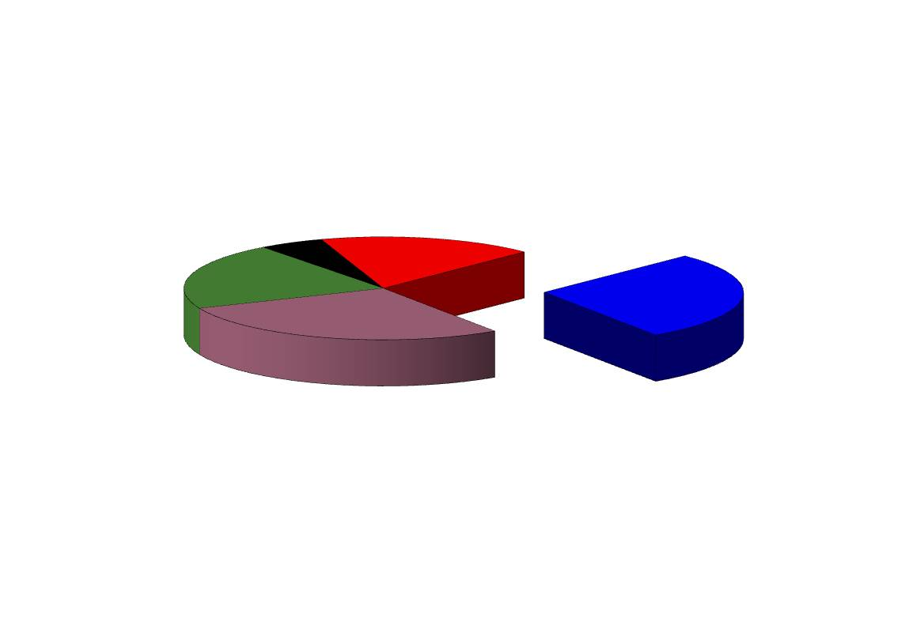
Enteric Pathogens of Global Importance
2.9 Million deaths/year
Cholera
(150,000 deaths)
ETEC diarrhea
(500,000 deaths)
Typhoid fever
(600,000 deaths)
Rotavirus diarrhea
(800,000 deaths)
Shigellosis
(800,000 deaths)
WHO Global burden of diseases/ update 2008,WHO/UNICEF

Slide 5
Isolation of enteric pathogens from ID Hospital, Kolkata
(Nov 2007 to Oct 2015)

Slide 6

Prevention
Sanitation
Developing country like India, the sanitation problem is acute
Rehydration Therapy
Rehydration therapy is not applicable to the invasive diarrhea.
Antibiotics
Global emergence of drug resistance, the choice of antimicrobial agents for treating shigellosis is limited.
Vaccine
For more than 50 years, scientists have been trying to come up with suitable candidate vaccines against enteric diseases.

Slide 7
Antimicrobial resistance of Shigella during 2010-15

Slide 8
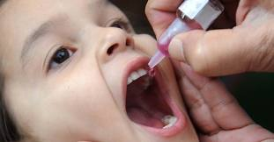
Vaccination will be the ultimate solution

Slide 9
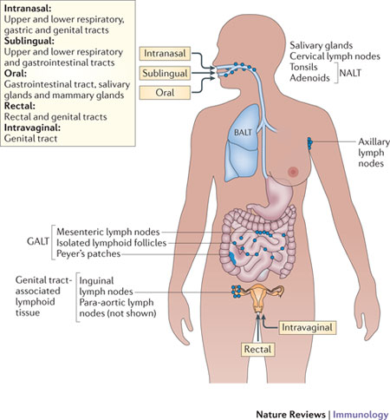
Routes for human vaccine administration
Oral route of vaccination is the best for the gastrointestinal diseases.

Slide 10

To prepare a unique vaccine formulation different from the candidate vaccines like conjugate, live attenuated, whole cell or ribosomal preparation

Slide 11
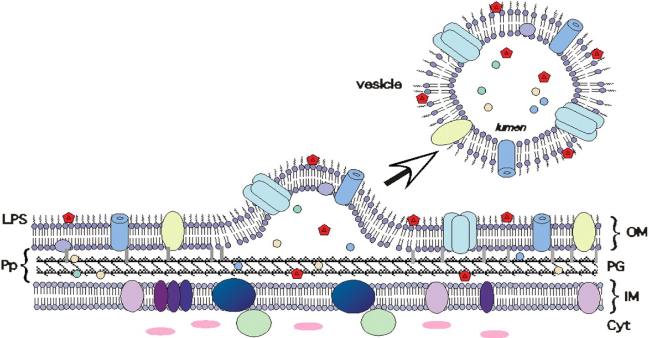
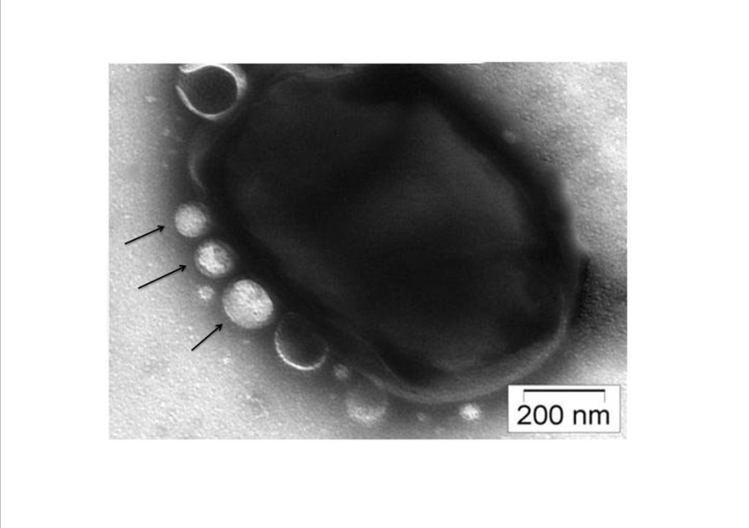
Outer Membrane Vesicle: A Novel Particle of Next Generation Vaccine
WHAT are OMVs?
Most of gram-negative bacteria secrete outer membrane vesicles (OMVs) into the extracellular environment during growth.
Spheroid particles of a heterogeneous size (10 to 300 nm in diameter) .
As because of OMVs originate directly from the plasma membrane of the cell, it reflects the outer membrane (OM) composition, containing LPS, glycerophospholipids, and OM proteins as well as enclosed periplasmic components .
Play role in interbacterial Interactions. Immunomodulatory activities.
Non living ; do not have the possibility of reversion like attenuated vaccines.

Slide 12
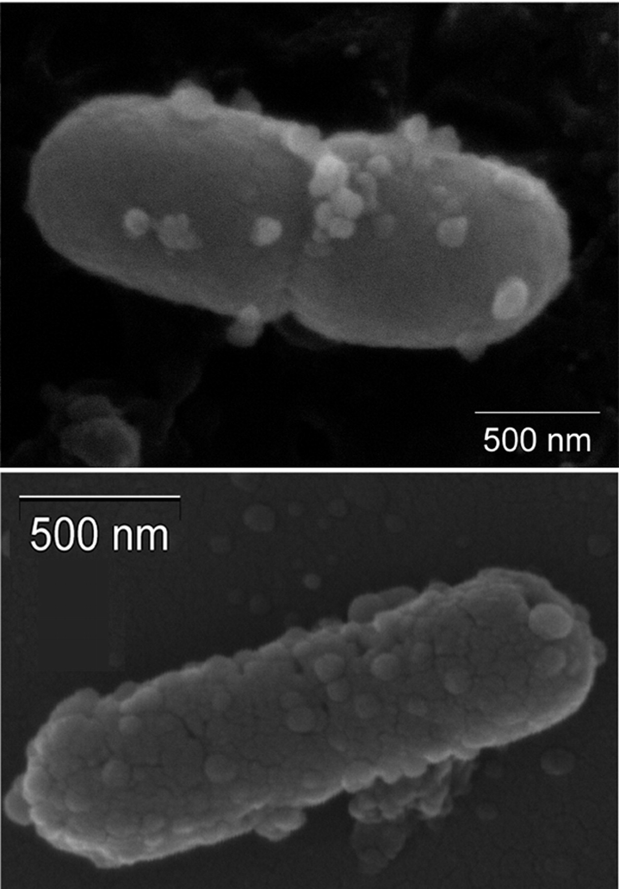

OUTER MEMBRANE VESICLES (OMVs) as a VACCINE CANDIDATE:
A new hope for vaccine study
Ellis T N , and Kuehn M J Microbiol. Mol. Biol. Rev. 2010;74:81-94

Slide 13
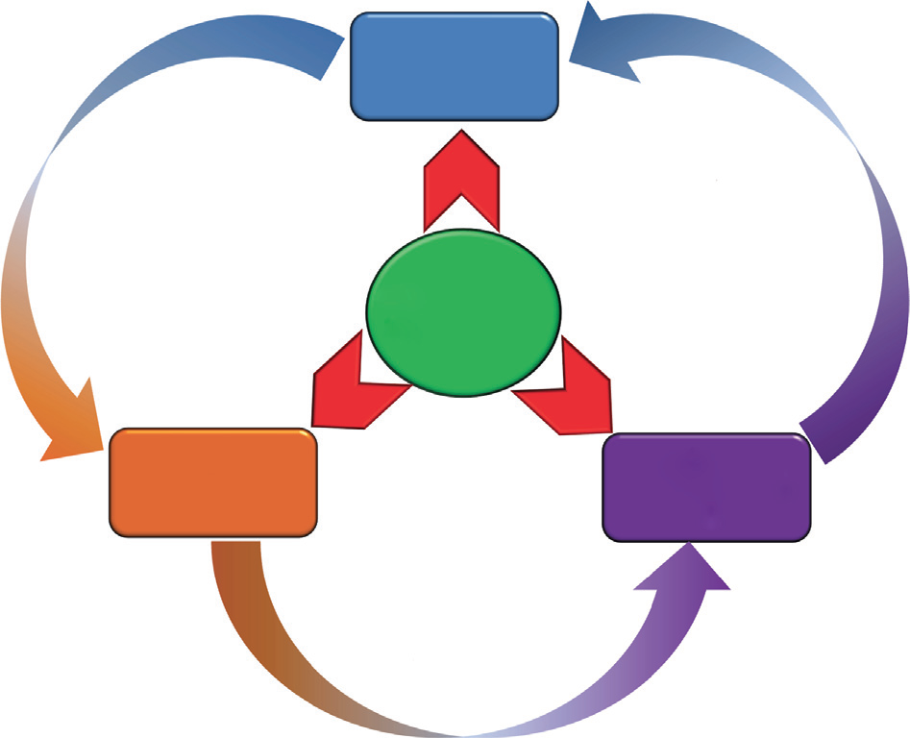
Effecter arms of new generation OMVs vaccines
Innate immunity cells
Recruitment and stimulation
Activation and modulation
OMVs can induce humoral and adaptive immunity and thus serve long term protection.
OMVs
Antigen presenting cells
Adaptive effector/me-mory cells
Education and maturation

Slide 14
Objectives of my study
Preparation of OMVs immunogen from different serotypes of Shigella sp.
2. To understand safety, immunogenicity and protective efficacy of OMVs against 50 heterologous Shigella sp. in animal model.

Slide 15
NICED repository (Shigella strains)
(200 strains)
Invasion assay in Caco 2 cell line
Sereny test in Guinea pig eyes
12 virulent strains finally selected
Secretion of OMVs
Presence of virulent plasmid
PCR of virulence associated genes

Slide 16
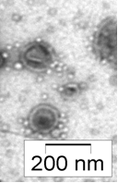
Preparation of outer membrane vesicles (OMVs)
8 to 10hr grown bacterial culture was centrifuged at 5000g for 30min.
5 µl of OMV suspension was observed under Tecnai 12 (Bio Twin Transmission electron Microscope, FEI, Netherland) operating at 80 KV by negative staining method.
Supernatant was passed through 0.45 and 0.22µm Millipore filter twice.
Resultant culture supernatant was subjected for ultra centrifugation (38,000 rpm for 3 hrs at 4° C)
Pellet was collected and resuspended in sterile PBS and the protein concentration was estimated by Bradford assay

Slide 17
Selection of strain for SOMVs formulation
S. boydii 4 (BCH612) was selected for OMVs isolation and single serotype vaccine formulation.

Slide 18
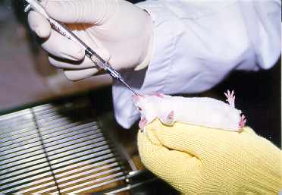
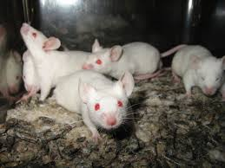
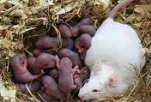
Protective Efficacy study- passive protection model
Adult male mice
Immunized female mice were mated with age matched males
Suckling mice
7 week old adult female mice
Immunized with the SOMVs
Challenged with wild type virulent Shigella strains to study the protective efficacy of the SOMVs vaccine formulation

Slide 19


Scheme for oral immunization with SOMVs and subsequent challenge study
1st Immunization
2nd Immunization
3rd Immunization
4th Immunization
Day 84-90
Mating
Day 14
blood
Day 28
blood
Day 56
blood
Challenge
Day 115- 121
Day 0
blood
Day 35
blood
Day 7
blood
Day 21
blood
Day 120
Blood
Day 78
Blood

Slide 20
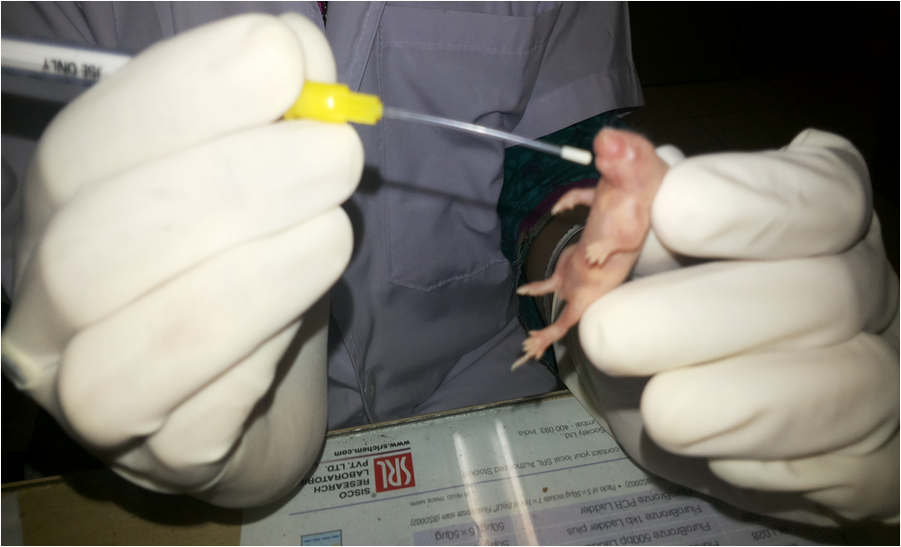
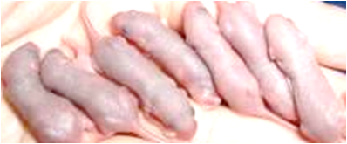
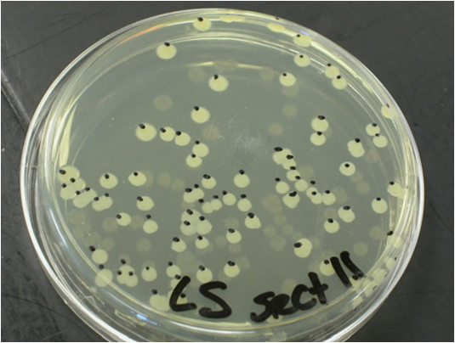
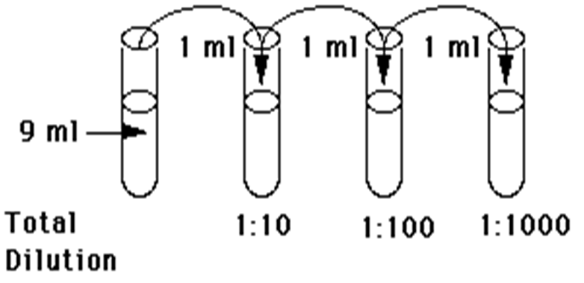
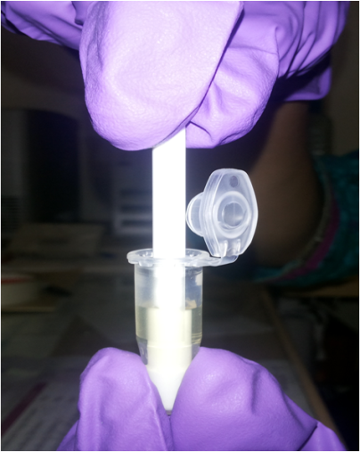
Colonization assay
After six hour incubation, neonates were sacrificed and their gut were taken out and homogenized
CFU/gm of intestine of suckling mouse

Slide 21
Protection study after SOMVs immunization
Nature of Study | Challenge strain | Experimental group | No. of animals | % of survival | Protective efficacy (%)
Homologous protection study | S.boydii type 4 (BCH612) | Immunized | 20 | 100 (20/20) | 100
 |  | Nonimmunized | 10 | 20 (2/10)
Heterologous protection study | S. dysenteriae 1 (NT4907) | Immunized | 20 | 85 (17/20) | 81
 |  | Nonimmunized | 10 | 20 (2/10)
 | S. flexneri 2a (B294) | Immunized | 20 | 80 (16/20) | 75
 |  | Nonimmunized | 10 | 20 (2/10)
 | S. flexneri 3a (C519) | Immunized | 20 | 70 (14/20) | 77
 |  | Nonimmunized | 10 | 10 (1/10)
 | S. flexneri 6 (C347) | Immunized | 20 | 80 (16/20) | 71
 |  | Nonimmunized | 10 | 30 (3/10)
 | S. sonnei (IDH00968) | Immunized | 20 | 80 (16/20) | 75
 |  | Nonimmunized | 10 | 20 (2/10)
× 100

Slide 22
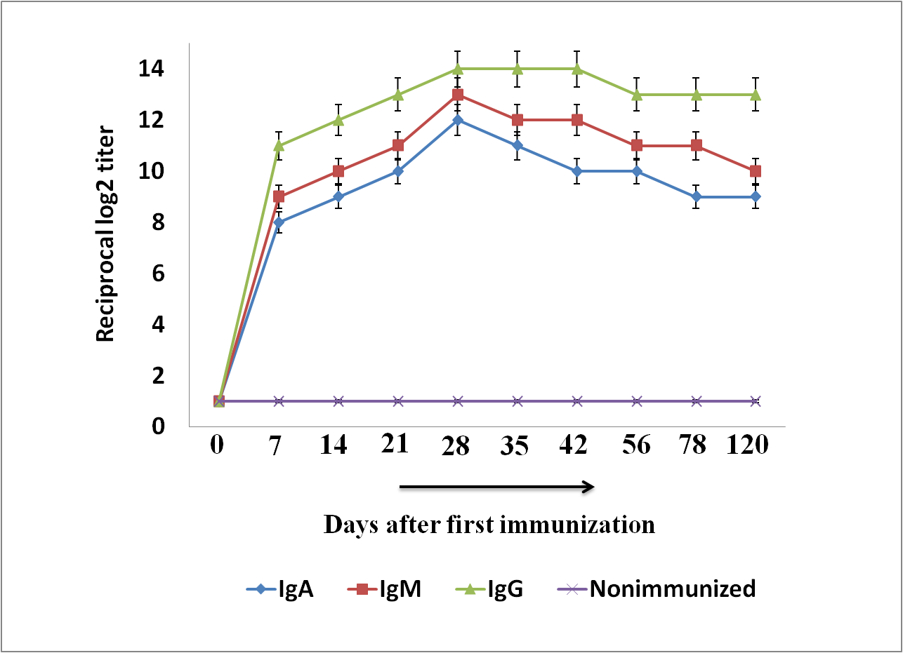
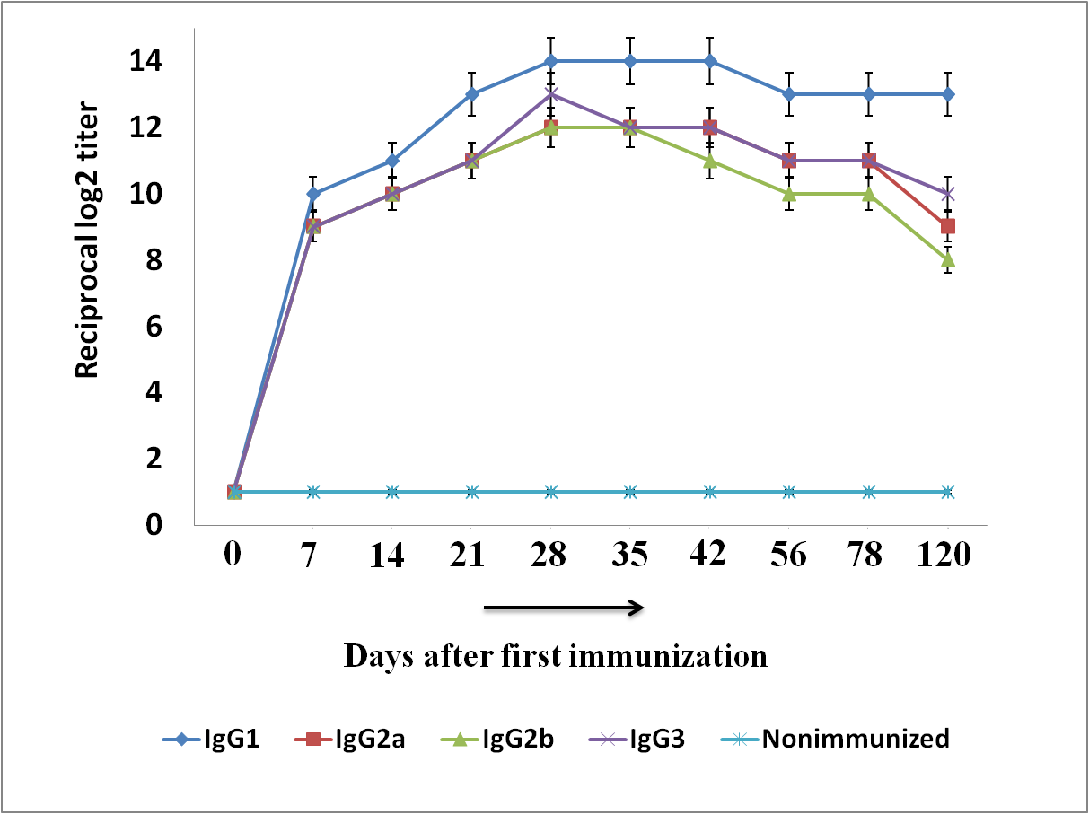
Serum immunoglobulin study of SOMVs

Slide 23
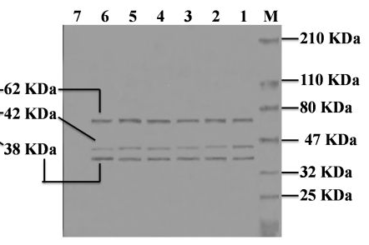
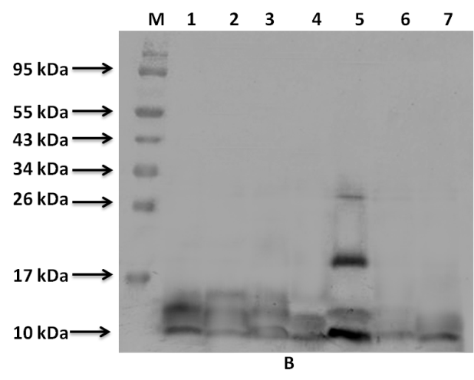
Specificity of the antibody response
A
B
Lane M: protein molecular weight marker (BioRad)
Lane 1: S. dysenteriae 1
Lane 2: S. flexneri 2a
Lane 3: S. flexneri 3a
Lane 4: S.flexneri 6
Lane 5: S. boydii type 4
Lane 6: S.sonnei
Lane 7: S. flexneri 1a (avirulent strain)
Western blot against LPS, probed with 28th day anti-SOMVs sera
Western blot against whole cell lysates, probed with 28th day anti-SOMVs sera
Notes:
Shigella boydii type 4 BCH612 secretes vesicles during growth which are highly immunogenic in adult mice.
High reciprocal increase of serum antibody response was noticed in immunized sera during the course of immunization. Titers were above the detection level over a 3-month period indicating a long-lasting immune response.
IpaB, IpaC and IpaD are probably the most immunogenic factors of OMVs.
These OMVs has given 100% homologous but 75% heterologous protection in average to the offsprings of immunized females.

Slide 24

Shigella boydii type 4 BCH612 secretes vesicles during growth which are highly immunogenic in adult mice.
IpaB, IpaC and IpaD are probably the most immunogenic proteins of OMVs.
These OMVs has given 100% homologous but 75% heterologous protection in average to the offsprings of immunized females.

Slide 25
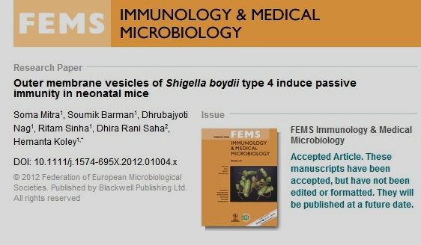

Publication date : 2012 Nov; 66(2):240-50.
This is the first report of outer membrane vesicles induced passive protection study in mice model against shigellosis.

Slide 26

Though 100% homologous protection was quite satisfactory,
75% average heterologous protective efficacy bestowed by the OMVs of S. boydii was not at all promising from the purview of disease prevalence and severity.

Slide 27
This is quite obvious if we look at the number of serotypes and subserotypes among Shigella sp.
A single serotype vaccine is not a very promising idea
Shigella
(50 serotypes)
Sero group A
Shigella
dysenteriae
[15 serotypes]
Sero group B
Shigella
flexneri
[14 serotypes]
Sero group C
Shigella
boydii
[20 serotypes]
Sero group D
Shigella
sonnei
[1 serotype]
Source: Levine MM et al, .Clinical trials of Shigella vaccines: two steps forward and one step back on a long, hard road. Nat Rev Microbiol. 2007 Jul;5(7):540-53. Review.

Slide 28

Multi-serotype form of vaccine is the future for absolute eradication of shigellosis associated death in young children

Slide 29

OMVs from multiple Shigella strains
Cocktail
Multi-serotype Outer Membrane Vesicles
Or
MOMVs

Slide 30
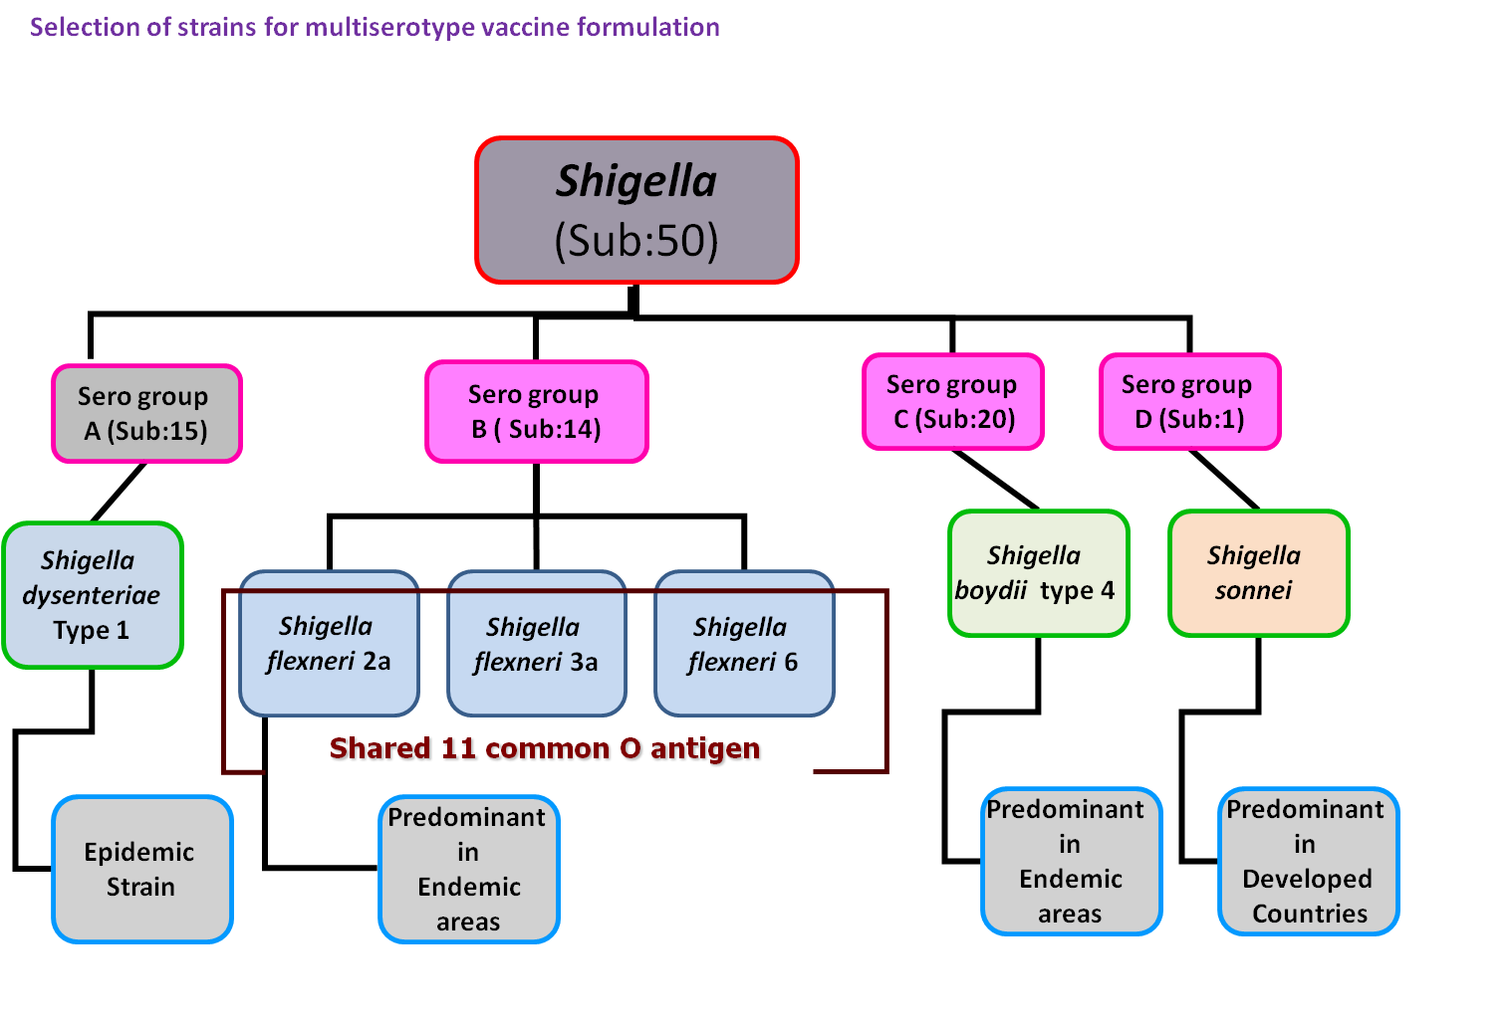
Selection of strains: Concept behind MOMVs vaccine formulation

Slide 31
Six components of the MOMVs (hexavalent) vaccine
S. dysenteriae 1 ∆stx (NT4907)
S. flexneri 2a (B294)
S. flexneri 3a (C519)
S. flexneri 6 (C347)
S. boydii 4 (BCH612)
S. sonnei (IDH00968)

Slide 32
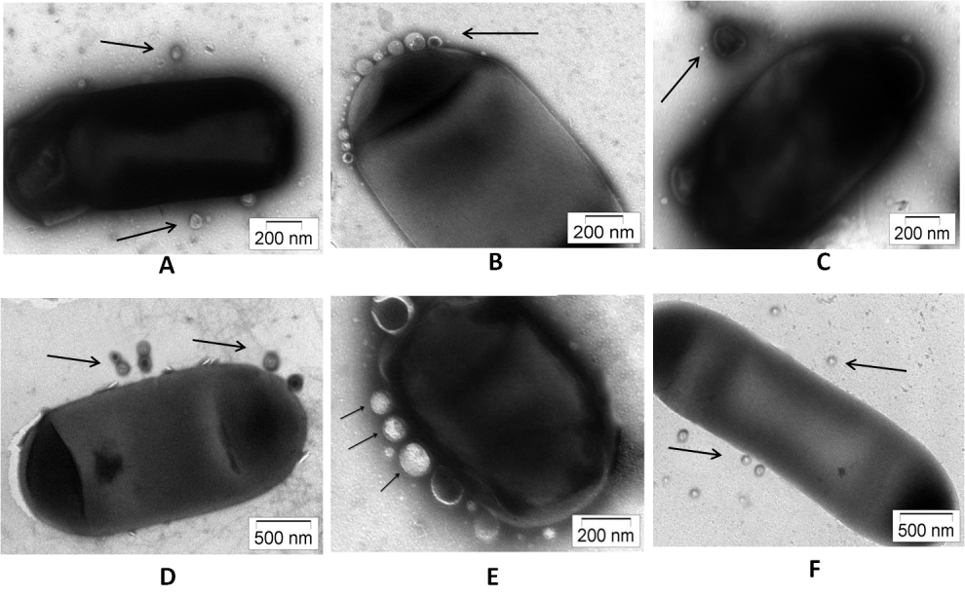
Electron microscopic view of OMVs secreting Shigella
A: S. dysenteriae1∆stx
B: S. flexneri 2a
C: S. flexneri 3a
D: S.flexneri 6
E: S. boydii type 4
F: S.sonnei

Slide 33
Protective efficacy of MOMVs
Challenged strain | Infectious dose₅₀ (ID₅₀) | Challenge doseª | Experimental group | Experimental neonates | % of survival after challenge | Protective efficacy (%) after challenge
S.dysenteriae 1 (A1) | 2 ± 0.201 × 10⁸/ml | 3 ± 0.336 × 10¹⁰ /ml | Control | 10 | 20 (2/10) | 87.5
 |  |  | Immunized | 20 | 90 (18/20)
S. flexneri 2a (NK3809) | 3 ± 0.251 × 10⁸/ml | 4 ± 0.258 × 10¹⁰ /ml | Control | 10 | 20 (2/10) | 100
 |  |  | Immunized | 20 | 100 (20/20)
S. flexneri 3a (NK3758) | 3 ± 0.193 × 10⁸/ml | 3 ± 0.101 × 10¹⁰ /ml | Control | 10 | 10 (1/10) | 83.33
 |  |  | Immunized | 20 | 85 (17/20)
S. flexneri 6 (NK4025) | 5 ± 0.211 × 10⁸ /ml | 5 ± 0.46 × 10¹⁰ /ml | Control | 10 | 30 (3/10) | 100
 |  |  | Immunized | 20 | 100 (20/20)
S. boydii 2 (NK4023) | 4 ± 0.190 × 10⁸/ml | 5 ± 0.64 × 10¹⁰ /ml | Control | 10 | 20 (2/10) | 87.5
 |  |  | Immunized | 20 | 90 (18/20)
S. sonnei (NK3918) | 2 ± 0.134× 10⁸/ml | 2 ± 0.167 × 10¹⁰ /ml | Control | 10 | 20 (2/10) | 93.75
 |  |  | Immunized | 20 | 95 (18/20)

Slide 34
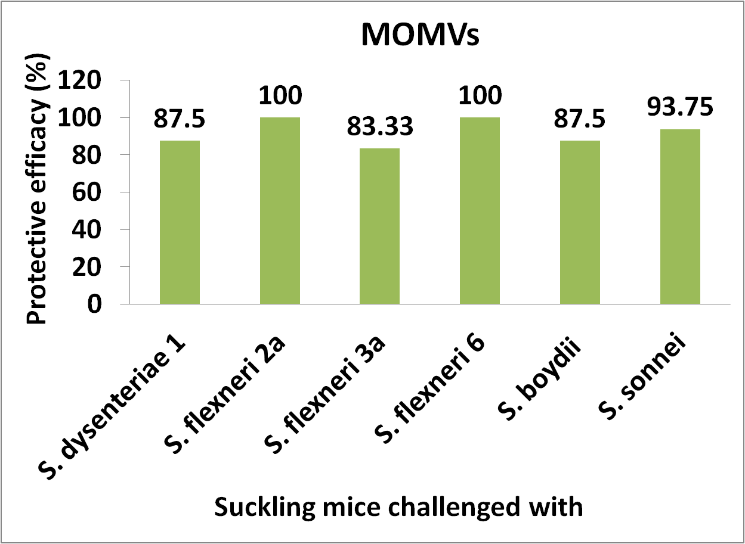
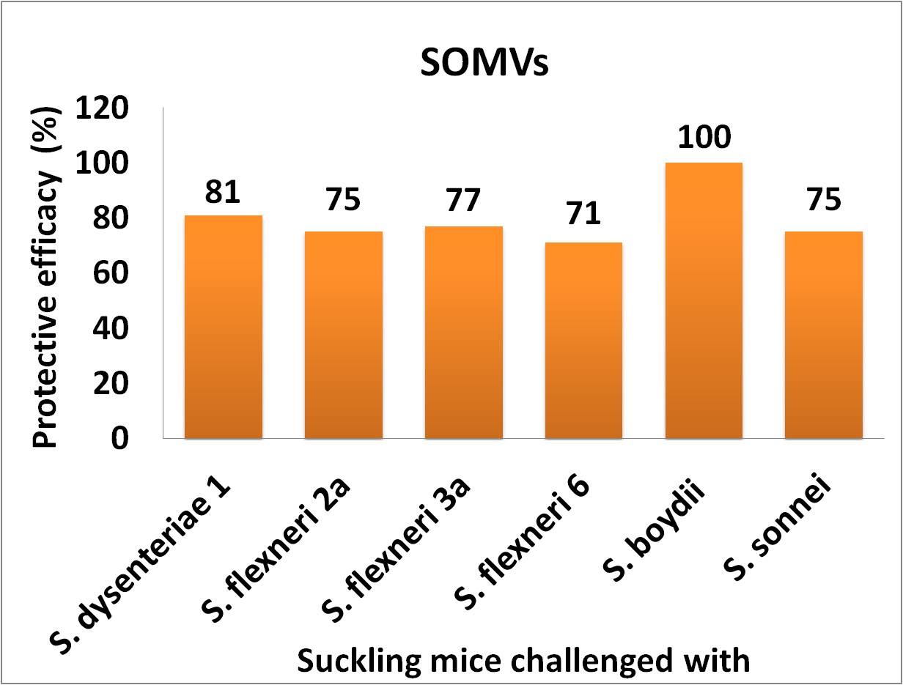
Comparison of protective efficacy
× 100

Slide 35
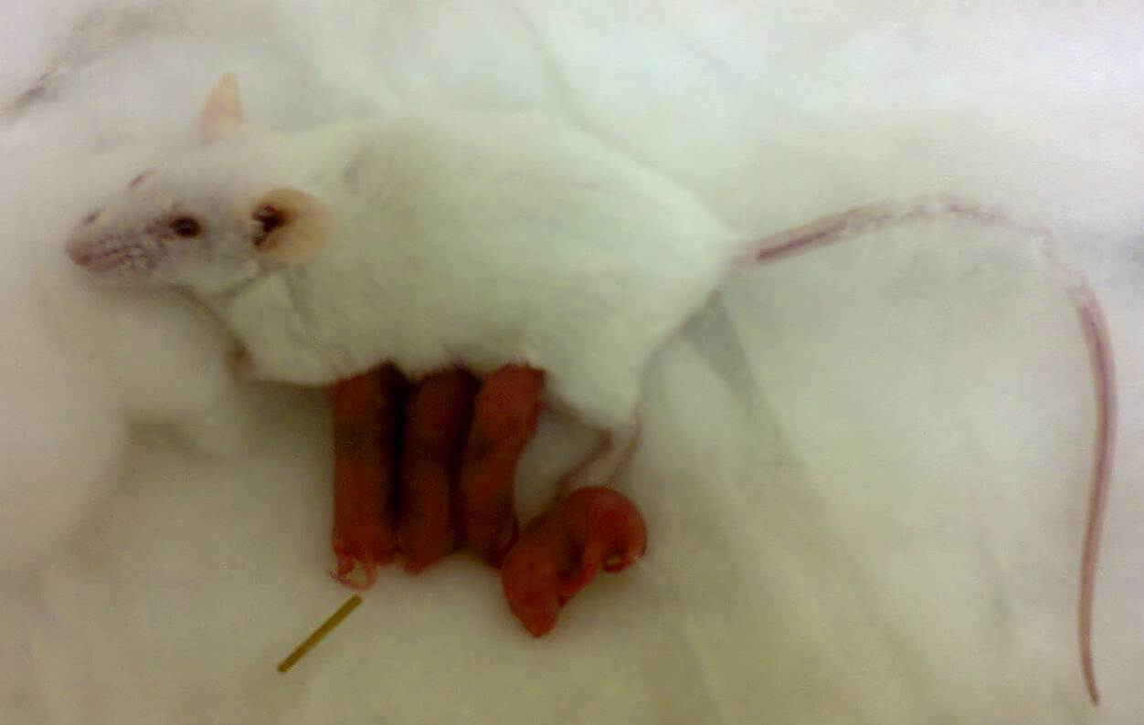
Mother’s milk: the main source of passive protection
Neonatal gut mainly contain milk from their mother.
Immunoglobulins in the gut of the neonatal mice from immunized dams were studied by ELISA

Slide 36
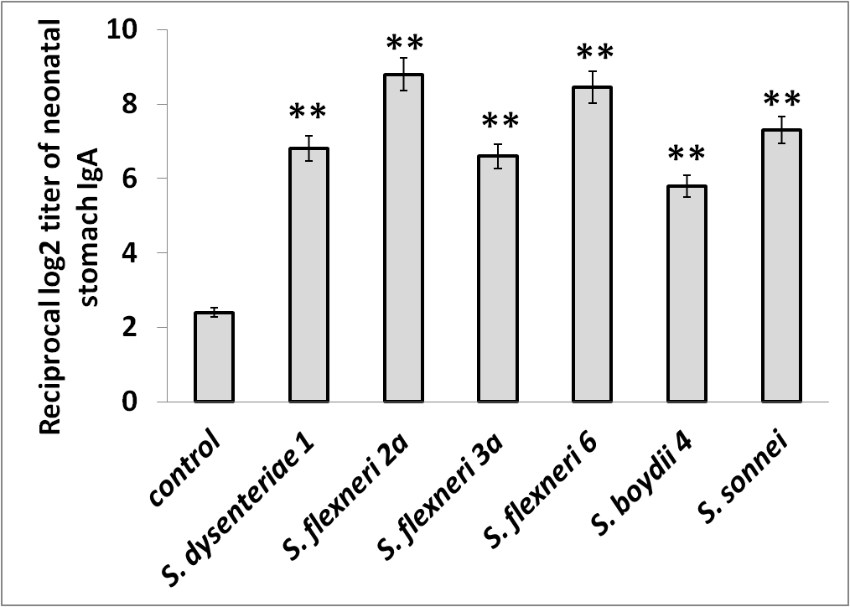
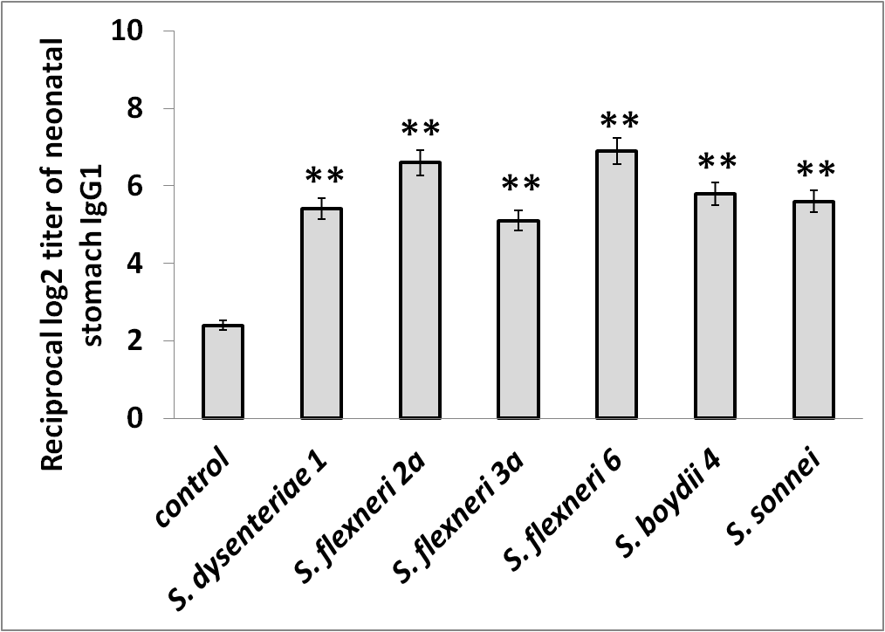
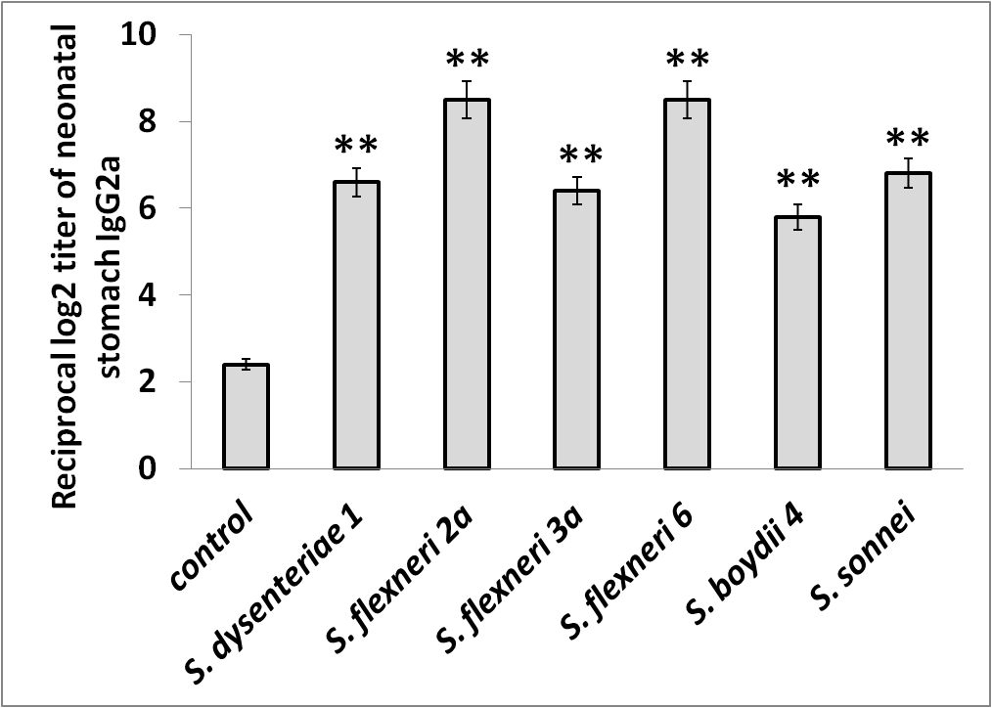
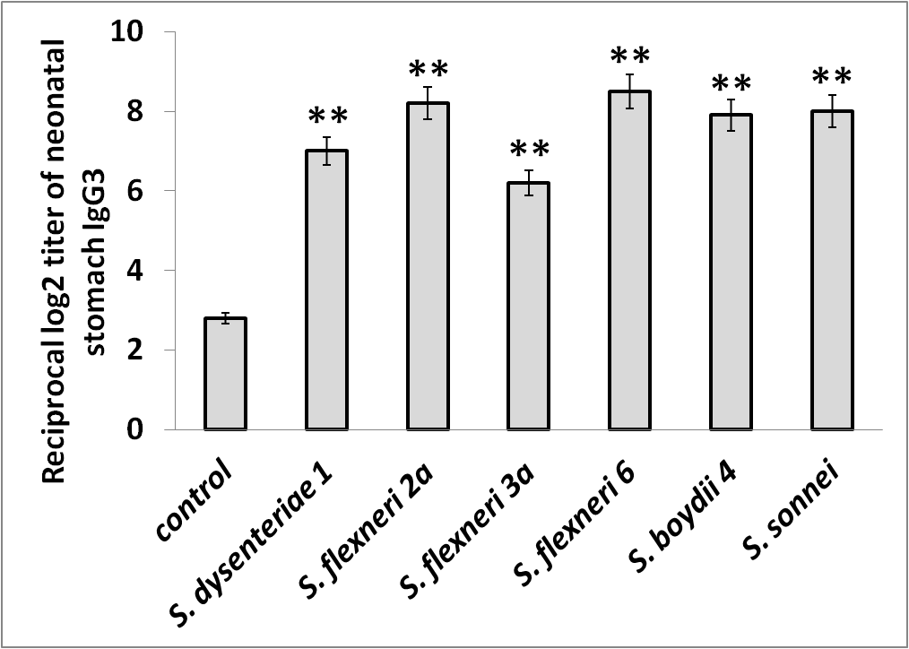
IgA
IgG1
IgG2a
IgG3

Slide 37
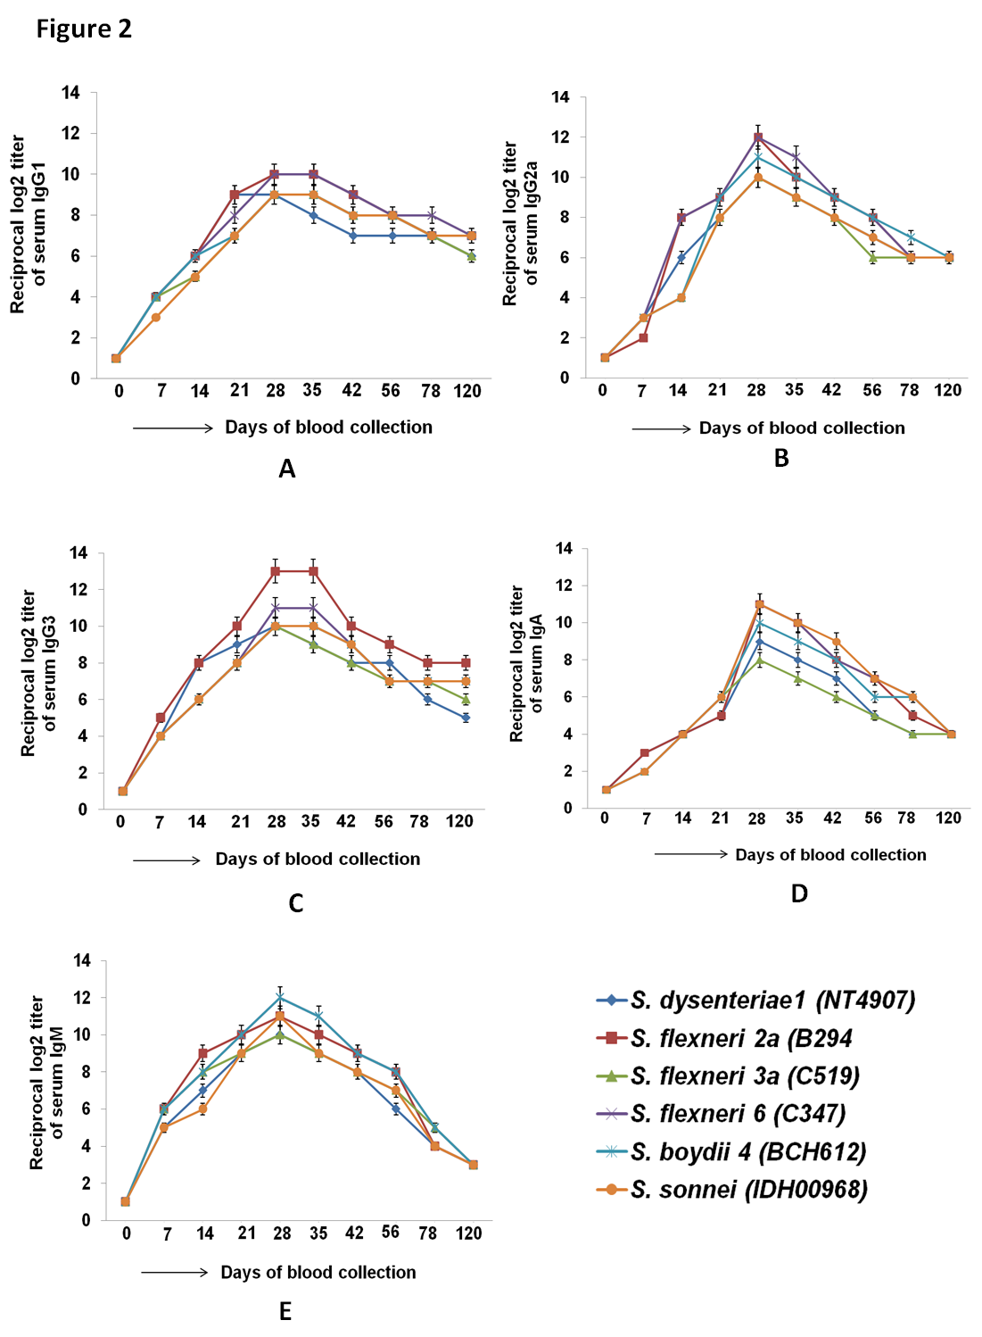
IgG1
IgG2a
IgG3
IgA

Slide 38
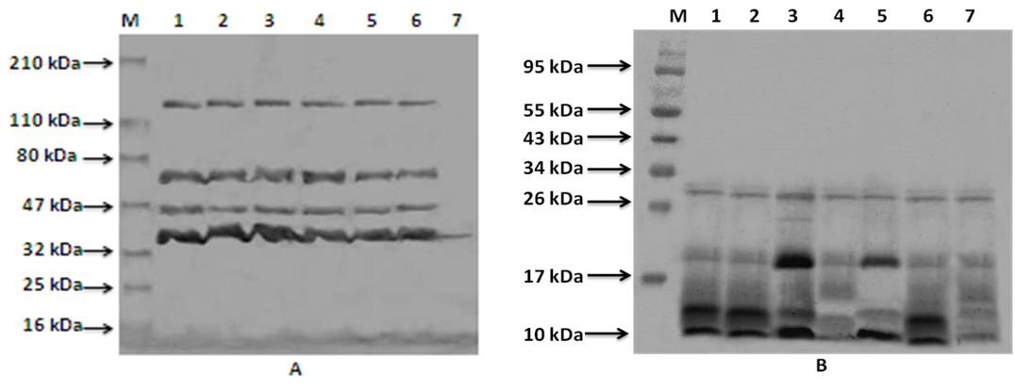
Western blot against whole cell lysates (WCL) and LPS: probed with anti-MOMVs sera
WCL
LPS
Lane M: protein molecular weight marker (BioRad)
Lane 1: S. dysenteriae 1 Lane 2: S. flexneri 2a
Lane 3: S. flexneri 3a Lane 4: S.flexneri 6
Lane 5: S. boydii type 4 Lane 6: S.sonnei
Lane 7: S. flexneri 1a (avirulent strain)

Slide 39

The protective nature of various proteins along with the natural adjuvant LPS, have made our newly developed multi-serotype (hexavalent) OMVs formulation an ultimate broad spectrum non-living vaccine candidate.
Multi-serotype (hexavalent) OMVs formulation without any artificial adjuvant conferred long term passive protection to neonatal mice against shigellosis.
It carries two important qualities of an ideal vaccine: broad spectrum immunogenicity and low reactogenicity.
It could be exploited for the development of a novel non-living vaccine against human shigellosis in near future.

Slide 40
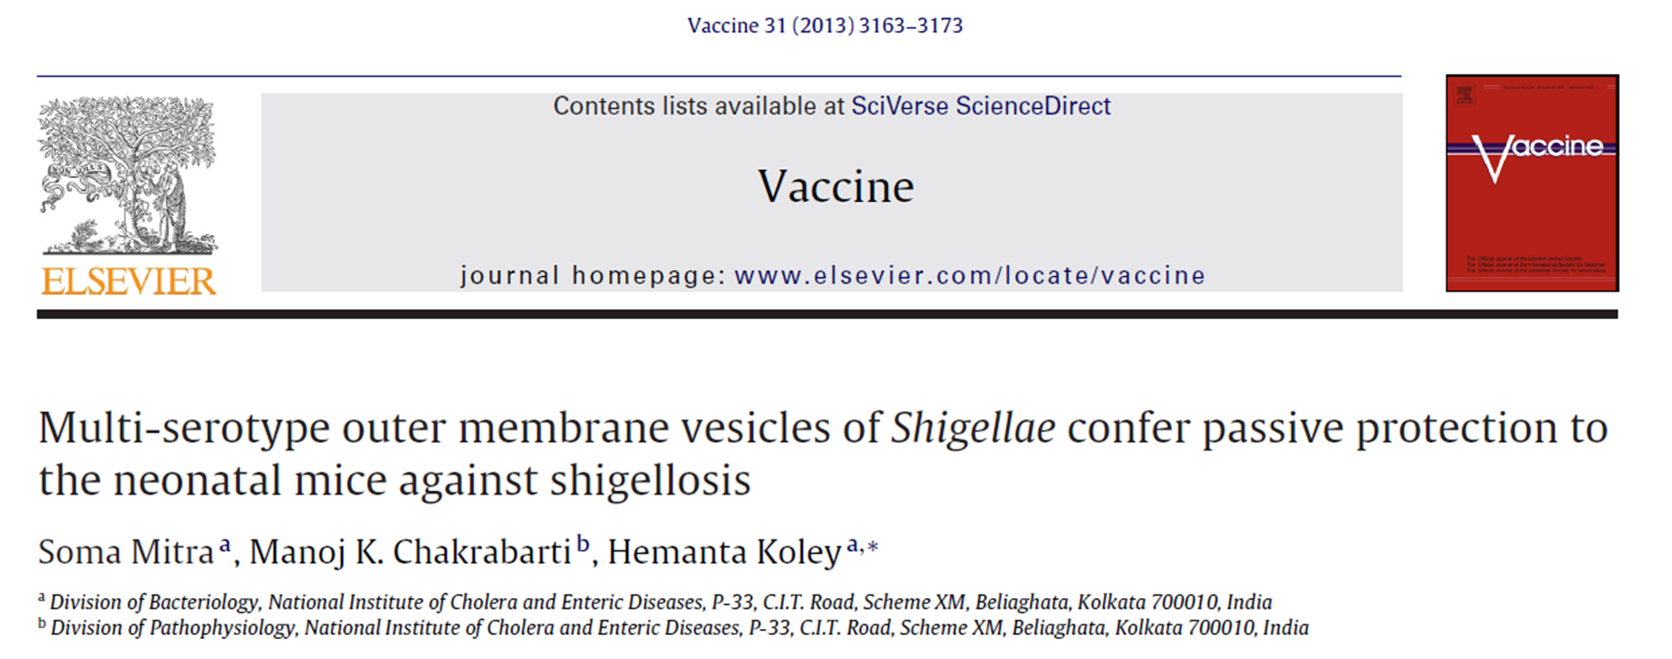
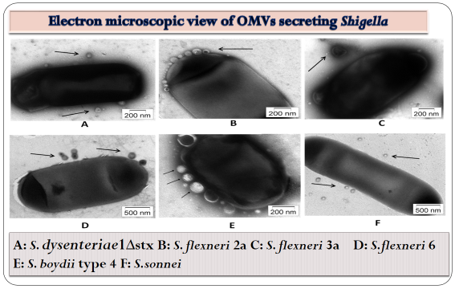
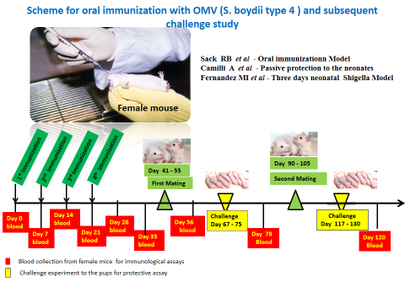
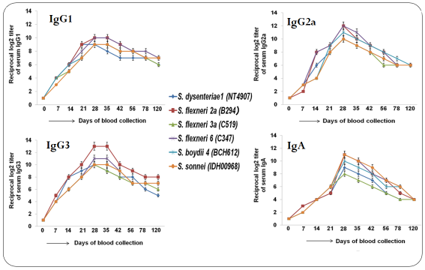
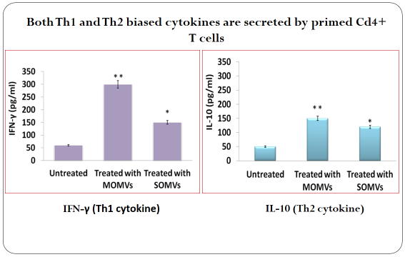
Highlights
Formulation of multi-serotype OMVs based immunogen against shigellosis.
Mixed Th1/Th2 cell mediated immune response without any adjuvant, in adult mice.
Up to 80% passive protection was observed in neonatal mice against shigellosis.
This is the first report on the competency of a multi-serotype OMVs based vaccine to confer protective immunity against shigellosis in mice model.

Slide 41
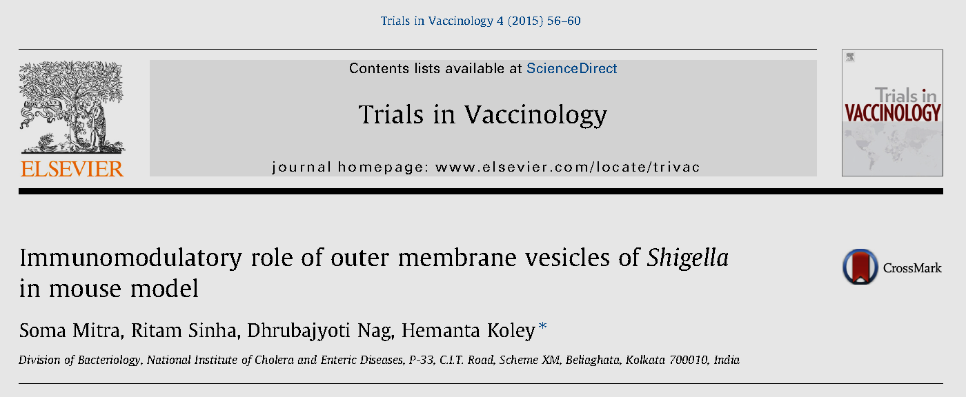
OMVs of Shigella activate various pro-inflammatory (TNF-a, IL-1b, IL-6, IL-12, IL-18, IFN-γ) and anti-inflammatory (IL-4 and IL-10) cytokine in vivo and in vitro system.
It also up regulated mixed Th1/Th2 cellular response which may induce long term immunity and protective efficacy against Shigellosis.

Slide 42







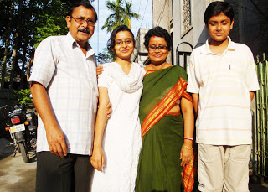

Contributed to my present work :
Senior Members
Soma Mitra MSc PhD
Soumik Barman MSc PhD
Nivedita Roy MSc PhD
Senior Students
Dhrubajyoti Nag MSc
Ritam Sinha MSc
Priyadarshini Mukherjee MSc
Junior Students
Debaki Ranjan Howlader MSc
Usasi Bhaumik MSc
Paushali Ghosh M Tech

Slide 43

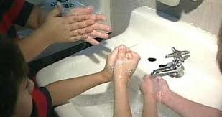

Need to Wait for Vaccine, why not follow these steps:
The following tips can help prevent shigella infection:
Wash hands thoroughly with soap, especially after going to the toilet.
Supervise hand washing of toddlers and small children after they use the toilet.
Take care of food and drinking water.
For more information about shigellosis check with your doctor or health department, or consult the CDC web site: www.cdc.gov/ncidod/dbmd/diseaseinfo/shigellosisg.htm

Slide 44
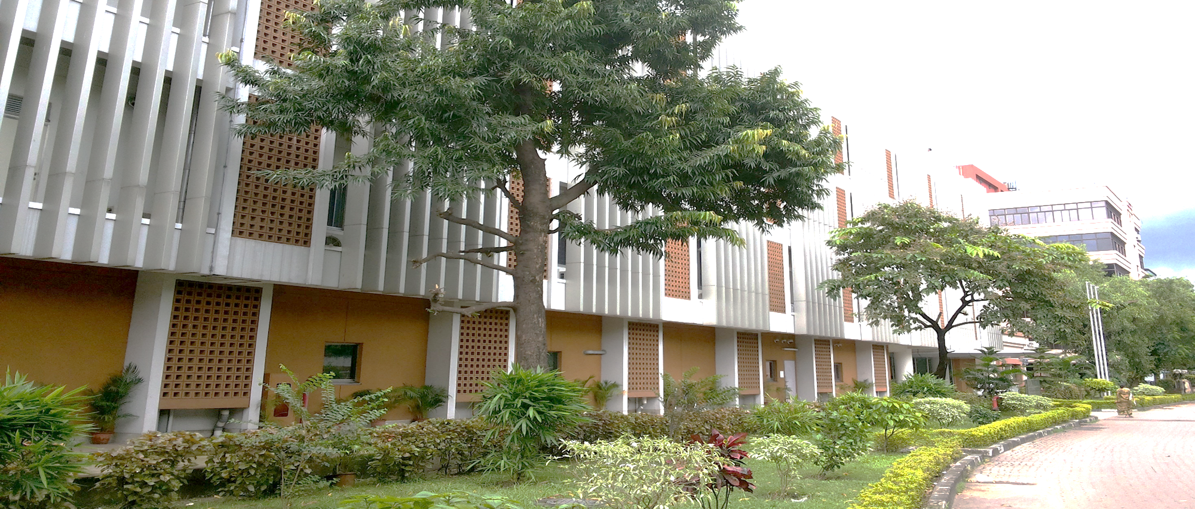

National Institute of Cholera and Enteric Diseases
(Indian Council of Medical Research)
P-33 CIT Road, Scheme-XM, Beliaghata,
Kolkata, India
Contact : hemantakoley@hotmail.com

