Slide 1
Risk based approaches to monitoring of vaccine clinical trials:
A quality driven and cost-effective model
Abby Abraham
Vice President – Clinical Solutions
www.algorics.com

Slide 2
Topics
Industry challenge
  Spiraling costs of clinical trials in drugs & vaccines
  Current state of clinical trial monitoring
  Monitoring outcomes & Quality
Solution
  What is RBM
  How does it work?
  How to implement?
  Technology intervention
A peek into data visualization and risk indication
Benefits of using RBM
Is RBM optional in the new world?

Slide 3

Affordability of medicines today

Slide 4

Industry challenge

Slide 5
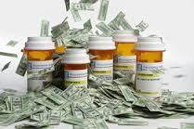
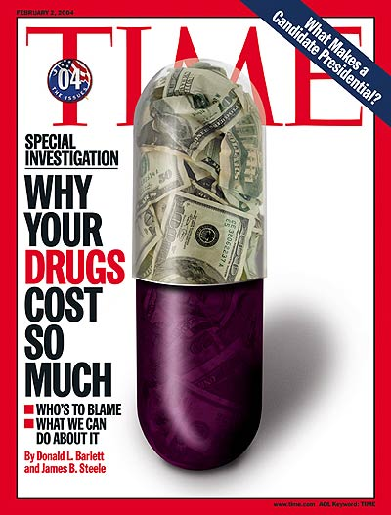
Vaccine development costs
Spiraling R&D costs:
  Vaccine R&D costs:
    WHO estimates between US$163 & $518 Mn
    US $500 Mn to US$ 1 Bn*
  Clinical development is expected to be ~ 60 to 70% of total R&D
    ~ $100 to $600 Mn USD
  Clinical monitoring and management costs 35 to 55% of phase II & III clinical trials
    ~ $44 Mn to $ 200 Mn
* Investing in vaccines for the developing world – PATH White paper, April 2009

Slide 6
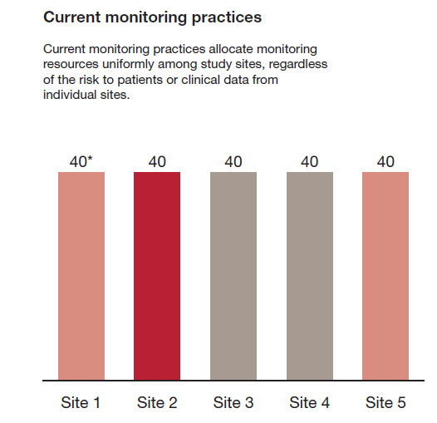

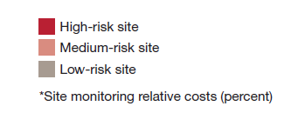
Clinical trial monitoring - current state
Risk based monitoring: Reduce clinical trial cost while protecting safety & Quality, March 2013
Notes:
Cost to Quality
Revenue Loss
Reputational Risk
Patient Safety Issues
Reactive for audit findings / low patient enrollment
100% Source data verification
Expensive Avg drug Devpt = 1.2 b USD

Slide 7
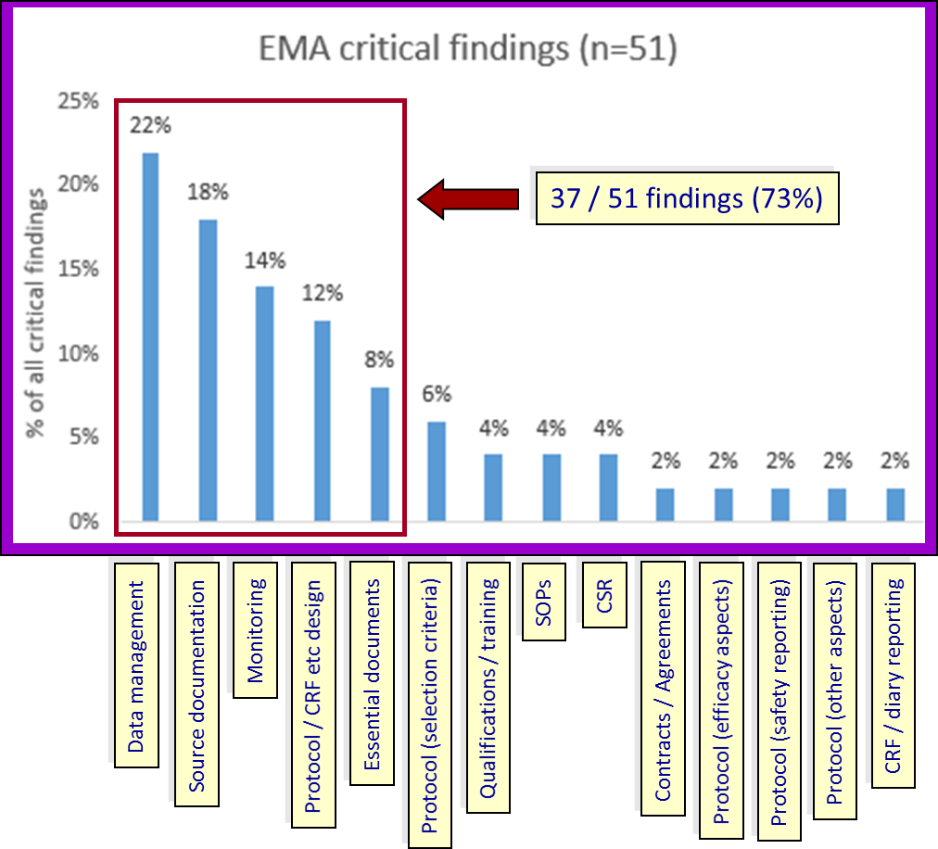
Monitoring outcomes – Critical findings
(last 10 years)
Source: Uniting to achieve oversight compliance by Alan M, Patrica L presented at PCT EU Conference, 6 November 2013

Slide 8
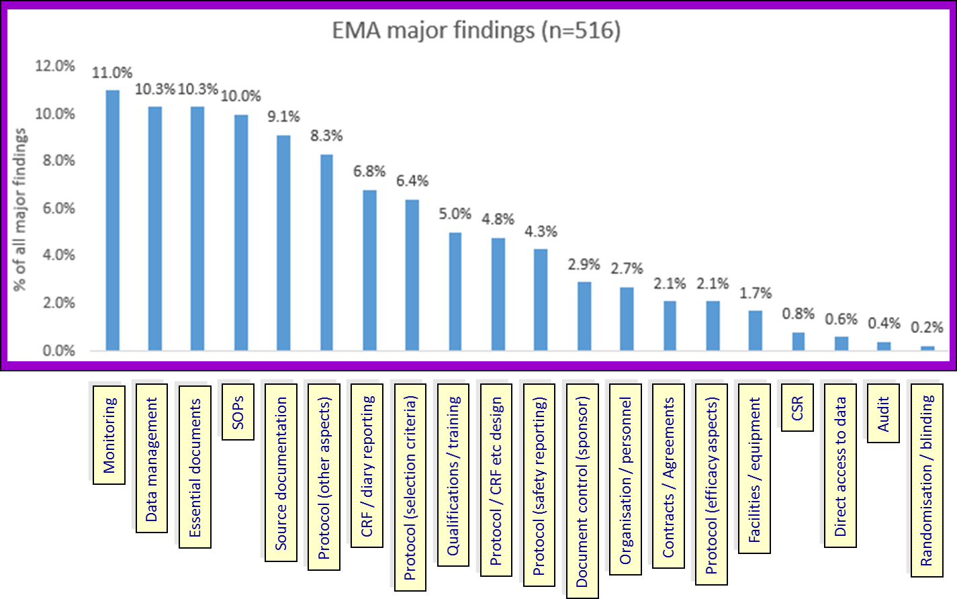
Monitoring outcomes – Major findings
(last 10 years)
Source: Uniting to achieve oversight compliance by Alan M, Patrica L presented at PCT EU Conference, 6 November 2013

Slide 9


Gap in monitoring methodology
Traditional on-site monitoring
Intensive manual analysis
Current approaches

Slide 10

Solution

Slide 11
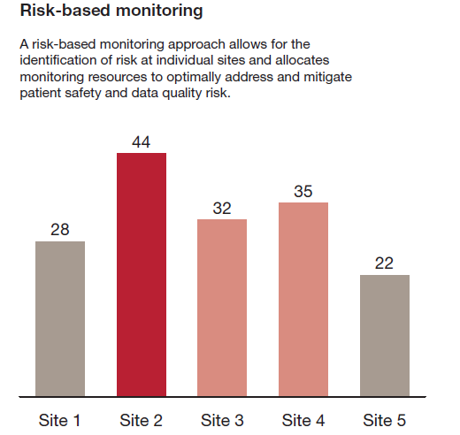
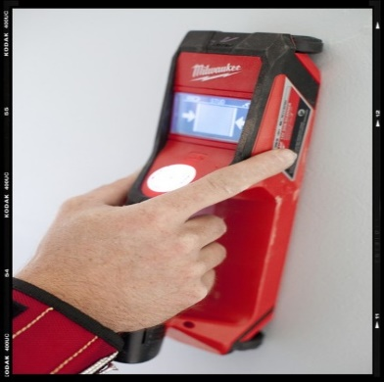
Solution (RBM)
PWC white paper on RBM, March 2013
Notes:
Cost to Quality
Revenue Loss
Reputational Risk
Patient Safety Issues
Reactive for audit findings / low patient enrollment
100% Source data verification
Expensive Avg drug Devpt = 1.2 b USD

Slide 12
What is Risk based monitoring?
Identify risks
Plan and prioritize risks
Monitor prioritized risks

Slide 13
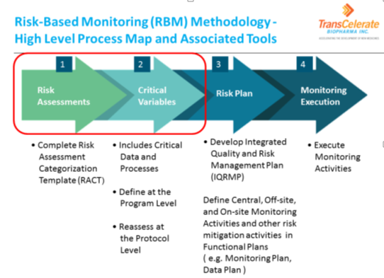
How does it work?

Slide 14
How to implement?
Identify Key Risk indicators/ Quality indicators
Use data visualizations
Layer it with thresholds
Use Statistical algorithms to grade risks
Use outputs for monitoring objectively

Slide 15

Fundamental requirement– Data confluence
Insight – Subject, Site and country level
eDC
CTMS
IXRS
ePRO
eTMF
other data sources

Slide 16
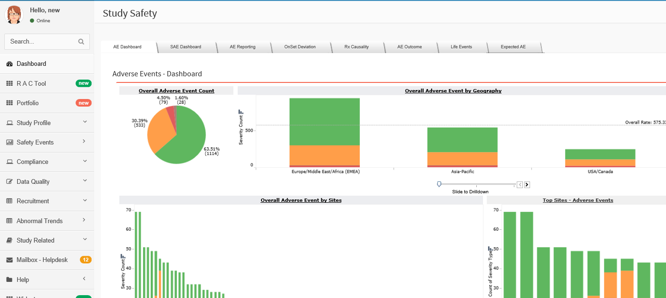
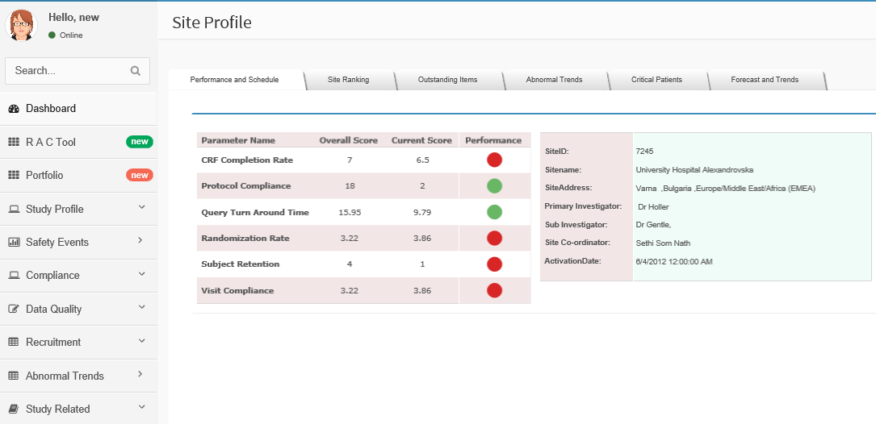
Monitor based on risks

Slide 17
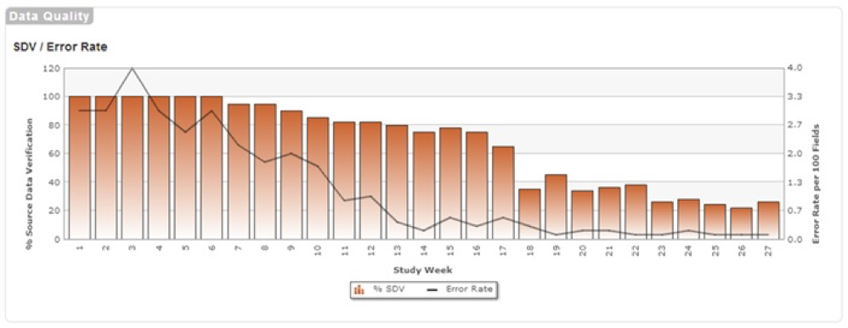
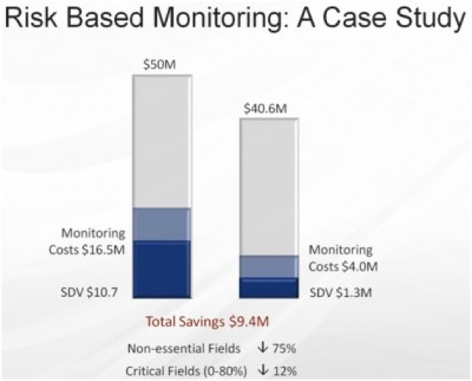
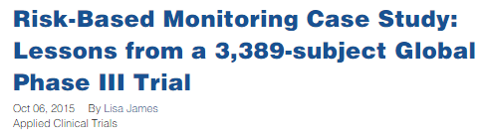
Expected Quality & Cost benefits

Slide 18
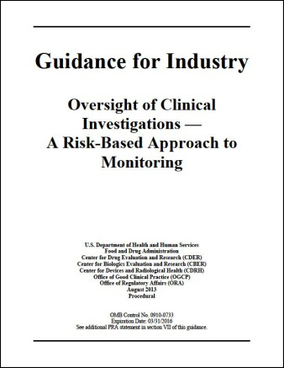
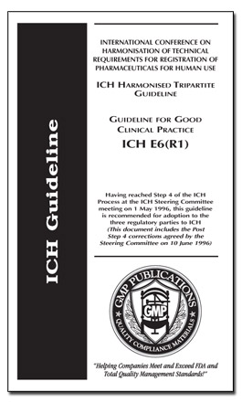
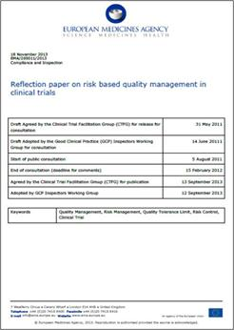



Is it “good to have” or “Must have”?

Slide 19

Thank you

