Slide 1

8th Indo Global summit and Expo on
Vaccines, Therapeutics & Healthcare (VTH-2015)
November 02-04, 2015 HICC, Hyderabad, India
Chandrashekhar G Raut
Sci-E & OIC
National Institute of Virology, Bangalore Unit,
RGICD Premises, 1st Main Someshwarnagar,
Near NIMHANS, DRC Post, Bangalore- 560029, India
Email: cgrniv@yahoo.co.in
Need of strengthening the well defined
in- vivo Systems for pre-clinical evaluation
of vaccines in India

Slide 2
Need of strengthening the well defined in- vivo Systems for pre-clinical evaluation
of vaccines in India
Present situation : key words
Population increasing, New area of land available occupied for housing , Agriculture land area decreasing , Ecological changes , Basic needs- Air, Water, Food ; Luxury – increasing , Recycling- Waste management; Density; Microorganisms ; Herd Immunity ; Susceptible population; Vaccines, Therapeutics, Healthcare; Lifestyle ; NCDs increasing ; For production of desired product- known defined raw materials; Safety and efficacy of products; Use of lab animals / in vivo systems; Defined lab animals – genetically & microbiologically………

Slide 3
Trends in Global Population
Global Population: 1950-2015
Total
Billions
Less developed countries
8
More developed countries
7
6
5
4
3
2
1
0
1950
55
60
65
70
75
80
85
90
95
2000
05
10
15
Source: US Bureau of the Census

Slide 4
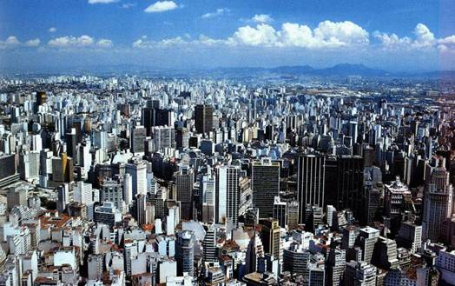
Rapidly Increasing Urbanization
2000
  47% world population living in urban areas
2030
  60% world population living in urban areas

Slide 5
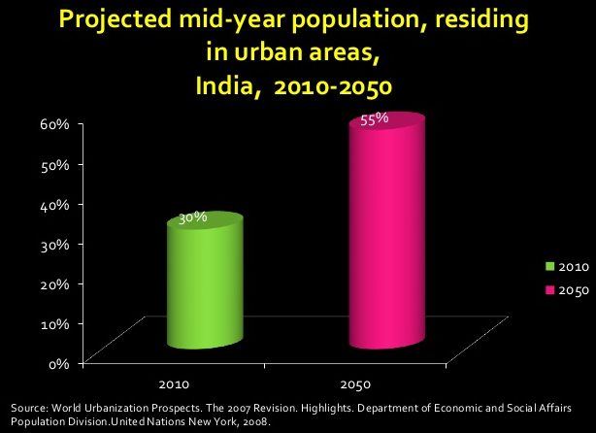

Slide 6
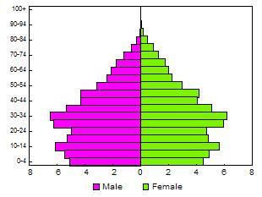
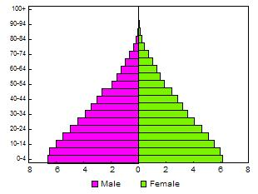
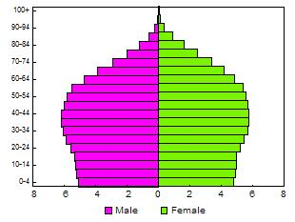
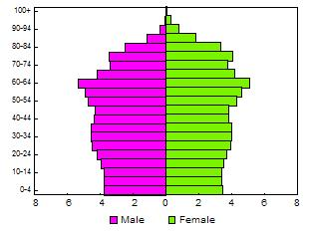
Population : India & China 2000 & 2050
China
India
2000
2050

Slide 7
ENVIRONMENT
Climate change
Mega-cities
Migration
Vector
proliferation
Pollution
Exploitation
Population
Growth
Antibiotics
HUMAN
Vector
resistance
Zoonosis
Food
production
VECTORS
ANIMALS
Intensive farming
Transmission

Slide 8
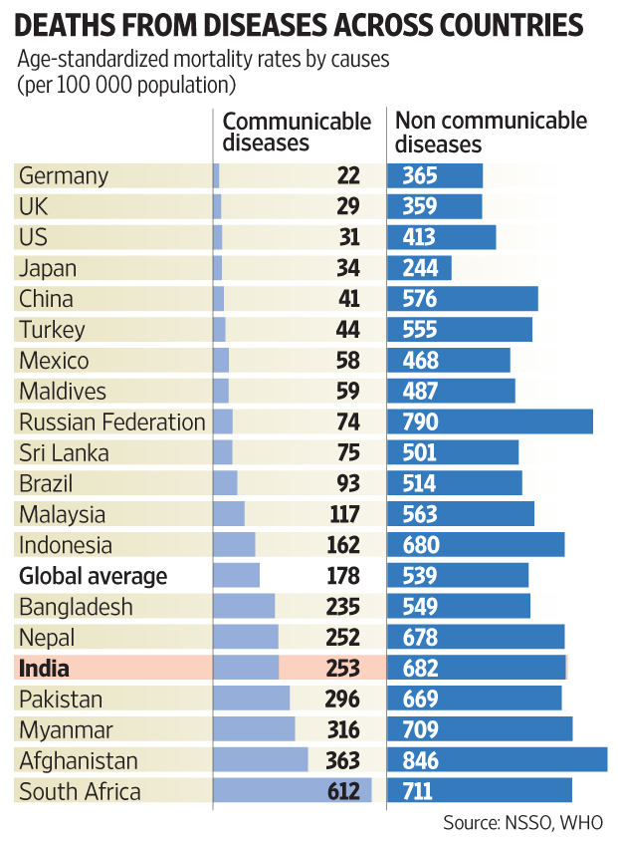

Slide 9
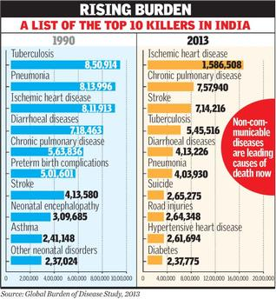

Slide 10
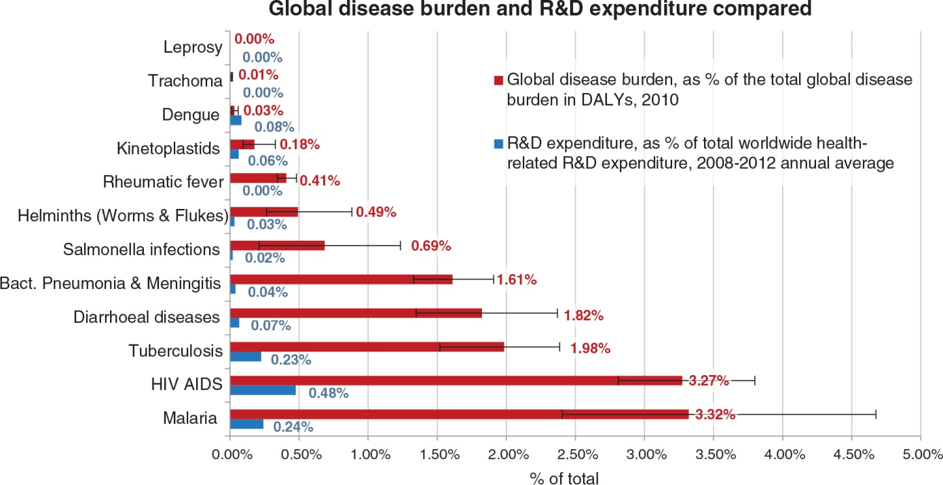

Slide 11
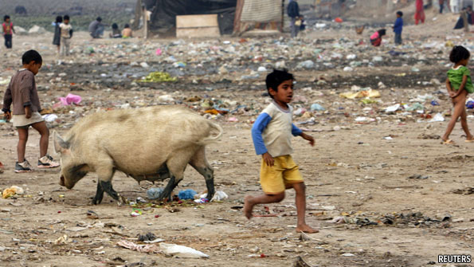
Japanese encephalitis
Influenza –Swine flu
Hepatitis E
PIG
Nipah virus
Enteric viruses

Slide 12
Vaccines-Historical Perspective
7th century- Indian Buddhists' drank snake venom to protect against snake bite.
10th century- Variolation to prevent smallpox in China and Turkey.
Early 1700s- Variolation introduced into England.
1760-70- The Jennerian era.
1875-1910- Dawn of Immunological Science.
1910-30- Early bacterial vaccines, toxins and toxoids.
1930-50- Early viral vaccines: yellow fever and Influenza.
1950-1970- The tissue culture revolution: poliomyelitis, measles, mumps and rubella.
1970-1990- Dawn of the molecular era: hepatitis B, Streptococcus pneumonia, Hemophilus influenza B.
Today- Glycoconjugate vaccines, rotavirus vaccine, human papilloma virus vaccine and herpes zoster vaccine.

Slide 13
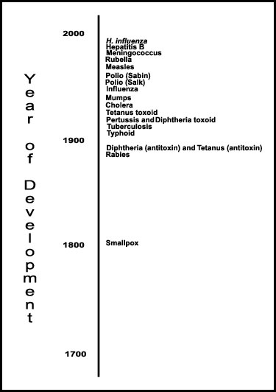
Years of Vaccine development

Slide 14
The Ideal Vaccine
Immunogenic
Long lasting immunity
Safe
Stable in field conditions
Combined
Single dose
Affordable (and accessible) to all

Slide 15
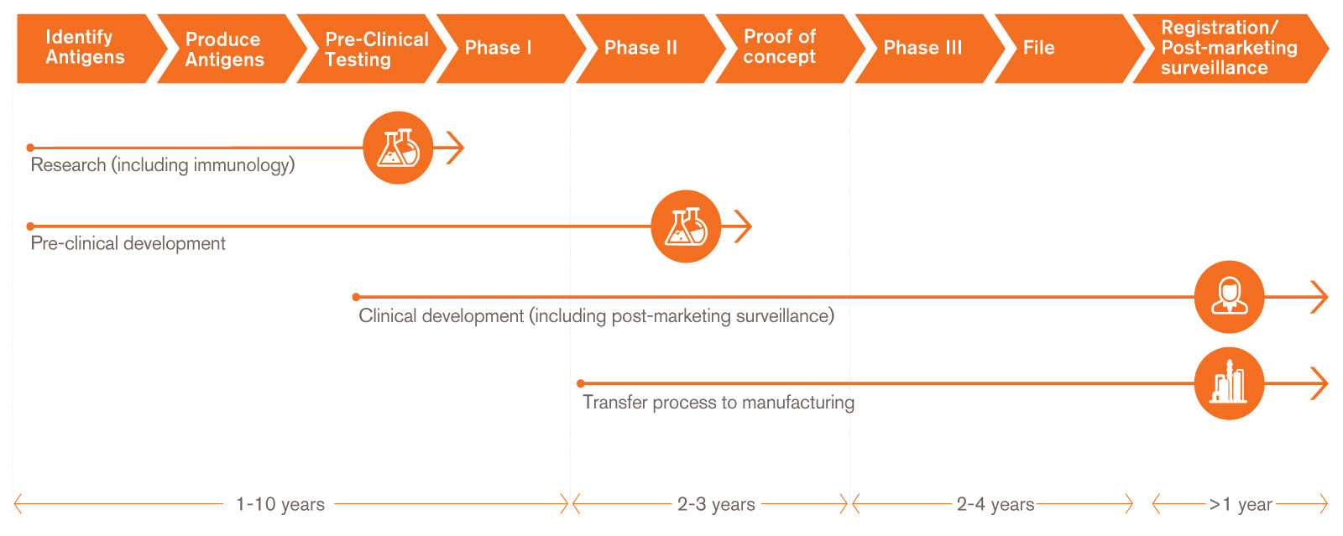
Vaccine development

Slide 16
Historically, there has been a close and longstanding association between microbiology and vaccine development and the use of laboratory animals.

Slide 17
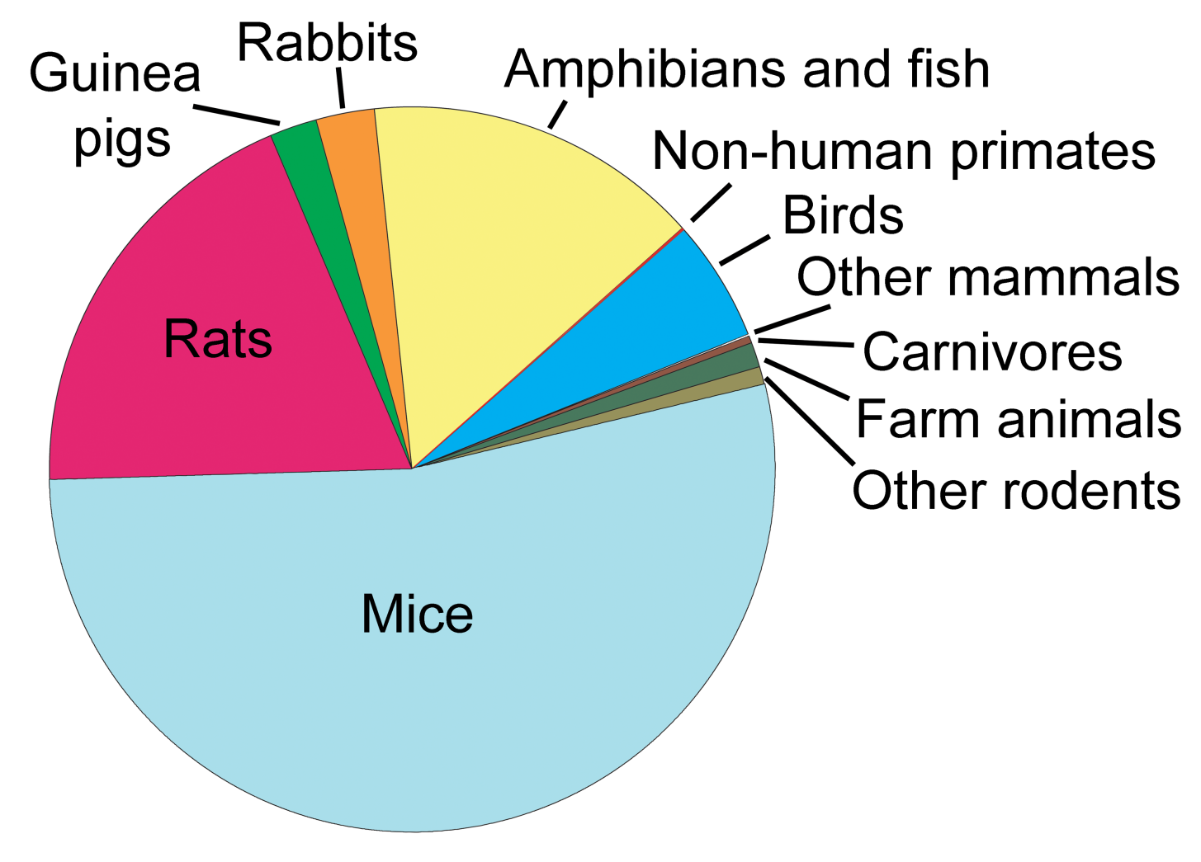
Use of lab animals

Slide 18
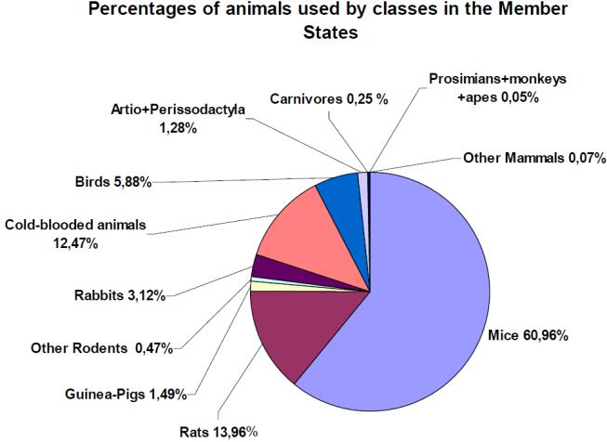

Slide 19
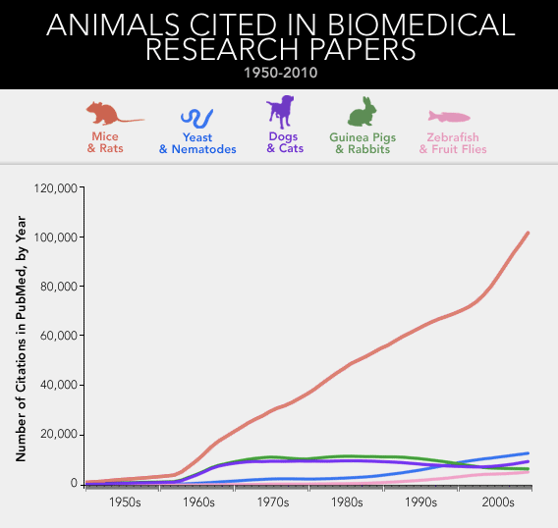

Slide 20
Defined status of lab animals
Genetic level
Species
Breed
Strain
Transgenic
Microbiological level
Known microflora of the species
Bacteria
Viruses
Parasites
Authentic sources:
Animals
Feed
Materials
Infrastructure specieswise
Housing Equipments
Monitoring
Frequency
Data maintenance
Normal parameters specieswise
Accreditation
Improvements

Slide 21
Monitoring authority
CPCSEA: “Committee for the Purpose of Control and Supervision of
Experiments on Animals” under MoEF&CC, GOI
Guidelines available
IAEC: Institutional Animal Ethics Committee
Nominees – nationwide
About 2000 lab animal facilities registered with CPCSEA
Recent developments: Online submission of projects, reports, new
registration, renewal , etc….

Slide 22
IAEC can approve : projects on mice, rats, guinea pig,
rabbits, birds
Large animals: Equines, Dogs, Farm animals
needs approval from IAEC & CPCSEA
Rehabilitation issues – progress is going on

Slide 23
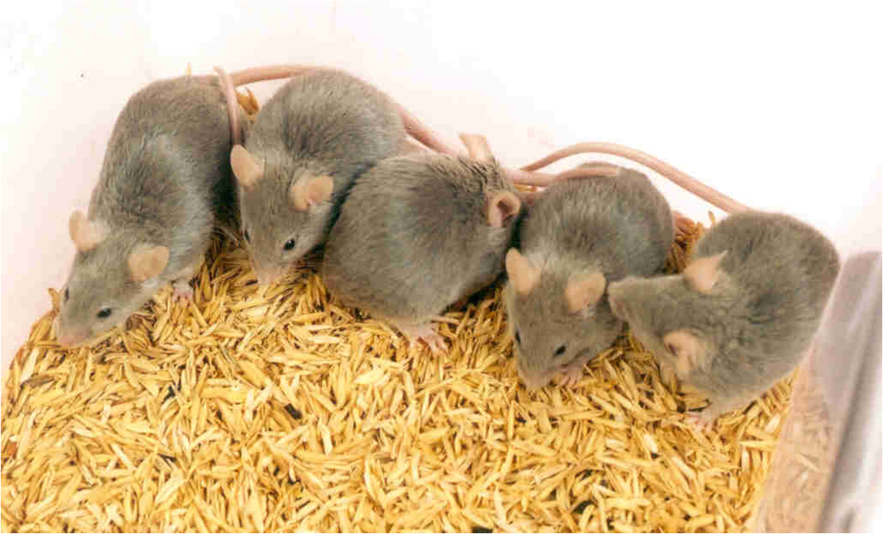
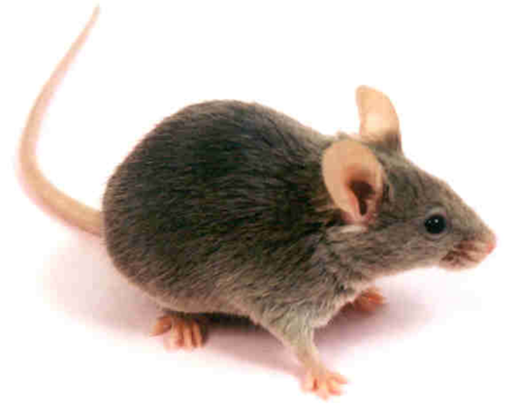
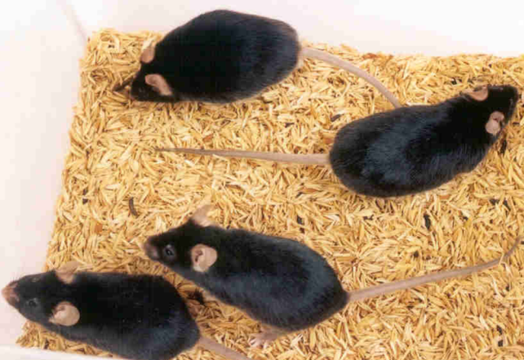
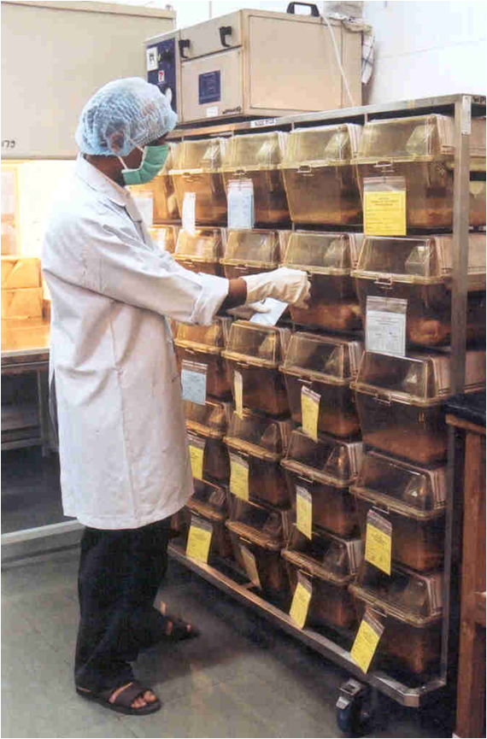
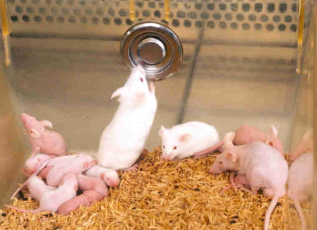
Different strains of mice (Inbred )
C3H/Hej
C57BL/6
DBA/2
Athymic nude mice

Slide 24
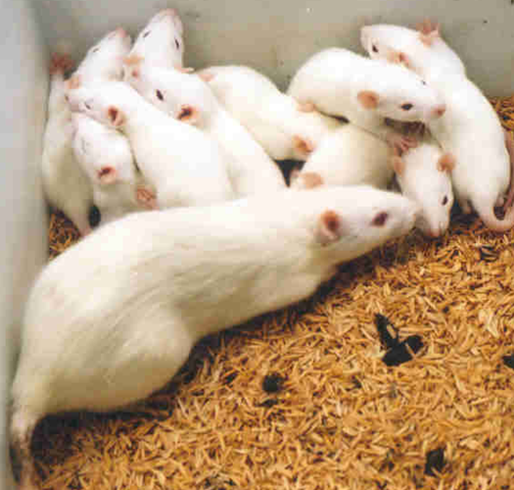
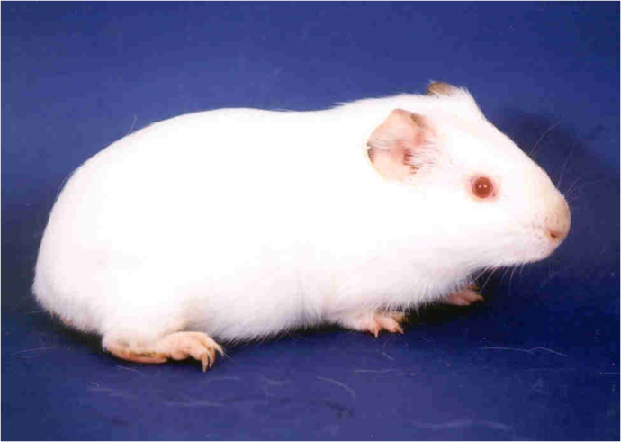
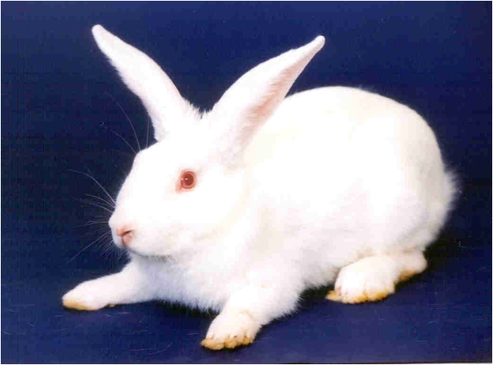
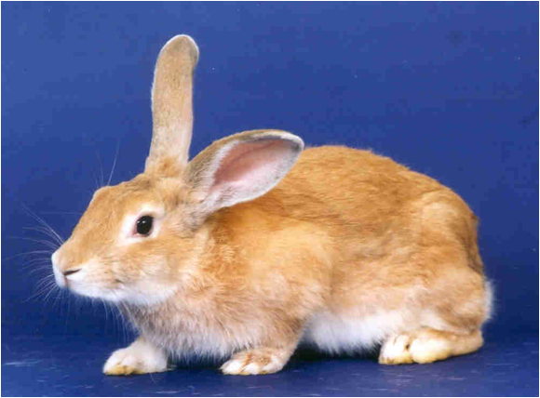
Other species of lab animals
Rat
Guinea pig
Rabbit – New Zealand White
Rabbit- Sandy Half Lop

Slide 25
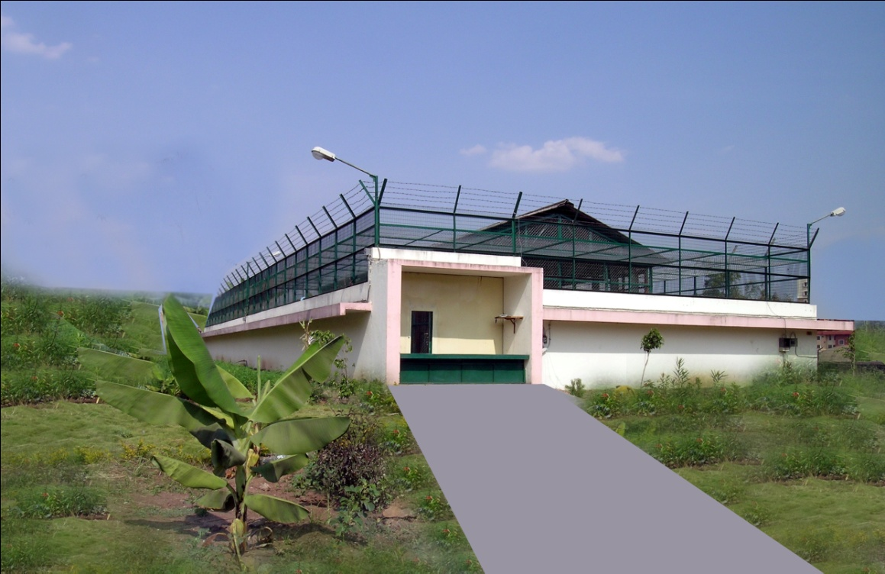
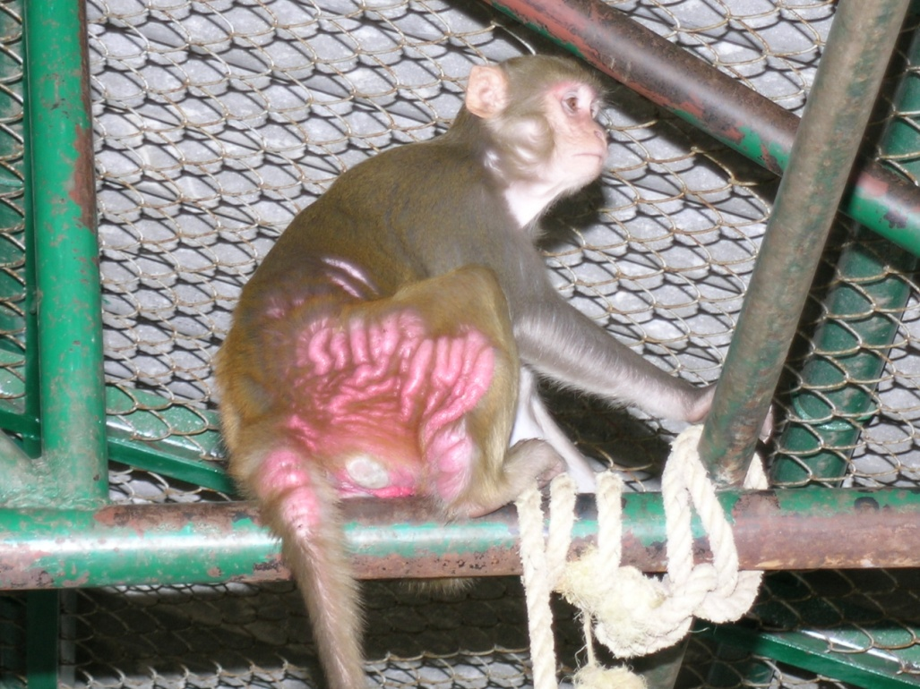
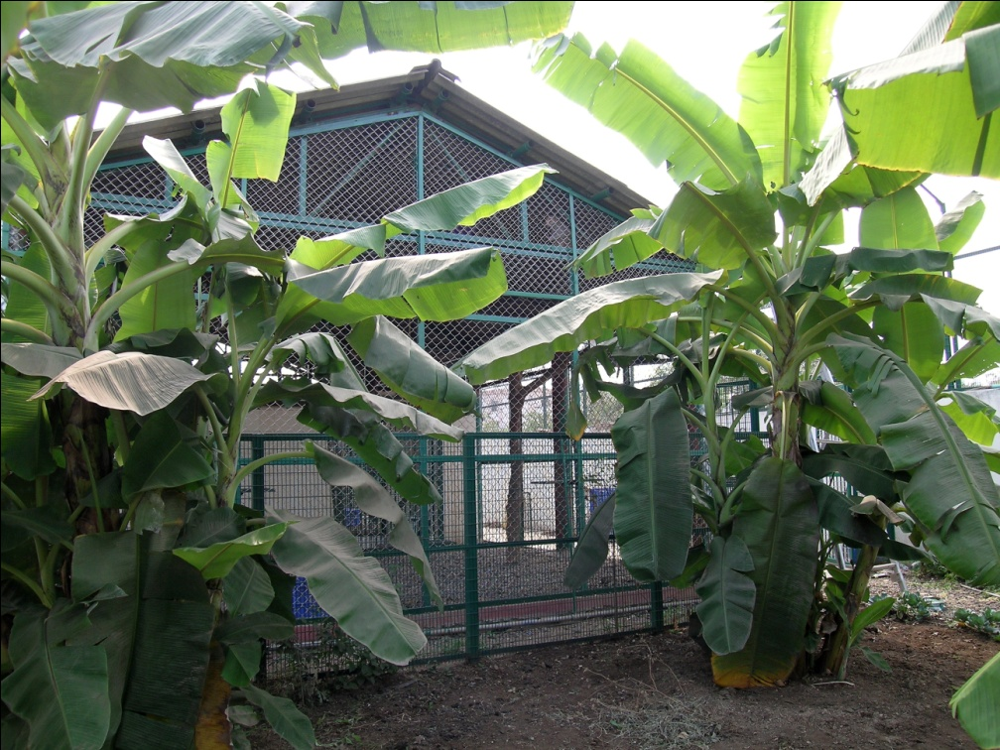
NHP- Rehabilitation ,
ecofriendly ,
with enrichment

Slide 26
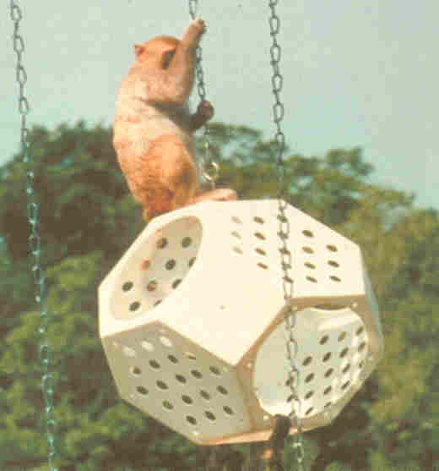
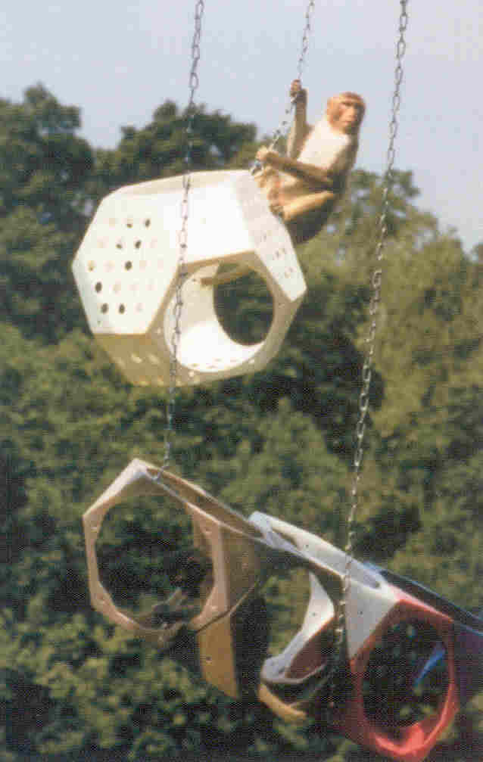
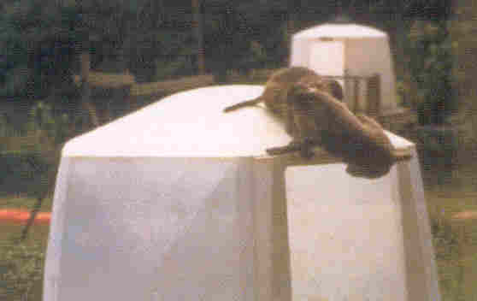
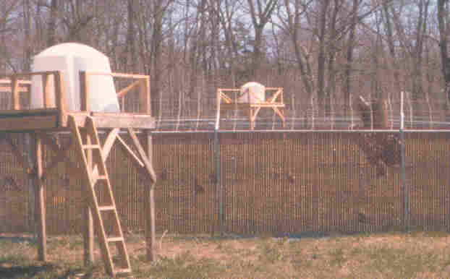
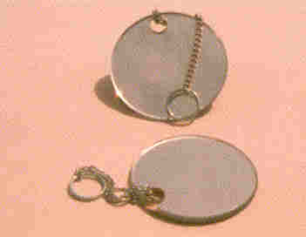
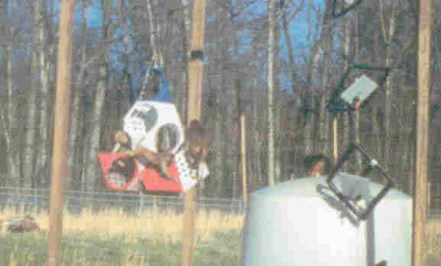
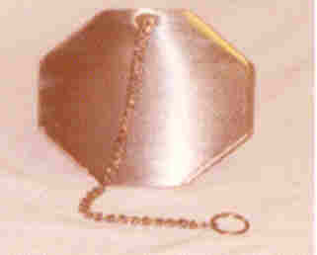
Rehabilitation: Enrichment of the monkeys
Stainless steel Mirrors;
Ladders;
Other Play things

Slide 27
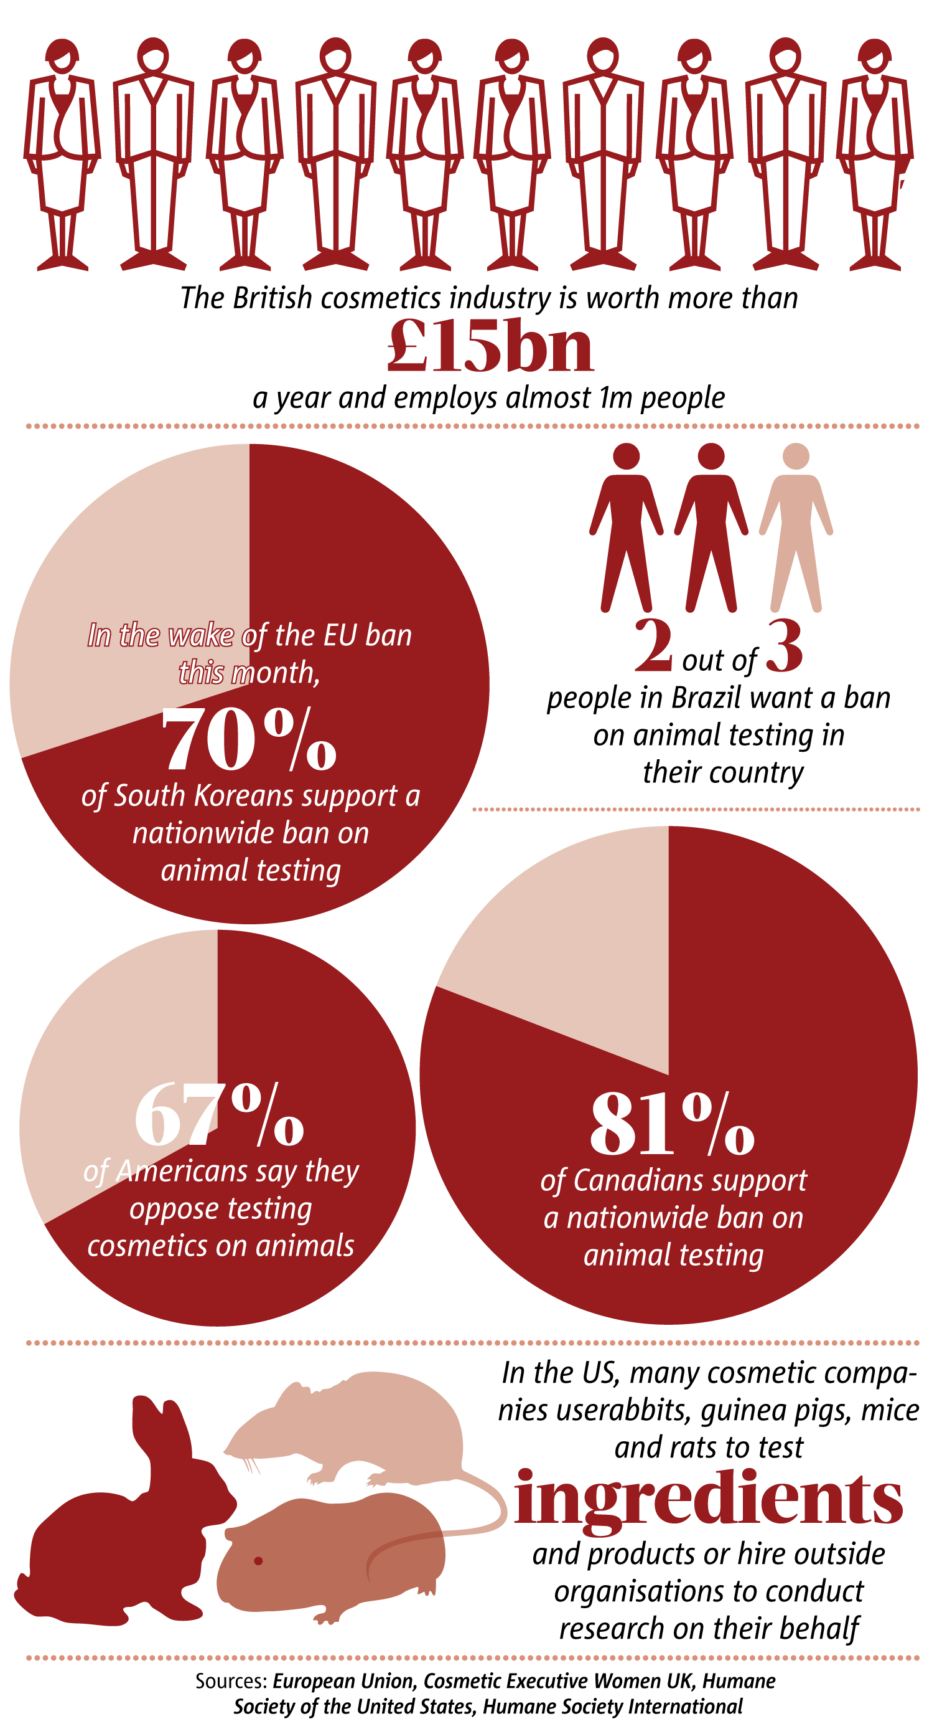
Ban on use of lab animals
in Cosmetic Industry

Slide 28
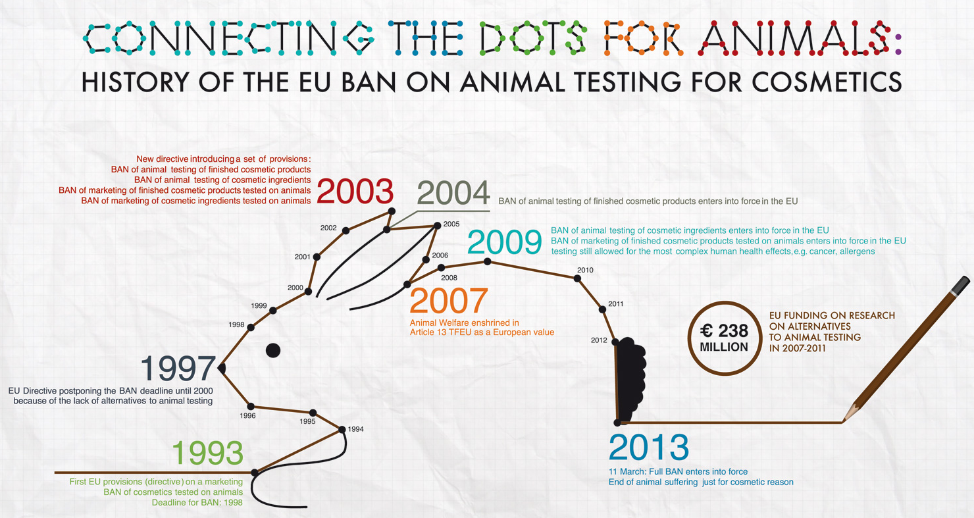

Slide 29
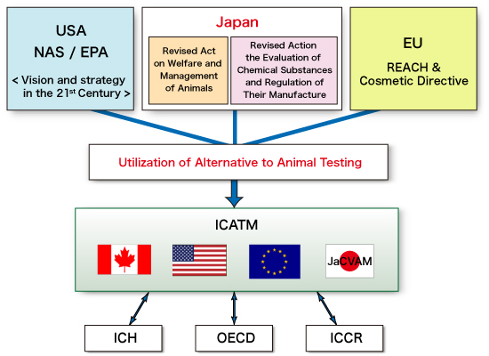

Slide 30
Alternatives to animal testing
Cell culture can be an alternative to animal use in some cases. For example, cultured cells have been developed to create monoclonal antibodies; prior to this, production required animals to undergo a procedure likely to cause pain and distress.
However, even though cell or tissue culture methods may reduce the number of experiments performed on intact animals, the maintenance of cells in culture normally requires the use of animal-derived serum.
Although exact figures are difficult to obtain, some have estimated that one million fetal cows are sacrificed each year to obtain the world's supply of fetal bovine serum, used to grow cultured cells.

Slide 31
Alternatives to Lab Animals use
Medical imaging is able to demonstrate to researchers both how drugs are metabolized by use of microdosing, and the detailed condition of organ tissue.
Bioengineered monkeys with human genetic diseases

Slide 32
The Three Rs (3Rs) are guiding principles for more ethical use of animals in testing. These were first described by W.M.S. Russell and R.L. Burch in 1959.
The 3Rs are:
Replacement which refers to the preferred use of non-animal methods over animal methods whenever it is possible to achieve the same scientific aims. These methods include computer modeling.
Reduction which refers to methods that enable researchers to obtain comparable levels of information from fewer animals, or to obtain more information from the same number of animals.
Refinement which refers to methods that alleviate or minimize potential pain, suffering or distress, and enhance animal welfare for the animals used. These methods include non-invasive techniques.
Rehabilitation : Large animals

Slide 33
Public –Private Partnership
With proper understanding aiming national importance.
Very good facilities at Govt Institutions- to be utilized according to the national programmes.

Slide 34
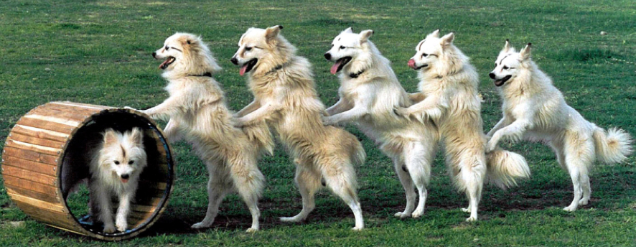
THANKS

