Slide 1
Rotavirus vaccine Development at Shantha
8th Indo-Global Summit and Expo on “Vaccines, Therapeutics and Healthcare”, Nov 02 – 04 2015, HICC, Hyderabad, India
Lopa Adhikary
Shantha Biotechnics Private Limited
(A Sanofi Company)

Slide 2
Snap Shot of Rota Vaccine
New Vaccine Development Path
Rotavirus – Burden of Disease and Vaccine Demand
Rotavirus Program at Shantha Biotechnics Private Limited
  About Shantha
  Rota Vaccine Program at Shantha
    Product development
    Clinical Development

Slide 3
New Vaccine Development in changing Scenario
New Vaccine Development
Intensifying Competition
Challenging affordability
Requires upgraded / enhancement
Of capability
Build up strategy based on market and customer needs
Achieve excellence in performance
Create sustainable product for customer

Slide 4
New Vaccine Development Path
Concept
Customer
Lead
Identific-
ation
Lead
Optimiza-
tion
Pre-
Clinical
Market
Authori-
zation
Post
launch
Product
management
Phase I
Phase II
Phase III
Pre-Launch
Research / pre-development
Early development
Late develop
Product Launch Stage
Commercial supply
Proof of
concept
Product development@ small scale,
Tox -study
Product development @ commercial scale,
Clinical development
Safety
Immunogenicity
Efficacy
Regulatory submission,
Market Authorization
Manufacturing license for routine production
Sustainable product for the customer

Slide 5
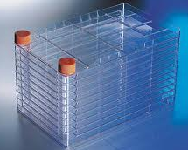
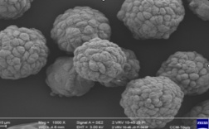
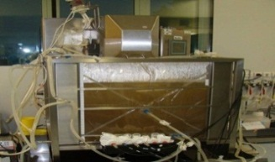
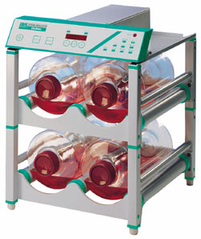
Development Stages for Rotavirus Vaccine (1/4)
Process Development
  Cell bank, Virus bank preparation, testing and characterization as per regulatory need
  Platform technology (cell Factory, Cell cube, Roller bottle, Bio-fermenter)
    Feasibility to scale up of upstream and down stream process
    Capacity build up to meet business need at competitive COGM
    Identify and finalize critical process parameters
    Inbuilt quality for routine production with robustness and batch consistency
    Clinical batch manufacturing
    Successful transfer of process from development to production

Slide 6
Development Stages for Rotavirus Vaccine (2/4)
Analytical development
  To be designed to address the requirements for National Regulatory Authority and compliance with WHO TRS 841 and ICH guidelines
  Finalize the list of Batch Release tests, In Process Control Tests, Process Monitoring Tests for Bulk and Finished Product
  Develop specifications for all the tests as per guideline
  Develop, qualify and validate test methods
  Stability study program
    @ Real Time, Accelerated, Stress stability, Cumulative
    With development / clinical / validation batches/ production batches of bulk and finished product
    To assign shelf life of bulk and finished product

Slide 7
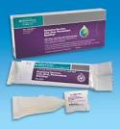


Development Stages for Rotavirus Vaccine (3/4)
Formulation Development
  Administration: Oral
  Presentation : Liquid / Lyophilized etc
    Composition: With or without animal origin
    Stabilization of virus
    Neutralization of acid
    Stability of vaccine
    Storage Temperature
  Container:
    Operation: easy to operate, quality and HSE compliance
    Market feasibility, competitive advantage
    Easy to handle, open and administer
    Product compatibility
    Impact on COGM

Slide 8
Development Stages for Rotavirus vaccine (4/4)
Clinical Development to address
  Safety of the vaccine
  Immunogenicity
  To select the dose
  Efficacy
Product Launch
  Regulatory Submission
  Market authorization
  Product Launch

Slide 9
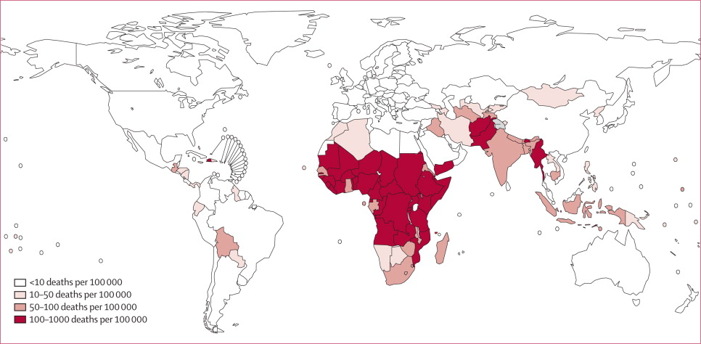
Rotavirus Burden of Disease
Rotavirus mortality in children younger than 5 years
Lancet Infectious Diseases 2012; 12: 136-141

Slide 10
Vaccine Demand and Licensure of New Vaccine
Rotavirus is one of the leading cause of viral diarrhea in children under the age of 5 years resulting in ~80% death in low income Asian and Sub-Saharan African countries
Affordable vaccine is still a significant medical need
Global demand for Rota vaccine will reach to ~ 270 million doses (post 2020) based on internal estimate
Currently available rotavirus vaccines (RotaTeq™, Rotarix™ & Rotavac™ ) can only partially satisfy the increasing rotavirus vaccine demand
Need to introduce more new vaccines into the market to avoid supply constrain for the global demand

Slide 11
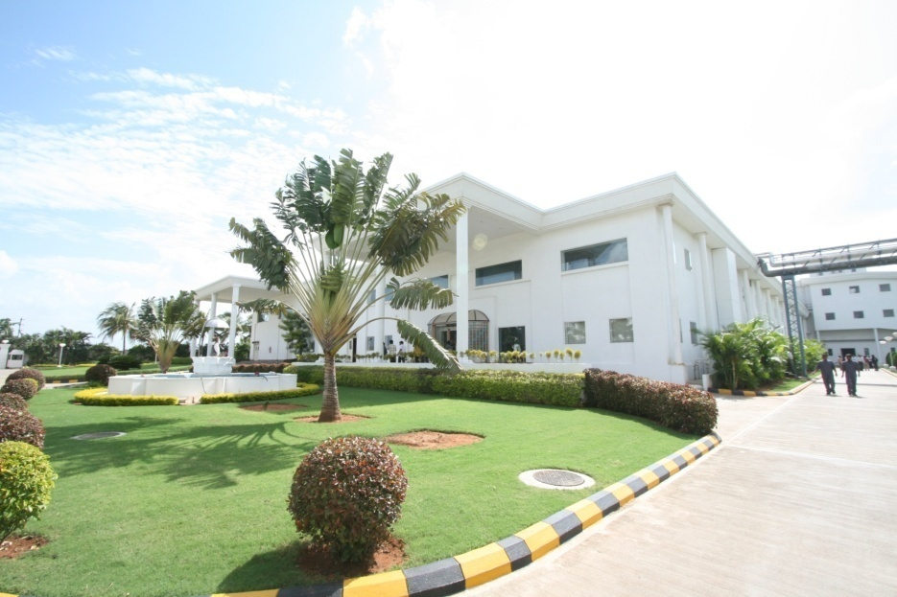

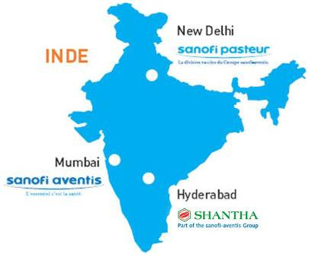



Rotavirus Vaccine program at Shantha
About Shantha
The first Indian company to develop, manufacture & market a recombinant human healthcare product in India – Shanvac™ B
The first Indian company to develop, manufacture & market in India an Oral Cholera Vaccine – Shanchol™
2009: Acquisition by Sanofi

Slide 12
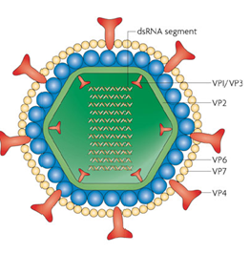
Rota vaccine Program at Shantha
doi:10.1038/nrmicro1692
doi:10.1038/nrmicro1692
doi:10.1038/nrmicro1692
Shantha has collaborated with National Institutes of Health (NIH), USA for Rota vaccine program.
The main objective of Rota vaccine program at Shantha is to develop and license a cost effective Rotavirus vaccine in India.
Live attenuated Bovine Human reassortant rotavirus vaccine is currently being developed by Shantha.
The vaccine includes 4 serotypes (G1, G2, G3 and G4) currently responsible for major outbreaks worldwide.
Nature Reviews Microbiology 2007; 5: 529-539

Slide 13
Rota Vaccine program at shantha
Product Development
Process
  Raw Material tested
  Cell bank, virus bank made , tested and characterized
  Upstream and down stream process optimized and validated
  Individual viral strains are cultured on Vero cells
  The monovalent harvest pools are stabilized and stored till formulated as tetravalent vaccine
  Phase III clinical batches manufactured, tested and characterized

Slide 14
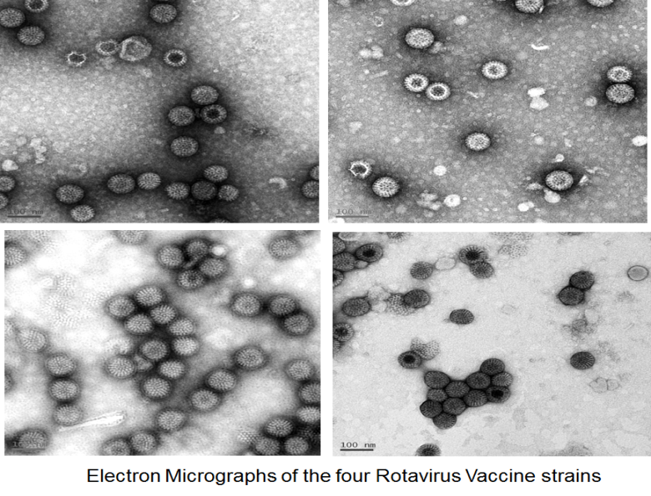
Rota Vaccine program at shantha
Product Development
Analytical
  All batch release tests, in process control tests and process monitoring tests were identified, developed and qualified and validated
  Specification developed as per regulatory need
  Viral Characterization
    The viral strains were extensively characterized during the production of rotavirus vaccine and found to be physically and genetically stable

Slide 15
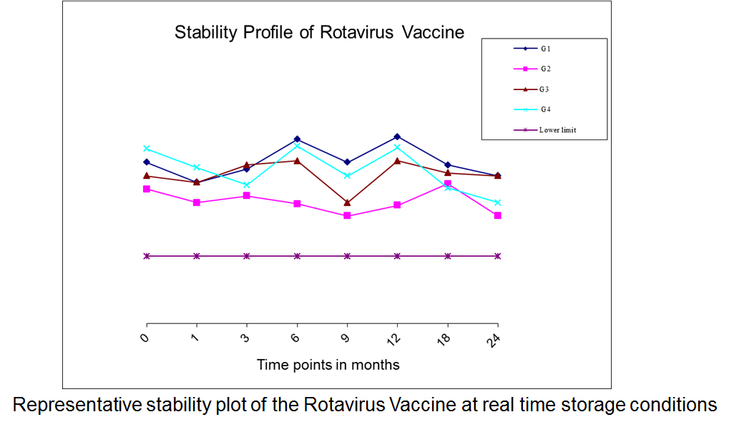
Rota Vaccine program at shantha
Product Development
Formulation
  The final vaccine is presented as a ready to use tetravalent liquid formulation of 2 mL/dose.
  The formulation contains necessary stabilizers to maintain viral stability
  It also contain antacids for resisting acidic environment of the stomach.
Stability profile of rotavirus vaccine
  The Liquid Formulation of the rotavirus tetravalent vaccine is stable for at least 24 months at real time storage conditions

Slide 16
Rota Vaccine Program at Shantha
Clinical Development - Rotavirus epidemiology study
Percentage Positivity
A total of 4,711 Diarrheal cases severe enough requiring hospitalization were studied
Stool samples were collected
from 2,051 & were subjected to
ELISA testing
541(26.4%) turned out to be
positive for Rotavirus
Reported winter seasonality
Ref: Vaccine 32S (2014) A13–A19

Slide 17
Rota Vaccine Program at Shantha
Clinical Development - Phase I Safety study
Phase I, Randomized, prospective, double blind, Placebo controlled safety evaluation study
Study Visit | D0 | D10
Gr 1 | *BRV-TV (High dose) | Follow up
Gr 2 | Placebo | Follow up
*BRV-TV: Rota vaccine manufactured, tested and released by Shantha Biotechnic Pvt. Ltd.
Result: During 10 days safety follow up period no AE/SAE was reported.
Vaccine 2014; 32S: A117–A123

Slide 18
Rota Vaccine Program at Shantha
Clinical Development - Phase II Clinical study
Age Study visit | W6 D0 | W10 D28 | W14 D56 | W18 D84
Gr 1 | BRV-TV (Low dose) | BRV-TV (Low dose) | BRV-TV (Low dose)
Gr 2 | BRV-TV (medium dose) | BRV-TV (medium dose) | BRV-TV (medium dose)
Gr 3 | BRV-TV (high dose) | BRV-TV (high dose) | BRV-TV (high dose)
Gr 4 | RotaTeq™ | RotaTeq™ | RotaTeq™
Gr 5 | Placebo | Placebo | Placebo
All infants | Pentavalent vaccine OPV Blood Sample Stool for viral shedding 3,5 and 7 days after vacc | Pentavalent vaccine OPV [Blood Sample] Stool for viral shedding 3,5 and 7 days after vacc | Pentavalent vaccine OPV Blood Sample Stool for viral shedding 3,5 and 7 days after vacc | Blood Sample Stool for viral shedding 3,5 and 7 days after vacc
Vaccine 2014; 32S: A117–A123

Slide 19
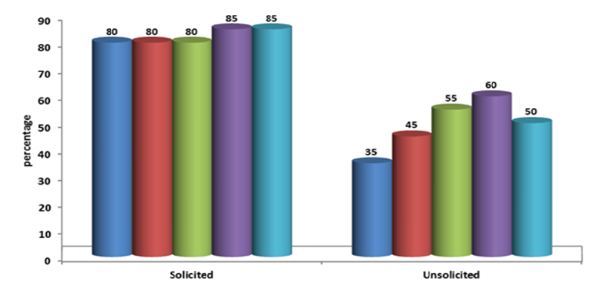
Rota Vaccine Program at Shantha
Phase I/II study - Solicited and Unsolicited Adverse Events
BRV-TV (Low dose)
BRV-TV (Medium dose)
BRV-TV (High dose)
Placebo
RotaTeq™
Conclusion: BRV-TV has a safety profile as good as placebo and the licensed vaccine
Vaccine 2014; 32S: A117–A123

Slide 20
Rota Vaccine Program at Shantha
Clinical Development - Phase I/II study: Immunogenicity Results
All doses tested were immunogenic resulting in an increase in anti-rotavirus IgA
Increasing doses resulted in a greater proportion of children seroconverting
Highest immune response was observed with BRT-TV (High dose)
Immune response against RotaTeq™ was found to be lower than with BRV-TV (High dose)
Lowest immune response was observed in placebo group
Vaccine 2014; 32S: A117–A123

Slide 21
Rotavirus phase III immune non-inferiority study (CTRI/2014/08/004893)
Multi-center, randomized, single blind, parallel arm, study
Total number of infants divided equally into two groups:
Study planned to be conducted at all sites (Pediatric and Public Health) attached to Medical Schools in India
 | 6 Weeks | 10 Weeks | 14 Weeks | 18 weeks
All Infants | Pentavalent vaccine & OPV | Pentavalent vaccine & OPV | Pentavalent vaccine & OPV | -
Group 1 | BRV-TV | BRV-TV | BRV-TV | -
Group 2 | RotaTeq™ | RotaTeq™ | RotaTeq™ | -
 | Blood sample | - | - | Blood sample

Slide 22
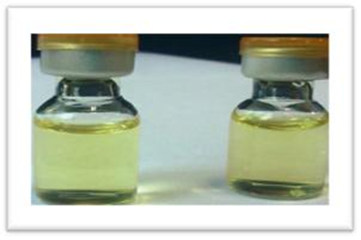
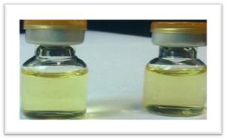
Rotavirus Vaccine program at shantha
Conclusion
A fully liquid, stable, having good safety profile and immunogenic live attenuated Rotavirus vaccine has been developed by Shantha Biotechnics Private Limited

Slide 23
Thank you

