Slide 1

Immune Complex as Vaccine against Tuberculosis
H.Shakila,
Associate Professor,
Madurai Kamaraj University,
Madurai, Tamilnadu

Slide 2
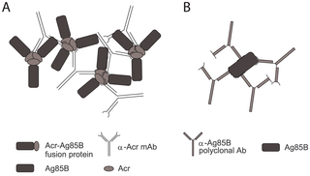
IMMUNE COMPLEXES AS VACCINES AGAINST TUBERCULOSIS

Slide 3
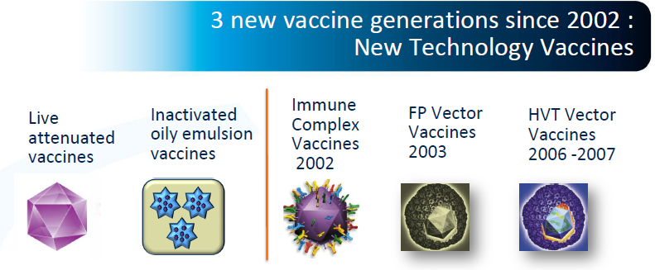
ICs as Vaccine Candidate
Adapted as vaccine strategy for Chicken Infectious Anemia Disease (Karel et al., 2011) and infectious bursal disease (Jeurissen et al., 1998).
Used to enhance antibody responses against neutralizing epitopes on HIV-1 envelope gp120 (Catarina et al., 2009).
Acts as molecular platform for adjuvant free vaccine delivery (Ilaria Pepponi et al., 2013)

Slide 4
IC & TB
Not all infected individuals develop TB especially the close contacts.
It was found that values of CIC levels and occurrence are increased in most of the patients with active TB (Dubaniewicz and Magdalena 1999).
It has been shown that ICs from patients with TB exhibit a profound effect on the granulocyte function, with activation of certain effector mechanisms and dampening of others (Senbagavalli et al., 2012).
It is hypothesized that ICs do have immunomodulatory role pertaining to TB.

Slide 5
Studies using whole organisms and sonicated organisms of H37RV
(Group A) antigen excess immune complex preparation AGX=49:1 (where antigen was 49 parts and antibody was 1 part) | (Group B) antibody excess immune complex preparation ABX=1:49 (where antibody was 49 parts and antigen was 1 part)
Ag alone =49 volume of antigen +1 volume of normal saline | Ag alone = 1 volume of antigen+ 49 volume of normal saline
Ab alone = 1 volume of antibody + 49 volume of saline | Ab alone = 49 volume of antibody+1 volume of normal saline
Control= Normal saline (N/S) | Control= Normal saline (N/S)

Slide 6
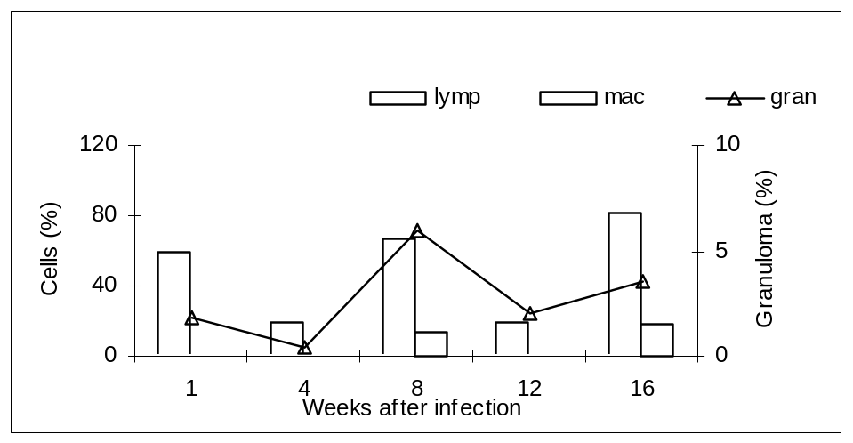
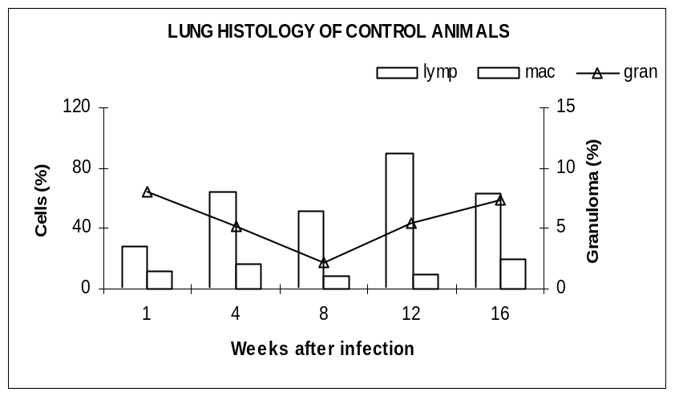
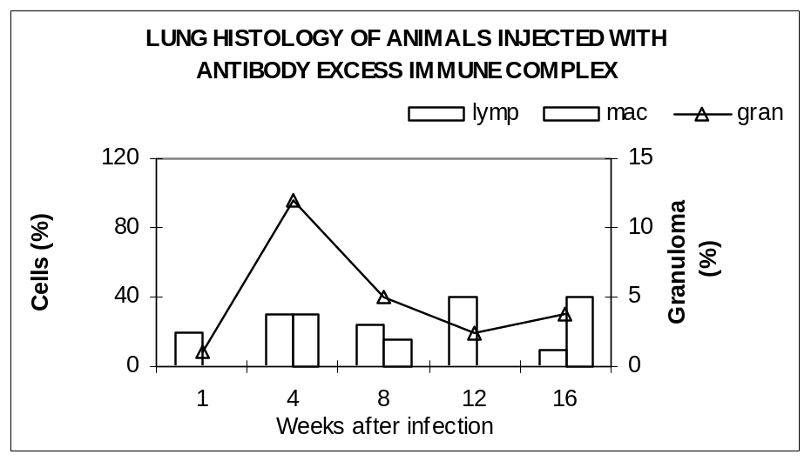
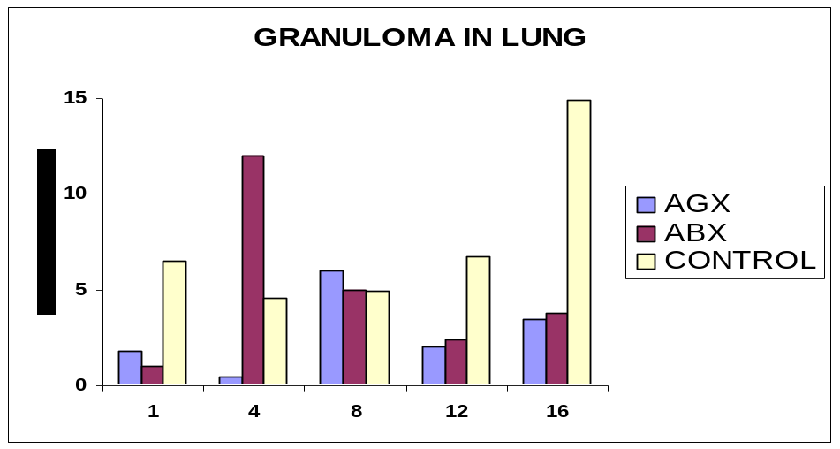

Slide 7
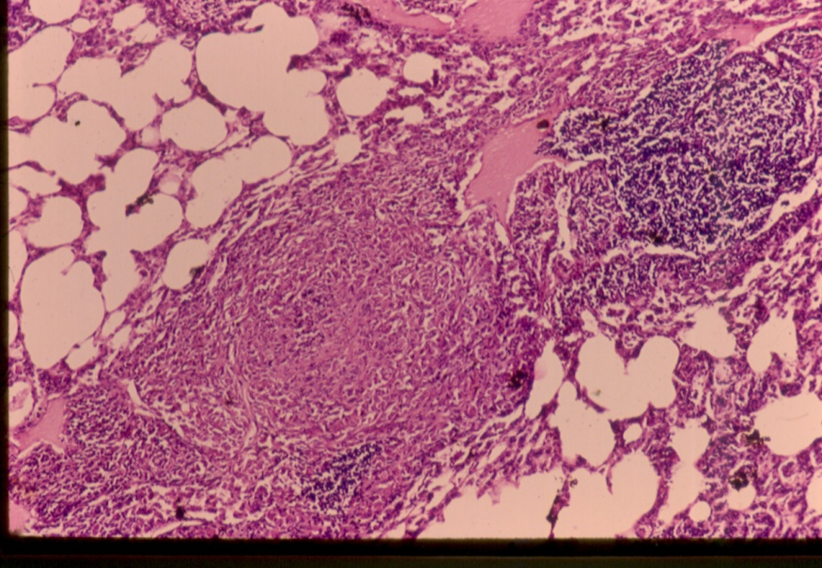
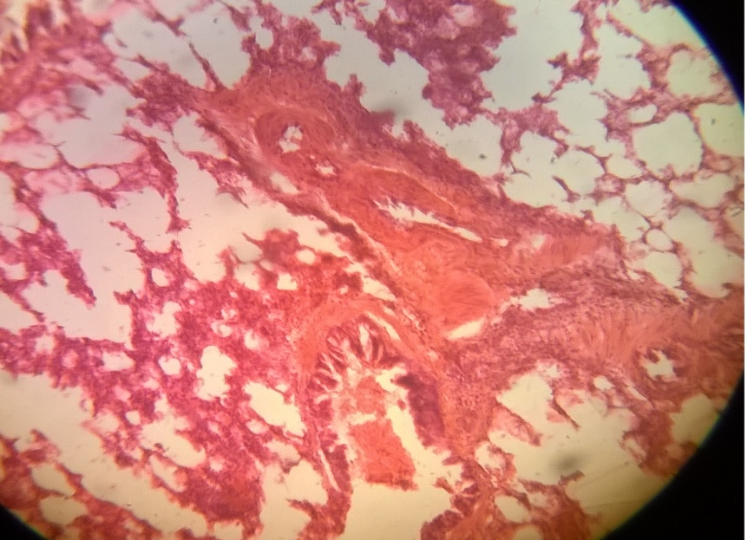
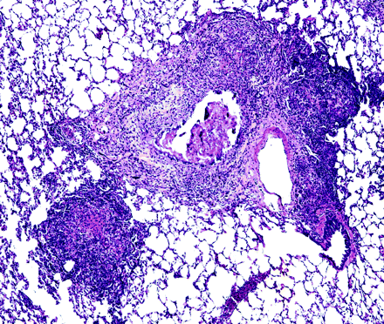
Lung of AGX group
Lung of ABX group
Lung of control group

Slide 8
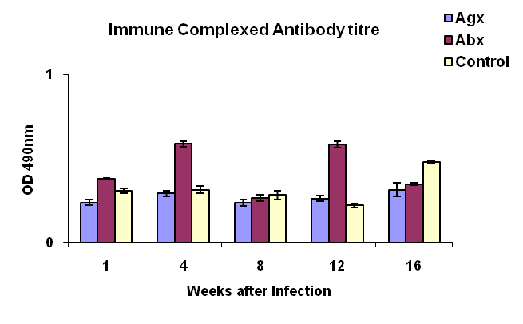
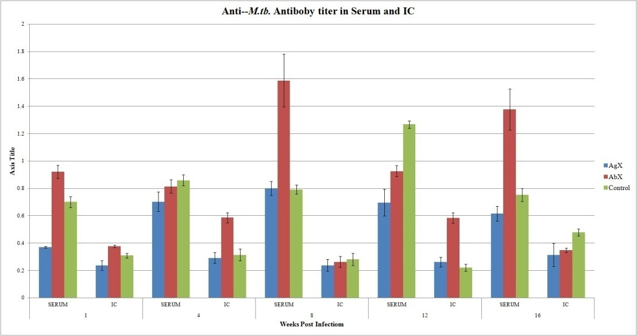

Slide 9
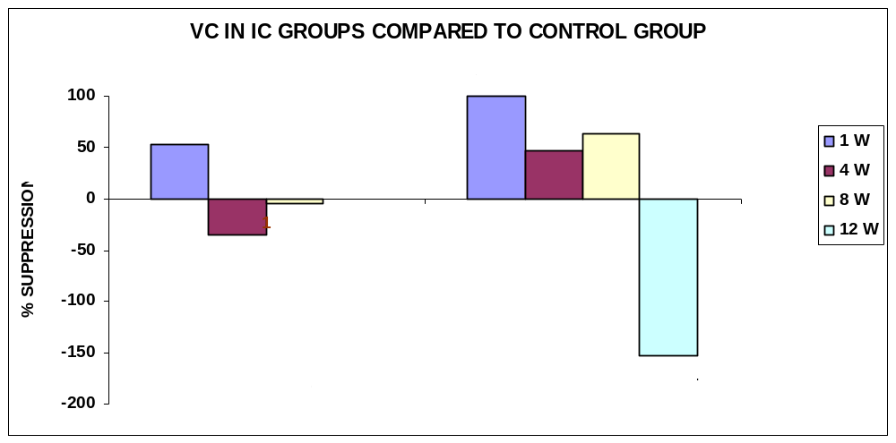

Slide 10
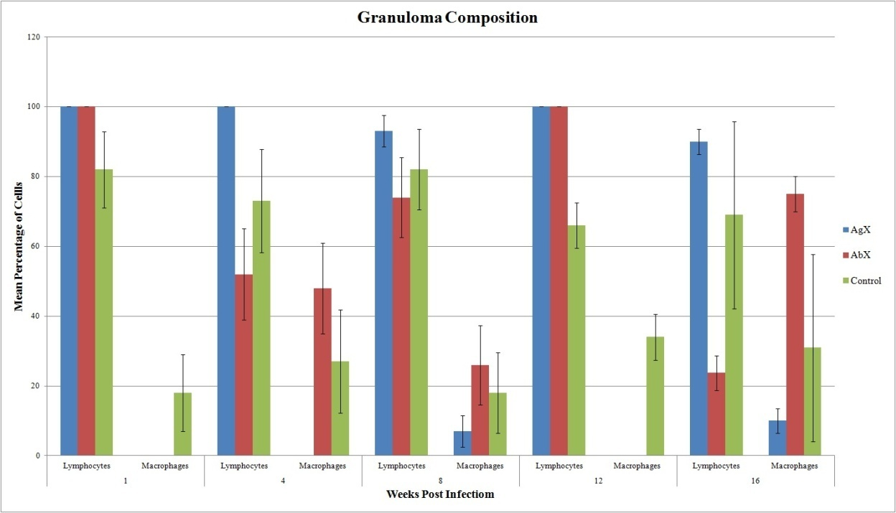
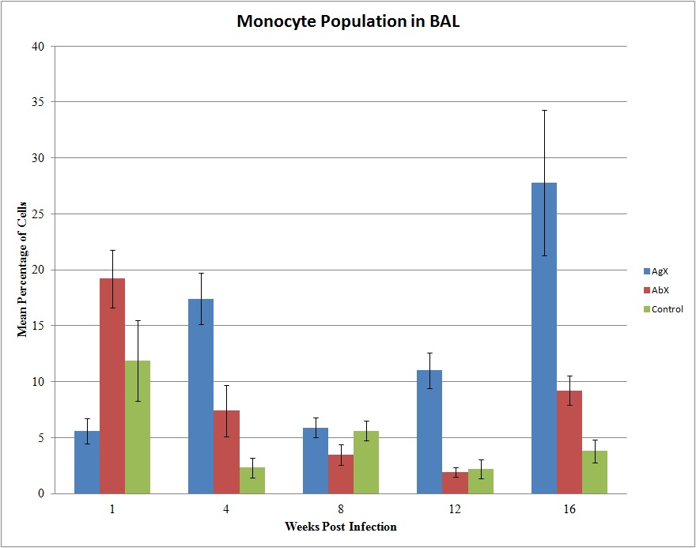

Slide 11
Our Current Study with CFP as antigen and infection by aerosol inhalation

Slide 12
Preparation of Immune Complex
Culture Filtrate Proteins and its specific antibody (BEI resources, NIH) was used.
Immune complexes were prepared by incubating antigen and antibody together for 60mins at 37⁰C.
From the above mixture ICs were isolated by PEG precipitation method.

Slide 13
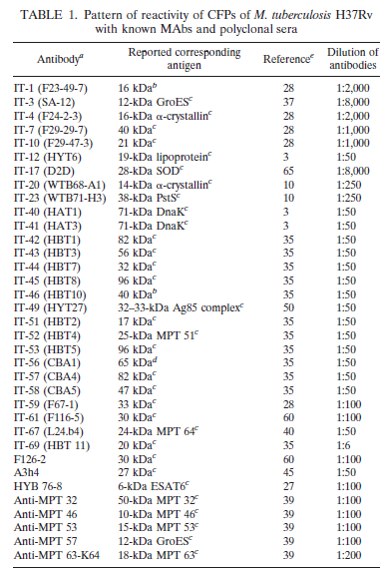
CFP as Antigen Source
Culture filtrate from Mycobacterium tuberculosis contains molecules which can promote protective immunity to tuberculosis in animal models.
The CF proteins CFP17, CFP21, CFP25 and CFP29 were all identified as strong interferon-γ inducers in M. tuberculosis-infected mice and in tuberculosis patients (Karin Weldingh and Peter Andersen 1999).
Sonnenberg & Belisle, 1997

Slide 14
Sensitization of Guinea Pigs with 10³ M. tuberculosis H37RV-by aerosol inhalation method using inhalation exposure system to all the three groups-Group I, II & III.
30 days
Injection of two composition of Immune complex-SC route to Group I and Group II alone
Group I-Antigen excess immune complex
Group II-Antibody excess immune complex
7 days
Infection of Guinea pigs with 10⁶ M. tuberculosis H37RV- by aerosol inhalation method using inhalation exposure system to all the three groups-Group I, II & III.
7 days
First Week – Blood Collection by retro orbital method from all the three groups-Group I, II & III.
60 days
8th Week-Blood Collection by cardiac puncture method and Harvesting the Tissue materials after sacrificing all the three groups-Group I, II & III.

Slide 15
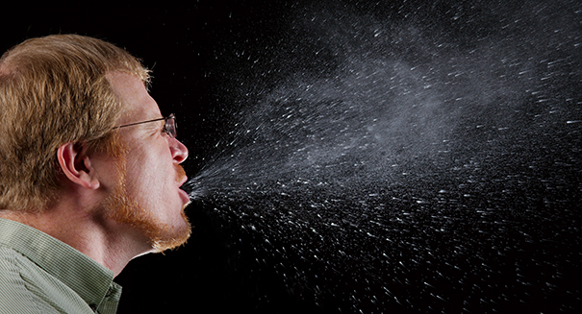
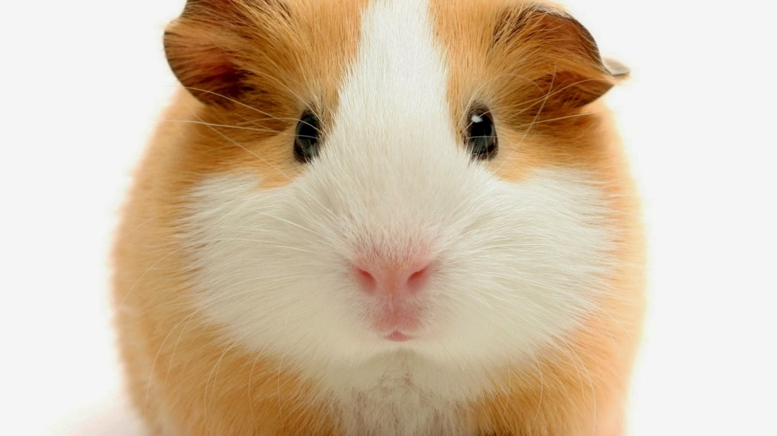
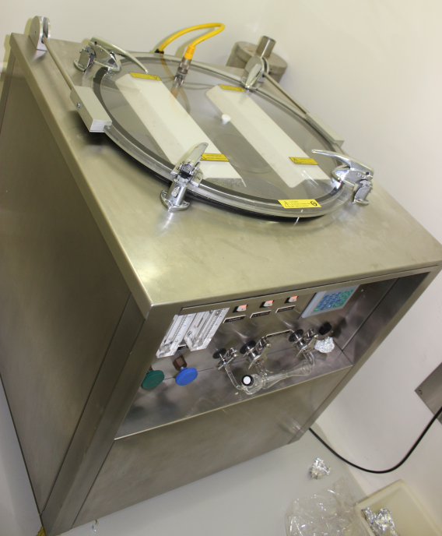

Slide 16
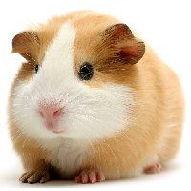
Experimental Set-Up
Animal: Cavia porcellus (Guinea Pig-Dunkin Hartley)
Sex: Male
Quantity: 15 Nos. in three groups
Place of the Study: BSL3 Laboratory for Animal Experiments, National JALMA Institute for Leprosy and other Mycobacterial Diseases, Agra, India.
Group I-Immunized with Antigen Excess IC (AgX-IC)
Group II-Immunized with Antibody Excess IC (AbX-IC)
Group III-Control
Naïve animal was also included.
All the groups were maintained in separate cages in isolators with proper feed and controlled temperature and humidity.
Infection was carried out via intra-nasal route using aerosol inhalation exposure system.

Slide 17
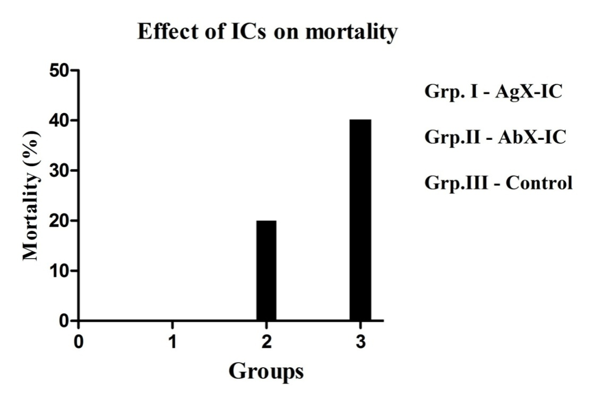
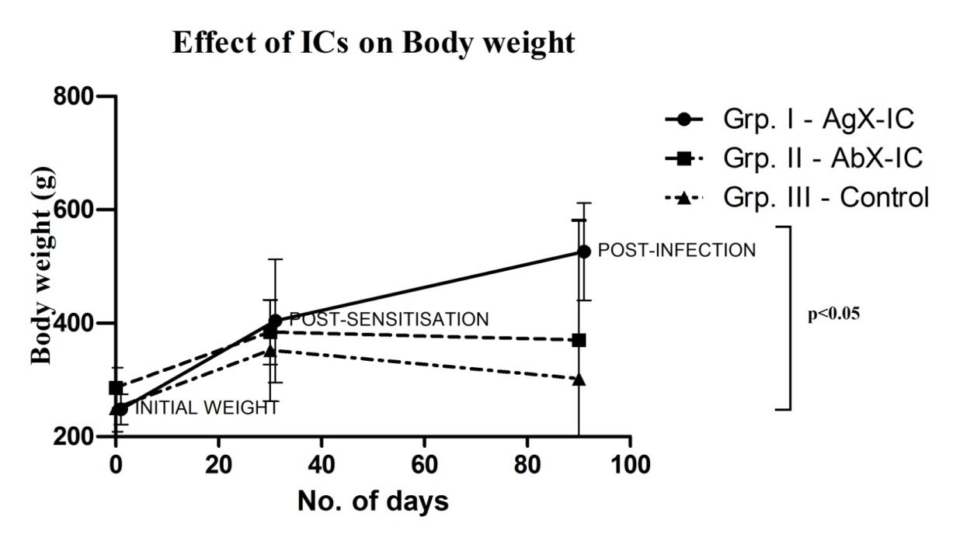
Group I with Agx-IC did not show any mortality while there was 20% and 40 % of mortality with Abx-IC group and control group respectively.
IC complex with antigen excess showing sustained increase in body weight of guinea pigs.

Slide 18
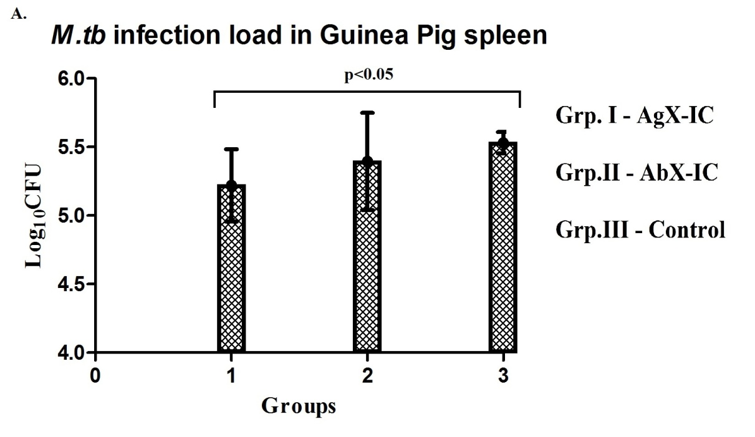
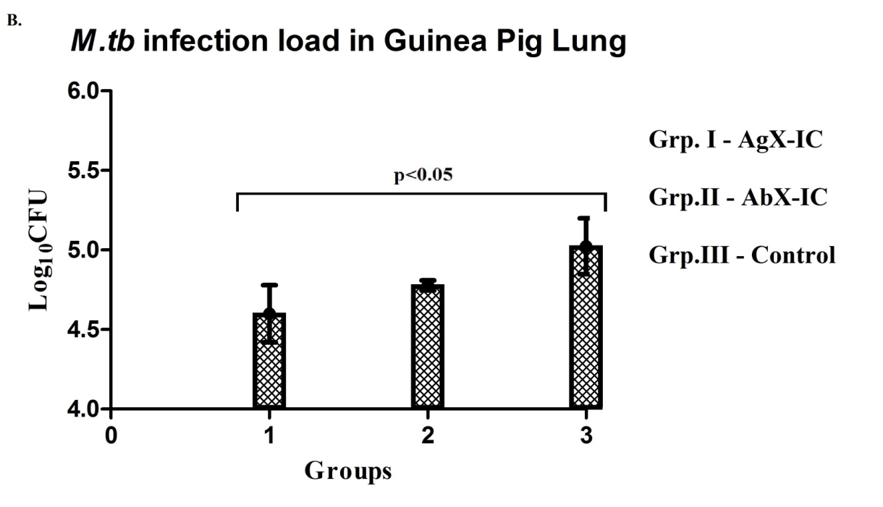
Colony Forming Units of M.tb in spleen (A) and lungs (B) of guinea pigs: IC immunized group I and II shows decrease in infection load than control group. The values are expressed as log₁₀ with statistical significance: p<0.05.

Slide 19
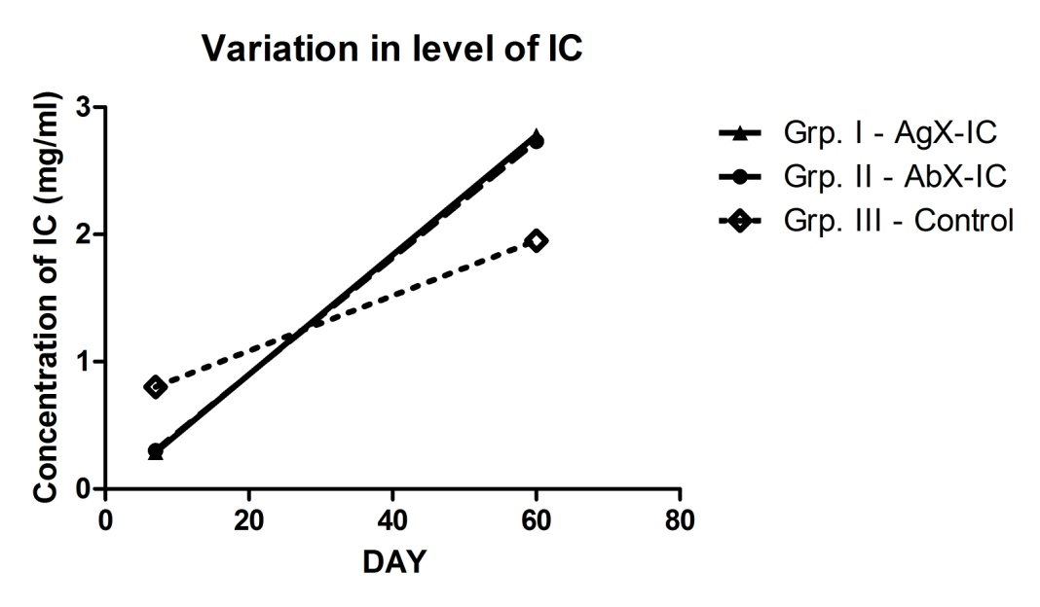
CIC level in guinea pigs serum showing significant difference between IC immunized test group and non-immunized control group (p<0.05).

Slide 20
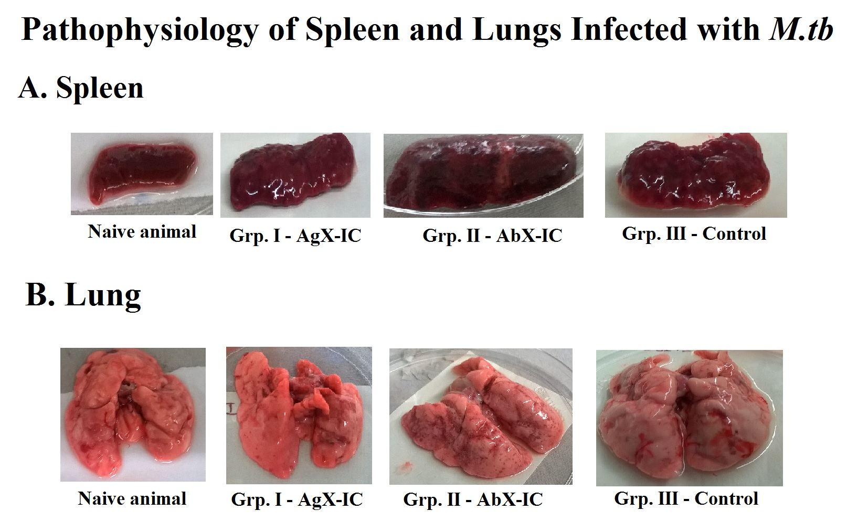

Slide 21
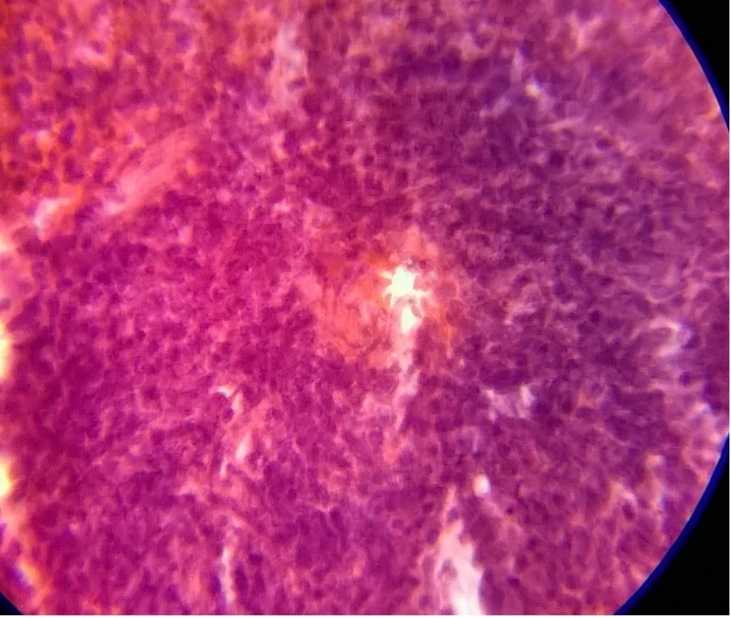
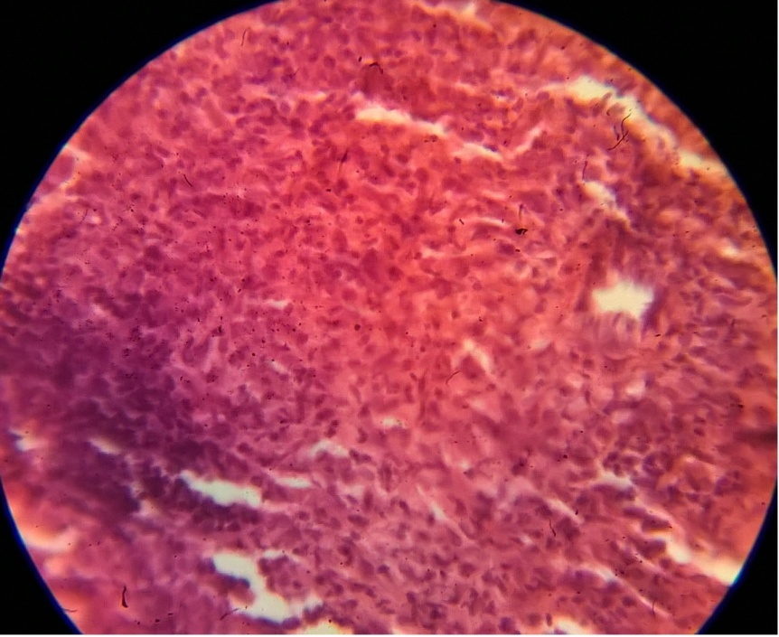
AGX spleen
Control spleen

Slide 22
Conclusions from our work:
1. Immunization with Immune complexes improved the body weight.
2. The morbidity and mortality was less in animals immunized with ICs when compared to the controls.
3. The bacillary load was reduced.
4. The type of granuloma observed seem to be protective in nature.
5. The antibody titer in the serum were more.
IMMUNE COMPLEXES HAVE A VACCINE AND ADJUVANT ACTIVITY

Slide 23


