Slide 1
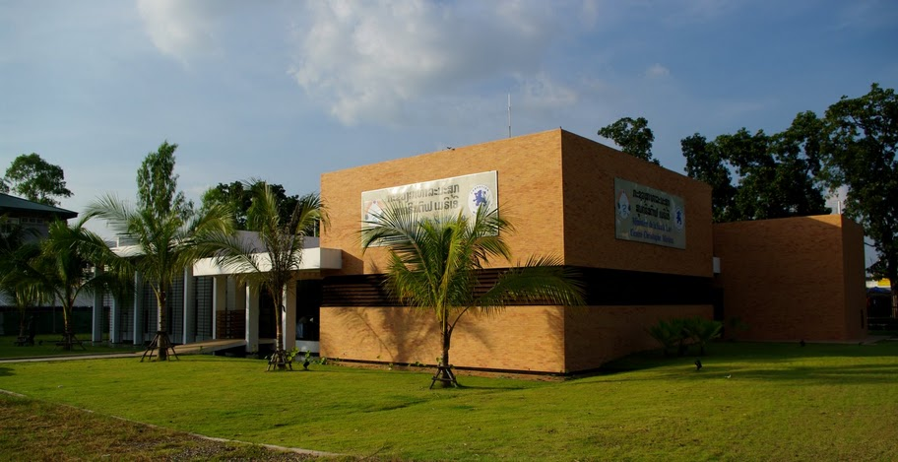


A CENTER OF THE MOH DEDICATED TO DIAGNOSIS AND RESEARCH IN INFECTIOUS DISEASES
LaoCol-VP: Performance of careHPV™ vs conventional Pap smear for the detection of cervical precancerous and cancerous lesions among HIV infected women in Lao PDR
9th Indo Global Summit on Cancer Therapy
2-4 Nov, 2015, Hyderabad, India
Dr. Phimpha Paboriboune, Scientific Director, phimpha@ccm-laos.org

Slide 2
Overview
HIV and HPV situation in Laos
Study Justification and Objective
Methodology
Preliminary results
Issues and Success factors
Conclusions

Slide 3
HIV and HPV Situation in Laos
Total population ≈ 6.8 M (2009), Female (>15y): 1.8 M
HIV infection
  Prevalence (2009): 0.3% of adults
  1st HIV-infected patient identified in 1990
  ARV treatment program since 2003: 1st & 2nd line regimen
  HIV VL & drug resistance testing available since 2009
  Patients registered (2014) : 5933
  - 3336 (56%) on ARV therapy
  - 2769 (83%) benefited from VL testing
  - 87% of them have VL <250 cp/ml
HPV infection
  No national screening and prevention program for cervical cancer
  Wide ignorance on cervical cancer and its prevention
  amongst Lao women
  Very few studies about cervical cancer
  Limited options for cancer treatment

Slide 4
Study Rationale & Objective
Study rationale
  Crude incidence in Laos: cervical cancer is the most common cancer in women: 15.8/100 000, but only 3.9% of women benefit from Pap smear screening.
  2nd leading cause of cancer death in women aged 15-44 years.
  A new rapid HPV test, careHPV™ showed high sensitivity for the detection of high grade cervical intraepithelial neoplasia (CIN).
Objective of the study
  To assess the performance of HPV screening with careHPV™ versus conventional Pap smear (CPS) for the detection of precancerous and cancerous cervical lesions among HIV-infected women in Laos.

Slide 5
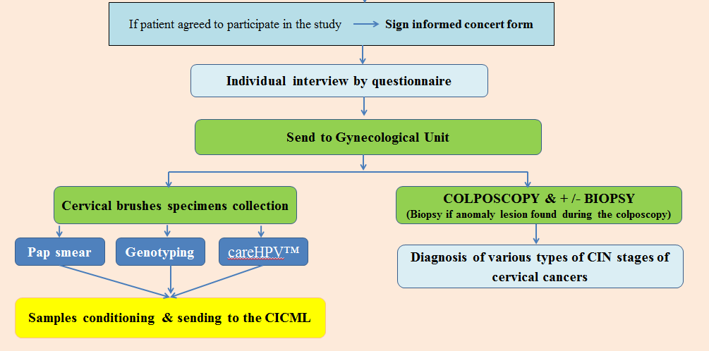
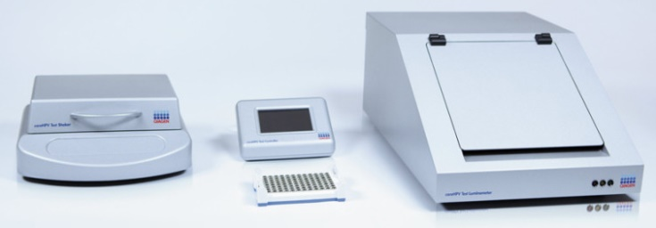
Methods: Flow chart
A transversal multicenter study in four HIV/AIDS treatment centers
Age: 25-65

Slide 6
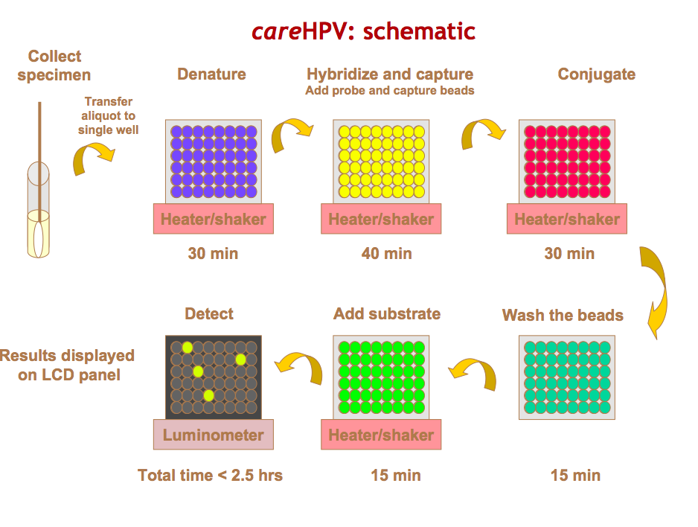
Methods: careHPV test
NA hybridization assay with signal amplification using microplate chemiluminescent for the qualitative detection of 14 HR-HPV (16/18/31/33/35/39/45/51/56/58/59/66/68).
The test is manufactured by QIAGEN company. Available in China and India in 2013 (official announcement).

Slide 7
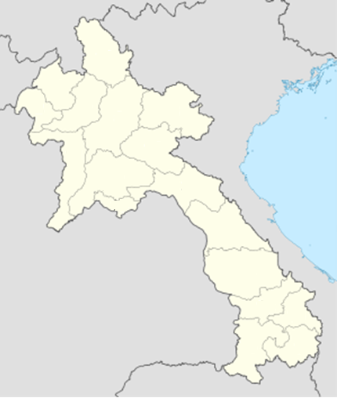
Results-1: Socio-demographics
Inclusion phase: 15 months (Feb 2014 to May 2015)
Total: 644 women with median age: 35.8 years [IQR:31-42]
Marital status:
  Married: 60%
  Widowed: 17.4%
  Separated/divorced: 16.3%
  Single: 6.3%
Education level:
  Illiterate: 11.5%
  Primary: 40.5%
  Secondary: 44.4%
  University: 3.6%
Average number of children: 2.0 ± 1.5
28
Luang prabang
Vientiane
283
(Sethathirath) &
228
Savannakhet
(Mahosot)
105

Slide 8
Results-2: HIV infection
Median duration of HIV infection: 4 years [IQR:1.4-6.7]
Average age at first intercourse: 16.1 ± 3.8 years
Number of sexual partners: 1 to 3: 94.6%, and 4 to 10: 6.4%
Current partner HIV positive:
  HIV POS: 50%
  HIV NEG: 20%
  unknown: 30%
HBV-HIV coinfection: 7.8%, unknown: 3.3%
HCV-HIV coinfection: 1.2%, unknown: 25%
median lowest CD4 count recorded: 149/mm³ [IQR: 51-274]
On ART: 93% (duration of 3.5 years), including 4% receiving PI based ARV.
  HIV RNA < 250 cp/mL: 82%
  median CD4 count : 368/mm³ [IQR: 238-504]

Slide 9
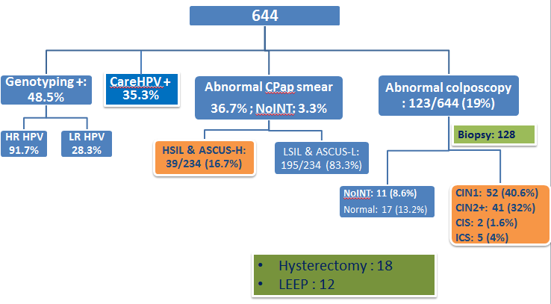
Results-3: HPV, Cytology, Histology
Samples classified by using the Bethesda System and the cervical intraepithelial neoplasia system.
Notes:
Le frottis cervical conventionnel, les résultats sont rendus selon la classification de Bethesda.
Lésions squameuses atypiques de haut grade (ASC-H)
Lésions intra épithéliales de bas grade (LIEBG/LSIL)
Lésions intra épithéliales de haut grade (LIEHG/HSIL)

Slide 10
Results-4: HR-HPV genotypes
%

Slide 11
Results-5: Sensitivity & Specificity careHPV Test and conventional PS (CPS) to detect ≥ CIN 2
careHPV | ≥ CIN 2 | < CIN 2 | total
positive | 38 | 189 | 227
negative | 9 | 407 | 416
total | 47 | 596 | 643
Sens: 80.9% (95% CI:66.7–90.9%).
Spec: 68.3% (95% CI:64.4–72%).
positive predictive value (PPV): 16.7% (95% CI: 12.1–22.2%).
negative predictive value (NPV): 97.8% (95% CI:95.9– 99%).
CPS | ≥ CIN 2 | < CIN 2 | total
positive | 17 | 22 | 39
negative | 29 | 555 | 584
total | 46 | 577 | 623
Sens: 37% (95% CI: 23.2–52.5%).
Spec: 96.2% (95% CI:94.3–97.6%).
positive predictive value (PPV): 43.6% (95% CI:27.8–60.4%).
negative predictive value (NPV 95% (95% CI:92.9– 96.6%).

Slide 12
Results-6: Sensitivity & Specificity of careHPV vs Conventional PS for the detection of CIN 2+
For 100 women, careHPV™ as screening test, followed by a colposcopy when positive, would allow the detection of 5.9 CIN2+ lesions. A CPS screening would allow the detection of 2.7 CIN2+ lesions.
The combination of the 2 tests and a colposcopy if at least one of them is positive would allow the diagnosis of 6.4 CIN2+ lesions for 100 women tested.

Slide 13
Issues and Success factors
  Clinical Investigators have a lack of knowledge of research process
  Lack of knowledge about cancer and wrong beliefs
  Filling of the forms for the study not perfect
  Difficulty to convince the women to be treated.
  Funds to implement the project (FMX and INCA, France)
  Infrastructures exist, but must be improved
  Partners (CHAS, HIV Centers, UHS, Anapath Laboratory, Fondation Merieux, CICML) are well interested and motivated

Slide 14
Conclusions
This project benefitted to the women who participated in the study: 48 women with precancerous and cancerous lesion were detected and 30 were treated. It’s a strong argument to implement a better screening for the cervical cancer in Laos.
The good practices for clinical research has to be reinforced and the investigators must be more informed about ethical aspects of research.
careHPV™ has better sensibility and lower specificity than CPS for the screening of cervical precancerous and cancerous lesions among women living with HIV in Laos. The role of HPV screening in the detection of cervix cancer needs to be further defined in this country. It is recommended to strengthen routine screening of cervical cancer particularly among HIV infected women.

Slide 15







Acknowledgement
Study team: Phimpha Paboriboune¹, Keokhethong Phongsavanh², Phetsamone Arounlangsy³, Bruno Flaissier¹, Valentina Picot⁴, Khamphang Sourinphoumy⁵, Oukham Aphayarath ², Phichit Phandolack⁶, Prasit Phimmasone⁷ , Nicole Ngo-Giang-Huong⁸, Mixi Xayaovong¹, Gonzague Jourdain⁸, Ketmala Banchongphanith⁹, Christophe Longuet⁴
¹ Infectiology Center Christophe Mérieux (CICML), Vientiane, DR Laos
² Sethattirath Hospital, Vientiane, DR Laos
³ Anatomopathology Laboratory, University of Health & Science, Vientiane, DR Laos
⁴ Fondation Mérieux, Lyon, France
⁵ Savannaketh Hospital, DR Laos
⁶ Luang Prabang Hospital DR Laos
⁷ Mahosot Hospital, Vientiane DR Laos
⁸ PHPT, Chiang Mai University, IRD, Chiang Mai, Thailand
⁹ Center HIV/AIDS & STI (CHAS)
Sponsors: French National Cancer Institute (INCa), Fondation Mérieux
Notes:
15

