Slide 1
25 YEARS OF AKT -
AN EVALUATION OF ITS FUNCTION IN CELL SURVIVAL AND CANCER
PROF. V. LAKSHMIPATHI
PROF (Retd.) CELL BIOLOGY &ENZYMOLOGY
KAKATIYA UNIVERSITY
WARANGAL-506009
Email: lvadlakonda@gmail.com

Slide 2

MY FORAYS INTO CELL SIGNALING STARTED
TWO YEARS AFTER
MY RETIREMENT (2006)

Slide 3
Akt (Protein kinase B)
DISCOVERY AS A NOVEL S/T KINASE
1991: Three independent groups, headed by Hemmings, Woodgett and Tsichlis, discovered a novel serine threonine (ser/thr) protein kinase
Screening cDNA libraries for novel ser/thr kinases:
  Jones PF, Jakubowicz T, Pitossi FJ, Maurer F, Hemmings BA(1991 May 15); Proc Natl Acad Sci U S A. – Named it as rac protein kinase (rac, for related to the A and C protein kinases; RAC-PK)
  Coffer PJ, Woodgett JR. (1991 Oct 15) Eur J Biochem. Human epithelial (HeLa) cDNA - Named it as Protein kinase B (between protein kinase A and C)
Isolated from oncogenic provirus, AKT-8
  Bellacosa A, Testa JR, Staal SP, Tsichlis PN. (1991 Oct 11) Science.– named it as Akt (designated after the oncogenic provirus, AKT-8).
Ever since its discovery, Akt remained the epicenter of cell survival pathways. It is at the center of all metabolic disorders, diabetes, obesity and cancer. Its aberrant activation has been documented well in cancer.
A coincidence: the target of rapamycin (TOR) was discovered in 1991 as a regulator of cell cycle.

Slide 4
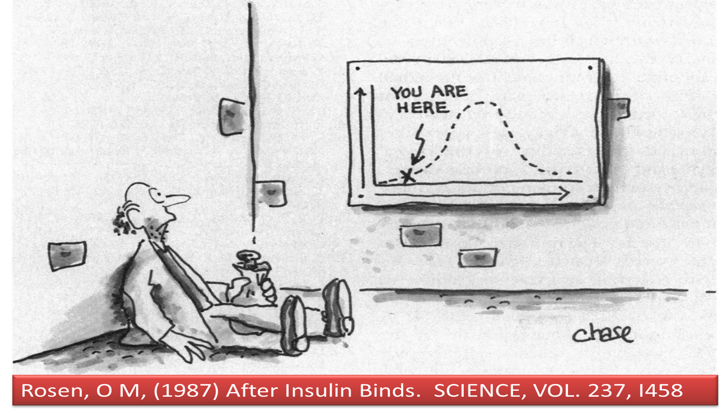
25 YEARS OF Akt, 93 YEARS OF INSULIN -
HAVE WE MOVED BEYOND ROSEN’S CARTOON?
Macleod (Nobel lecture on insulin discovery) 1925 -“At the present we are entirely at loss to account for the disappearing glucose (from blood).”
Ironically, we still do not have answer to this!
1987
65 YEARS AFTER
INSULIN DISCOVERY
Polonsky, K S.
N Engl J Med 2012; 367:1332-40
“if one views diabetes from a public health and overall societal standpoint, ---------during the past 200 years, -----we are arguably worse off now than we were in 1812”.

Slide 5

Akt DOMAIN STRUCTURE, PHOSPHORYLATION AND REGLUATION
IIS
PHOSPHOINOSITIDES
(OVER ALL REGULATORS OF THE PATHWAY)
Nutrients, PLD/PA
?
IKKBε-TBK1
(INFLAMMATION)
PI3K
mTORC2
DNA –PK
(DNA DAMAGE)
PIP₂
PIP₃
PTEN
PHOSPHORYLATION
IN CYTOPLASM?
PDK1
COTRANSLATIONAL
PHOSPHORYLATION
[PROTECTIVE AGAINST UBIQUITINATION]
UPON T308 PHOSPHORYLATION
Akt DISSOCIATES FROM THE MEMBRANE INTO THE CYTOPLASM
ACTIVATES mTORC1
MEMBRANE
T/308
T/450
S/473
Akt
TRANSLOCATES TO THE MEMBRANE AND mtorc2 phosphorylates Akt ON S473 which
PROMOTES GLUCOSE UPTAKE
TARGETS OF S473
FoxO; BCl2 FAMILY PROTEINS
GSK3β, AS160(GLUT4)
TARGETS OF T308
TSC2; GLUT1 (GSK3β?)
mTORC1
(ANABOLIC ACTIVITY)
PHLPP
PP2A

Slide 6
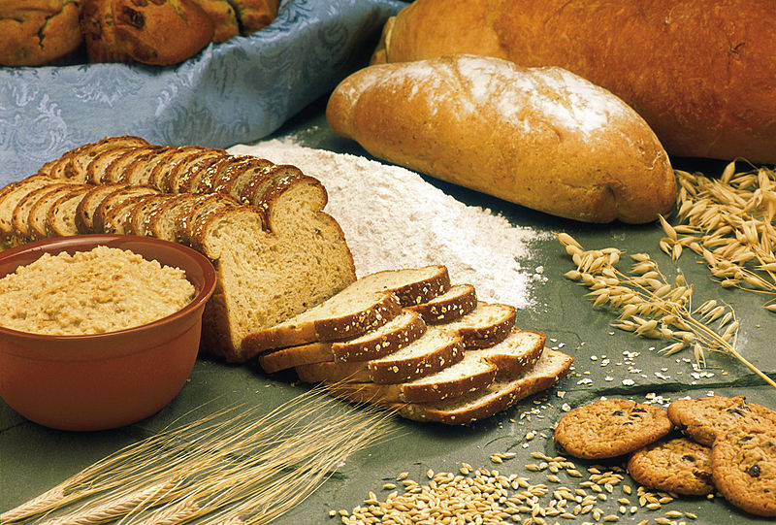
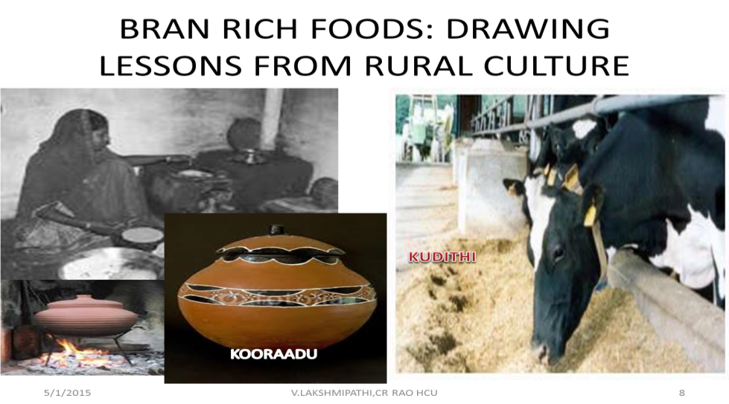
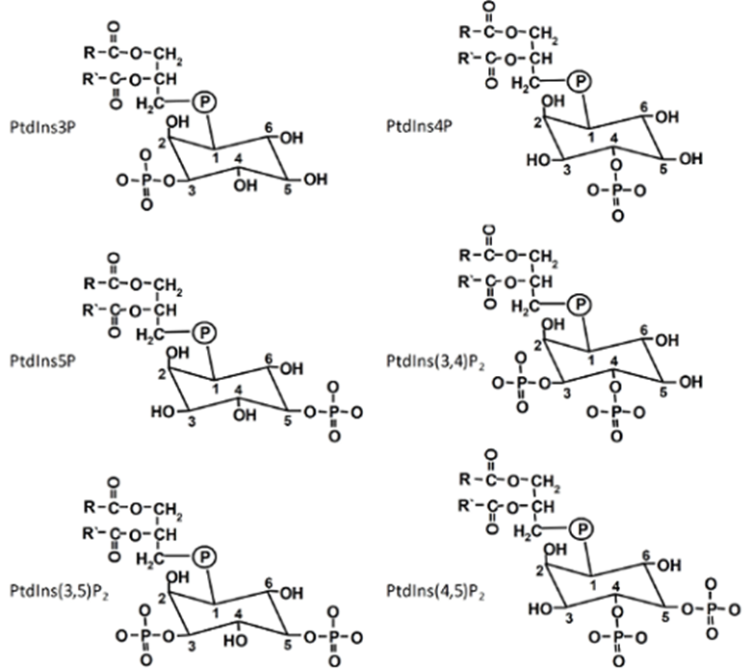
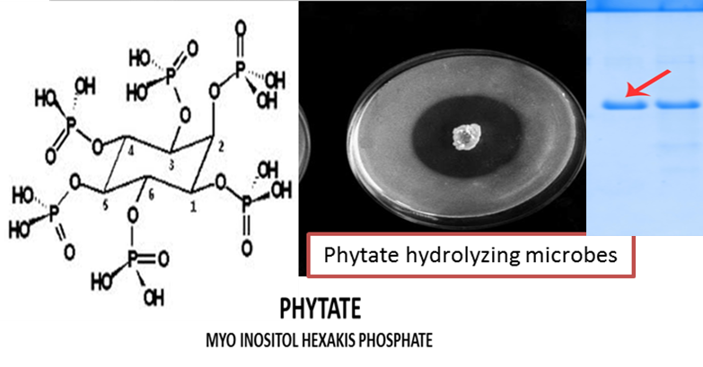
CEREALS: BEYOND FIBER!
PHOSPHOINOSITIDES IN MEMBRANE DYNAMICS
(LESSONS FROM RURAL INDIA AND COLON CANCERS)
WHOLE-GRAIN CEREALS?!?!
IS THERE A THING BEYOND FIBRE?
KOORAADU
KUDITHI
P
SUMA, MUKESH, LAKSHMIPATHI V; World Journal of Microbiology & Biotechnology 20: 531–534, 2004.

Slide 7
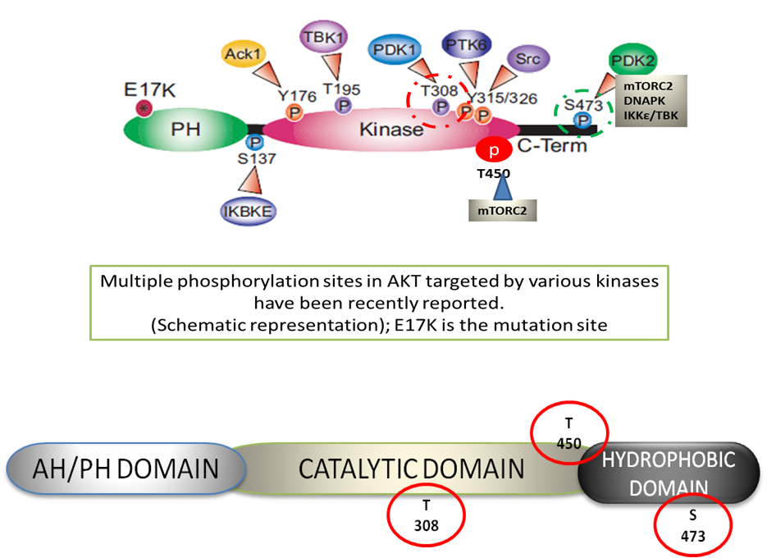
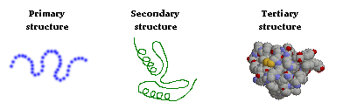
Akt IN THE MIDST OF NUTRIENT UPTAKE AND UTILIZATION
TRANSLOCATION
TO MEMBRANE
On T308 Phosphorylation,
Akt dissociates from the membrane, Localizes into cytoplasm phosphorylates TSC2 & inhibits it
T
308
Nutrients
uptake
S
473
mTORC2
TSC1/2
Nutrients inside the cell
protein synthesis
PDPK1
(PDK1)
mTORC1
activation
IIS
ENERGY FOR
Nutrient utilization
Pi
GLYCOLYSIS, KREBS CYCLE
& OXPHOS
(ATP PRODUCTION)
O₂

Slide 8
mTORC1 AND mTORC2 HAVE DIFFERENT PROTEIN COMPONENTS AND FUNCTIONS
PKC
SGK
Akt S473
Akt T308
DEPTOR
mLST8
COOPERATIVE ACTION OF BOTH mTORC1 AND mTORC2 IS REQUIRED FOR TRANSLATION OF SEVERAL HOUSE KEEPING PROTEINS, WHICH INCLUDE Akt , INSULIN SIGNALING MOLECULES, LIKE IGF, AND PI3K REGULATOR PTEN
DEPTOR
mLST8
mTOR
mTOR
PROTOR
RAPTOR
PRAS 40
RICTOR
mSIN1
mTORC1
mTORC2
RICTOR, mSIN1, PROTOR DEFINE THE C2 COMPLEX | RAPTOR, PRAS40 DEFINE THE C1 COMPLEX
RAPAMYCIN INSENSITIVE | RAPAMYCIN SENSITIVE
UPSTREAM OF Akt; ACTIVATES KREBS CYCLE | DOWN STREAM OF Akt; ACTIVATES GLYCOLYSIS
CYTOSKELETON REORGANIZATION (PROMOTES NUTRIENT, IONS UPTAKE) | ACTIVATES NUTRIENT UTILIZATION
ACTIVATED WHEN ASSOCIATED WITH RIBOSOMES | ACTIVATED BY ATP; PHOSPHORYLATES S6K AND 4E-BP1/2; ACTIVATES RIBOSOME BIOGENESIS, EIF4 DEPENDENT PROTEIN SYNTHESIS
INHIBITED BY S6K PHOSPHORYLATION OF RICTOR/ mSIN1 | INHIBITS AUTOPHAGY, MITOPHAGY; PROMOTES BIOSYNTHESIS
ATP GENERATING
ACTIONS
ATP CONSUMING
ACTIONS

Slide 9
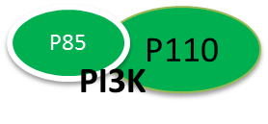

FEEDBACK LOOPS IN Akt FUNCTION
ON T308 PHOSPHORYLATION Akt ENTERS INTO CYTOPLASM AND PHOSPHORYLATES TSC2 RELEASING ITS INHIBITORY EFFECT ON RHEB- mTORC1 COMPLEX
Rictor phosphorylation impairs mTORC2 function and glucose uptake; but protects IRS from ubiquitination
mTORC1 / S6K
NUTRIENTS ACTIVATE
mTORC2 AND Akt
TRANSLOCATION
TO THE MEMBRANE
mTORC2
T/450
S/473
T/308
AMINOACIDS KEEP mTORC1 ACTIVE
INDEPENDENT OF IIS, WHICH DISRUPTS mTORC2 & CAUSES INSULIN RESISTANCE
MEMBRANE
Serine phosphorylation of IRS
by mTORC1/ S6K inhibits
insulin signaling
IRS dissociates from the receptor
mTORC2 promotes ubiquitination of serine phosphorylated IRS
P
TSC2
PDPK1
(PDK1)
PIP3
TSC1
ANABOLIC PROGRAMMING
mTORC1 REGULATOR
RHEB
RIBOSOME BIOGENESIS
INSULIN/
IGF
YP
IRS 1/2
mTORC1
PIP2
CYTOPLASM
PROTEIN SYNTESIS
SP
Tyr phosphorylation promotes IRS, Receptor complex
LIPID SYNTHESIS
AMINO ACIDS
(AA)
MITOPHAGY
AUTOPHAGY
mTORC1/ S6K
Dvl
Wnt PATHWAY
CELL PROLIFERATION

Slide 10

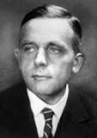
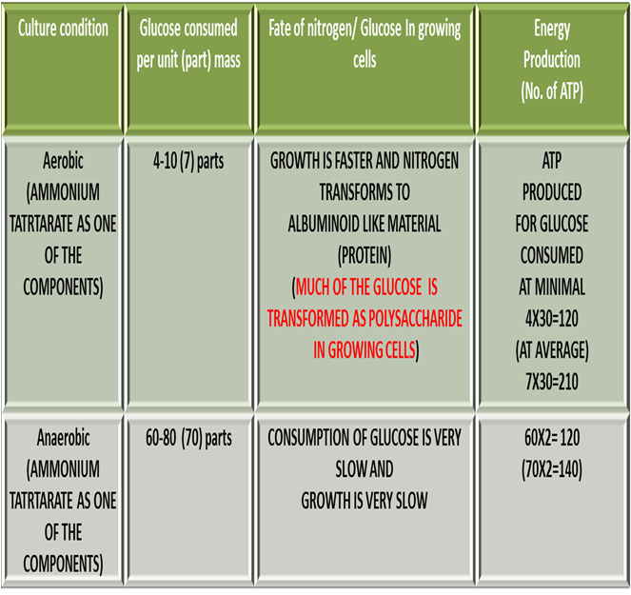
INVERSE RELATION BETWEEN CONSUMPTION OF GLUCOSE & O₂ - NITROGEN AND
PHOSPHATE TRIGGER CELL GROWTH
AEROBIC GLYCOLYSIS
(GLUCOSE CENTRC VIEW: ENERGY SUPPLIED BY CARBOHYDRATE MAIN TRIGGER FOR GROWTH)
?
CANCER CELLS HAVE DAMAGED RESPIRATION & DEPEND ON FERMENTATION FOR ENERGY FOR CELL PROLIFERATION.
IGNORED NITROGEN; PASTEUR WAS CATEGORICAL IN HIS DEMONSTRATION THAT NITROGEN TRIGGERS GROWTH.
CANCER CELLS CONSUME MORE OF GLUCOSE AND PRODUCE LACTIC ACID.
THIS THEORY IGNORES THE ROLE OF AMINO ACIDS AND FATTY ACIDS IN ENERGY PRODUCTION.
MORE IMPORTANTLY, THE HYPOTHESIS LIMITS BASIC FUNCTION OF MITOCHONDRIA & KREBS CYCLE TO ATP GENERATION AND IGNORES SUBSTRATE SHUTTLES AND ROLE IN BIOSYNTHESIS.
Barnett, J. A. (2000). A history of research on yeasts 2

Slide 11
LACTIC ACID AT THE CENTER OF CELLULAR METABOLISM
Berzelius (1808) -muscles of hunted stags - carbohydrates are split to lactic acid during active muscular activity.
Fletcher and Hopkins (1907) Frog muscles produce lactic acid steadily both during activity and rest and it disappears when O₂ is admitted.
Meyerhof (1920-30)- Muscle glycogen is cleaved to lactic acid.
Cori cycle- Muscle lactic acid converted to glucose in liver (inter organ transport)
The notion prevailed in spite of the fact that it was shown that heavy muscular exercise can be performed on pure fat diet, and the respiratory quotient (RQ) supports the complete combustion of fat (Lundsgaard¹¹).
Warburg (1927) – proliferative cells produce lactic acid.
Pasteur reaction - damaged respiration leads to aerobic glycolysis
Respiratory uncouplers - glycolyse the cells
‘Pasteuriana’- glucose transport, metabolism, proliferation - lactic acid
It projects ignores role of amino acids, fatty acids, and inorganic phosphate in cell energy production
LACTIC
ACID
GLUCOSE: THE ONLY SOURCE OF LACTATE
&
ENERGY

Slide 12
INORGANIC PHOSPHATE (Pi) IN INSULIN SIGNALING?
  Macleod’s Nobel lecture
  Inorganic phosphate (Pi) :
    Insulin reduces circulating levels of both glucose and Pi.
    During recovery period Pi reappears in blood at a faster rate and is excreted in urine.
  Fate of glucose in cells:
    Glucose is neither converted into glycogen nor oxidized, but recycled as some unknown hexose phosphates.
  Excessive insulin action:
    Excessive insulin action results in hypoglycemic symptoms, which promote increased intake of O₂ in insulin deprived experimental animals and man.
    It is controlled, when sugar is administered along with insulin.

Slide 13
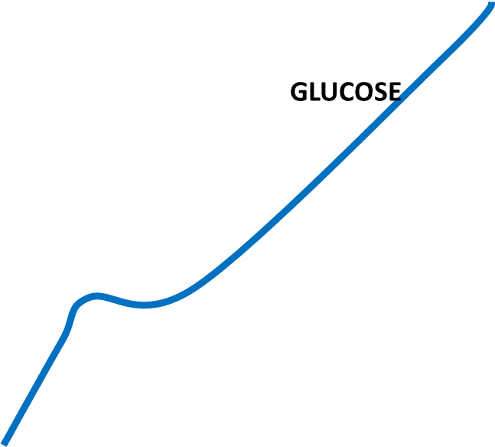

1a
1b
ACTIVITY
OXIDATIVE
PHOSPHORYLATION
BIOSYNTHESIS
MITOCHONDRIAL
RESPIRATION
CRABTREE EFFECT
O₂
O₂
Pi
GLYCOLYSIS
Nrf2
WARBURG EFFECT
OXIDATIVE
PHOSPHORYLATION
ATP PRODUCTION
BIOSYNTHESIS
SERINE, FOLATES
NUCLEOTIDES, etc.
2 Min
2 MINUTES
GLUT1
mTORC1
Akt T308
PI3K
INSULIN
GLUT4
AktS473
mTORC2
IBSEN; RACKER
RELATION BETWEEN GLUCOSE,
Pi, O2 CONSUMPTION
SPATIO - TEMPORAL RELATION BETWEEN SIGNAL PATHWAYS, O2,PI & GLUCOSE UPTAKE
TIME COURSE (MIN)

Slide 14
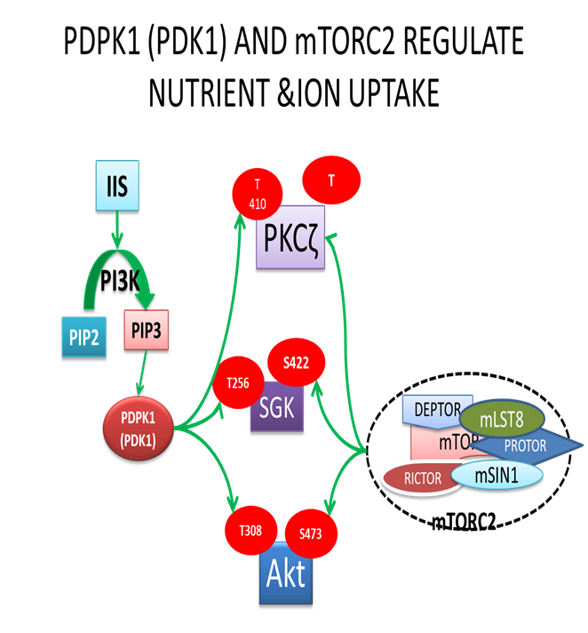
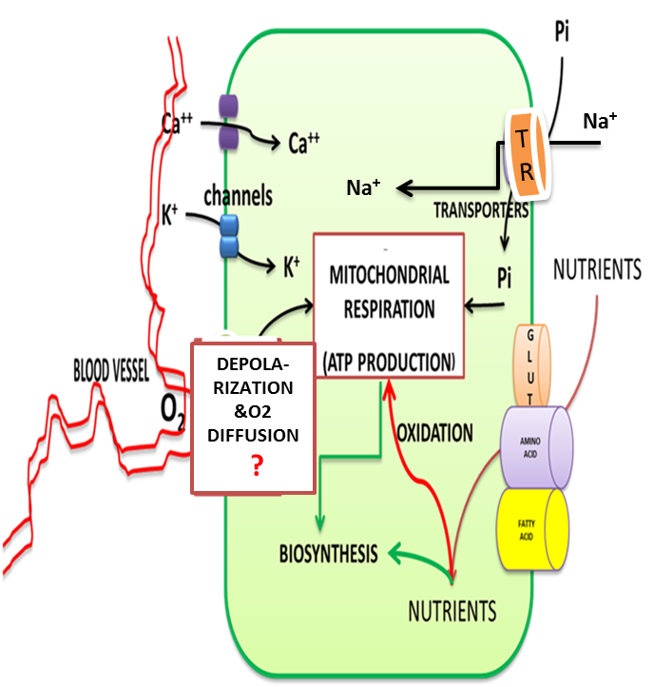
mTORC2 REGULATES ION, NUTRIENT TRANSPORTERS & OXYGEN,ENERGY DYNAMICS

Slide 15
OXYGEN PROMOTES BOTH ENERGY PRODUCION AND BIOSYNTHESIS
LIPID SYNTHESIS
CITRATE
(CYTOPLASM)
REDUCTIVE CARBOXYLATION/ NITRIFICATION
CO₂
ISOCITRATE
NH₄⁺
EXPORT
NADP⁺
NADPH+H⁺
α- KETO-GLUTARATE
CITRATE
+
SH
-S-S-
ANABOLISM
A
AH2
NNT
ROS
REGULAE FLUX BETWEEN ENERGY AND BIOSYNTHESIS ?
MALATE
CATABOLISM
ATP
NAD⁺
NADH+H⁺
Electron transport
system
PYRUVATE
BCA
METABOLISM
CO₂
OXIDATION
(H⁺+H⁻)
DENITRIFICATION
TRANS AND DEAMINATION
NH₄⁺
LACTATE
ALANINE
FAD⁺
FADH₂

Slide 16
FEEDBAK LOOPS REGULATE GLUCOSE
TRANSPORTERS, GLUT4 AND GLUT1
ENVIRONMENTAL SIGNALS,
NUTRIENTS (AMINO AIDS)/
GROWTH FACTORS, TRANSFORMING SIGNALS
INSULIN SIGNALING MOLECULES
(AKT, IGF, PTEN & HOUSE KEEPING PROTEINS/ ENZYMES ?)
mTORC1
mTORC2
INSULIN SIGNALING
(PI3K – Akt T308)
Cooperative action
HYDROPHOBIC MOTIF PHOSPHORYLATIONS
AMINO ACIDS
TSC1/2
AKT S473
SGK3
PKCζ
Rag GTPases
ENHANCED ACTIVATION OF mTORC1
AMINO ACIDS,IONS &
O₂ UPTAKE ?
Rheb
TBC1D4
GLUT1 MEDIATED
GLUCOSE UPTAKE
mTORC1
GLUT4 MEDIATED
GLUCOSE UPTAKE
KREBS CYCLE, ENERGY & ROS PRODUCTION, CATAPLEROSIS
NUTRIENTS UTILIZATION
GLYCOLYSIS
(BIOSYNTHETIC ACTIVITY;
ENERGY CONSUMPTION)
TBC1D4
TBC1D1
AMPK

Slide 17
Akt IN REGULATION OF MITOCHONDIAL RESPIRATION
ER/ NUTRIENT STRESS
AMINO ACIDS
mTORC2
COOPERATIVE
ACTION
(TRANSLATION)
FYN
mTORC1
Akt
GSK3β
S
473
4E-BP1
S6K
INSULIN SIGNALS
?
Nrf2
PROTEIN SYNTHESIS
INCREASED GLUCOSE
UPTAKE
PHLPP
ANTIOXIDANT & MITOCHONDRIAL
RESPIRATORY GENES
ROS
LOW
GLUCOSE
HIGH
GLUCOSE
ATP /ADP RATIO

Slide 18
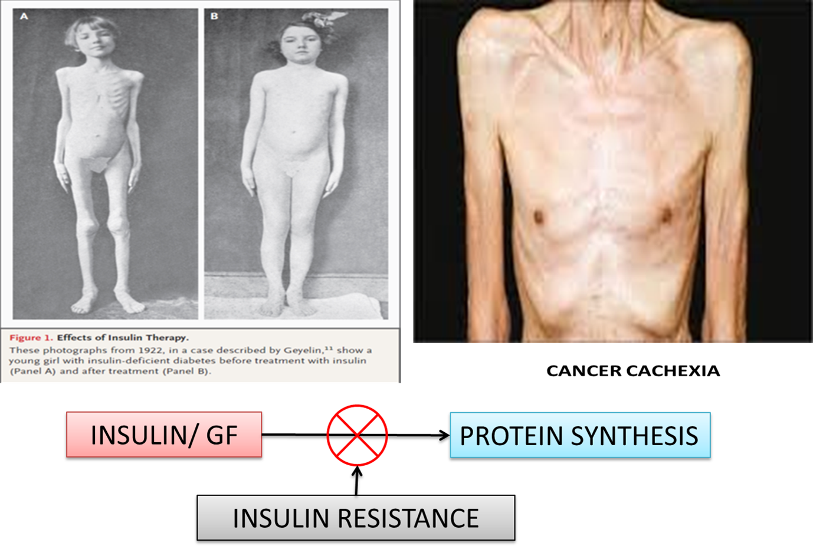
INSULIN AND GLUCOSE REGULATES PROTEIN SYNTHESIS
Downstream of insulin activated and mTORC1 and in energy spent situations, AMPK promotes glucose uptake by phosphorylation of AS160; TBC1D1 appears to play critical role on this.
AS160
Rab GTPase
AMPK
Akt S473
AMINO ACIDS
PLD/ PA ?
PI3K
mTORC2
GLUT4
P70S6K
INSULIN
AktT308
BASAL MECHANISM OF REGULATION OF PROTEIN SYNTHESIS
RIBOSOME BIOGENESIS
INSULIN RECEPTOR/ IRS
COMPLEX
PROTEIN SYNTHESIS
TSC1/2
Rheb
mTORC1
GLU-COSE
RAPAMYCIN
4E-BP1
GLUCOSE
GLYCOGEN
GAPDH
GLUT1
?
ATP
INSULIN RESISTANCE RELEASES REGULATION OF TSC1/2, INHIBITS GLUCOSE AND PI UPTAKE
GLYCOLYSIS
OXPHOS
LOW
GLUCOSE
Pi
BASAL

Slide 19
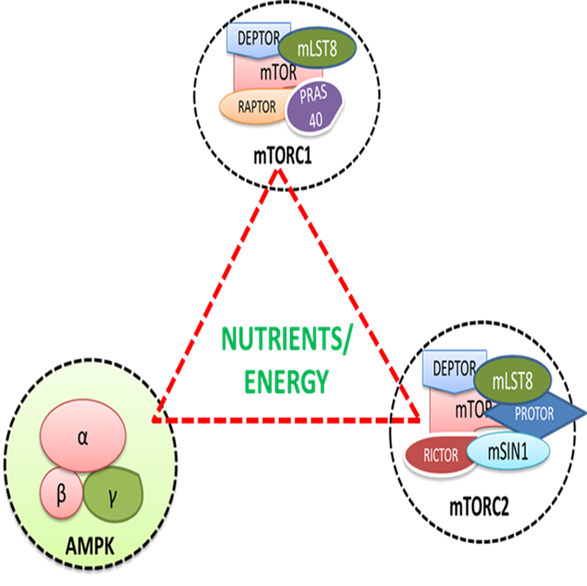
mTORC1 is activated by nutrient & energy enriched state
AMPK inhibits mTORC1
Down regulation of AMPK activates mTORC1& promotes glucose induced protein synthesis
Causes insulin resistance
Activated mTORC1 inhibits mTORC2;
mTORC2 inhibition regulates nutrient uptake but Its disruption causes
Insulin resistance
Ribosomal association of mTORC2 promotes assembly of IIS signals; activation of IIS leads to activation of mTORC1
Activated by
energy
spent state
Activated by
nutrients, growth signals

Slide 20
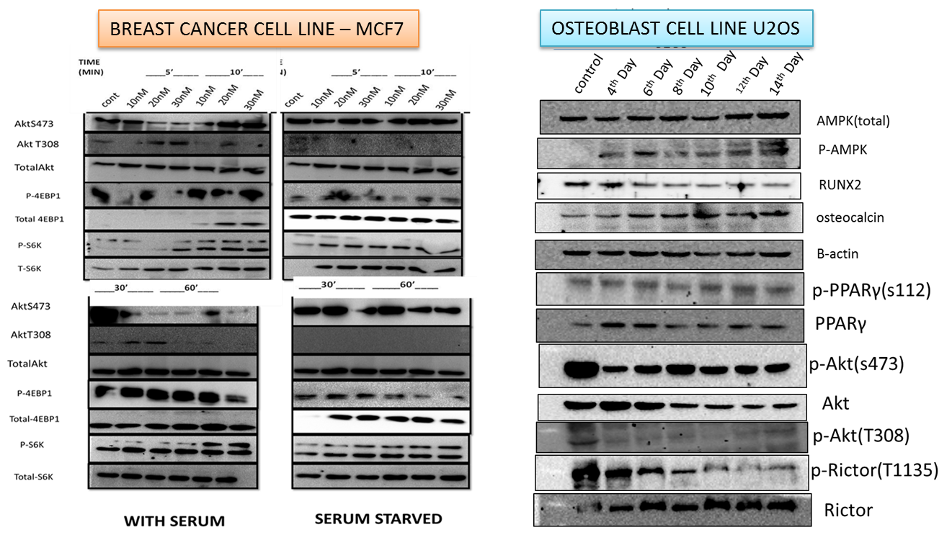
WORK IN HCU
(BINDU MADHAVA REDDY’S LAB)

Slide 21
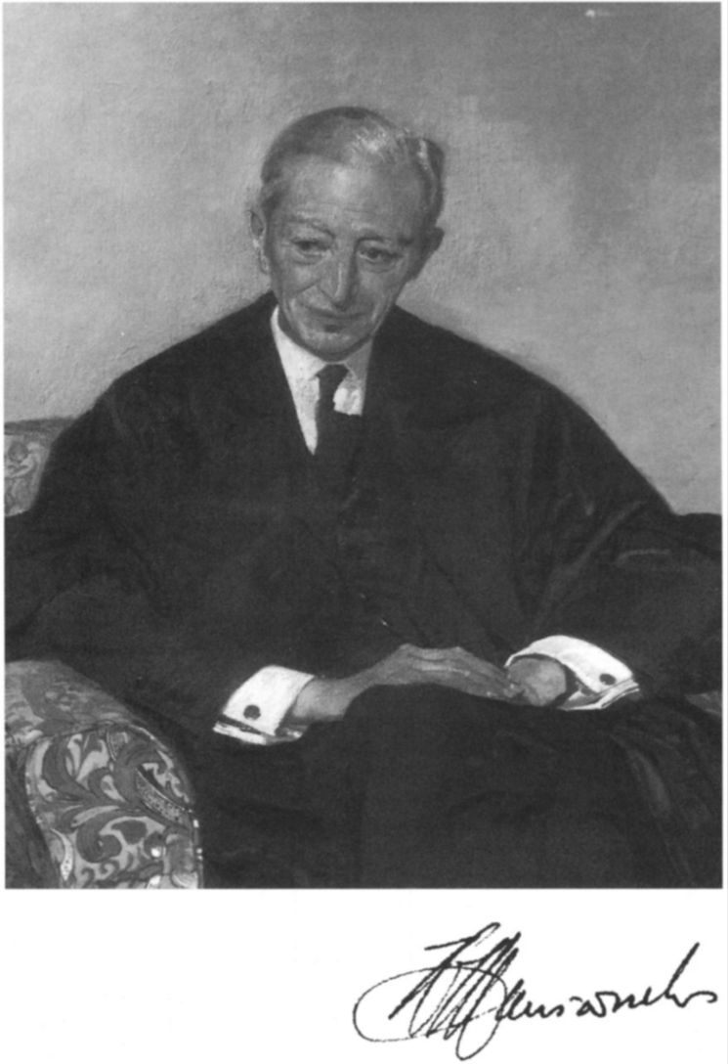

Biographical Memoirs of the Royal Society, Vol. 41 (Nov., 1995),
THANK YOU
FOR YOUR PATIENCE
-----Himsworth stands out ------------------a great variety of worthwhile careers------------------------------------------- could not, of course, command success in all his endeavours; but like Cato in Addison's tragedy, he generally deserved it; nor could he have foreseen ---------------------- academic philistinism which was to overtake -------------in 1980s
SIR DOUGLAS BLACK

