Slide 1
About Omics Group
OMICS Group International through its Open Access Initiative is committed to make genuine and reliable contributions to the scientific community. OMICS Group hosts over 400 leading-edge peer reviewed Open Access Journals and organize over 300 International Conferences annually all over the world. OMICS Publishing Group journals have over 3 million readers and the fame and success of the same can be attributed to the strong editorial board which contains over 30000 eminent personalities that ensure a rapid, quality and quick review process.

Slide 2
About Omics Group conferences
OMICS Group signed an agreement with more than 1000 International Societies to make healthcare information Open Access. OMICS Group Conferences make the perfect platform for global networking as it brings together renowned speakers and scientists across the globe to a most exciting and memorable scientific event filled with much enlightening interactive sessions, world class exhibitions and poster presentations
Omics group has organised 500 conferences, workshops and national symposium across the major cities including SanFrancisco,Omaha,Orlado,Rayleigh,SantaClara,Chicago,Philadelphia,Unitedkingdom,Baltimore,SanAntanio,Dubai,Hyderabad,Bangaluru and Mumbai.

Slide 3


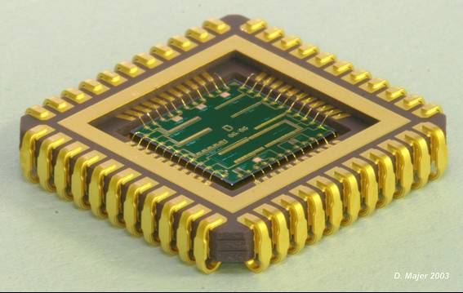

MOVPE Droplets Heteroepitaxial
Growth Model
S. Shusterman E. Cohen, N. Elfassy, D. P. Kumah, Y. Yacoby, R. Clarke, Y. Paltiel
Applied Physics Department
Center for nano science and nano technology,
HUJI, Israel

Slide 4
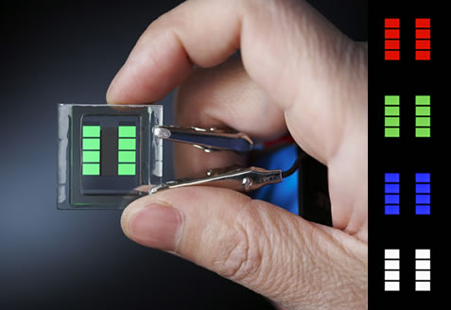
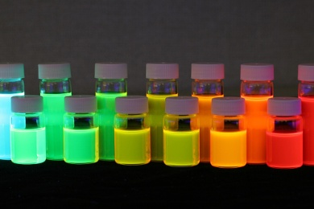
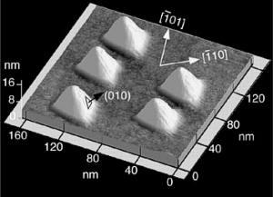
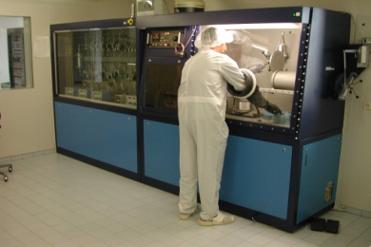
Motivation and Goal
Self-assembled quantum dots (SAQDs)
Scientific and
applicative interest
Fine tuning of their
opto-electronic properties
Size, shape, chemical
composition, strain fields
Growth process

Slide 5
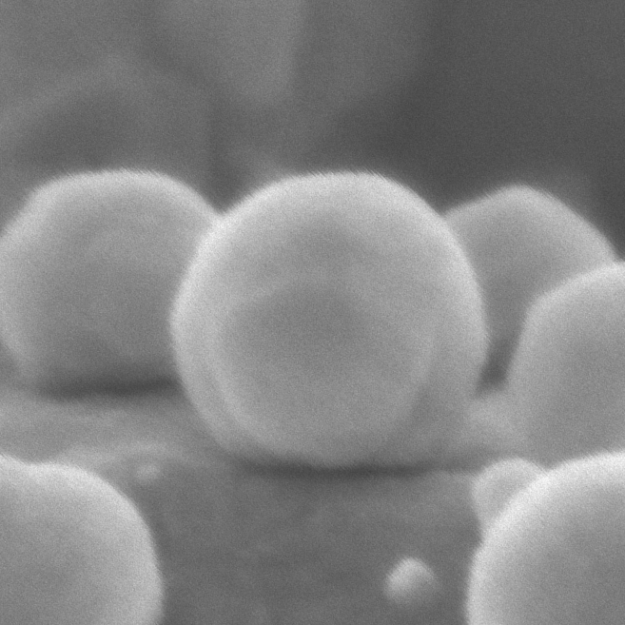
Outline
DHE growth mode.
Critical issues and possible problems
Characterization methods
  HR TEM + Peak Pair Algorithm (PPA)
  Kelvin Probe Force Microscopy (KPFM)
  X-ray Coherent Bragg Road Analysis (COBRA)
DHE growth model

Slide 6
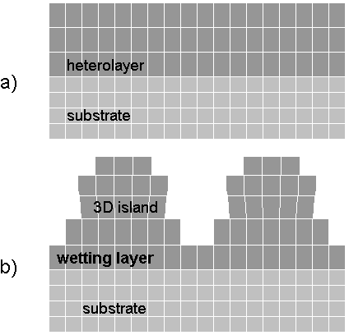
Stranski-Krastanov growth mode
surface free energy of deposited material
surface free energy of substrate
interface energy
strain energy of the layer
S-K growth method can be useful for materials systems with 5-7% lattice mismatch
Notes:
The common method to fabricate SAQDs is the strain-driven Stranski-Krastanov (S-K) mode. Because of high structural crystallinity, high density and simple growth procedures, self-organized QDs grown by the S-K growth mode have become extremely attractive in the case of lattice-mismatched systems such as Ge/Si and InAs/GaAs systems. In this method the deposited film is initially two-dimensional (usually up to 2-4 monatomic layers) and then begins to form clusters on top of a wetting layer after some critical thickness growth. The S-K growth mode requires a large mismatch between the substrate and the QD materials, and this mismatch is one of the main driving forces leading to formation of the 0D nanostructures.
D.J. Eaglesham and M. Cerullo, Phys. Rev. Lett., 64, 1943 (1990).
Y.-W. Mo, D.E. Sawage, B.S. Swartzentruber, and M.G. Lagally, Phys. Rev. Lett. 65 (8), 1020 (1990).

Slide 7
Droplet hetero-epitaxy (DHE) growth mode
First stage of the growth:
low melting point group II- III- or IV element nano-droplets formation on the substrate.
Second stage of the growth:
reaction of these droplets with one or more group V- or VI elements in the gas phase (liquid-phase-epitaxy-like crystallization)
N. Koguchi, et al, J. Cryst. Growth, 111, 688, (1991).
T. Mano, et al, Jpn. J. Apll. Phys. 33, 4580 (2000).
V. Mantovani, et al, J. Appl. Phys. 96, 4416 (2004).
Notes:
An alternative approach for growth of the binary or more complicated III-V compound QDs, known as the droplet epitaxy or droplet heteroepitaxy (DHE) method, has emerged recently. The DHE method was developed two decades ago and consists of two basic stages:
formation of low melting point group III element nano- liquid droplets on the substrate from metallorganic source
and subsequent exposure of these droplets to the gas phase flow of one or more group V elements to form the desired III-V nano-crystal.
The method is very sensitive to the growth parameters, but gives great flexibility in realizing QDs growth on different substrates in both lattice-matched and lattice-mismatched systems.
Although we start from liquid droplets, under the right conditions, we end up with single crystal dots, again – with atomic registration with the underlying substrate.
N. Koguchi, S. Takahashi and T. Chikyow, J. Cryst. Growth, 111, 688, (1991).
V. Mantovani, S. Sanguinetti, M. Guzzi, E. Grilli, M. Gurioli, K. Watanabe and N. Koguchi, J. Appl. Phys. 96, 4416 (2004).
T. Mano, K. Watanabe, Sh. Tsukamoto, Y. Imanaka, T. Takamasu, H. Fujioka, G. Kido, M. Oshima and N. Koguchi, Jpn. J. Apll. Phys. 33, 4580 (2000).
Jeong-Rae Ro, Sung-Bock Kim, Kyoungwan Park, El-Hang Lee and Jihwa Lee, J. Cryst. Growth, 201/202, 1198 (1999).
Although we start from liquid droplets, under the right conditions, we end up with single crystal dots, again – with atomic registration with the underlying substrate.

Slide 8
Parameters that influence optical and electrical properties
Size and shape of QD
  Band gap change due to Quantum effect
  Shift from direct to indirect transitions
Composition
  Band gap and offset change due to elements intermixing
Crystalline structure
Presents of strain and growth defects
  Band gap change due to different ordering
  Band gap variations due to strain
  we need methods for characterization and control composition and strain with sub nanometer resolution!

Slide 9
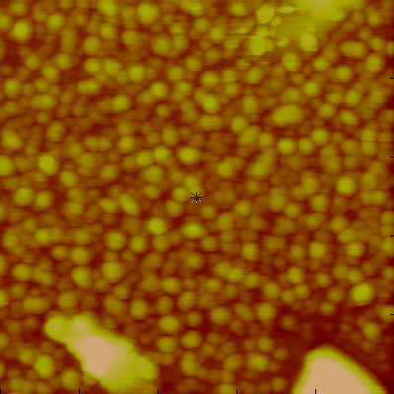
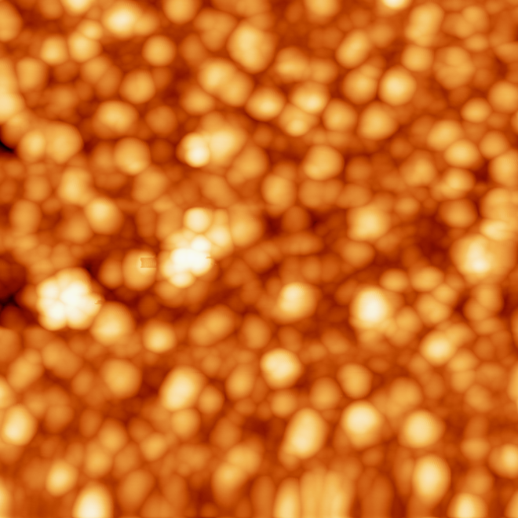
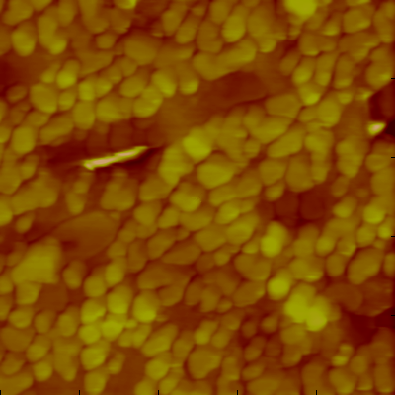


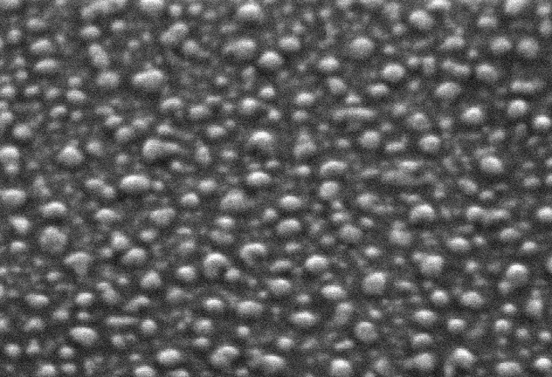
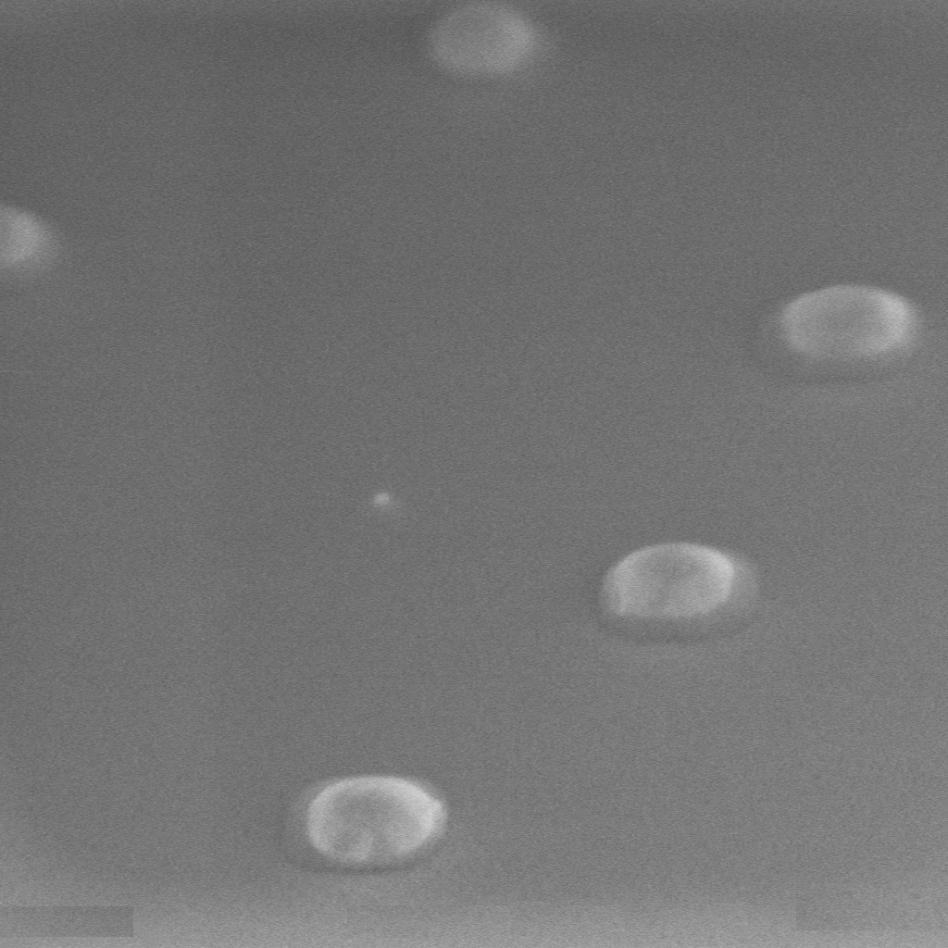
Droplet Hetero-Epitaxy (DHE)
InSb/GaAs
InAs/GaSb
InSb/InSb
30nm
30nm
(high density)
40nm
200nm
200nm
200nm
200nm
200nm
200nm
(low density)
200nm
500nm
200nm
500nm
Highly strained
Low strain
No strain

Slide 10
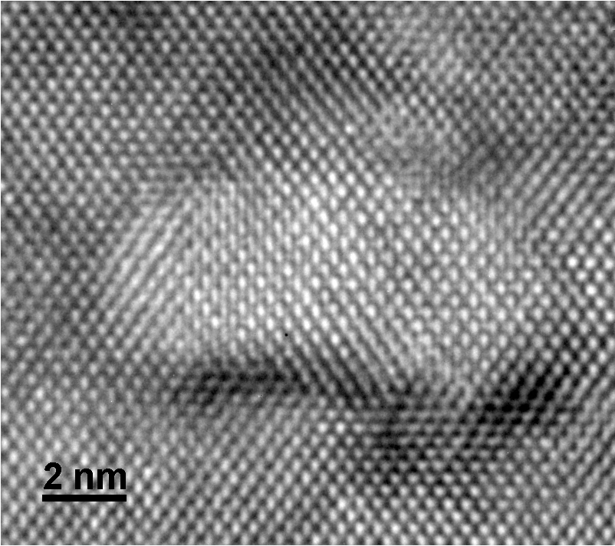
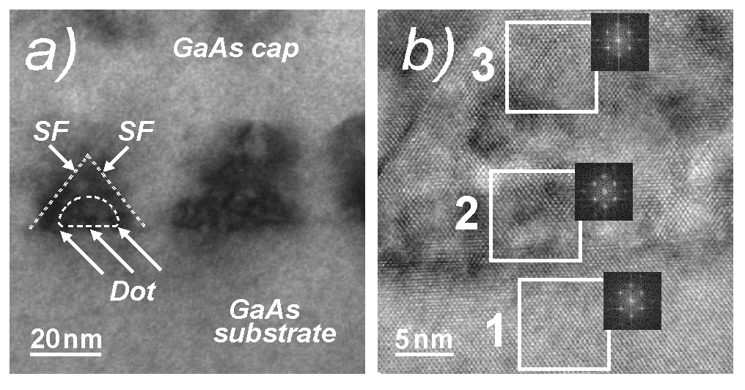
Dot’s characterization by TEM
c)
c)
HRTEM image of DHE dot The growth is epitaxial, concave shape of dot
The dot lattice constant calculated from FFT is different from expected
1 – GaAs substrate a_{GaAs}=5.74±0.02 Å,
2 – QD a_{Dot} = 6.06±0.03 Å (a_{InSb}= 6.479 Å a_{InAs}= 6.058 Å)
3 – GaAs cap layer a_{cap} = 5.73±0.04 Å.
Notes:
3.

Slide 11
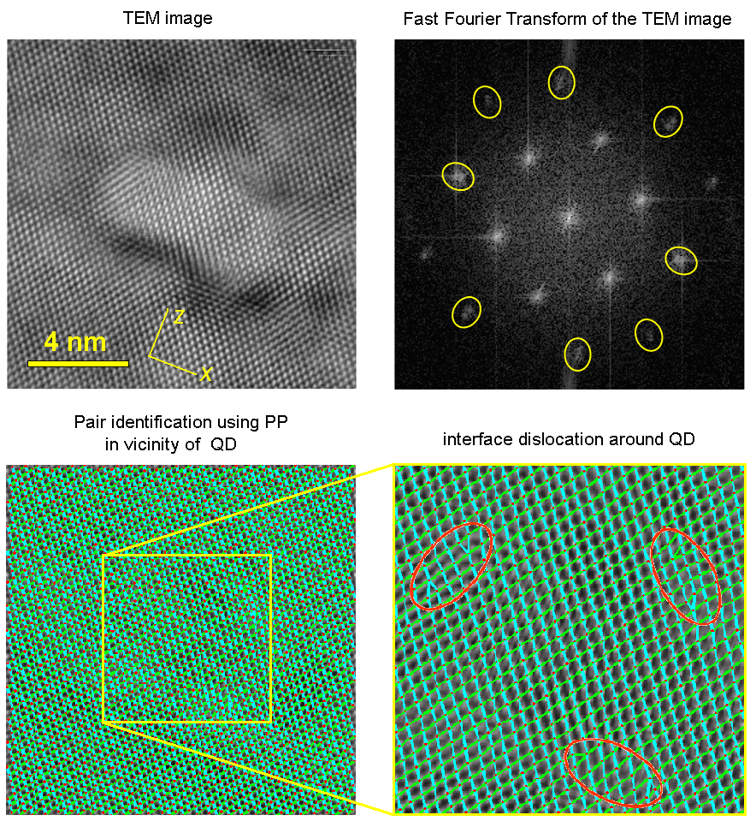
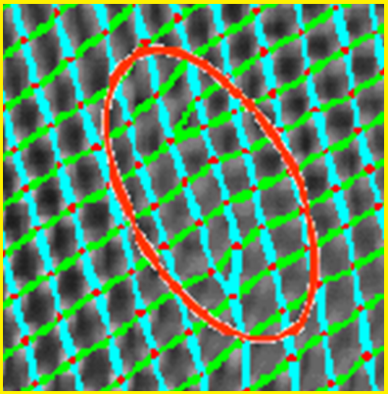
Strain determined using
Peak Pairs algorithm
a)
Misfit dislocations
Strain distribution
3
z
2
3
x
z
1
x
P.L. Galindo, et al,
Ultramicroscopy, 107, 1186 (2007).

Slide 12
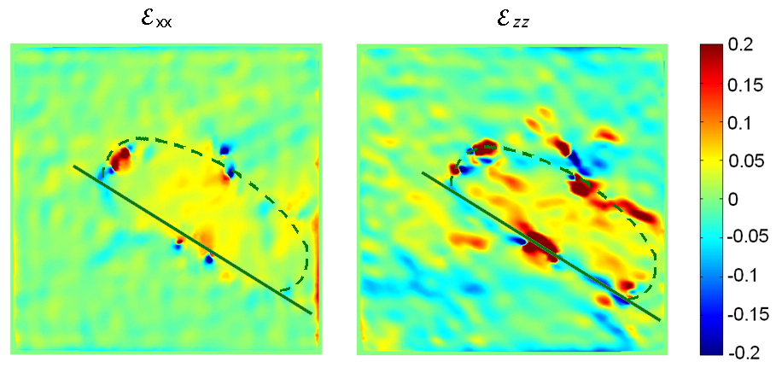
Strain determined using
Peak Pairs algorithm
a)
a)
b)
z
z
x
x
(a) Displacement fields map in X direction.
(b) Displacement fields map in Z direction.
The different colors in dot-substrate interface in X and Z maps indicate the presence of strain.
S. Shusterman, A. Raizman, A. Sher, Y. Paltiel, A.Schwarzman, O.Azriel, A. Boag, Y. Rosenwaks and P.L. Galindo, Europhys Letters 88 66003 (2009).
Notes:
PPA has been successfully applied to areas containing defects, and therefore, it is an appropriate method for use in the real space approach for obtaining field mapping at interfaces in plastically relaxed systems and defective regions, such as dislocated areas.
Strain fields maps in vicinity of the QD in X (a) and Y (b) directions are shown. The different colors in dot-substrate interface in X and Y maps indicates on presence of strains. The strain profile under the dot in X direction (c) is in a good agreement with theoretical results: under the dot it is tensed, far from the dot the substrate is fully relaxed, so it should be compressed close of the dot edge.

Slide 13
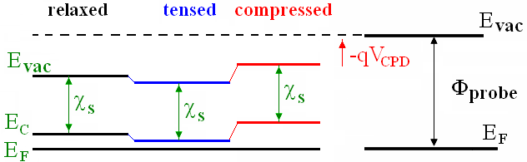
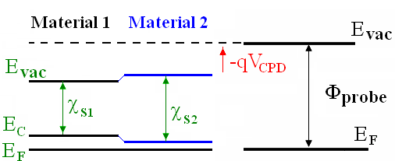
Contact potential difference (CPD)
Notes:
Appling a strain field to SC leads to changes in the Contact Potential Difference via the variation of the conduction band minimum energy, E_{C},.
In the case of two different materials we should take into account also Band gap alignment and affinity changes between these materials.
So, the main goal now is determination of strain and composition distribution around the dots.
Combine with 15

Slide 14
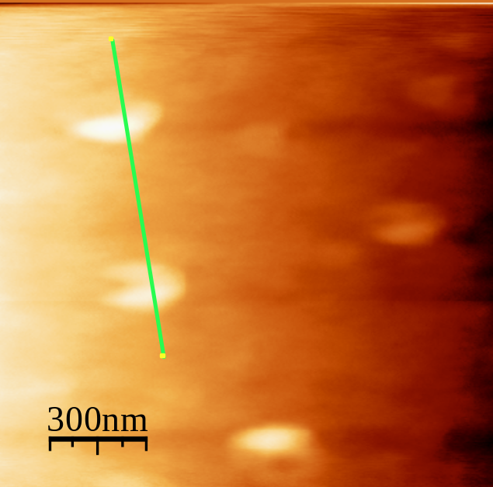
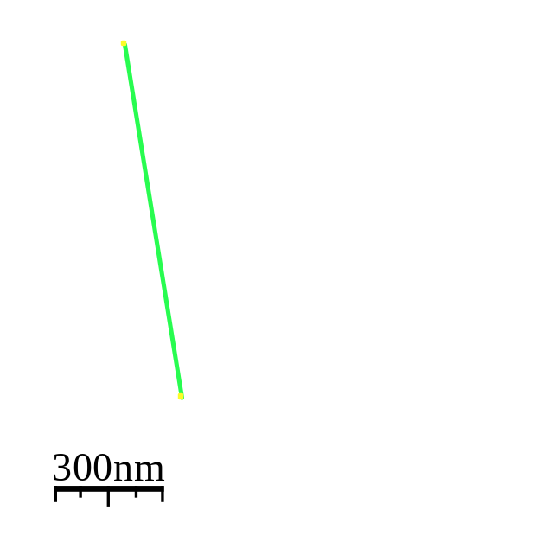
InSb nano-dots grown on InSb
(unstrained system)
topography
CPD
S.Shusterman, A.Raizman, Y.Paltiel, A.Sher, A.Schwarzman, E.Lepkifker and Y. Rosenwaks, Nanoletters, 7, 2089 (2007).
Notes:
For InSb dots grown on InSb, there are no strain and composition changes, so no work function difference is expected. Indeed, the large Nano Crystals are clearly observed in the topography image, but cannot be resolved in the CPD image.

Slide 15
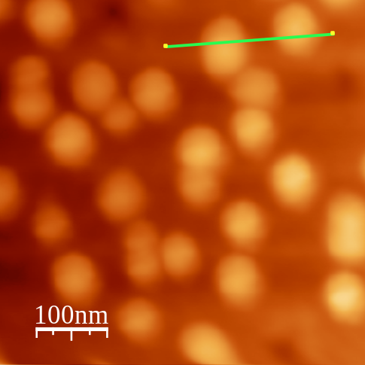
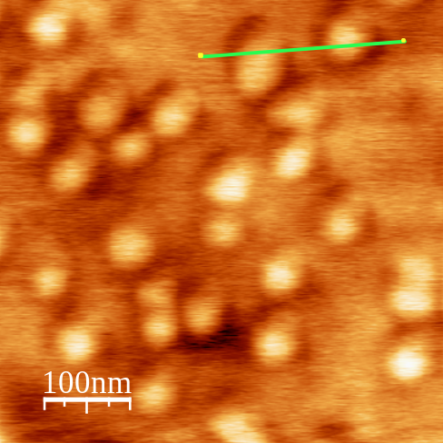
InSb nano-dots on GaAs
(strained hetero-system)
topography
CPD
S.Shusterman, A.Raizman, Y.Paltiel, A.Sher, A.Schwarzman, E.Lepkifker and Y. Rosenwaks, Nanoletters, 7, 2089 (2007).
Notes:
In the case of InSb dots on GaAs the situation is more complicated. A clear correlation between the two images is observed. However, the dark rings around the dots observed in the CPD image can not be explained only by composition changes.

Slide 16
Simple CPD calculation
First SC material (InSb in our case):
E_{g1} – InSb band gap ,
χ₁ – InSb affinity
Second SC material (substrate):
E_{g2} – substrate band gap,
χ₂ – substrate affinity,
offset - valence band offset of InSb-substrate system
χ =4.07eV
χ =4.06eV
GaSb
χ =4.59eV
χ =4.90eV
InSb
0.73eV
0.18eV
InAs
GaAs
0.35eV
1.42eV
Notes:
Simple CPD calculation can be obtained by taking into account the electron affinity, band gap and valence band offsets
reported for these unstrained materials. The result obtained using this simple calculation is very close to the measured one.
The CPD between the InSb dot and the GaAs substrate can be estimated using this simple model.

Slide 17
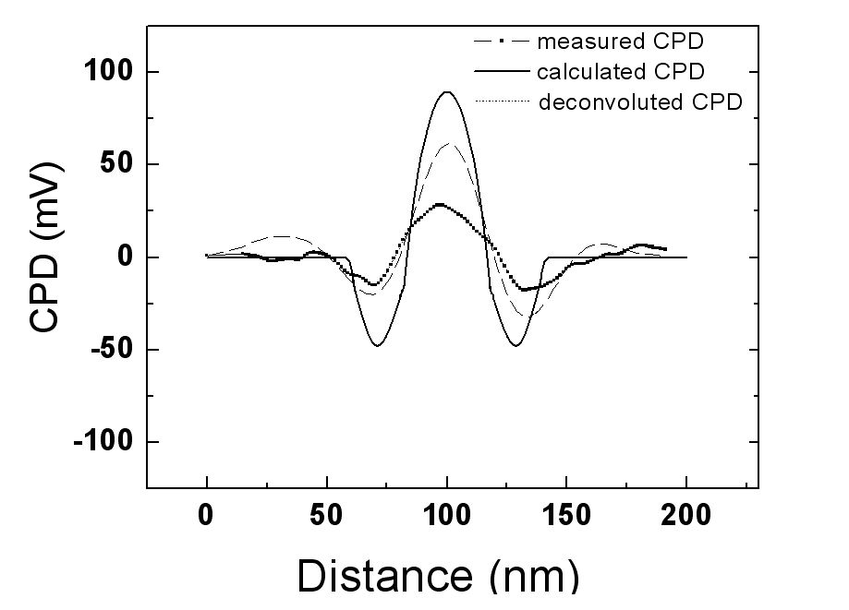
Comparison of the simulated and the measured CPD
S.Shusterman et al., Nanoletters, 7, 2089 (2007).

Slide 18
Summary so far
DHE is a very flexible method
Dots of different sizes and composition can be grown on any substrate.
HRTEM results show that the growth is complicated (strain dislocations, composition change)
Kelvin probe gradient of composition and strain
We need a non destructive method to map these effects within sub nano resolution

Slide 19
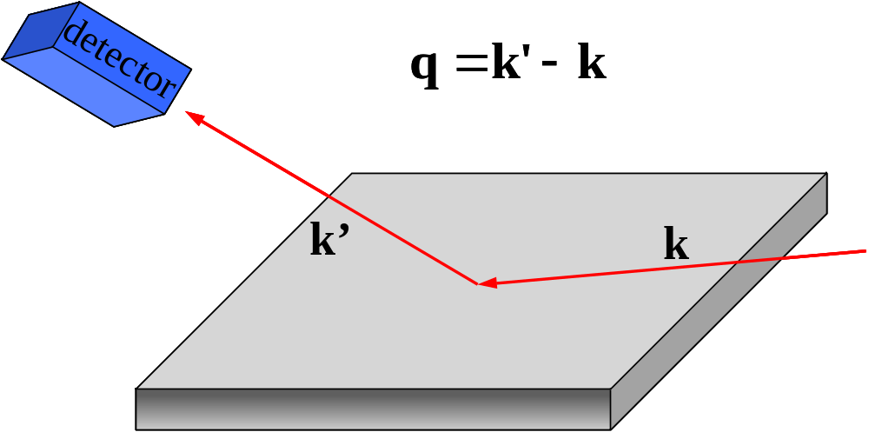
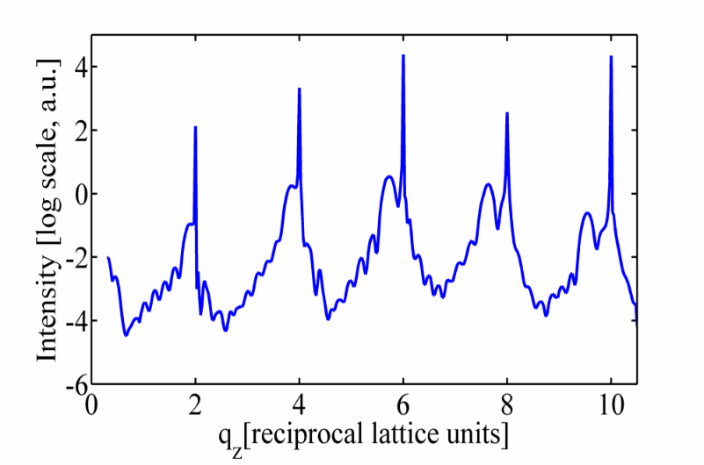
Surface X-ray diffraction
Surface X-ray diffraction (SXRD)
  Phase problem
  Direct phase retrieval methods
Detailed atomic structure
Walther et al. Phys. Rev. Lett. 86, 11 (2001)
Keizer et al. App. Phys. Lett 96, 6 (2010)

Slide 20
COBRA (Coherent Bragg Rod Analysis)
Total electron density consists of:
  Substrate with known structure
  Epitaxial layer with unknown electron density
Assumption: unknown part varies slowly relative to the known part
?
Notes:
We shall use such method called coherent bragg rod analysis, or COBRA. COBRA is able to solve structures with 2D periodicity, such as epitaxial layers or quantum dots.
It separates the total diffraction – marked here in T – into two: The substrate – S – which has a known structure, and the unknown epitaxial layer – U.
The assumption behind it is that the unknown part varies slowly relative to the known part. With out getting too much into the math, this is achieved by proper selection of several parameters in the analysis.
We end with a set of solvable equations from which we are able to retrieve the information of the diffraction phase. So we are able to reconstruct the 3D electronic structure led to the measured diffraction intensities.

Slide 21
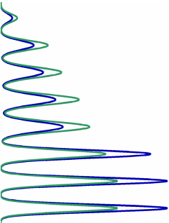
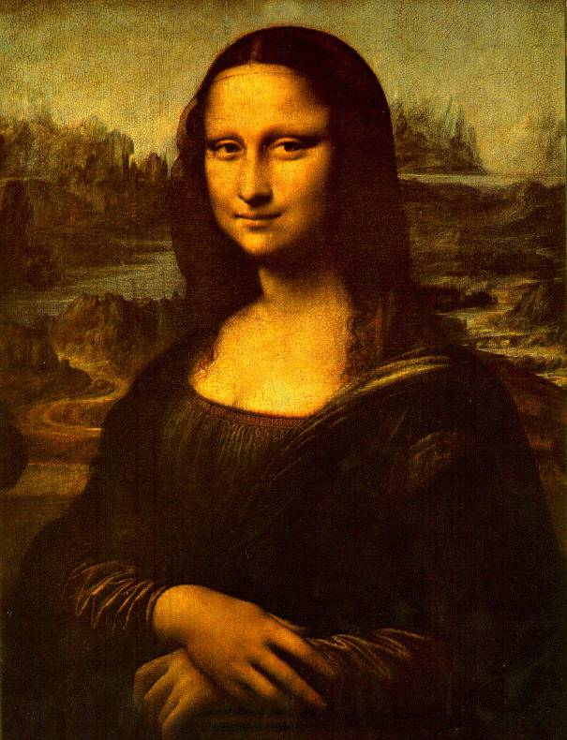

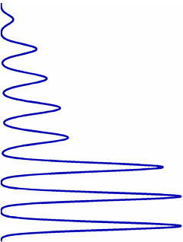
COBRA
(Coherent Bragg Rod Analysis)
What we get? Electron density “folded” in 2 dimensions to substrate-defined unit cell
Anomalous scattering
Height
Electron Density

Slide 22
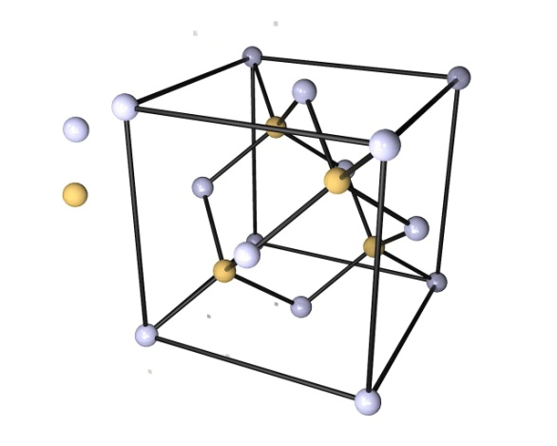
Results – InAs/GaAs
Group III elements (Ga/In)
Group V elements (As)
0.5
Ga K-Edge (E_{beam}=10.36keV)
0.4
As K-Edge (E_{beam}=11.86keV)
0.3
G-V (As)
G-III (In/Ga)
Electron Density [a.u.]
0.2
0.1
0
-30
-20
-10
0
10
20
30
40
Height [angstrom]
Cohen et al. App. Phys. Lett. 98, 24 (2011)

Slide 23

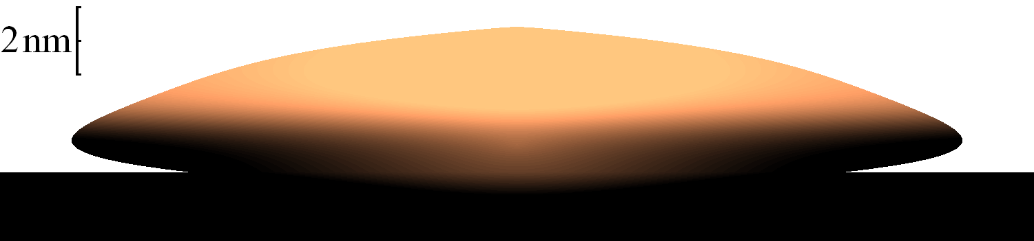
Results – InAs/GaAs
Substrate/dot materials intermixing
1
x (In Concentration)
0.5
InAs
0
-20
-10
0
10
20
30
Height [angstrom]
InAs
In Ga As
x 1-x
GaAs Substrate
GaAs
Notes:
From these results we can get the shape and the composition map of the dots. We see that we did get InAs on GaAs, but only after a layer of mixed materials from the dots and the substrate. We also observed a core richer in In which tend to segregates.

Slide 24
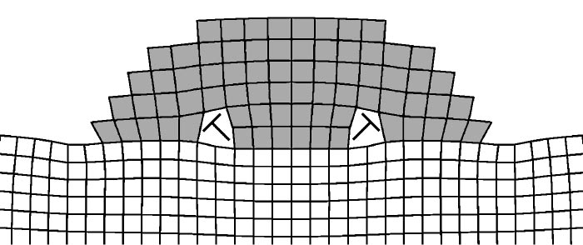
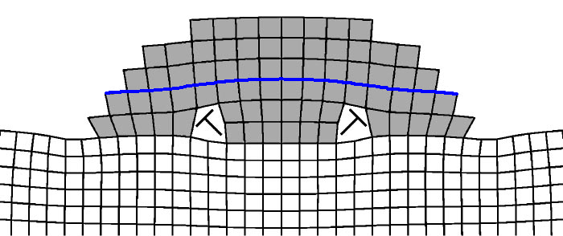
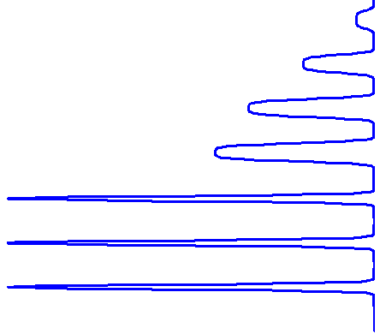
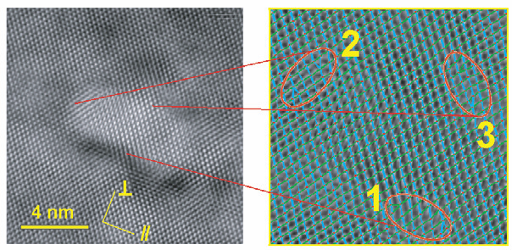

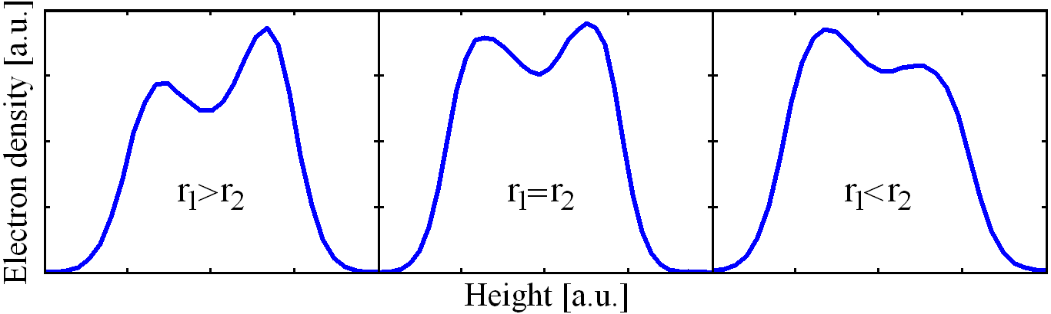

Results – InAs/GaAs
Group III elements (Ga/In)
0.5
r₁
r₂
0.4
0.3
Electron Density [a.u.]
Spencer, Tersoff Phys. Rev. B 63, 20 (2001)
0.2
0.1
0
-30
-20
-10
0
10
20
30
40
Height [angstrom]
Shusterman et al. EPL 88, 6 (2009)

Slide 25
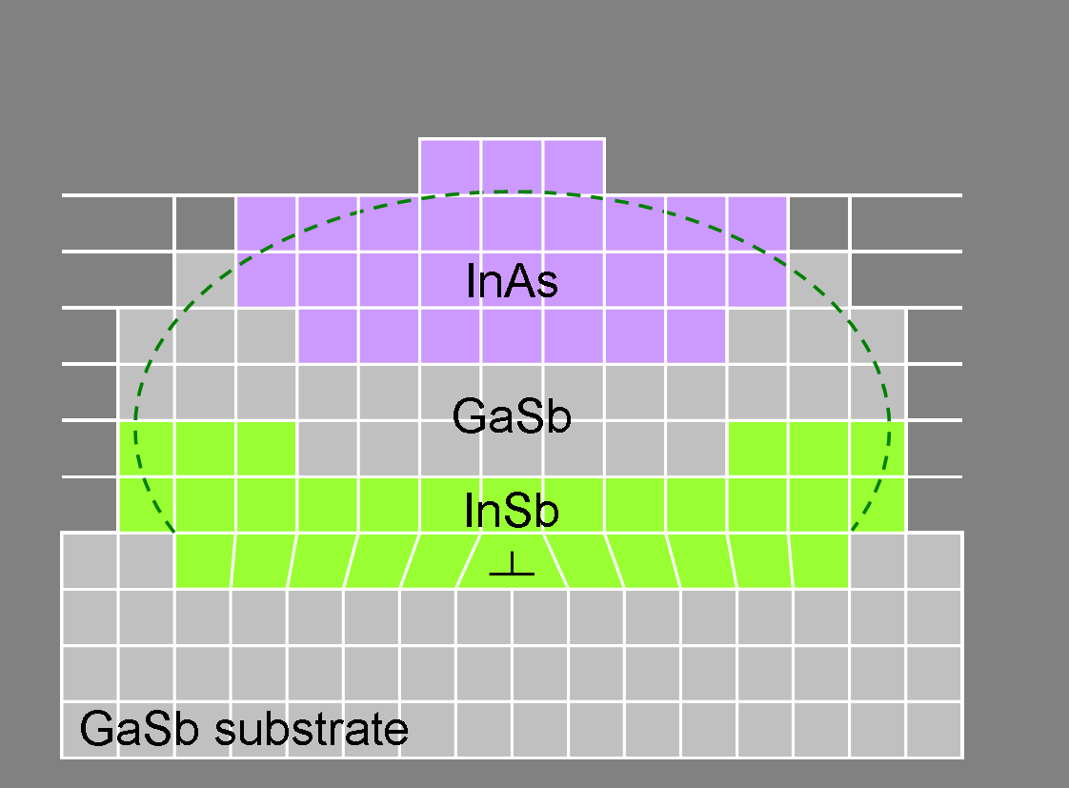
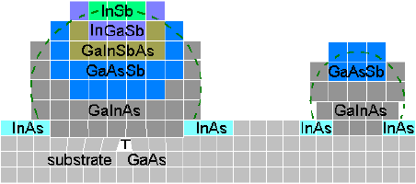
Results – Other Systems
InSb/GaAs
InAs/GaSb (lattice matched system)
Kumah et al. Nat. Nano 4 (2009)
Eyal Cohen et al. (2012)
Notes:
Replace slides with new slides on model

Slide 26
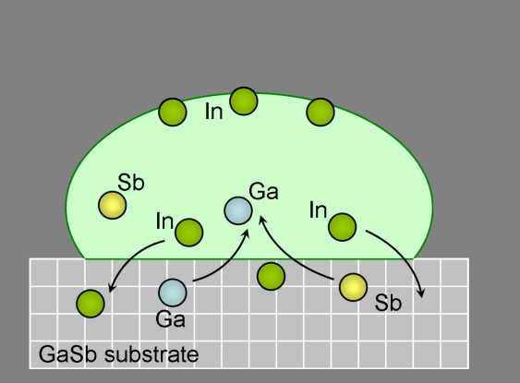
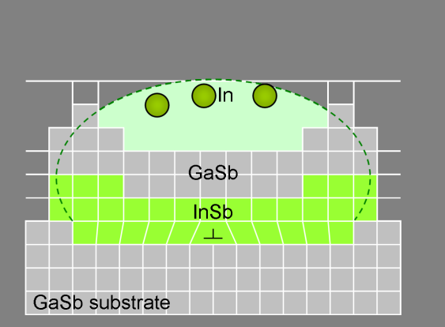
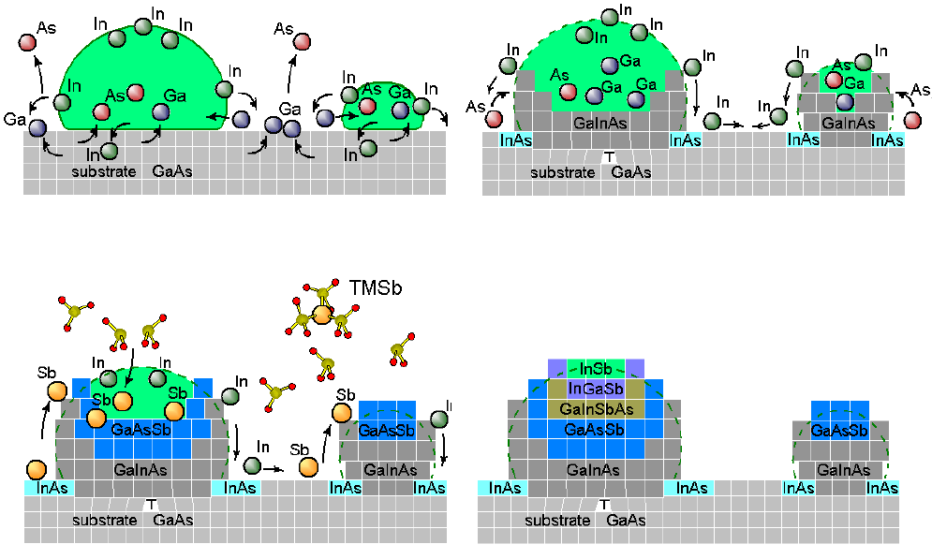
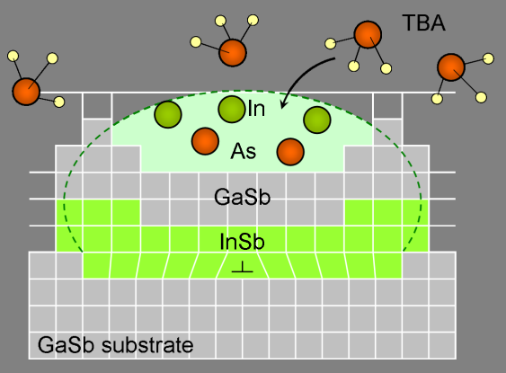

Growth Model
InSb/GaAs
InAs/GaSb (lattice matched system)
(1)
(2)
(1)
(2)
(3)
(4)
(3)
(4)

Slide 27
Conclusions
Droplet Hetero-Epitaxy is very fixable and sensitive to surfactants, temperature, intermixing
We have developed new arsenal of unique methods to characterize self-assembled quantum dots; Kelvin probe, Non-destructive COBRA, HRTEM pair peak algorithm.
A detailed growth model enables the growth control
Notes:
To conclude, we have demonstrated here the use of COBRA in order to characterize self-assembled quantum dots, as a unique and non-destructive method.
We have discovered the DHE growth method is very sensitive to the existence of surfactants, the growth parameters and the dots we end up with have a considerable intermixing of materials.
We believe that by controlling those growth parameters, one can realize many new and interesting nano-structures

Slide 28
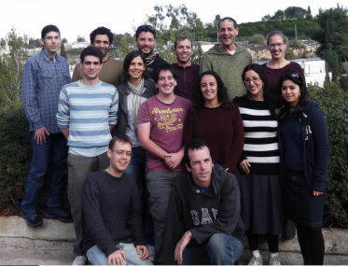

Many thanks to
http://aph.huji.ac.il/people/paltiel/index.html
Our Group: Dr. Shira Yochelis, Naomi Elfassy, Eyal Cohen, Eran Katzir , Avner Neubauer, Ayelet Strauss, Guy Koplovitz, Oren Ben Dor, Odelya Koslovsky, Yaalat Chen. Zohar, Ido Eisnberg, Yuval Shifriss, Ohad Westrich
And
Sergey Shusterman
Applied Physics Division, Solid State Physics Group, Soreq NRC, Israel
Yizhak Yacoby, Racah Institute of Physics, HUJI
Roy Clarke, Divine Kumah, Naji Husseini, Chris Schelpütz, Yongsoo Yang,
University of Michigan, Ann Arbor, MI
Financing:, ISF, ISF-BICORA, DARPA, MOD, Israel Taiwan, Magneton
Capital Nature , FTA and Peter Brojde center
Notes:
28

Slide 29
Let Us Meet Again
We welcome all to our future group conferences of Omics group international
Please visit:
www.omicsgroup.com
www.Conferenceseries.com
http://optics.conferenceseries.com/

