Slide 1




Ex vivo DNA
damage response
to predict therapy
assays in
response
tumor
slices
Dik C. van Gent
NWO

Slide 2
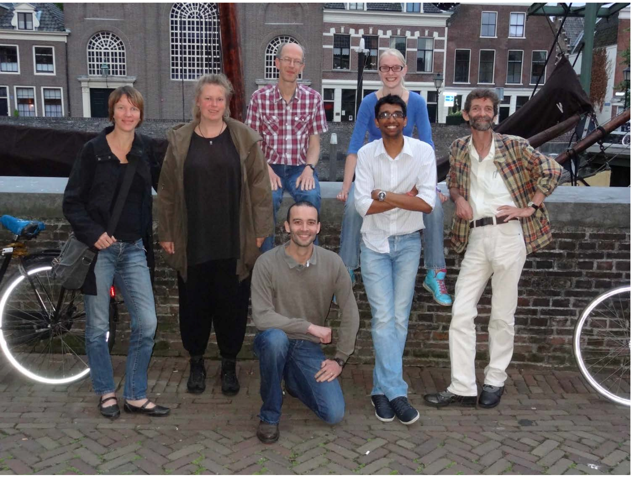

Slide 3
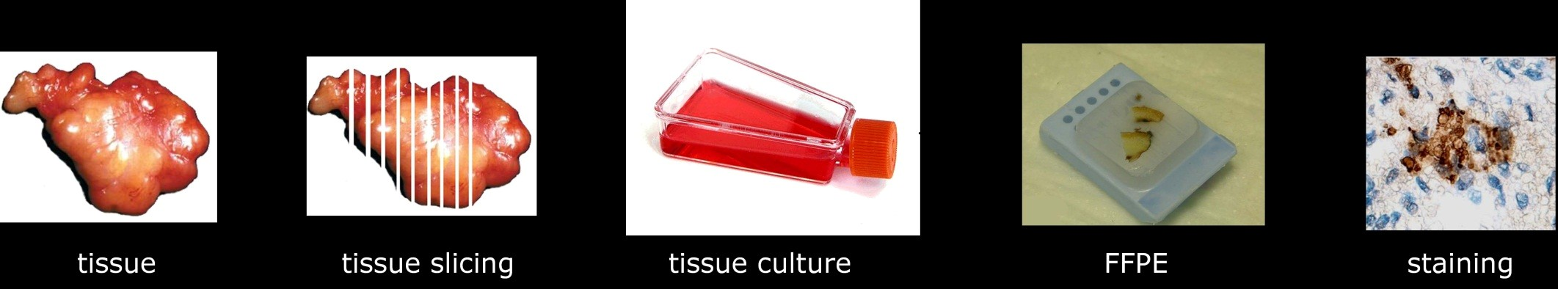
DNA
damage response
in
tumors
Tumors often have DDR defects
Can DDR in cells be compared to DDR in tissues?
-In vivo treatment followed by staining
-Ex vivo culturing, treatment and staining

Slide 4
DNA
damage
response
in
tumor
slices
•
Optimise tissue viability:
–
–
–
Type of medium
Rotation
Automated tissue slicing

Slide 5

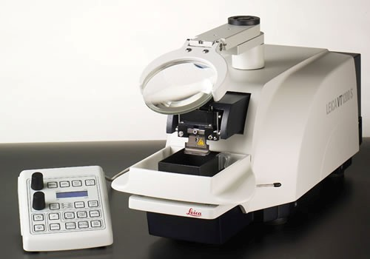
Tissue
slicing
Leica Vibrotome 1200 S
Automated tissue slicer
300 μm slices

Slide 6
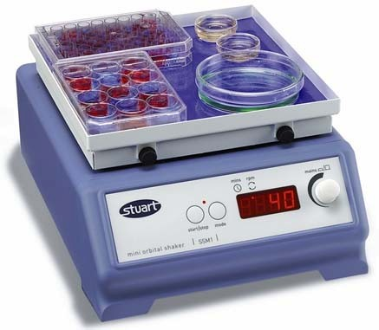
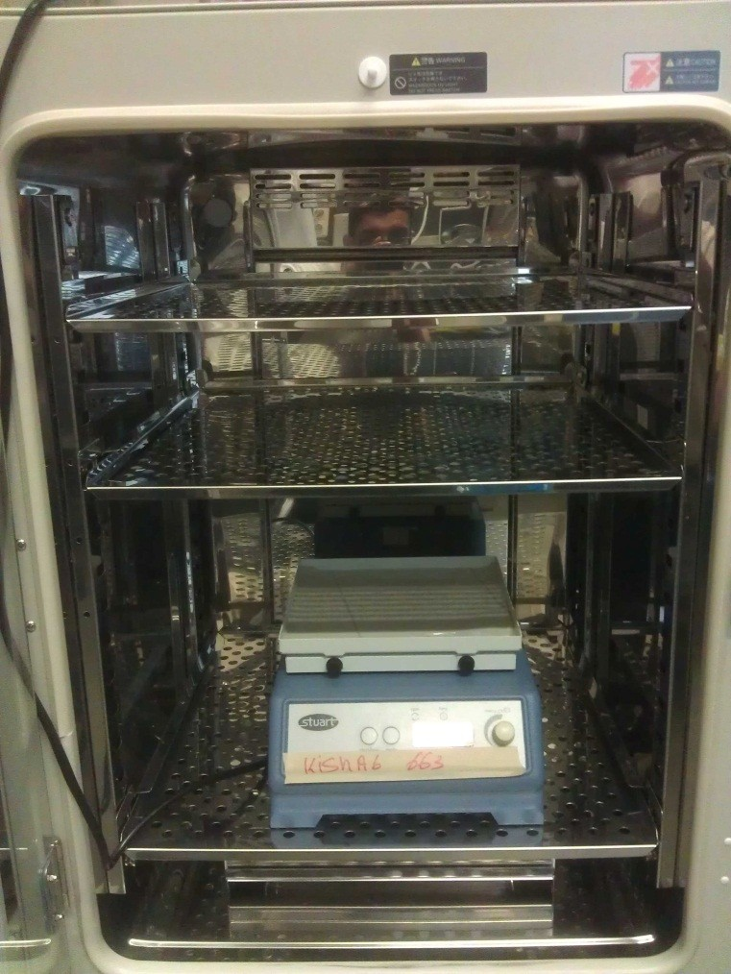
Rotation/
Shaker
Stuart mini orbital shaker
Placed in CO₂ incubator
60 rpm

Slide 7
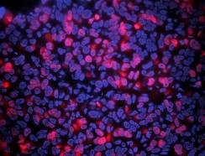
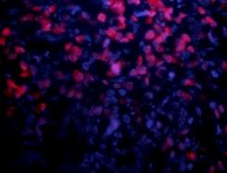
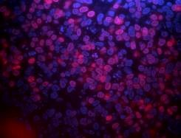
Viability
xenograft tumor
culture
X13
Untreated
96hr
2hr
144hr
Dapi
EdU (DNA synthesis)
% EDU positive
cells remains
constant
for 6 days!

Slide 8
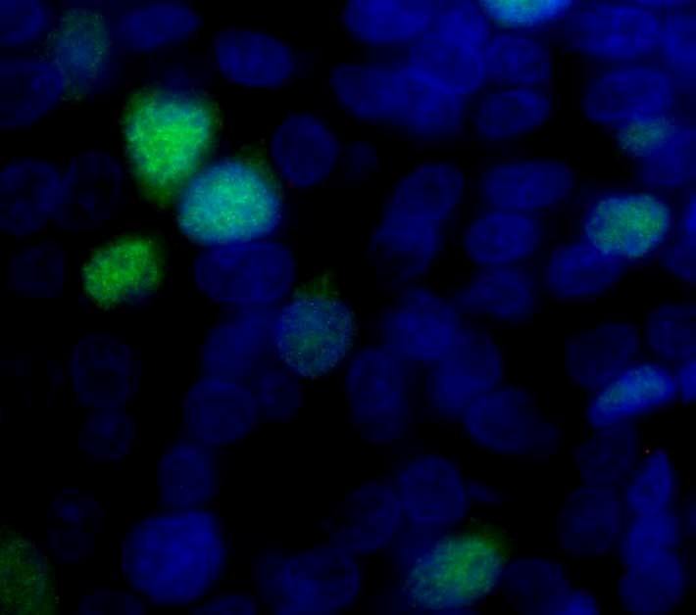
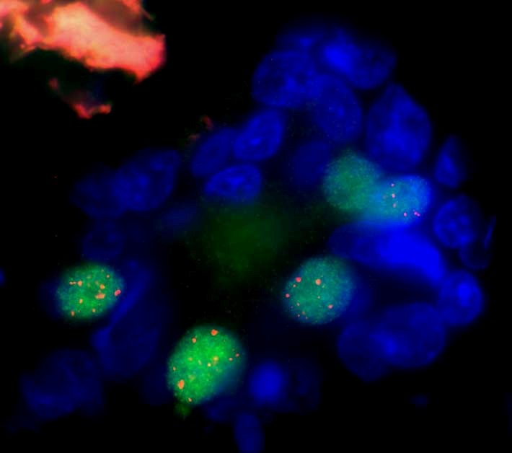
Rad51
foci
formation
Untreated
Red= Rad51
2hr
post 10Gy
Blue=Dapi
Green= Geminin
Quantification: % of Geminin positive cells with Rad 51 foci

Slide 9
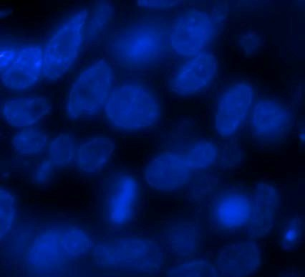
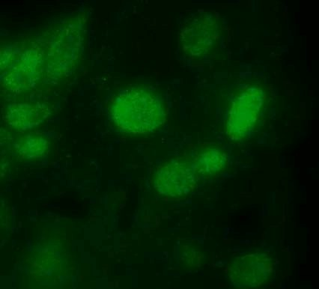
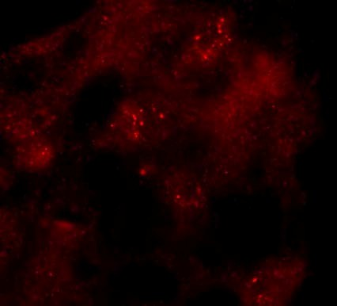
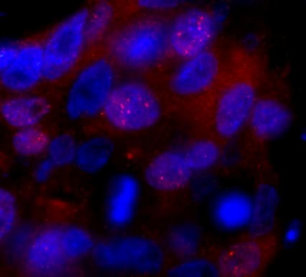
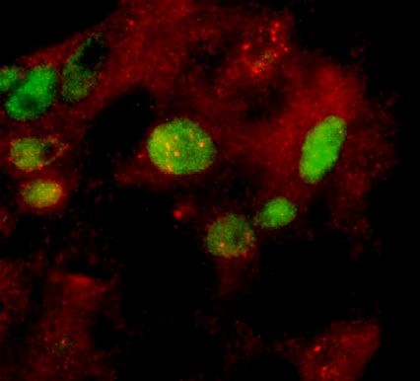
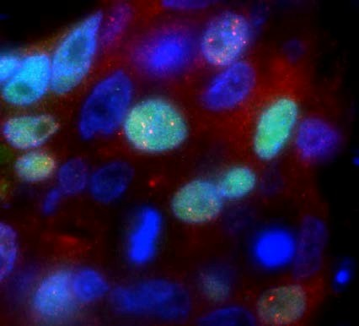
Xenograft
6:
5Gy
2hr
Dapi
Geminin
Rad
51
Dapi/ Geminin
Geminin/ Rad 51
Dapi/ Geminin/ Rad51

Slide 10
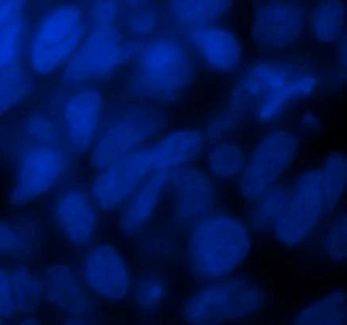
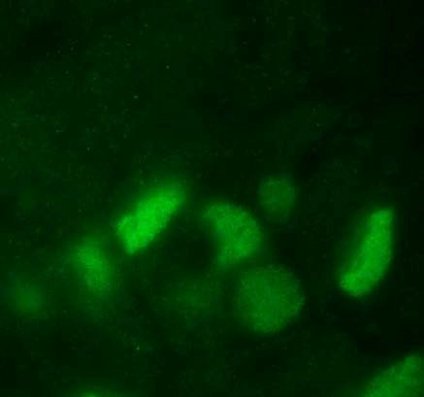
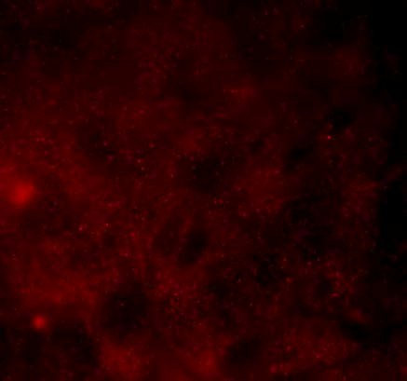
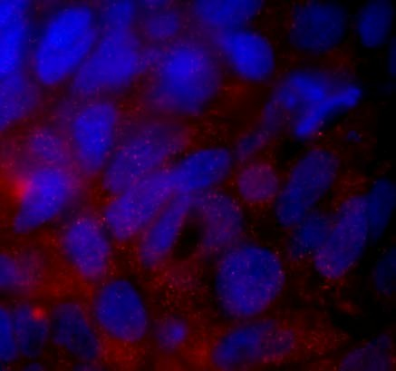
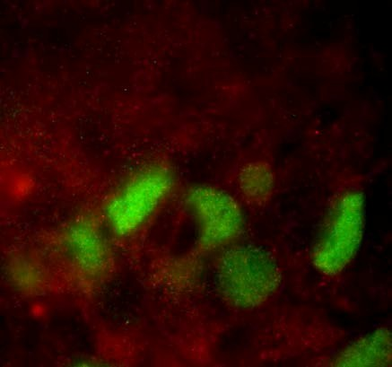
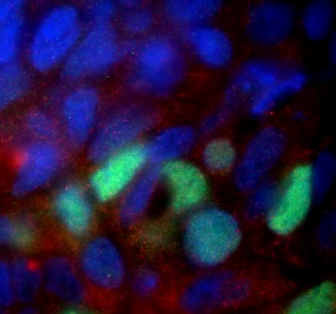
Xenograft
2:
5Gy
2hr
Dapi
Geminin
Rad
51
Dapi/ Geminin
Geminin/ Rad 51
Dapi/ Geminin/ Rad51

Slide 11
Rad51
focus
formation
Rad51/Geminin
100
90
80
70
60
50
40 Rad51/Geminin
30
20
10
0
Tumor sample
Geminin cells with Rad51 foci (%)
)
)
T162(1)
T162(2)
T250(3)
T250(4)
T162(7)
T162(8)
T250(13)
BC263 (17)
BC263 (18)
T241(5)
T283(6)
T241(10)
T283(11)
T283(12)
HBCx-10 (14
HBCx-17 (19
BRCA 1 def
BRCA 2 def
Non BRCA

Slide 12
RAD51
foci
in
tumors
Total number of tumors: 75
No tumor/ no irradiation: 22
Rad51 assay performed: 44
No/ few GMN cells: 7
37 tumors could be analyzed
To be analyzed: 9

Slide 13
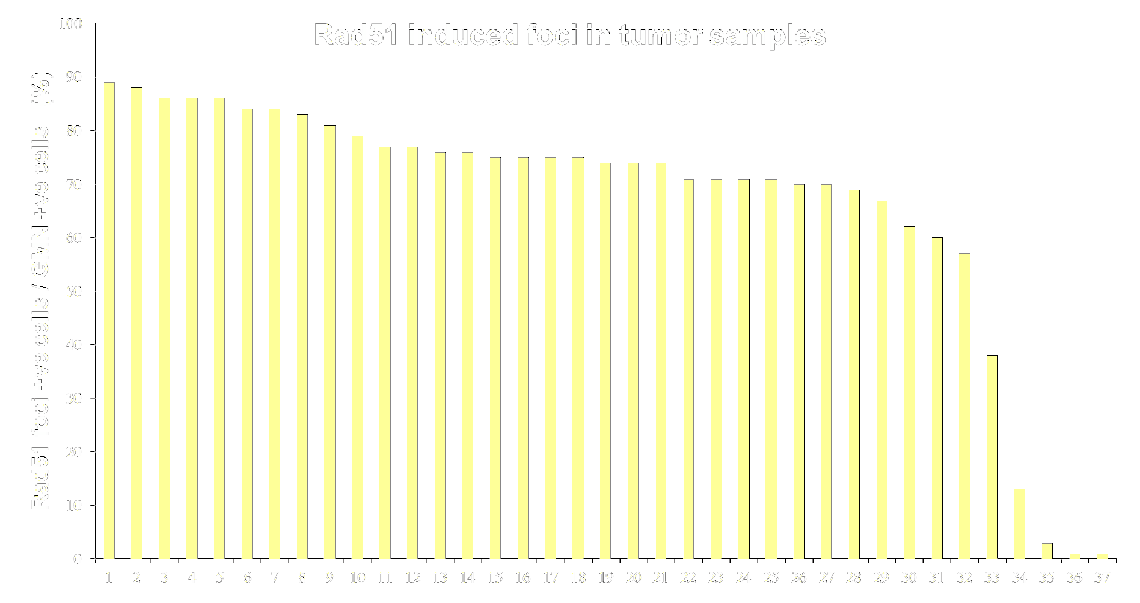
RAD51
foci
in
tumors

Slide 14
Sequencing
of
tumors
Three tumors have been sequenced
for
68
DDR
genes
Result:
1 BRCA2 mutation (ER+)
2 without BRCA mutations

Slide 15
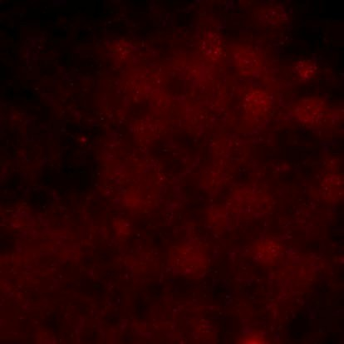
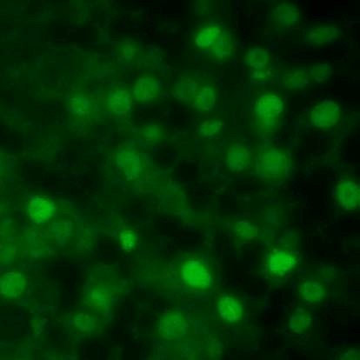
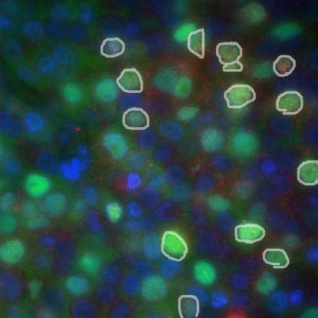
An
interesting
human
tumor
•
•
Breast cancer
5Gy 2hr:
sample
from
Havenziekenhuis
Rad51
Geminin
Dapi/ Geminin/
Rad51
•
•
Extremely high % Geminin+ cells
No clear induction of Rad51 foci

Slide 16
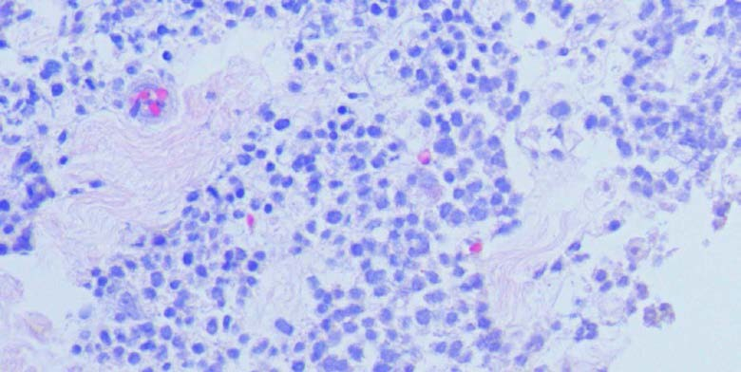
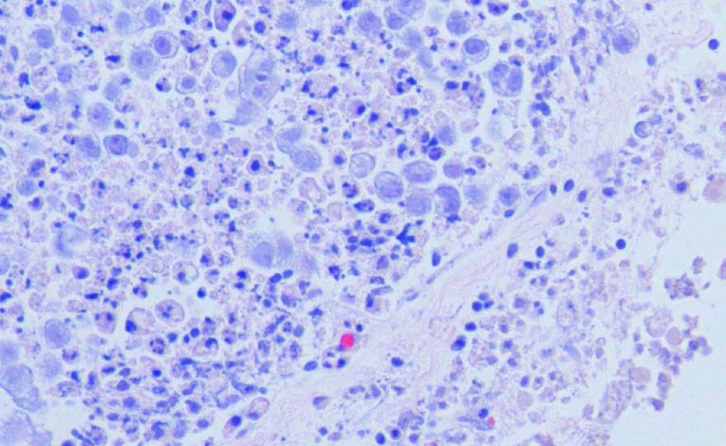
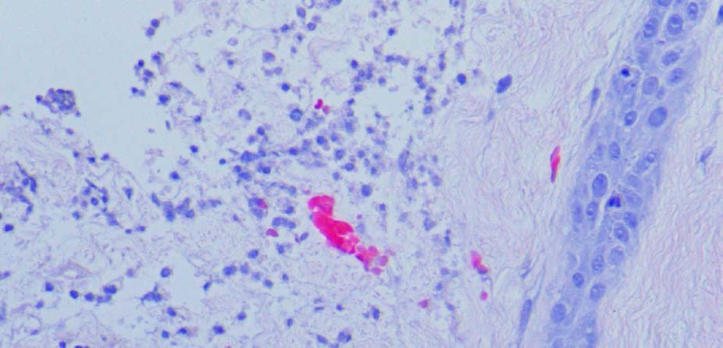
M028
–
4
days
Olaparib
10
µM

Slide 17
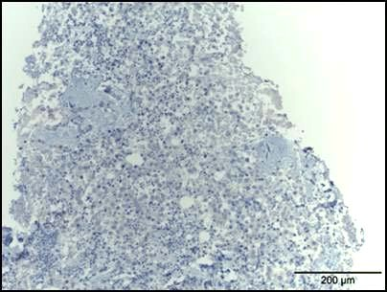
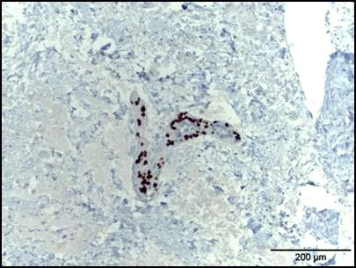
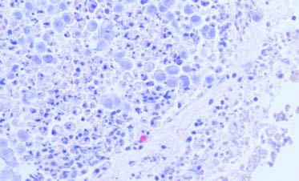
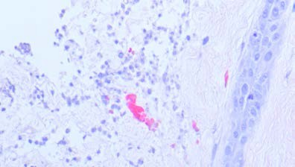
M028 – 4 days Olaparib 10 μM
p63: specific marker for myo-epithelial cells, only present in normal mammary glands.

Slide 18
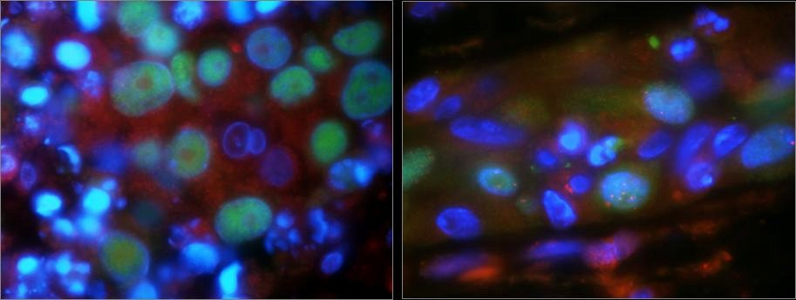


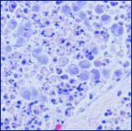
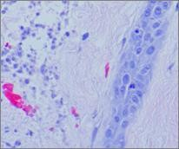
M028 – 4 days Olaparib 10 μM
Blue= Dapi Red= Rad51 Green= Geminin

Slide 19
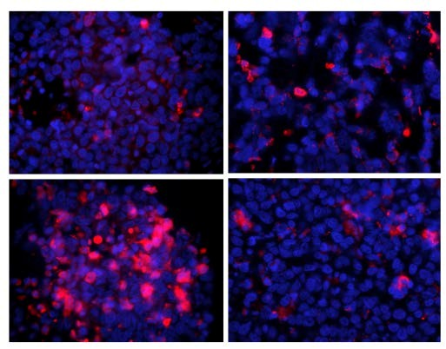
Cleaved
Caspase
3
(Apoptosis)
Impaired
RAD51
foci
Normal
RAD51
foci
96 hour
Untreated
Control
96 hour
10 µM Olaparib

Slide 20
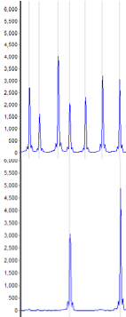
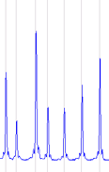
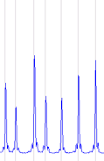
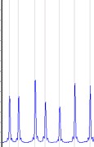
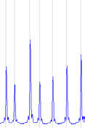
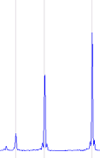
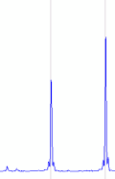
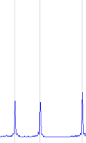
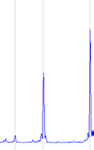
Why
was
this
tumor
sensitive?
Me
HhaI
CEPH control
DNA
P1
M028
tumor
normal
tumor
normal
Without restriction enzyme
With restriction enzyme
Analysis: BRCA1 promoter
methylation
(no protein expression)

Slide 21
Conclusions
•
•
•
•
•
•
Tumor slices can be cultured for at least
They still continue their cell cycle
a week
RAD51 foci are a read out for HR capacity
BRCA1 deficient tumors do not form RAD51 foci
10% of random mammary tumors is foci negative Analysis: 1 x BRCA2 mutation, 2 x BRCA1 promoter methylation (no protein expression), 1 x not yet analyzed

Slide 22
Future
challenges
•
•
•
•
Find similar defects in other tumors
Develop novel therapeutic strategies Predict optimal therapy for each individual Will cancer be a chronic disease soon?
tumor

Slide 23
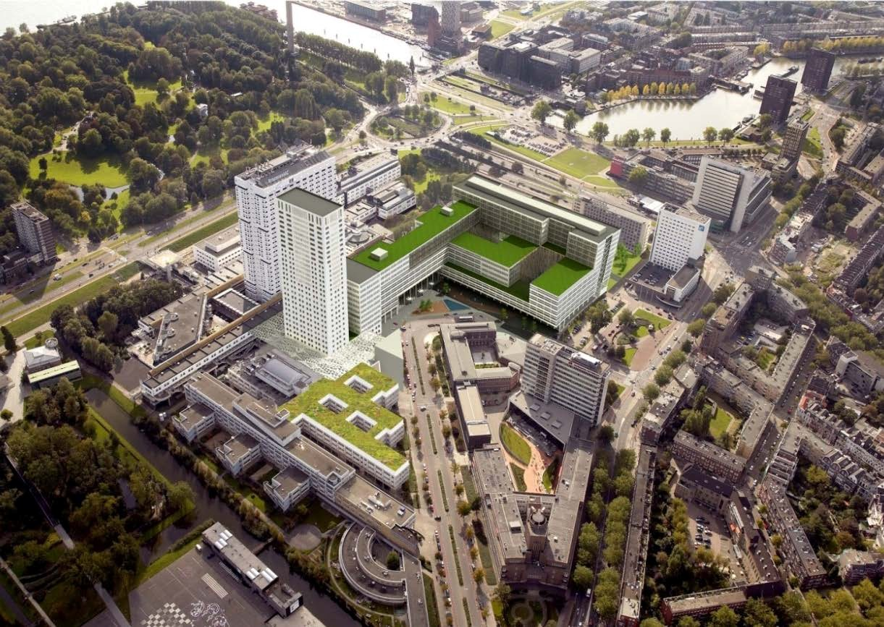









Kishan Naipal
Nicole Verkaik Inger Brandsma Roland Kanaar Jan Hoeijmakers Dik van Gent
Dept. of Genetics
Agnes Jager (clinic)
Carolien van Deurzen
(Pathology)
John Martens (Medical
Petra ter Brugge
Jos Jonkers
NKI Amsterdam
Johan de Winter
Oncology)
VU medical center, Amsterdam

